Slide 2
CLS Spark
CLS Spark Overview
Benefits of participating
Application tips
Questions!

Slide 3
What is the CLS Program?
Immersive summer opportunity to study languages and cultures essential to America’s engagement with the world
Funded by the U.S. Government
Apply for a language program either overseas or offered virtually through CLS Spark

Slide 4
What is a Critical Language?
Less-commonly taught and studied on U.S. campuses
Critical to our engagement with the world, and to U.S. national security and economic prosperity
Prepare U.S. students to compete in a globalized workforce

Slide 5
Languages Offered
CLS Spark Virtual Institutes
Experience Level | Languages
Virtual program only open to beginning level students with no formal classroom experience | Arabic
 | Chinese
 | Russian

Slide 6
CLS Spark Structure
Students participate as a cohort and share the same weekly schedule
10 hours of live, synchronous class per week
Individual consultations
All students have a language partner
Virtual cultural activities
Optional career development workshops and networking

Slide 7
Program Benefits
Funded program includes:
All language instruction and cultural programming
Course materials and textbooks
A stipend to contribute to equipment and connectivity costs
U.S. academic credit through Bryn Mawr College
Certified language gains using widely-recognized ACTFL OPI assessment

Slide 8
Program Benefits
Additional benefits include:
Non-Competitive Eligibility (NCE) for U.S. government positions
Opportunity to build community with cohort that represents the diversity of the United States
Access to CLS and Department of State International Exchange alumni networks and resources
Consideration as a semi-finalist for the 2025 CLS Program institutes abroad

Slide 9
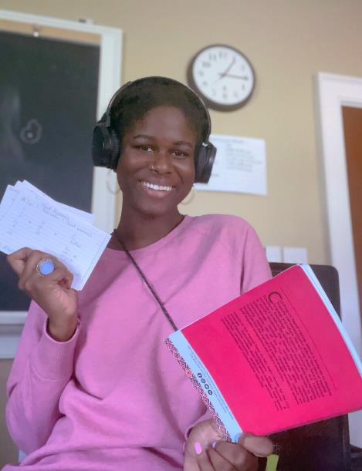
Eligibility
U.S. citizen or national
Enrolled in a degree-seeking program at a U.S. based institution
Must be earning an undergraduate (associate, bachelor's) degree
Graduating seniors are eligible
No GPA requirement

Slide 10
An Opportunity for Everyone
CLS Cohorts are diverse:
All fields of study
All types of institutions and regions of the U.S.
Different levels of experience with language and travel
Over 50% self-identify as students of color
Over 30% receive Pell Grants
The CLS Program does not discriminate on the basis of disability or medical condition
Inclusive student support structures

Slide 11
CLS Spark—Essays & Criteria
Three Short Answer Essays (300-350 words)
Motivation and Commitment
Access to Language Learning Opportunities
Statement of Experience
No letter of recommendation required
Applicants should articulate readiness and resolve for contributing to a group-based intensive virtual program.
Applicants should focus on the impact of CLS Spark on their access to language and intercultural learning opportunities.

Slide 12
Resources!
Do your homework
Articulate how the access and opportunity offered by CLS Spark connects to your academic and professional goals
Watch the application tips video!
Seek help on your campus!
Instructors and advisors
Writing centers
Study abroad, fellowships, and scholarships offices

Slide 13
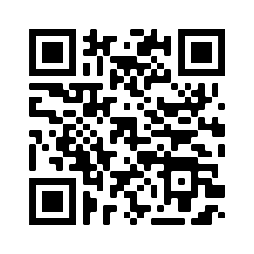
Apply for Summer 2024
Application Deadline: November 14, 8:00pm EST
Semifinalist Notification: Late January
Finalist Notification: March
Programs Begin: June
Online application at
www.clscholarship.org/apply

Slide 14
Stay in Touch
Follow us for updates!
Join us for CLS Spark language-specific webinars.
Register at clscholarship.org/events
@CLScholarship
@CLSScholarship
fb.com/CLScholarship

Slide 15
Questions?
cls@americancouncils.org
CLScholarship.org/events
@CLScholarship
fb.com/CLScholarship
@CLSScholarship

