Slide 2
Welcome!
My CLS Program Experience
CLS Program Information
Program Benefits
Questions
Notes:
In this presentation, I will highlight my CLS experience, provide an overview of the CLS Program, the benefits of participating, and more. I'll have time at the end of the presentation to answer some of your questions.

Slide 3
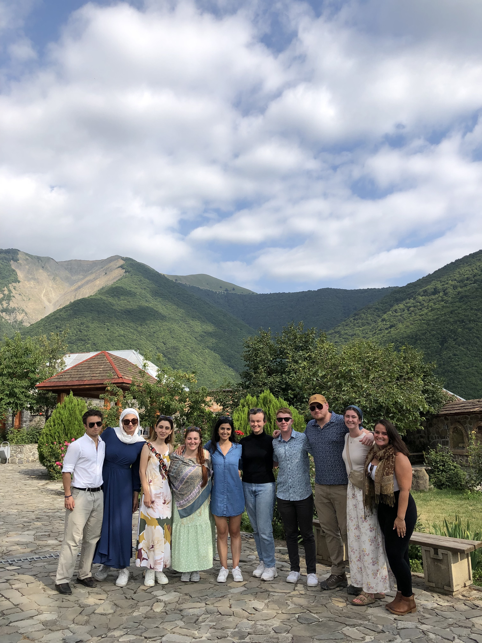
CLS [insert year] Program Experience
I spent a summer learning [language] in [program site]
Here are some highlights of my experience! With photos!
Use Your
Photos Here!
Notes:
Here’s where you can go into detail about your experience on the CLS Program. Include your own pictures to really make your story come to life and share your enthusiasm for the program!

Slide 4
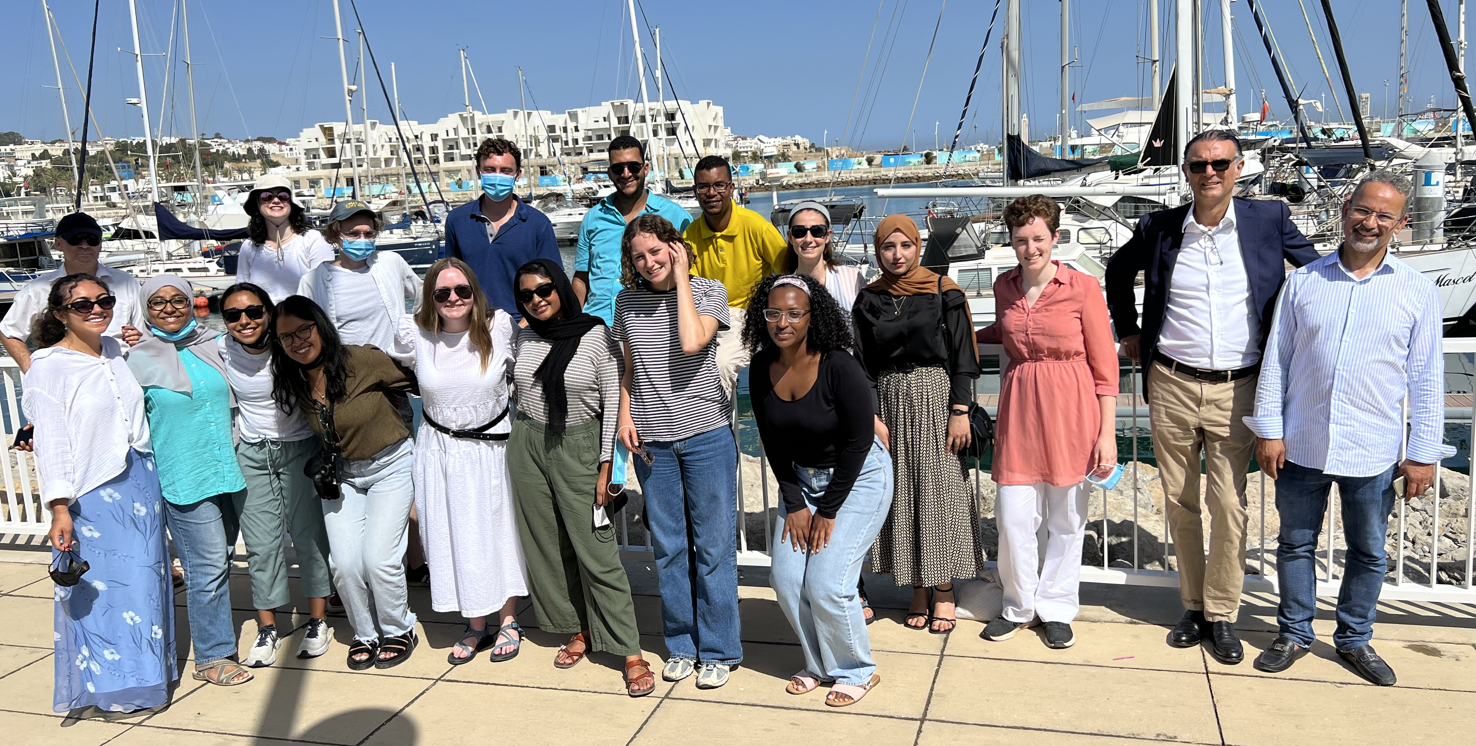
CLS [insert year] Program Experience
More information about my experience on the program! Topics could include
In-class experience
Virtual program experience
Experience living in your host city
Cultural activities and program excursions
Your language partner
Photos!
Notes:
Add as many slides as you’d like to show your experience on the program, but remember that you’re not giving a recap of every single activity you participated in. Try to stick to the highlights that show important parts of what made your CLS experience unique. Some topics could include:
Your language partner
Program excursions
In-class experiences
Everyday occurrences that taught you interesting things about the host culture
Virtual program experiences or experiences living in your host city

Slide 5
What is the CLS Program?
Immersive summer opportunity to study languages and cultures essential to America’s engagement with the world
Funded by the U.S. Government
Apply for a language program either overseas or offered virtually through CLS Spark
Notes:
The CLS Program is an intensive summer opportunity, funded by the U.S. government, for students to study one of 13 languages essential to our engagement with the world.
Students may apply for the CLS Program, through which they will study at a CLS host institute overseas, or for CLS Spark, which is a virtual initiative offering beginning-level Arabic, Chinese and Russian.

Slide 6
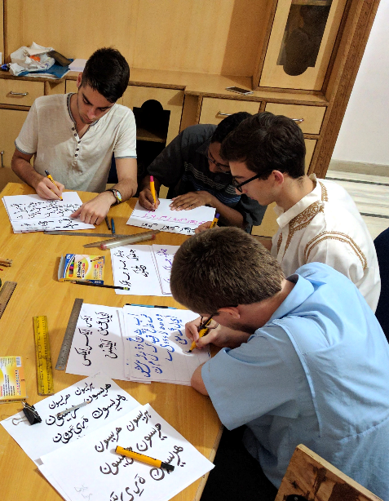
What is a Critical Language?
Less-commonly taught and studied on U.S. campuses
For U.S. students in all fields to study critical languages
Critical to our engagement with the world, and to U.S. national security and economic prosperity
Prepares U.S. students to compete in a globalized workforce
Notes:
The CLS Program supports U.S. students in all fields of study to learn what the U.S. Department of State refers to as “critical” languages. Critical languages are languages that are essential to the United States’ national security, economic prosperity, and engagement with the world, and they tend to be less commonly taught in the United States.
Further notes -
You do NOT need to know:
Why any language in particular is or is not considered to be a critical language
The answer to every specific program question—you can direct them to program resources for those!

Slide 7
Languages Offered
The CLS Program Overseas Institutes
Experience Level | Languages
Open to students at all language levels, including beginners | Azerbaijani, Hindi, Indonesian, Persian, Portuguese, Swahili, Turkish and Urdu.
One year of prior study required | Arabic, Chinese, Korean and Russian
Two years of prior study required | Japanese
Notes:
The CLS Program overseas offers instruction in thirteen critical languages. Some CLS languages have prerequisite requirements to participate in the CLS Program overseas. Arabic, Chinese, Korean, and Russian require one year of prior experience and Japanese requires two years of previous language learning experience to participate in the CLS Program at institutes abroad. Students applying for languages with required previous study may substitute other language learning experience for formal classes, such as self-study, tutoring, high-school coursework, or knowledge of the language from their home environment.
Further notes - Don’t worry about needing to know all of the prerequisites for the languages! This can give students an overview, and they can find more detailed information about language levels on our website.
The biggest distinction to know here is that CLS Spark, which is a virtual program, offers beginning-level instruction in the three languages listed.

Slide 8
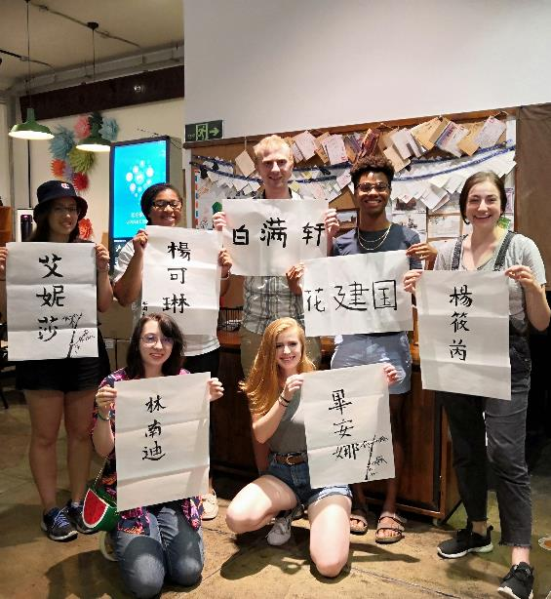
CLS Program Structure
Students participate as a cohort and share the same weekly schedule
15 hours of class per week
Language agreement
All students have a language partner
Cultural classes and activities
Excursions to explore the cultural heritage of the host country
Students live with host families, where possible
CLS is not a research, independent study, or internship program
Notes:
The CLS Program takes place over the course of 8—10 weeks during the summer at overseas institutes. Students participate in the program as a member of a cohort, sharing the same schedule over the course of the program. There are 15 hours of language classes each week, cultural activities, and local excursions. Participants agree to a language policy that requires them to speak only in the language they are studying. Each participant is paired with a language partner who is a local student or member of the host community to practice speaking outside the classroom. Whenever possible the CLS Program will place students with host families or students may have a local university roommate.
Further Notes – You can share more information about your day-to-day experience on the program!
How much time did you spend in class? What was the workload like?
What kinds of cultural activities and excursions did you take part in?
What did you do with your language partner?

Slide 9
Eligibility
U.S. citizen or national
Enrolled in a degree-seeking program at a U.S. based institution
Must be earning an undergraduate (associate, bachelor's) or graduate (master's, doctoral, professional) degree
Graduating seniors are eligible
No GPA requirement
Notes:
Students are eligible for the CLS Program if they are U.S. citizens or nationals enrolled in an accredited degree-granting program at a U.S.-based institution at the time of applying. Applicants for the CLS Program at overseas institutes may be at the undergraduate or graduate level. Students who are graduating seniors at the time of application and students enrolled in one-year master’s programs are eligible to apply.
Students from any field of study can prepare a competitive application for the CLS Program. The program looks for applications from students of all majors at all levels of language learning, and we encourage students of all disciplines to think about how critical languages can help their careers.
An application for the 2024 CLS Program includes three short-answer essays and a personal statement. There is no letter of recommendation requirement.

Slide 10
CLS Spark Structure
Intensive virtual language and cultural learning program
10 hours of live class per week and 2 hours of cultural activities and individual consultations per month.
Offering language instruction at beginner level in Arabic, Chinese, and Russian
Group instruction provided by host institutions abroad
Professional development opportunities and inclusive on-program support
For undergraduate students only
Notes:
CLS Spark supports U.S. undergraduate students in all fields of study to learn either Arabic, Chinese, or Russian at the beginning level. It is offered for those who have no previous formal classroom study of these languages. If you have are at the advanced beginner, intermediate, or advanced level, you should apply for the CLS Program overseas institutes instead.
CLS Spark takes place over the course of 8 – 10 weeks during the summer. Small group classes and activities are facilitated by host institutions abroad. Each cohort of students participates in a total of 90 hours of programming throughout the summer. Each week, this includes 10 hours of live, synchronous class instruction. In addition, participants spend time learning about the culture of partner institutions in interactive and engaging cultural activities, such as tea ceremonies, calligraphy lessons, films, and virtual city tours. Each week, CLS Spark participants have individualized tutoring sessions with their instructors, adapted to their specific needs.
CLS Spark participants also have language partners from host communities to help practice everyday conversation skills. Participants of CLS Spark build community with each other through optional career development workshops and networking opportunities.

Slide 11
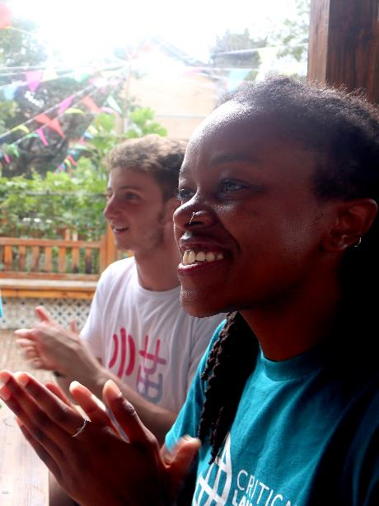
Program Benefits
Make substantial gains in language skills:
Two semesters worth of coursework (and academic credit through Bryn Mawr College)
Certified OPI certificate to demonstrate language proficiency
Advance your career
Many U.S. companies give advantage to candidates with language skills
Non-Competitive Eligibility (NCE) for federal government positions
Build international relationships
Learn to effectively collaborate and communicate with people in cross-cultural settings
Join a network of inspiring alumni
Notes:
CLS Program participants make significant gains in their language abilities. In just eight to ten weeks, students complete the equivalent of two semesters of undergraduate coursework. Students receive certification of their language gains through an ACTFL-OPI certificate upon completion of their program. And while CLS participants have no service commitment to the U.S. government after completion of the program, alumni are eligible for non-competitive eligibility for U.S. government jobs, which makes pursuing a career in the civil service much easier if that is your goal. CLS alumni also become a part of the rich and diverse network of U.S. Department of State International Exchange Alumni.
Personalize this! What were your experiences of the benefits of the program?
Your language gains?
Any changes in your career or academic goals based on participation in the program?
Any skills outside of language gains that you developed as a result of participation in the program?
What has been your experience with the alumni community?
Any opportunities you’ve been able to take advantage of thanks to being an alumna/us of the CLS Program?
Any other alumni you’ve connected with throughout your time on the program or since?

Slide 12
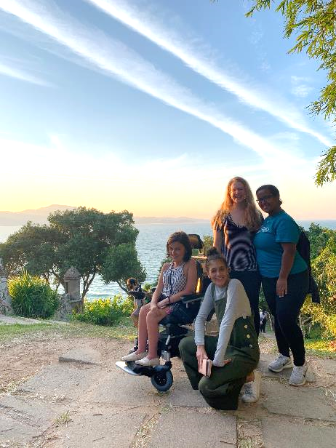
An Opportunity for Everyone
CLS cohorts are diverse:
All fields of study
All types of institutions and regions of the U.S.
Different levels of experience with language and travel
Over 50% self-identify as students of color
Over 30% receive Pell Grants
The CLS Program does not discriminate on the basis of disability or medical condition
Inclusive student support structures
Notes:
Students selected for CLS come from all different academic backgrounds, fields, and degree programs – and have different levels of experience with language and travel.
The CLS Program also actively recruits students from groups underrepresented in study abroad, including students of color, students with disabilities, students from community colleges, and non-traditional students.
The CLS Program is a great opportunity for all students and the CLS Team works year-round with the Department of State and partner institutions to ensure that inclusive support structures are in place to ensure a safe and successful summer for all scholars.

Slide 13
Resources!
The CLS Website
Find information about eligibility criteria, language levels, and prerequisites
Watch the CLS application tips video
Find CLS Advisors on your campus http://clscholarship.org/universities
Seek help on your campus!
Instructors and advisors
Writing centers
Study abroad, fellowships, and scholarships offices
Notes:
You can check out the CLS website for more information about eligibility criteria, language levels and prerequisites. There are also short videos on the application timeline and selection process, as well as our application tips video which talks you through how to craft strong responses to each of the essay prompts. You can also check out the CLS YouTube channel for recordings of language-specific webinars.
You can also reach out to professors and trusted resources on your campus for help with your application. Faculty and instructors might have ideas for areas of international interest in your field. A writing center, fellowship or scholarship office, study abroad office, or honors program may be good places to start to get feedback on your essays.

Slide 14
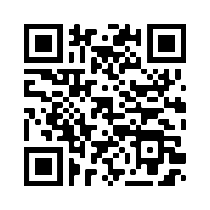
Apply for Summer 2024
Application Deadline: November 14, 8:00pm EST
Semifinalist Notification: Late January
Finalist Notification: March
Programs Begin: June
Online application at
www.clscholarship.org/apply
Notes:
The application for CLS 2024 is now open. The deadline for the CLS Program is November 14 at 8 PM ET or 5 PM PT.
By late January, every applicant will be notified of whether or not they will advance to the second round of selection.
Those who advance to the second round can expect to be notified by early March of whether they have been selected for the award. Students who are selected for the award will have about two weeks to either accept or decline the offer, at which point declined awards will be offered to alternate candidates.

Slide 15
Other Opportunities
studyabroad.state.gov
Benjamin A. Gilman International Scholarship
Fulbright U.S. Student Program
Boren Awards
Notes:
In addition to CLS, there are a lot of other opportunities for students to go abroad. You may want to share these resources with your peers to explore further:
Students can visit studyabroad.state.gov to see other U.S. Department of State programs
Visit their campus study abroad offices to find out about other study abroad opportunities available to them
If you’ve participated in other programs, you are welcome to add those here.

Slide 16
Questions?
cls@americancouncils.org
CLScholarship.org
fb.com/CLScholarship
@CLSScholarship
@CLScholarship

