Slide 1
Coral Live 2021
GCSE / A-LEVEL | AGES 14-18
Human activity and the coral ecosystem

Slide 2
Human activity and the coral ecosystem
Learning outcomes
The value of coral reef ecosystems to humans and the planet
Human induced threats and their impacts to the coral reef ecosystem to include: climate change, major drainage basin schemes, onshore developments, desalinisation, pollution, tourism, fishing

Slide 3
Human activity and the coral ecosystem
How is nature valuable to humans?
Aside from its extraordinary wonder, humans have started to place a monetary value on nature. This is done using a system known as ecosystem goods and services. Goods are what an ecosystem provides and services are what an ecosystem does for people.
Examples of goods are raw materials, e.g. wood, or food, e.g. fish.
Examples of services are climate regulation e.g. by ocean circulation, and erosion prevention, e.g. by mangroves.

Slide 4
Human activity and the coral ecosystem
Further reading
How do ecosystems and economies compare?
VIEW SUBJECT UPDATE

Slide 5
Human activity and the coral ecosystem
How is the coral ecosystem valuable to humans?
The total economic value of the reef has been estimated at an astounding USD 9.9 trillion per year (Constanza et al 2014). This is more than the annual Gross Domestic Product of the United Kingdom, Germany and France combined.
For the coral reefs, these goods and services are valued at over USD 350,000 per hectare per year. Some of the figures that make up this sum are surprising. The two highest values are for Erosion Prevention (USD 153,214 per hectare per year) and Recreation (USD 96,302 per hectare per year). Food only accounts for USD 677 per hectare per year. Other high figures include Genetic Resources at USD 33,048 per hectare per year.

Slide 6
Human activity and the coral ecosystem
Coral reef ecosystem goods and services per hectare per year (int$)
4 categories used for calculations
Provisioning services
Regulating services
Habitat services
Cultural services
Source: Constanza et al 2014

Slide 7
Human activity and the coral ecosystem
Further reading
What are coral reefs and why are they important?
VIEW SUBJECT UPDATE

Slide 8
Human activity and the coral ecosystem
Coral and erosion prevention
Erosion prevention is the service that coral reefs provide for coastal settlements. 275 million people live near reefs and coral reefs protect over 150,000 kilometers of coastline in 100 countries. Imagine a storm and high waves coming in from the sea. The coral reef acts as a natural barrier absorbing this energy.
The value given to this service is what it would cost to create an artificial equivalent.

Slide 9
Human activity and the coral ecosystem
Coral and genetic resources
Coral reefs are the most biodiverse ecosystem on the planet supporting 25% of all marine life.
Genetic resources refer to the fact that the coral reefs may prove to be the medicine cabinet of the 21st century with over half of all research into new cancer treatments focused on chemicals found in marine organisms.
Some of the value calculated for genetic resources will be an estimate of the value of these and other new medicines.

Slide 10
Human activity and the coral ecosystem
Coral and tourism
Coral reef tourism is estimated to be worth an astonishing $36 billion/year, supporting over 70 million trips annually.
Coral tourism can be both a threat and a benefit to the coral ecosystem, depending on how it is managed and whether profits are reinvested into conservation efforts.

Slide 11
Human activity and the coral ecosystem
Coral reef uses summary
Coastal protection
Tourism
Medicine
Human uses for coral reefs
Food
Science research

Slide 12
Human activity and the coral ecosystem
Valuing Curacao’s coral reefs
Diagram to show value of coral reef per hectare per year
Fisheries $14,800
Diving and snorkeling tourism $40,800
Research $500
Carbon sequestration $1,400 (global average)
Coastal protection $tbd (not enough current data)
With 785 ha of coral reef in Curacao, total value of over $45 million per year.
Source: Economic Valuation of Curaçao’s Marine Resources 2016

Slide 13
Human activity and the coral ecosystem
Main threats to coral reefs
Sewage and algae
Water quality
Ocean acidificat-ion
Coastal develop-ment
Threats to the coral reef
High CO₂ oceans
Coral bleaching
Over-fishing
Storm damage
Physical damage

Slide 14
Human activity and the coral ecosystem
Further reading
Human impacts on coral reefs
VIEW SUBJECT UPDATE

Slide 15
Human activity and the coral ecosystem
Curacao and overfishing
The reefs of Curaçao are overfished as a result of high fishing pressure and the uncontrolled use of spear guns, fish traps, and gill-nets.
Annual fish catch in Curacao has declined by 63% between 1905 and 2016.

Slide 16
Human activity and the coral ecosystem
Further reading
The effects of overfishing on coral reefs
VIEW SUBJECT UPDATE

Slide 17
Human activity and the coral ecosystem
Curacao and coastal development
Coastal development activities, such as sewage discharge and artificial beach construction, are likely to have caused the decline of the shallow reefs.
Sewage can increase the amount of algae on the reef flat and this can overgrow the coral.

Slide 18
Human activity and the coral ecosystem
Further reading
How does water quality affect the coral reefs?
VIEW SUBJECT UPDATE

Slide 19
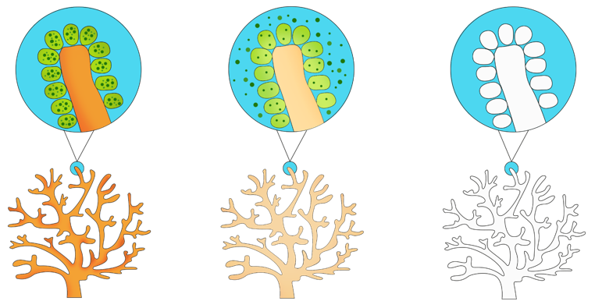
Human activity and the coral ecosystem
Curacao and coral bleaching
Massive coral bleaching has been documented for Curaçao reefs: in 1987, 1990, 1995 and 1998.

Slide 20
Human activity and the coral ecosystem
Further reading
Will coral reefs survive this century?
VIEW SUBJECT UPDATE

Slide 21
Human activity and the coral ecosystem
Curacao and coral disease
Disease has affected the coral reef in Curacao during the 1980s and 1990s. There was an outbreak of white band coral disease in 1980.
Scientists are still unsure as to what causes white band and other coral diseases.

Slide 22
Human activity and the coral ecosystem
Curacao and storm damage
Curacao is outside of the most frequent hurricane tracks, and storm damage is rare. However, corals in Curacao were badly affected by Hurricane Lenny in 1999.
Reef damage surveys at 33 sites conducted between November 1999 to April 2000, following the storm, documented occurrences of toppling, fragmentation, tissue damage, bleaching, and smothering due to the storm

Slide 23
Human activity and the coral ecosystem
Types of questions we can ask
Level 1 | Level 2
Who/What/Where/When/How/ Describe/ What is? | Retell...in your own words... What is the difference between..?
Level 3 | Level 4
Do you know of an instance where... Why is _____ significant? How is ______ related to______? | How does ____ compare with ____? What evidence do you have for______?

Slide 24
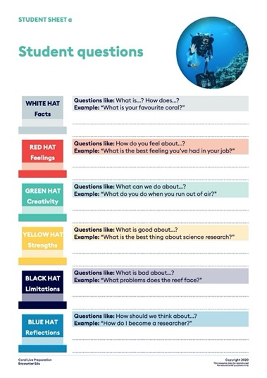
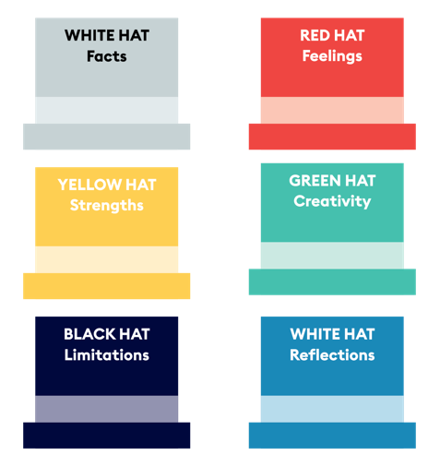
Human activity and the coral ecosystem
Thinking hat questions

Slide 25
Human activity and the coral ecosystem
Image Credits
Slide | Title | Attribution
1 | Coral bleaching | By The Ocean Agency
3 | Earth | Public Domain
4,6,19 | Images | By XL Catlin Seaview Survey
5 | Staghorn coral | By CARMABI
8 | Blue vase sponge | By Tisquesusa via Wikimedia
9 | Tourism | By CARMABI
16 | Algal reef | By Tony Hudson via Wikimedia
17 | Satellite image | By NASA
19 | Coral bleaching | By XL Catlin Seaview Survey
20 | Coral bleaching | By The Ocean Agency
21 | Coral storm damage | By XL Catlin Seaview Survey

