Slide 1
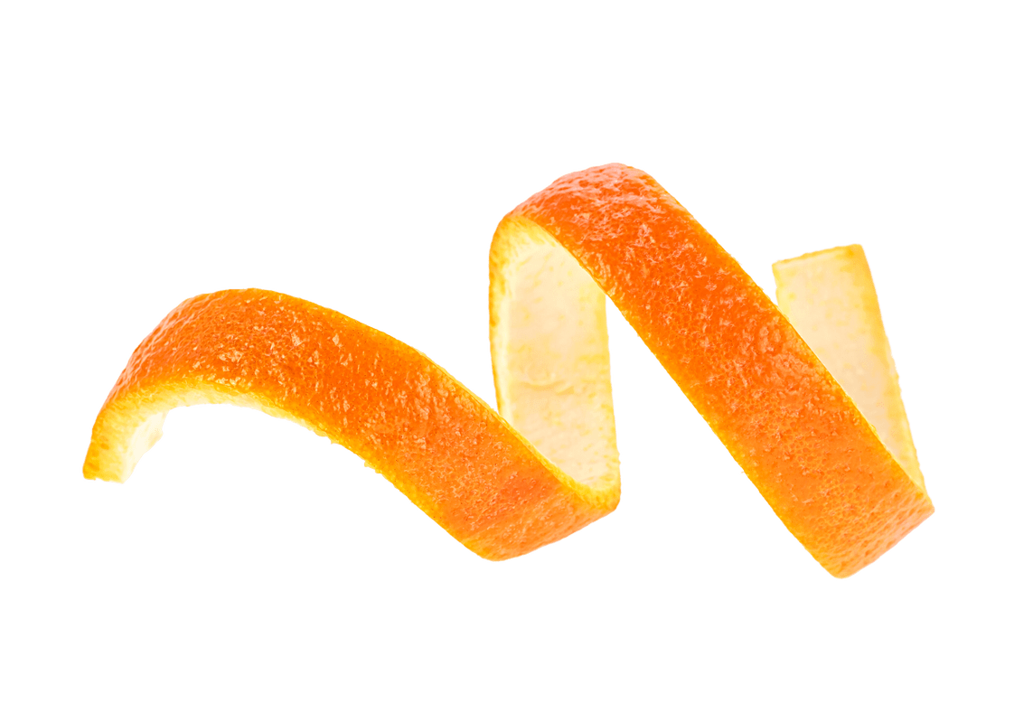
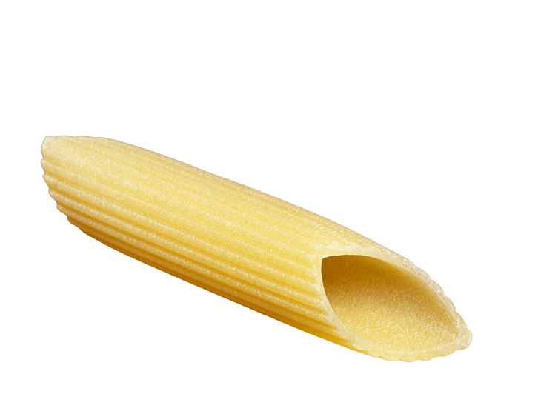
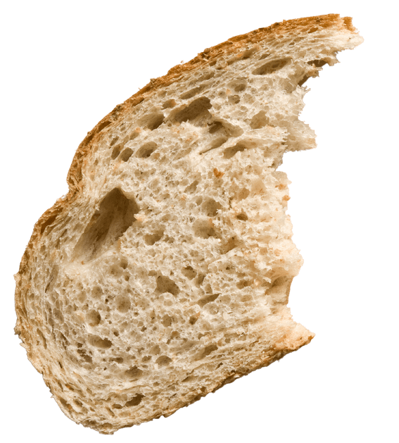
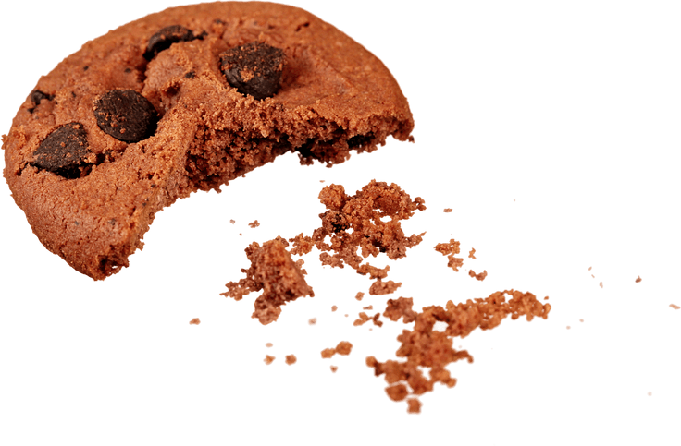
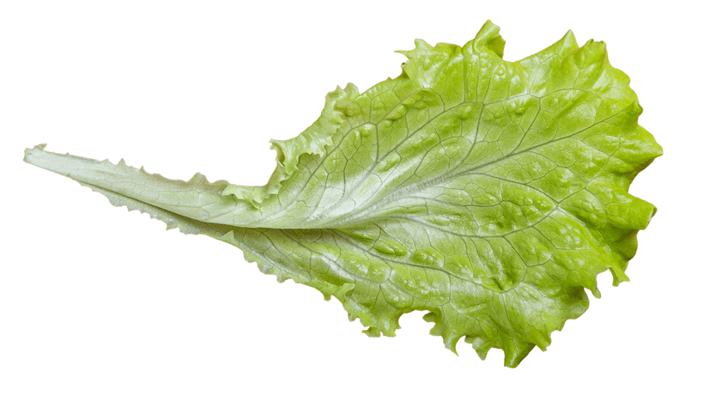
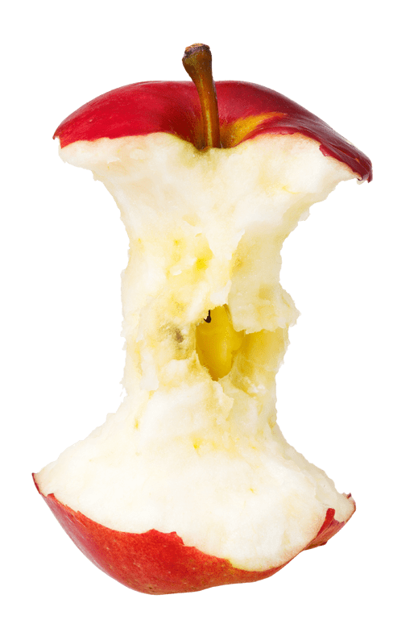
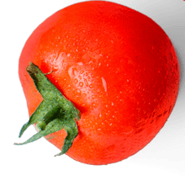
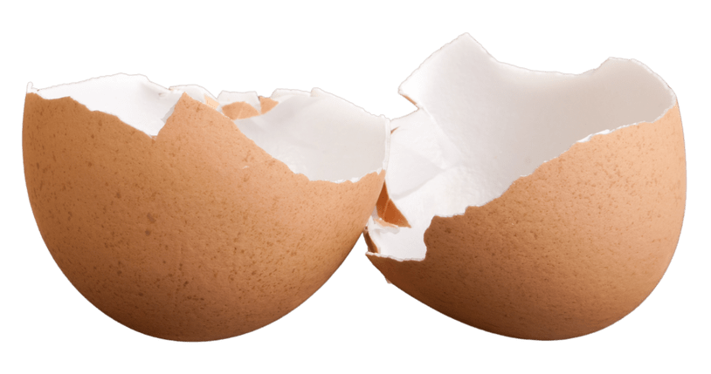
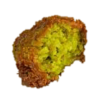
TURNING PEELS INTO POWER
THE STORY OF RECYCLED
LEFTOVERS
Notes:
explain what happens to food waste that gets recycled vs. food waste that goes into the residual, encouraging pupils to make the right decision and recycle where there is the option. Explain to pupils how to use their food waste recycling services properly, e.g. avoid contamination.

Slide 2
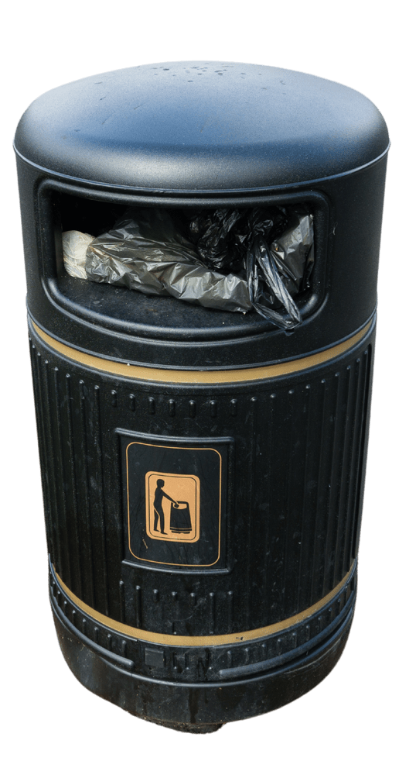
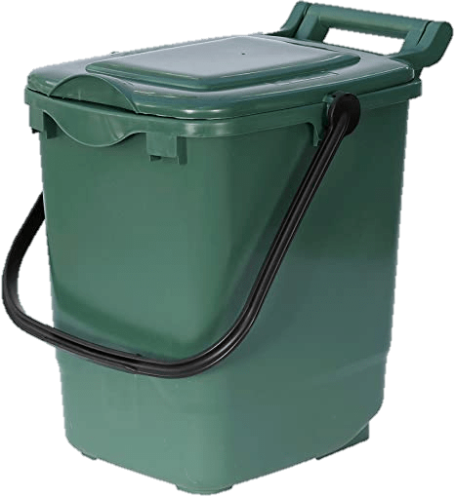
WHAT HAPPENS TO YOUR LEFTOVERS?
RECYCLING
RUBBISH
Notes:
Recycling and rubbish collections are different. They are collected differently and are taken to different places to be processed.

Slide 3
RECYCLING (turned into something useful)
Notes:
If you put your food waste in the recycling bin, it will be collected by special trucks that don’t use petrol (they are powered by biogas, which is made from food waste!) These trucks take food waste to a biogas plant, where it is turned into useful products like fuel for the trucks and fertiliser for fields and gardens, which helps plants grow.

Slide 4
WHAT HAPPENS TO YOUR LEFTOVERS?
Notes:
This video explains the procedure in more detail of turning food waste into useful products.

Slide 5
RUBBISH (creates waste and pollution)
Notes:
If you put your food waste into the black bin (rubbish), it will be collected by rubbish trucks and taken to a railway station in west London. Here, the rubbish is loaded onto trains and taken to one more place – an Energy from Waste plant. At the EfW, rubbish is burned under controlled conditions to generate electricity.

Slide 6
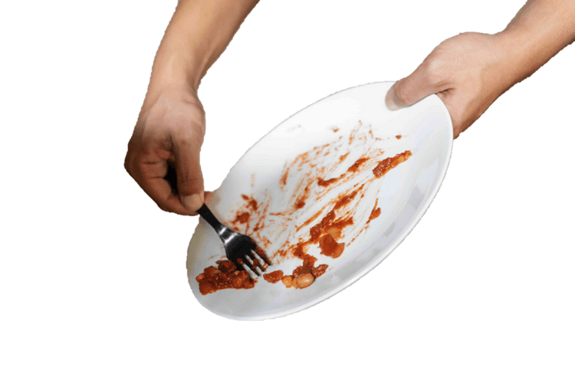
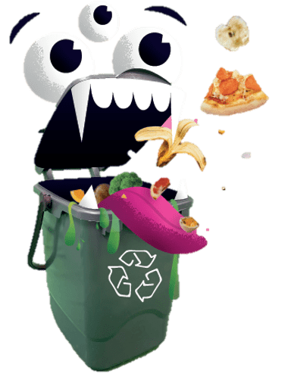
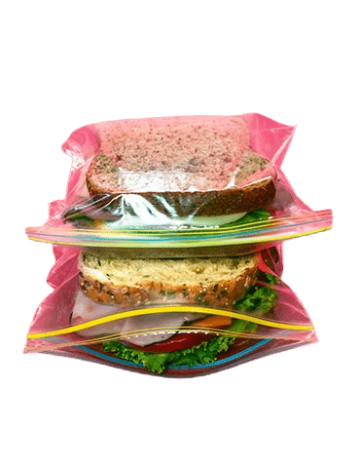
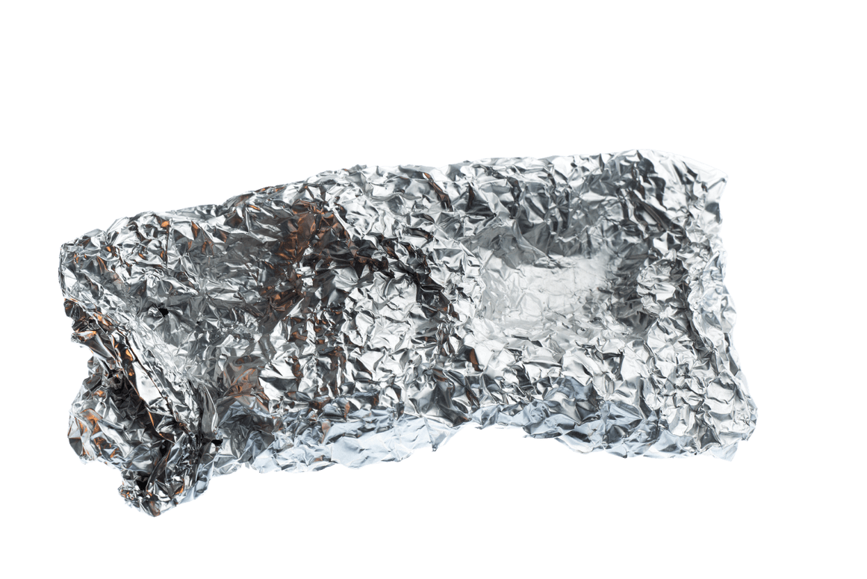
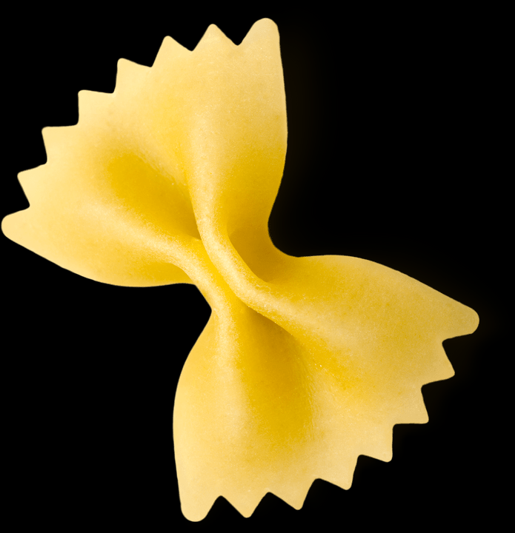
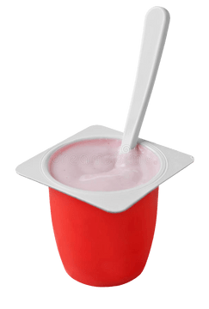
WHAT GOES IN THE FOOD BIN?
Fruit
Vegetables
Bread
Plate scrapings
Plastic
Liquid
Yoghurt
Tin foil
Notes:
What can/can’t you put into your food recycling bin? Why do you think plastic/foil/non-food items can’t go in? (Explain that food waste breaks down much faster than these materials, so when it goes to the biogas plant, for the machines to work properly they can only deal with food waste). Liquids such as oil or soup should not go in the bin because it will make it too heavy and difficult for the recycling crews to collect.

Slide 7
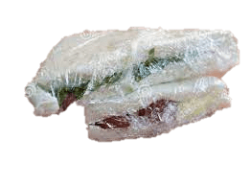
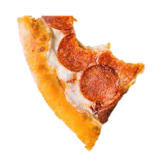
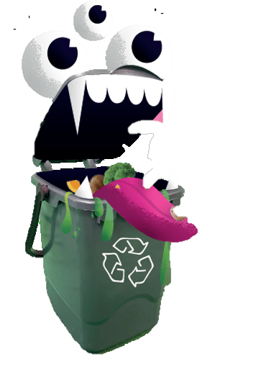
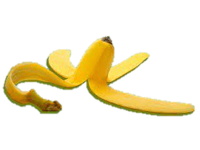
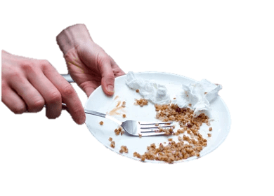
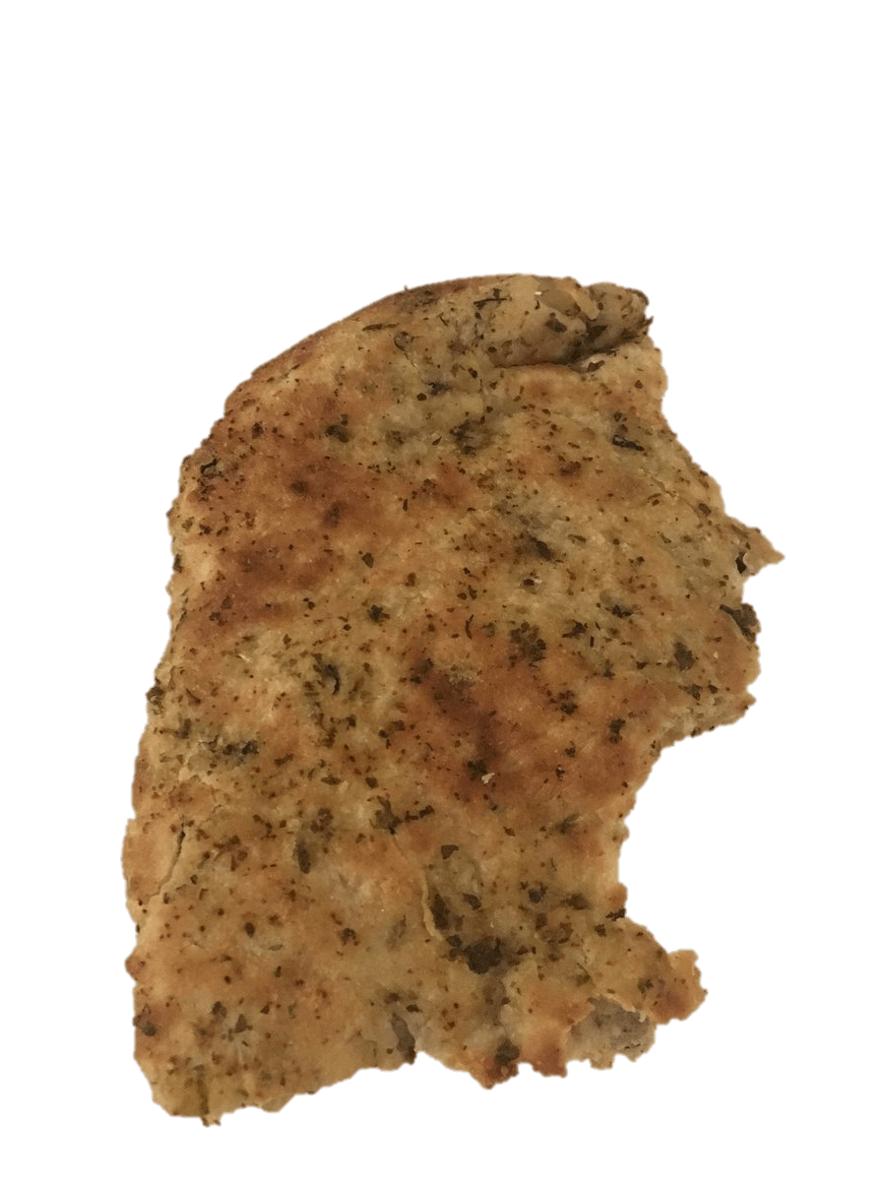
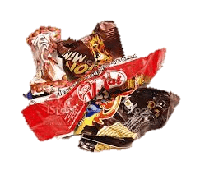
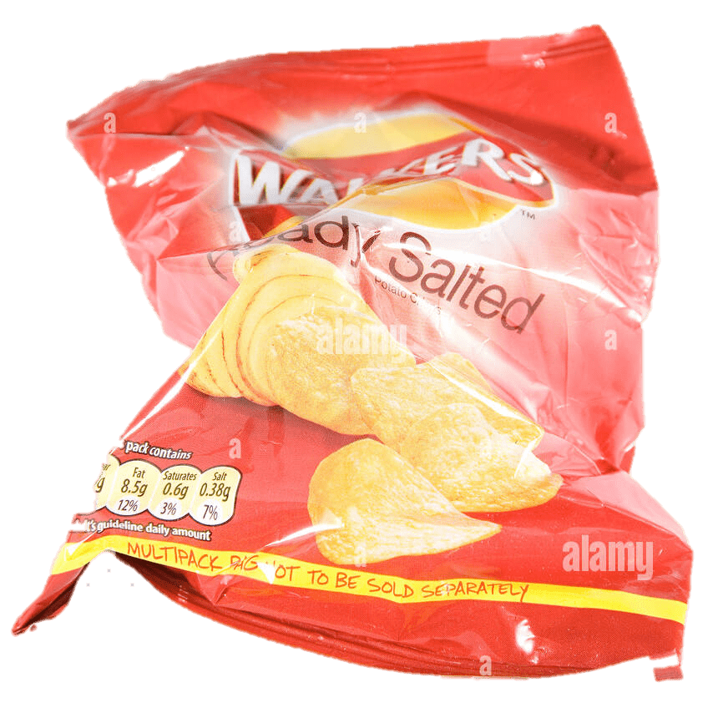
RECYCLING or RUBBISH?
Notes:
Recycling or rubbish guessing game.

Slide 8
DISCUSSION TIME
Why should we recycle food waste?
Do you recycle food waste at home?
What can/can’t go in the food recycling bin?
What happens to recycled food?
What happens to food in the rubbish bin?
Notes:
Split class into groups or do a shout out discussion using prompts on screen.

Slide 9
Notes:
End with any final questions.

