Slide 1
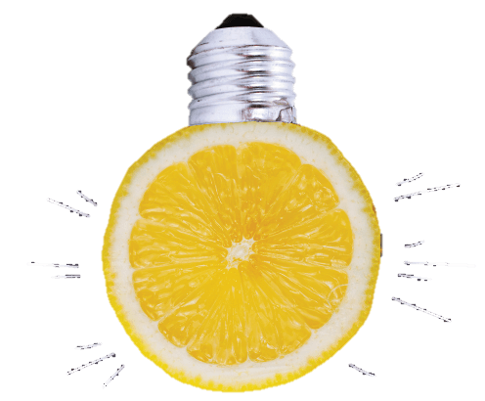
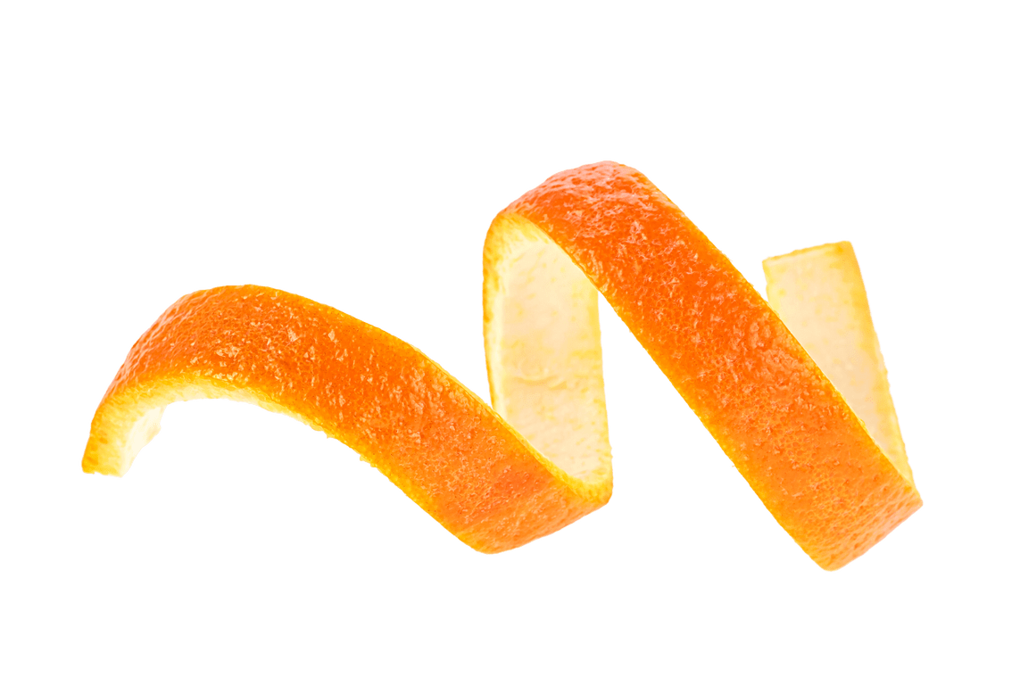
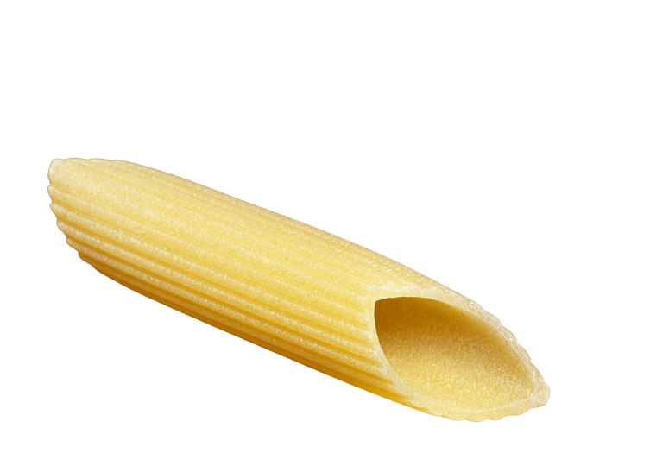
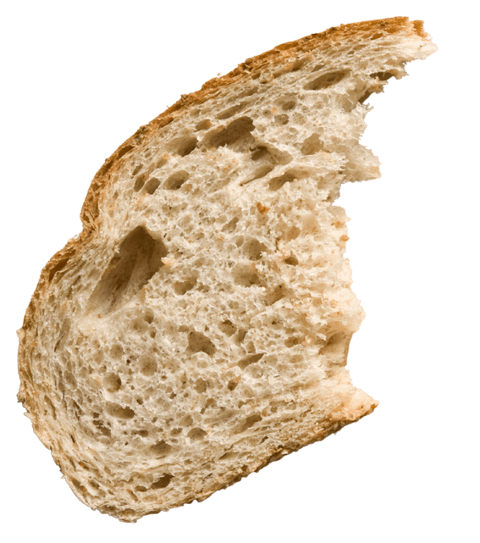
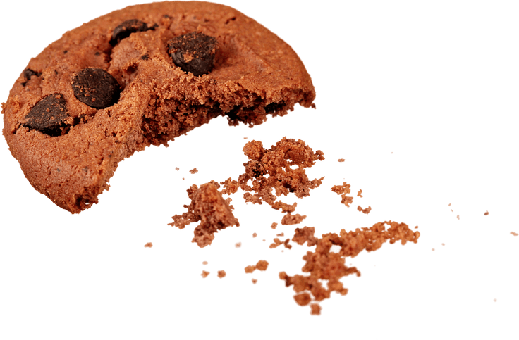
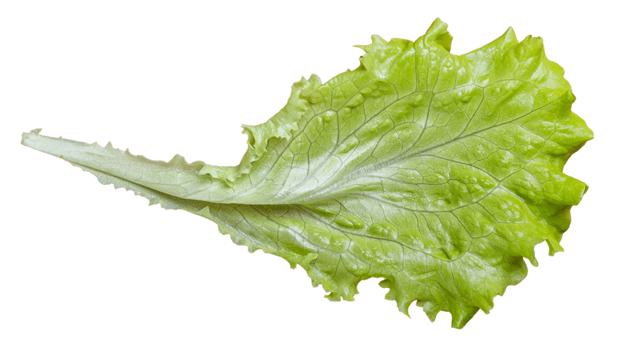
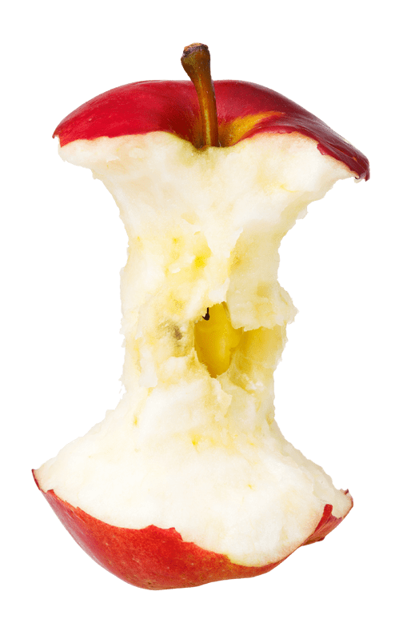
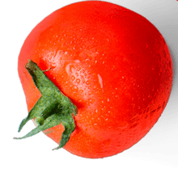
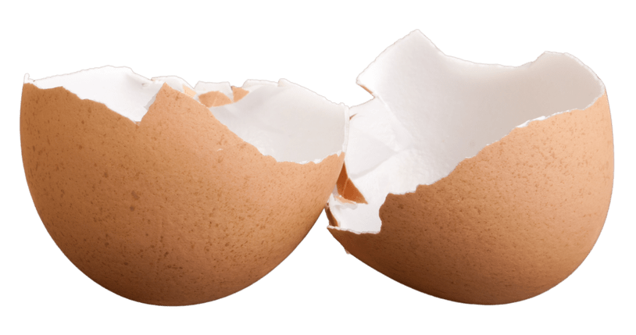
TURNING PEELS INTO POWER
THROUGH FOOD
WASTE RECYCLING

Slide 2
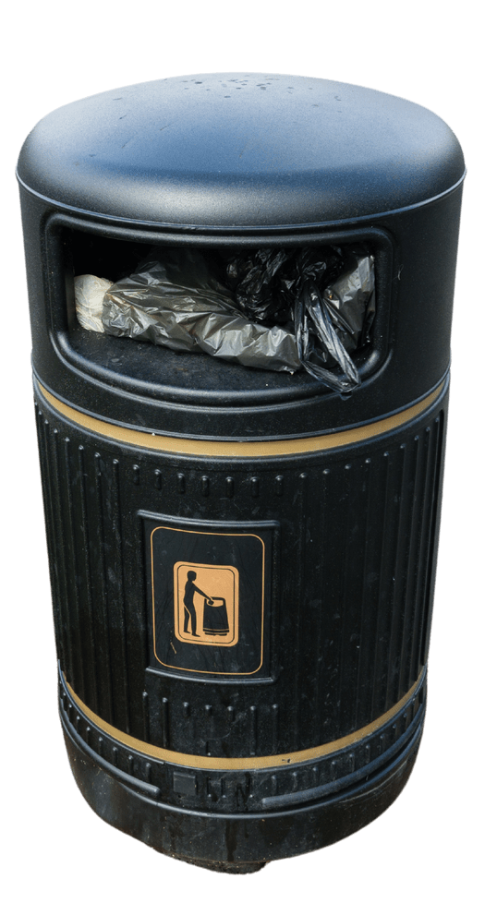
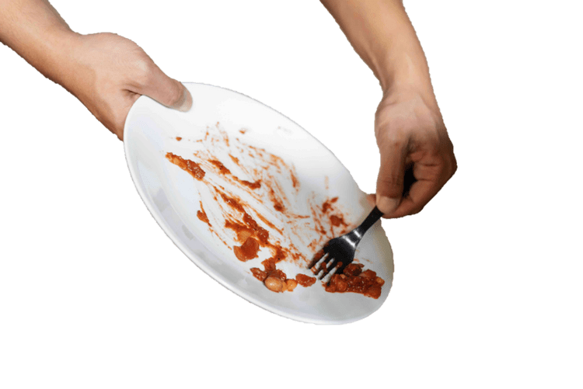
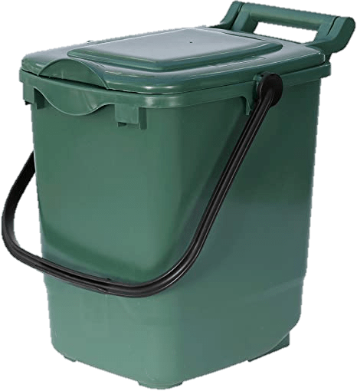
WHAT HAPPENS TO YOUR FOOD WASTE?
RECYCLING
RUBBISH

Slide 3
RECYCLING (turned into something useful)
Collected by trucks
powered by biogas!
Turned into biogas through
anaerobic digestion
100% renewable, clean energy & compost

Slide 4
WHAT HAPPENS TO YOUR LEFTOVERS?

Slide 5
RUBBISH (creates waste and pollution)
Collected by
bin trucks
Loaded onto
trains
Burned at an Energy from Waste plant, making electricity, CO2 and ash

Slide 6
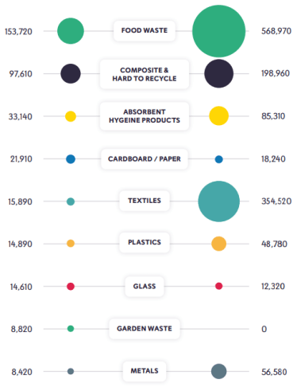
FOOD WASTE &
CARBON
Waste Tonnage
Embodied Carbon (tCO2eq)
Out of all waste, food has the highest carbon impact
Every year, UK households throw out 6.5m tonnes of food waste – the same as 18 Empire State buildings!
If we recycled all of this, the impact would be the same as planting 200m trees per year
Around 60% of all ‘rubbish’ is food waste that could be used as biogas, a 100% renewable, carbon neutral alternative to natural gas/oil

Slide 7
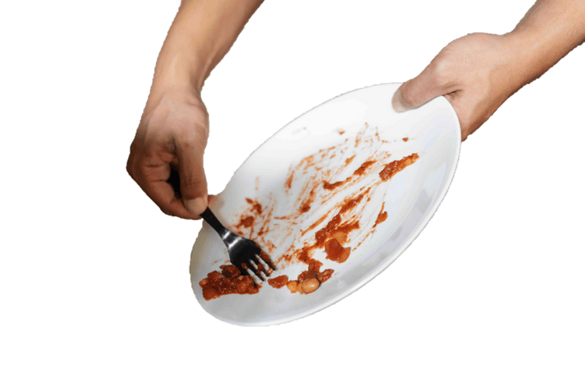
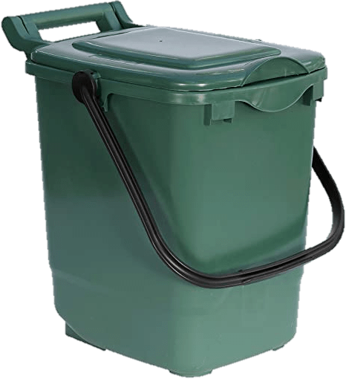
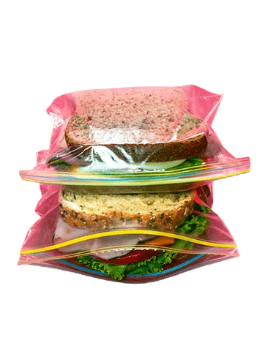
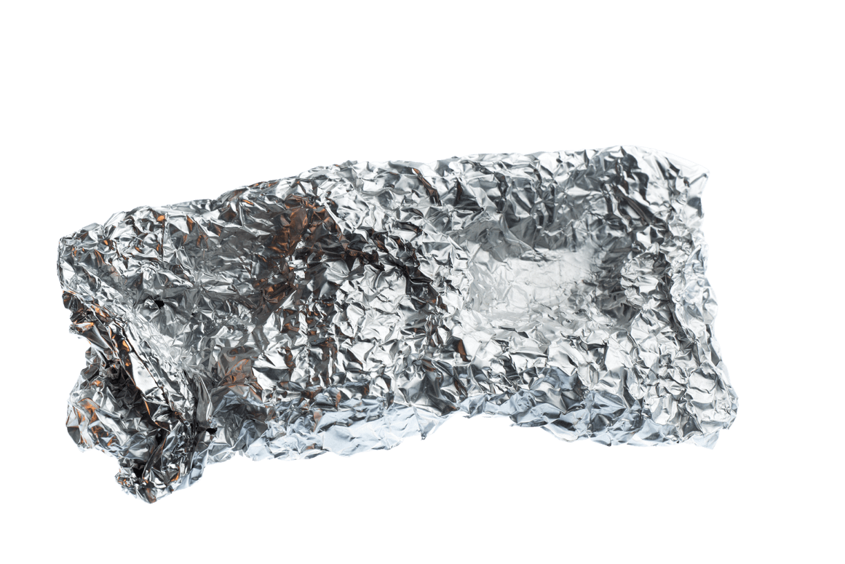
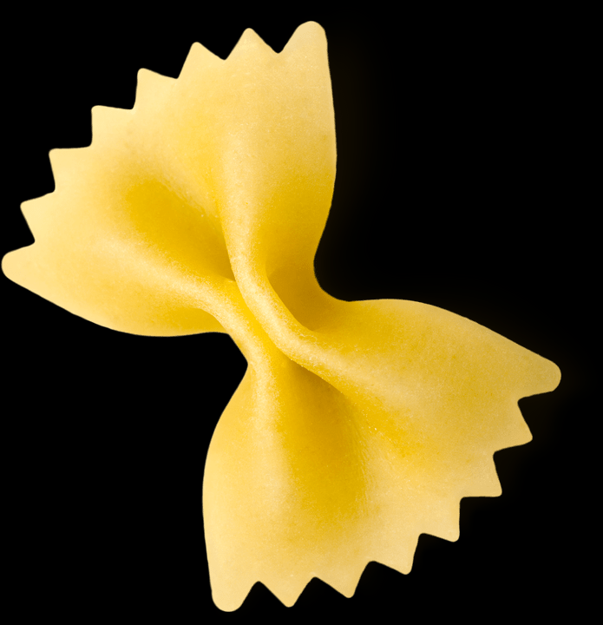
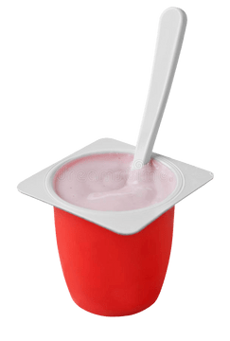
WHAT GOES IN THE FOOD BIN?
Fruit
Vegetables
Bread
Plate scrapings
Plastic
Liquid
Yoghurt
Tin foil

Slide 8
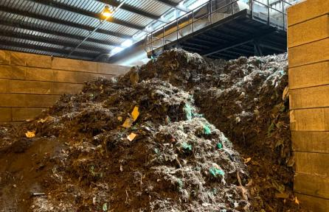
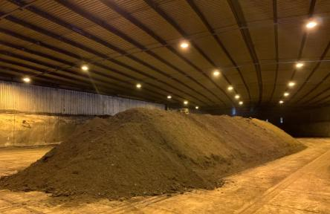
WHY CAN’T PLASTIC GO IN THE FOOD BIN?
At the composting plant, plastic can’t be broken down like food waste. It takes much longer – up to 500 years!
Plastic pollutes the compost and must be removed, so that it doesn’t end up in fields and gardens.

Slide 9
RECYCLING YOUR FOOD WASTE IS ONE OF THE BIGGEST ACTIONS YOU CAN TAKE AGAINST CLIMATE CHANGE
DO THE RIGHT THING
USE THE RIGHT BIN

Slide 10
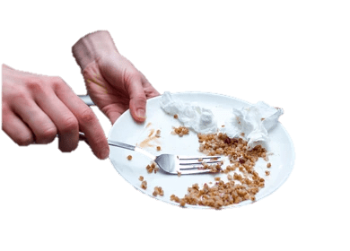
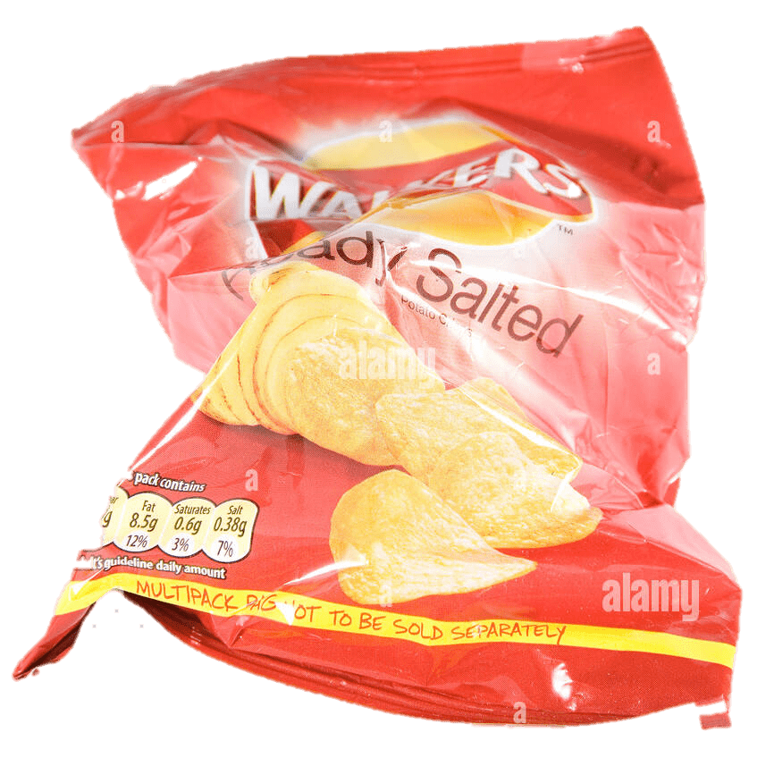
DISCUSSION TIME
Why should we recycle food waste?
What can/can’t go in the food recycling bin?
What happens to recycled food?
What happens to food in the rubbish bin?

