Slide 1
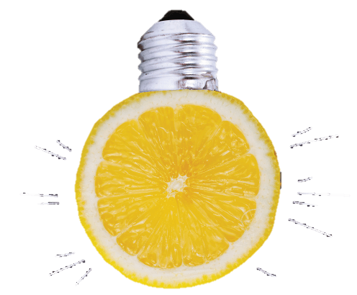
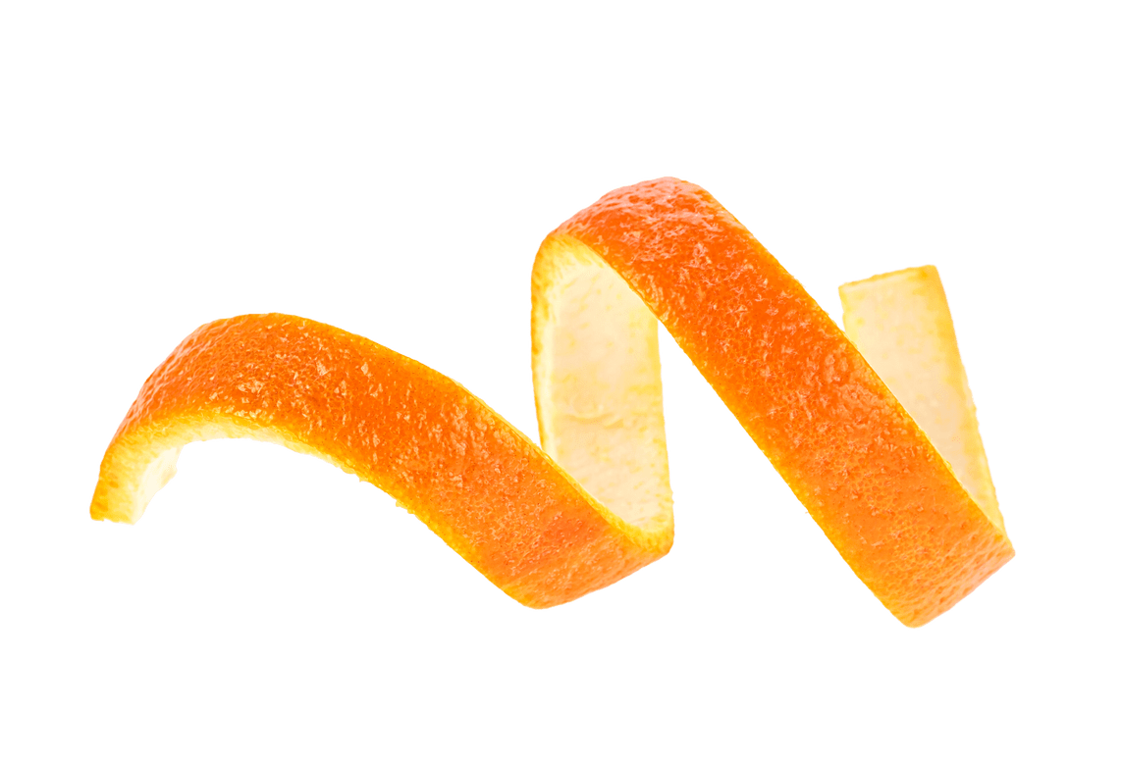
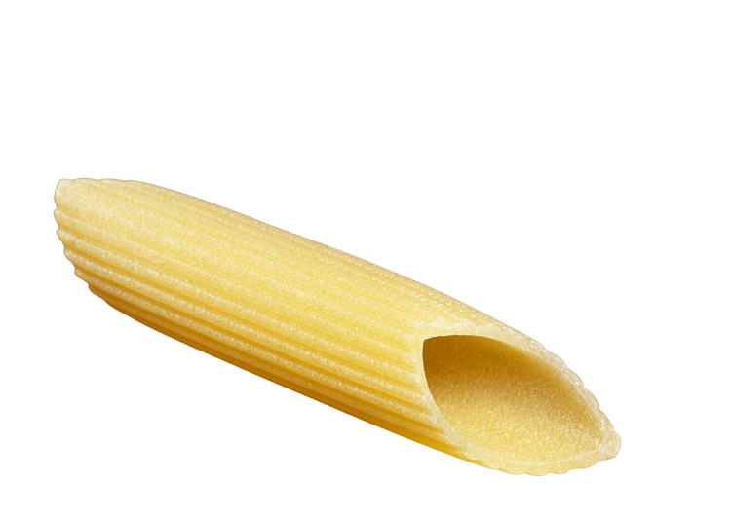
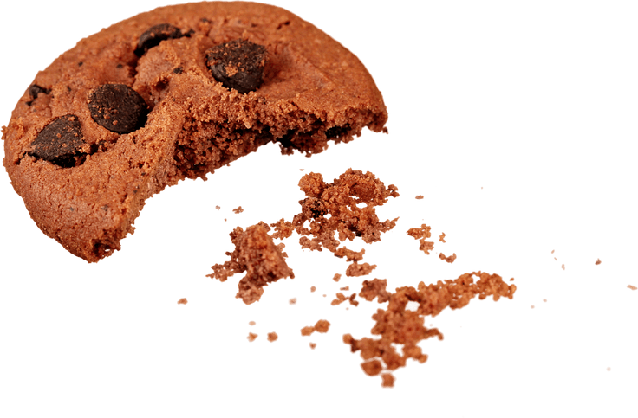
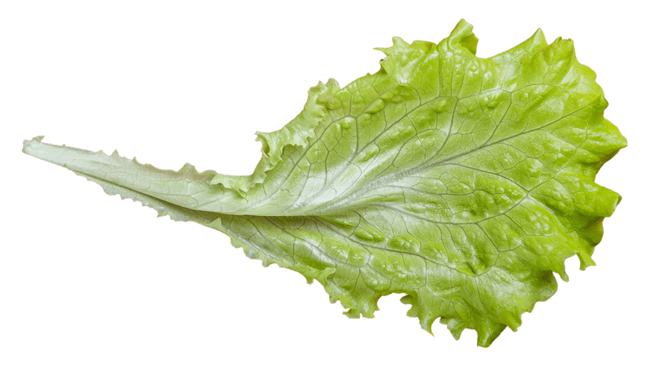
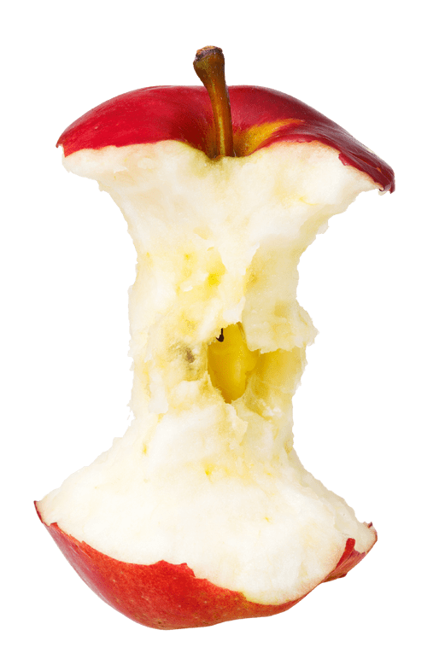
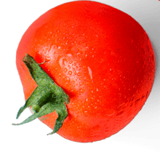
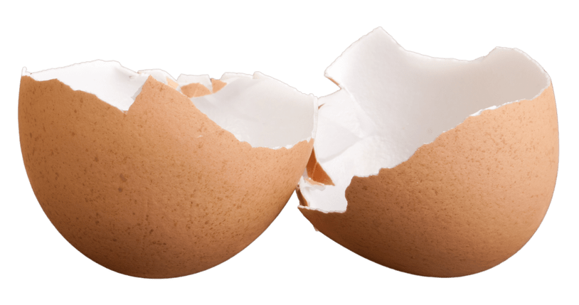
TURNING PEELS INTO POWER
THROUGH FOOD
WASTE RECYCLING
Notes:
explain what happens to food waste that gets recycled vs. food waste that goes into the residual, encouraging pupils to make the right decision and recycle where there is the option. Relate to wider context of resource pressure and climate change. Explain to pupils how to use their food waste recycling services properly, e.g. avoid contamination, emphasising it is the right thing to do.

Slide 2
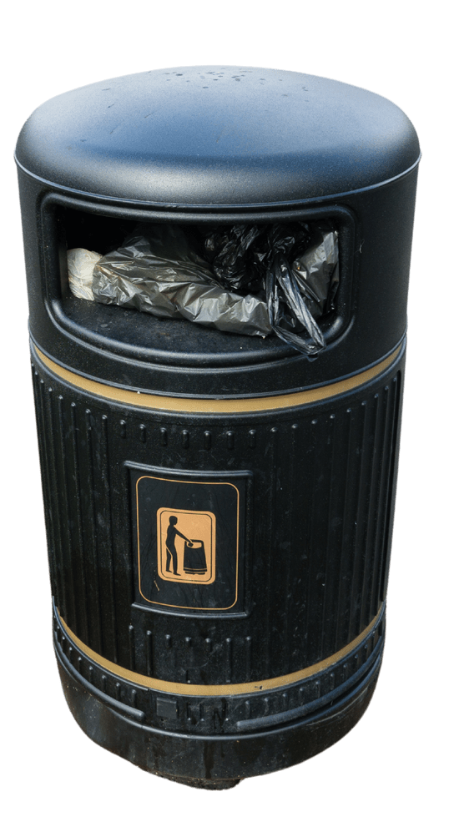
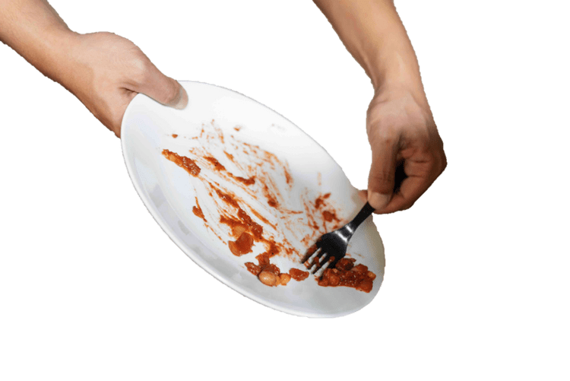
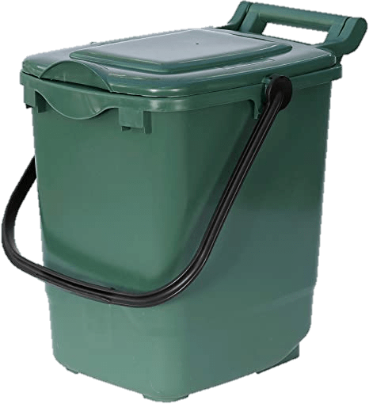
WHAT HAPPENS TO YOUR FOOD WASTE?
RECYCLING
RUBBISH
Notes:
Recycling and rubbish collections are different. They are collected differently and are taken to different places to be processed. Food waste is usually collected weekly to avoid pests and smells, whilst black bin rubbish is collected less to encourage more recycling.

Slide 3
RECYCLING (turned into something useful)
Collected by trucks
powered by biogas!
Turned into biogas through
anaerobic digestion
100% renewable, clean energy & compost
Notes:
If you put your food waste in the recycling bin, it will be collected by trucks that don’t use petrol (they are powered by biogas, which is made from the food waste they collect!) Nothing gets wasted. These trucks take food waste to a biogas plant, where it is turned into useful products like fuel for the trucks and fertiliser for fields and gardens.

Slide 4
WHAT HAPPENS TO YOUR LEFTOVERS?
Notes:
This video explains the procedure in more detail of turning food waste into useful products.

Slide 5
RUBBISH (creates waste and pollution)
Collected by
bin trucks
Loaded onto
trains
Burned at an Energy from Waste plant, making electricity, CO2 and ash
Notes:
If you put your food waste into the rubbish, it will be collected by rubbish trucks and taken to a railway station in west London. Here, the rubbish is loaded onto trains and taken to one more place – an Energy from Waste plant. At the EfW, rubbish is burned under controlled conditions to generate electricity. While this is better than landfill, the process still produces waste products such as CO2 associated with transporting and incinerating the rubbish, plus the ash leftover from burning it. The ash might be recycled as aggregates in construction, or it may be landfilled.

Slide 6
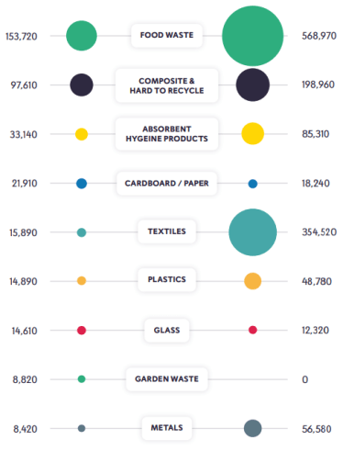
FOOD WASTE &
CARBON
Waste Tonnage
Embodied Carbon (tCO2eq)
Out of all waste, food has the highest carbon impact
Every year, UK households throw out 6.5m tonnes of food waste – the same as 18 Empire State buildings!
If we recycled all of this, the impact would be the same as planting 200m trees per year
Around 60% of all ‘rubbish’ is food waste that could be used as biogas, a 100% renewable, carbon neutral alternative to natural gas/oil
Notes:
Food waste (by weight) is the largest waste material collected in west London. An average of 40-60% of people’s rubbish bins is actually recyclable food waste that could be used to create clean, green energy.
Food waste is also the material with the highest carbon footprint. If we recycled the 6.5m tonnes of food waste that goes to waste in the UK every single year, it would have the same impact as planting 200m trees.

Slide 7
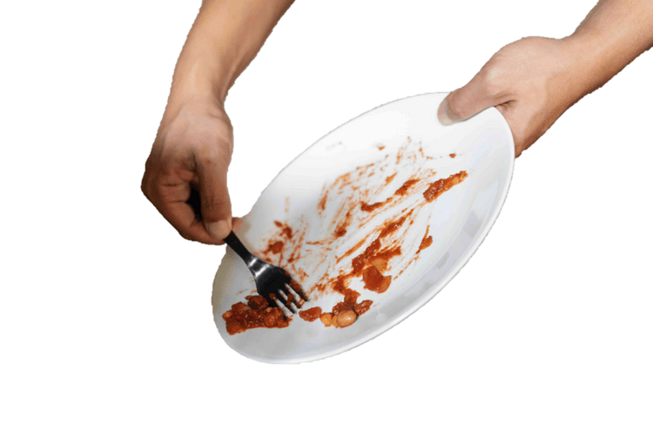
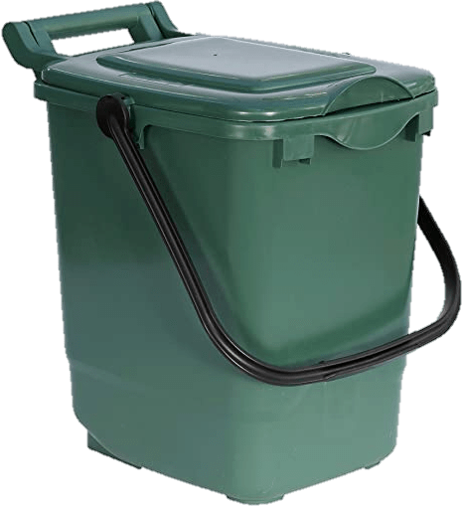
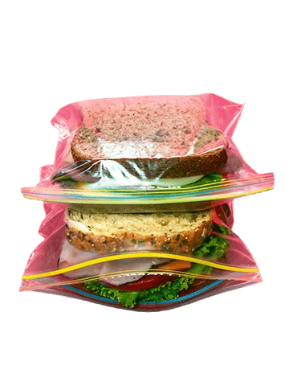
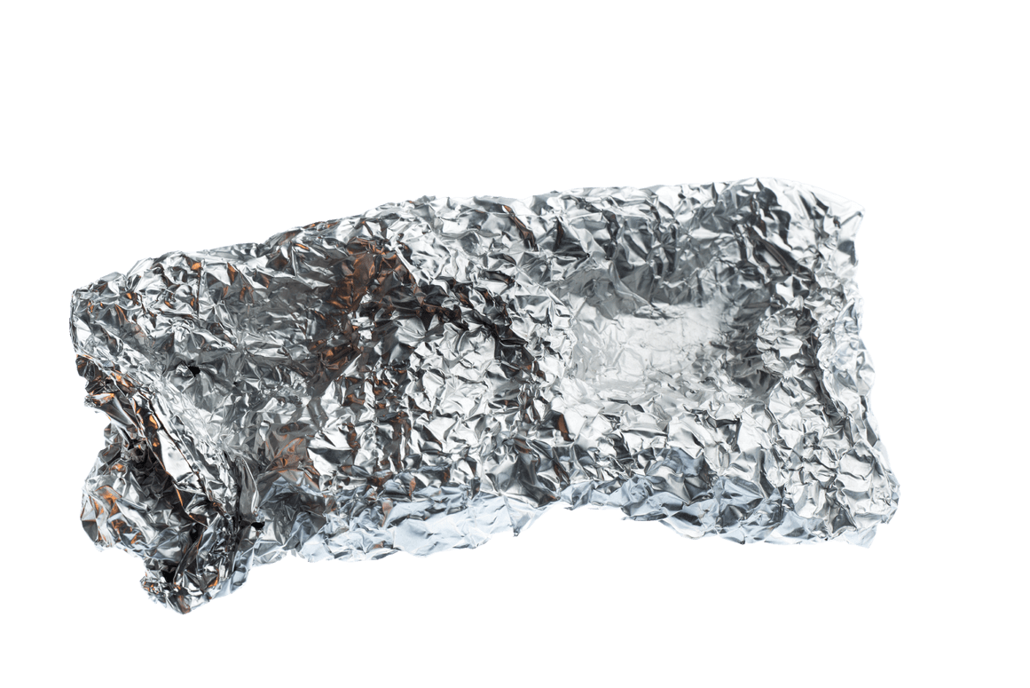
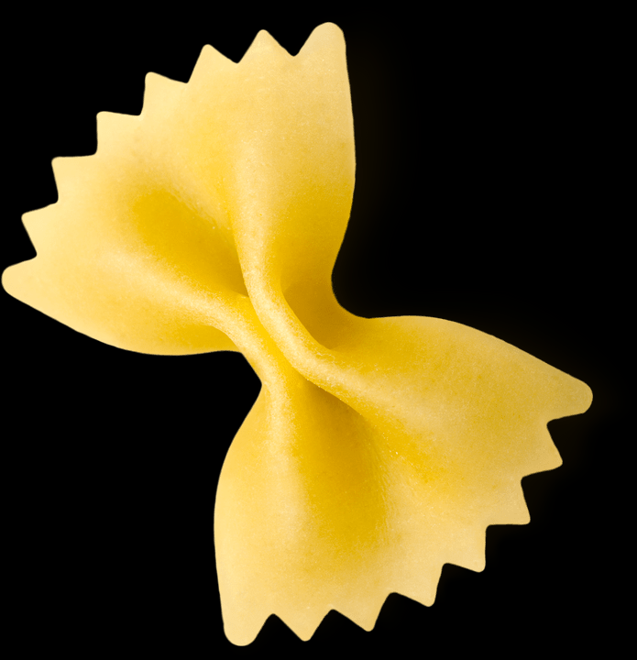
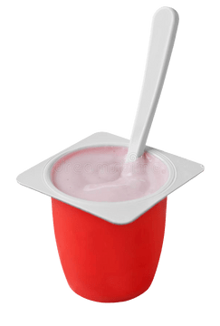
WHAT GOES IN THE FOOD BIN?
Fruit
Vegetables
Bread
Plate scrapings
Plastic
Liquid
Yoghurt
Tin foil
Notes:
What can/can’t you put into your food recycling bin? Why do you think plastic/foil/non-food items can’t go in? Liquids such as oil or soup should not go in the bin because it will make it too heavy and difficult for the recycling crews to collect.

Slide 8
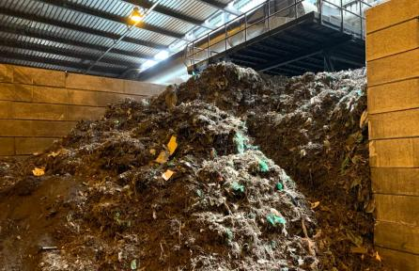
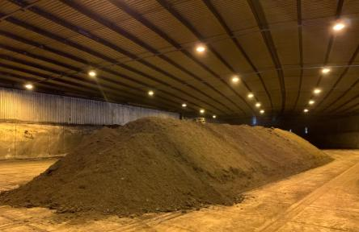
WHY CAN’T PLASTIC GO IN THE FOOD BIN?
At the composting plant, plastic can’t be broken down like food waste. It takes much longer – up to 500 years!
Plastic pollutes the compost and must be removed, so that it doesn’t end up in fields and gardens.
Notes:
Explain that food waste breaks down much faster than these materials, so when it goes to the biogas plant, for the machines to work properly they can only deal with food waste.

Slide 9
RECYCLING YOUR FOOD WASTE IS ONE OF THE BIGGEST ACTIONS YOU CAN TAKE AGAINST CLIMATE CHANGE
DO THE RIGHT THING
USE THE RIGHT BIN
Notes:
Choosing to recycle your food waste is one of the biggest actions you can take as an individual against climate change. Soon, it will be the law for all households in England to have a weekly food waste collection service.

Slide 10
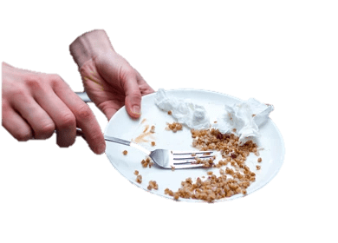
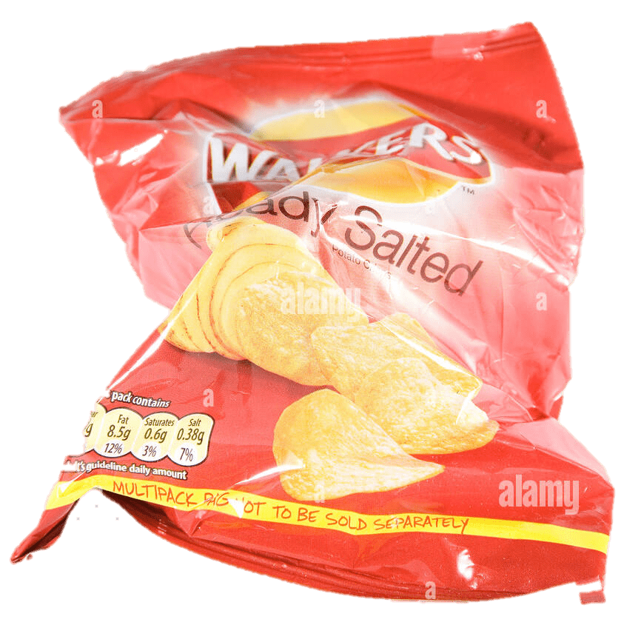
DISCUSSION TIME
Why should we recycle food waste?
What can/can’t go in the food recycling bin?
What happens to recycled food?
What happens to food in the rubbish bin?
Notes:
Split class into groups or do a shout out discussion using prompts on screen.
End with any final questions.

