Slide 1
What is Down syndrome?

Slide 2
Why is it called Down syndrome?
In 1866, an English doctor named John Langdon DOWN described the characteristics of Down syndrome.

Slide 3
What were some of the characteristics John Langdon Down observed?

Slide 4
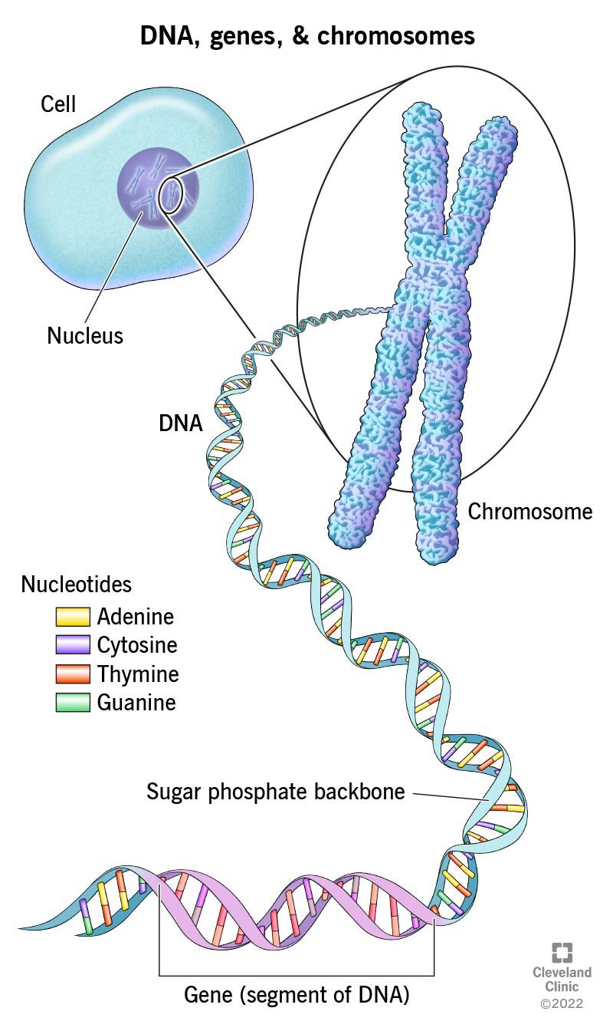
Your body is made up of TRILLIONS of cells. Each cell is a copy of a single cell that divided itself to make all the cells in your body. Your cells need instructions to create who you are. Your DNA, genes and chromosomes work together to tell your body how to form and function.
DNA is in every cell in your body. Chromosomes are found carrying your DNA in the nucleus of your cells. DNA looks like a spiral staircase (double helix.)
- Cleveland Clinic 2022

Slide 5
More About Chromosomes
Chromosomes are tiny thread-like structures inside your body. Within each chromosome there are hundreds of genes. Genes determine everything about you!
Genes hold the instructions to make you who you are. Genes decide things like gender, hair color, eye color, skin color and height!
Most of the time, chromosomes divide into 22 numbered pairs—with one chromosome from each parent to make the pair.

Slide 6
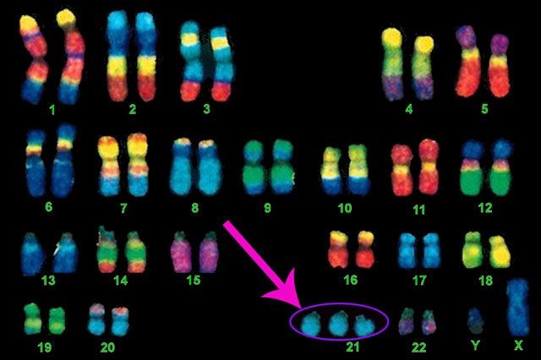
Sometimes, very rarely, something doesn’t line up quite right and one of the pairs has an additional chromosome (trisomy) or a missing chromosome (monosomy.)
Down syndrome occurs when there is an extra 21st chromosome—that’s why it is also called Trisomy 21!!!

Slide 7
How Does having an extra chromosome IMPACT people with Down syndrome?
Every person develops different skills and strengths throughout their life – this includes things like learning to crawl, walk, jump, speak, read, and throw a ball!
No person develops that same or at the same speed.
For people with Down syndrome, the extra chromosome changes the way their brain and body develop.
Sometimes, this makes them learn skills a little bit slower than you!

Slide 8
How Does having an extra chromosome IMPACT people with Down syndrome?
And while JUST LIKE YOU, people with Down syndrome look the most like their moms and dad and siblings, but they also may have some features in common with other people with Down syndrome like…
A smaller pinky finger
A gap between their big toe and second toe
Smaller ears
Shorter-than-average height
They also may have some medical conditions that require a few more doctor’s visits than you…like low muscle tone or hearing impairment or even things with their heart that require a special doctor.

Slide 9
More Alike Than Different
And while JUST LIKE YOU, people with Down syndrome look the most like their moms and dad and siblings, but they also may have some features in common with other people with Down syndrome like…
A smaller pinky finger
A gap between their big toe and second toe
Smaller ears
Shorter-than-average height
They also may have some medical conditions that require a few more doctor’s visits than you…like low muscle tone or hearing impairment or even things with their heart that require a special doctor.

Slide 10
Visit www.dsamn.org for even more information about Down syndrome

