Slide 1
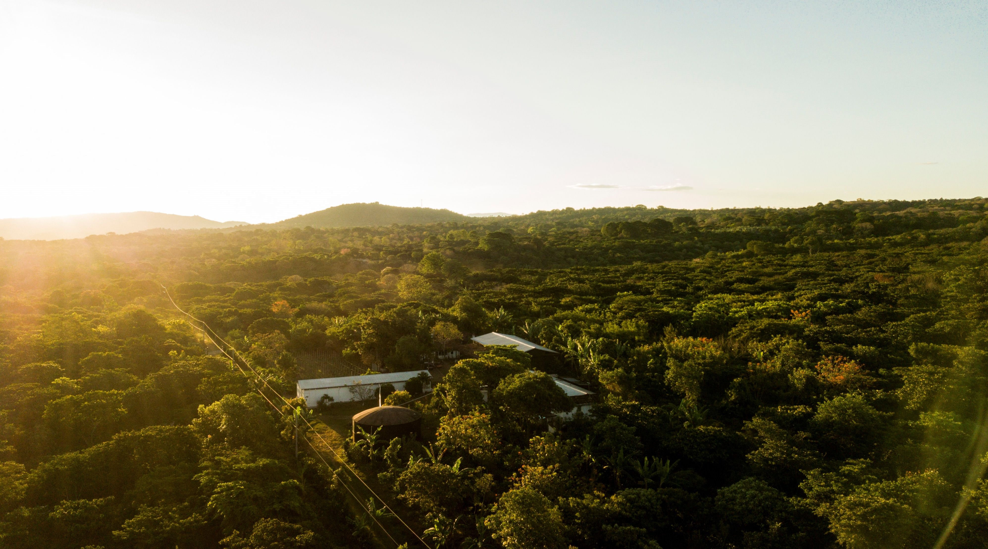
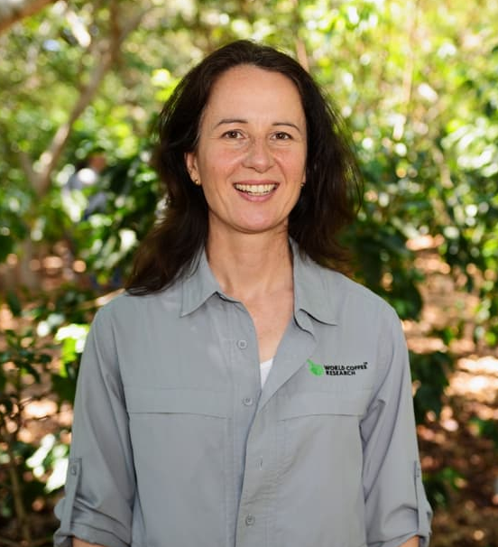
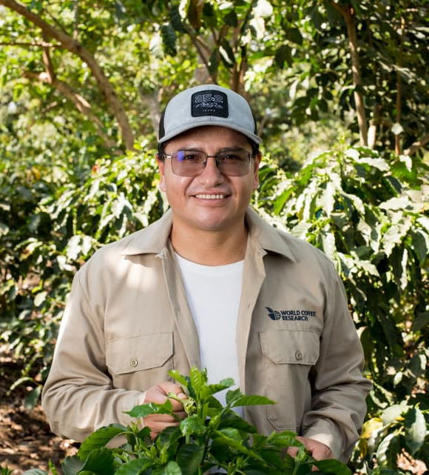
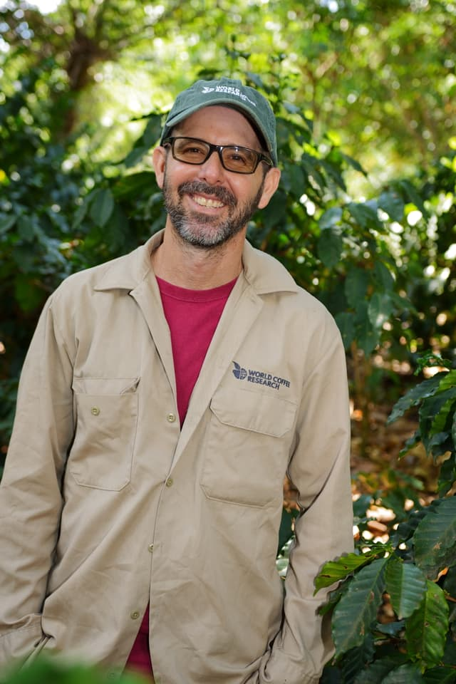

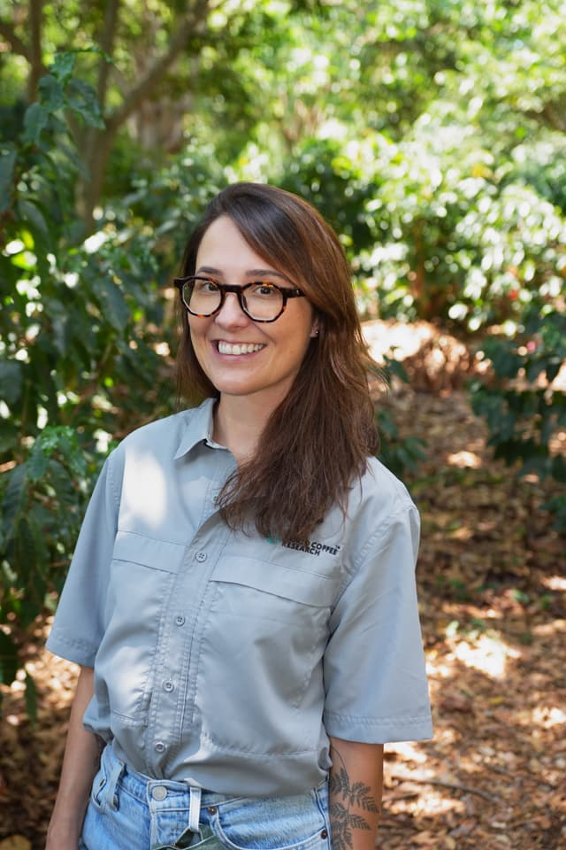
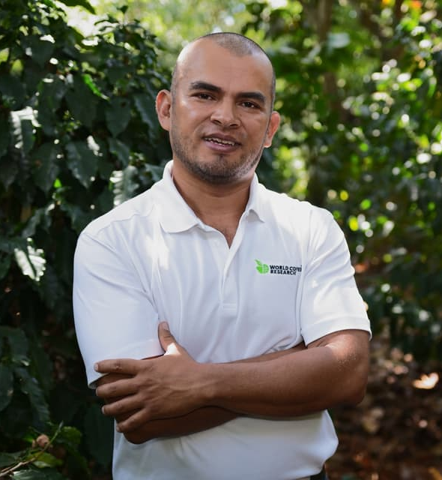
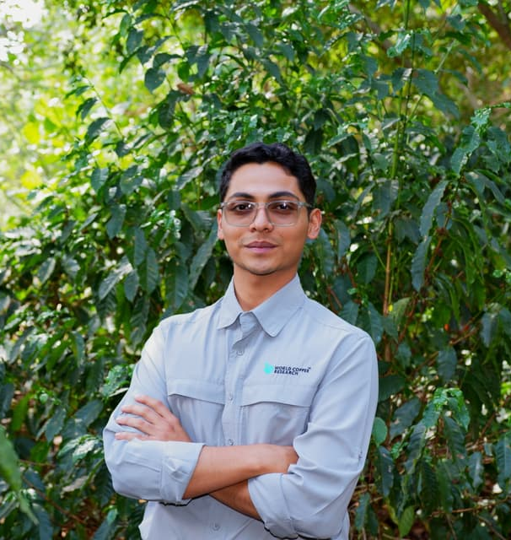

Innovea
Global Coffee Breeding Network
Ph.D.Tania Humphrey
Project Steward
Ph.D. Santos Barrera
Project Manager
Ph.D. Jorge Berny Scientist Leader
Scan the QR code or go to worldcoffeeresearch.org/innovea to read more about the program.
Ph.D. Verônica Belchior
Research Scientist
Coffee quality
M.Sc. Elly Castro
Senior
Research Technician
I.A. Research Technician

Slide 2
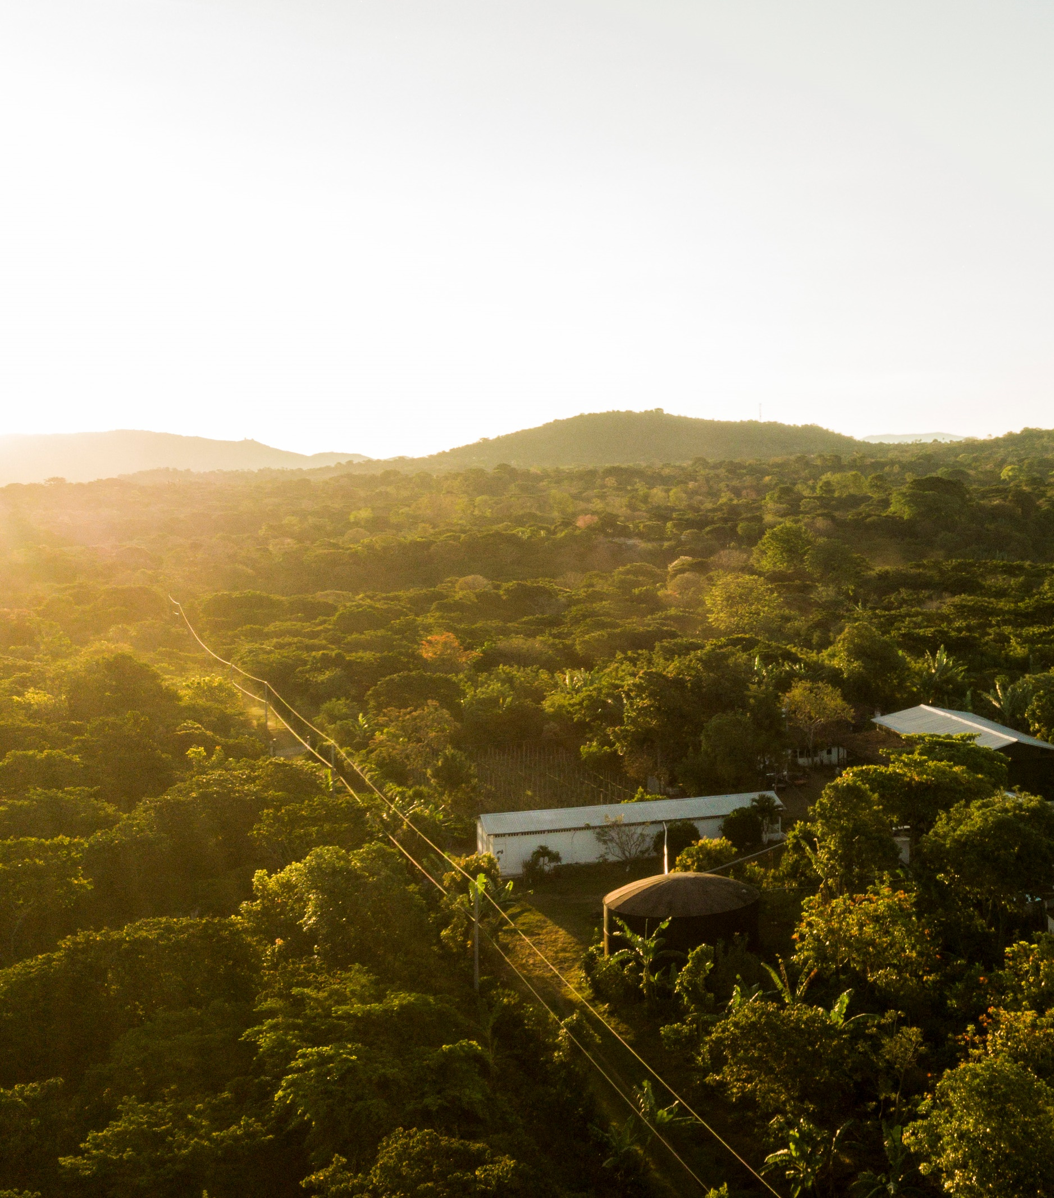
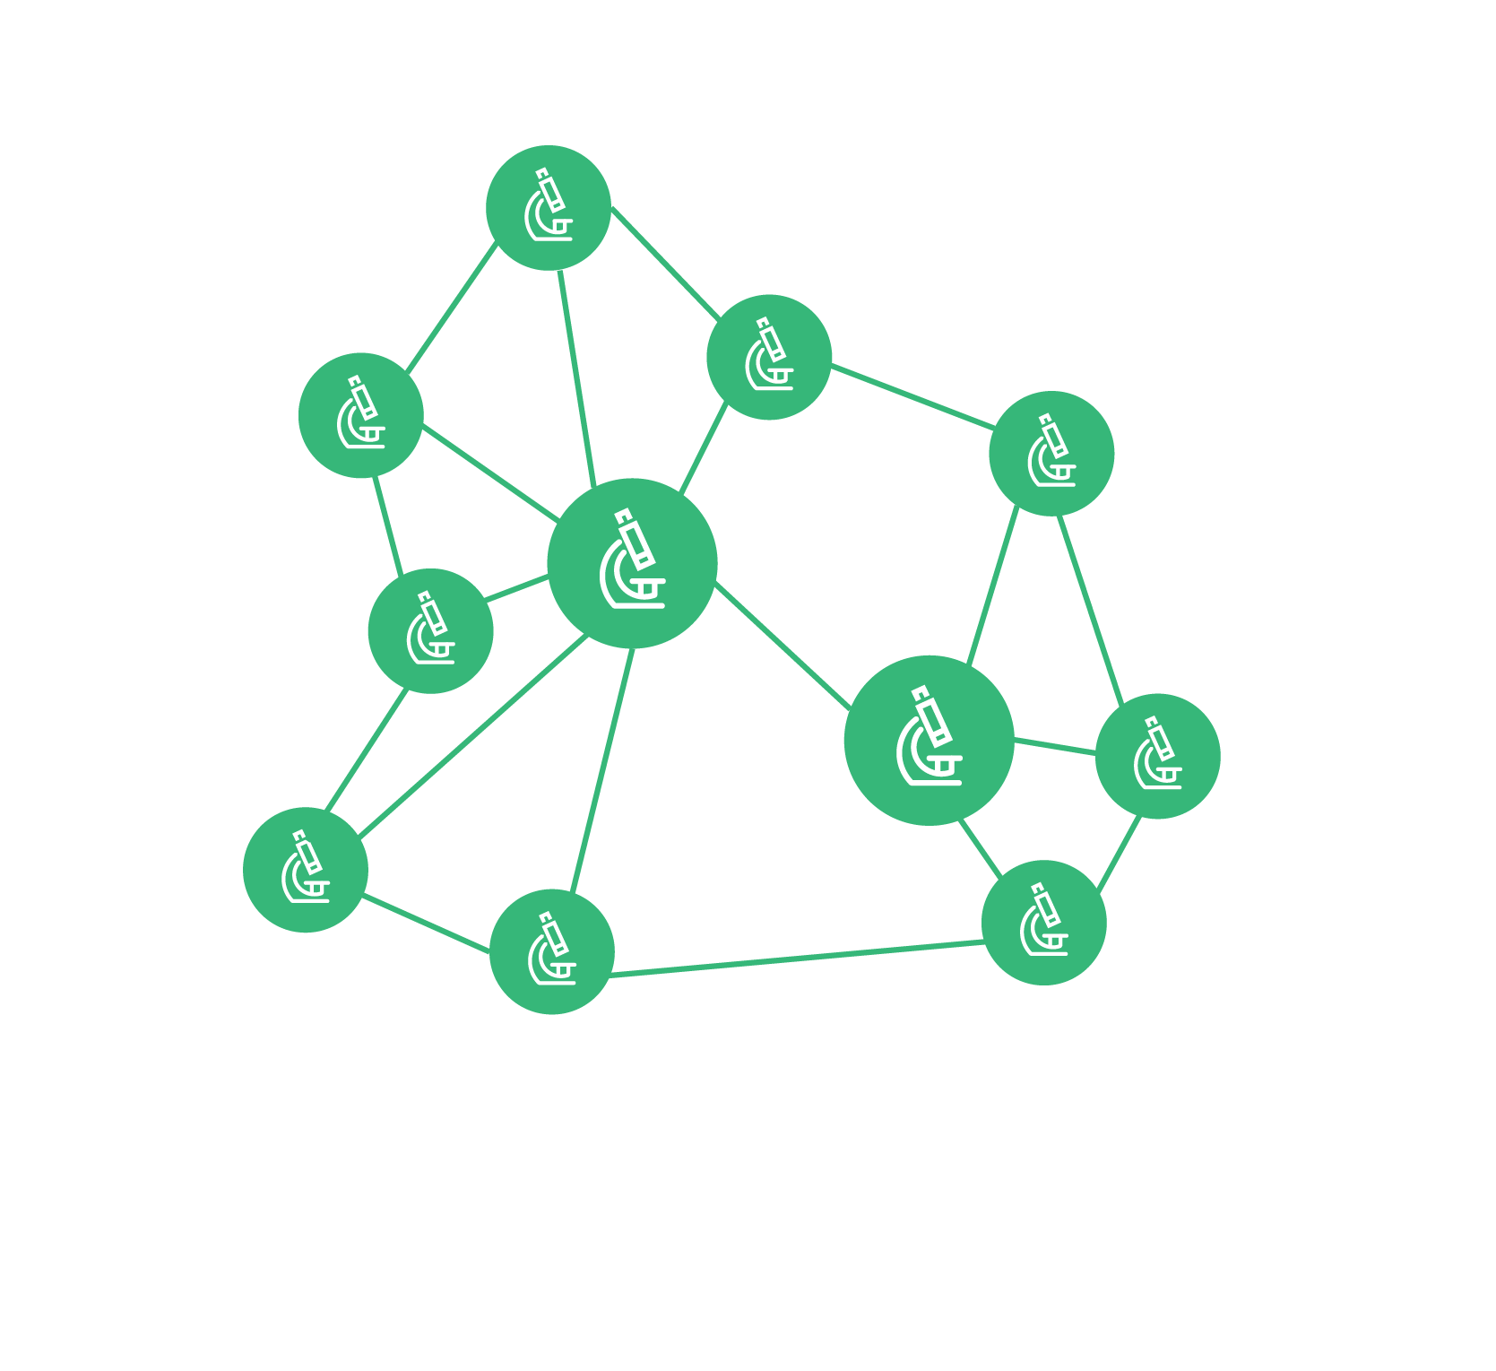
Innovea
Global Arabica Breeding Network
Costa Rica
Uganda
Mexico
Rwanda
Peru
Kenya
Indonesia
India
United States
High performing commercial varieties
Population improvement strategy
Multi-environment testing
Notes:
Build a network
Provide germplasm for breeding
Capacity development

Slide 3
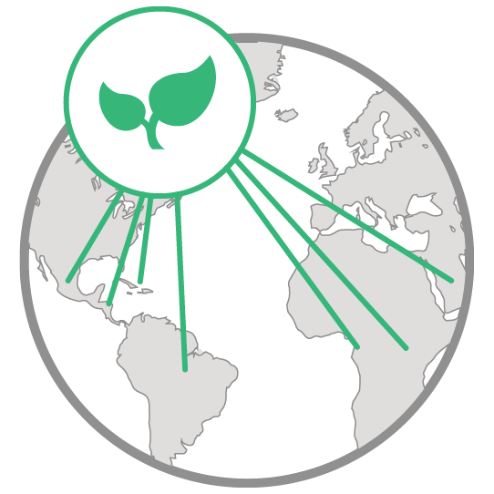










Innovea Global Coffee Breeding Network Partners

Slide 4
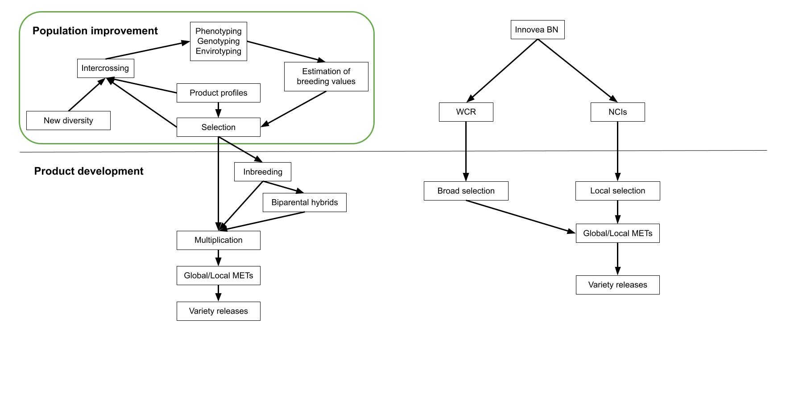
Focus: Population improvement to address low genetic gain
Innovea
Seed propagated
  Inbreds
  Hybrids
Vegetatively propagated
  Hybrids
Innovea PD

Slide 5
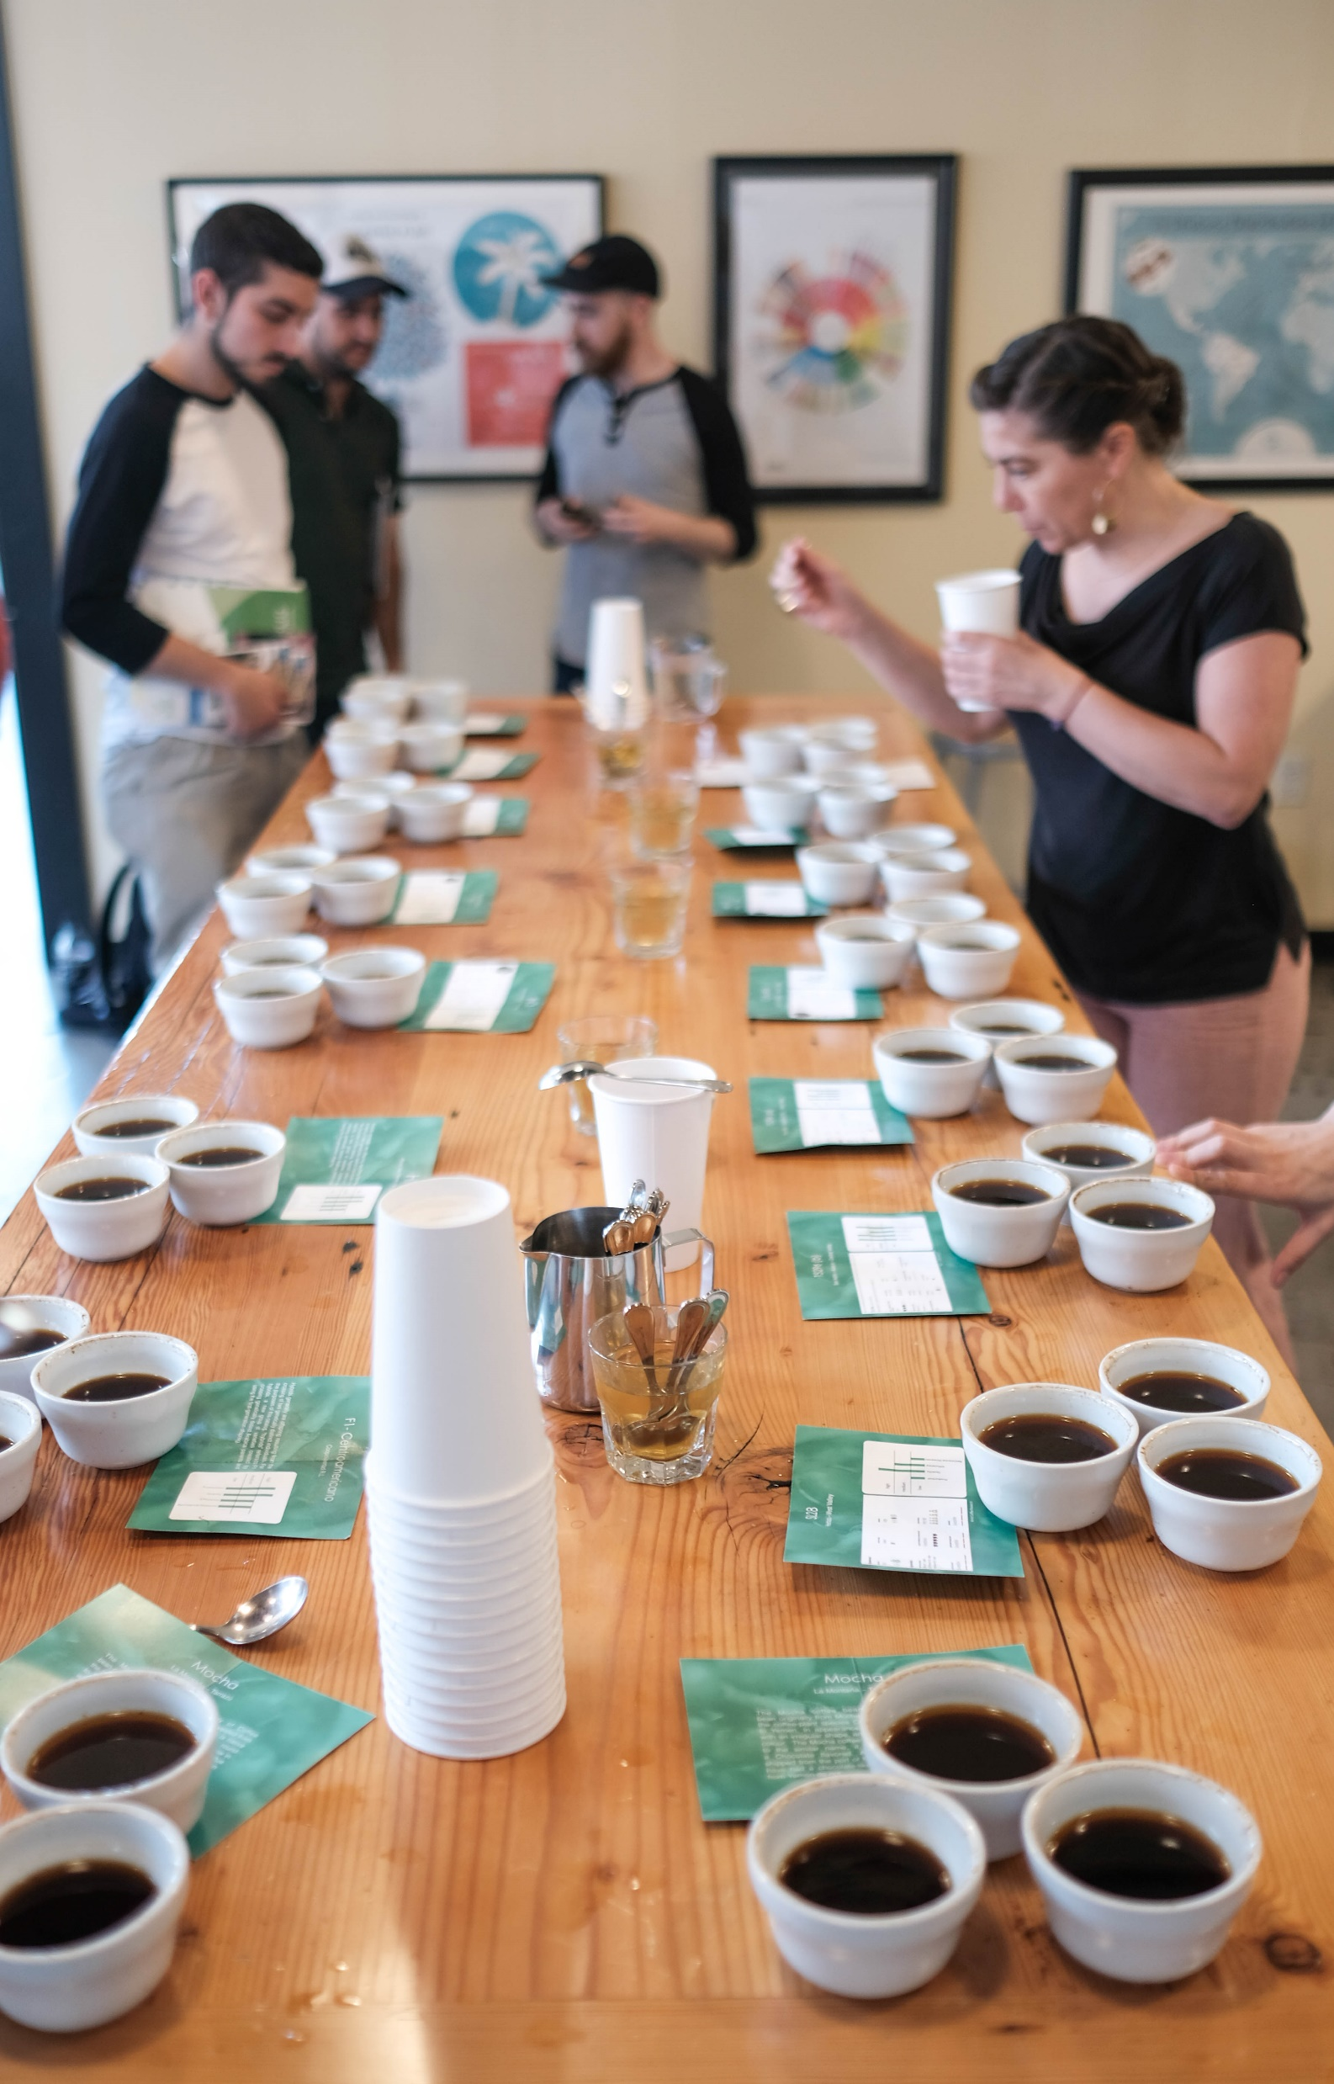

A network of cooperating institutions
Selecting the right starting material
High priority traits
  Yield
  Coffee Leaf Rust resistance
  Coffee Berry Disease resistance
  Cup quality
High-performing commercial lines
Global multi-year dataset from WCR’s International Multi Location Variety Trial (IMLVT)
Diverse combinations of genetic backgrounds
Sourced from different countries: Brazil, India, Kenya, Costa Rica, Nicaragua, El Salvador

Slide 6
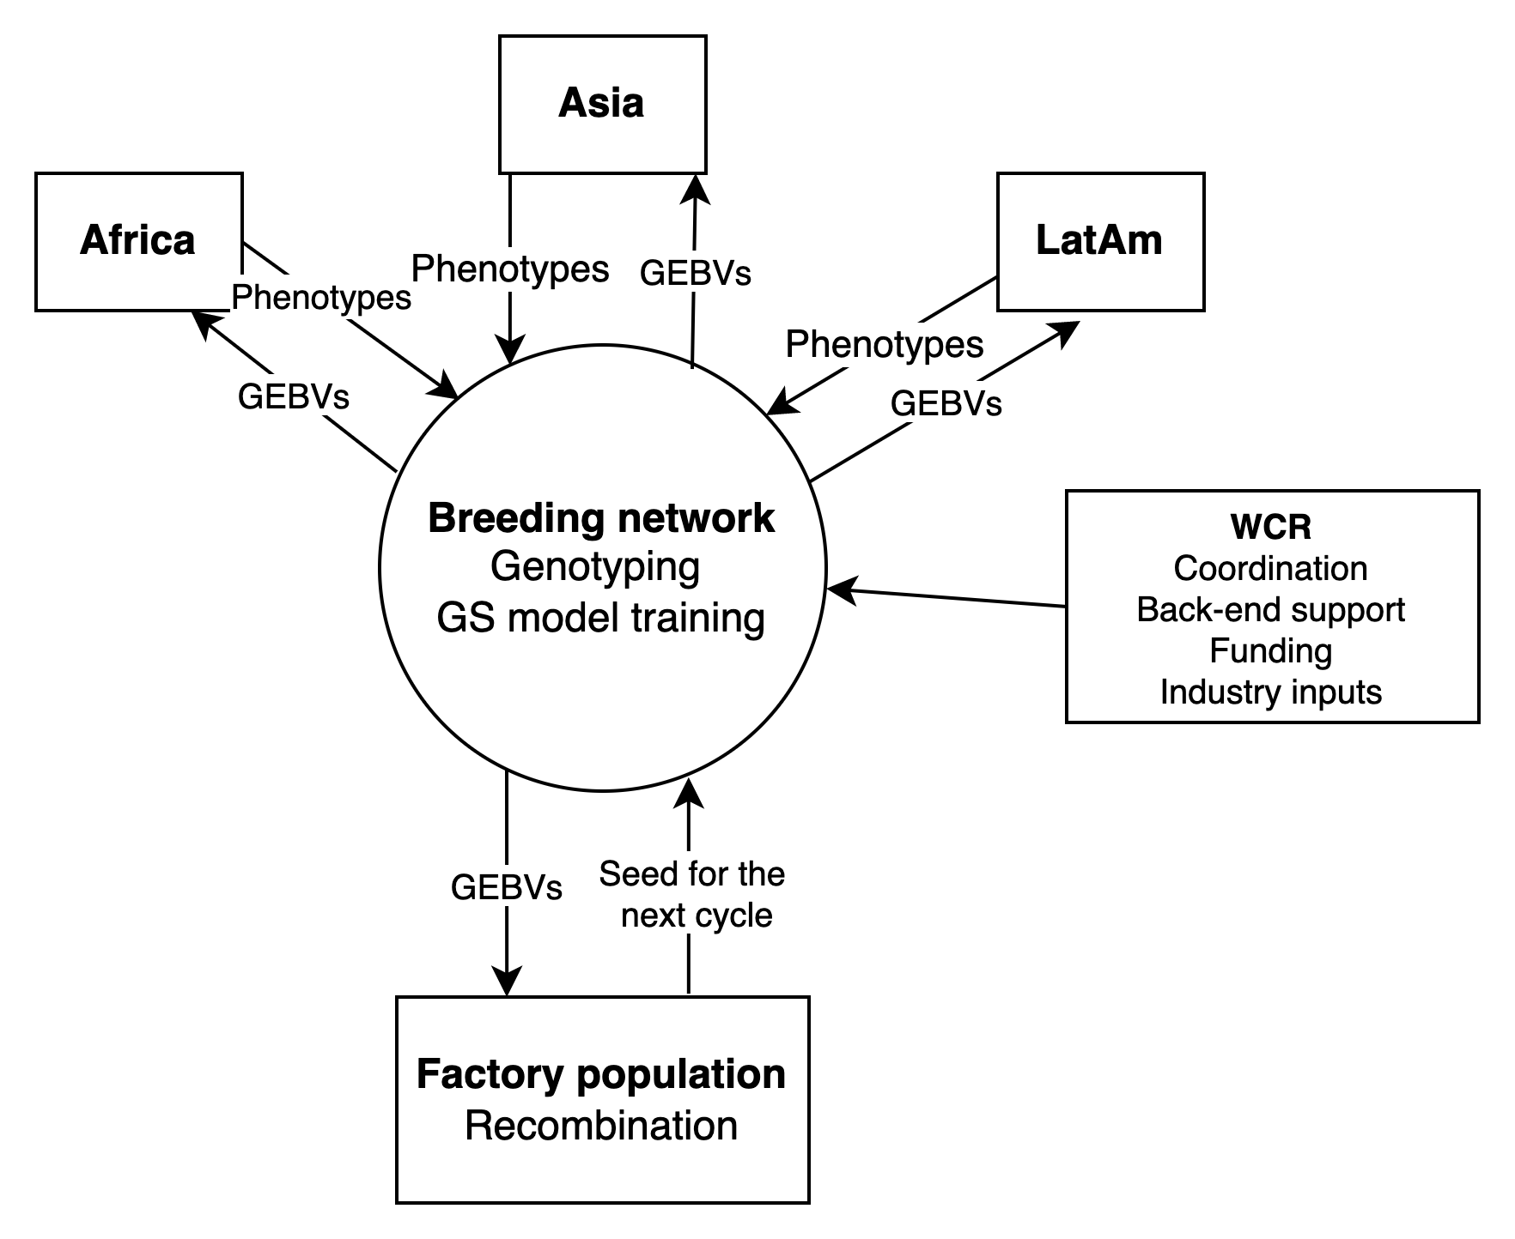
Globally distributed breeding modeled on CGIAR breeding networks
Covarrubias-Pazaran et al. 2021. Front. Plant Sci. 12:681624
Centralized recombination
Multi-environment testing
Large populations based on multiparental crosses
Genomic selection
Rapid cycling recurrent selection
GEBV = Genomic estimated breeding values

Slide 7
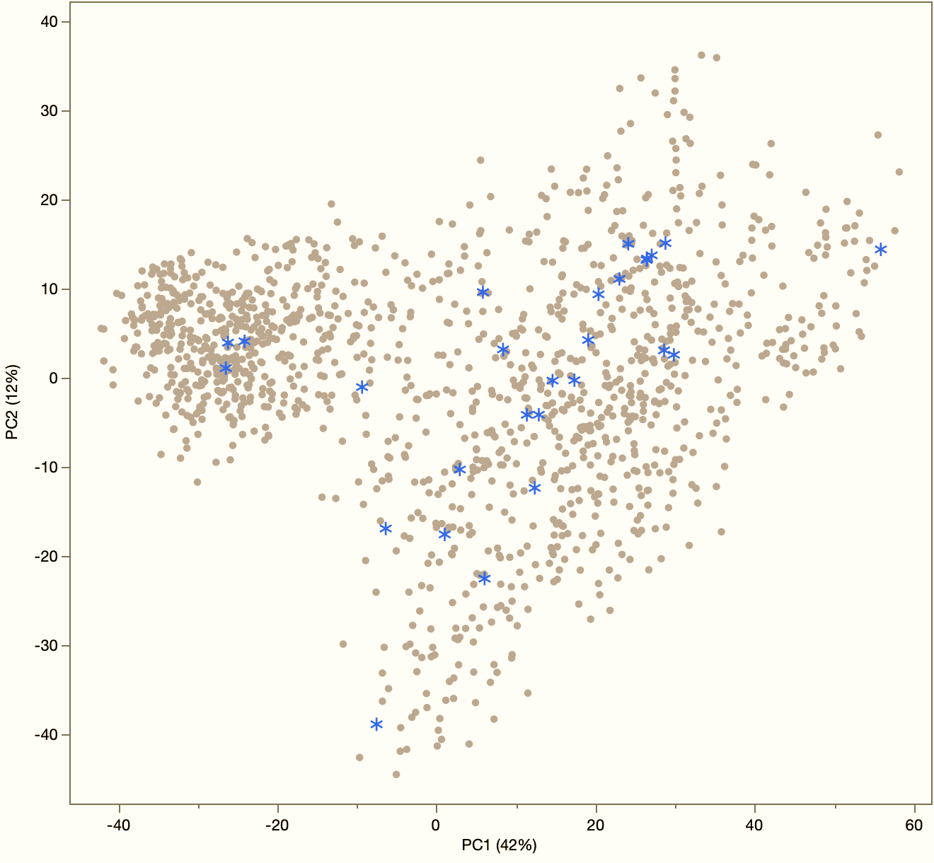
Founders and overall arabica diversity
Elite parents
  IMLVT
  WCR´s F1s
Genetic diversity
  HdTs, arabustas, liberca introgressions, wild/landraces
Diverse sources of:
  Productity
  Resistances
  Quality
  Plant type
Wild & landraces
Introgressed
Bourbons
Typicas
Notes:
Total of 1500 simples
Group on left is Ethipian landraces

Slide 8
Crossing scheme
Connected multiparent populations
3 & 4-way crosses and parents F2s
Benefits:
  Lower population structure
  Moderate minor allele frequencies
  Higher prediction accuracy accross families

Slide 9
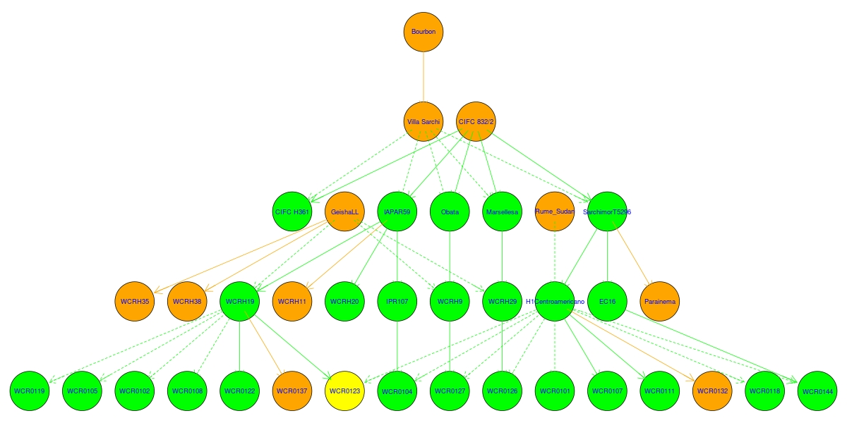
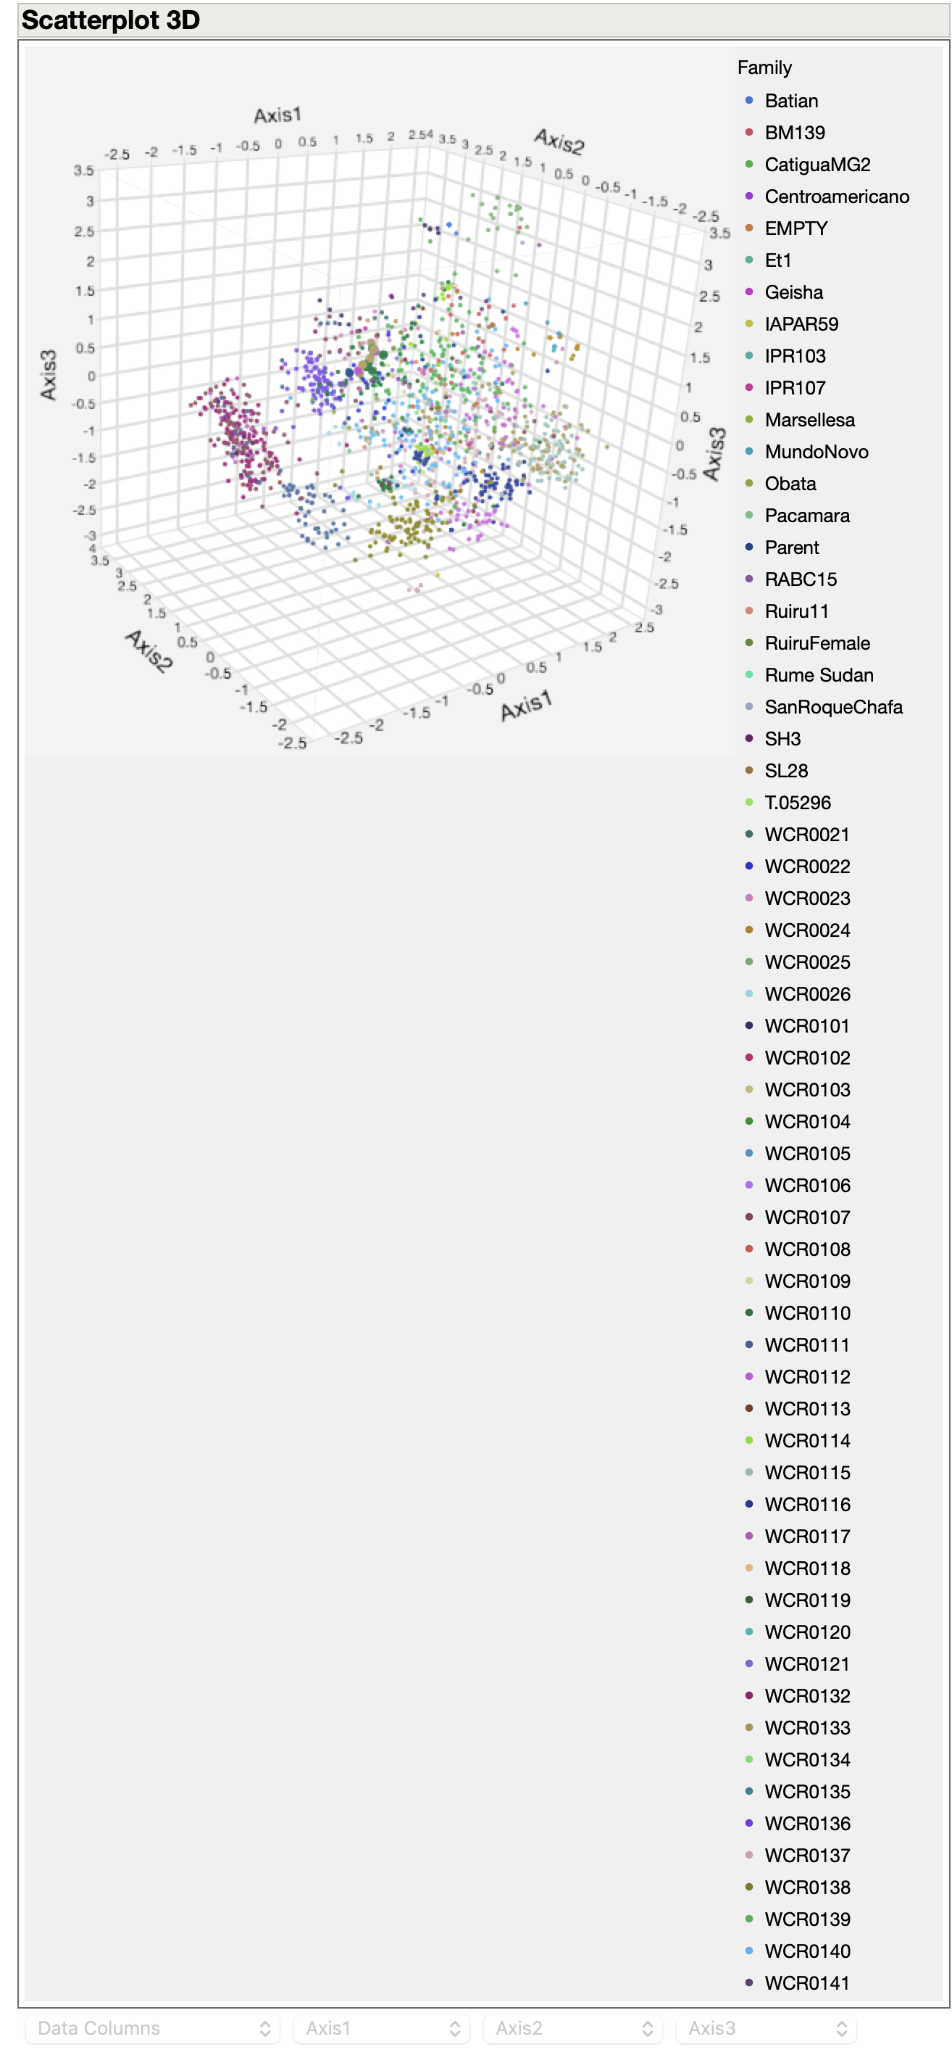
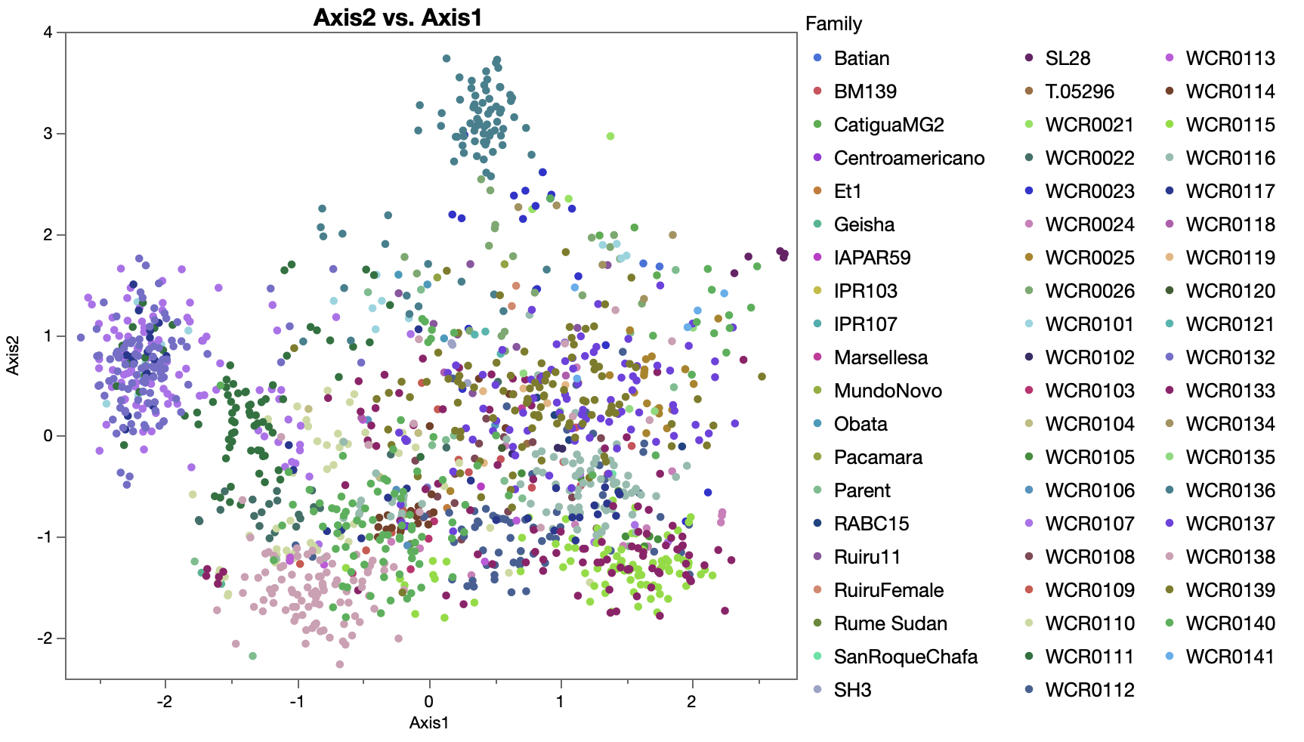
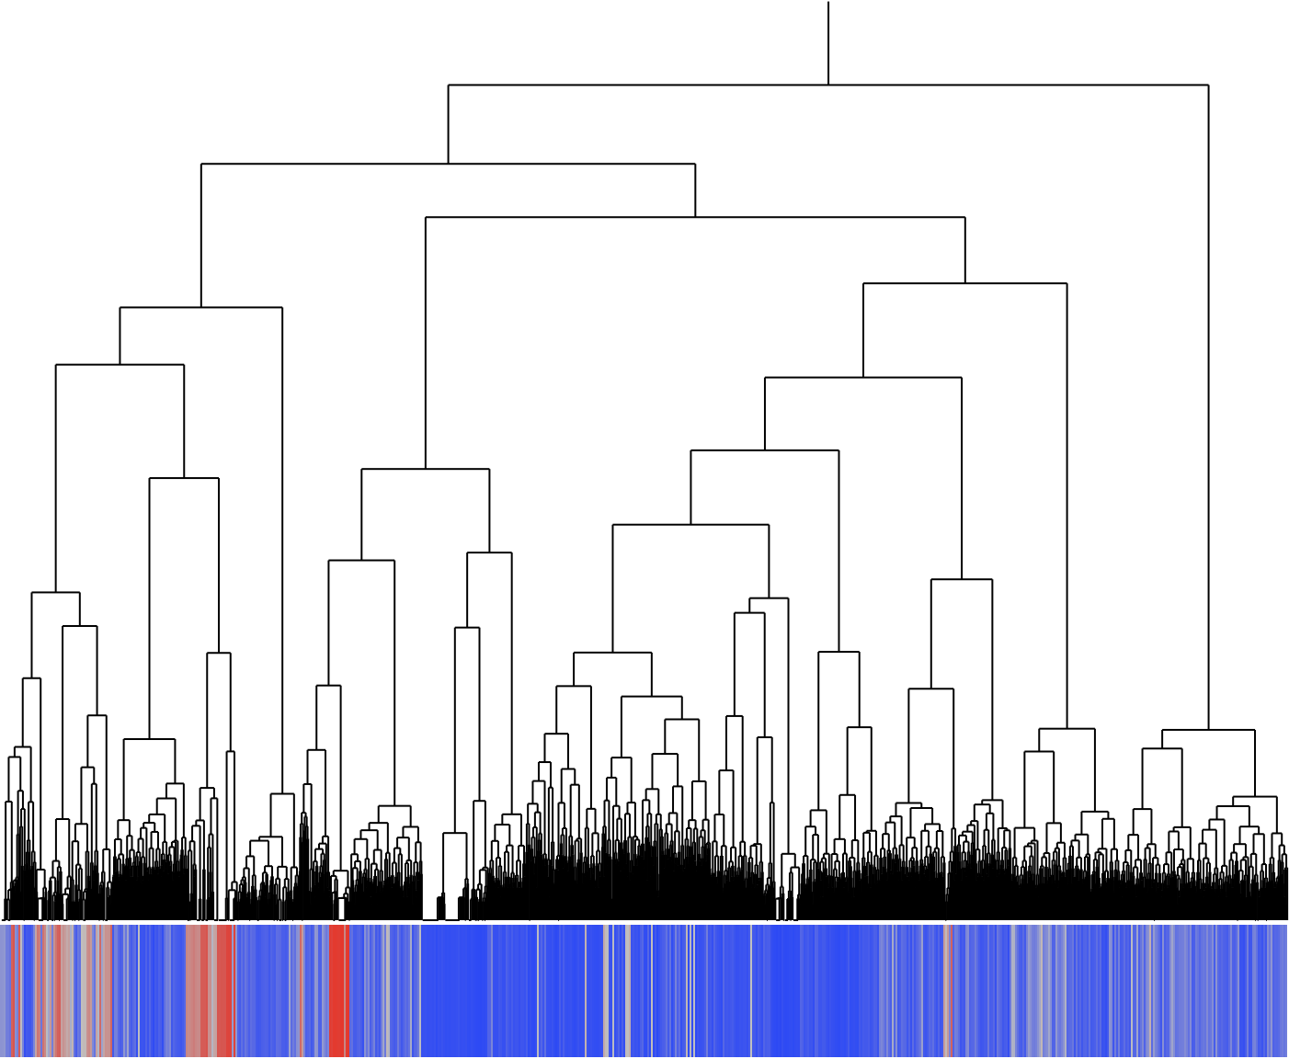
Founders and progeny population structure

Slide 10
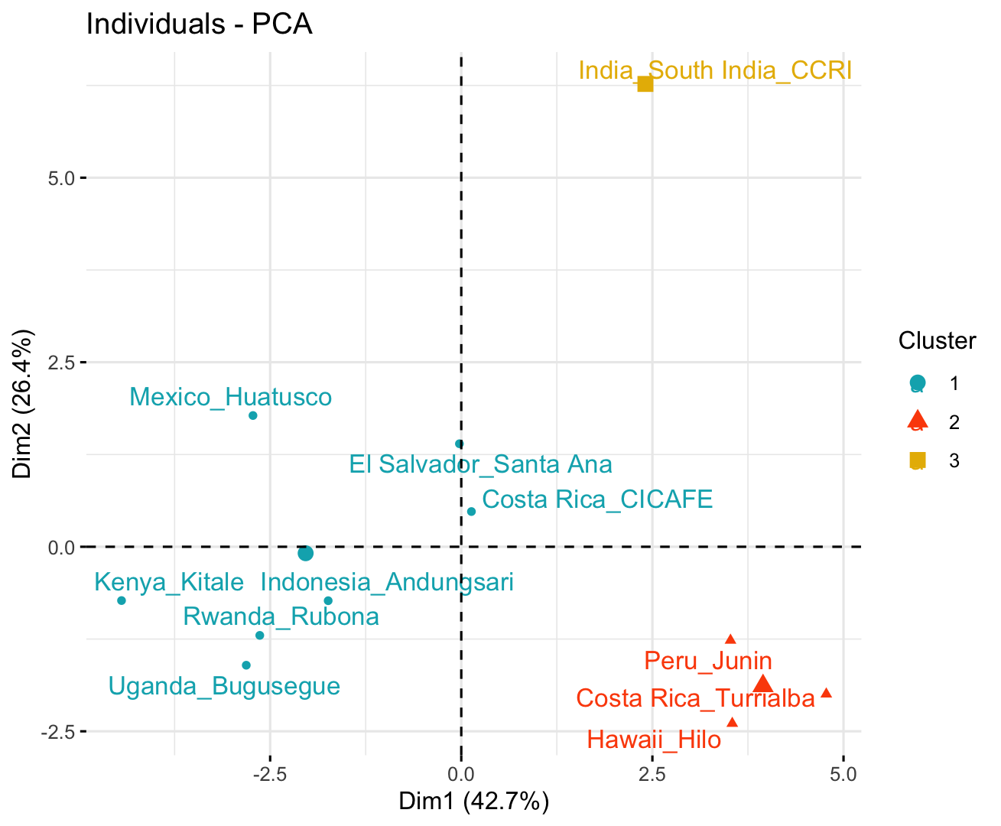
Site selection
Maximizing range of environmental conditions
Accessibility and site management
Dim-1 = elevation and temperature variables
Dim-2 = mostly rainfall variables.
  Includes sites with mid to high altitude, colder and dryer places
  Lower elevation, warmer and wetter places, with Cluster 3 relatively higher, but more rain seasonality.

Slide 11

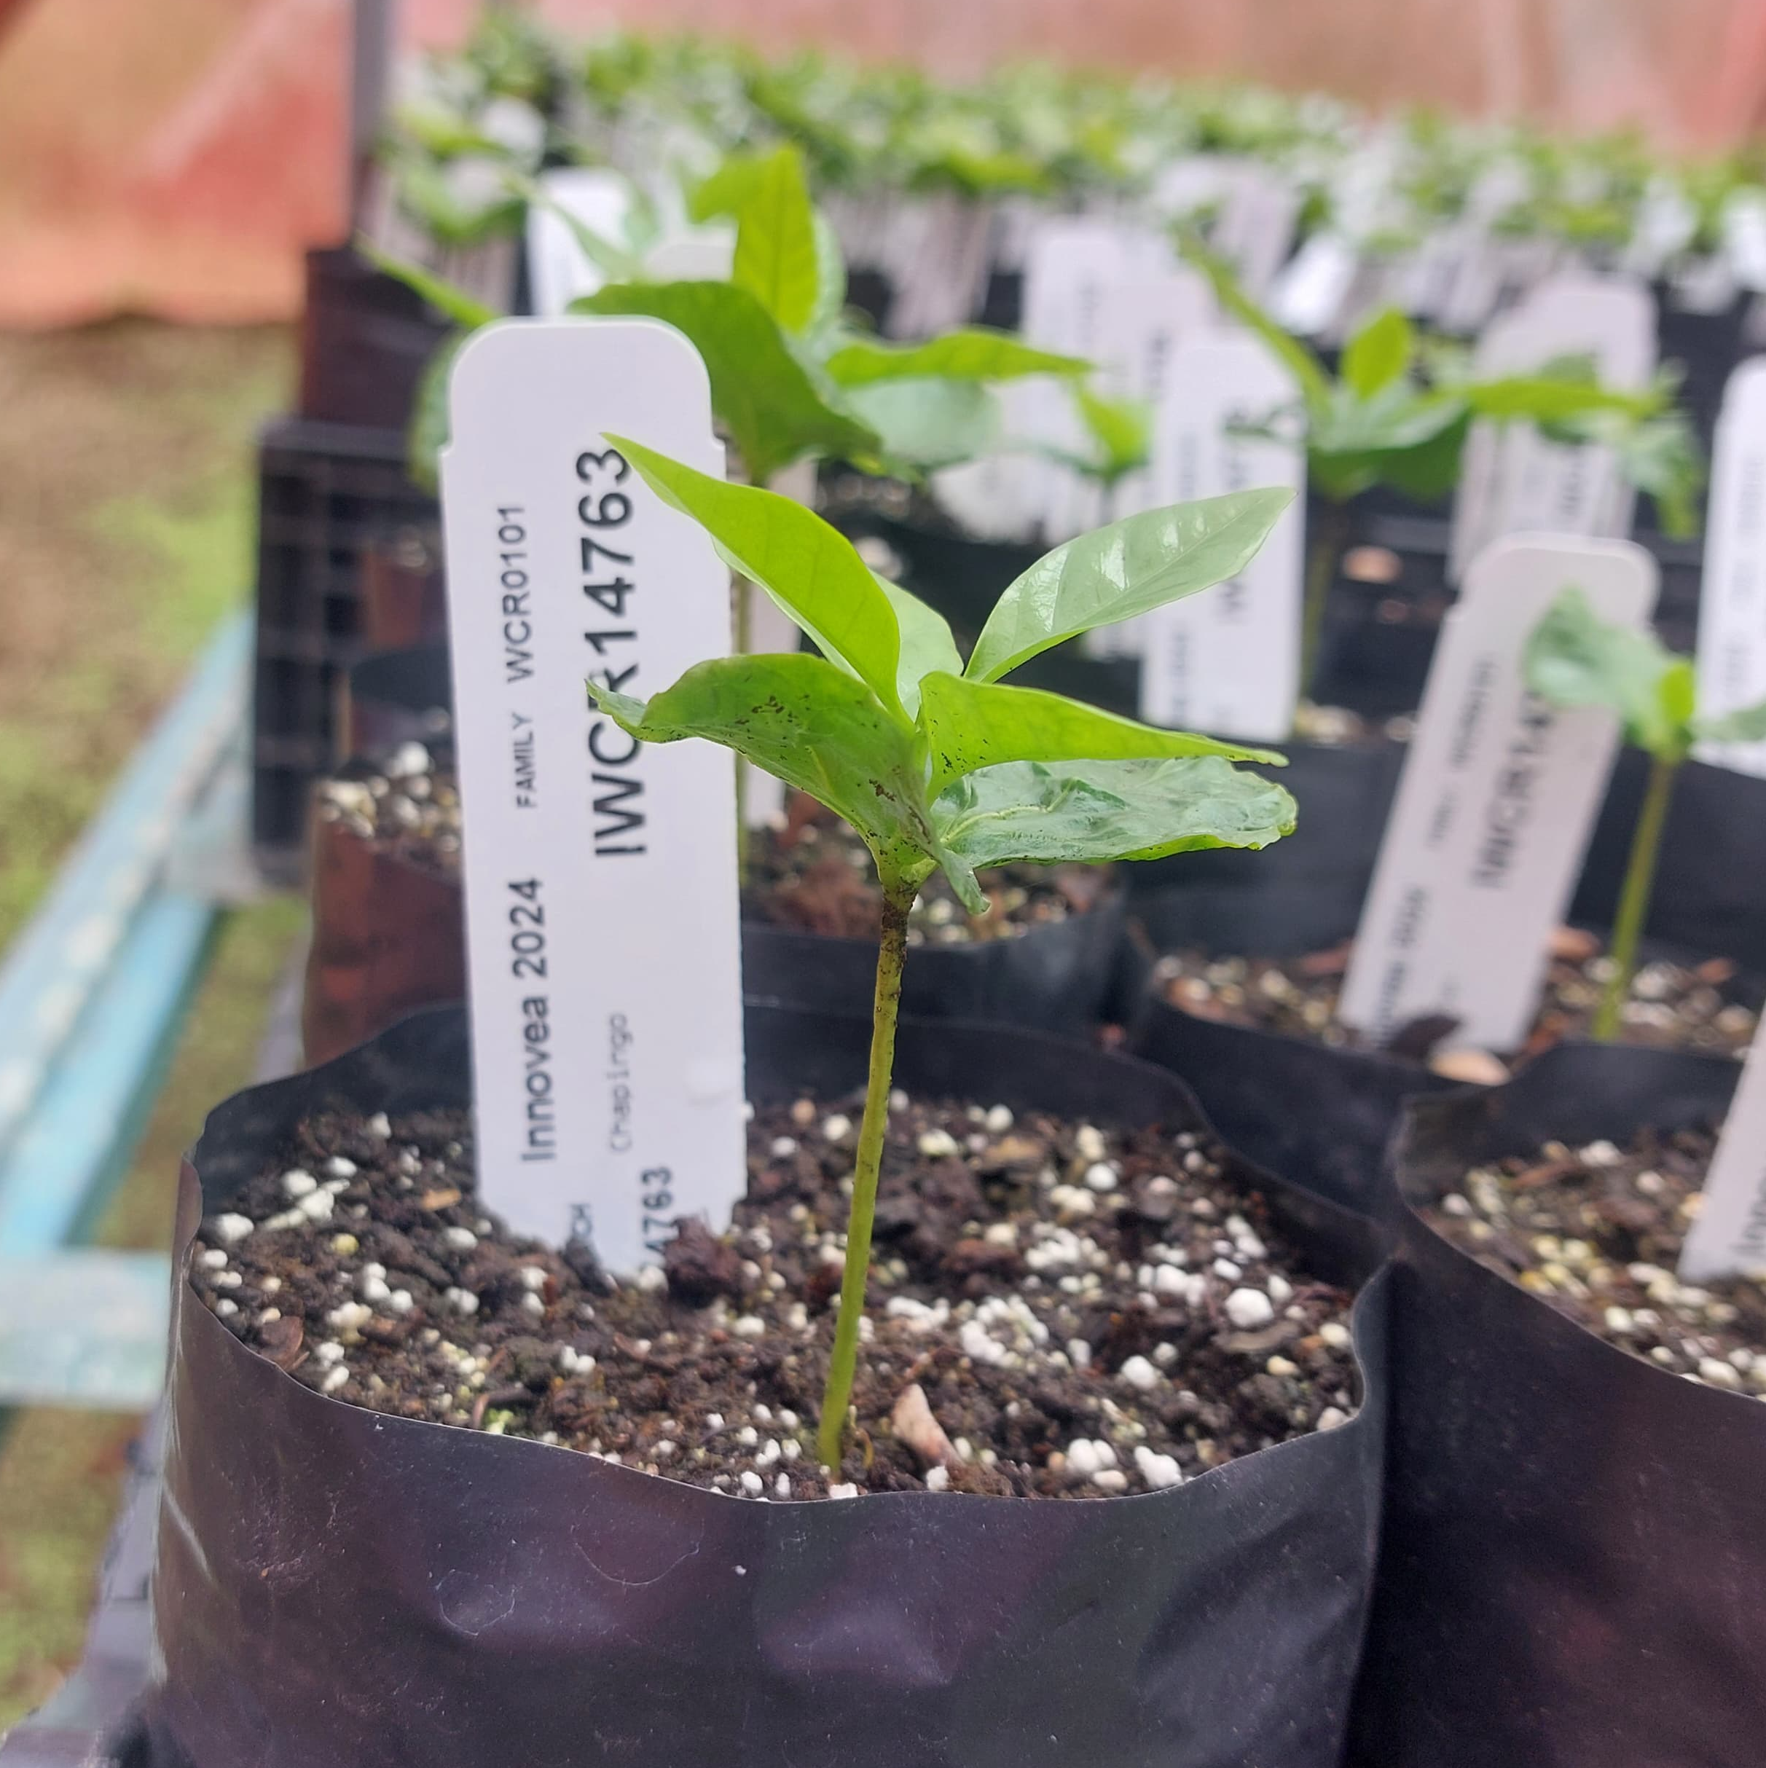
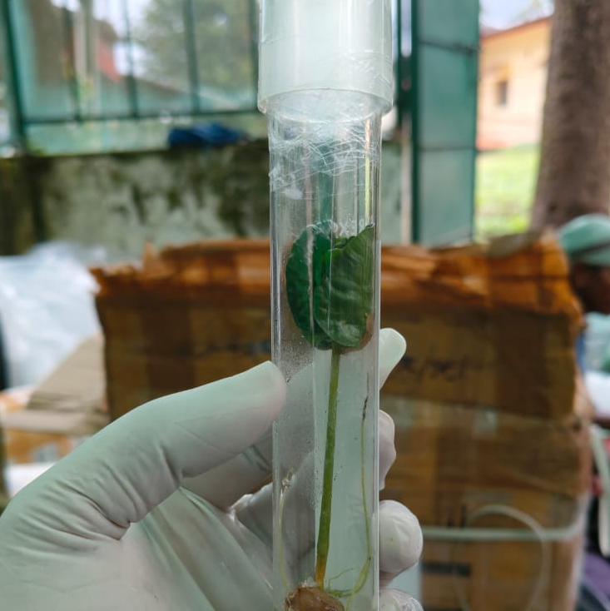
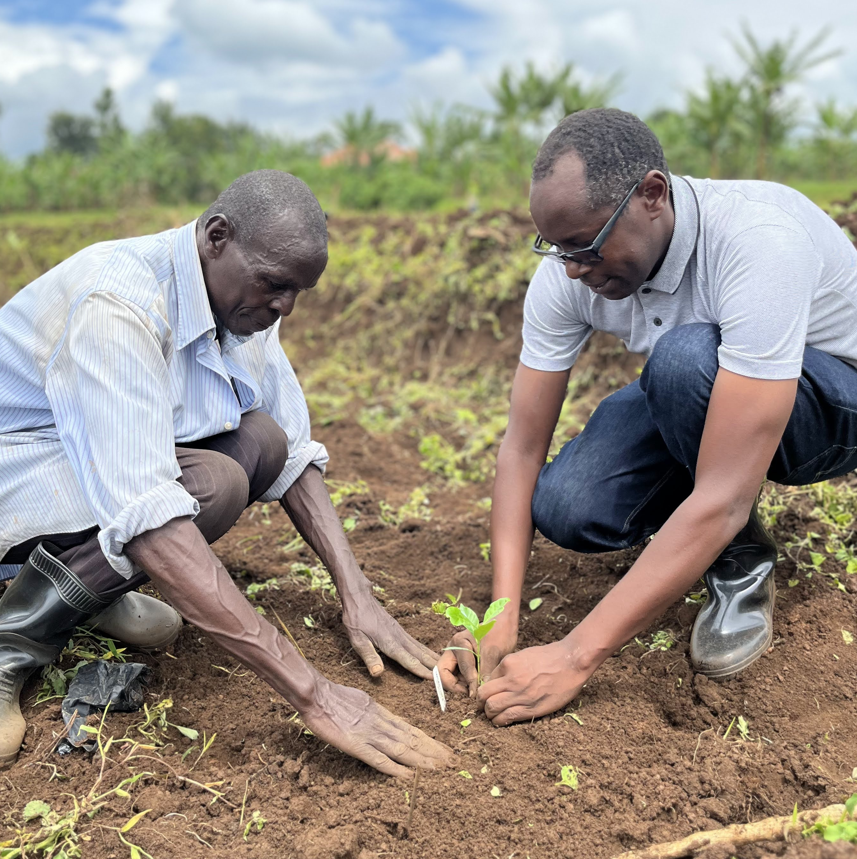
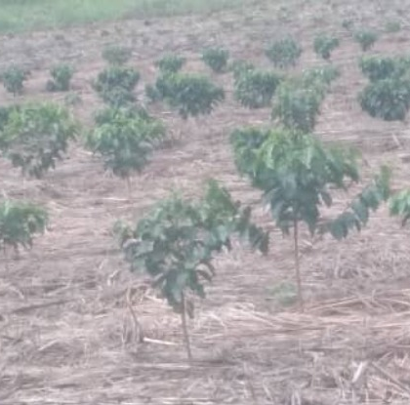
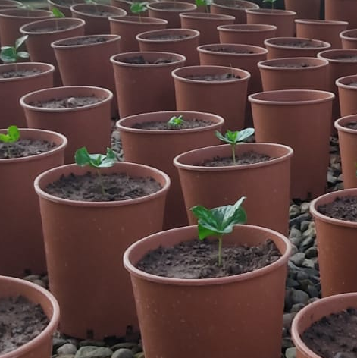
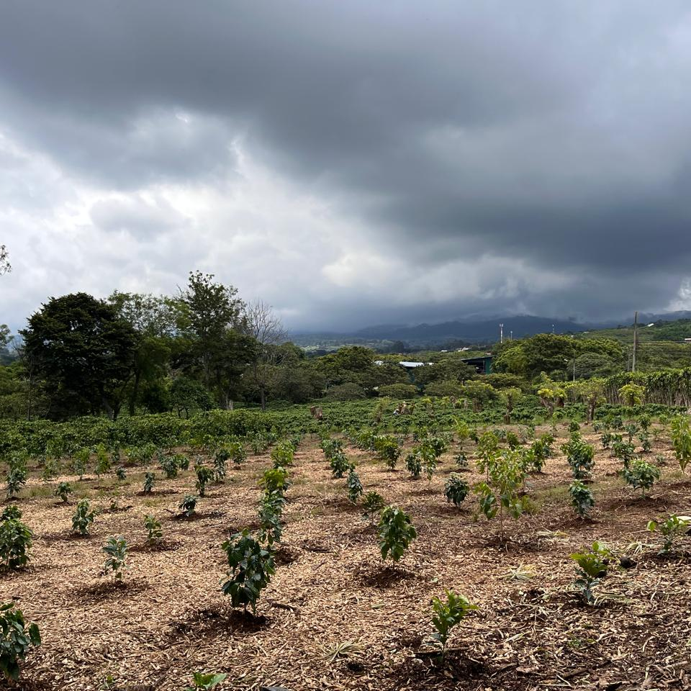
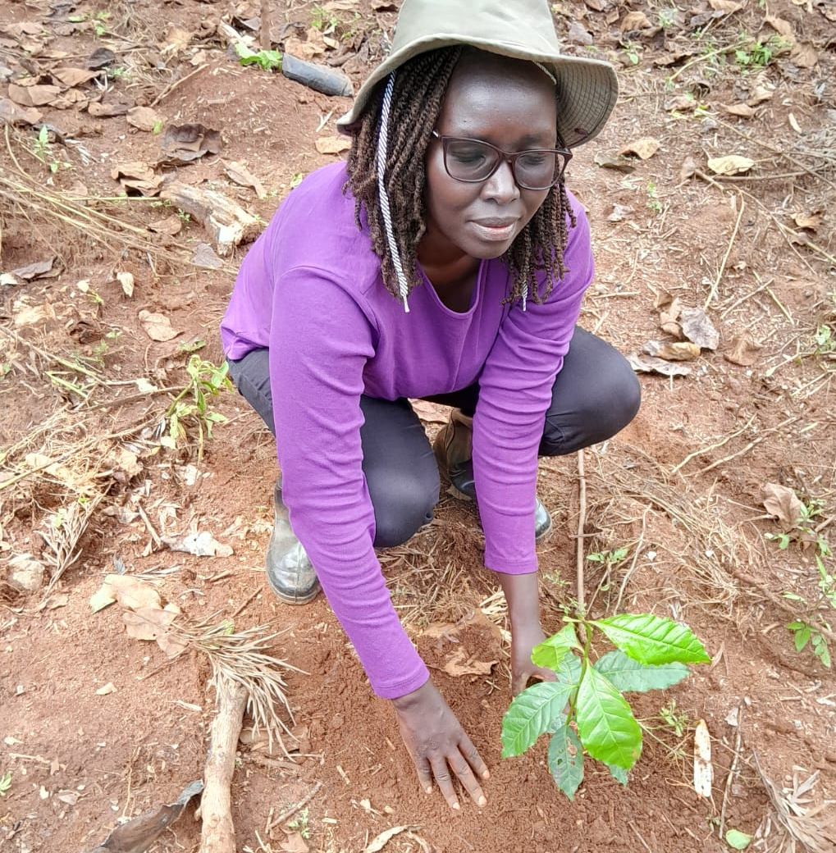
In 2024, Innovea went from idea → reality. Trees are going into the field across the network. This was the network’s single largest political + logistical hurdle. We’re on our way!
Innovea
Rwanda
Mexico
India
Costa Rica
Peru
Uganda
Kenya
Notes:
No one has ever operated a program at this scale before, with the complexity of competitive national governments.
The elegance and power of Innovea for generating climate resilient coffee varieties was its design. That design requires that we succeed at this step – to have material in many different sites around the world.
That power is now going to be realized in the varieties generated. And that is what sets us apart.
We’ve accomplished the most challenging step to realizing the potential of this design.
PEOPLE—Led by our world-class breeding team + partners
PARTNERS—Unprecedented partnerships w/ 9 countries; 8 have received plants + six sites are planted as of today
PLANTS—Unprecedented genetics that will only get better – none of these countries had ever had access to this density of genetics

Slide 12
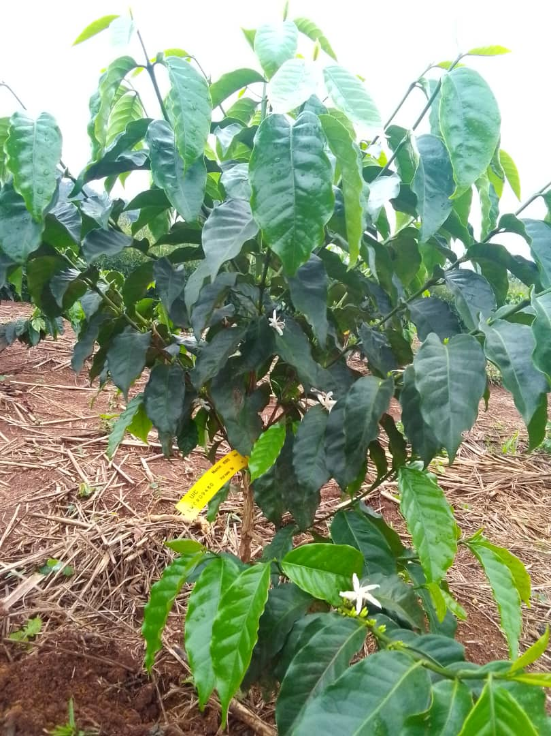
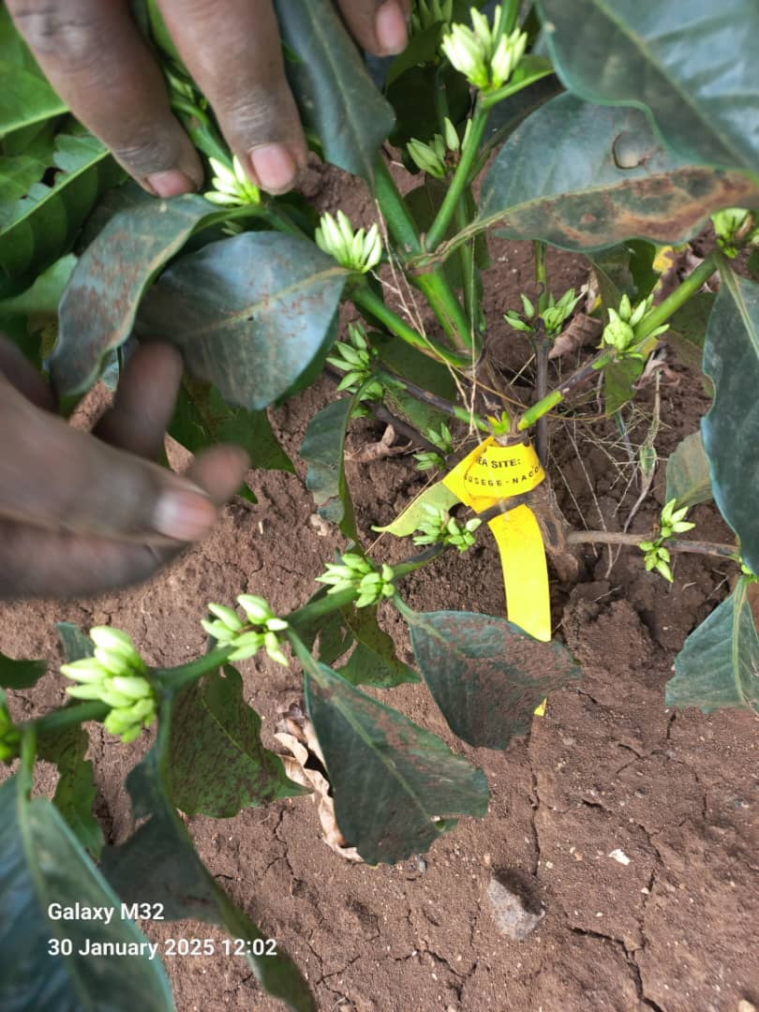
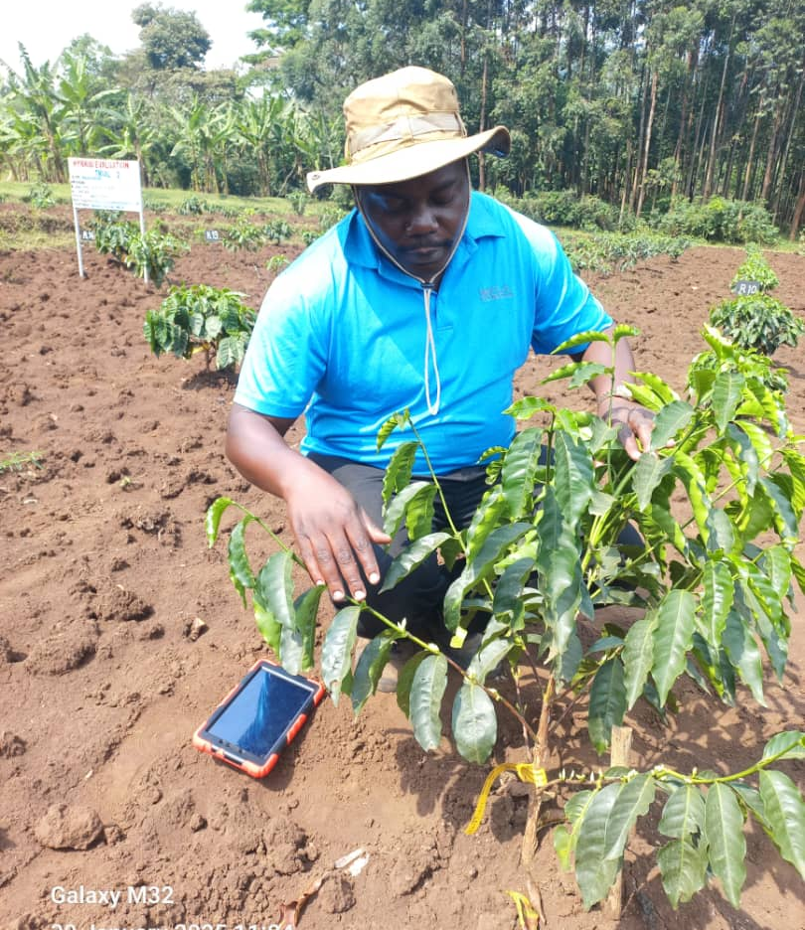
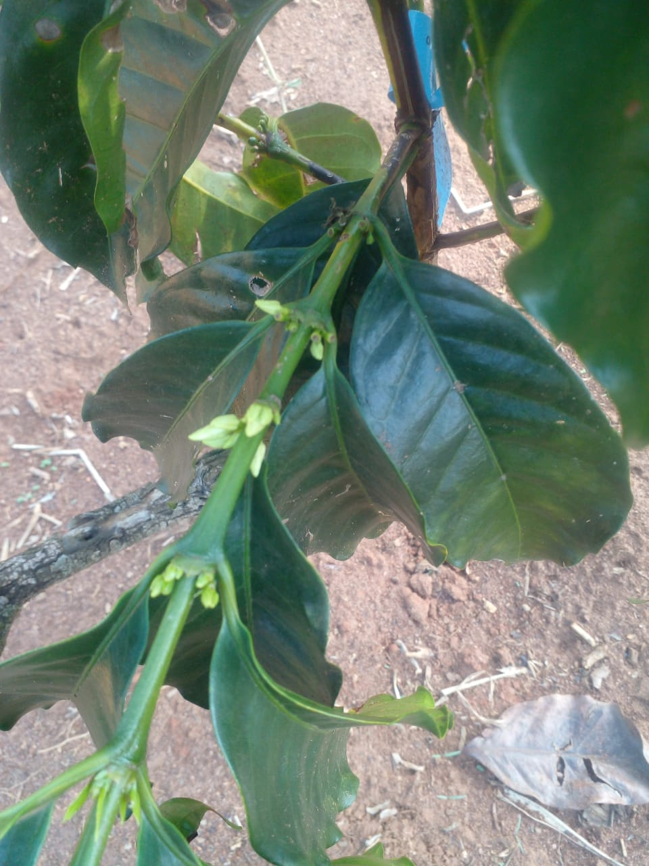
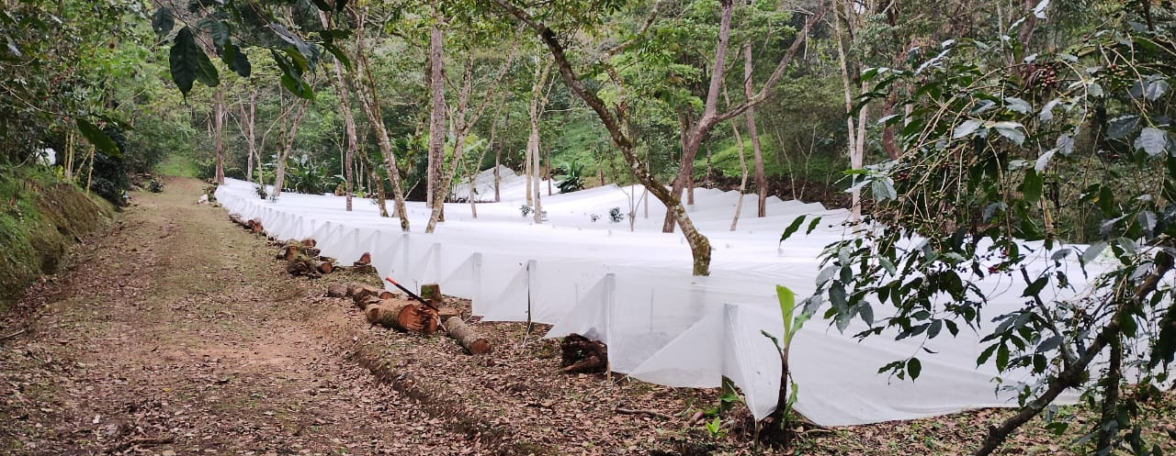
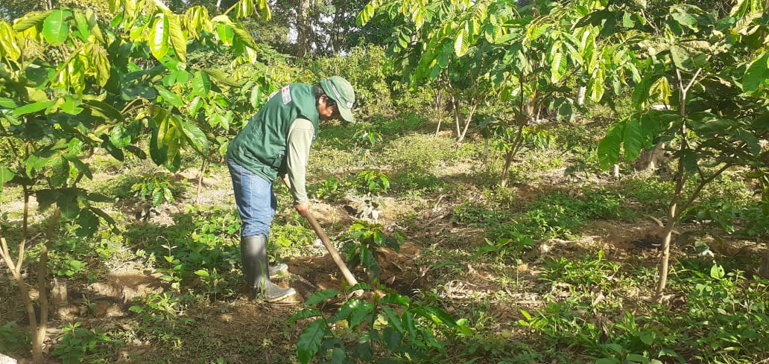
Innovea
East Africa Partners and ICAFE (CR) are collecting flowering date. The first year of yield is 2025.
Mexico, and Peru plants in the field are growing well. Partners are collecting plant development data and CLR.
India and USDA (Hilo), plants are still in nursery stage.
Indonesia, crosses will be made this March/April and seed will be sent early 2026.
RAB
NaCORI
UACH
KALRO
INIA

