Slide 1
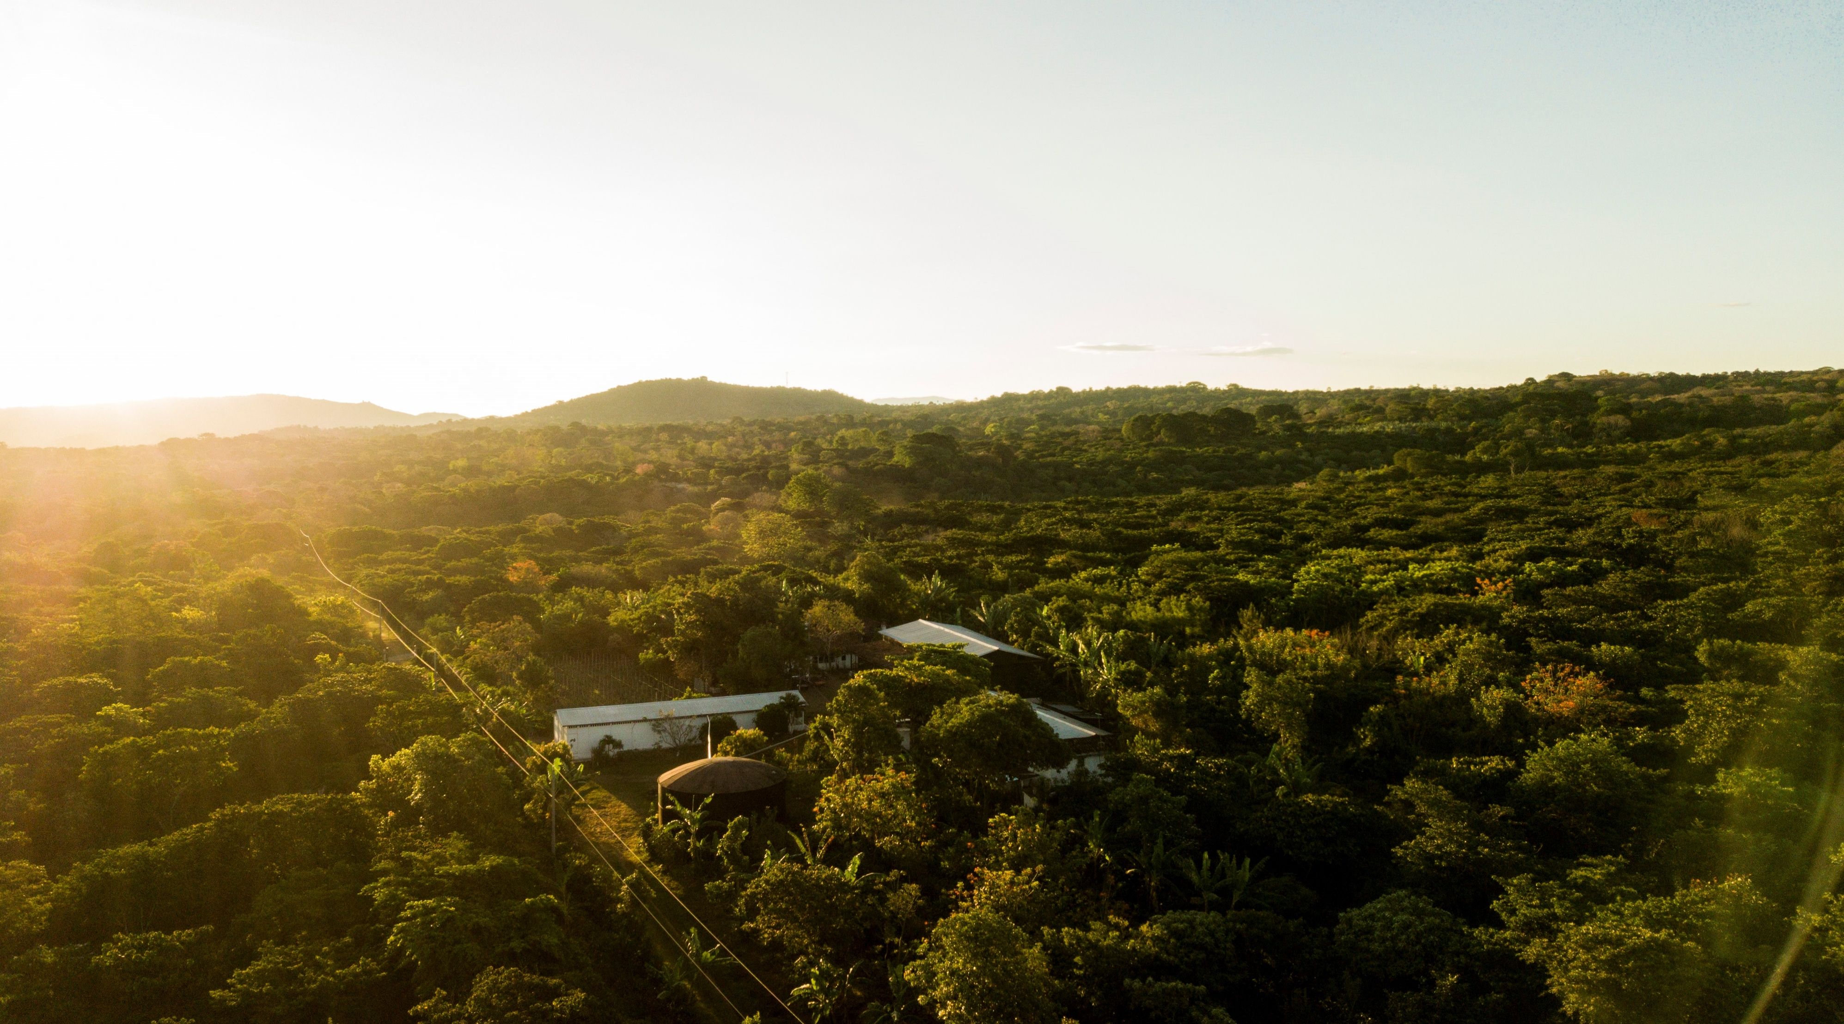


Other phenotyping data collection (including CBD)
Innovea Network Breeders Meeting
Cenicafe, Manizales, Colombia
November 17-21, 2025

Slide 2
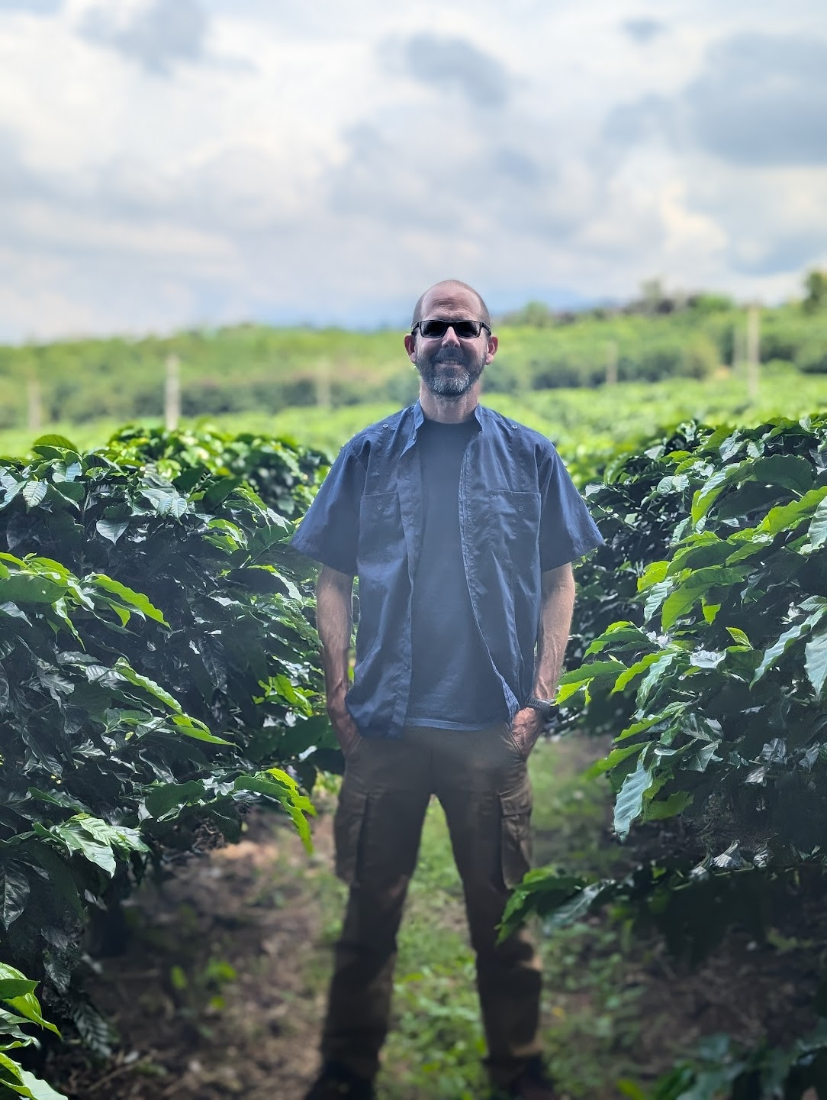
Presenters
Jorge Berny
Research Scientist, Plant Breeding and Genomics
World Coffee Research

Slide 3
Objectives
Discussion about describe what other data is being collected or will/could be collected
Examples of collected data: ICAFE, WCR
Anthracnose, CBD/CFR unified protocol

Slide 4
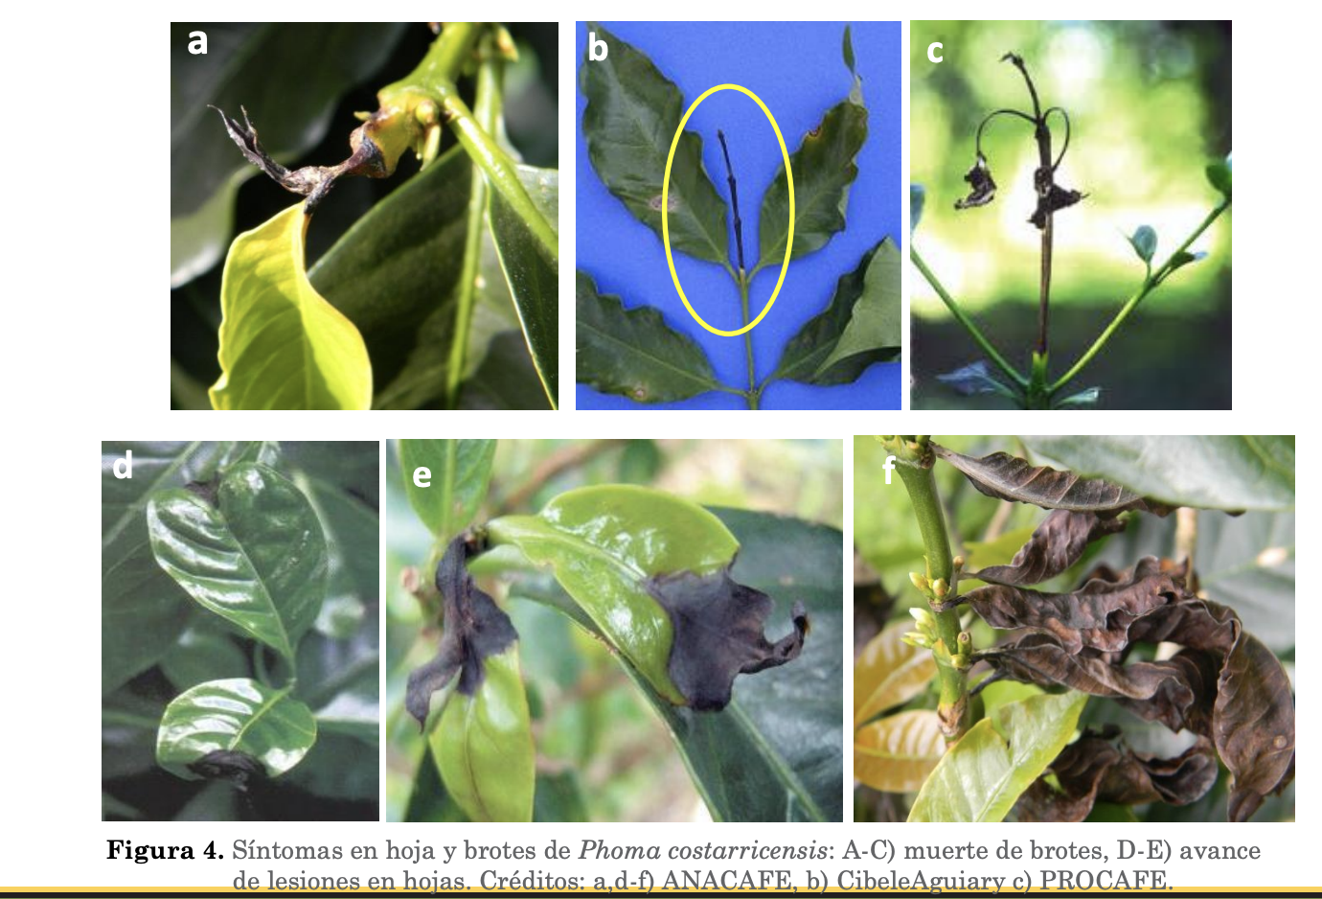
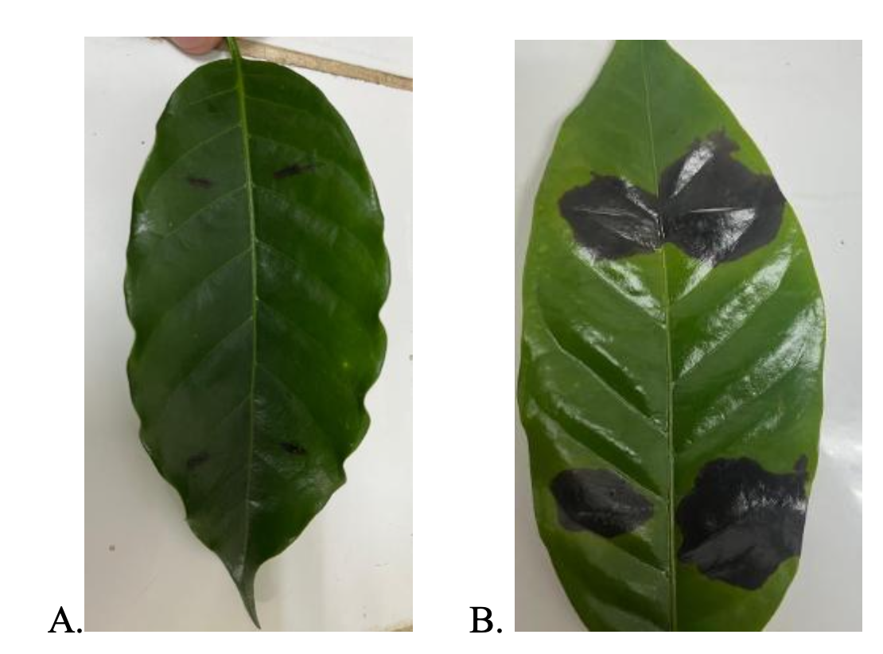
ICAFE´s evaluation to Phoma

Slide 5
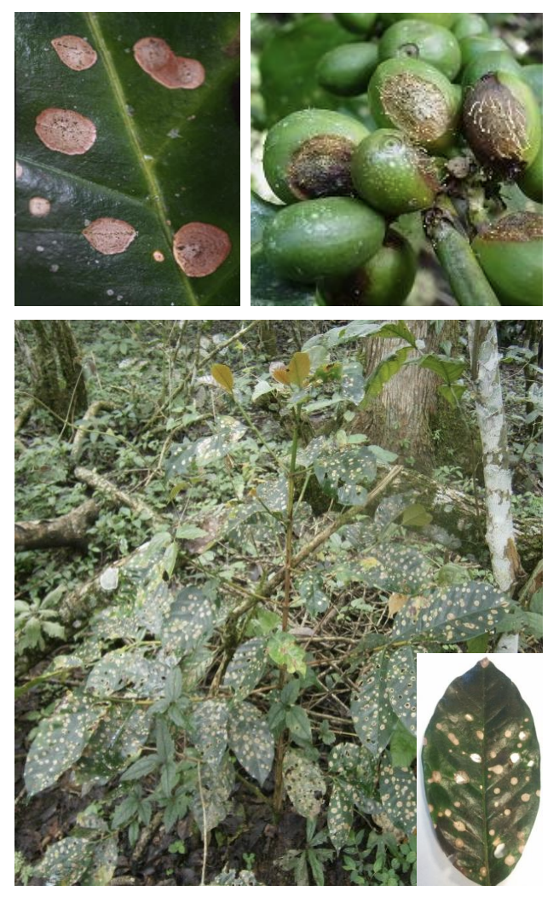
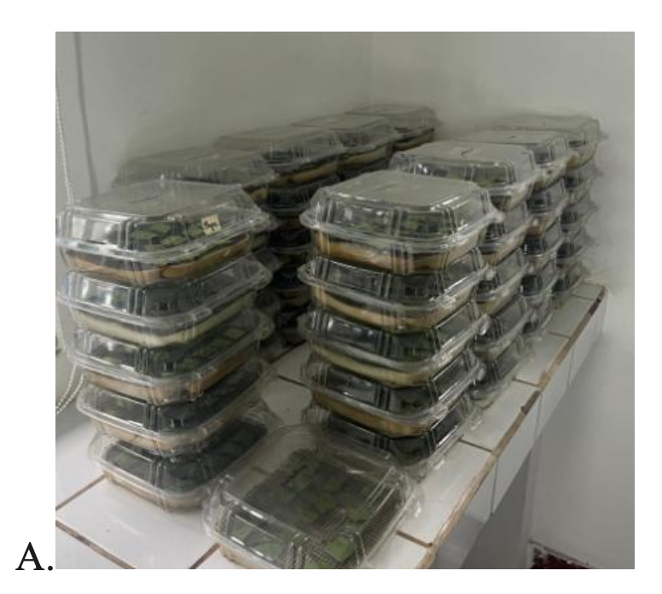
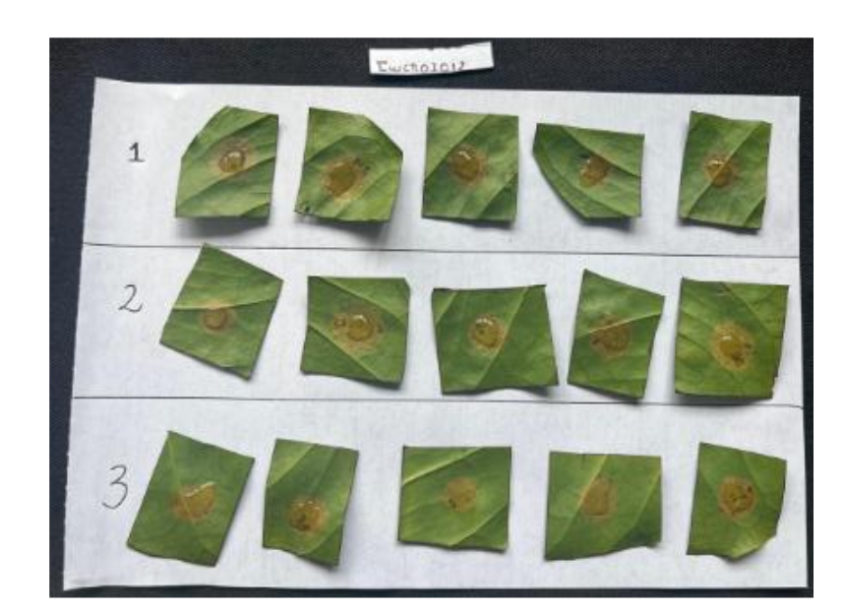
ICAFE´s evaluation to Ojo de Gallo (American Leaf Spot, Mycena citricolor)

Slide 6
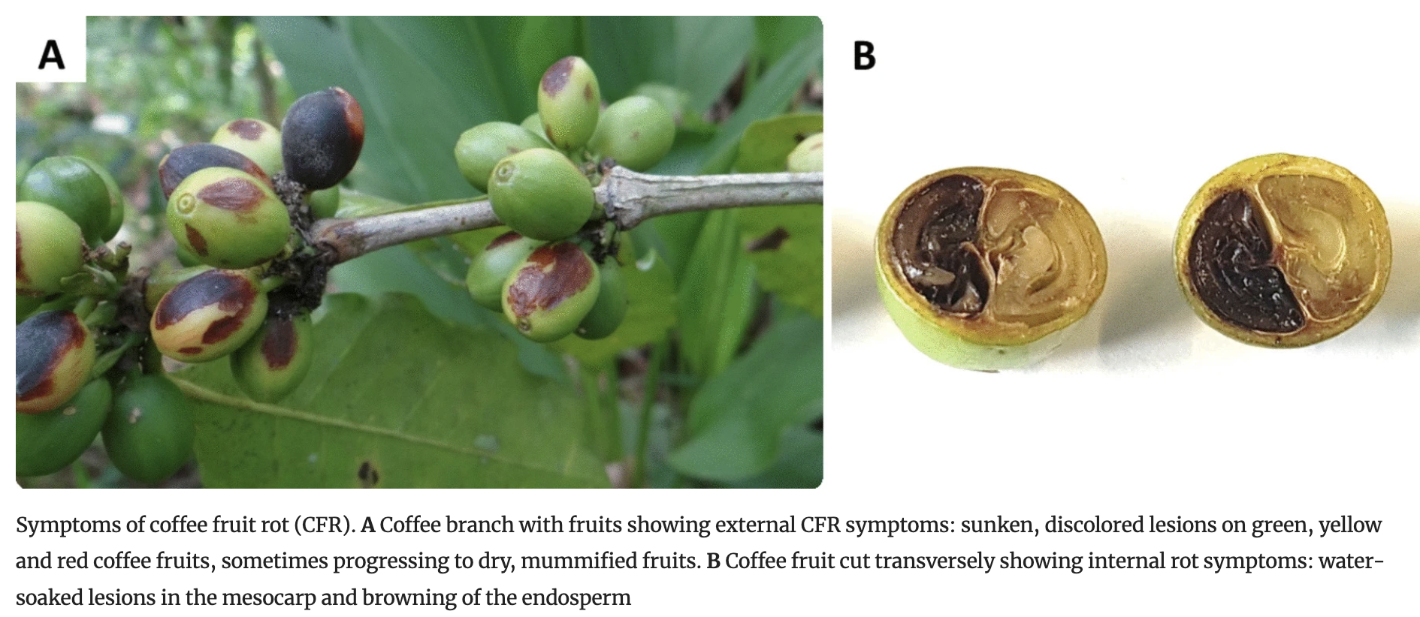
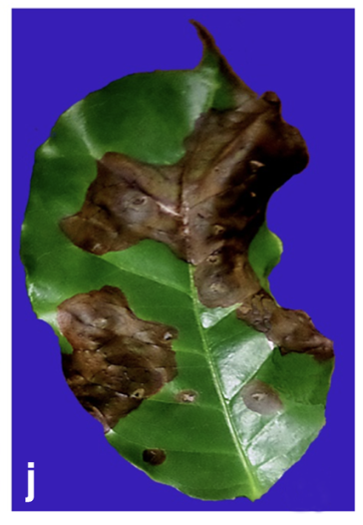
Anthracnose/CBD/CFR
External fruit rot, caused by various Colletotrichum species, is widespread
For C. kahawae there are 3 loci conferring resistance
It is unknown if the same loci work for other species,and for leaf/stem damage
Colletotrichum species | Region
kahawae | Africa | McDonald, (1927)
fructicola, siamense, theobromicola, tropicale | Puerto Rico | Serrato-Diaz, et al., (2020)
theobromicola, gloeosporioides, siamense, gigasporum, karstii | México | Cristóbal-Martínez et al., (2017)
siamense, fructicola,. Aenigma, theobromicola, gigasporum, vietnamense, nymphaeae | Malasia | Tang et al., (2026)
Serrato-Diaz, et al., (2020)
Cristóbal-Martínez et al., (2017)

Slide 7
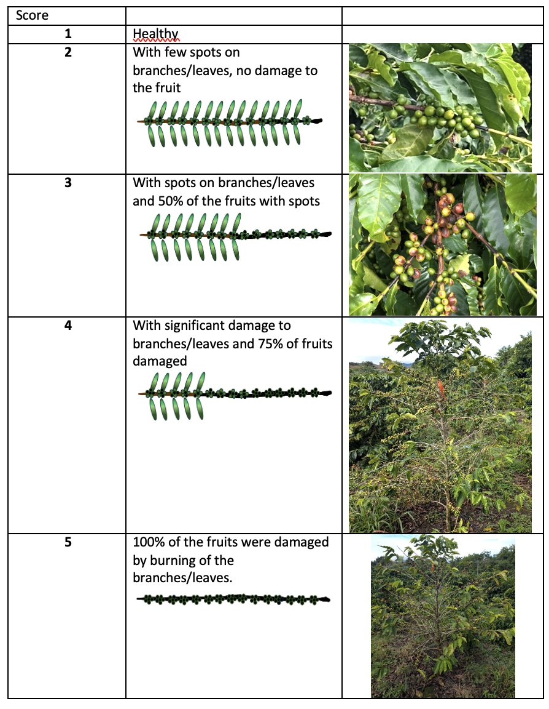
Innovea phenotyping
With the partners in Africa and El Salvador a simplified phenotyping protocol has just recently been tried
Since it´s present in most other sites it would be advantageous to create a consensus on the protocols and phenotype
WCR@FA1

Slide 8
Opitions to phenotype Anthracnose/CBD/CFR – In plant evaluation
Incidence:
% of affected branches
  Damaged/total in 9 branches (3 top, 3 middle, 3 bottom)
% of affected fruits
  Damaged/total fruits in 3 branches
Severity
Severity scale of damaged fruits
0 = resistant
1 = 1% - 25% moderately resistant
2 = 26% -50% moderately susceptible
3 = 51% - 75% susceptible
4 = 76% - 100% highly susceptible

Slide 9
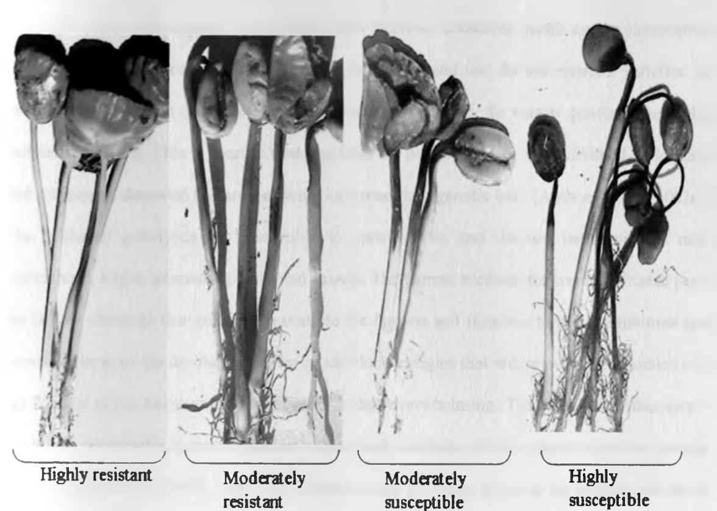
Anthracnose/CBD/CFR – hypocotyl innoculation
Six-week-old seedlings will be inoculated with a conidia spore suspension
2 rep test with a few as 10 plants per rep
Gichuru (2007)

Slide 10
Discussion about describe what other data is being collected or will/could be collected

