Slide 1
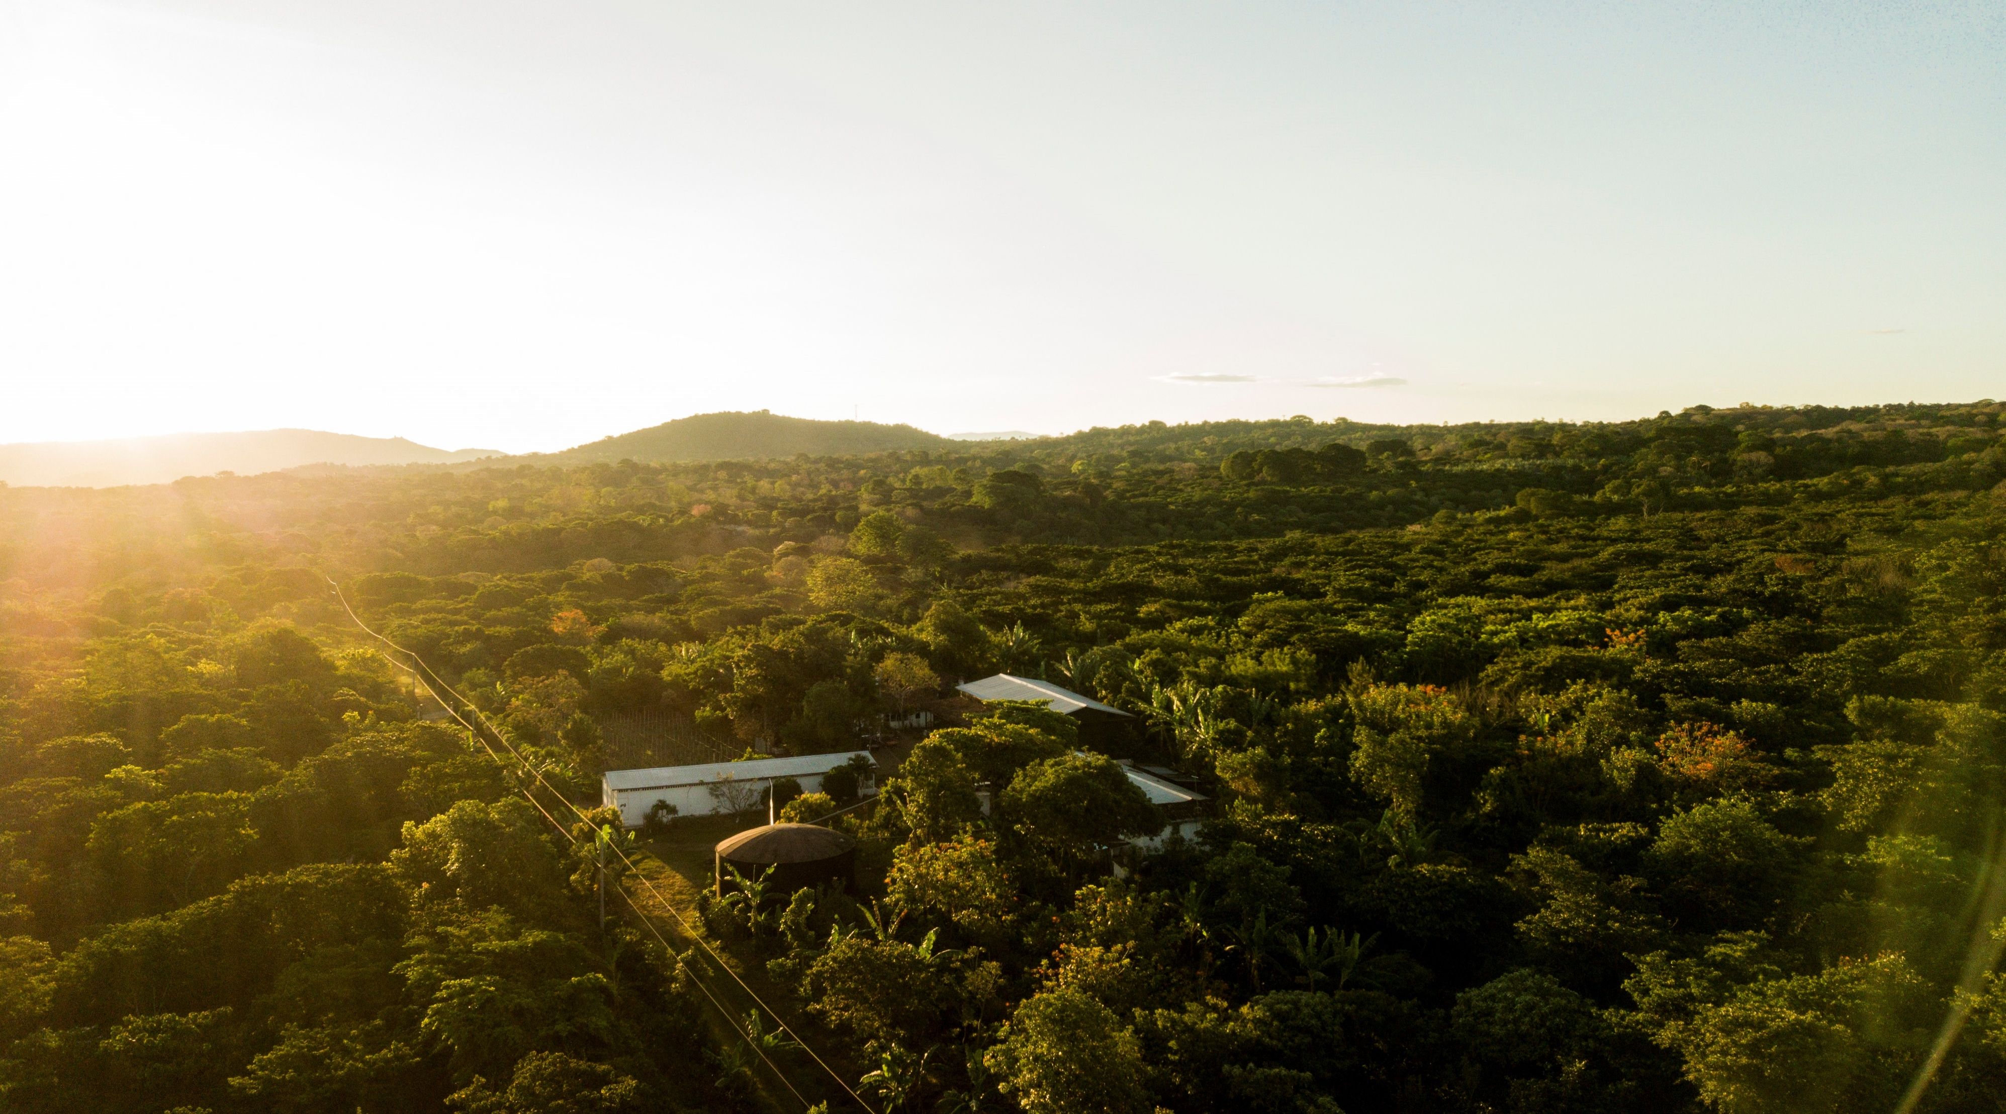


Innovea Data Management
Innovea Network Breeders Meeting
Cenicafe, Manizales, Colombia
November 17-21, 2025

Slide 2

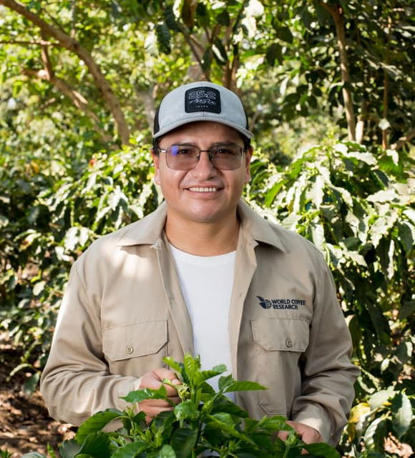
Presenters
Santos Barrera, Ph.D.
Senior Research Scientist, Plant Breeding and Genomics
World Coffee Research
James Gimase, Ph.D.
Chief Research Scientist. Plant Breeding
KALRO

Slide 3
Glossary
Phenome: Breeding data management system
ARCBD: Augmented Randomized Complete Block Design. In this kind of design, the approach is to build augmented blocks and allocate the same number of controls in every block along with the treatments.
Traits: Phenotypic variables to collect
Metadata: It's the background information that describes, explains, and provides context for other data, making it easier to find, use, and manage

Slide 4

Experimental Designs
Objective of an experimental design: To evaluate and compare the response of several conditions or circumstances of interest.
  Treatments (e.g., genotypes)
  Experimental units / Measurement
  Random or background noise Data
  Research hypothesis
Design of Experiment Principles
Randomization. It ensures that treatments are assigned without bias to the different experimental units.
Replication. It allows us to increase the precision of the experiment by observing the effect of a treatment several times, and also by separating background noise from the real treatment effect.
Blocking. It provides control, up to a certain degree, of environmental variation by grouping similar units together.

Slide 5

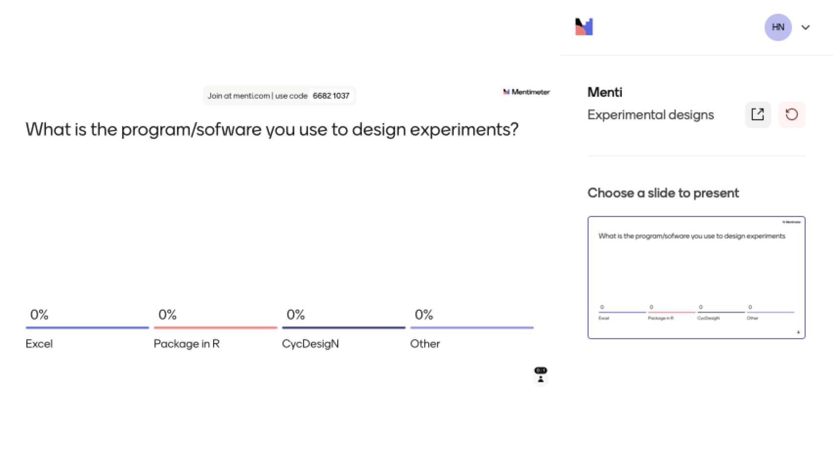

Slide 6
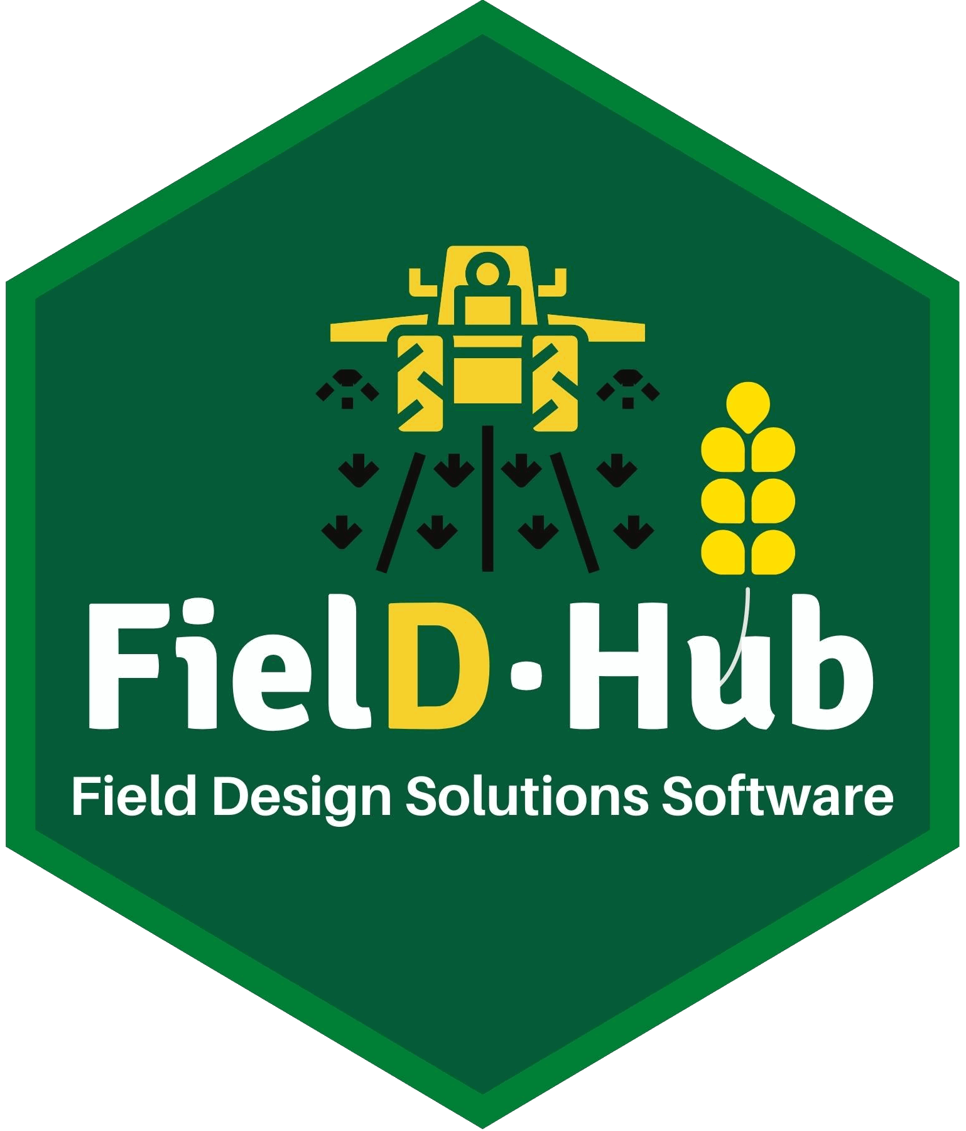
Innovea-Arabica Experiments
Experimental designs, based on the availability of individuals
ARCBD-row-col
Balance number of families across different blocks
Checks repeated across blocks
https://didiermurillof.github.io/FielDHub/index.html

Slide 7
Field Books
Field Books, Field Maps, and Metadata
  Metadata information
    Capture relevant information about the experiment, such as agronomy management, if possible, soil data, and so on
  Variables to measure
  Field books are standard
  Field Map

Slide 8

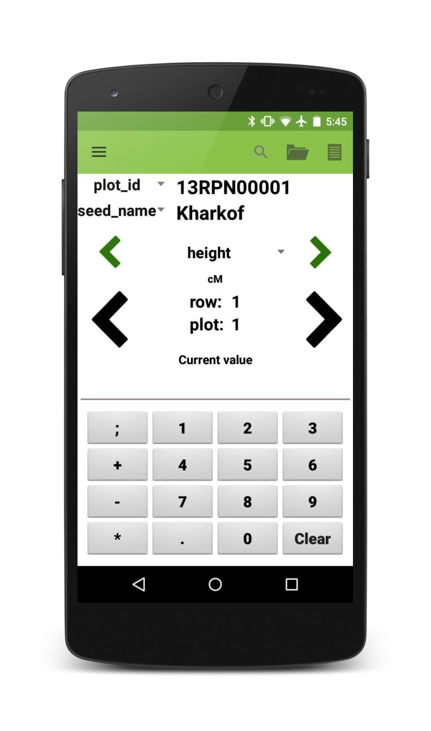

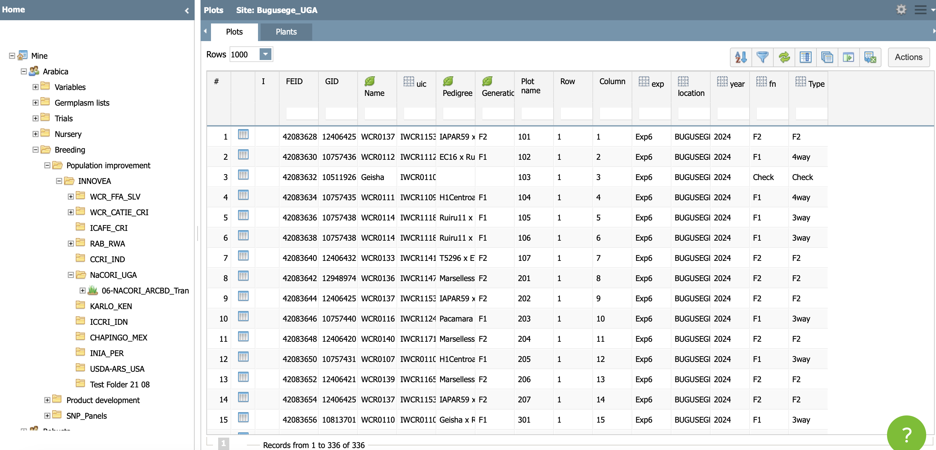

01 DATA
Drive
Data are uploaded into Gdrive
Data are then stored/managed on Phenome
Data are collected on FieldBook

Slide 9

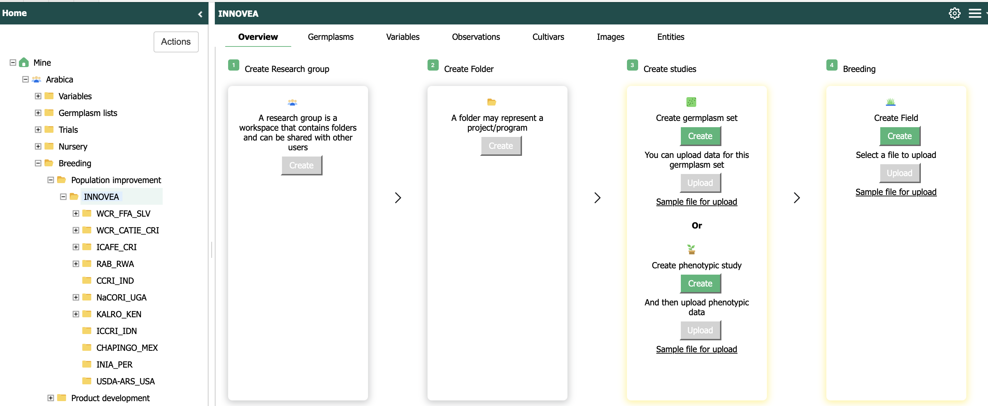
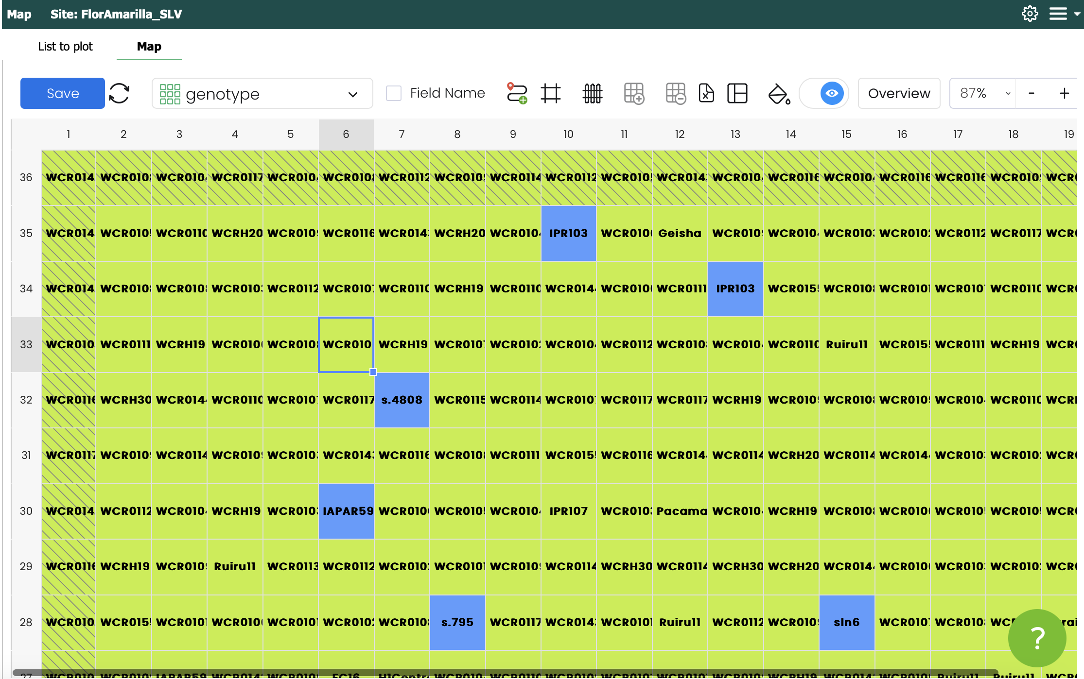
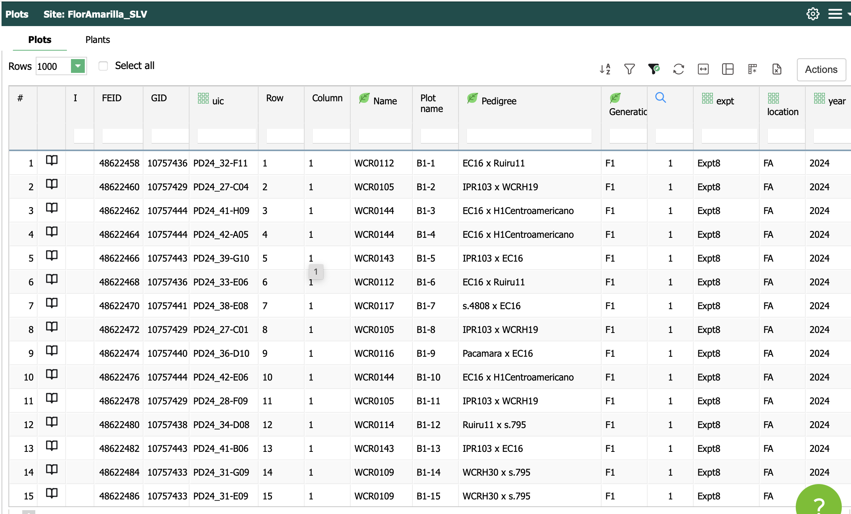
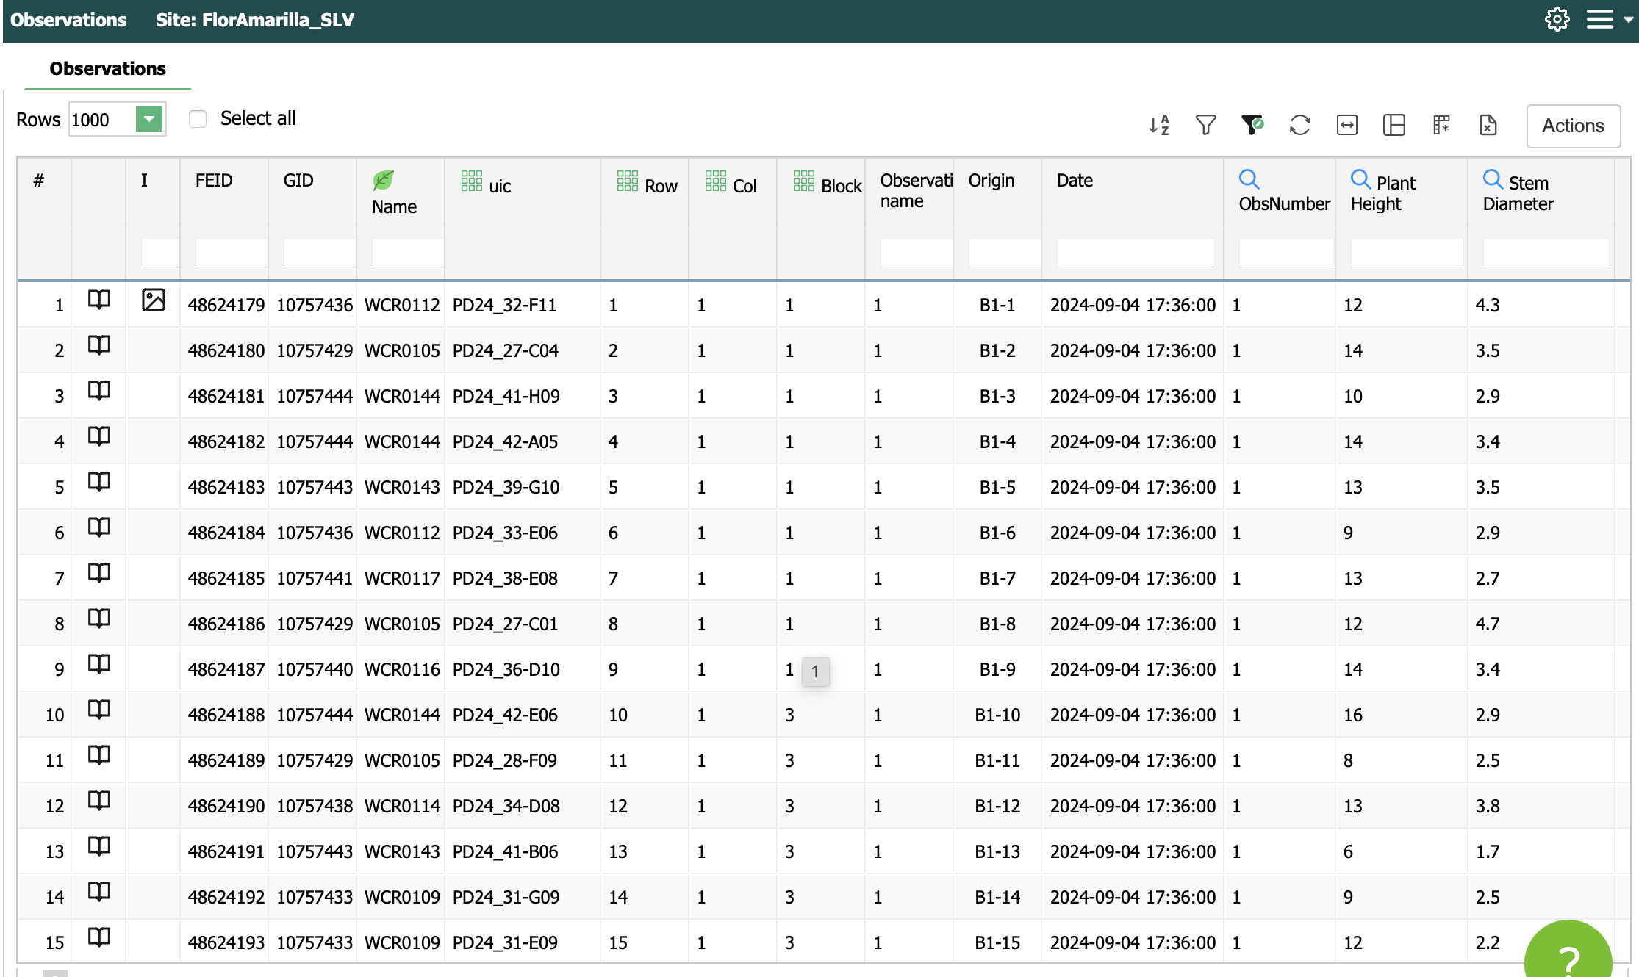
Phenome

Slide 10


02 QC - Preprocessing
Double-check trial layout, line name, data format, experimental design.
Exploratory Data Analysis (EDA), outlier detection, connectivity among trials, summary statistics.
Visualization boxplots, violin plots, heatmaps.
Filtering by % missing values, trials with no variation.

Slide 11
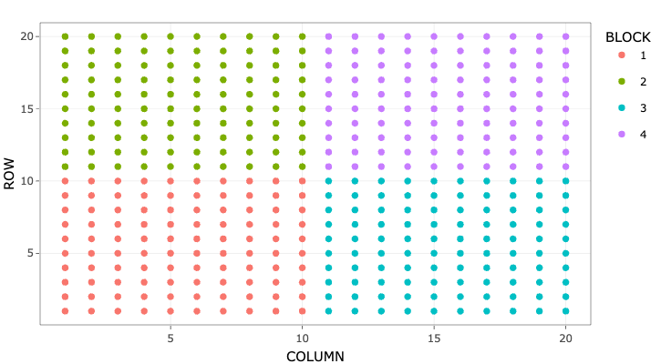
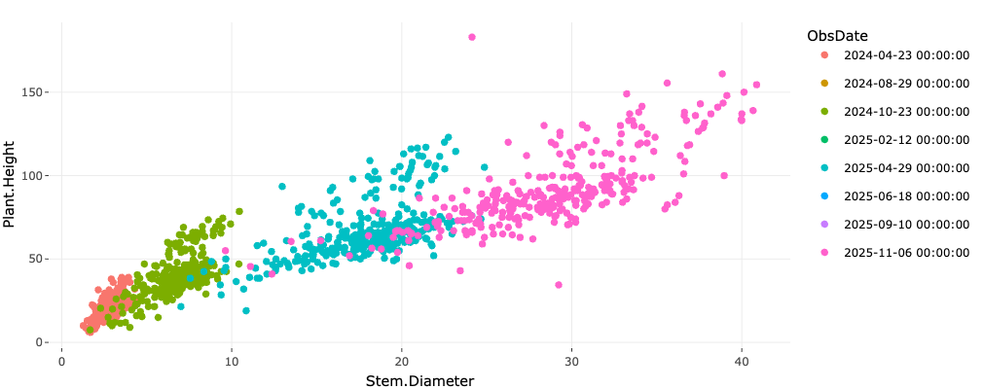
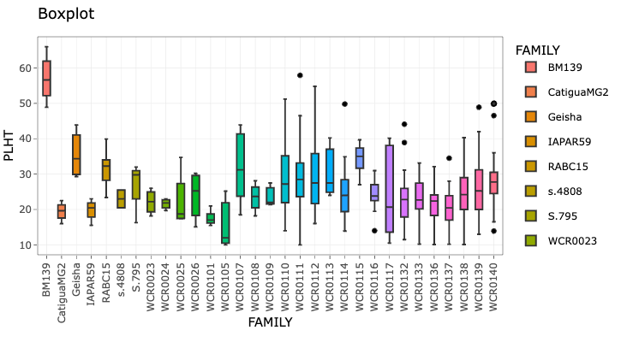
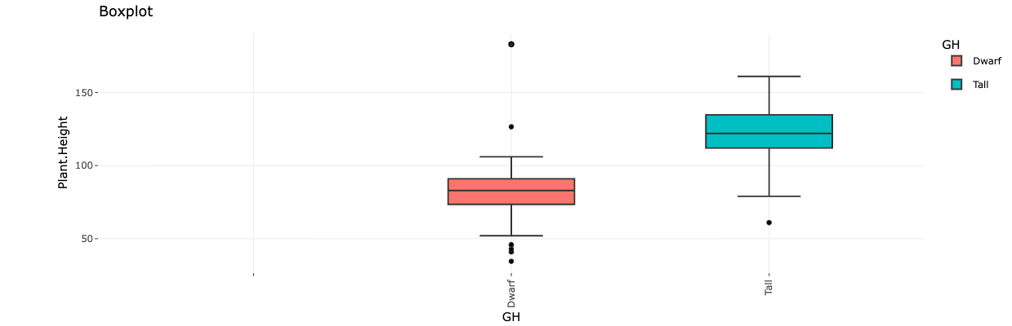

Descriptive Plots
https://apariciojohan.github.io/MrBeanApp/
Correlation = 0.913 / p.value = 0

Slide 12
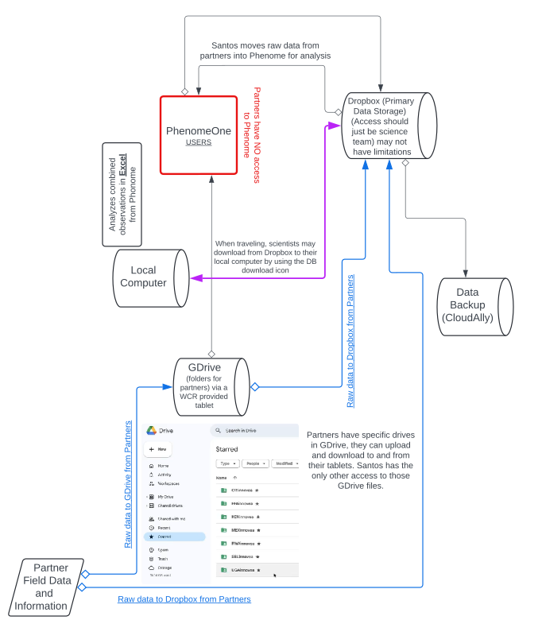
Data Management and Storage WCR

Slide 13
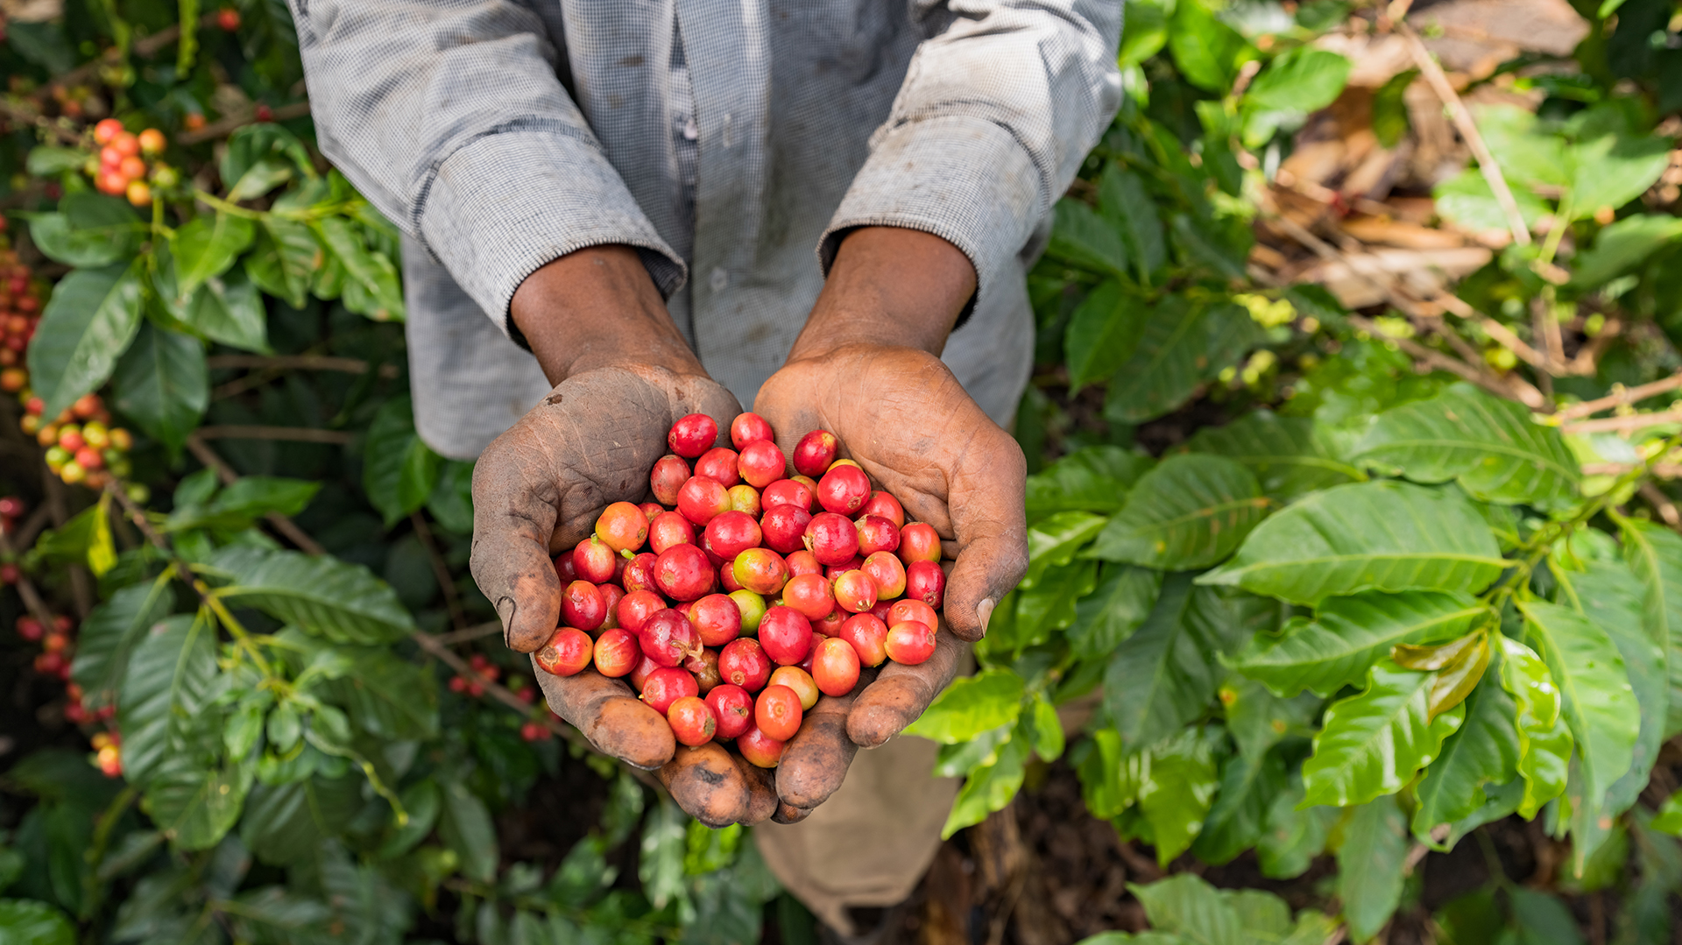
Example Partner Data Management (Case, KALRO)

Slide 14
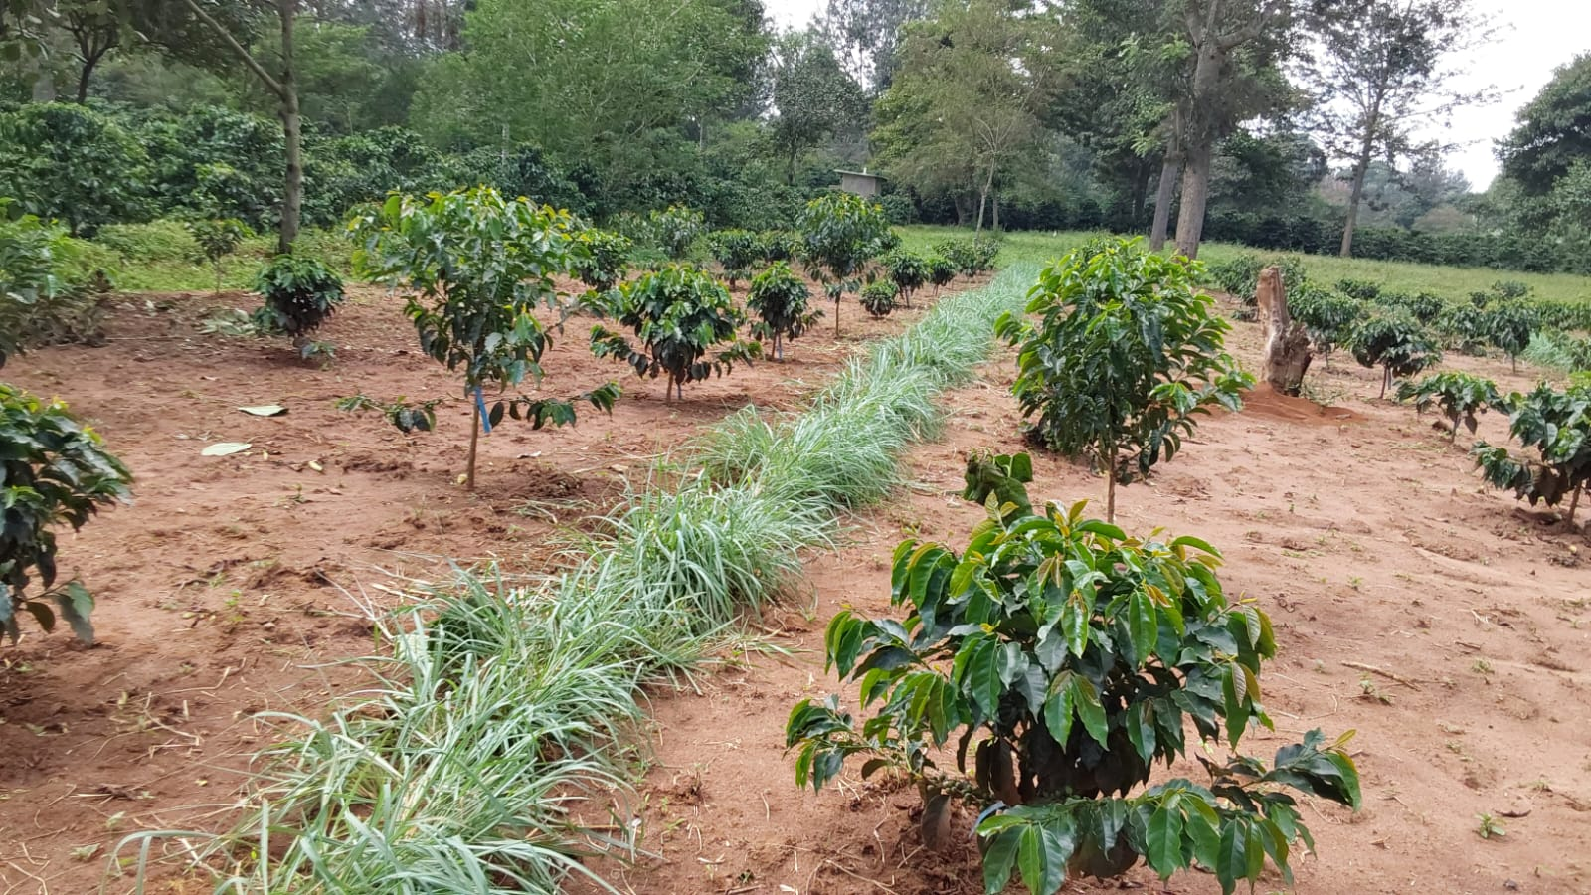
KALRO - Innovea plot - Kitale

Slide 15
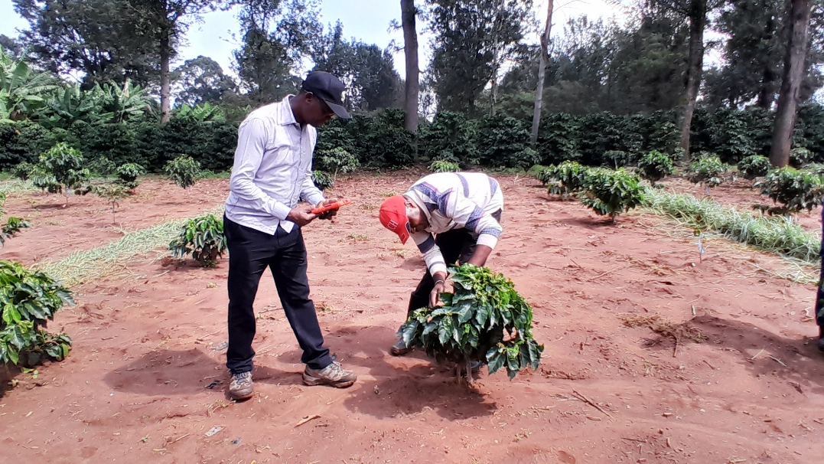
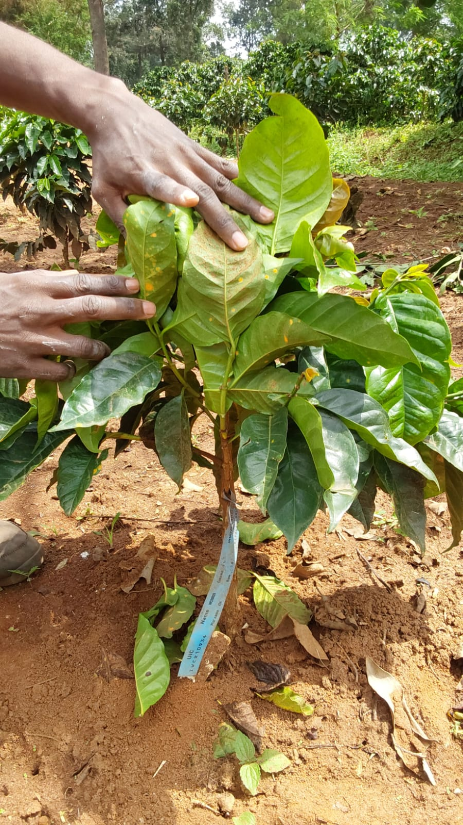
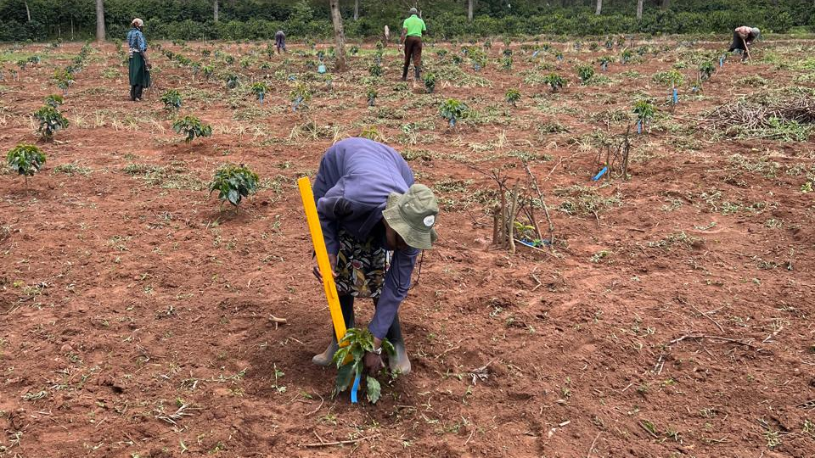
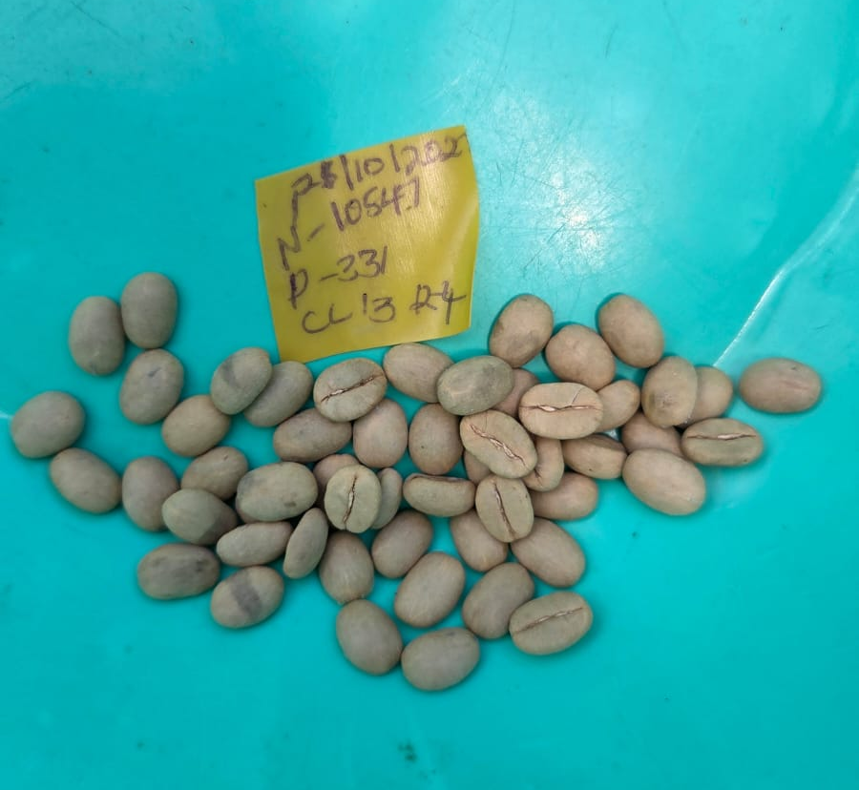
Data collection - Disease, growth and yield

Slide 16
KALRO INNOVEA – Data management
Resources
Field Map
Field Book
Branded Tablet
Data collection
Growth: Twice per year
Disease: at peak
seasons
Management
KALRO : Data entered to field book
Cross checked for missing values
Uploaded into Innovea drive
Shared through email (Back up)
BACK UP
KALRO : Data
PC Files
Google drive
Shared email files
Printed files
Yield : As cherry ripens, weight per genotype
KALRO: Result
Discuss result
Compile report
Report Files
WCR :
Quality check
Analysis
Share result
Data type:
Growth
Disease
Yield

Slide 17
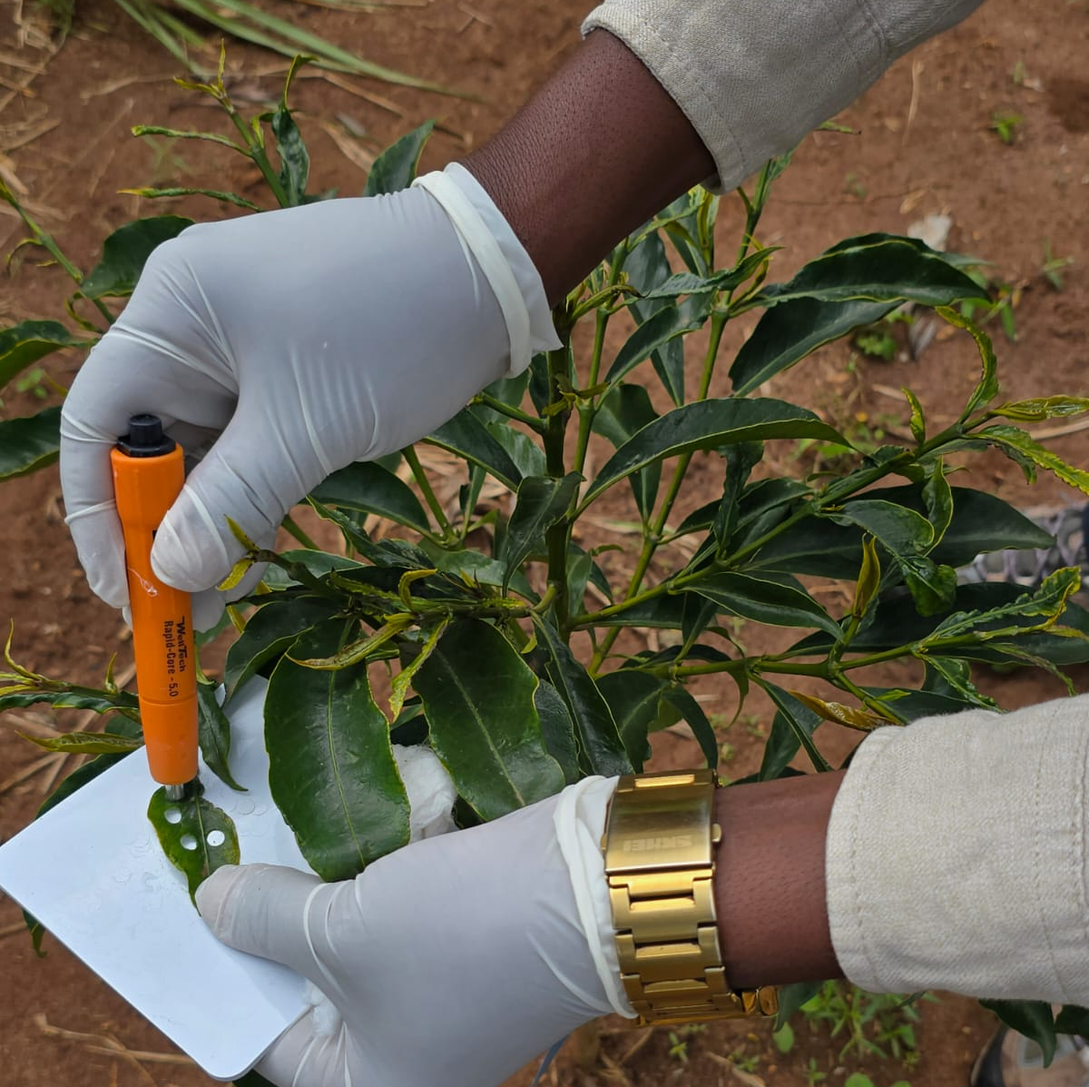
Genotyping Data
Samples collected and shipped
For genotyping
Genotyping results shared through WCR
Local analysis and interpretations
Computation of institutional report

Slide 18
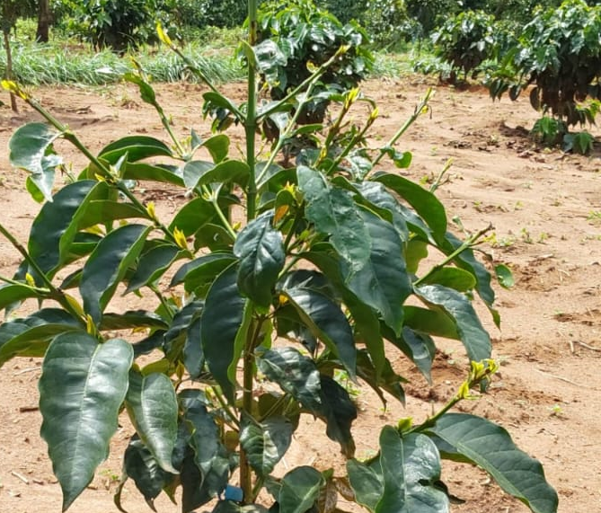
Other Observation
Crinkle leaf
Nutritional Deficiencies
Environmental effects on plants – Crinkle leaf
Insect and other Pest damages
Corrective action:
Immediate and follow up on effectiveness

Slide 19
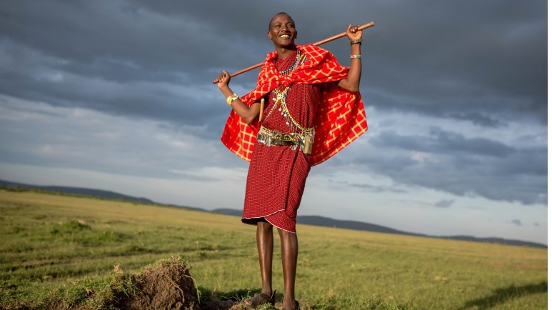
Thank you - GRACIAS

