Slide 1



Innovea - Arabica Yield Data Collection
Innovea Network Breeders Meeting
Cenicafe, Manizales, Colombia
November 17-21, 2025

Slide 2
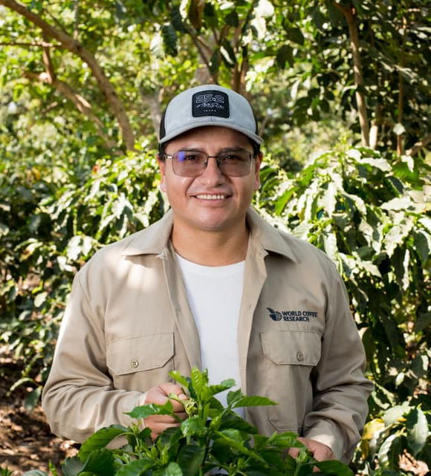
Presenter
Santos Barrera, Ph.D.
Senior Research Scientist, Plant Breeding and Genomics
World Coffee Research

Slide 3
Glossary
Phenome: Breeding data management system
ARCBD: Augmented Randomized Complete Block Design
Traits: Phenotypic variables to collect
Metadata: It's the background information that describes, explains, and provides context for other data, making it easier to find, use, and manage

Slide 4
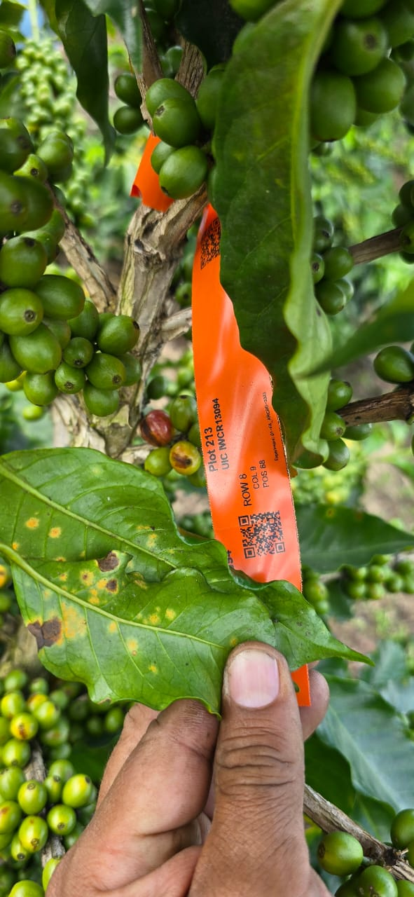


Core Principle: Individual Tree Traceability is Paramount
The entire experimental structure hinges on the fact that each tree is genetically different and each tree is the experimental unit. Therefore, samples must never be mixed.
Separation Rule
Each tree must be harvested and data recorded separately. This separation must be maintained throughout the entire subsequent postharvest process.
Unique Identifier Code (UIC)
The UIC is the link that ensures traceability. Collection bags must be labeled immediately with harvest date and UIC to ensure traceability from the very beginning.

Slide 5
Variables to Measure for Yield
Name of Trait | Abbreviated name | Growth stages | Scale type | For continuous: units of measurement | Description | measurement observations
Number of harvests |  | Reproduction | Continuous | number | number of times the plot needed to be harvested in a year | Every harvest time
Fresh Cherry yield | FCYLD | Maturity | Continuous | g | weight of the fresh cherries in grams per harvest | Every harvest time
Total Fresh Cherry yield | FCYLD-Total | Maturity | Continuous | g | Total weight of the fresh cherries in grams | Every harvest time
Outturn | OT | Post-harvest | Continuous | % | proportion of green coffee beans obtained from a specific quantity of fresh coffee | Once at the peak of harvesting
green bean weight | GBW | Post-harvest | Continuous | g | weight of green beans | Once at the peak of harvesting
100-green bean weight | GBW100 | Post-harvest | Continuous | g | weight of 100 green beans without deffects | Once at the peak of harvesting
Green bean defects | GBD | Post-harvest | Continuous | % |  | Once at the peak of harvesting
Seed density (g/ml) | SD | Post-harvest | Continuous | g/ml | 100 green beans can be put in a graduated cylinder and submerged in a known volume of water | Once at the peak of harvesting
Proportion of green beans above screen 15 | PSA15 | Post-harvest | Continuous | % |  | Once at the peak of harvesting
Note: All the variables have to be measured per individual tree

Slide 6

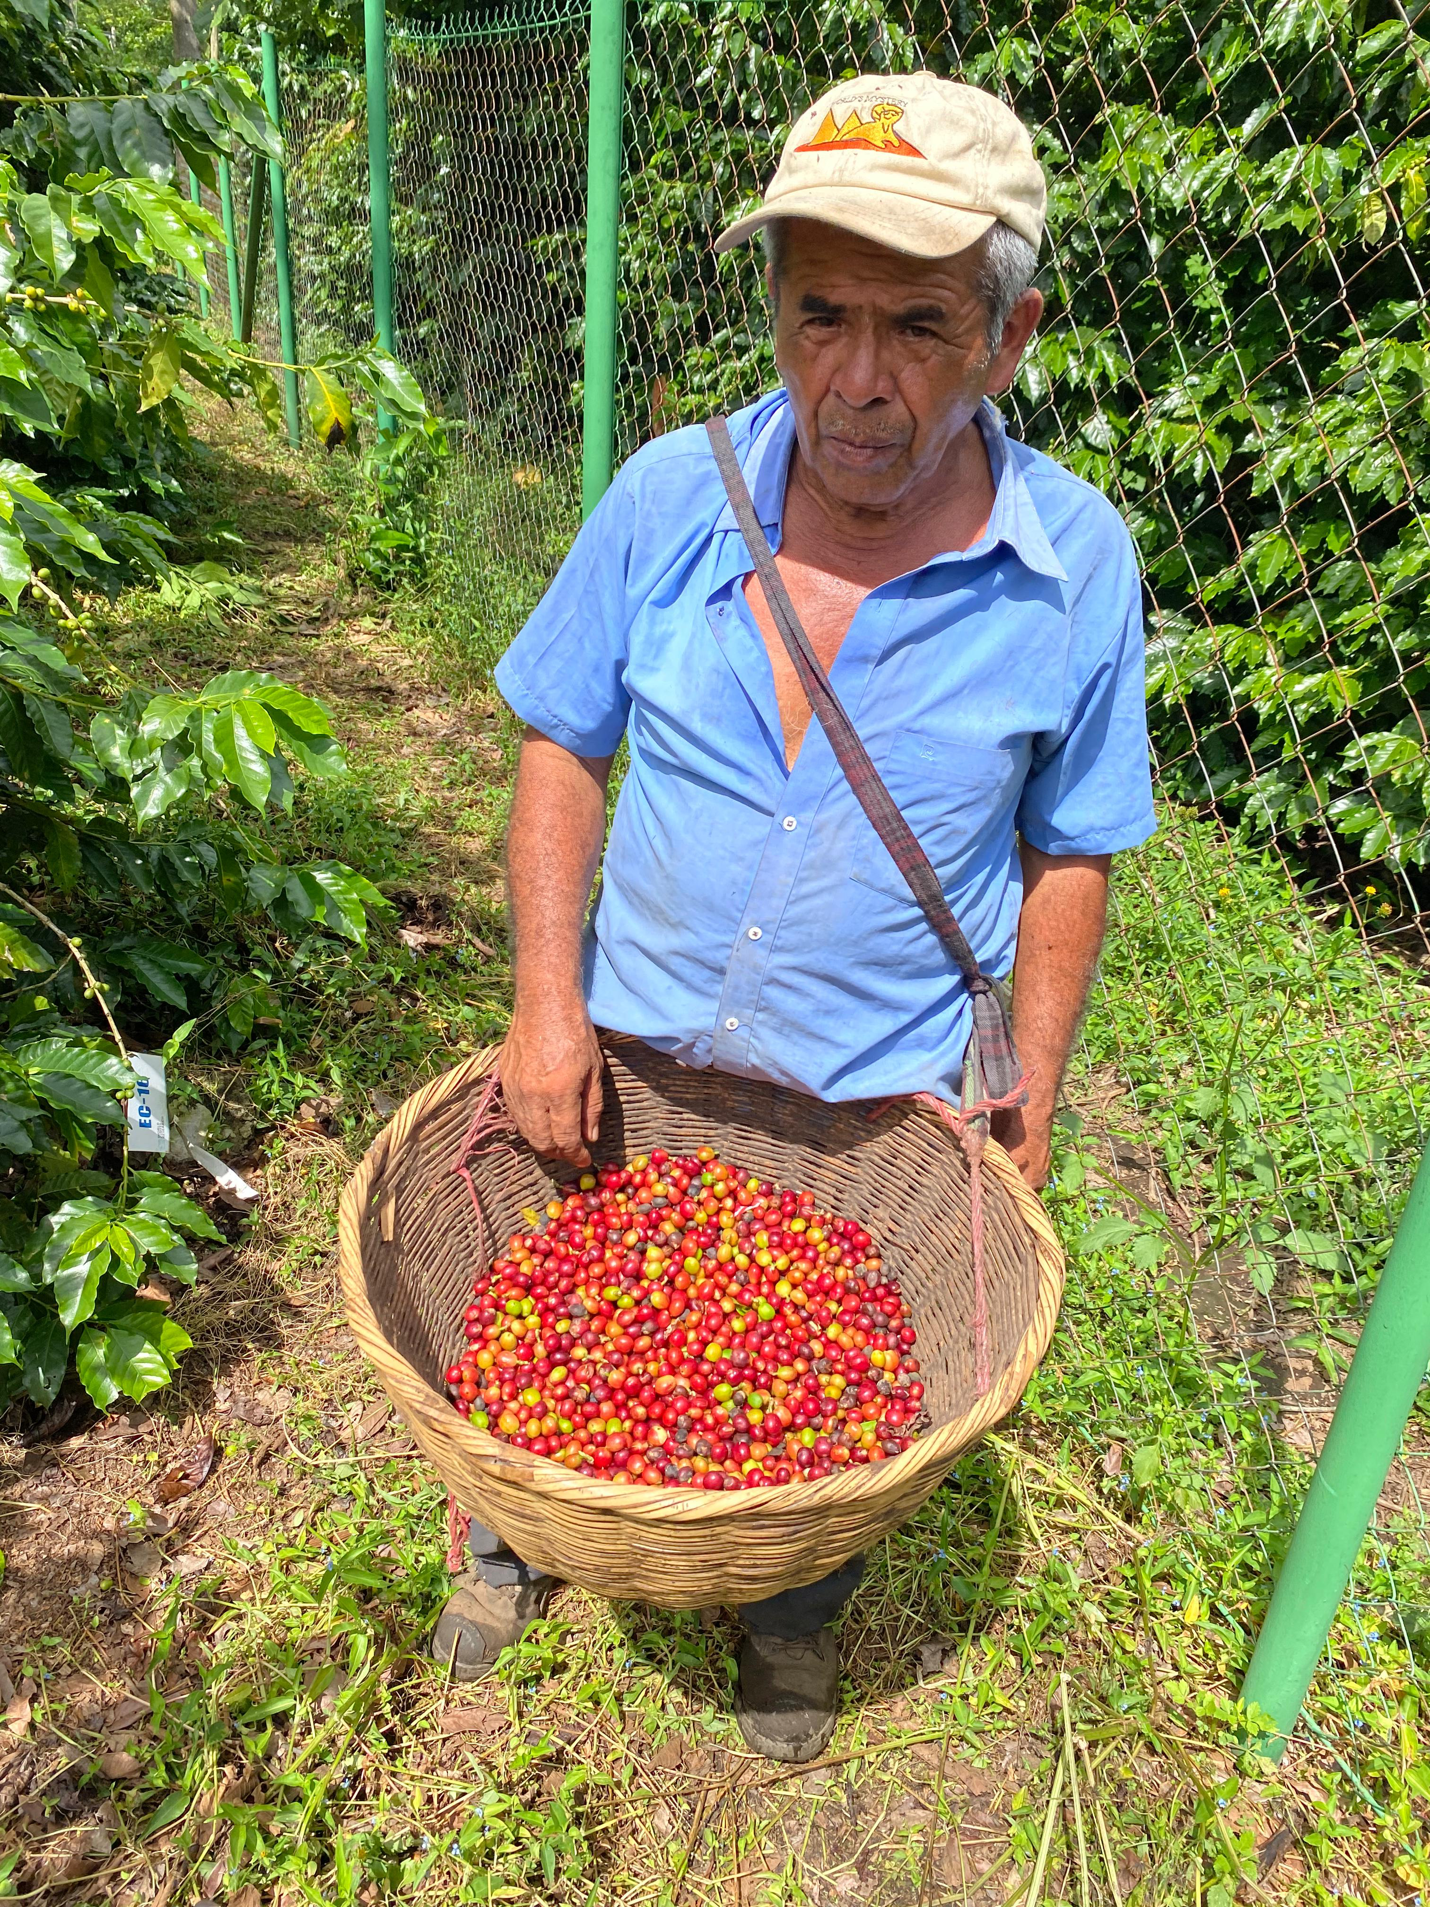
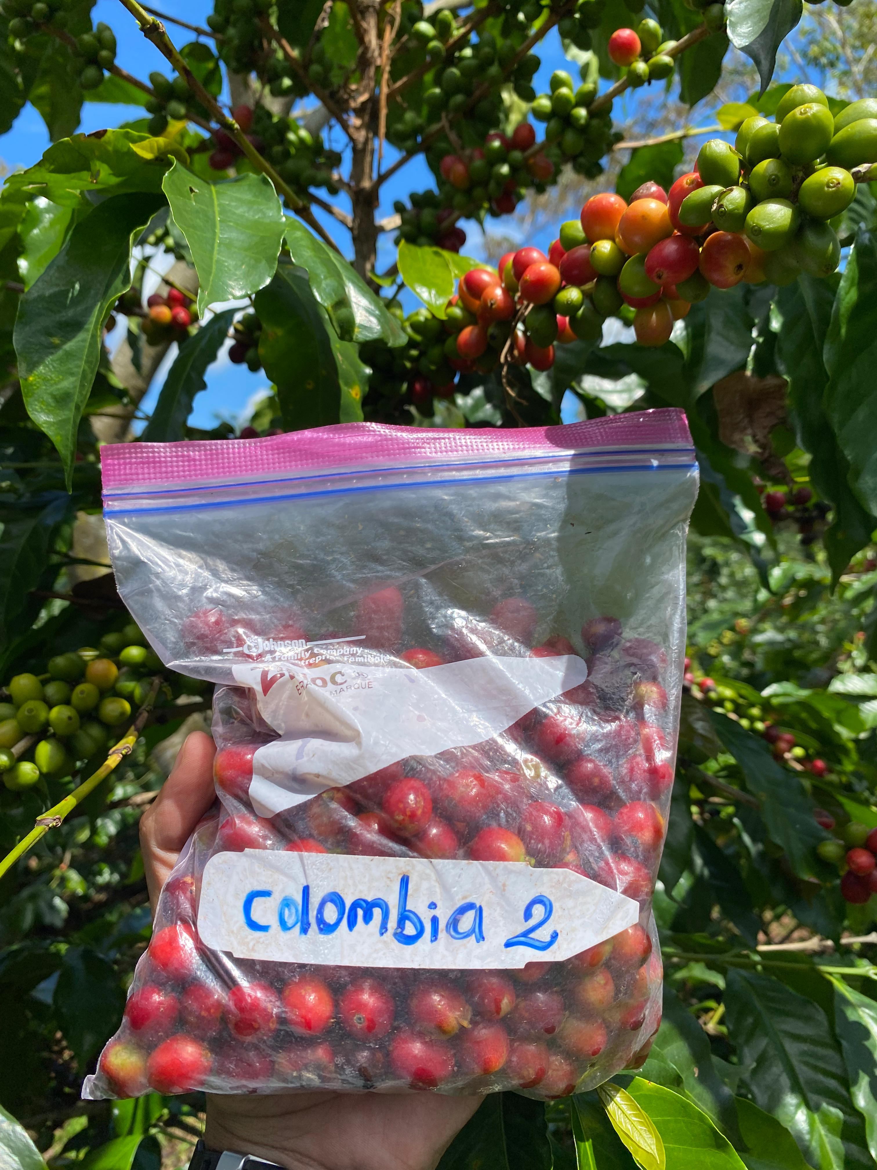
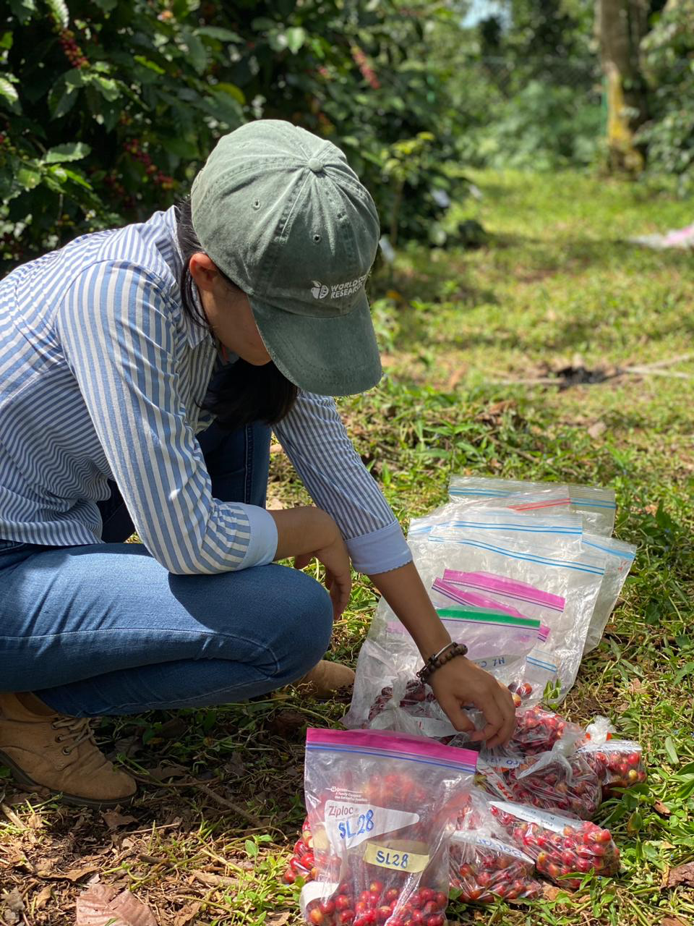
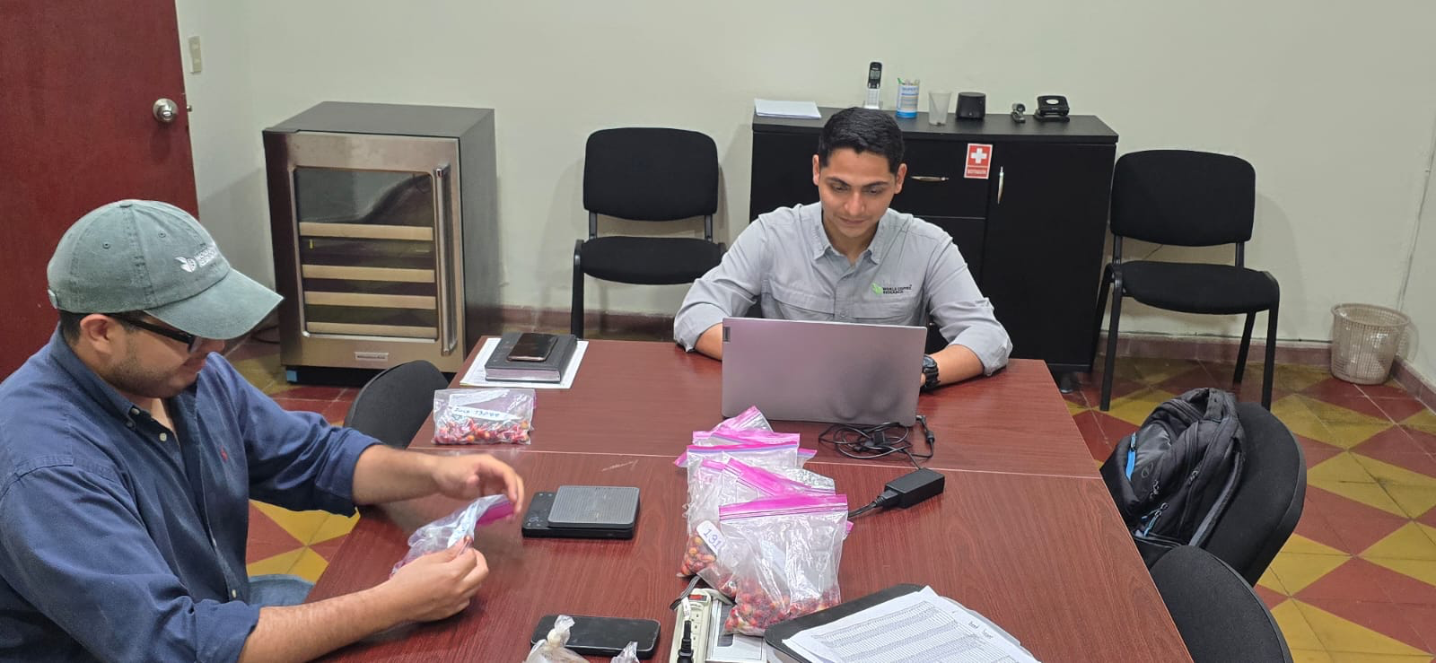
FCYLD: weight of the fresh cherries in grams per harvest
Harvest Initiation & Timing
When to Start
The first round of harvest must start one week after the first mature cherry is spotted.
Harvest Frequency
Harvest should be done every two weeks once the first cherries are mature, or more often if needed.
Managing Variability
Due to genetic differences, different trees can have different harvest dates, potentially resulting in 6 or more different harvest dates for the trial as a whole.

Slide 7
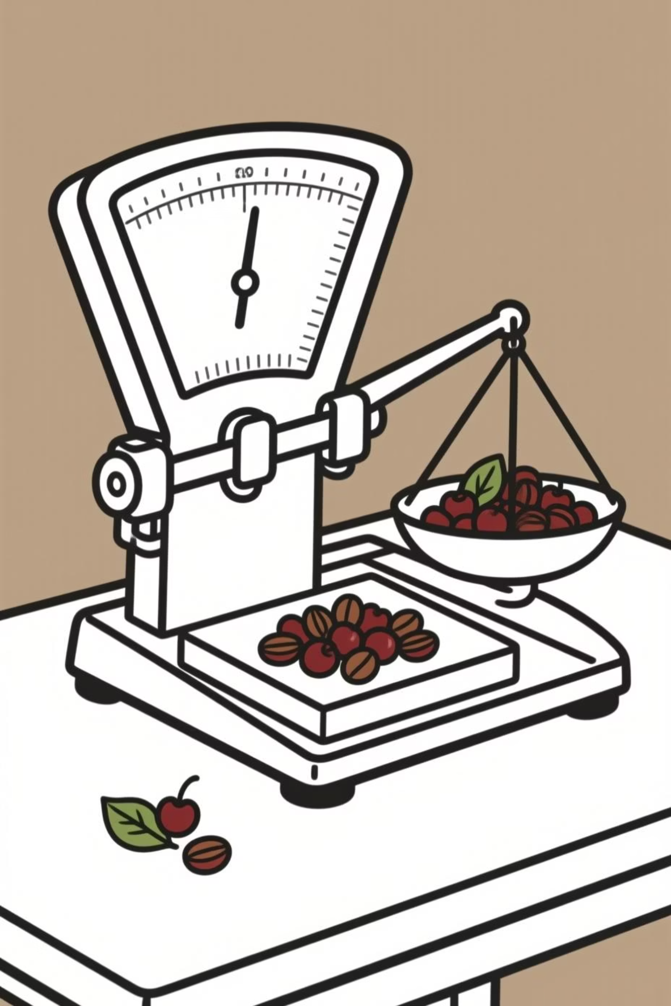
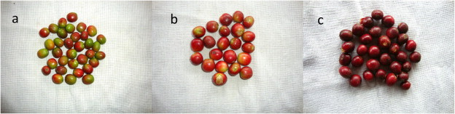
Critical Harvest Execution Steps
01
Selective Picking
Harvest only red, and slightly ripe cherries. Avoid selecting unripe cherries during picking (a).
02
Tare the Scale
Tare the scale with the cherry receptacle before weighing to ensure accurate measurement.
03
Weigh Tree by Tree
Harvest and weigh each tree separately to capture accurate Fresh Cherry yield (FCYLD).
04
Label Immediately
Label collection bag with harvest date and UIC to maintain traceability from the beginning.

Slide 8

Never Mix Samples
Each tree is genetically unique. Maintaining separation throughout the entire process is absolutely critical for data integrity and experimental validity.

Slide 9


Post-Harvest Evaluation: Yield Components
While harvest captures weight, the post-harvest phase captures crucial quality metrics.
This evaluation is generally done once at the peak of harvesting.
Goal of Post-Harvest
Timing is Critical
Evaluate outturn, seed characteristics, and green bean quality.
If cherries are processed immediately, pulping should begin within 4 hours of harvesting to prevent quality degradation.

Slide 10
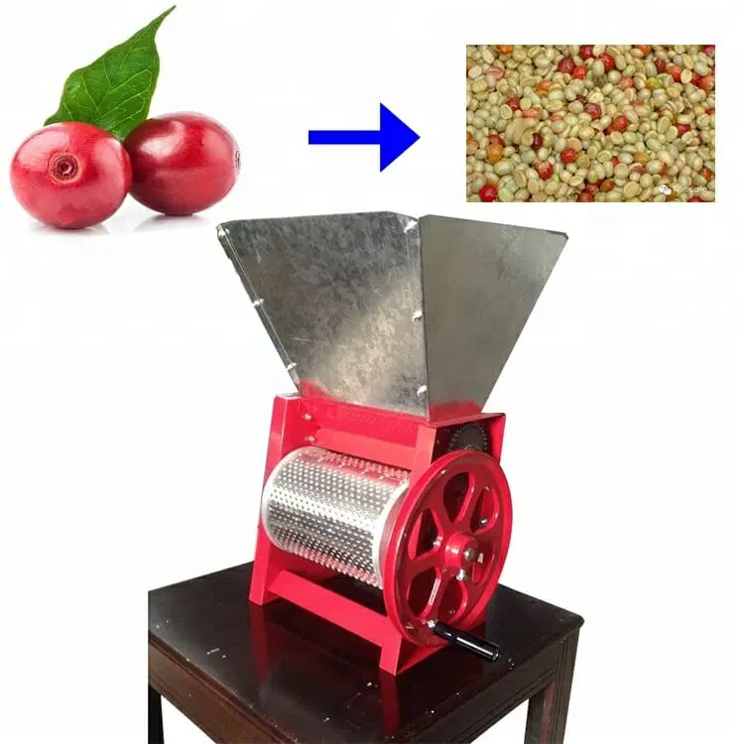
Depulping the Cherries
Proper depulping is essential for maintaining sample integrity and quality. Each tree's sample must be processed separately.
Timing
Calibration
Pulping should begin within 4 hours of harvesting the cherries. This time constraint is critical to prevent quality degradation.
Ensure the depulper is properly calibrated to accommodate the fruit size of each variety, especially critical for large-fruit types like Pacamara.
Process
Feed red, ripe cherries into the pulping machine following manufacturer's instructions. Use one clean plastic bucket to collect wet parchment. Manually remove any remaining pulp before fermentation.

Slide 11
Fermentation Process
Fermentation is a critical step that requires careful monitoring to ensure proper bean development and prevent off-flavors.
Late Afternoon: Begin Pulping
1
Start pulping in the late afternoon so the sample can ferment overnight. This allows technicians to check beans for completed fermentation starting in the early morning.
2
Setup
Place pulped beans into a clean bucket and add fresh, clean water, approximately 30% of the total volume. Cover with clean plastic film to prevent insect contamination.
Monitor Conditions
3
pH should drop to between 3.9 and 4.2. Temperature should not exceed 32°C. The process can take between 8–15 hours.
4
Washing
Wash beans thoroughly, changing water repeatedly until all mucilage is removed. Drain excess water and transfer clean parchment to the drying area.

Slide 12





Parchment Drying
Drying must be gradual and even to prevent fungal growth. Beans with higher moisture content or improper fermentation are susceptible to fungal growth during storage, which can reduce bean quality.
Protection
Monitoring
Completion
Cover coffee at night with jute cloth or black plastic film. During rain, shield using plastic tarps or bring inside. Keep the label visible.
After 3-4 days of drying, begin taking moisture readings with a calibrated moisture meter.
When moisture is at 11-12%, the coffee is done drying. Remove from drying tables and place in cloth or plastic sacks labeled with the UIC.
Estimated time: Many days, up to 2 weeks (will depend on climate)

Slide 13




Key Data Collected from Green Bean Batch
After processing (hulling), the green beans yield critical metrics that provide essential quality
and yield information for each tree.
Total Green Bean Weight (GBW)
The weight of the entire batch of green beans from each individual tree.
Screen Size/Uniformity
The entire batch must be run through a size 15 screen. This helps calculate the proportion of green beans above screen 15 (PSA15).
Defective Beans
Assessed by taking a random 100-gram sample from the total batch to identify quality issues.
Seed Density and Weight
100-green bean weight (GBW100) and volume are measured from beans that did not pass through the size 15 screen.

