Slide 1



Optimizing our Approach to Cupping
Innovea Network Breeders Meeting
Cenicafe, Manizales, Colombia
November 17-21, 2025

Slide 2

Presenter
Veronica Belchior, Ph.D.
Research Scientist – Coffee Quality Evaluation
World Coffee Research

Slide 3

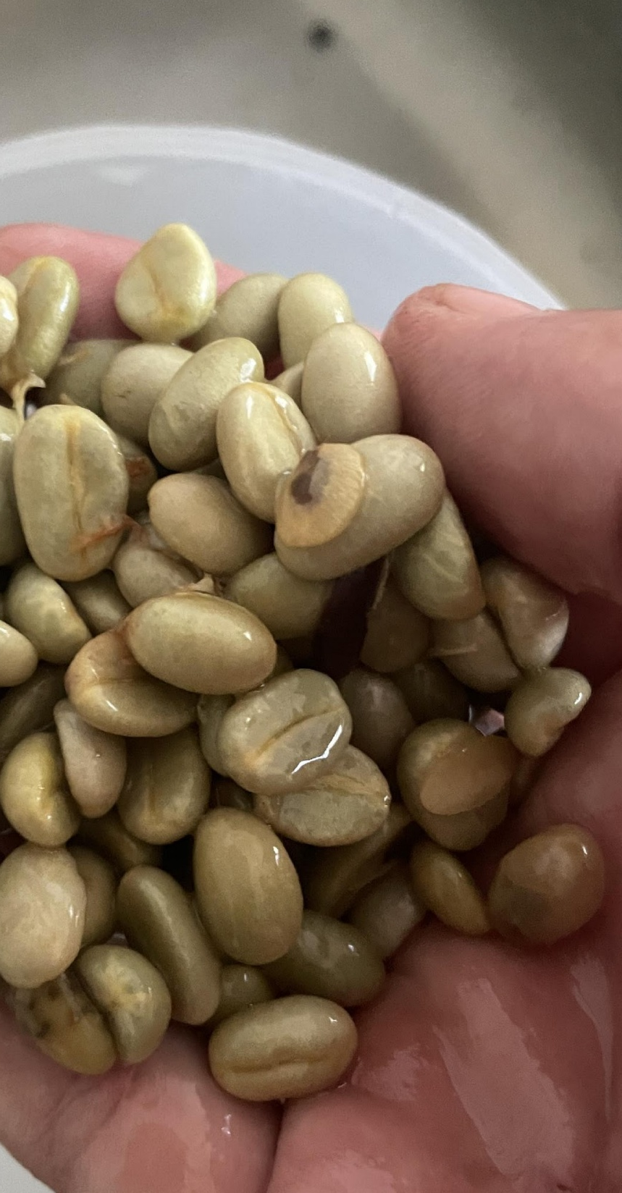
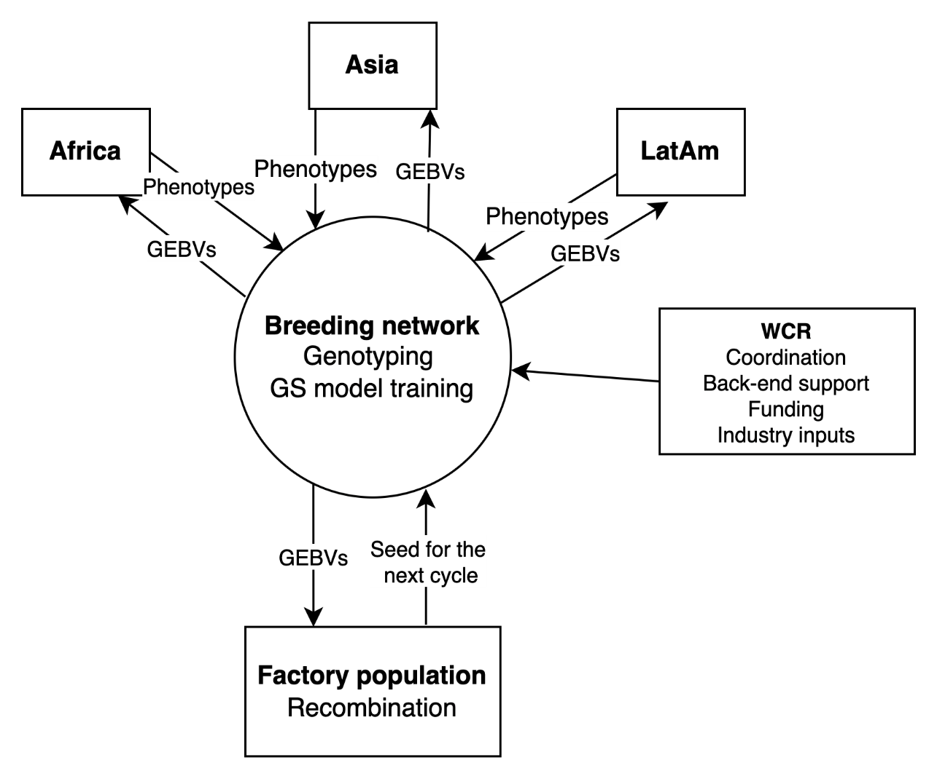


Challenge: evaluating cup quality in a global breeding network
~5,000 single trees w/ unique genetics → small quantities of coffee
Global logistics
Confounding factors: processing, roasting
Subjectivity in cupping protocol
GEBV = Genomic estimated breeding values

Slide 4
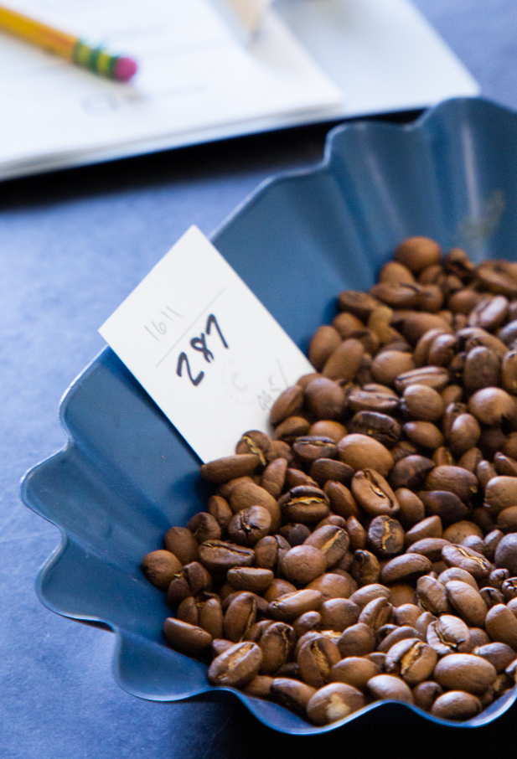
Refining our approach to evaluating coffee quality
  Can we use cupping to effectively differentiate quality in samples of different genetic backgrounds?
  Use IMLVT material as a trial run of global quality evaluation
Comparing the SCA protocol and new “Coffee Value Assessment”
  Comparing local and centralized cupping
Can we control the “noise” from processing and other impacts on quality?

Slide 5
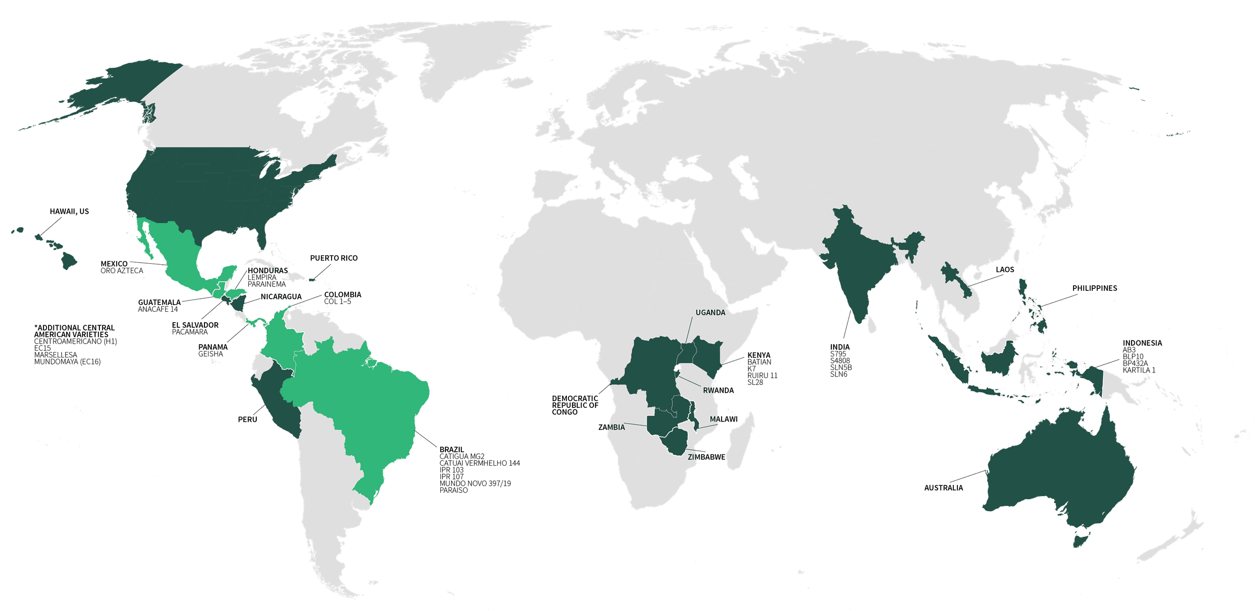
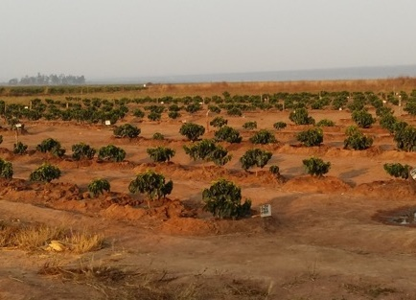
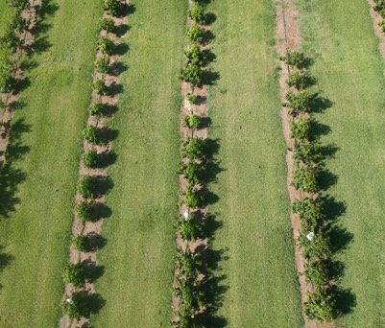
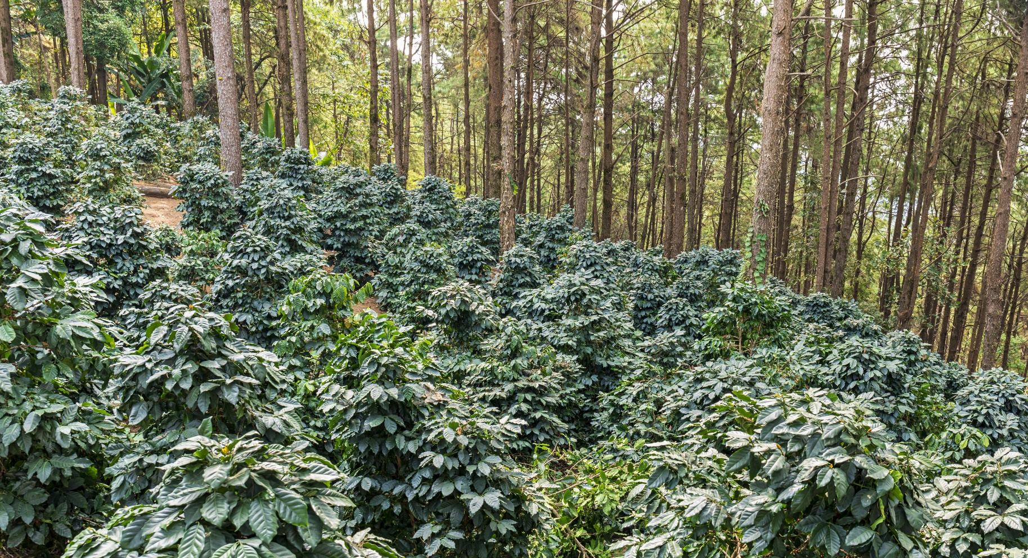
Multi-environment testing
International Multilocation Variety Trial
31 varieties, 28 sites, 16 countries

Slide 6
A centralized cupping of global samples
Same variety specific samples growing in three different sites
Using the Coffee Value Assessment (CVA) protocol by SCA
Hosted by a commercial cupping lab in USA
10 cuppers: Veronica + 9 professional cuppers from the company
  CVA training
Same cupping preparation:
  Table set
  Roasting profile
Comparison to local cupping data collected at origin using the former SCA protocol

Slide 7
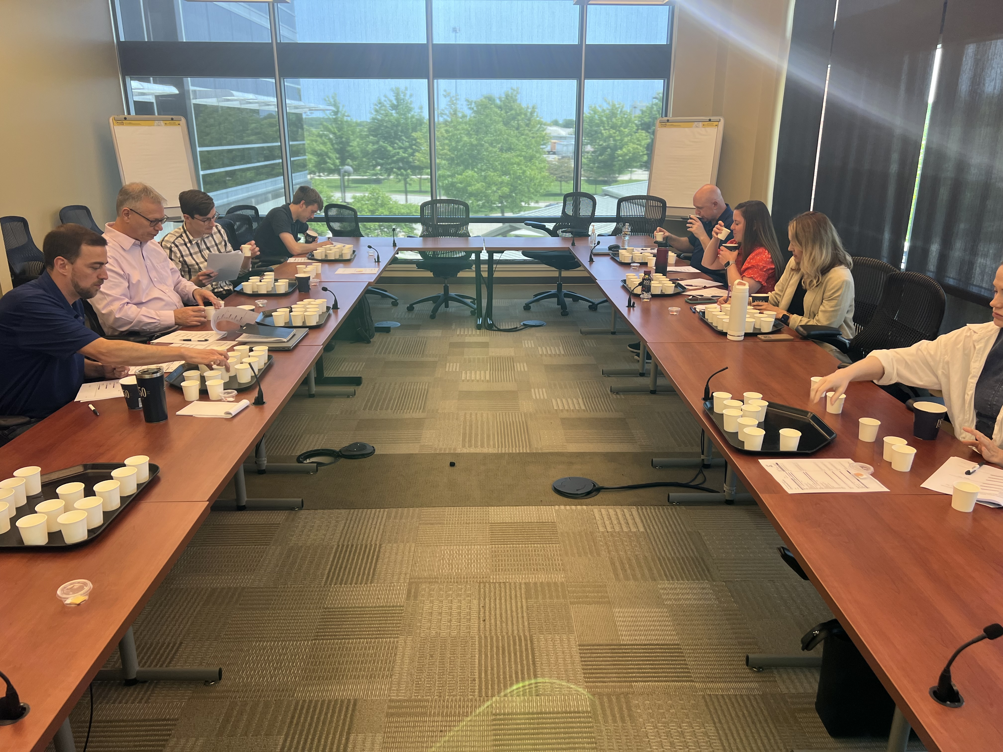
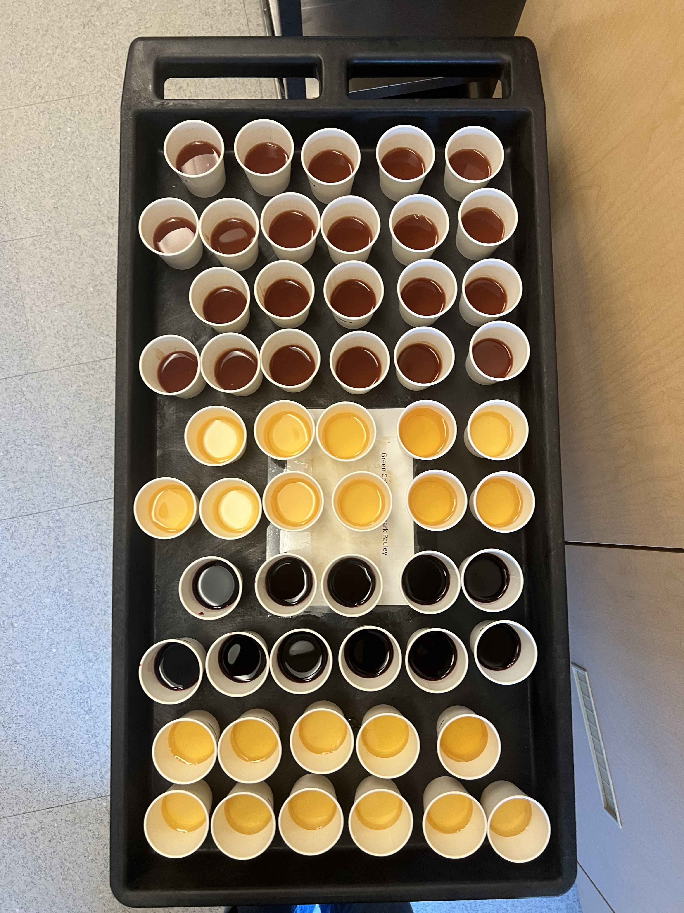
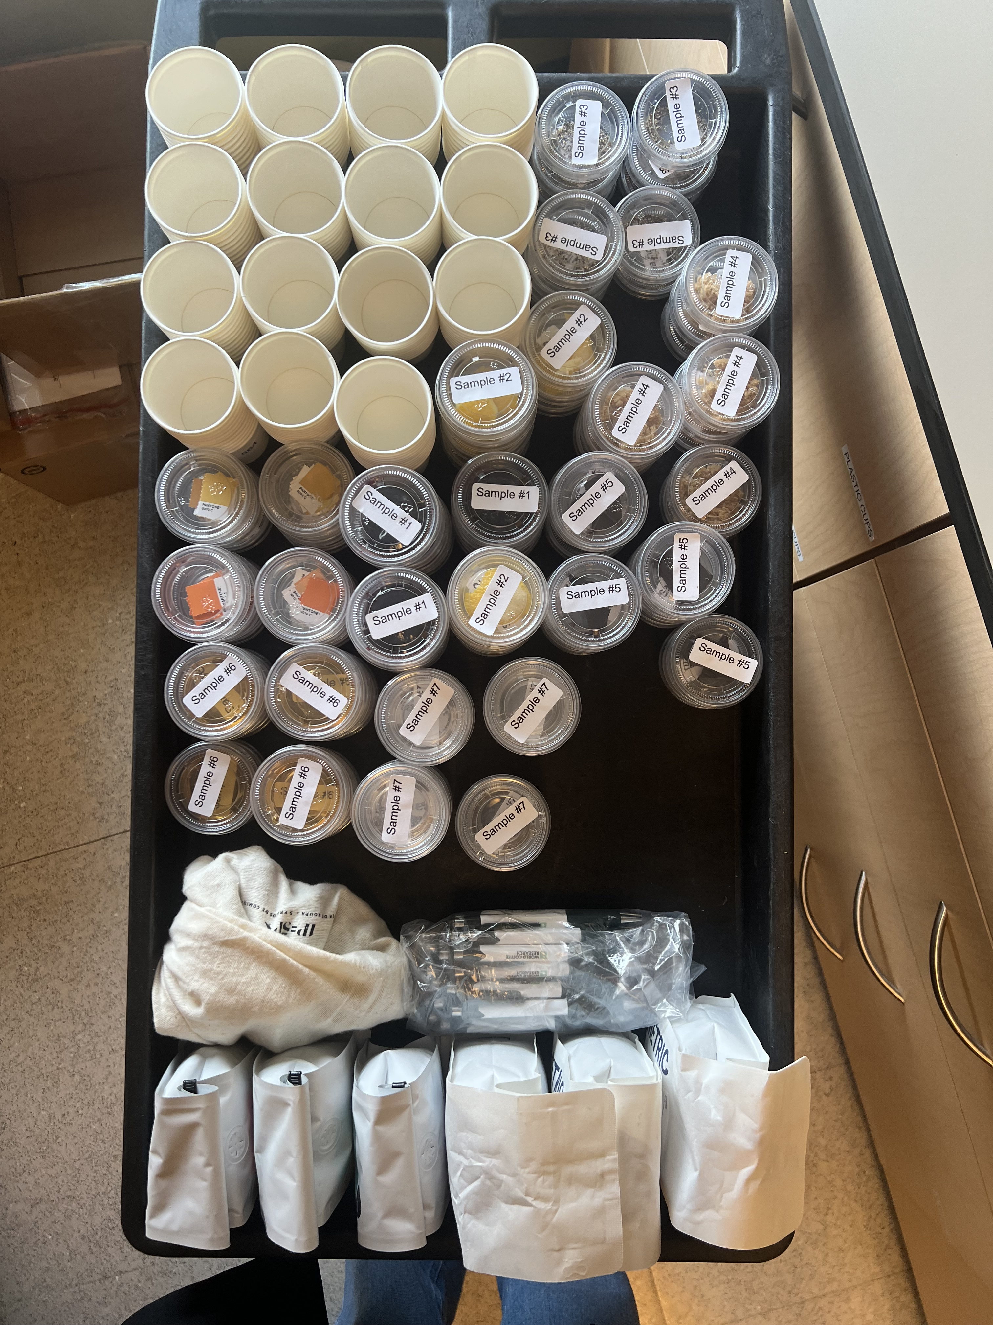
Standardization: Improving the reliability of cupping
The cuppers must be submitted to a training with references of aromas, flavor, acidity, mouthfeel
The cuppers should be calibrated regarding the goals of the sensory assessment. For calibration, references must be used
The roasting profile must follow the SCA Standards

Slide 8
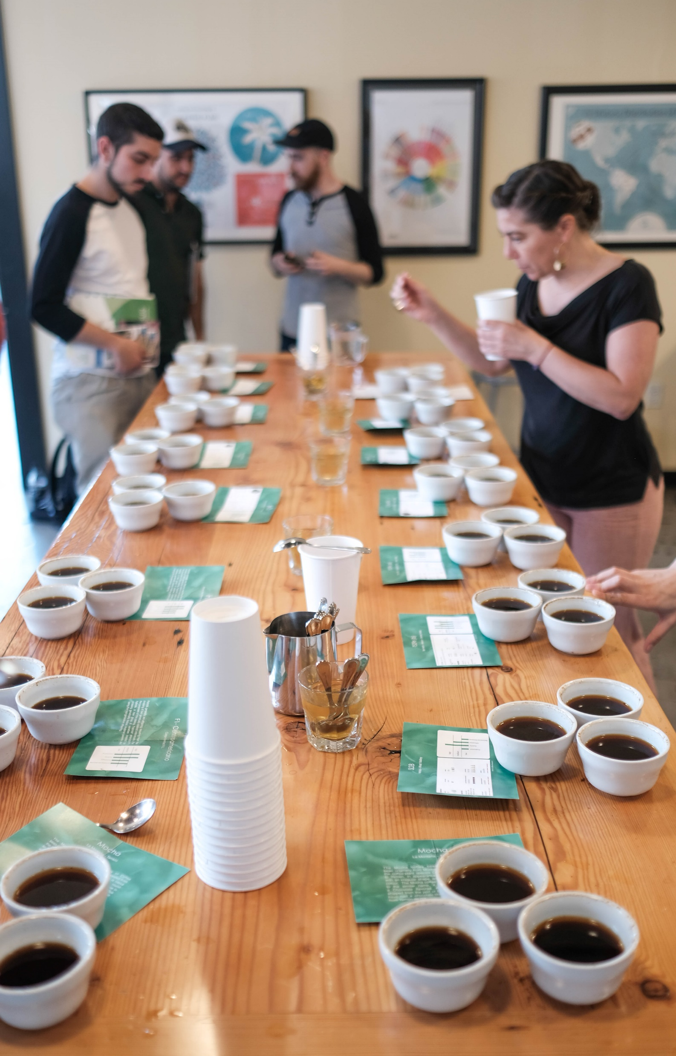
Cupping with the SCA’s Coffee Value Assessment (CVA)
Our breeding program needs standardized methodology that can be applied consistently year after year by different people operating in different locations.
The protocols developed by the Specialty Coffee Association (SCA) represent the most widely accepted tool available.
The SCA’s recently launched Coffee Value Assessment (CVA) is a more scientifically sound upgrade to the previous “SCA protocol” that more effectively controls for bias and personal preference.
Using the CVA enables us to standardize measurement and definitions to generate useful data. It does not mean we are targeting our Arabica selections for the specialty coffee market.

Slide 9
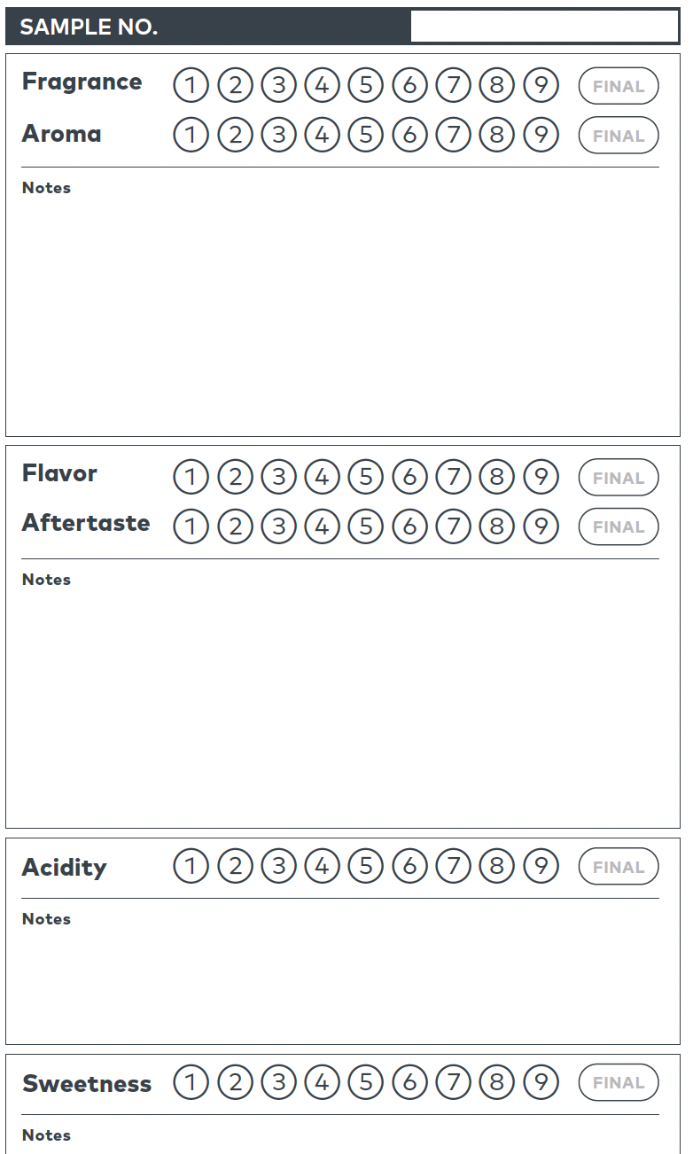
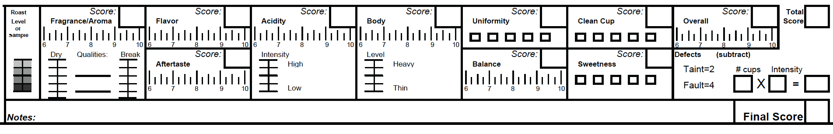
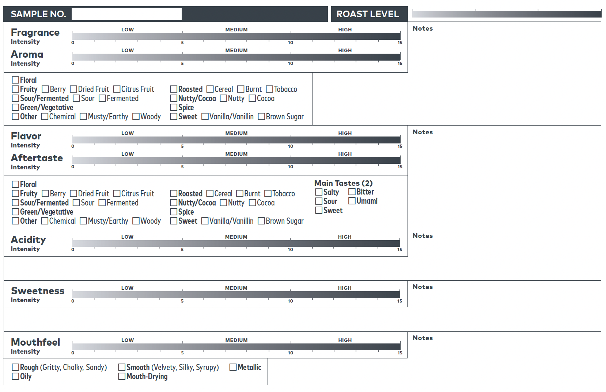
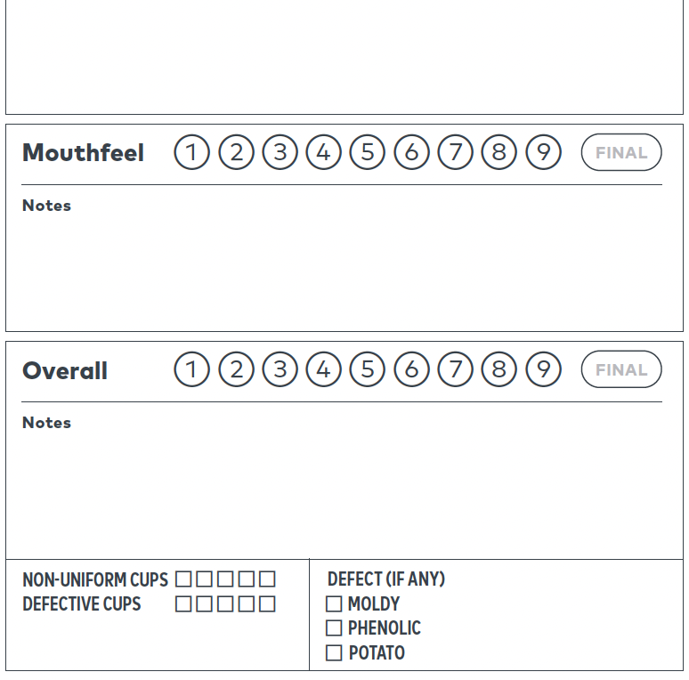
Former SCA Cupping Form (2004)
CVA – Affective Assessment (2024)
CVA – Descriptive Assessment (2024)

Slide 10

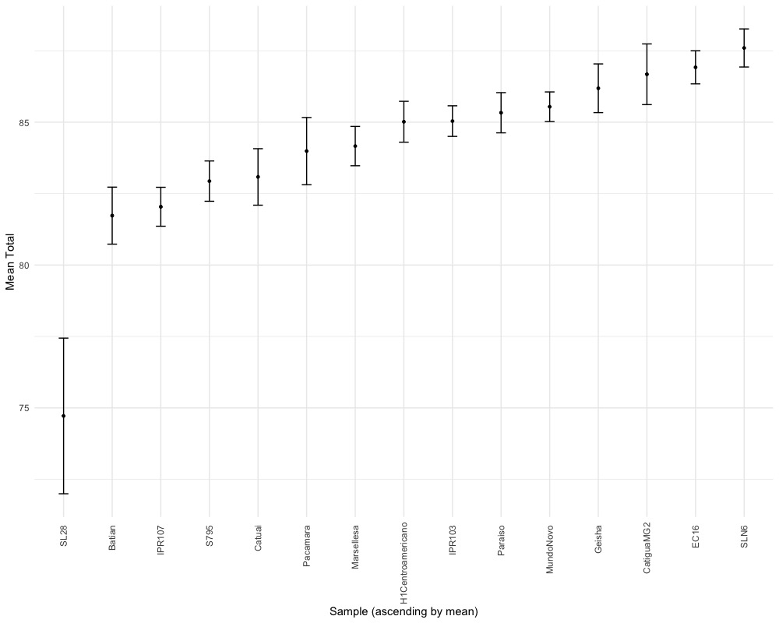
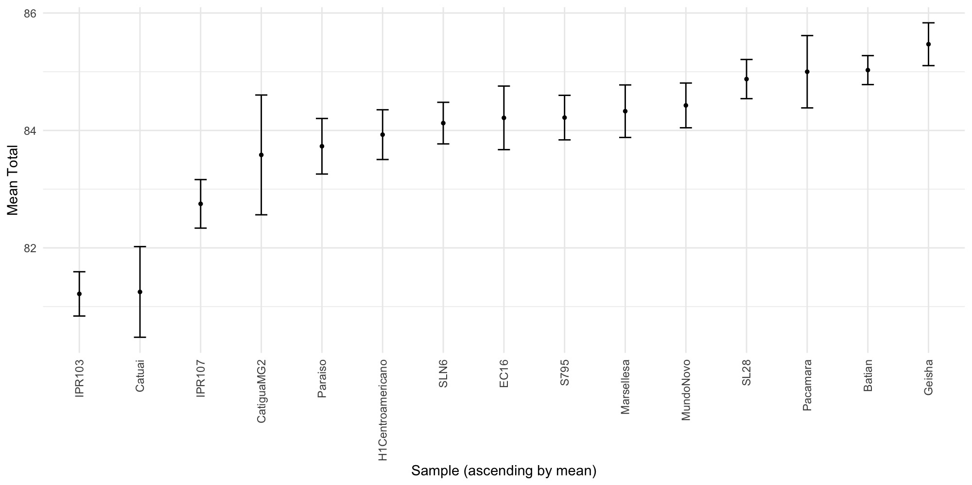
Results - Total Score
Centralized - CVA
Scores: 71 to 89
1
2
3
Local – Former SCA
Scores: 80 to 86
- The scatter plot indicates that most samples were scored higher in centralized cupping than in local cupping.
- CVA impact.
- CVA is more effective in differentiating samples than the former SCA form.

Slide 11
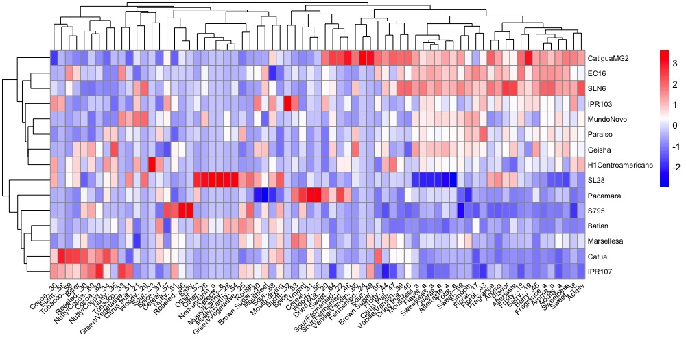
Descriptive Assessment
The Descriptive Assessment gives us an objective characterization of the coffee sensory profile.
Dendrogram and heatmap - Two groups
There are two main groups of samples clustered according to the main attributes used to define samples.
Negative
Positive

Slide 12

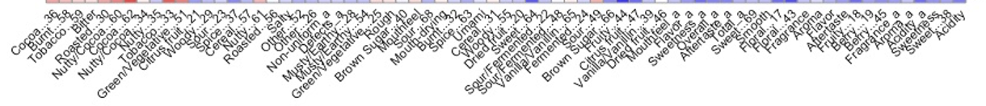
Descriptive Assessment
Negative
Positive
Catigua MG2 (Mean score 85 in local cupping and 88 in centralized cupping)
Medium (0 to 1): flavor, aftertaste, floral, smooth.
Medium to high (1 to 2): acidity, sweet, sweetness, fragrance, aroma, berry, mouthfeel.
High (2 to 3): dried fruit, vanilla/vanillin, citrus fruit, fruity, brown sugar, sour/fermented, sour.

Slide 13
Descriptive Assessment
Descriptive Assessment
Negative
Positive
IPR103 (Mean score 82 in local cupping and 84 in centralized cupping)
Medium (0 to 1): sweetness, fragrance, aroma, flavor, aftertaste, woody.
Medium to high (1 to 2): berry, floral, sweet, tobacco, cocoa.
High (2 to 3): spice, burnt, mouthfeel, mouth-drying.

Slide 14
Descriptive Assessment
Negative
Positive
SL28 (Mean score 86 in local cupping and 75 in centralized cupping)
Low (-2 to -1): total, aftertaste, overall, sweetness, flavor, mouthfeel.
Medium (0 to 1): fruity, berry, fragrance, aroma.
Medium to high (1 to 2): mouth-drying, rough, brown sugar, green/vegetal.
High (2 to 3): musty-earthy, defects, non-uniform, other.

Slide 15
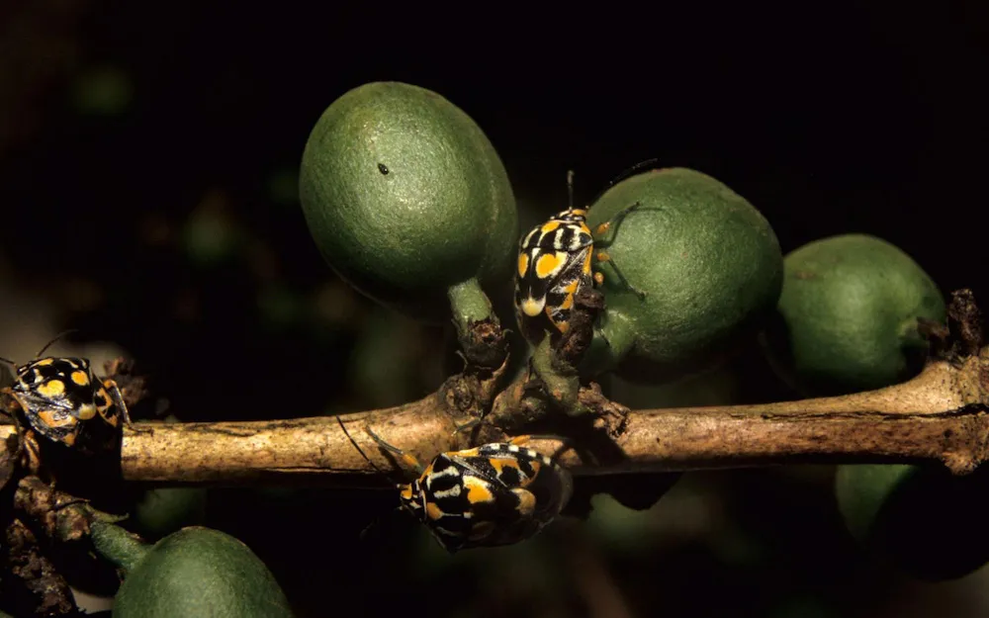
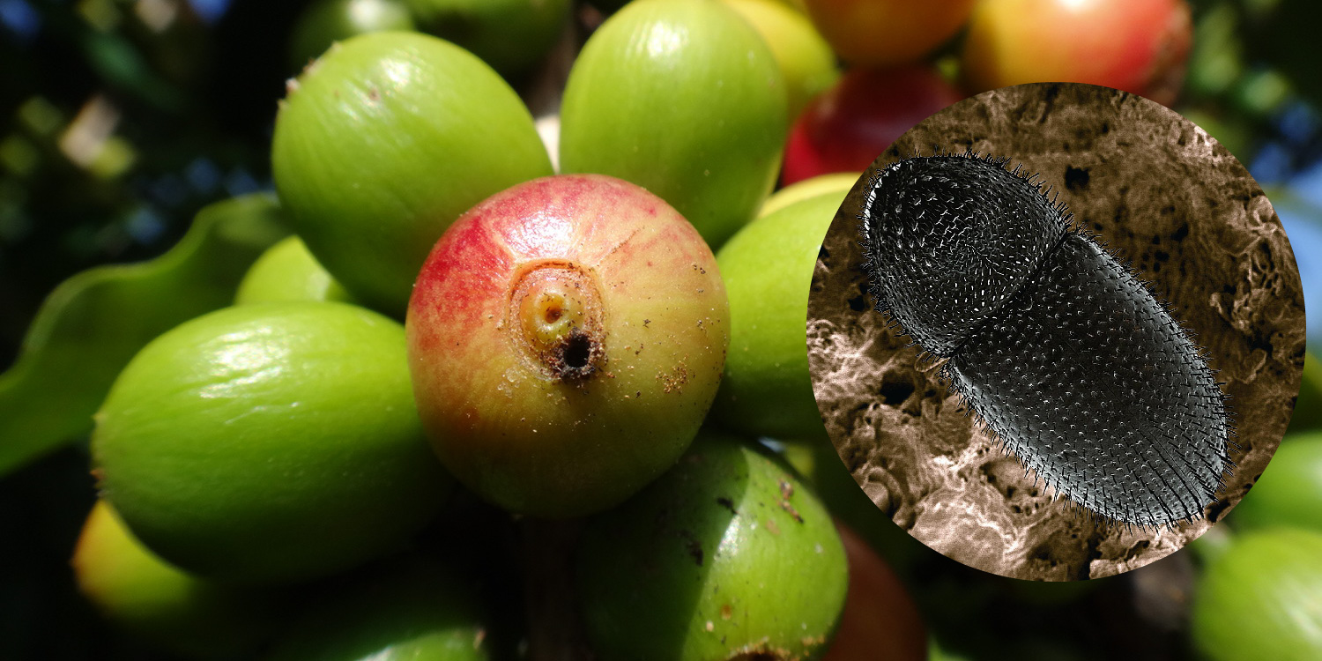
Beverage Defects
Musty/earthy: fungal growth ➔ processing
Potato: bacteria after Antestia bug damage ➔ crop management
Green/Vegetal: immature beans ➔ processing and roasting
Rough: immature beans ➔ processing and roasting
Chemical: chemical composition imbalance (damaged beans) ➔ processing and roasting
Antestia bug in coffee cherry
Coffee Berry Borer

Slide 16
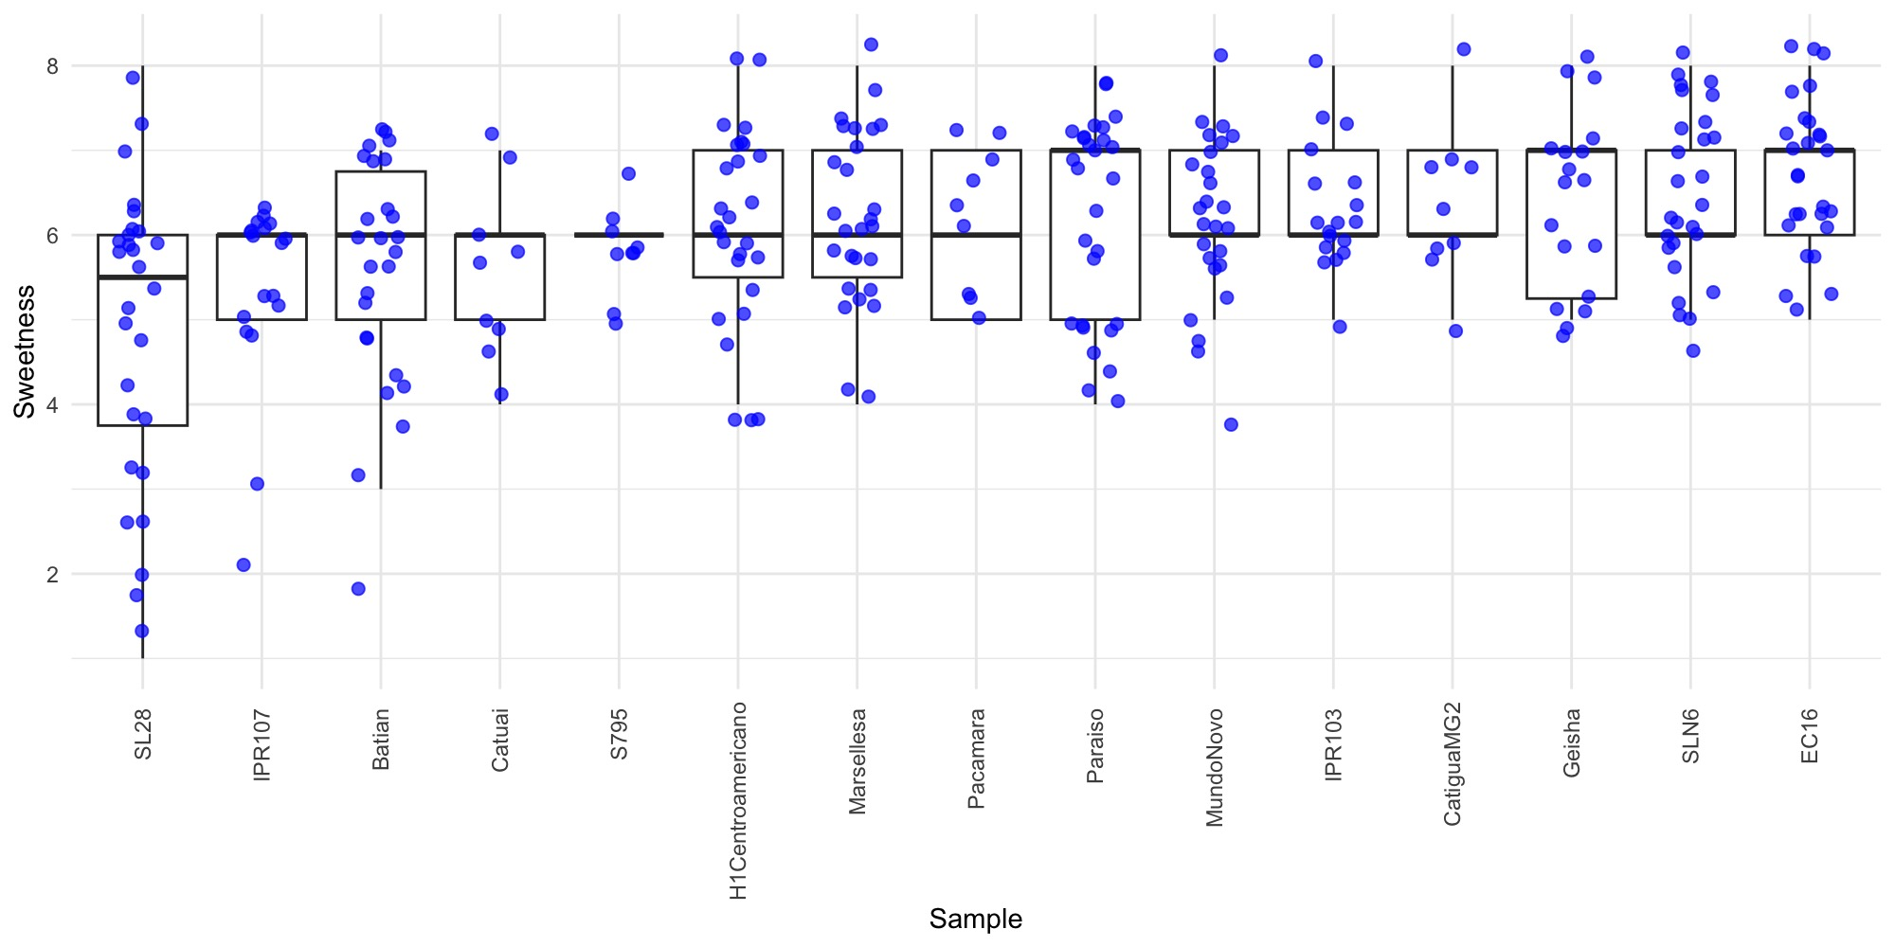
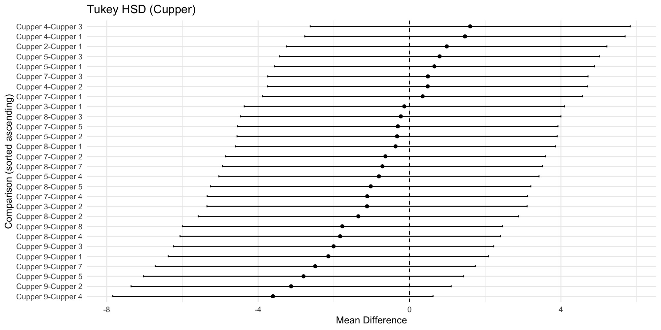
Professional cuppers are highly consistent
Centralized Cupping –
Total Score
Cuppers are not different from each other p>0,05
Scoring the intensity of sweetness
Professional cuppers
Freshly trained to use the CVA
Cupping together at a single location
Pairwise comparison of cuppers’ overall score

Slide 17
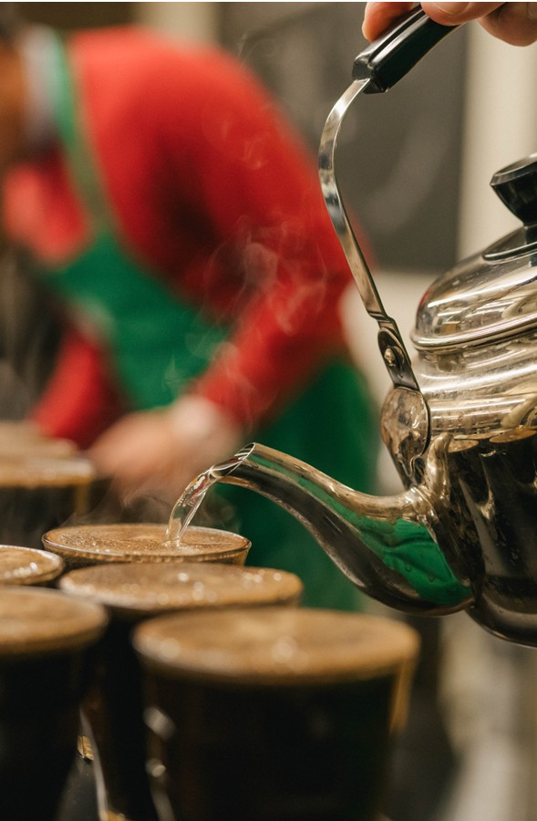
Conclusions
Sample Differences
  Samples are significantly different overall (p < 0.001).
  The Descriptive Assessment described the differences through different attributes.
Cuppers Consistency
  Two-way ANOVA and Pairwise Comparison show no significant differences among cuppers across sites or samples (p > 0.05).
Sample Performance
  The variety SL28 had moldy and potato defects in one site
  Impact of Processing
CVA – descriptive and affective evaluation (reliable tool to discriminate and differentiate samples)
We are developing a high-throughput tool to help access quality

Slide 18
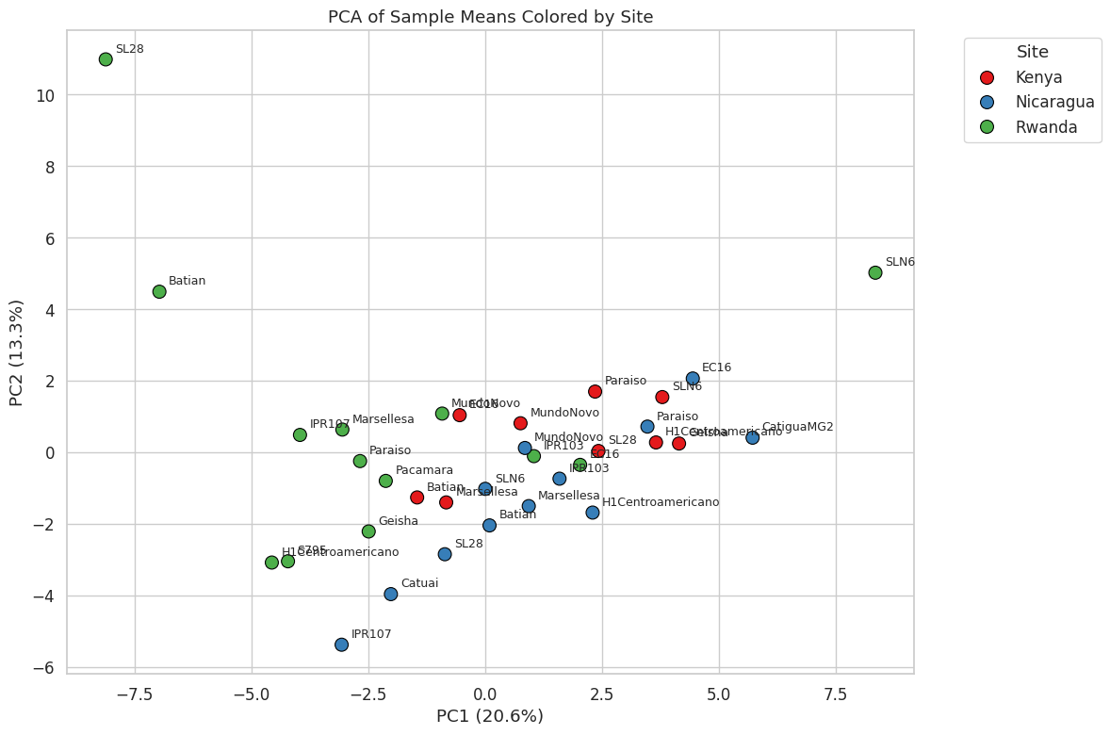
Descriptive
Assessment
Catigua MG2
EC16
Geisha
H1 Centroamericano
IPR103
Mundo Novo
Paraiso
SLN6
Descriptive Assessment
1
2
3
Batian
Catuai
Pacamara
Marsellesa
IPR107
SL28
S795
PC1 splits two groups of samples according to main attributes and total scores.
Lower scores
Higher scores
Main problem: SL28 – tasted moldy and potato.
Most of the samples from one of the sites didn’t perform well in centralized cupping, which raised the question regarding crop management or harvesting, and post-harvesting process.

