Slide 1



Standardizing Post-Harvest Processing for Coffee Quality
Innovea Network Breeders Meeting
Cenicafe, Manizales, Colombia
November 17-21, 2025

Slide 2

Presenter
Veronica Belchior, Ph.D.
Research Scientist – Coffee Quality Evaluation
World Coffee Research

Slide 3
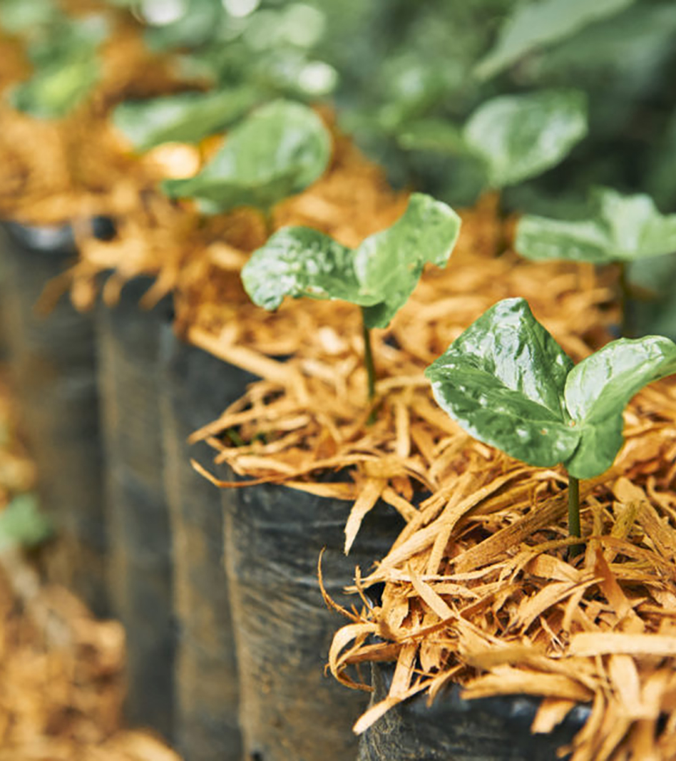

Introduction
Quality is a complex trait to define.
It plays a critical role in determining market value and success.
To ensure that genetic potential is not overlooked, the process must be carefully controlled.
Each genotype requires individual processing to capture its unique quality expression.
Focus on cup quality

Slide 4
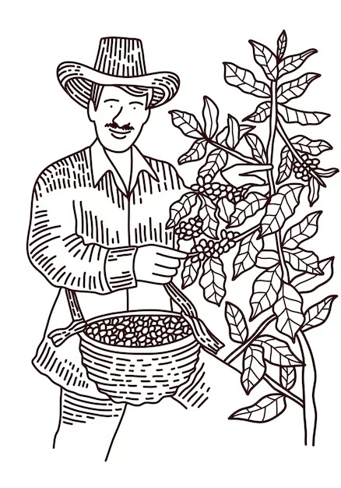
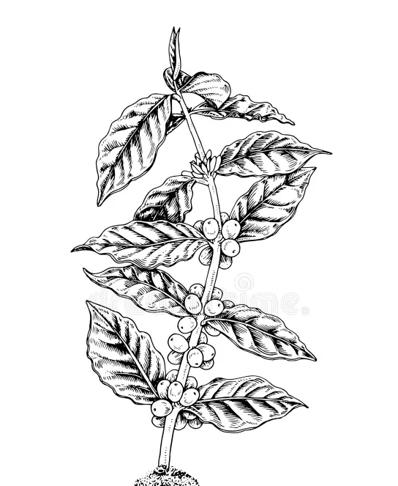
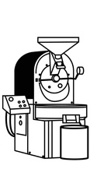
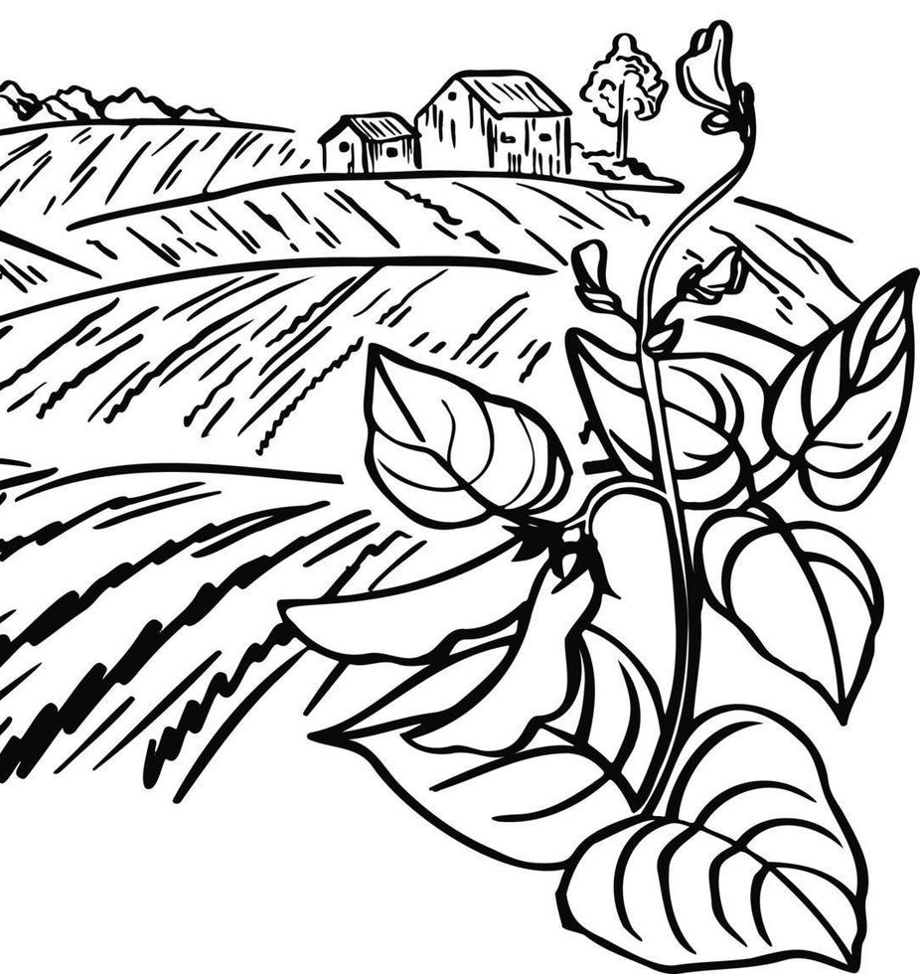

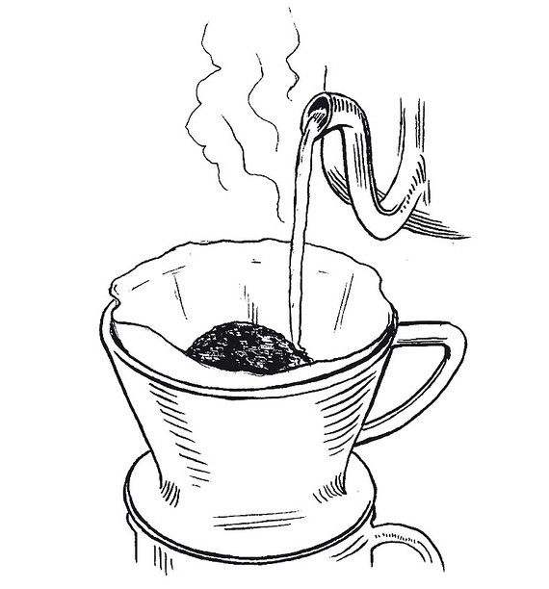
Factors influencing cup quality
Plant genetics
Growing conditions
Harvesting and post-harvest processing
Roasting
Blending
Brewing

Slide 5
Materials necessary
Field form
Plastic vessels or buckets
Electronic scale
Labels/tags
Plastic bags
Depulping machine
African beds
Cloth or plastic sheeting
pH meter
Thermometer
Manual or electric huller
Trays to dry samples
Hermetic bags to store the samples

Slide 6
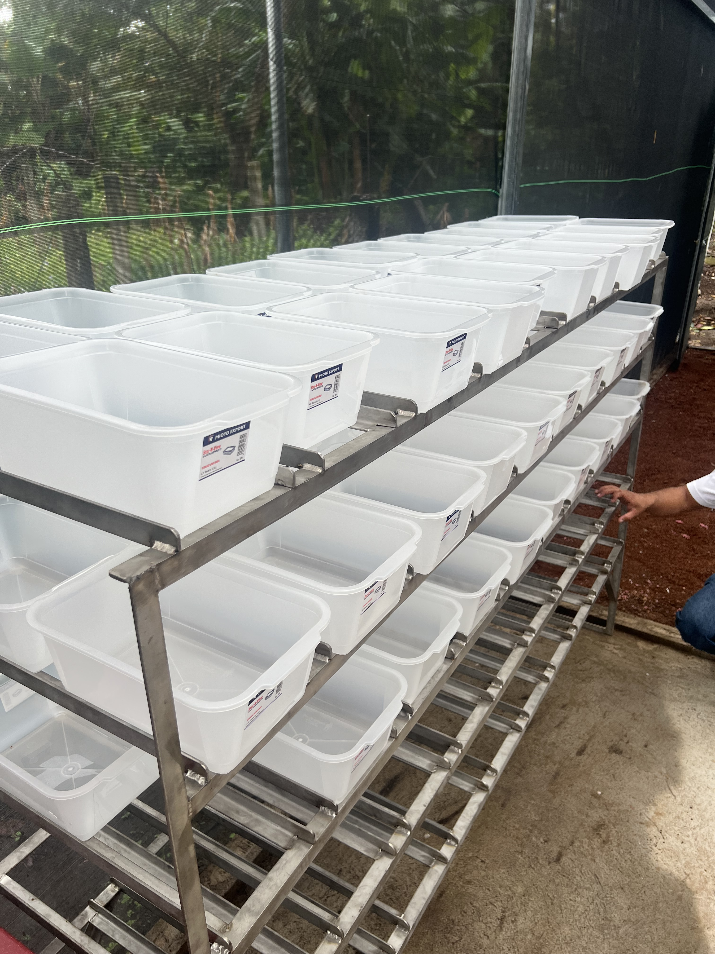
Materials necessary
Field form
Plastic vessels or buckets
Electronic scale
Labels/tags
Plastic bags
Depulping machine
African beds
Cloth or plastic sheeting
pH meter
Thermometer
Manual or electric huller
Trays to dry samples
Hermetic bags to store the samples

Slide 7
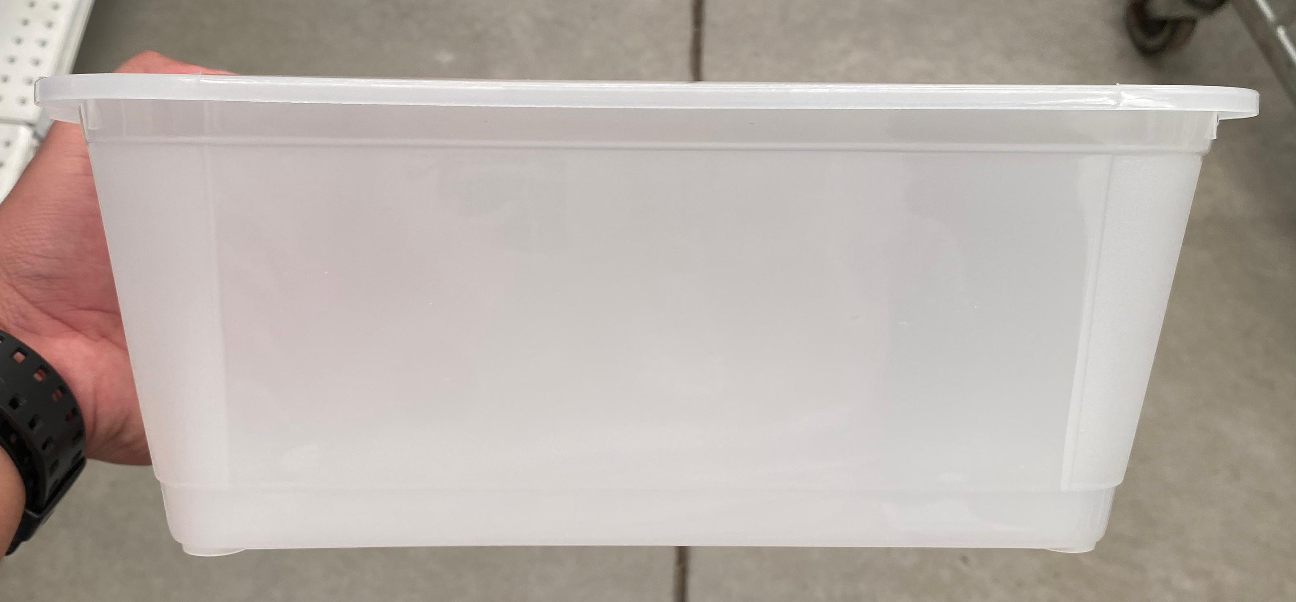
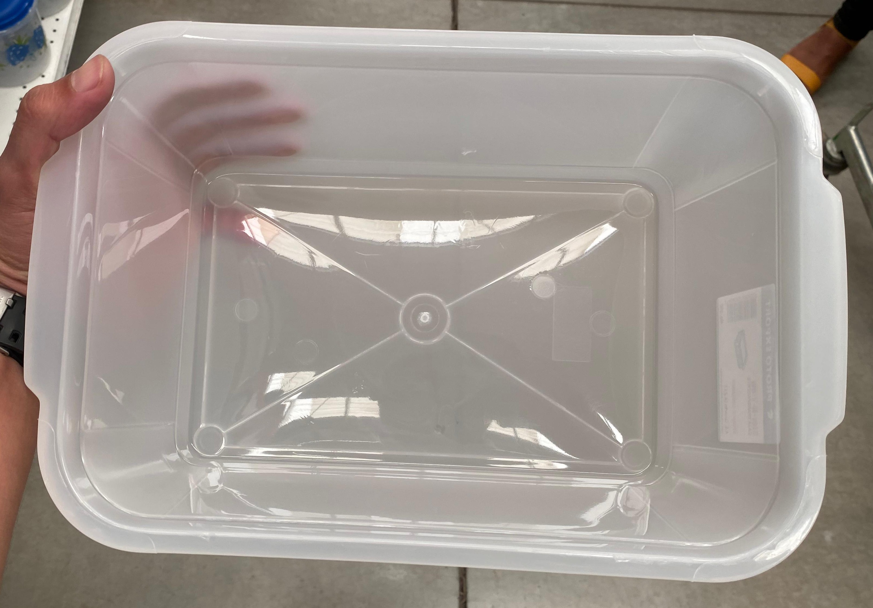
Materials necessary
Field form
Plastic vessels or buckets
Electronic scale
Labels/tags
Plastic bags
Depulping machine
African beds
Cloth or plastic sheeting
pH meter
Thermometer
Manual or electric huller
Trays to dry samples
Hermetic bags to store the samples
Volume: ~ 4 L
Number of vessels according to your daily capacity

Slide 8
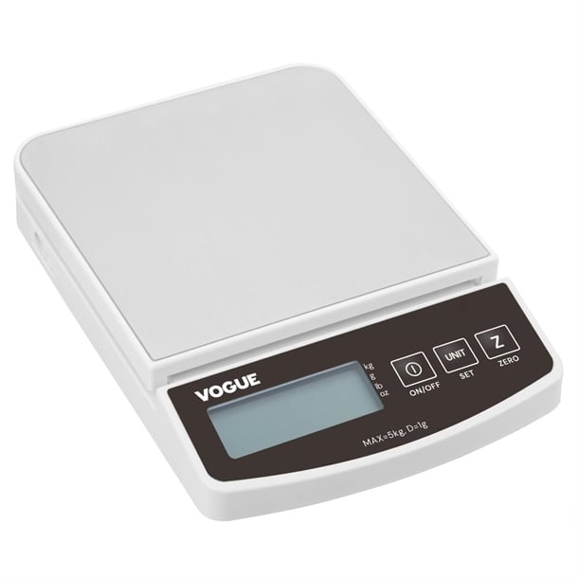
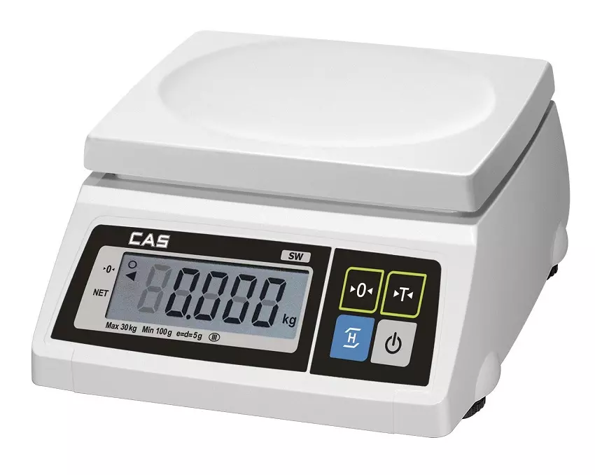
Materials necessary
Field form
Plastic vessels or buckets
Electronic scale
Labels/tags
Plastic bags
Depulping machine
African beds
Cloth or plastic sheeting
pH meter
Thermometer
Manual or electric huller
Trays to dry samples
Hermetic bags to store the samples
5 Kg

Slide 9
Materials necessary
Field form
Plastic vessels or buckets
Electronic scale
Labels/tags
Plastic bags
Depulping machine
African beds
Cloth or plastic sheeting
pH meter
Thermometer
Manual or electric huller
Trays to dry samples
Hermetic bags to store the samples
Plastic tags to add inside the fermentation vessels
Note:
- Sample
- Date
- Total time of fermentation
- pH of the coffee mass at the end of fermentation

Slide 10

Materials necessary
Field form
Plastic vessels or buckets
Electronic scale
Labels/tags
Plastic bags
Depulping machine
African beds
Cloth or plastic sheeting
pH meter
Thermometer
Manual or electric huller
Trays to dry samples
Hermetic bags to store the samples
To harvest the samples. The same number of samples.

Slide 11
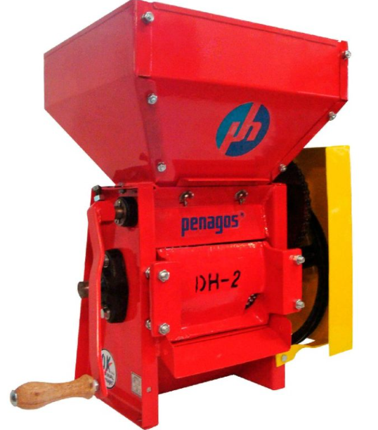
Materials necessary
Field form
Plastic vessels or buckets
Electronic scale
Labels/tags
Plastic bags
Depulping machine
African beds
Cloth or plastic sheeting
pH meter
Thermometer
Manual or electric huller
Trays to dry samples
Hermetic bags to store the samples
Sample capacity

Slide 12
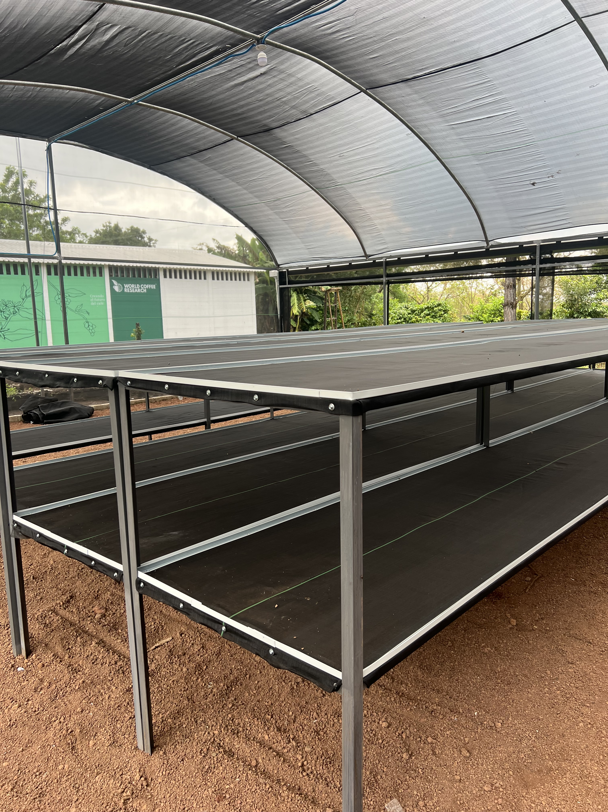
Materials necessary
Field form
Plastic vessels or buckets
Electronic scale
Labels/tags
Plastic bags
Depulping machine
African beds
Cloth or plastic sheeting
pH meter
Thermometer
Manual or electric huller
Trays to dry samples
Hermetic bags to store the samples

Slide 13
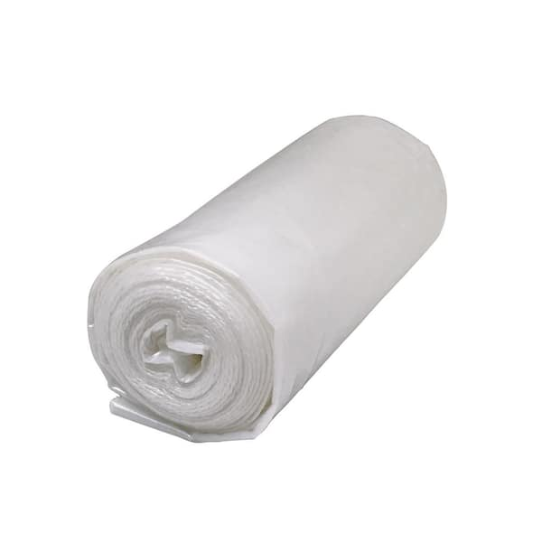
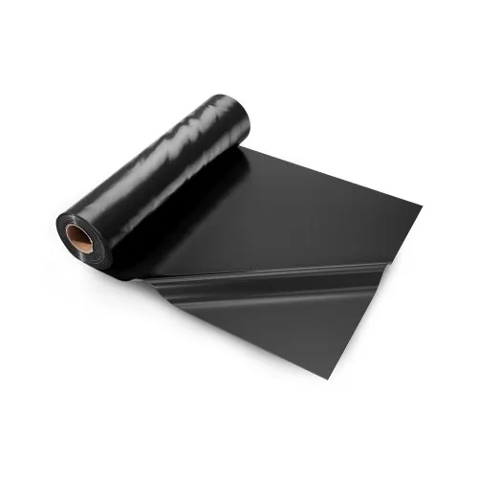
Materials necessary
Field form
Plastic vessels or buckets
Electronic scale
Labels/tags
Plastic bags
Depulping machine
African beds
Cloth or plastic sheeting
pH meter
Thermometer
Manual or electric huller
Trays to dry samples
Hermetic bags to store the samples
To cover the samples during fermentation and drying

Slide 14
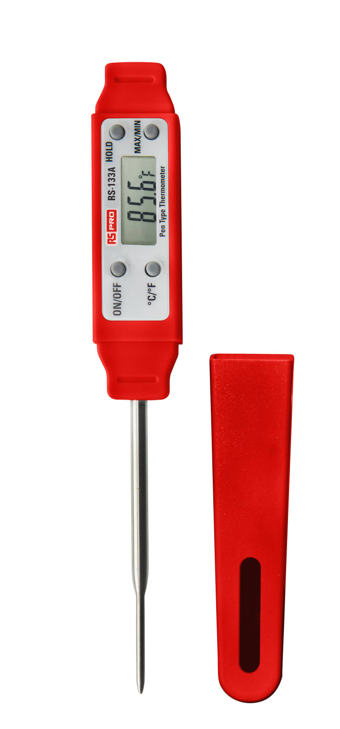
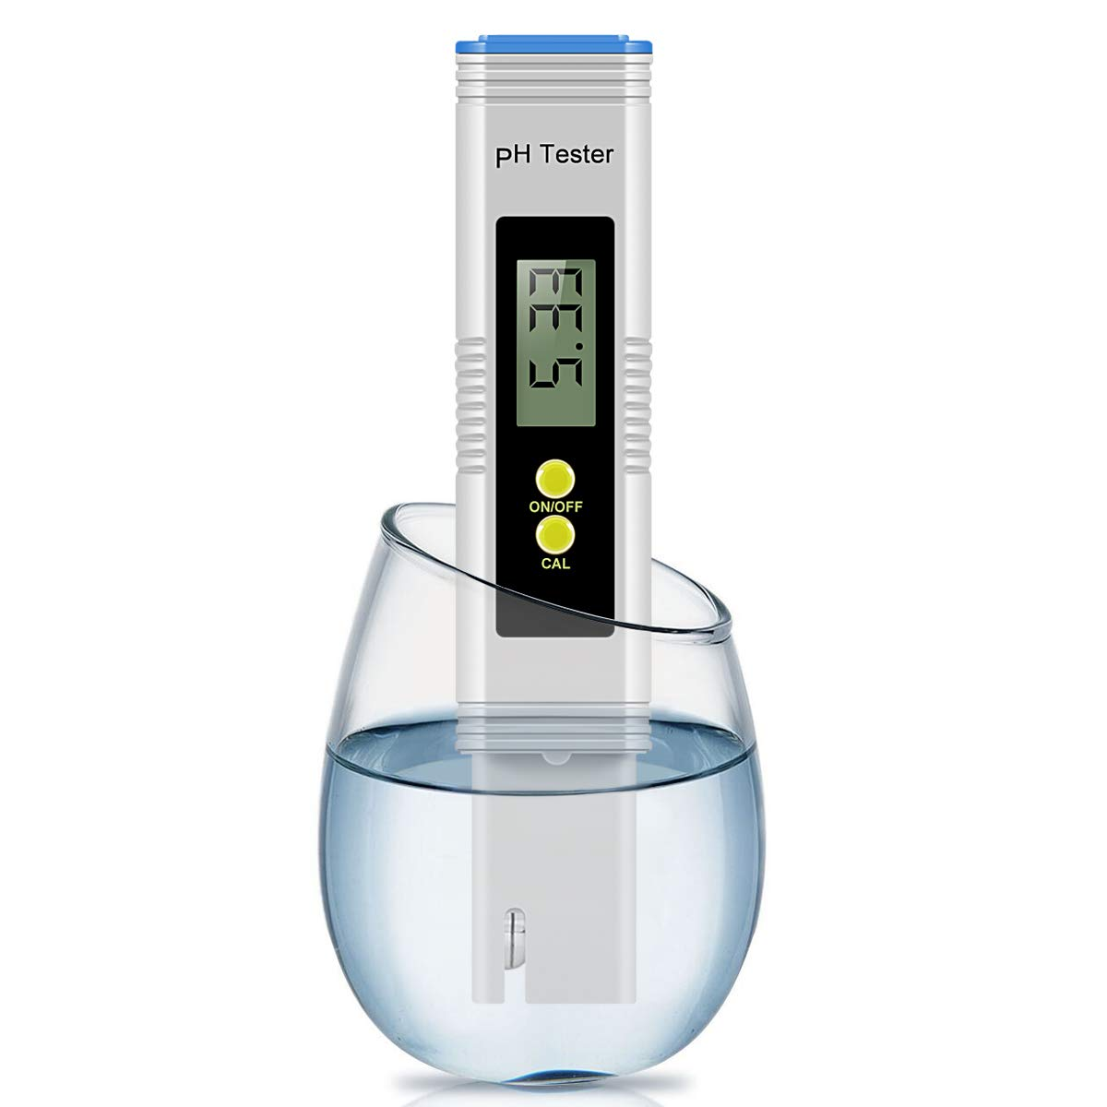
Materials necessary
Field form
Plastic vessels or buckets
Electronic scale
Labels/tags
Plastic bags
Depulping machine
African beds
Cloth or plastic sheeting
pH meter
Thermometer
Manual or electric huller
Trays to dry samples
Hermetic bags to store the samples
Parameters for fermentation

Slide 15
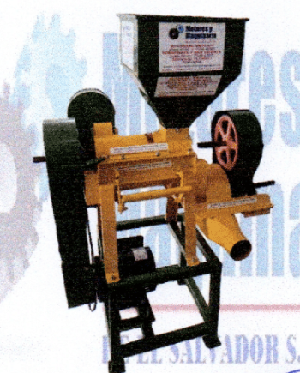

Materials necessary
Field form
Plastic vessels or buckets
Electronic scale
Labels/tags
Plastic bags
Depulping machine
African beds
Cloth or plastic sheeting
pH meter
Thermometer
Manual or electric huller
Trays to dry samples
Hermetic bags to store the samples
Sample capacity

Slide 16
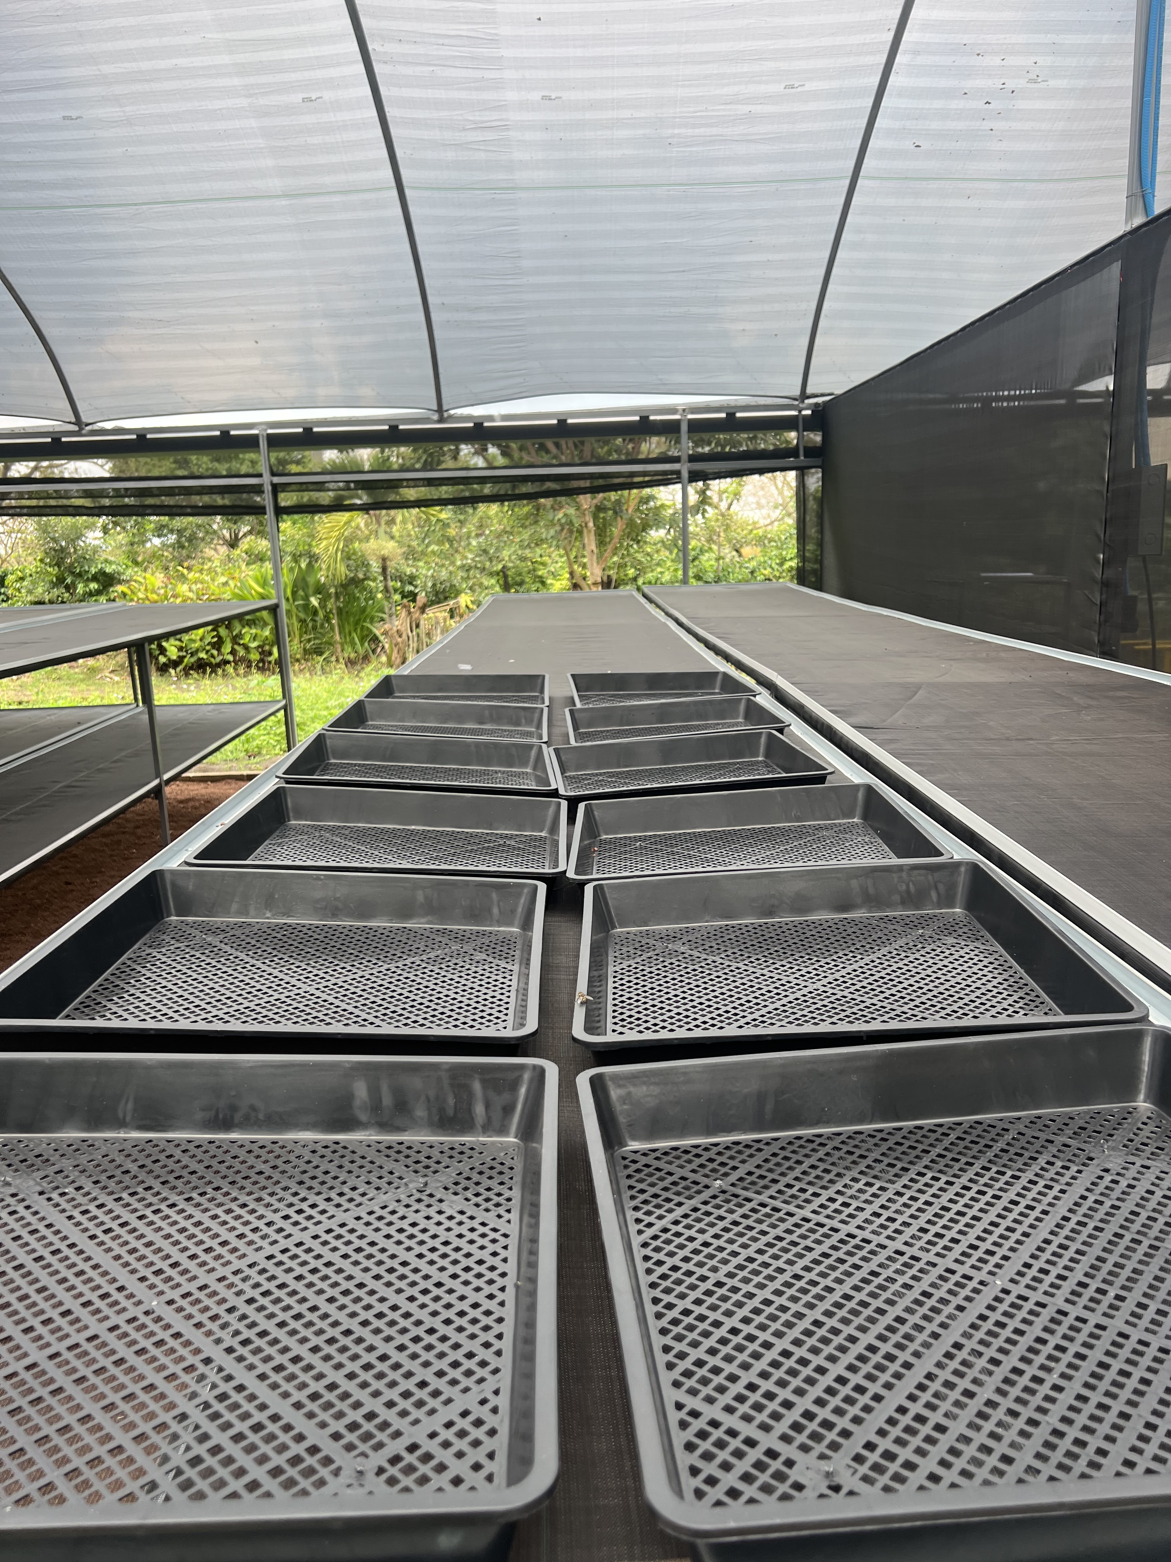
Materials necessary
Field form
Plastic vessels or buckets
Electronic scale
Labels/tags
Plastic bags
Depulping machine
African beds
Cloth or plastic sheeting
pH meter
Thermometer
Manual or electric huller
Trays to dry samples
Hermetic bags to store the samples

Slide 17
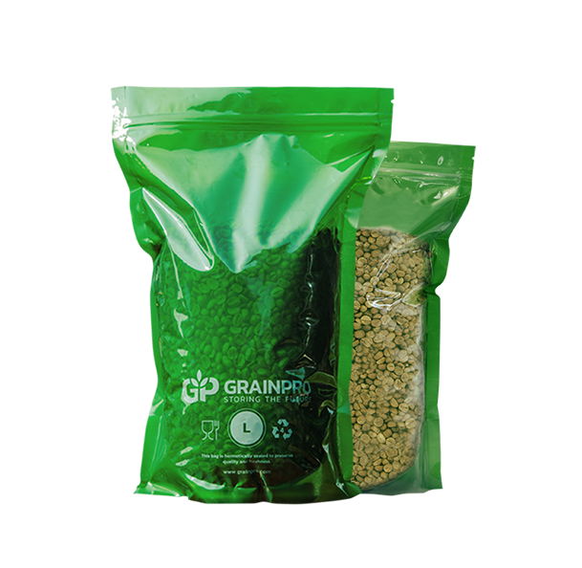
Materials necessary
Field form
Plastic vessels or buckets
Electronic scale
Labels/tags
Plastic bags
Depulping machine
African beds
Cloth or plastic sheeting
pH meter
Thermometer
Manual or electric huller
Trays to dry samples
Hermetic bags to store the samples
No need to be GrainPro

Slide 18
Harvest and Post-harvest
All processing equipment must be cleaned up before/after use
Inspect to remove residual beans after each batch
Harvest starts when >80% of cherries are ripe.
Focus on cup quality

Slide 19
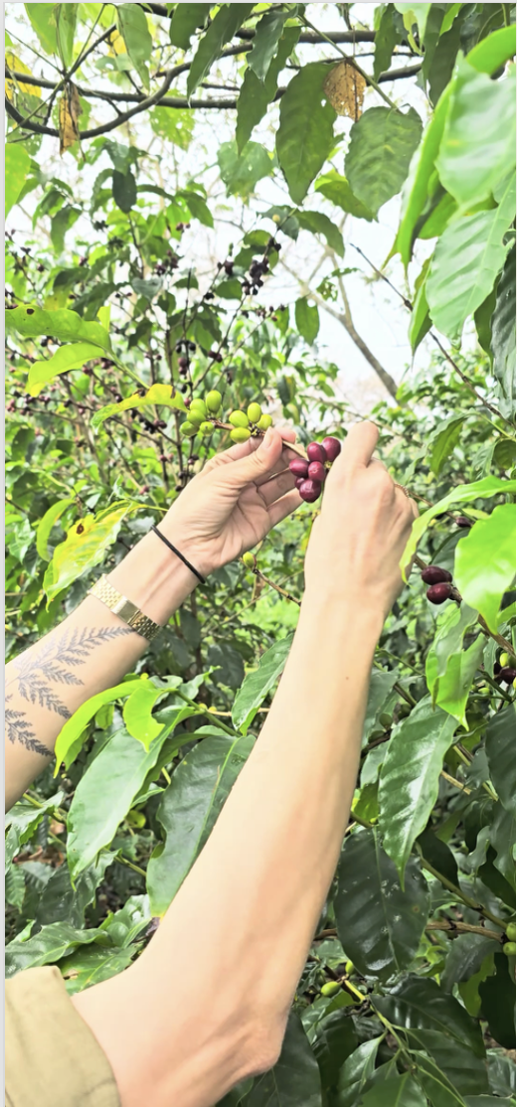
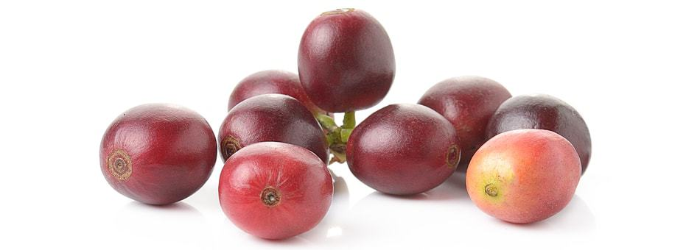
Harvest and Post-harvest for coffee quality
1- Harvest
We collect cherries from the whole plant
1.1- Pick only ripe cherries.
Cherries should be hand-harvested and kept in plastic bags.
RIPE
UNRIPE

Slide 20
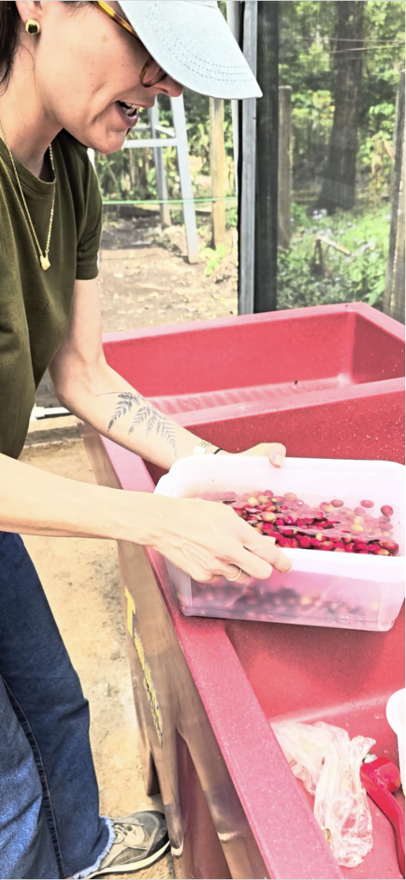
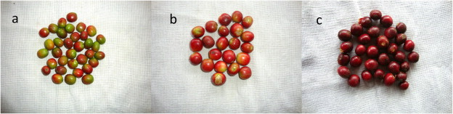
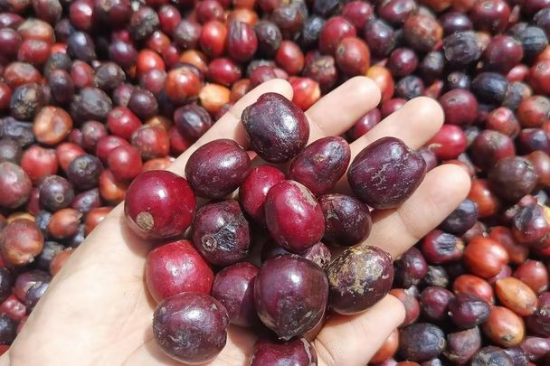
Select the unripe and overripe cherries and put them aside.
Image: a-b: unripe; c: overripe
1.2- Soak the cherries in fresh water (VIDEO)
- Remove and discard any cherries that float.
- Only healthy, disease-free cherries should be retained.

Slide 21
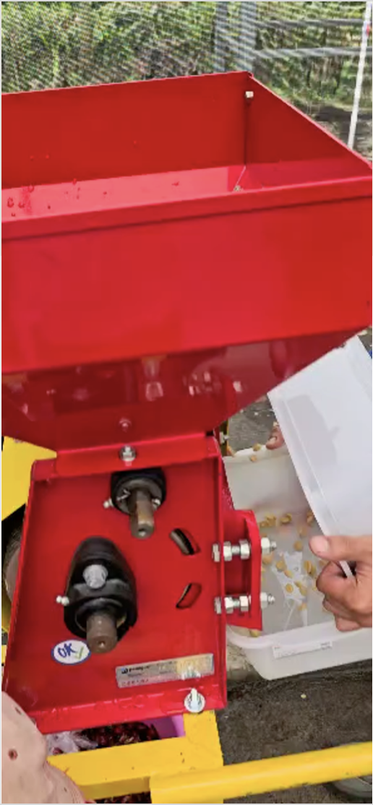
2- Depulping
Begin pulping in the afternoon
Estimated time: 10 minutes per genotype
Should begin within 4 hours of harvesting
Ensure the depulper is calibrated to the fruit size of each genotype.
Feed the red, ripe cherries into the machine (VIDEO).
Note: Fresh and clean water is recommended.
Collect the wet parchment in a clean plastic vessel.
Remove the water and weigh (Kg) the wet parchment.

Slide 22
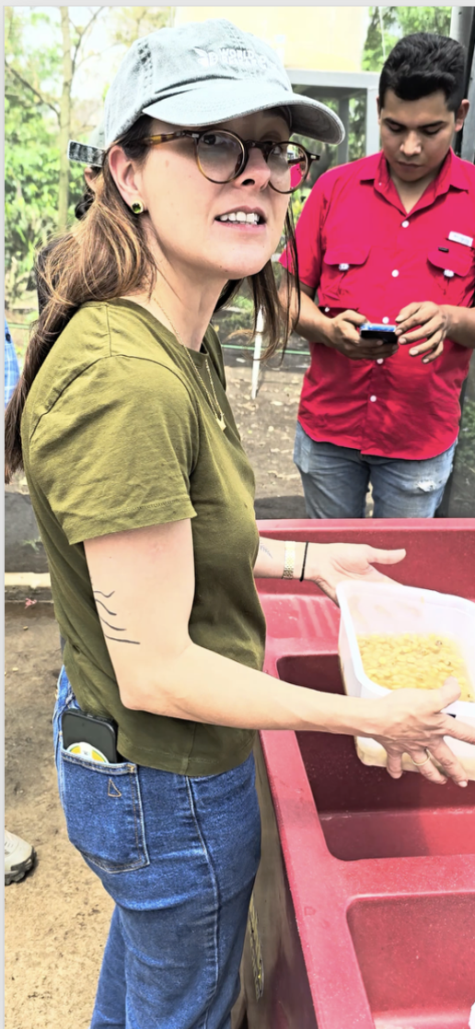
3- Fermentation
The wet parchment will be soaked in clean water to remove the mucilage
Estimated time: 10-18 hours
Estimated time might differ across varieties
Use the clean vessel to place the wet parchment.
Add 30% of clean water.
Record the initial temperature and pH of the coffee mass.
Tag: date, start time of fermentation, pH.
Cover the vessel with a cloth sheeting (avoid insects).

Slide 23
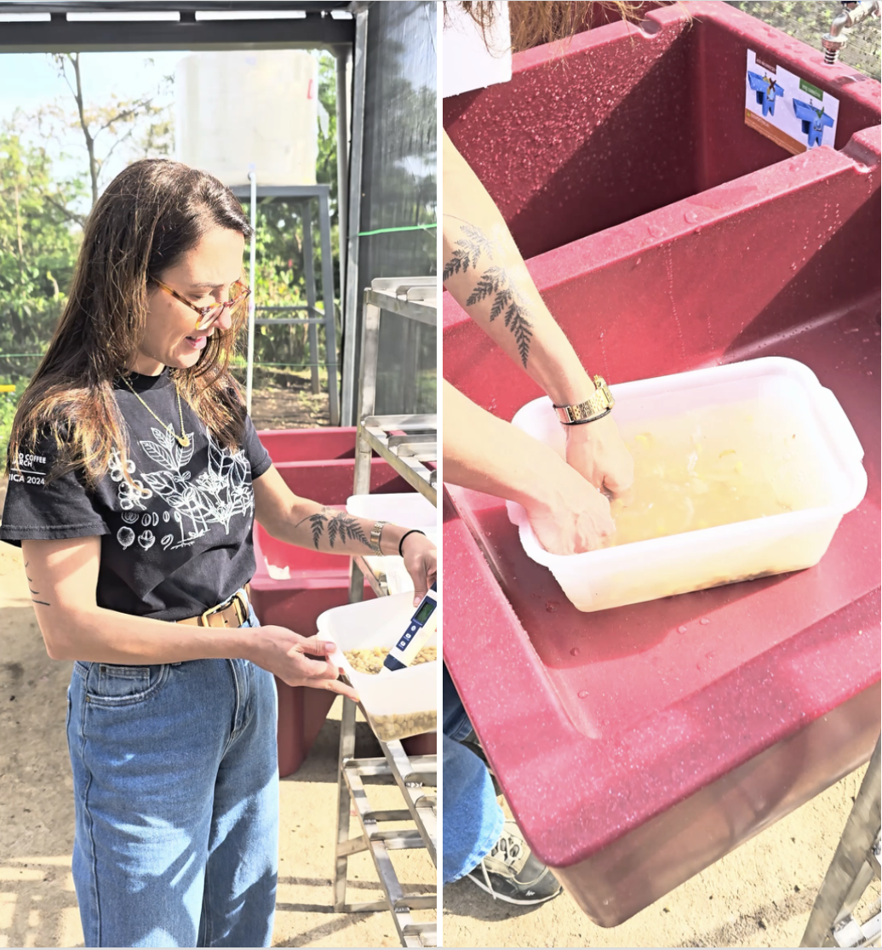
Fermentation
Fermentation is complete when pH drops to between 3.9 and 4.2.
The beans lose their slippery texture and produce a scratchy sensation when rubbed.
Washing
At the scratchy point, wash the beans thoroughly.
Change the water several times until the mucilage is removed.
Drain the water and transfer the parchment to the drying area.

Slide 24
4- Parchment drying
Estimated time: up to 2 weeks
Controlled, gradual, and uniform manner
Avoid temperature higher than 40ºC
Beans with high moisture are susceptible to fungal growth
First day
Day 1: Move each sample 16 times throughout the day
Day 2: Move the samples every hour. Check moisture.
Day 3: Move the samples every hour. Check moisture.
Day 4 or 5: Overnight folding (layer 4 cm). Check moisture.
One layer of 0,7 to 1 cm
Parchment
1 cm
Dash line = tray
Shade = parchment layer

Slide 25
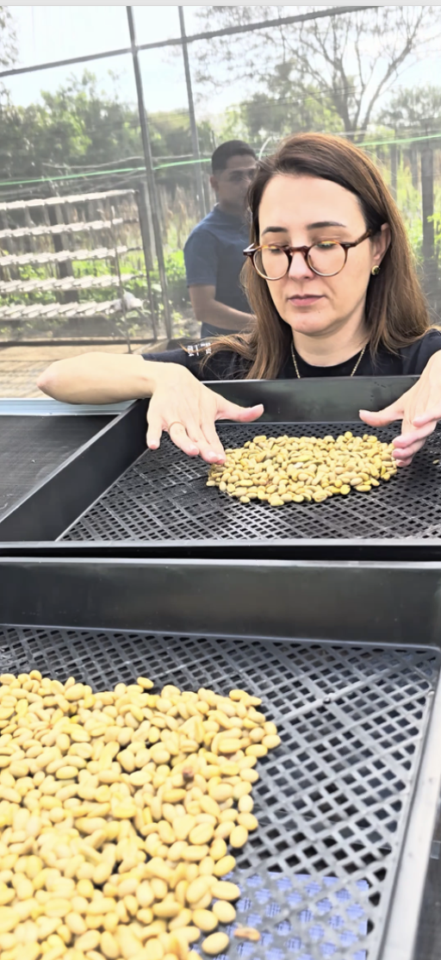
Folding system for wet parchment
First day
25% moisture
One layer of 0,7 to 1 cm
~ 5th day
4 cm
Parchment
1 cm
Parchment
Dash line = tray
Shade = parchment layer
Once the beans reach 25% moisture, begin afternoon raking (after 5:00 PM) and cover (optional) the samples overnight. Next morning: uncover the beans and repeat the layer.
Repeat it until the beans reach 10 - 12% moisture

Slide 26
5- Parchment storage
The storage environment should be clean, well-ventilated, leak-proof, and free of pests
Optimal storage condition: humidity of 65% and temperature below 20ºC
Store the parchment in hermetic bags.
Do not store fertilizers, fuels, oils, or other volatile substances in the same facility.
Keep coffee out of direct sunlight and water.
Resting period: ~2 months

Slide 27
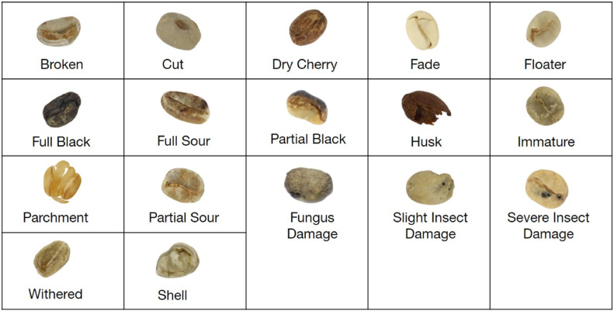
6- Hulling and sorting
Mechanical hulling.
Separate floaters.
Discard the beans:
  Partially pulped
  Diseased
  Physically damaged
  Complete: SCA

Slide 28
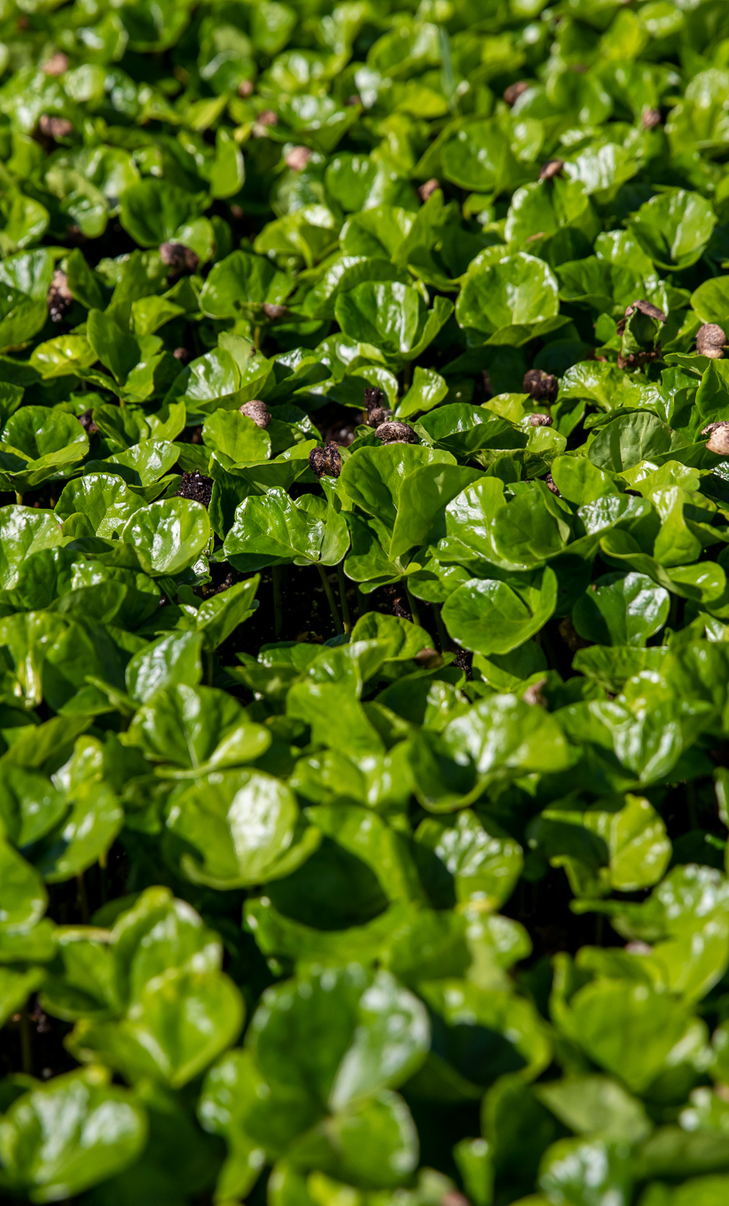
Final remarks
Cup quality begins with rigorous control at every step of the post-harvest process.
Standardized methods ensure that quality differences reflect true genetic potential rather than environmental or processing variability.
Consistent data collection—temperature, pH, time, and moisture—allows meaningful comparisons across genotypes and sites.
Our collaboration is key to achieving reliable, reproducible, and scalable quality assessments for the success of Innovea.

Slide 29
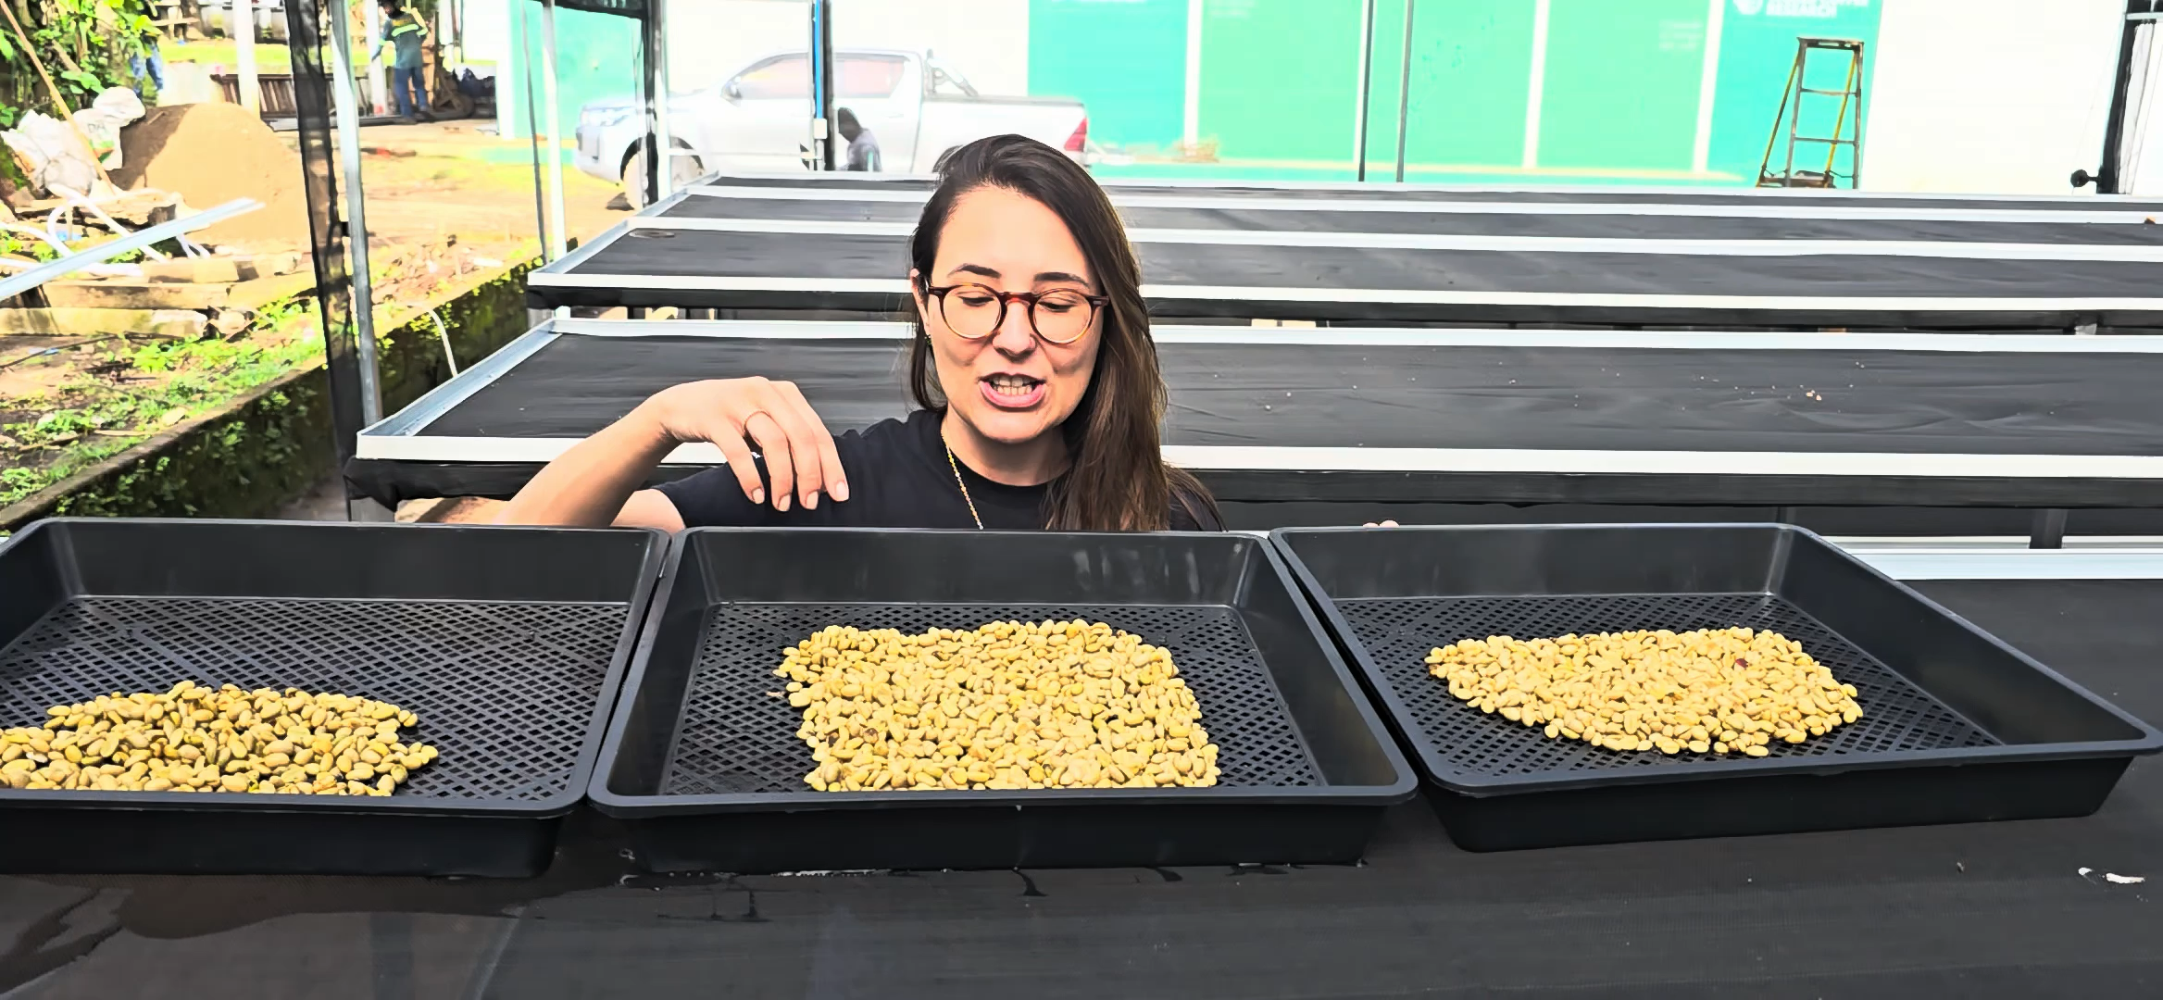
Folding system for wet parchment
First day
25% moisture
Second fold
Third fold
One layer of 0,7 to 1 cm
~ 5th day
2nd or 3rd day
4th or 5th day
4 cm
4 cm
5 cm
5 cm
Parchment
1 cm
2 cm
3 cm
Dash line = tray
Green shade = parchment layer
Once the beans reach 25% moisture, begin afternoon raking (after 3:00 PM) and cover the samples overnight. Next morning: uncover the beans and repeat the layers.
Repeat it until the beans reach 10 - 12% moisture

