Slide 1
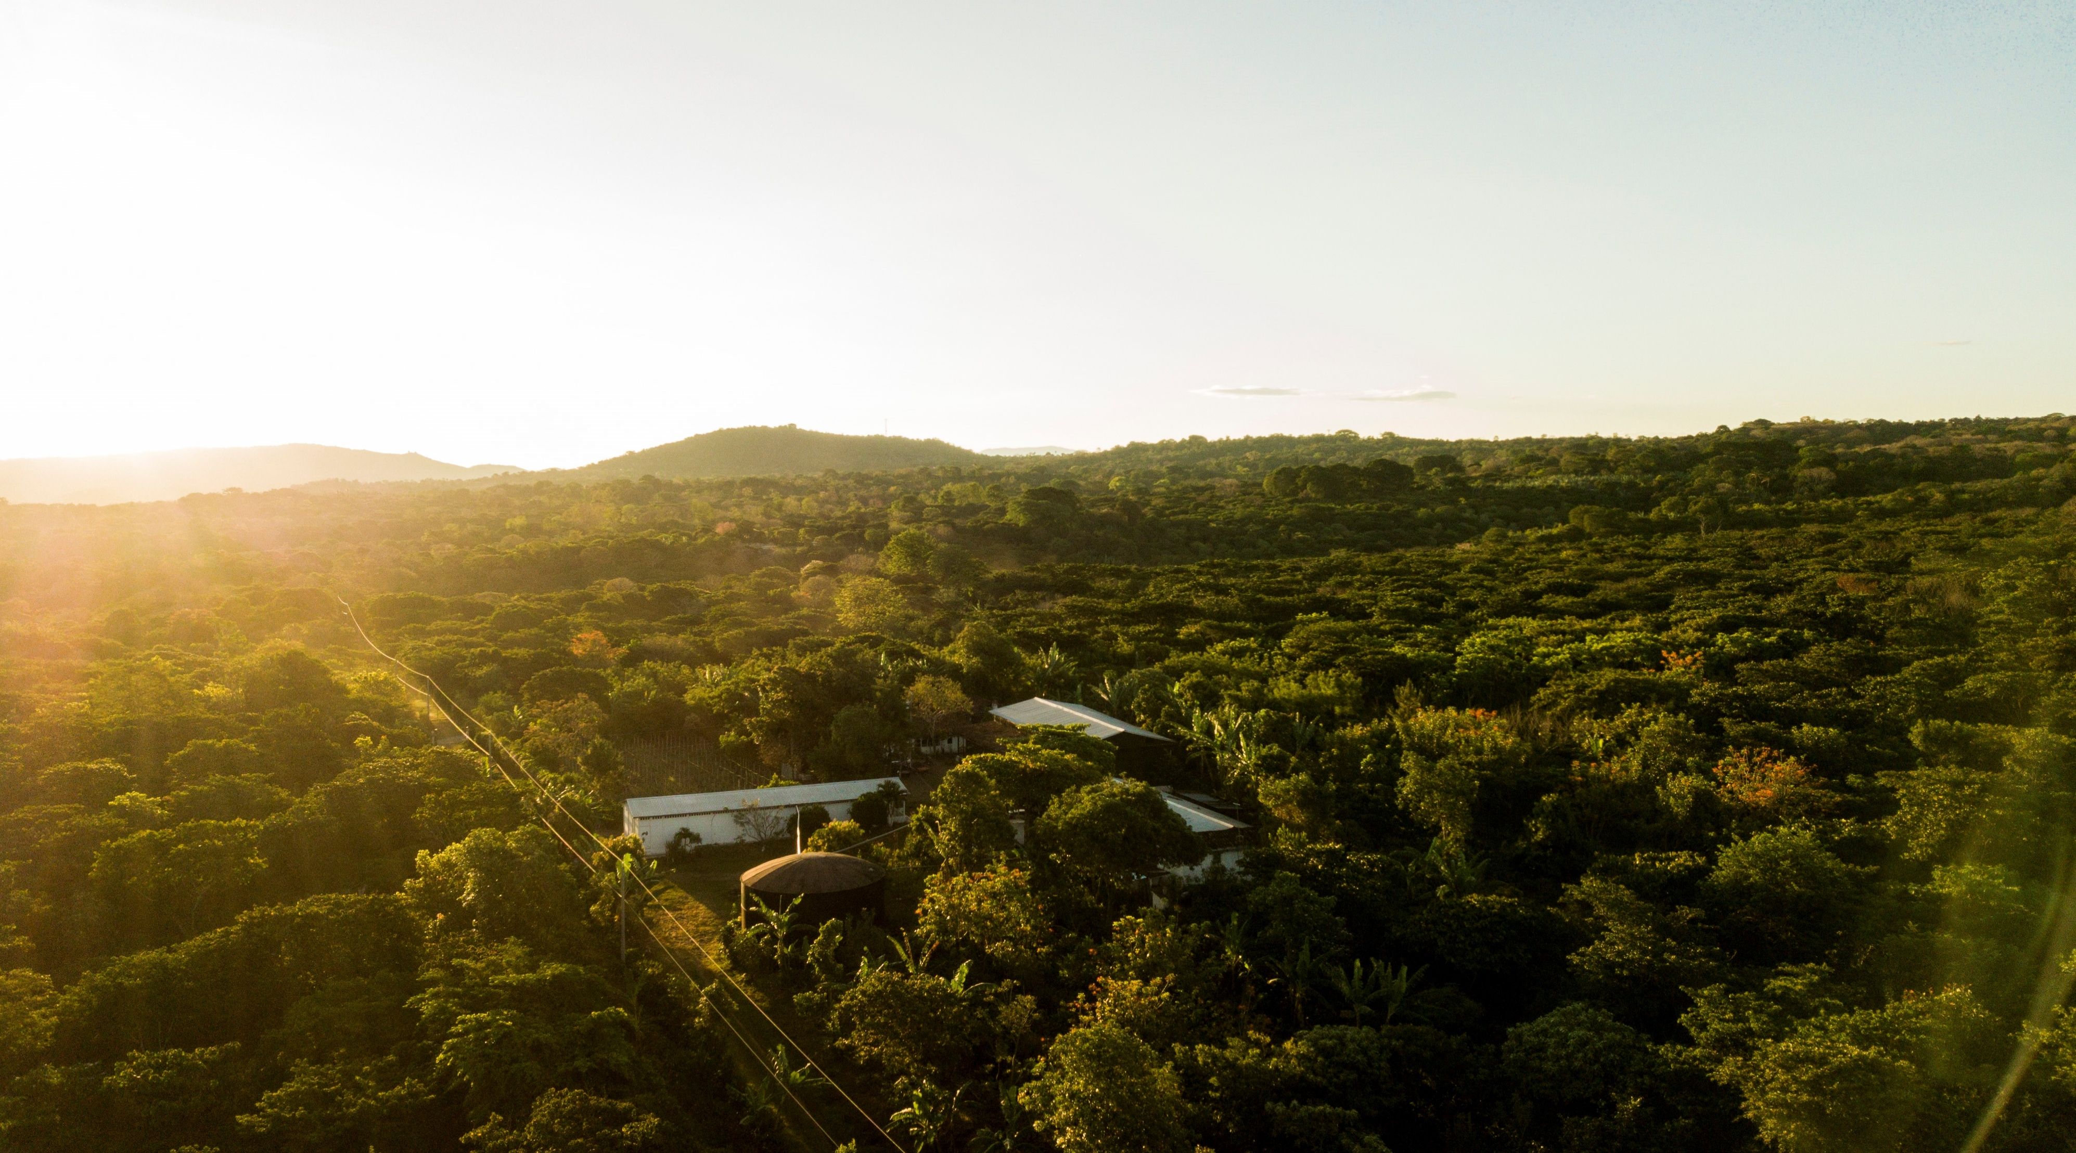



Marker development – CLR resistance
Innovea Network Breeders Meeting
Cenicafe, Manizales, Colombia
November 17-21, 2025

Slide 2
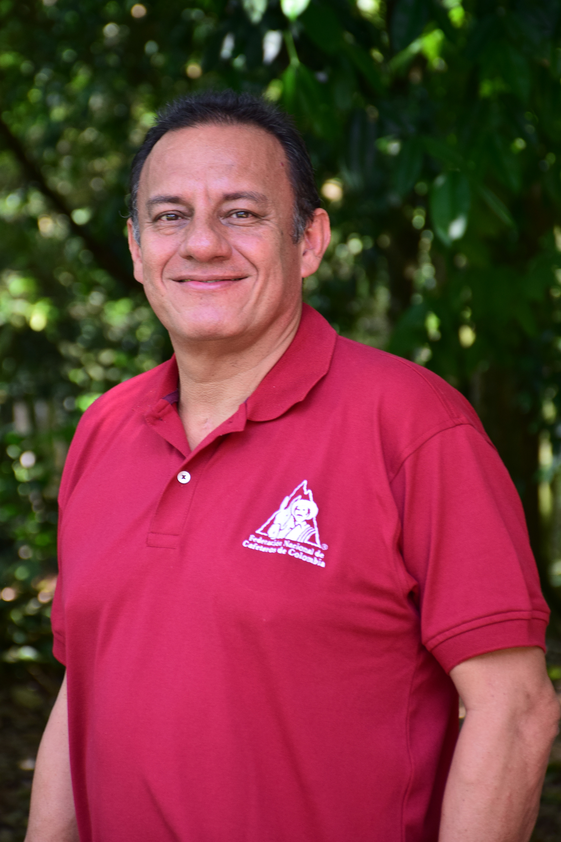
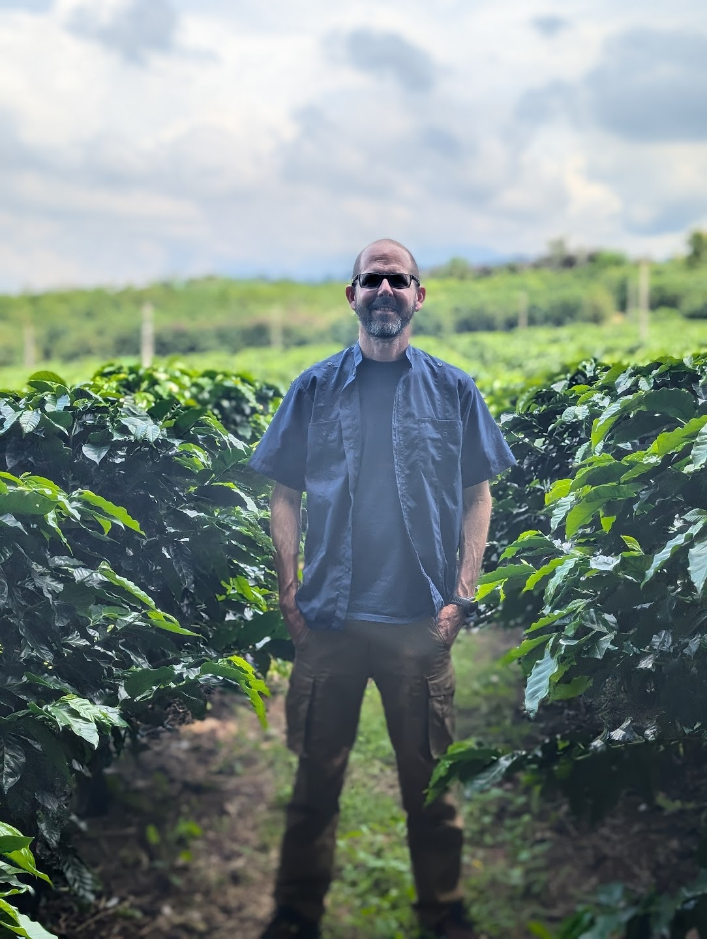
Presenters
Marco Cristancho
Leader Plant Pathology Department
Cenicafe
Jorge Berny
Research Scientist
World Coffee Research

Slide 3
Outline
Coffee Rust Worldwide and Colobmbia status
Tools for breeding
General marker development
Mapping CLR resistance
  Populations
  Isolates
Linkage mapping methods and expected results

Slide 4

Coffee Rust
WORLDWIDE Status

Slide 5
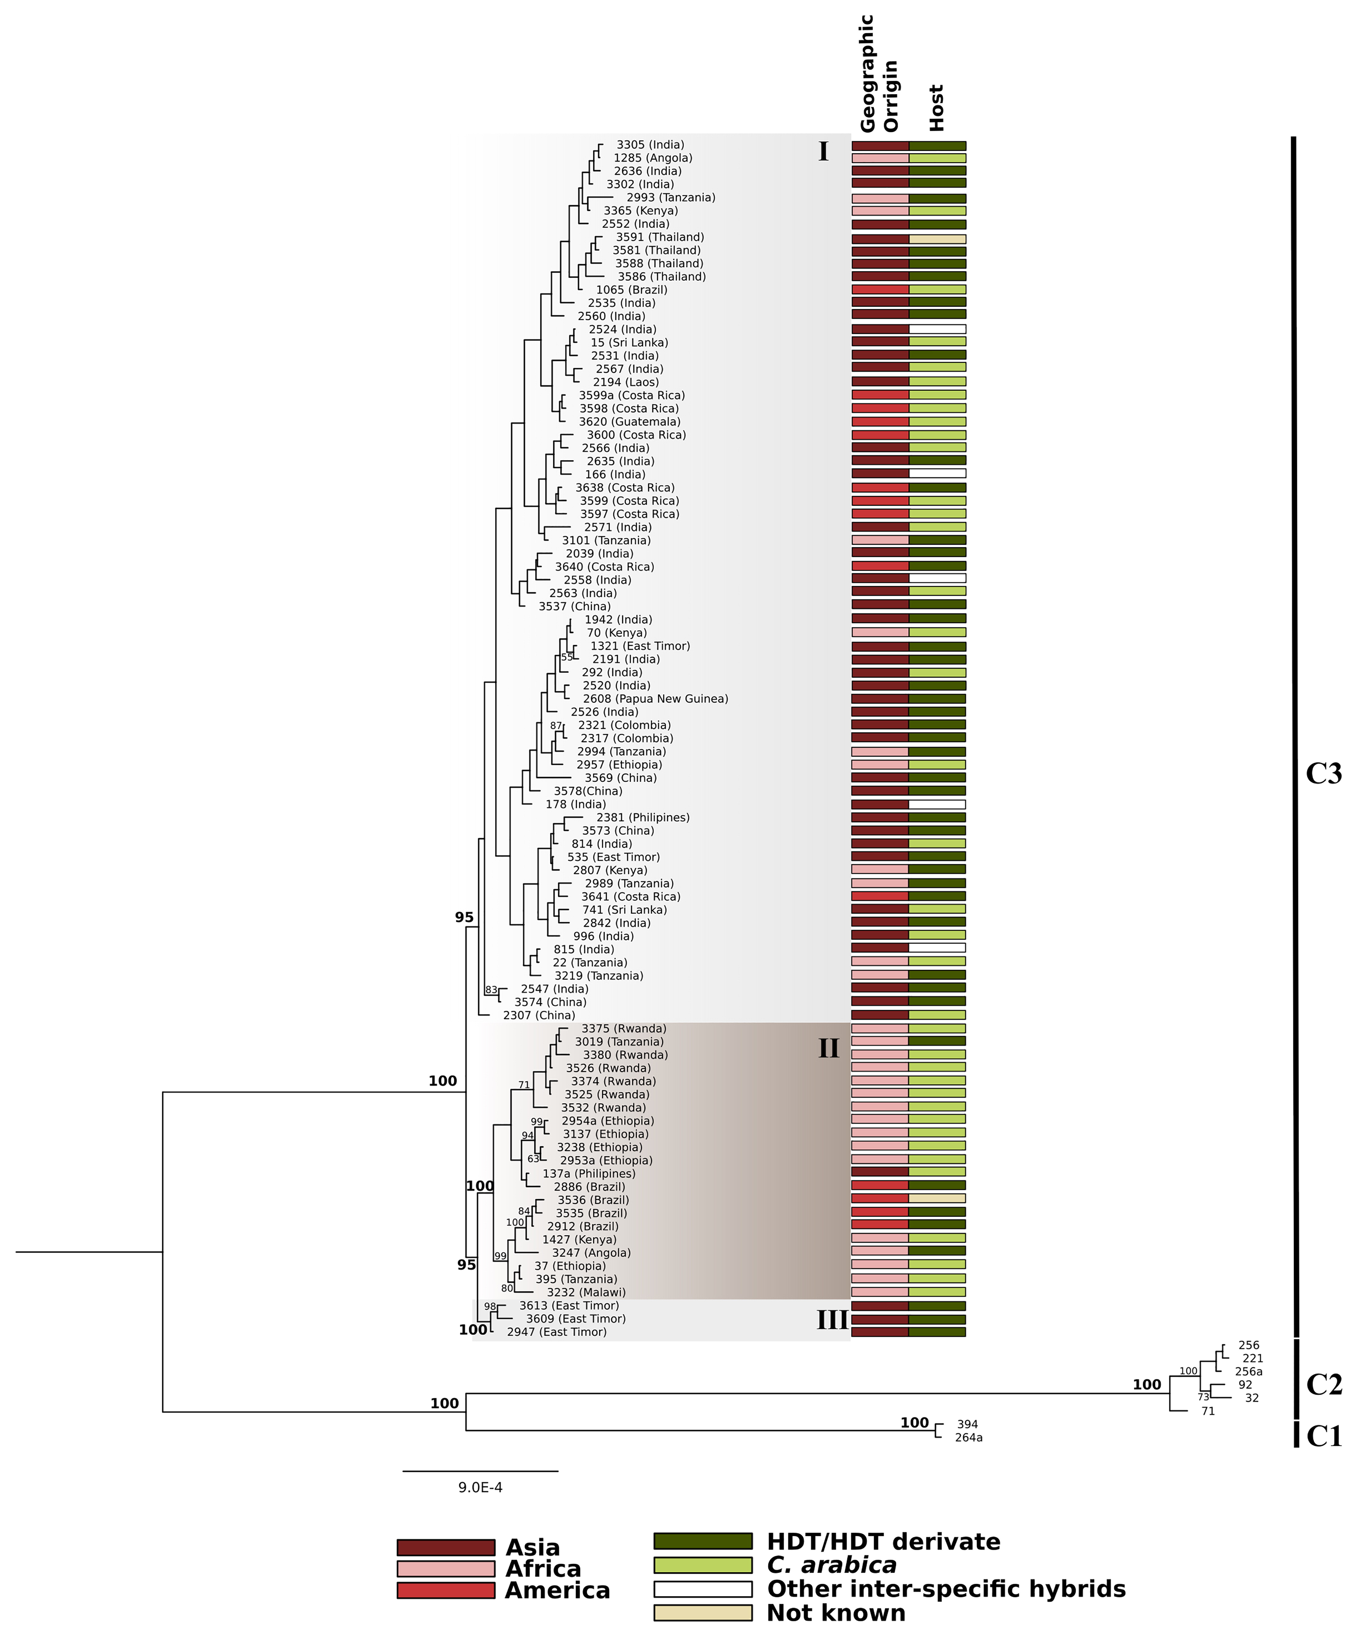
Phylogenetic relationships among 99 isolates of Hemileia vastatrix.
Published in: Ana Sofia B. Rodrigues; Diogo Nuno Silva; Vitor Várzea; Octávio S. Paulo; Dora Batista; Phytopathology® 2022, 112, 1998-2011.
Copyright © 2022 The American Phytopathological Society • DOI: 10.1094/PHYTO-09-21-0376-R

Slide 6
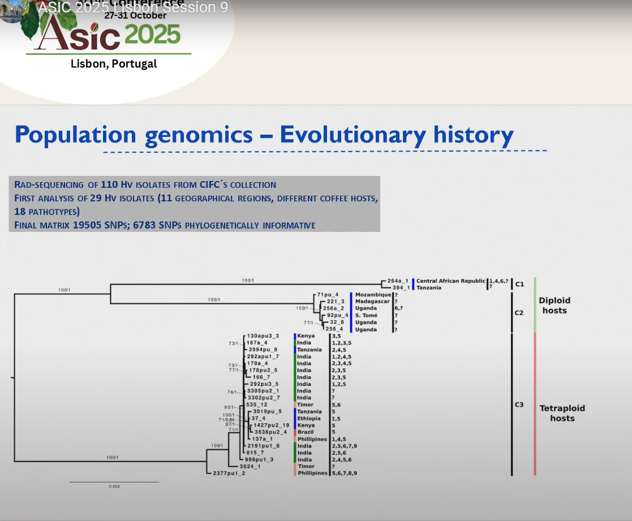
Dora Batista, ASIC 2025

Slide 7
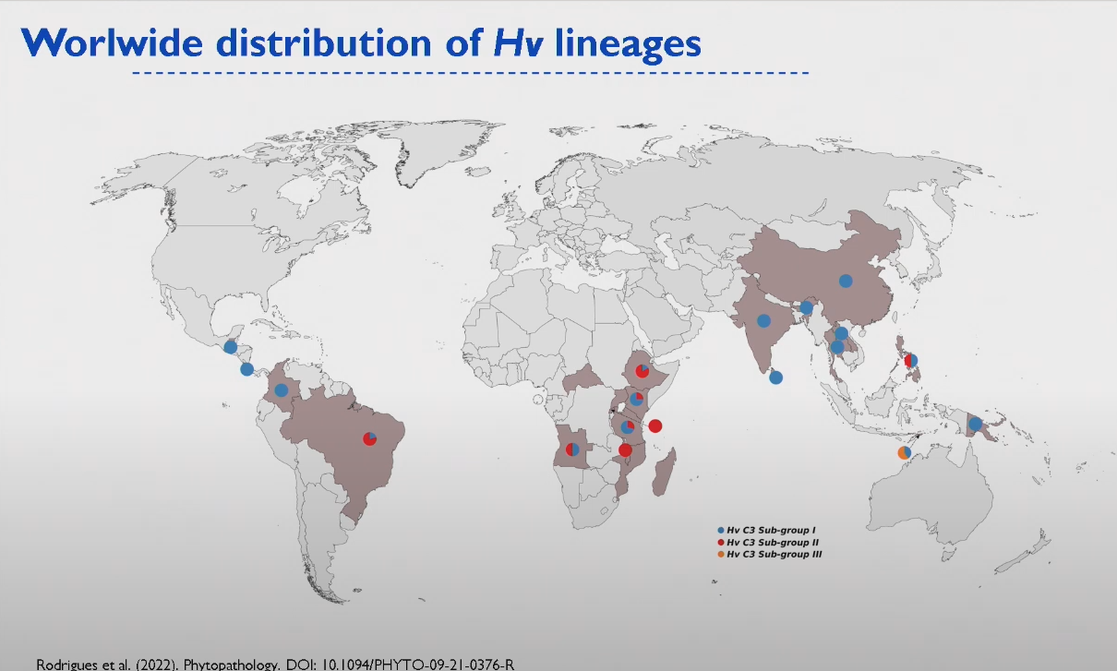

Slide 8
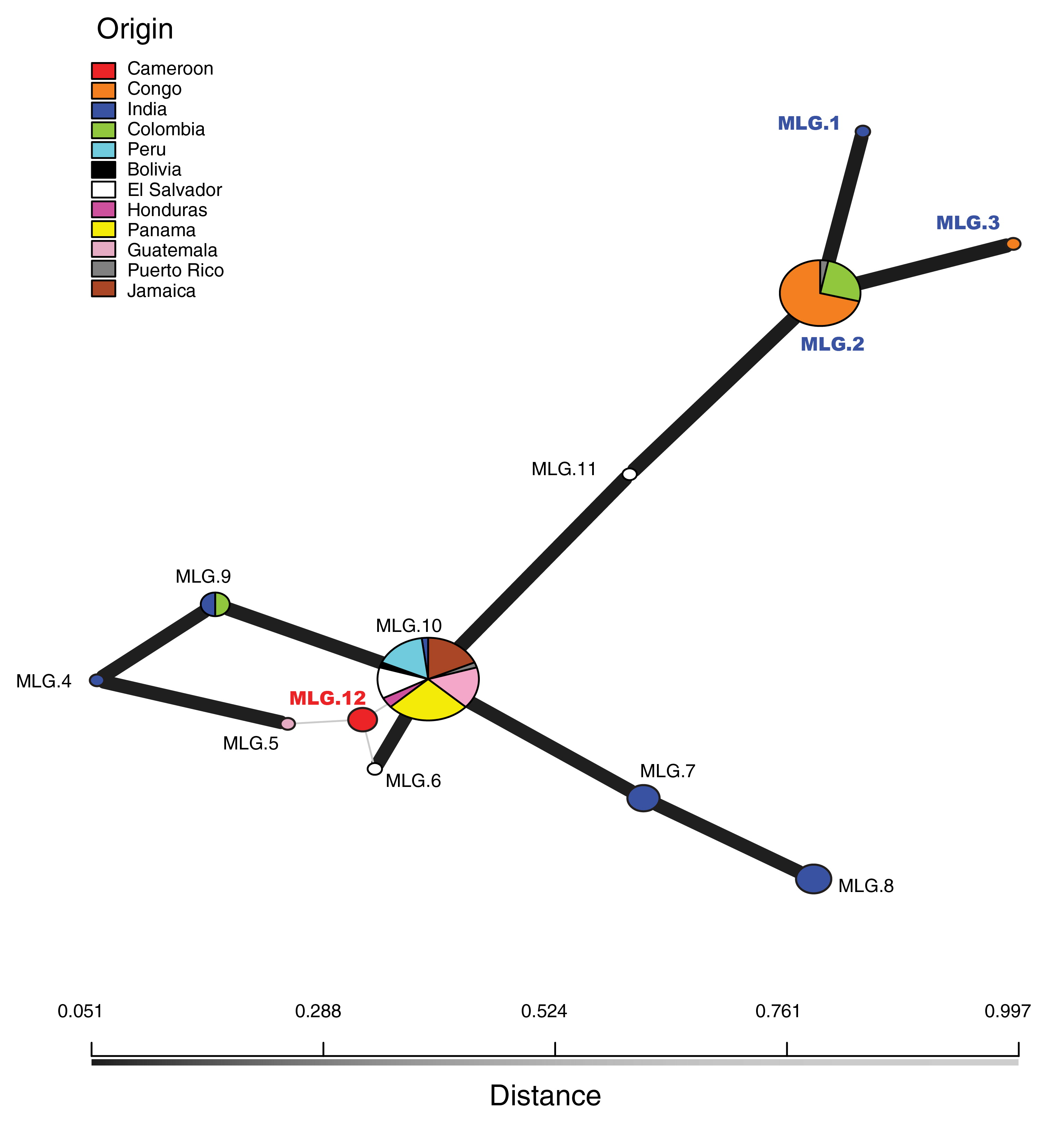
Population structure of global Hemileia vastatrix isolates
Minimum spanning network (MSN) of the eight multilocus genotypes (MLGs) of sampled Hemileia vastatrix isolates (n = 105)
Published in: Luis A. Ramírez-Camejo; Amnat Eamvijarn; Jorge R. Díaz-Valderrama; Elena Karlsen-Ayala; Rachel A. Koch; Elizabeth Johnson; Sòlene Pruvot-Woehl; Luis C. Mejía; Christophe Montagnon; Casto Maldonado-Fuentes; M. Catherine Aime; Phytopathology® 2022, 112, 643-652.
Copyright © 2022 The American Phytopathological Society • DOI: 10.1094/PHYTO-06-21-0255-R

Slide 9
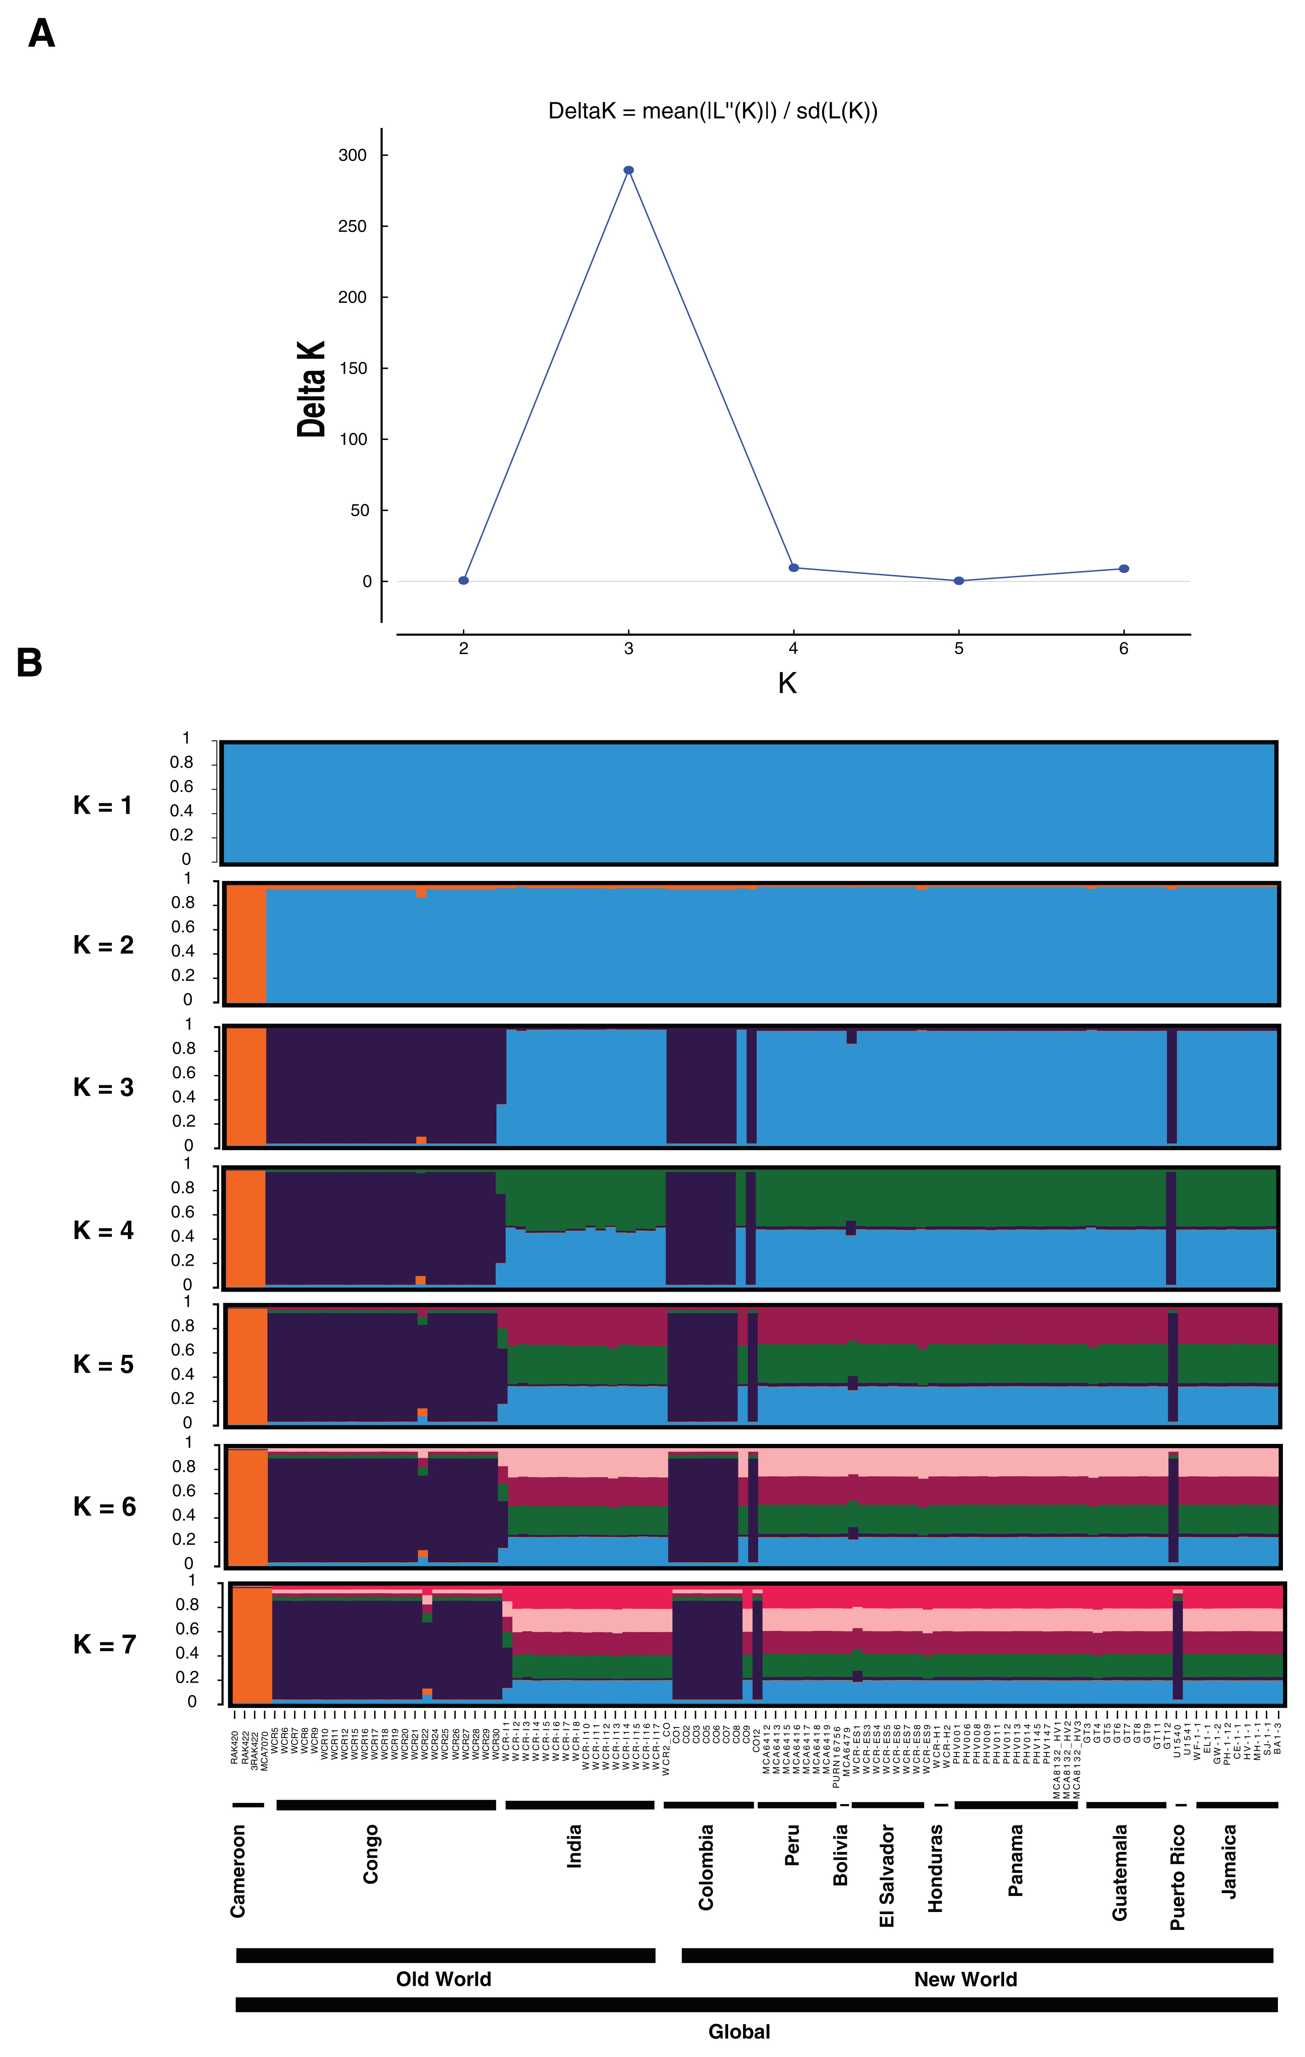
Population structure of global Hemileia vastatrix isolates
(n = 105) based on eight SSR markers
Published in: Luis A. Ramírez-Camejo; Amnat Eamvijarn; Jorge R. Díaz-Valderrama; Elena Karlsen-Ayala; Rachel A. Koch; Elizabeth Johnson; Sòlene Pruvot-Woehl; Luis C. Mejía; Christophe Montagnon; Casto Maldonado-Fuentes; M. Catherine Aime; Phytopathology® 2022, 112, 643-652.
Copyright © 2022 The American Phytopathological Society • DOI: 10.1094/PHYTO-06-21-0255-R

Slide 10
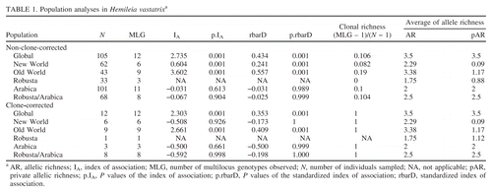
Population structure of global Hemileia vastatrix isolates
Published in: Luis A. Ramírez-Camejo; Amnat Eamvijarn; Jorge R. Díaz-Valderrama; Elena Karlsen-Ayala; Rachel A. Koch; Elizabeth Johnson; Sòlene Pruvot-Woehl; Luis C. Mejía; Christophe Montagnon; Casto Maldonado-Fuentes; M. Catherine Aime; Phytopathology® 2022, 112, 643-652.
Copyright © 2022 The American Phytopathological Society • DOI: 10.1094/PHYTO-06-21-0255-R

Slide 11
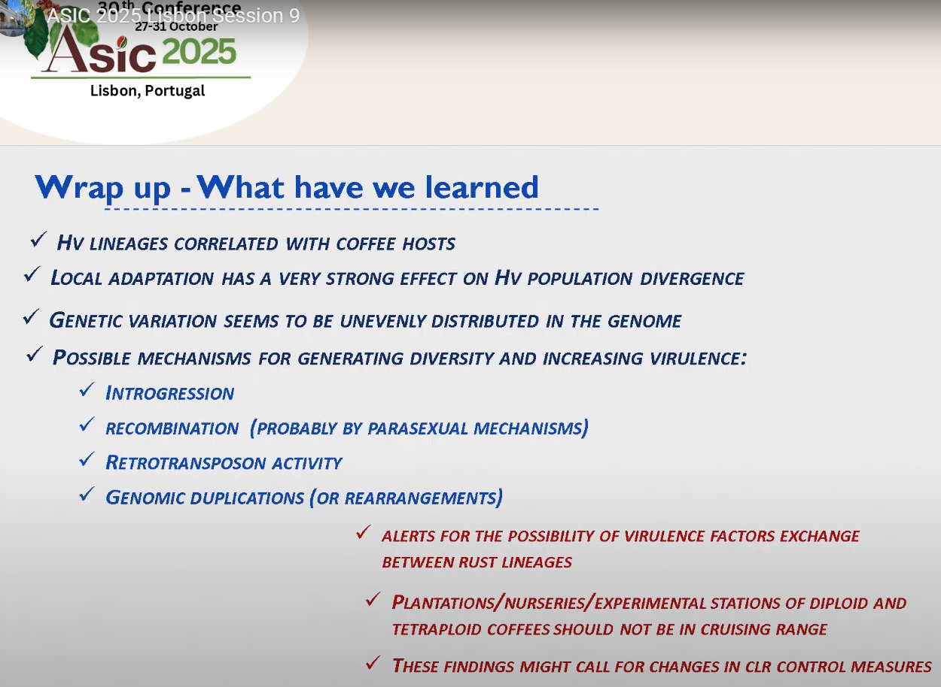
Conclusions

Slide 12
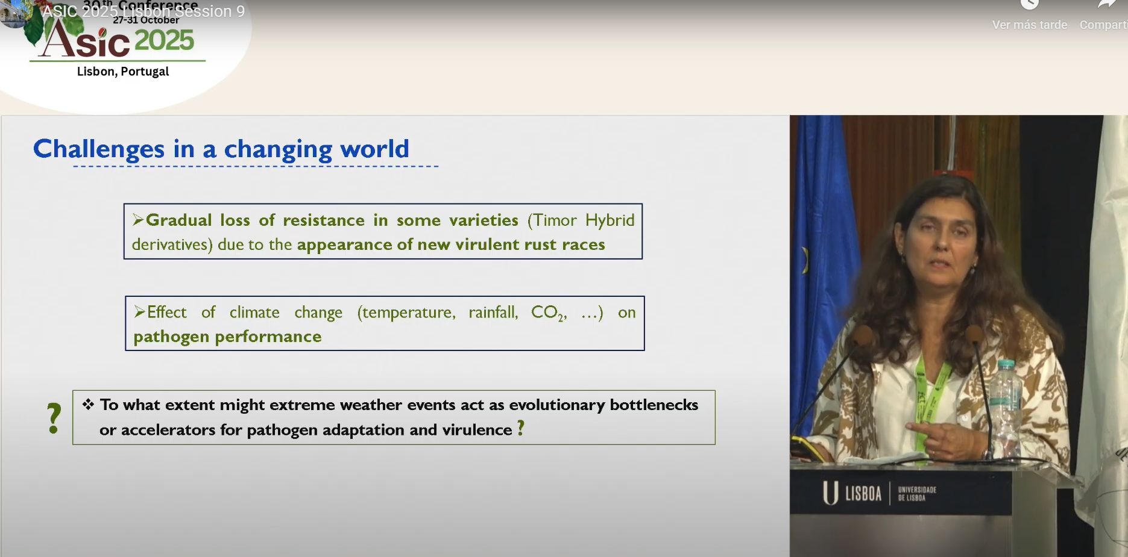
Challenges

Slide 13
Coffee Rust
COLOMBIA Status

Slide 14
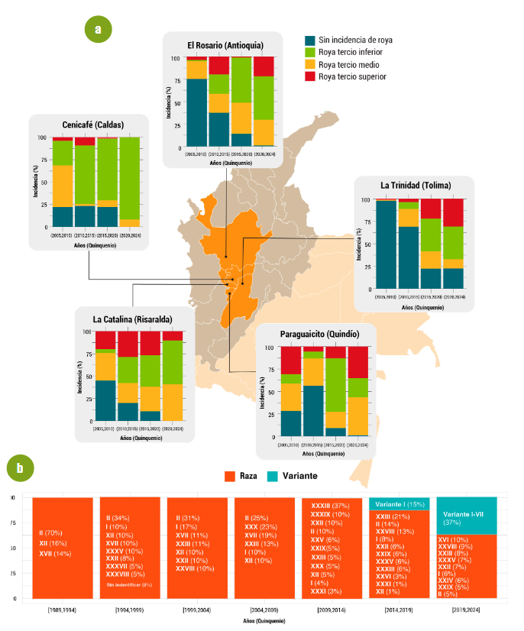
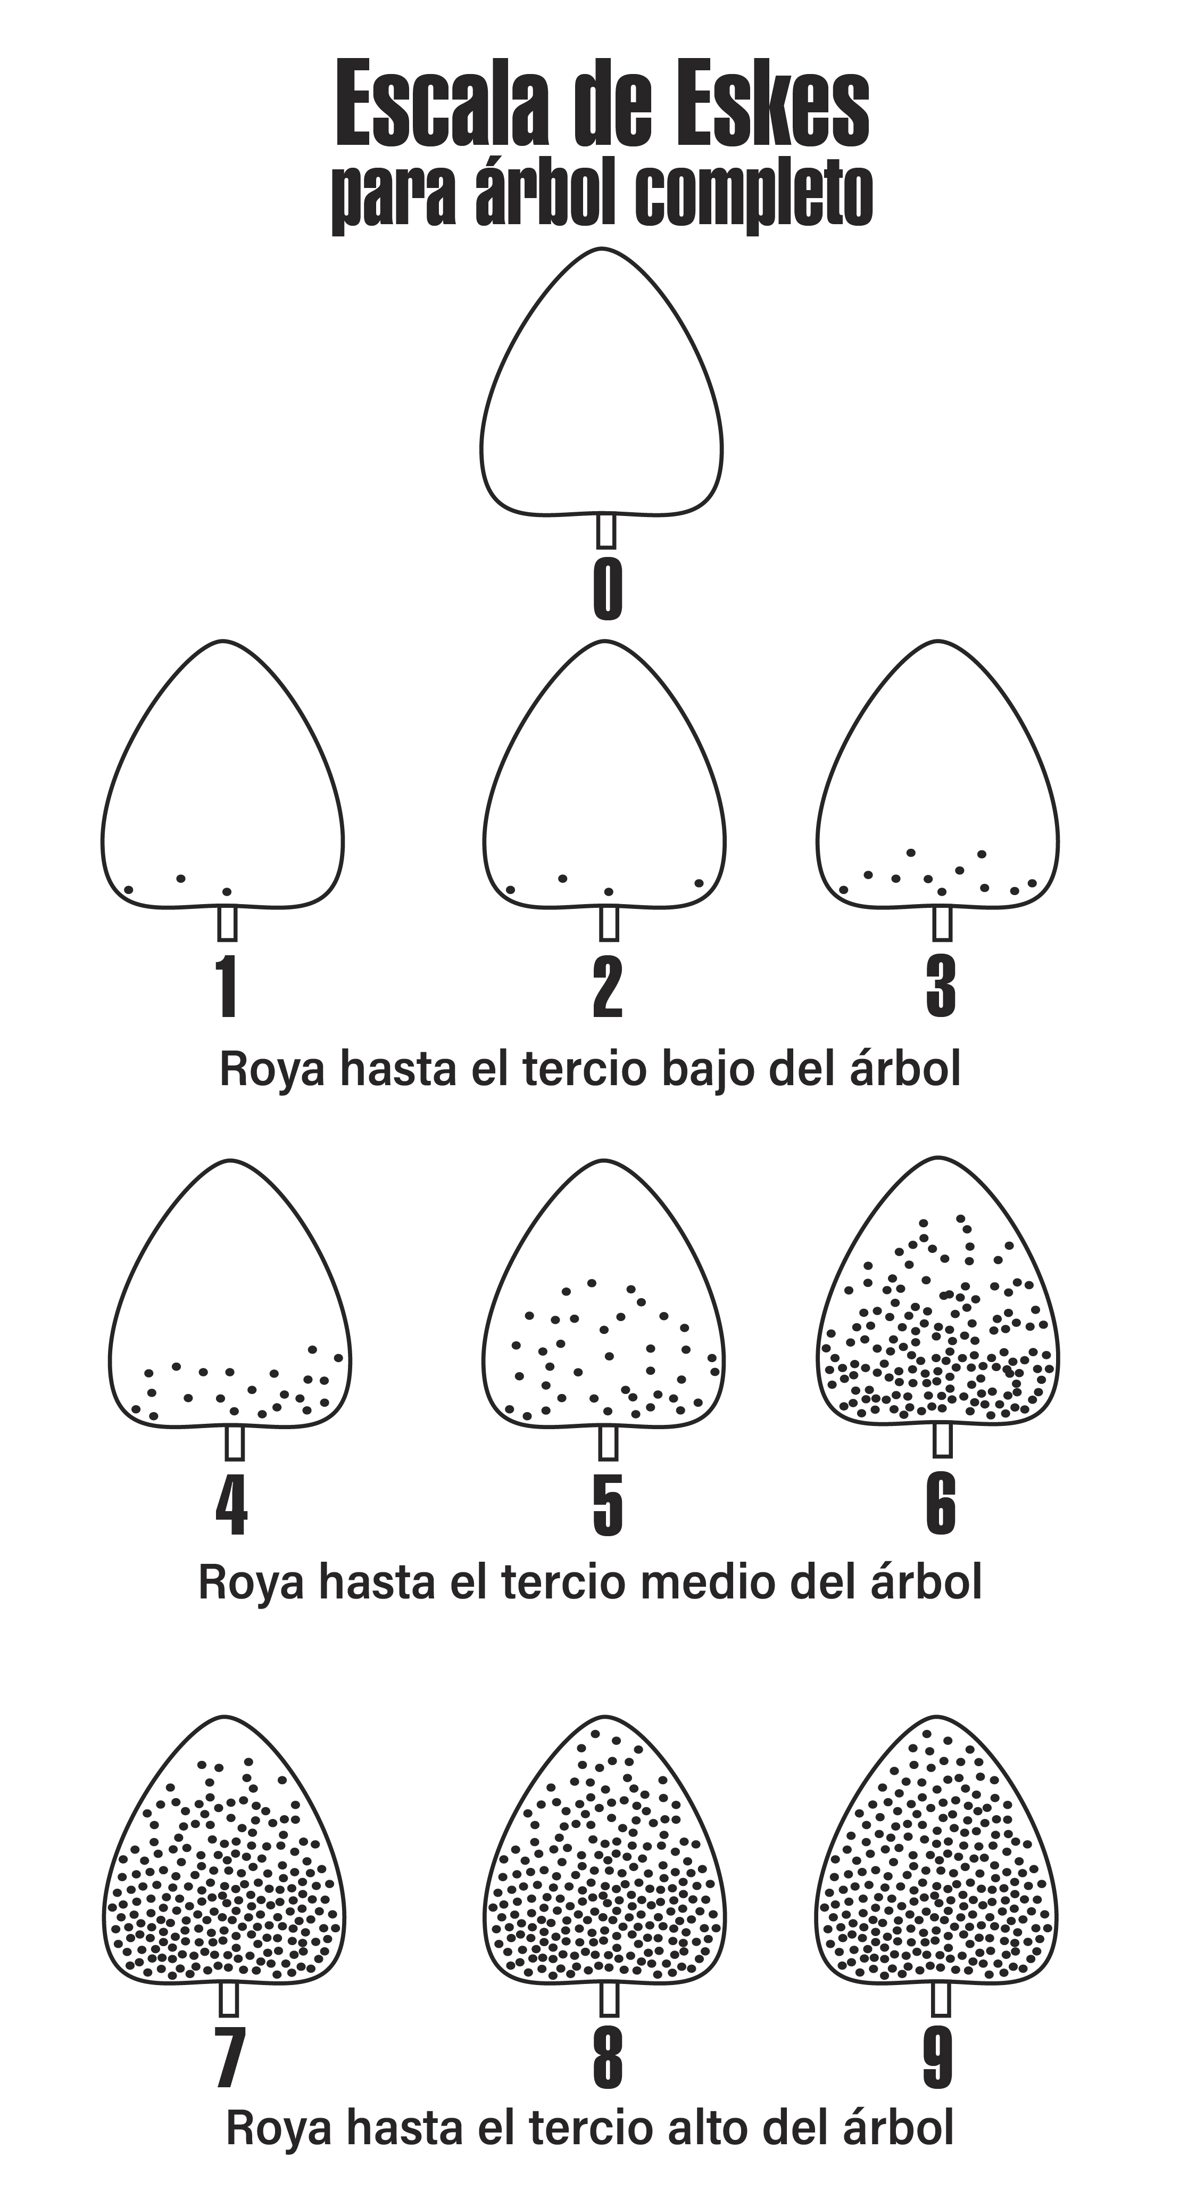

Slide 15
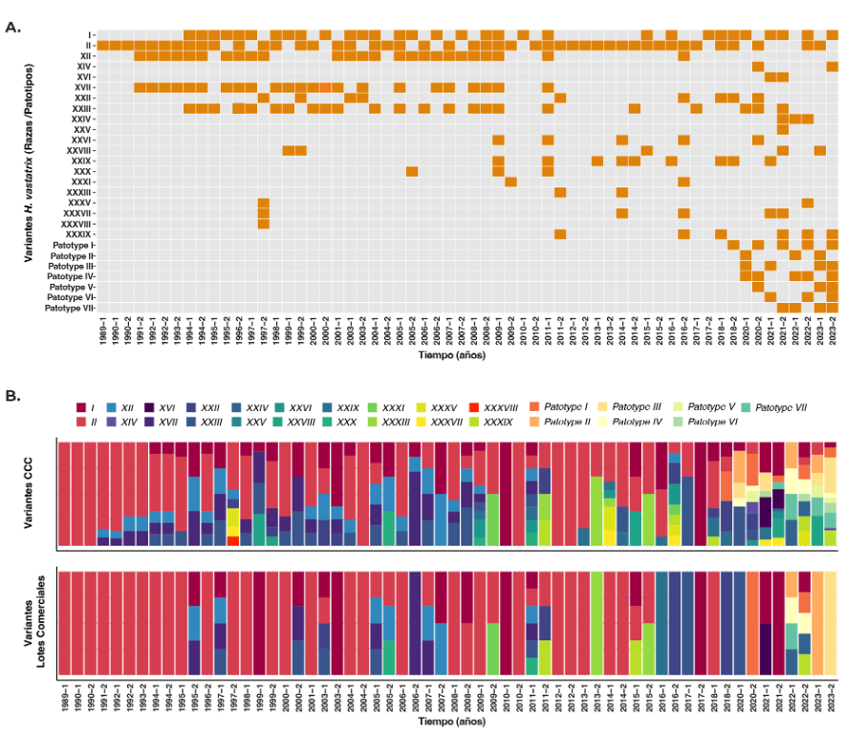
Coffee Rust Variants in Colombia

Slide 16
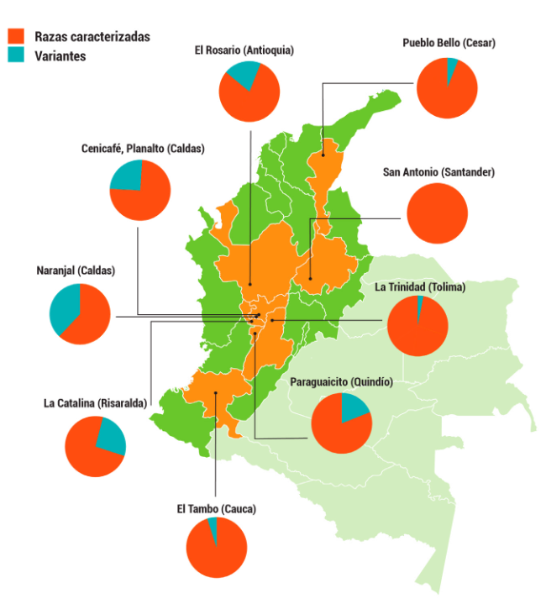
Coffee Rust Races and Variants in Colombia

Slide 17
Coffee rust present today in Colombia is genetically more complex that the rust that arrived in 1983

Slide 18
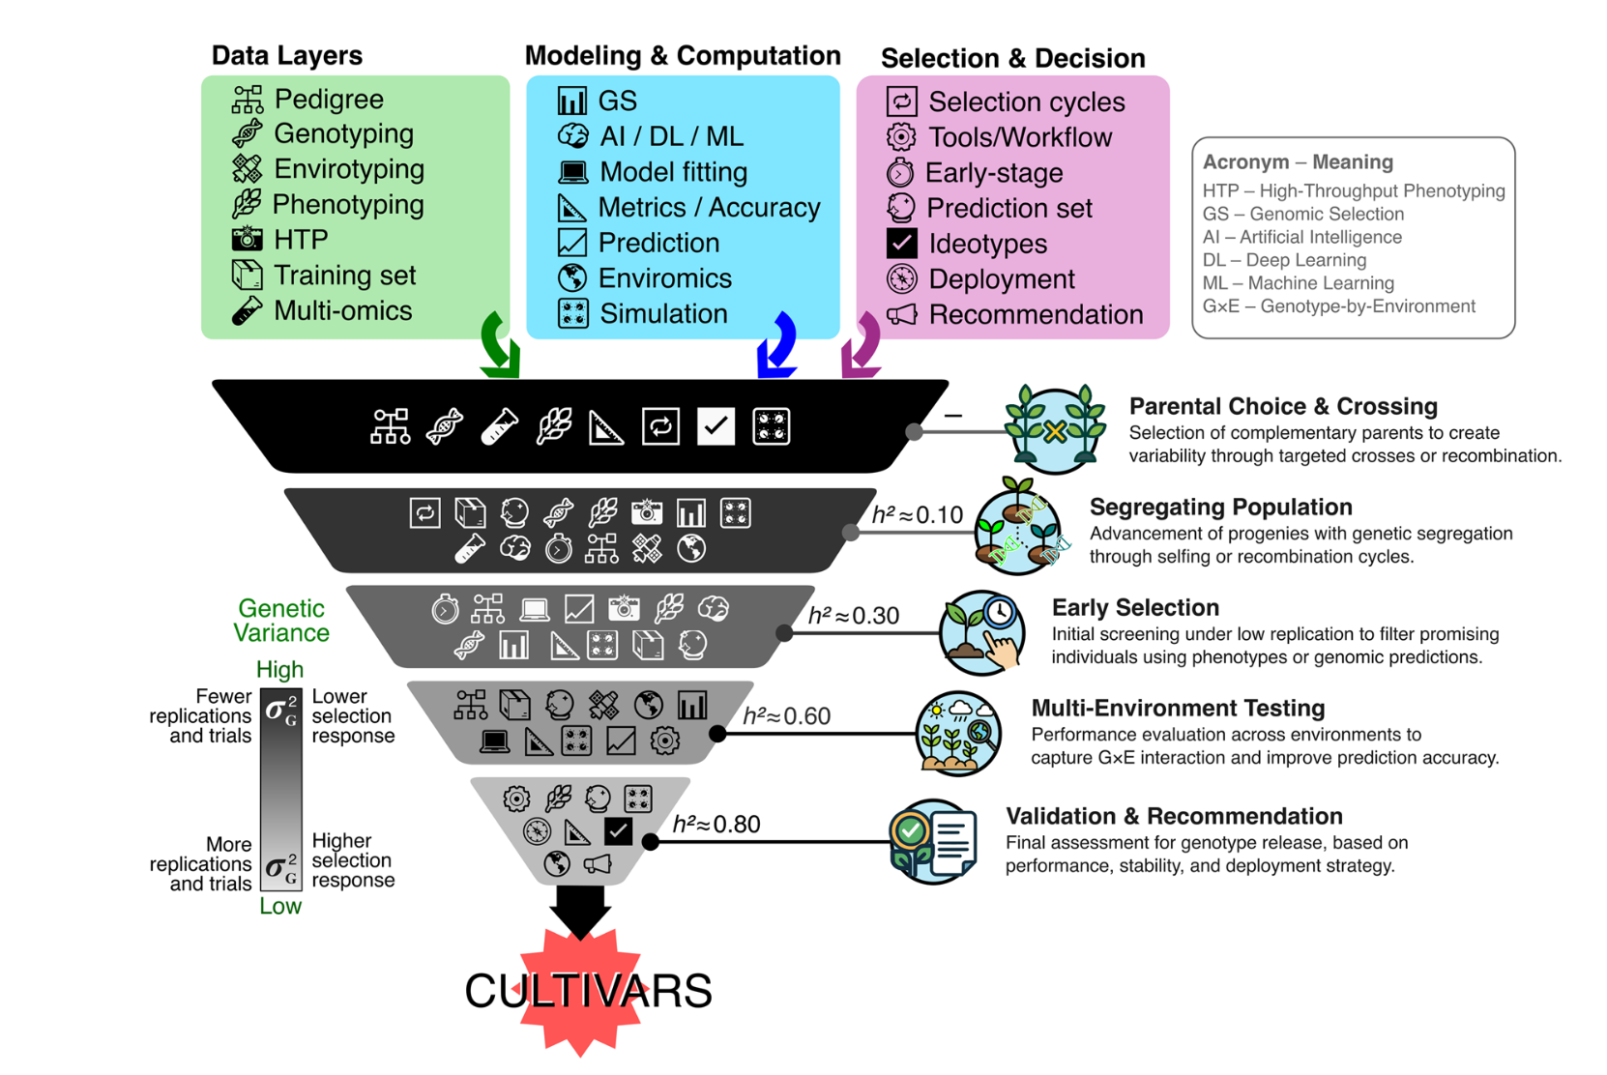

Tool development for breeding
Marker assisted selection

Slide 19
SH genes conferring resitance to CLR
Chromosome candidates:
SH6-9:
  Ca TDF77 NBS-LRR - Chr11c (Ariyoshi et al., 2024)
Other many breeding wise important unknonws:
How many genes are really conferring resistance
Effect sizeTamaño del efecto
Interaction with races
Interaction between genes
Are arabusta introgressions the same as HdTs?

Slide 20
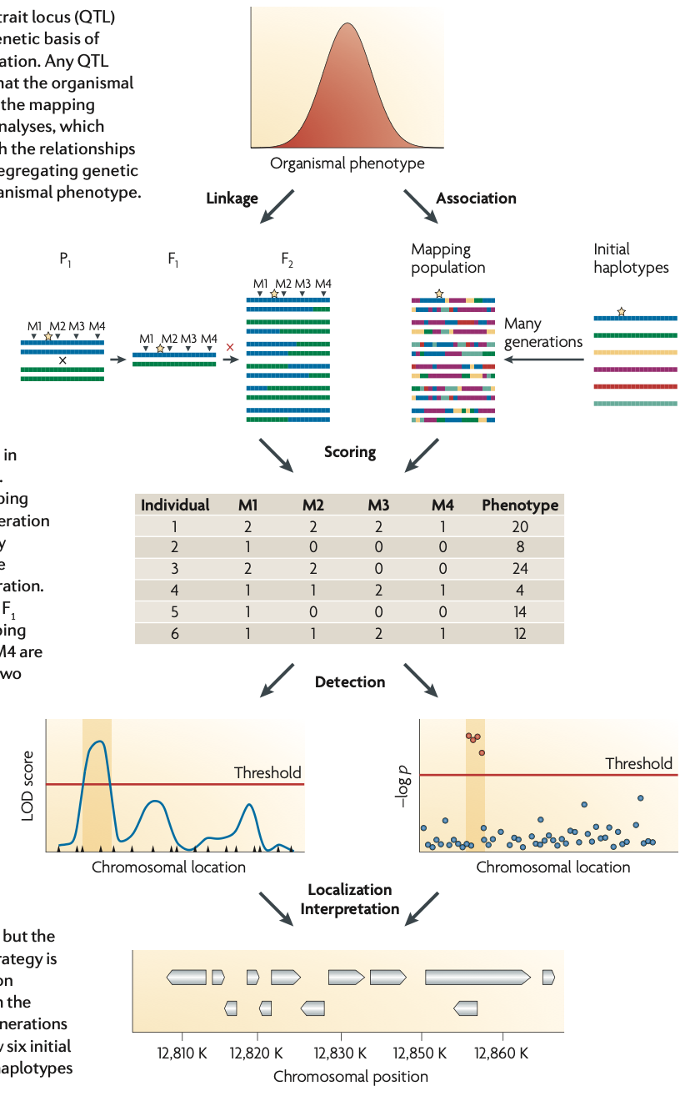
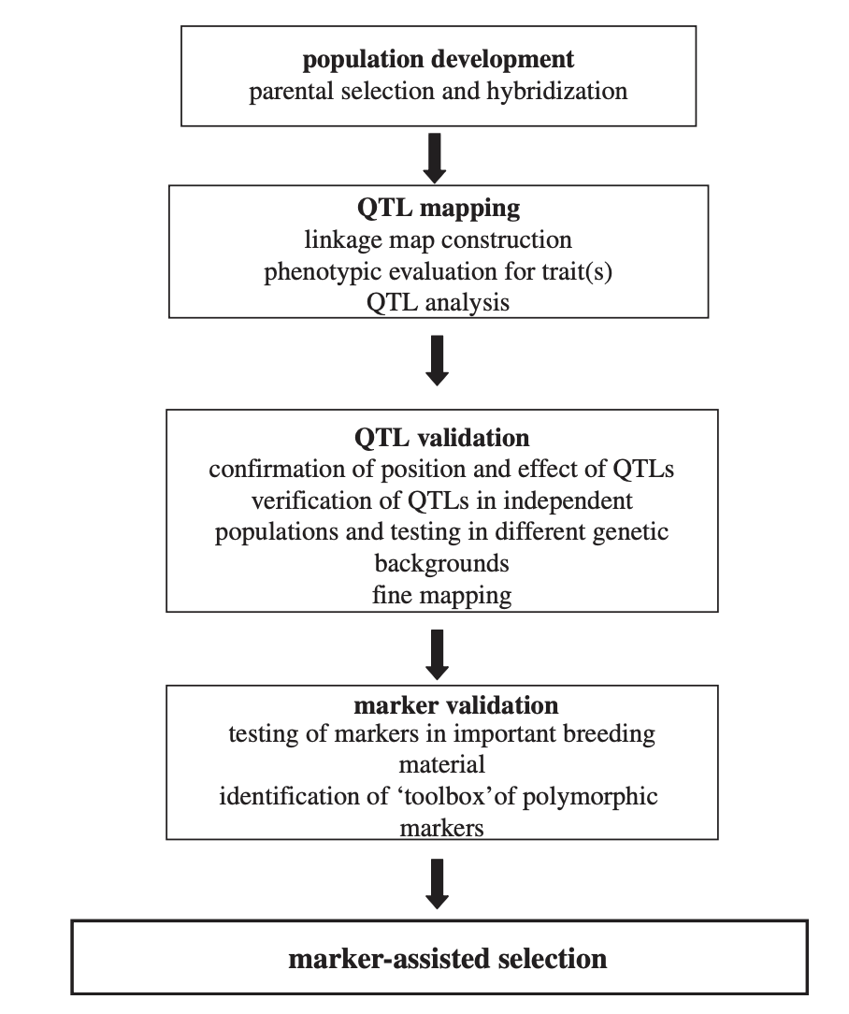

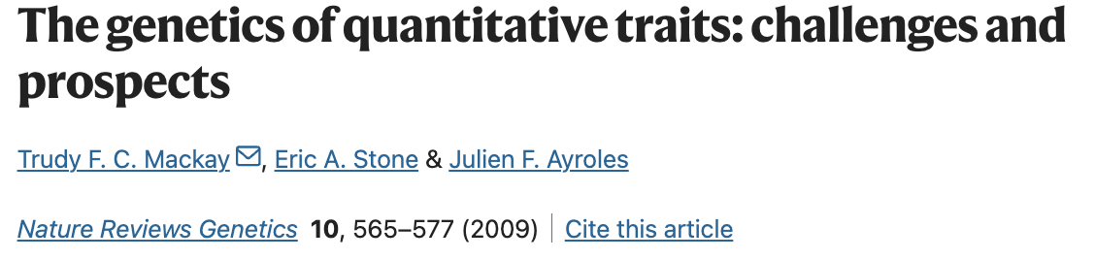
Mapping and marker development
Needs:
Suitable population(s)
Trait variation
Medium – high density genotyping
Stats
  Map construction
  Mappping

Slide 21
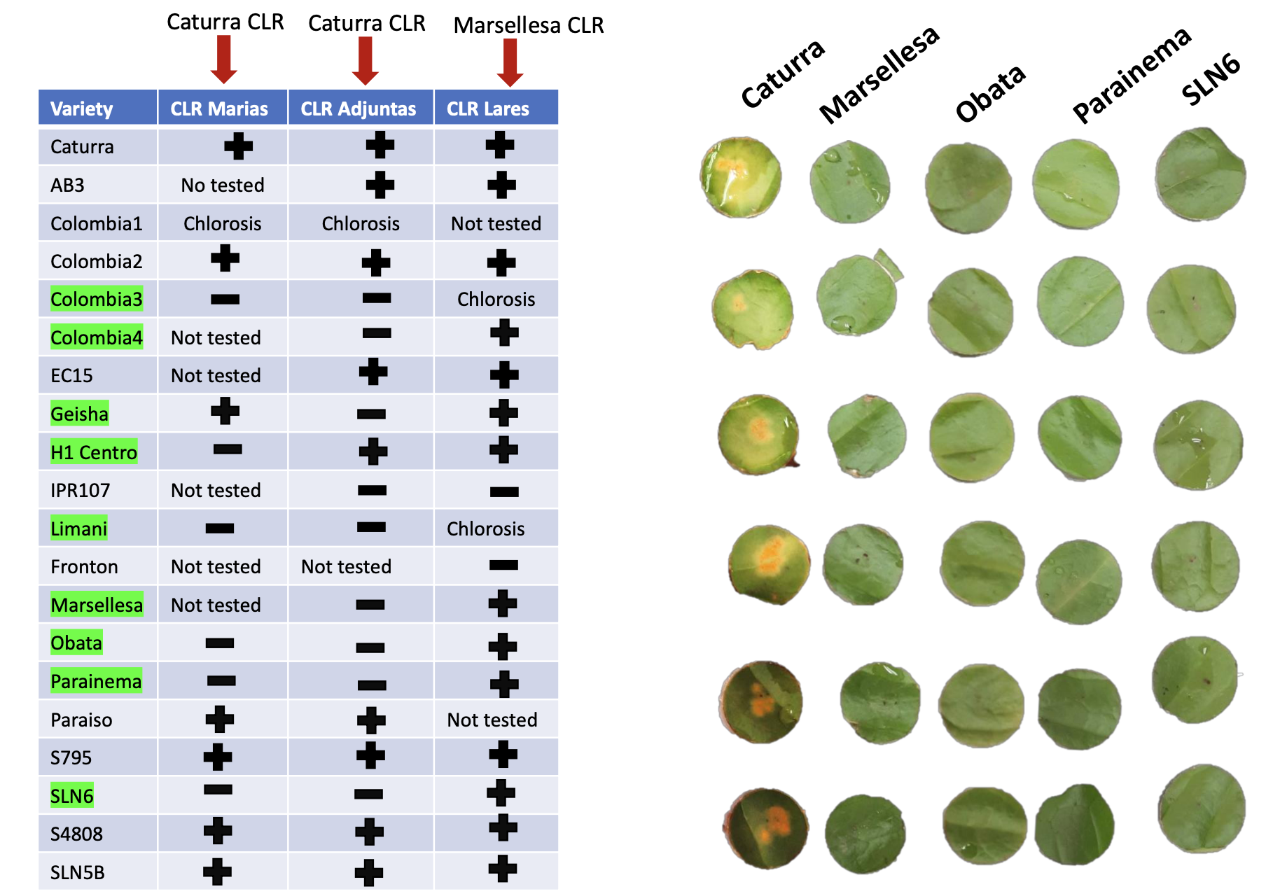
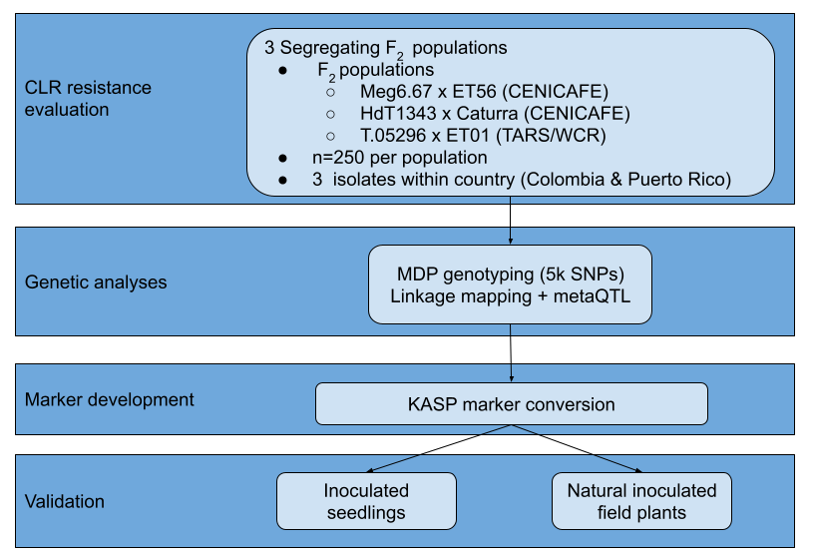
Mapping CLR resistance

Slide 22
Populations

Slide 23
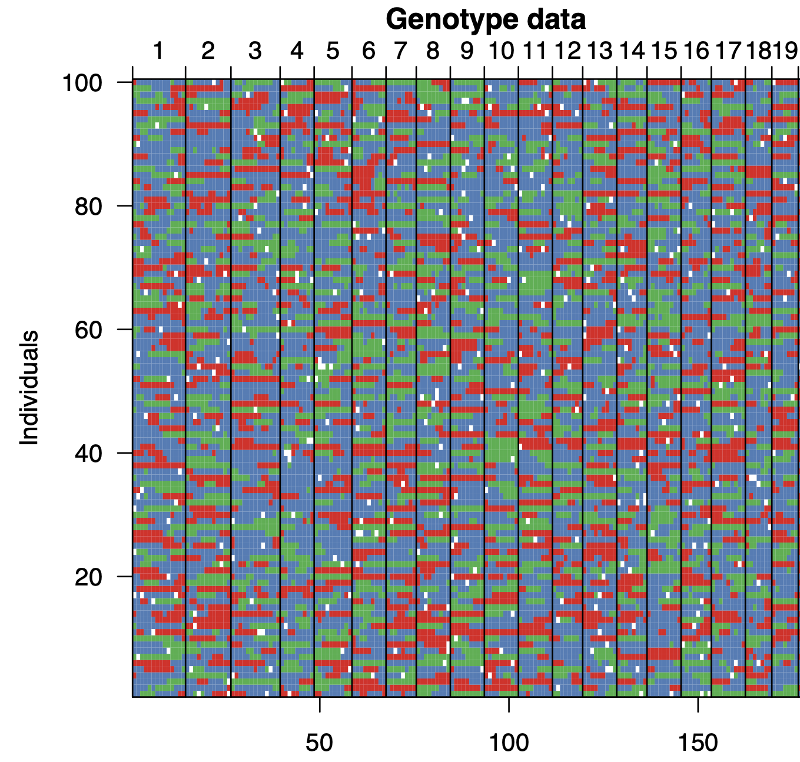
Linkage mapping for each population
Isolate specificity ?
+
Dominance effect?
Chr9
QTL interaction?
Markers
Phenotypes
Parental 1 allele homozygous
High level
Parental 2 allele homozygous
Intermediate level
Heterozygote
Low level

Slide 24
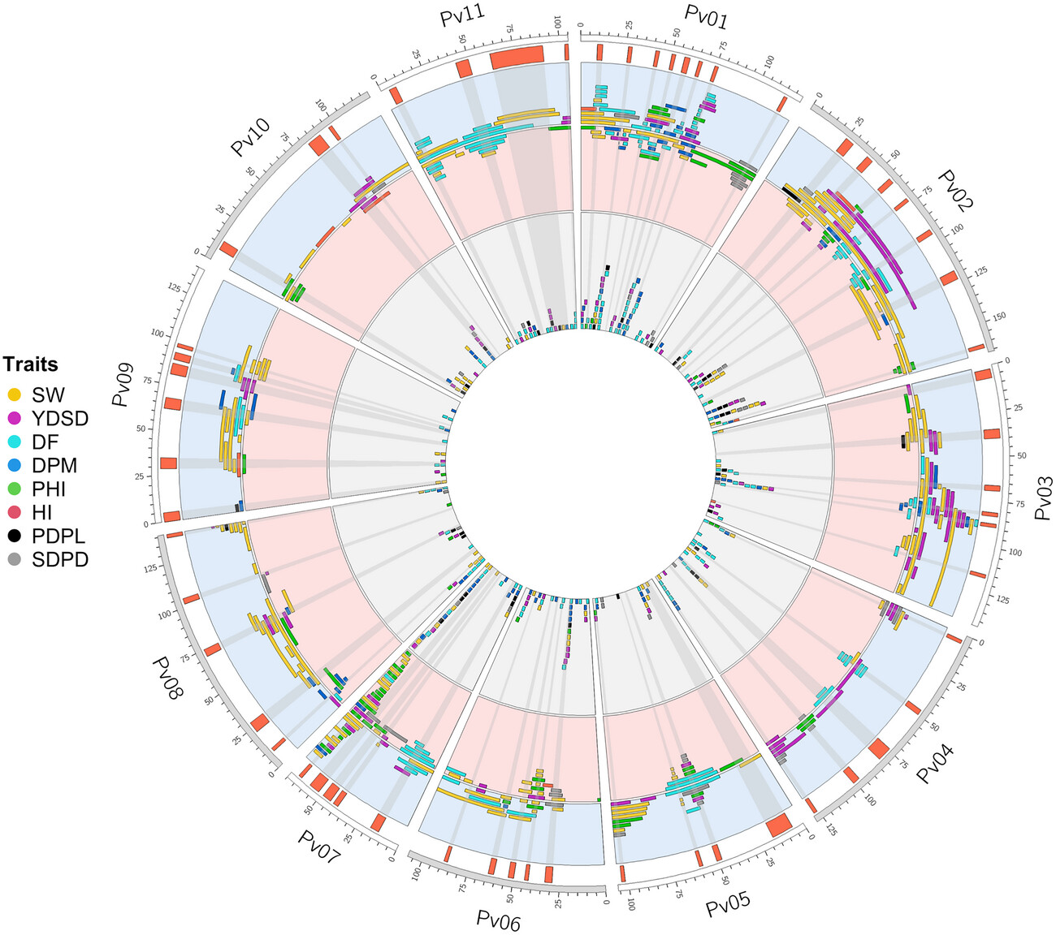
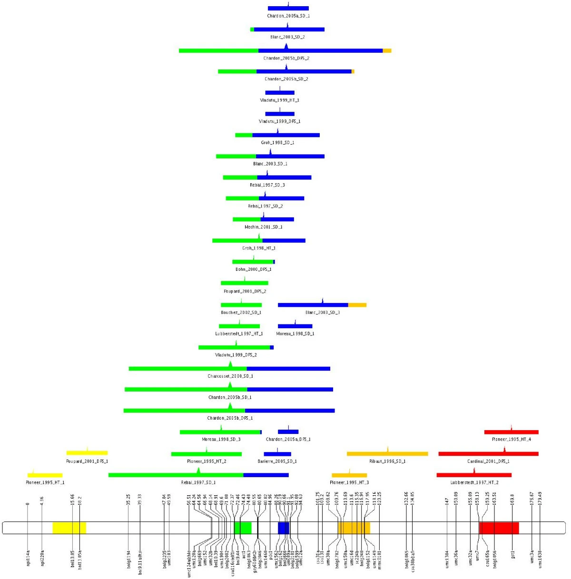
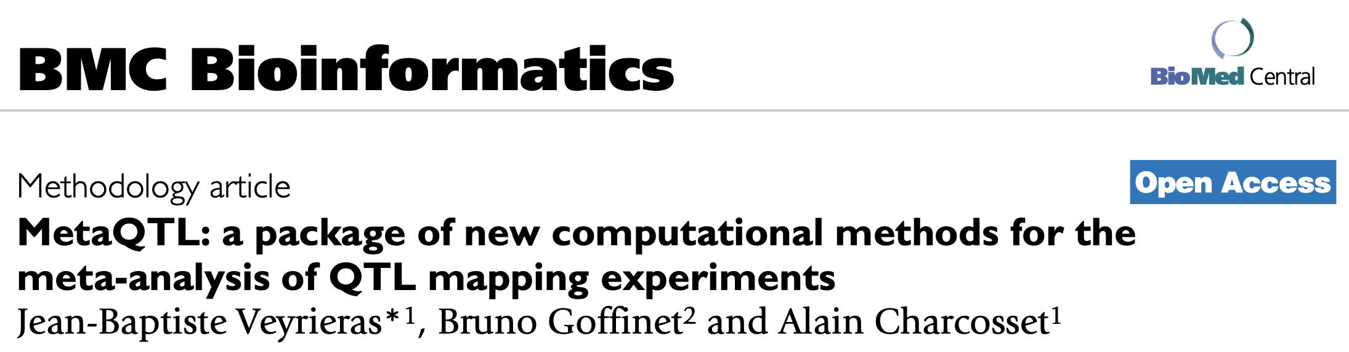
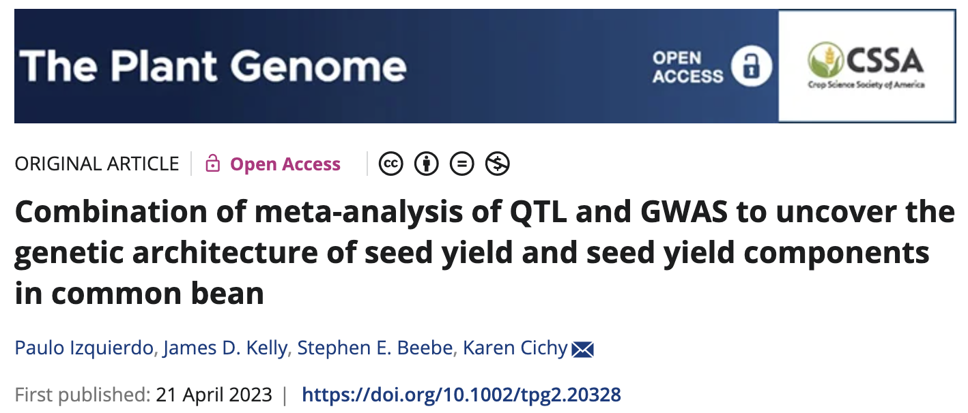
metaQTL – integrating populations and isolates

Slide 25
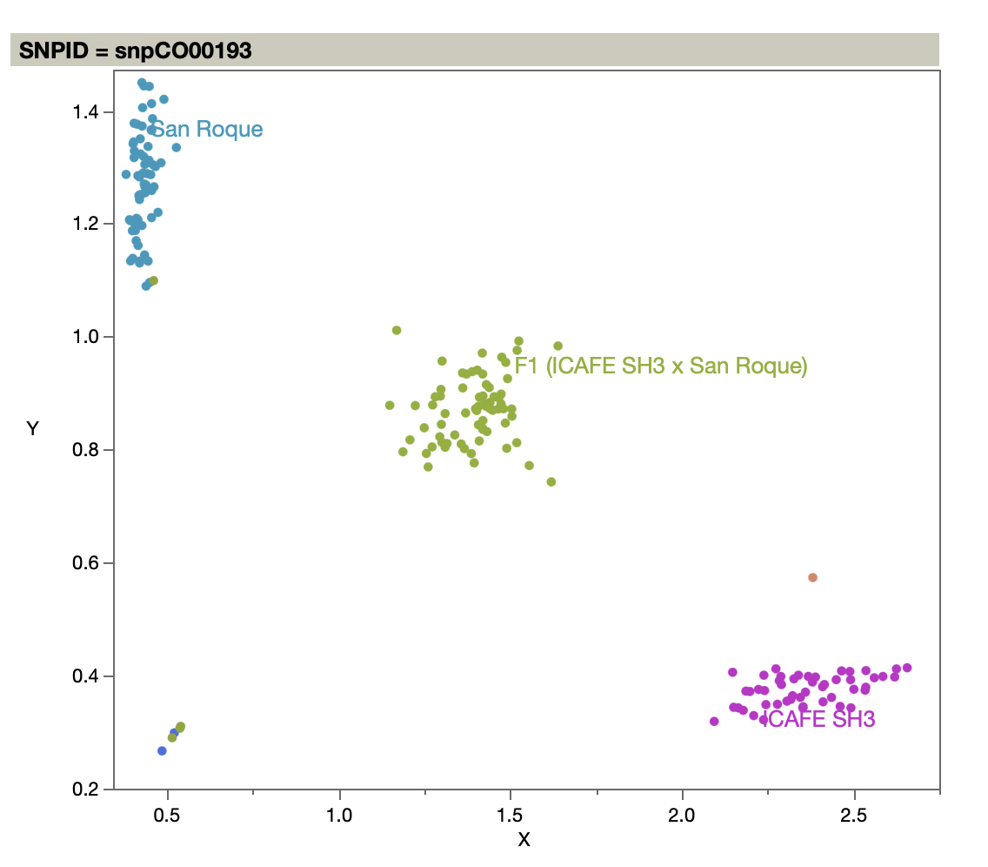



Nexs steps – integration + validation
Linkage mapping with biparental populations
LOD
Pop1 - isolate 6
Pop2 - isolate 1
Pop3 – isolate 2
KASP marker development of peak & flanking markers + overrlapping expression differential polymorphism
Test in different breeding populations
GWAS with populations
-log10(p)
+
Expression analyses
Log fold change
Refinement, identification of new resistance sources, develop targeted mapping populations
-
0
60 Mbp
Chr1c

Slide 26
Outputs
Number, effect and interactions of QLTs
Stability of QTLs by isolate
Marker validation in independent populations
DArTag to KASP marker conversion

Slide 28
Leftovers

Slide 29
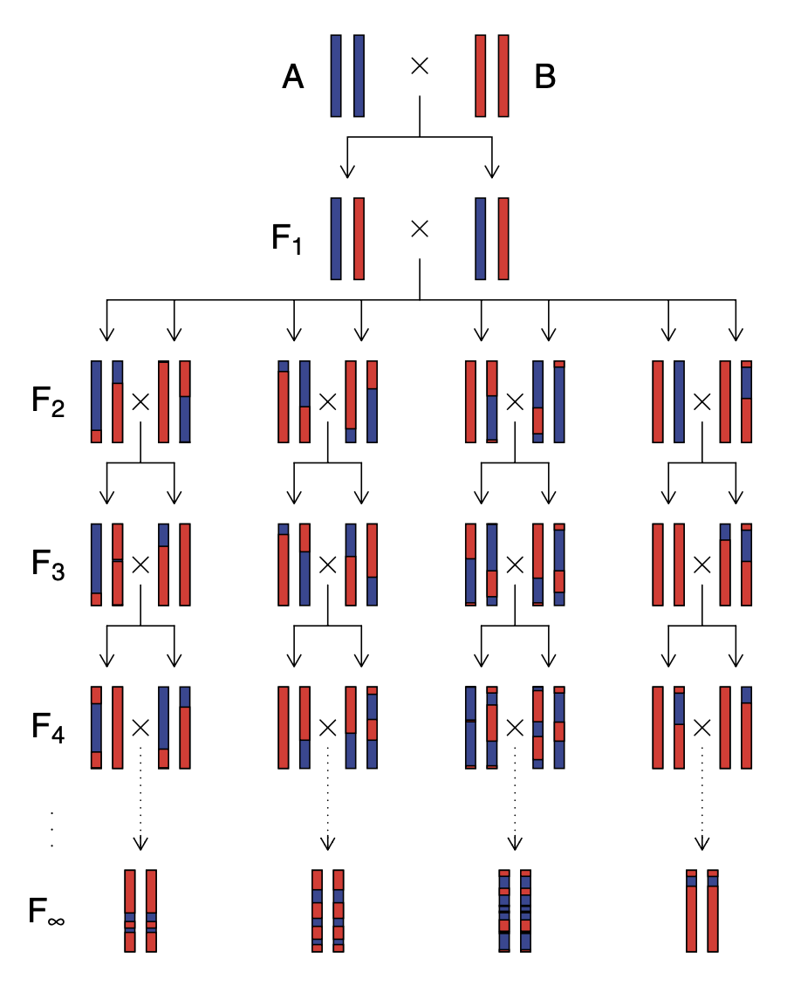
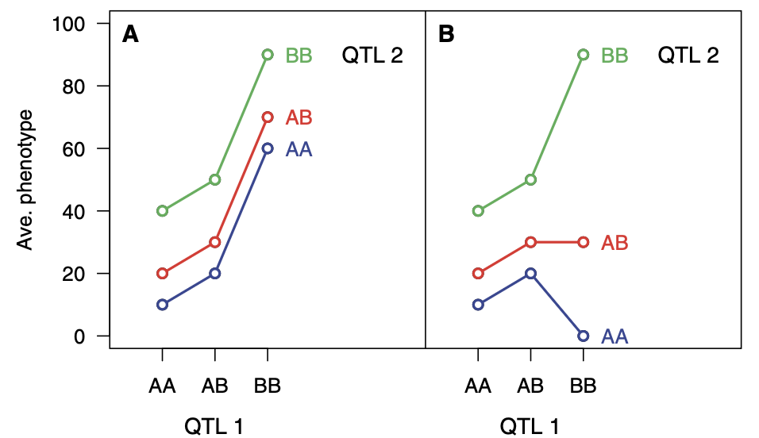
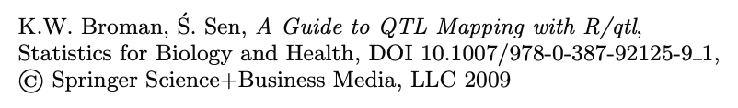
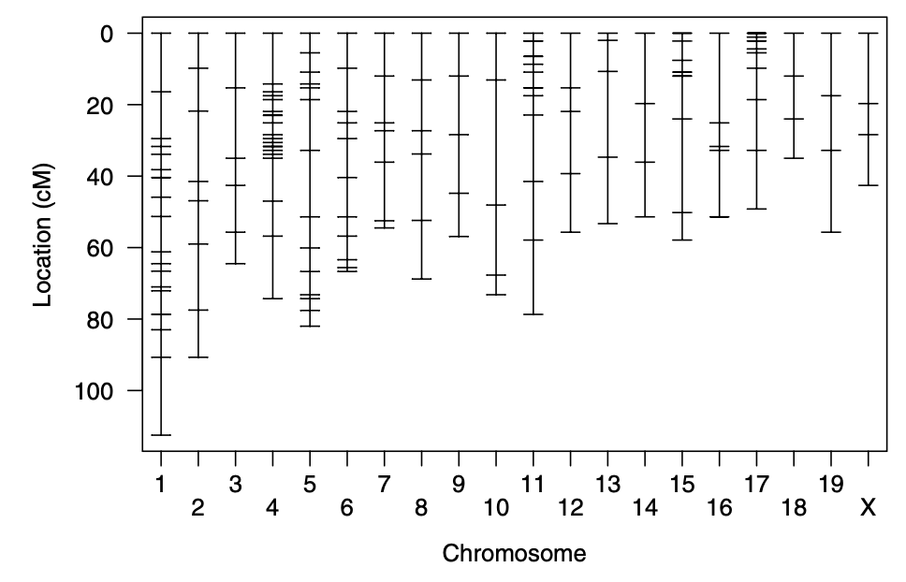

Slide 30
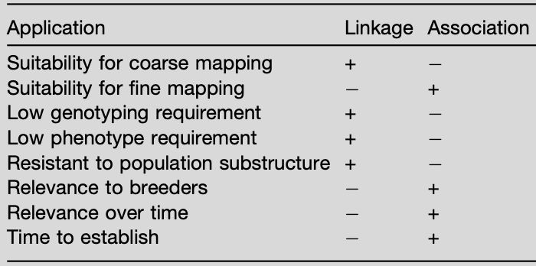

Slide 31
SH genes conferring resitance to CLR
Cuantos estan realmente confiriendo resistencia
Tamaño del efecto
Interacción con el aislado/raza
Interacción entre genes, menores y mayores
La introgresión de arabusta es la misma de los HdTs?
Chromosome candidates:
SH6-9:
  Ca TDF77 NBS-LRR - Chr11c (Ariyoshi et al., 2024)

Slide 32
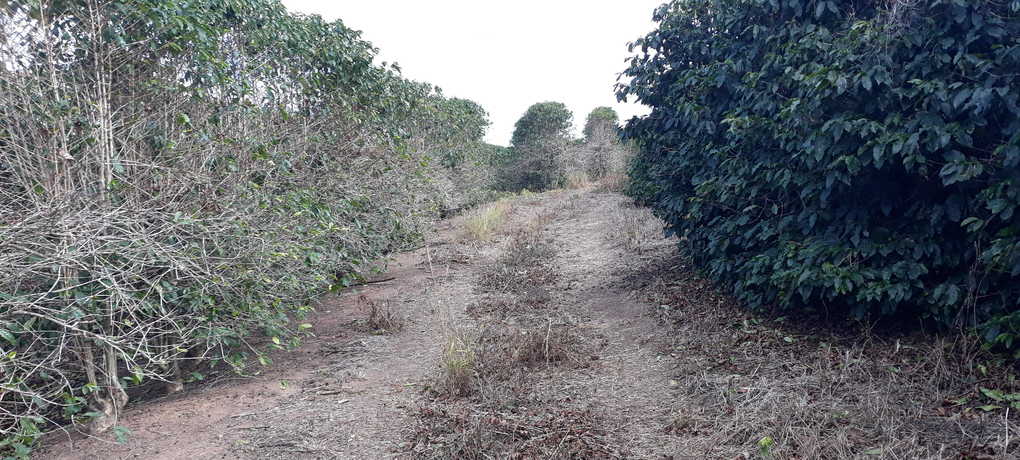
CLR globally
The single most consequential constraint in arabica coffee production
Caused by the obligate parasitic fungus Hemileia vastatrix.
In severe infections, this fungus can defoliate coffee plants and impact yield by reducing flower quantity, fruit production and sensory attributes
55 CLR races have been identified worldwide
Developing varieties with inherent resistance is more economically and environmentally sustainable

