Slide 1



Global Perspectives and Industry trends
Innovea Network Breeders Meeting
Cenicafe, Manizales, Colombia
November 17-21, 2025

Slide 2


Where are we at this moment?
Subhead can be roughly 80 characters, move bullets down if more space is needed.
Bullet points can be set at size 18-24
Set in Source Sans Pro Light
Keep bullet points short and to the point
Bullets points should not extend beyond 2/3 the length of the page to improve legibility
Replace placeholder photos, with relevant photos as needed

Slide 3
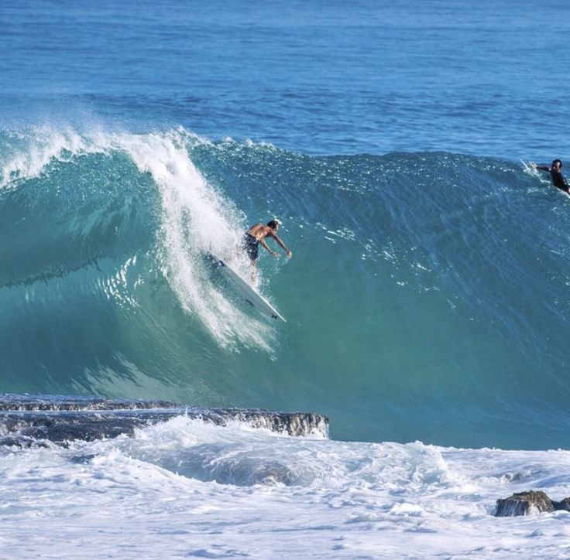
In surfing – a double up wave is when 2 waves combine creating a larger, steeper wave

Slide 4
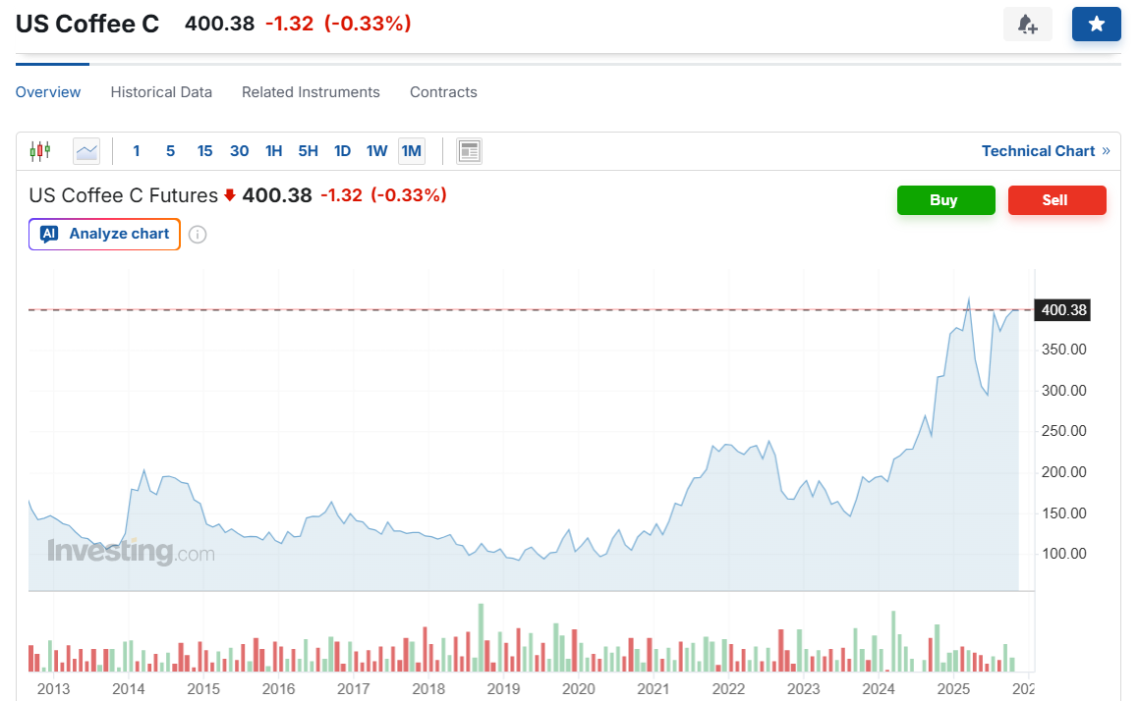

Multiple disruptions – a “triple up?”
Economic and Geopolitical Instability
Climate and Production Challenges
Shifting Consumer Landscape

Slide 5
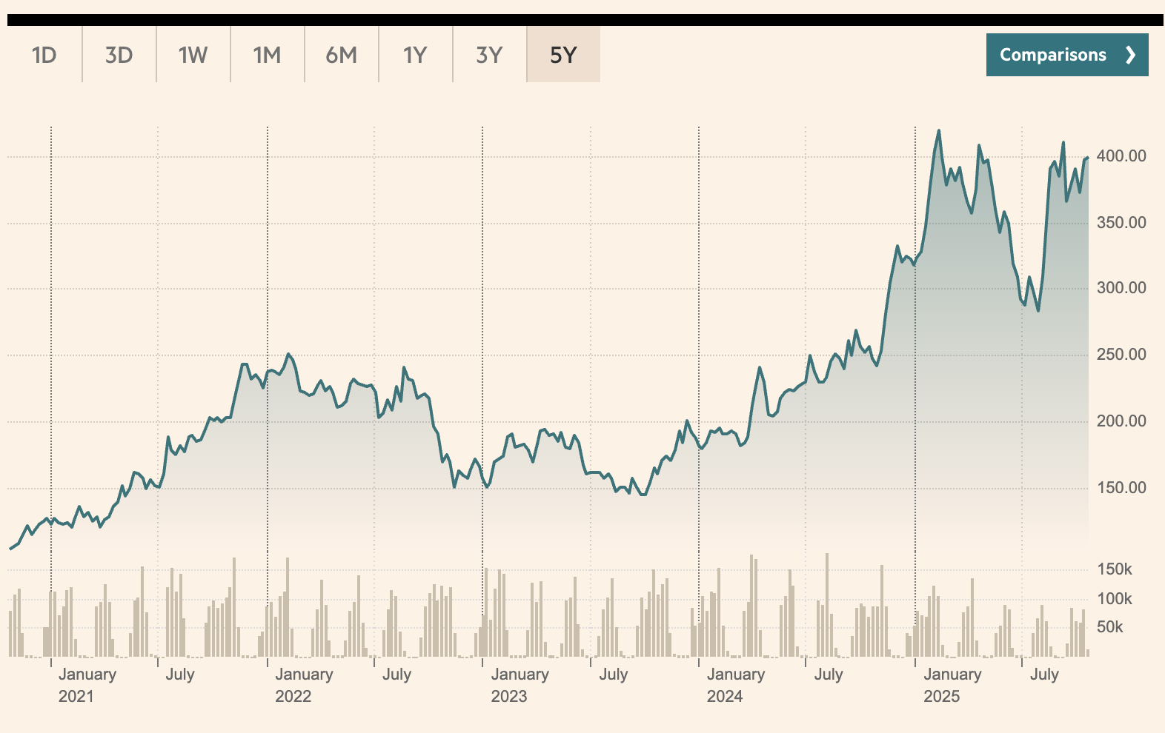
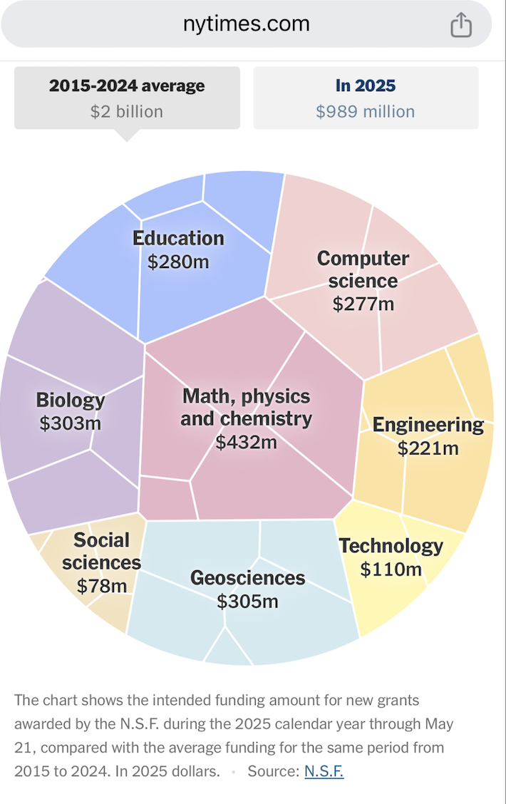
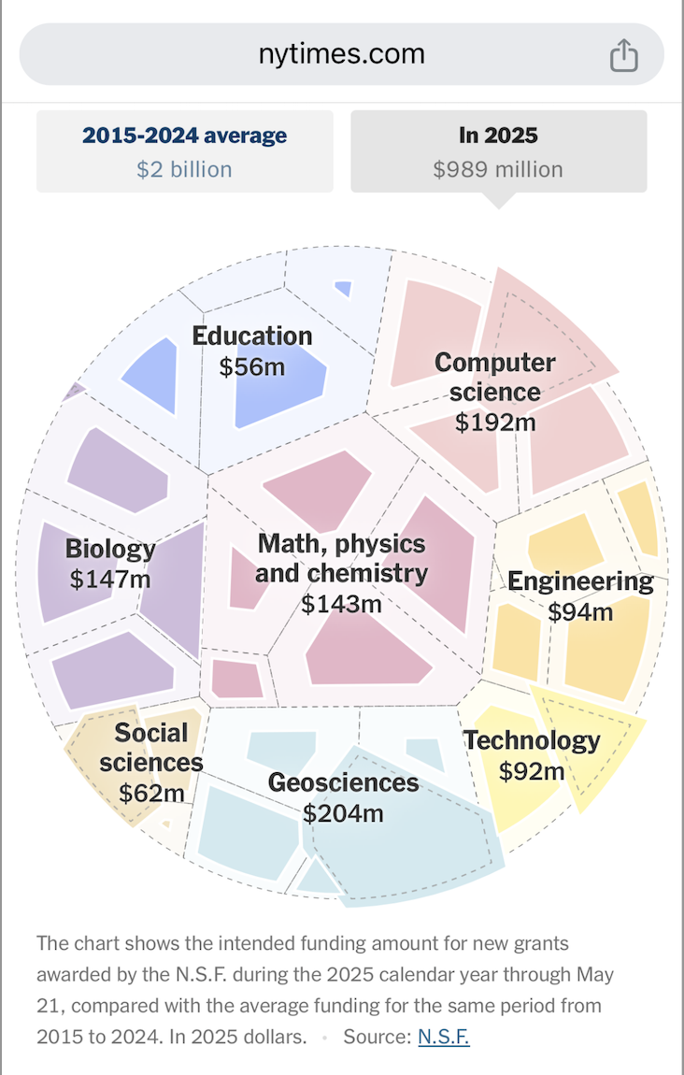
Economic and Geopolitical instability
Historic high coffee prices
Historic, global contraction of public investment in science and foreign assistance
Cheerio, old chaps, Oct 2025
It’s not just the U.S. axing foreign aid. The U.K. has taken a hatchet to it as well, and the financial repercussions of that are becoming apparent. Devex.
Storied Mott MacDonald closes Development Arm due to UK development aid contraction.
Notes:
In the case of WCR, disruptive external forces are converging—historic high prices, the deceleration of public funding for science globally, the climate crisis.
I don’t have to tell any of you what the image on the left is. This is not fun. Misery loves company, welcome to the Board meeting.
On the right we see a representation of the contraction of US federal science funding – it has declined by over half in just 8 months, a loss of >1 billion dollars. We’ve seen similar stunning declines in USDA funding, and development assistance funding. These are the main pools of public funds that WCR has historically tapped to leverage your investment in us.
And it’s not just the U.S. - this public funding contraction is global. Here in the UK, Storied Mott Macdonald the international development arm of the business has been shut down and all 500 staff have been laid off.
In this presentation I’m going to take you from your low-lows, because of these high highs – a set us on a path to explore the opportunity on our horizon

Slide 6
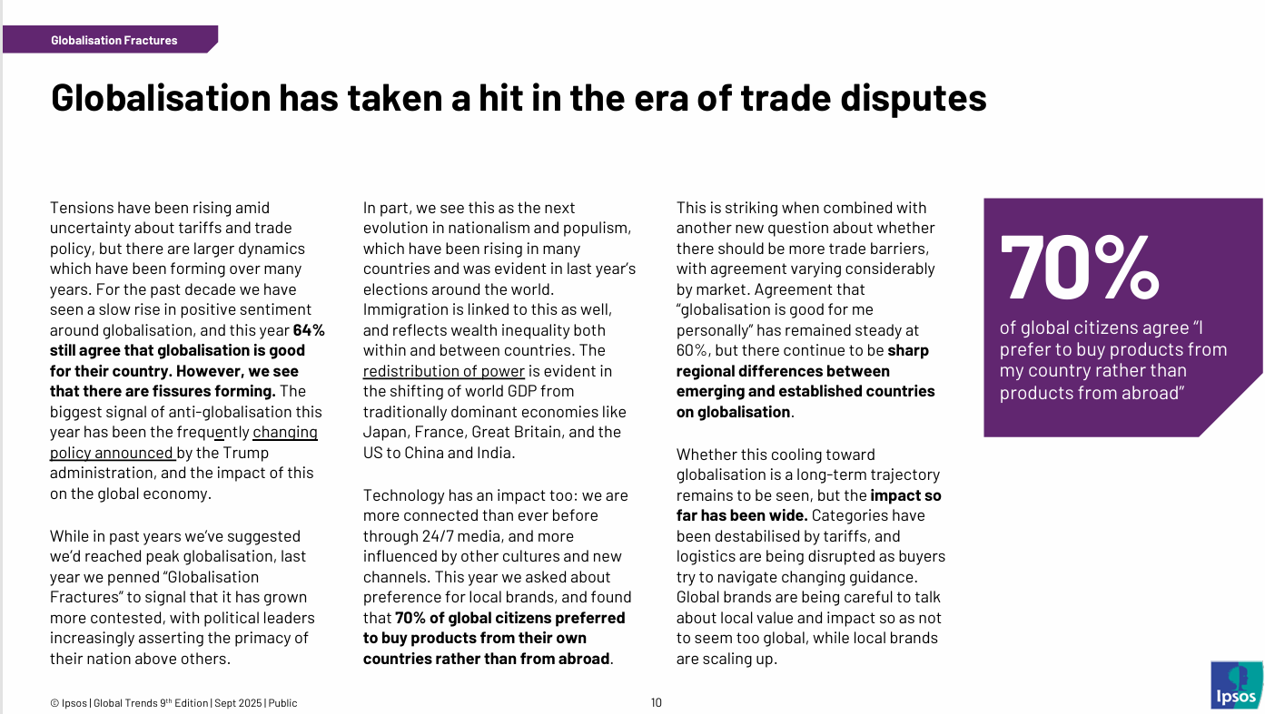

Slide 7

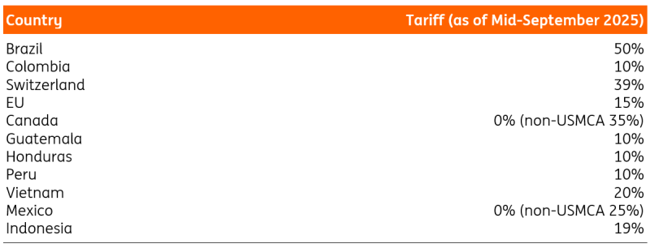
In 2025, the US government introduced tariffs – a blunt force tool for reversing trade deficits– but coffee was collateral damage
Replace placeholder with graphs, charts, photos, or other content as needed

Slide 9
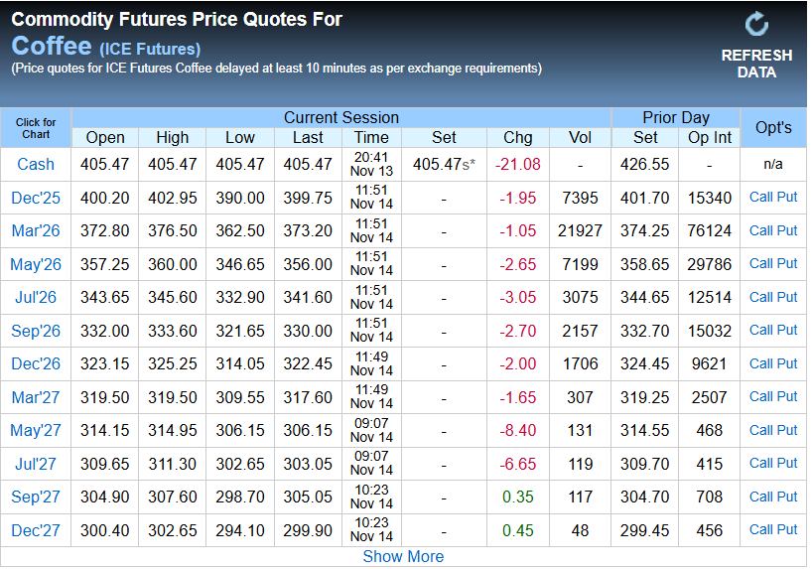

Slide 10
Higher near-term costs: The high price of near-term contracts makes immediate coffee purchases more expensive for roasters and other businesses.
Procurement and hedging challenges: An inverted market complicates buying and hedging strategies, as traditional models are less reliable. Roasters are hesitant to take on expensive inventory due to the fear of future price drops, but also need to secure supply.
Increased consumer prices: The high cost of near-term coffee translates to higher retail prices for consumers.
Reduced importer incentive: Importers are less incentivized to take on risk and move coffee from origin to destination, which can lead to a mismatch of supply and demand
INVERTED MARKET??

Slide 11
What does this market mean for coffee roasters and the larger industry?
Instability ≠ no future planning, focus on now
Companies become risk averse
Focus short term solutions – financials reported quarterly
Difficult to identify funding for longer term investments

Slide 12
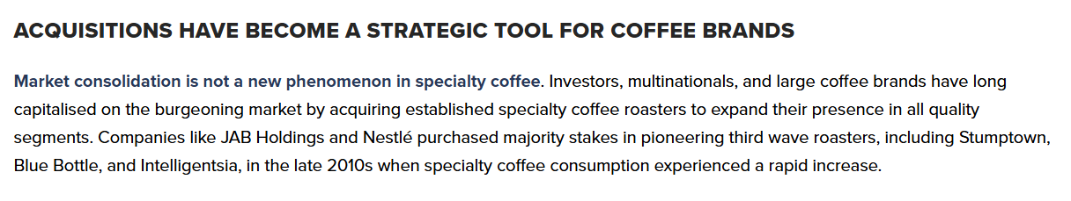
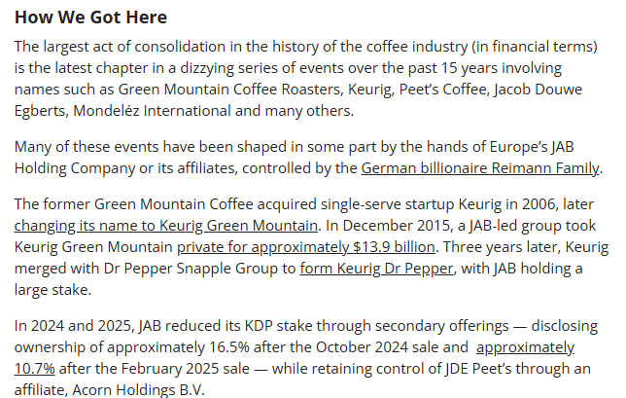
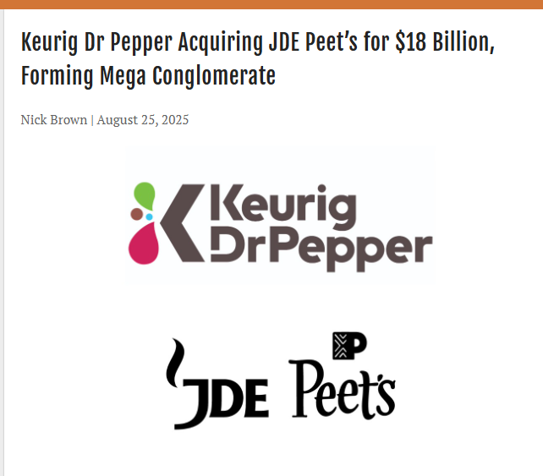

Slide 13
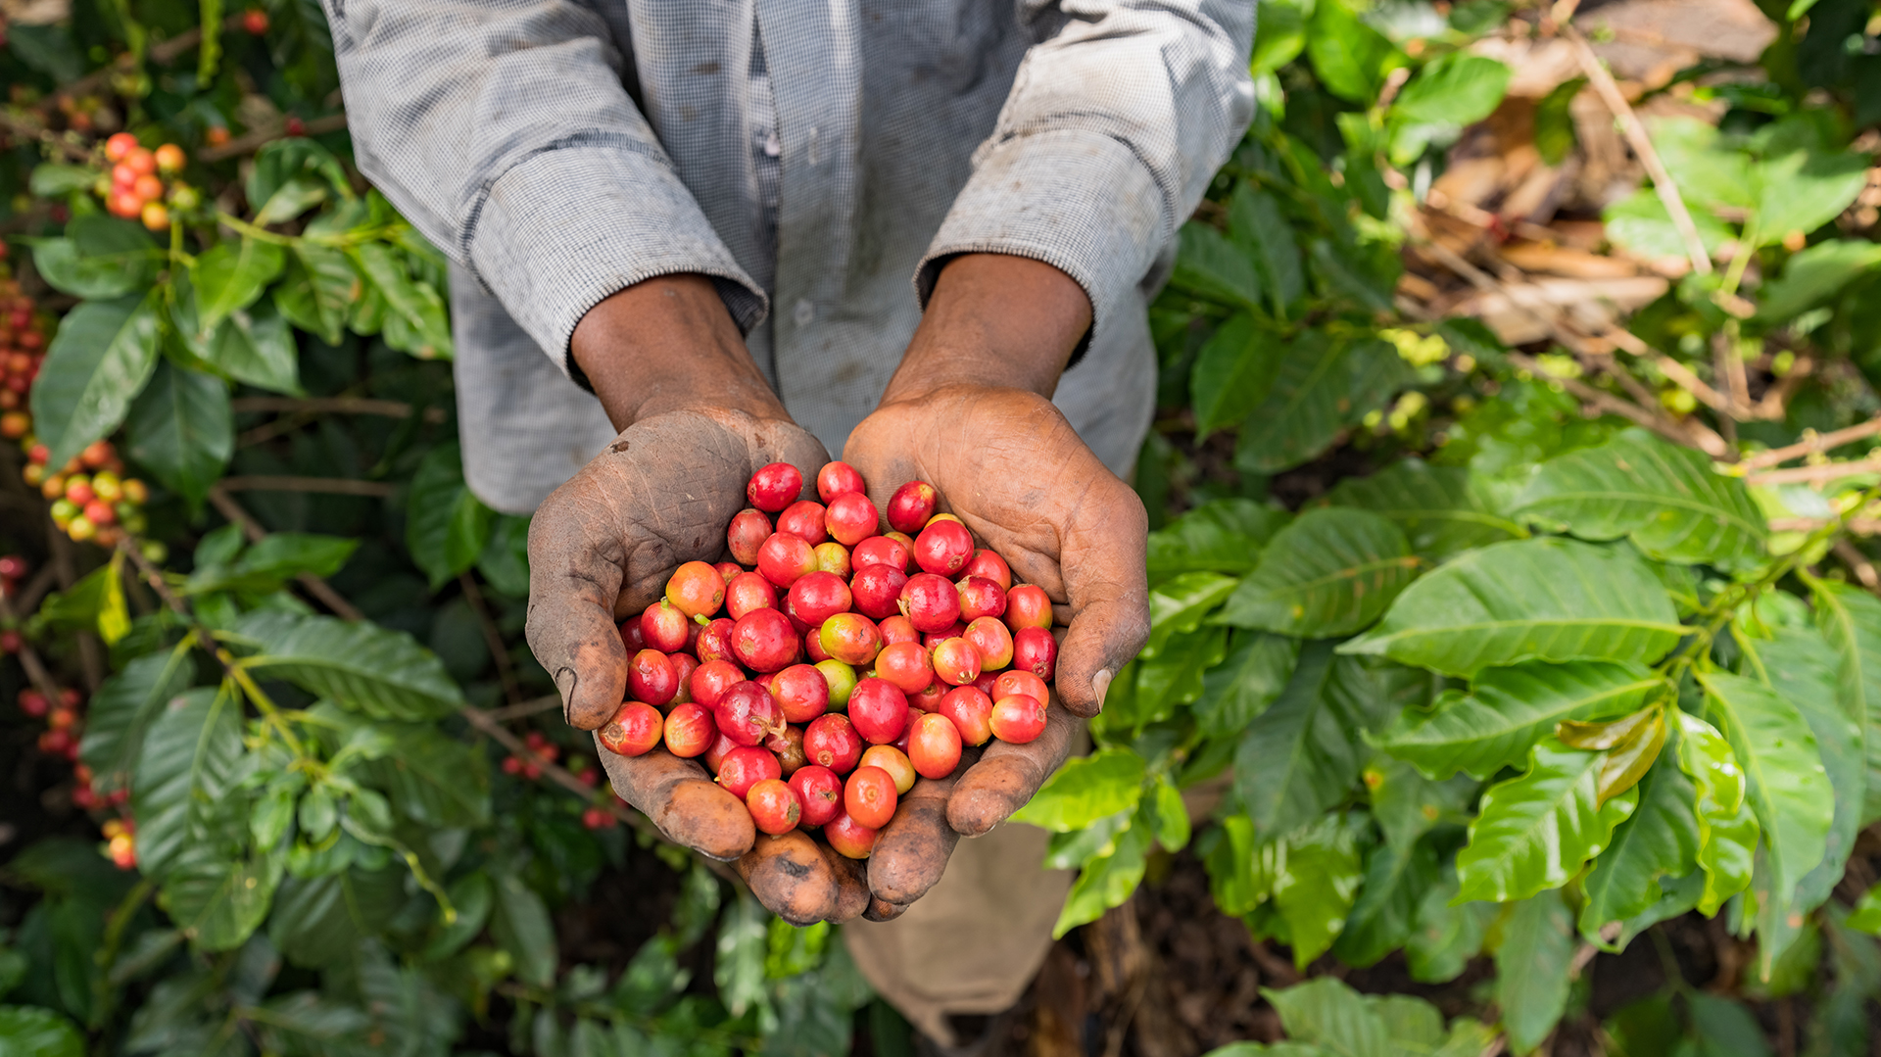
Climate and production

Slide 14
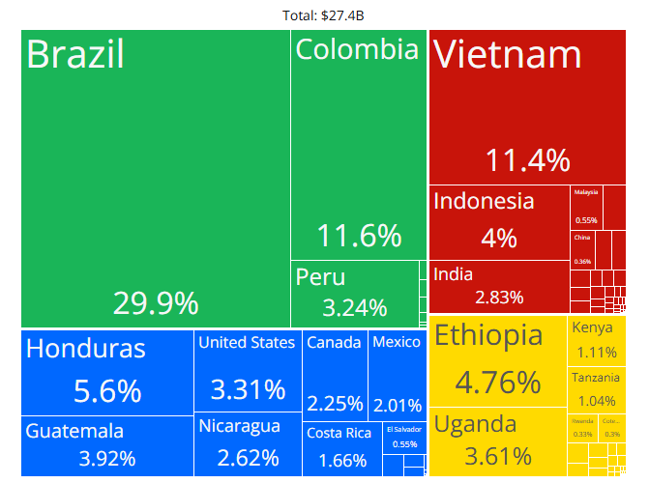
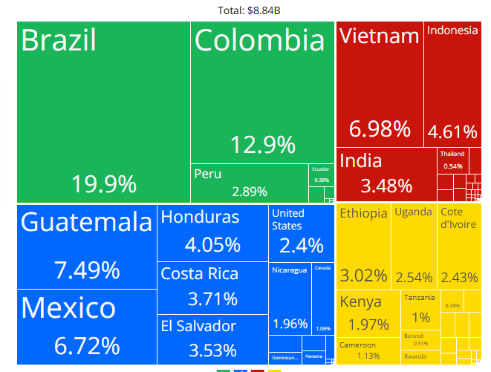
Exports of coffee in 2023 vs 2020

Slide 15
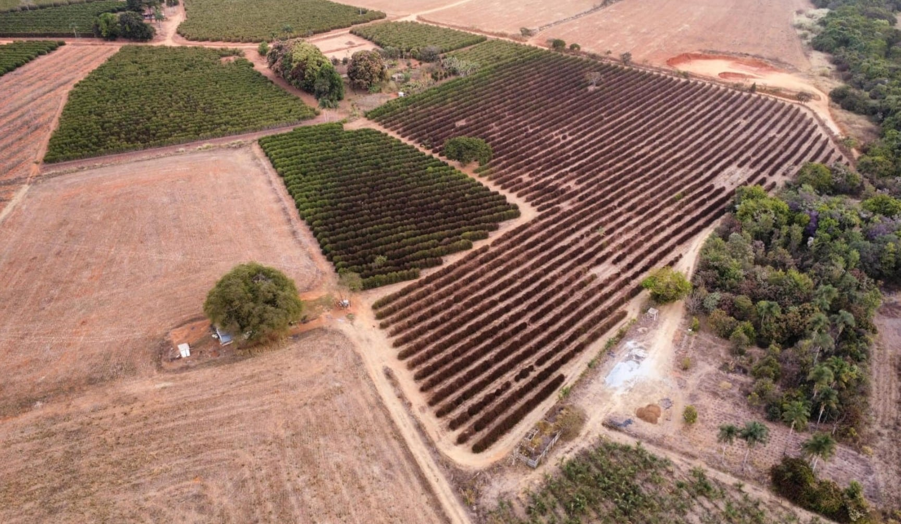

Slide 16
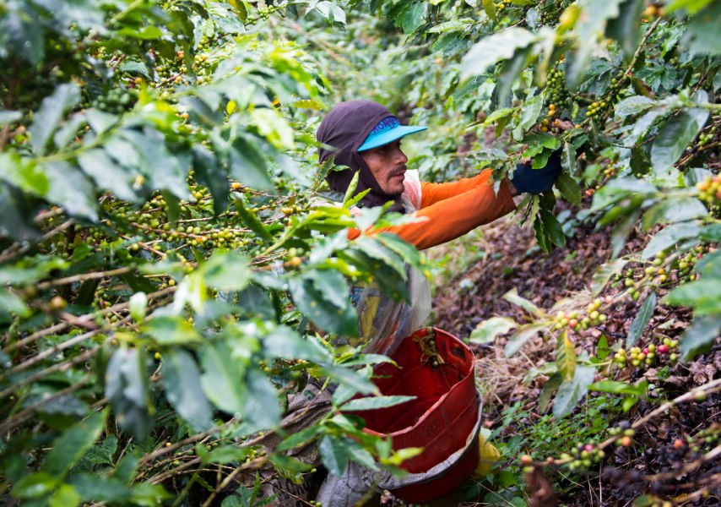

Labor shortages
Labor – a current and looming issue
Most producing countries hand harvest (exception of Brazil)
Harvest represents 40-60% of cost of production.
Migration has decreased
Extremely low pay, alternatives are more attractive
Generational shift

Slide 17
Consumers

Slide 18
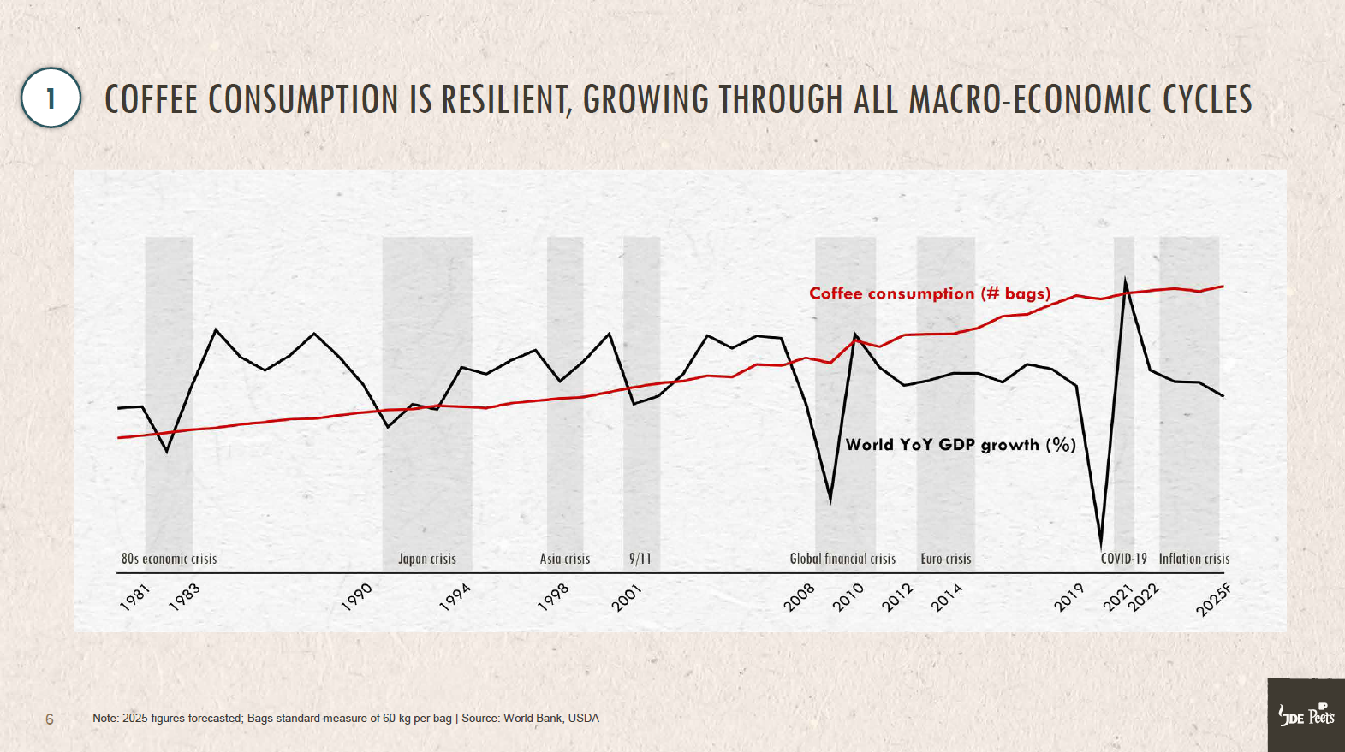

Slide 19


Changing tastes
Gen Alpha and producing countries
Increasing consumption in producing countries
Tea drinkers becoming coffee drinkers
Coffee as an Ingredient
Aesthetic and Flavored Drinks
“Content”
At home consumption
Convenience and Novelty
Info highlight

Slide 20
When the world feels unstable,
innovation often follows.
— Jennifer Welch, Bloomberg GeoEconomics
Notes:
She goes on to say: “Periods of geopolitical tension are often associated with arms races, trade barriers and conflict. But there is an upside: They have often fueled leaps in technology — from World War I’s advances in aviation, medicine and communications to the Cold War’s space race and technology revolution. Today, geopolitical friction is mobilizing vast investments in AI, quantum computing, biotechnology, semiconductors and other technologies — proof that volatility can sometimes be a catalyst for progress.”
This creates a unique moment of opportunity for us to answer disruption with disruption. When Shah talks about how disruption creates opportunity – in particular opportunity for the private sector to step in and center market-based solutions to difficult problems, like many of those we face in coffee. He is, in effect, talking about us. This is exactly what you all are doing via WCR.

Slide 21



Slide 22
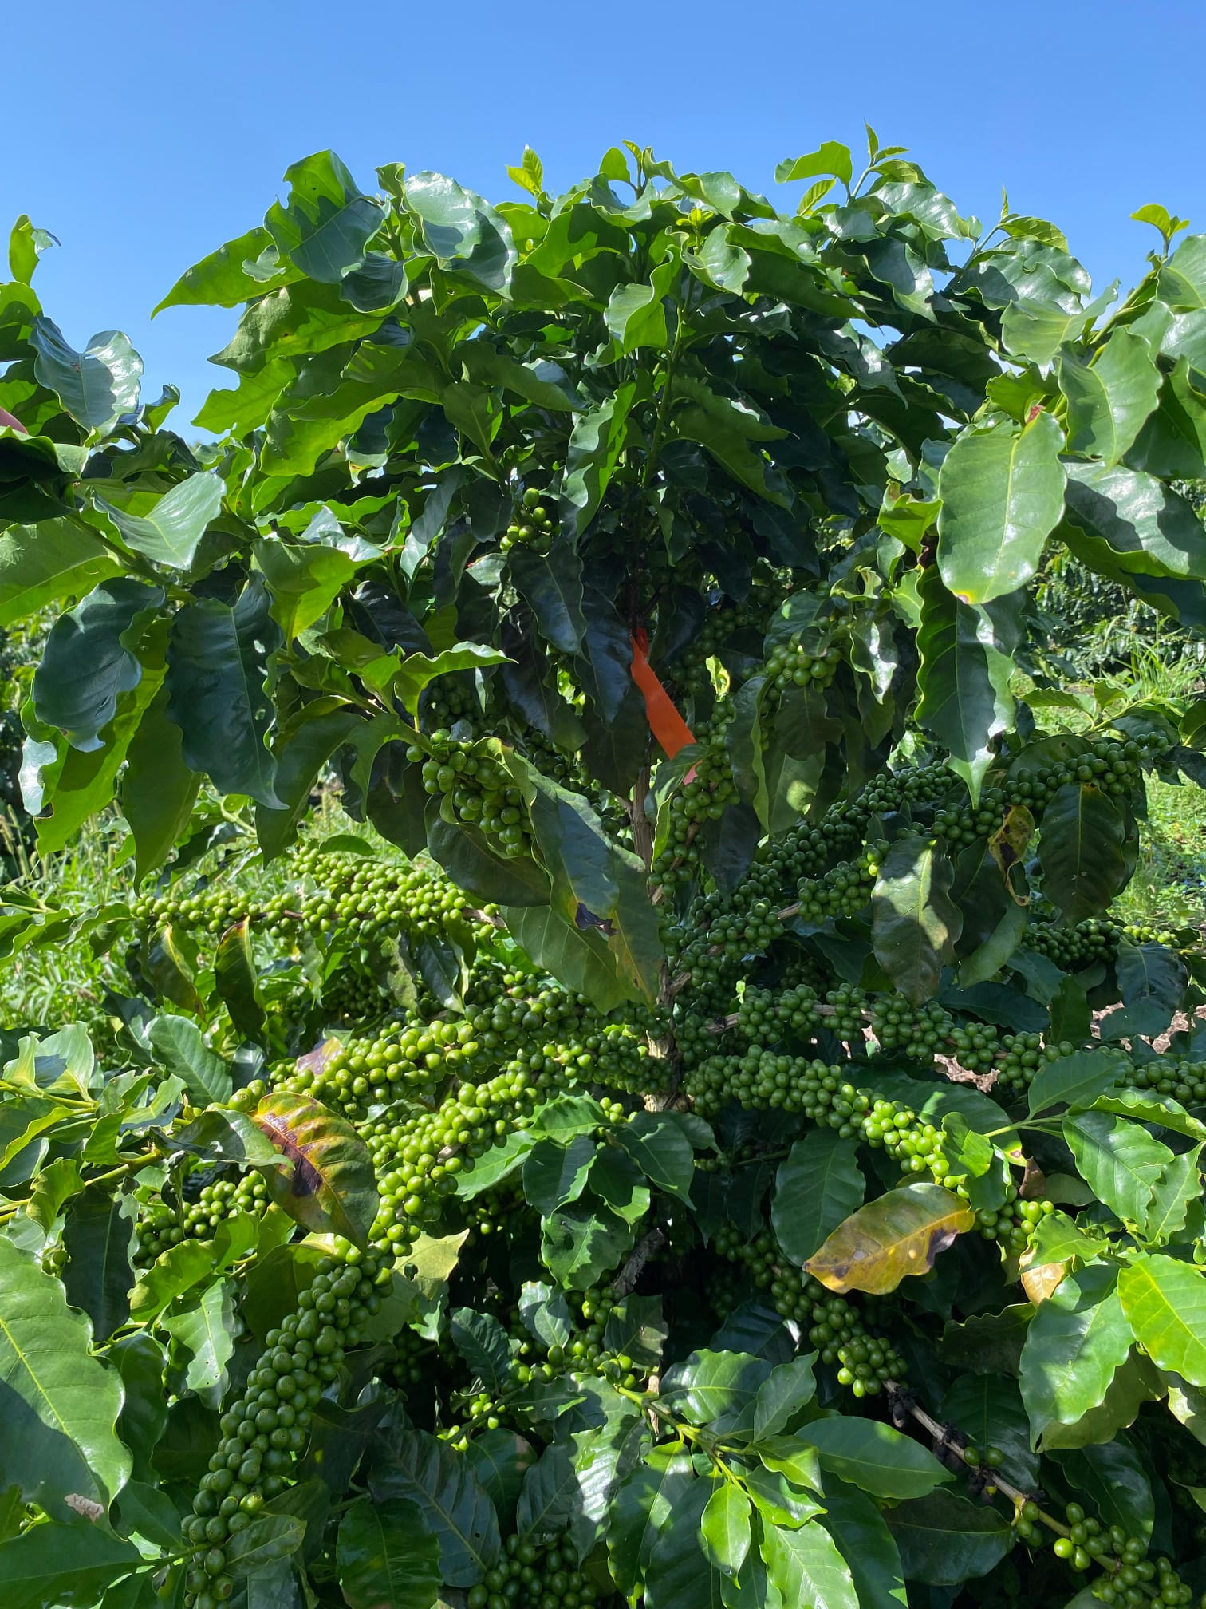
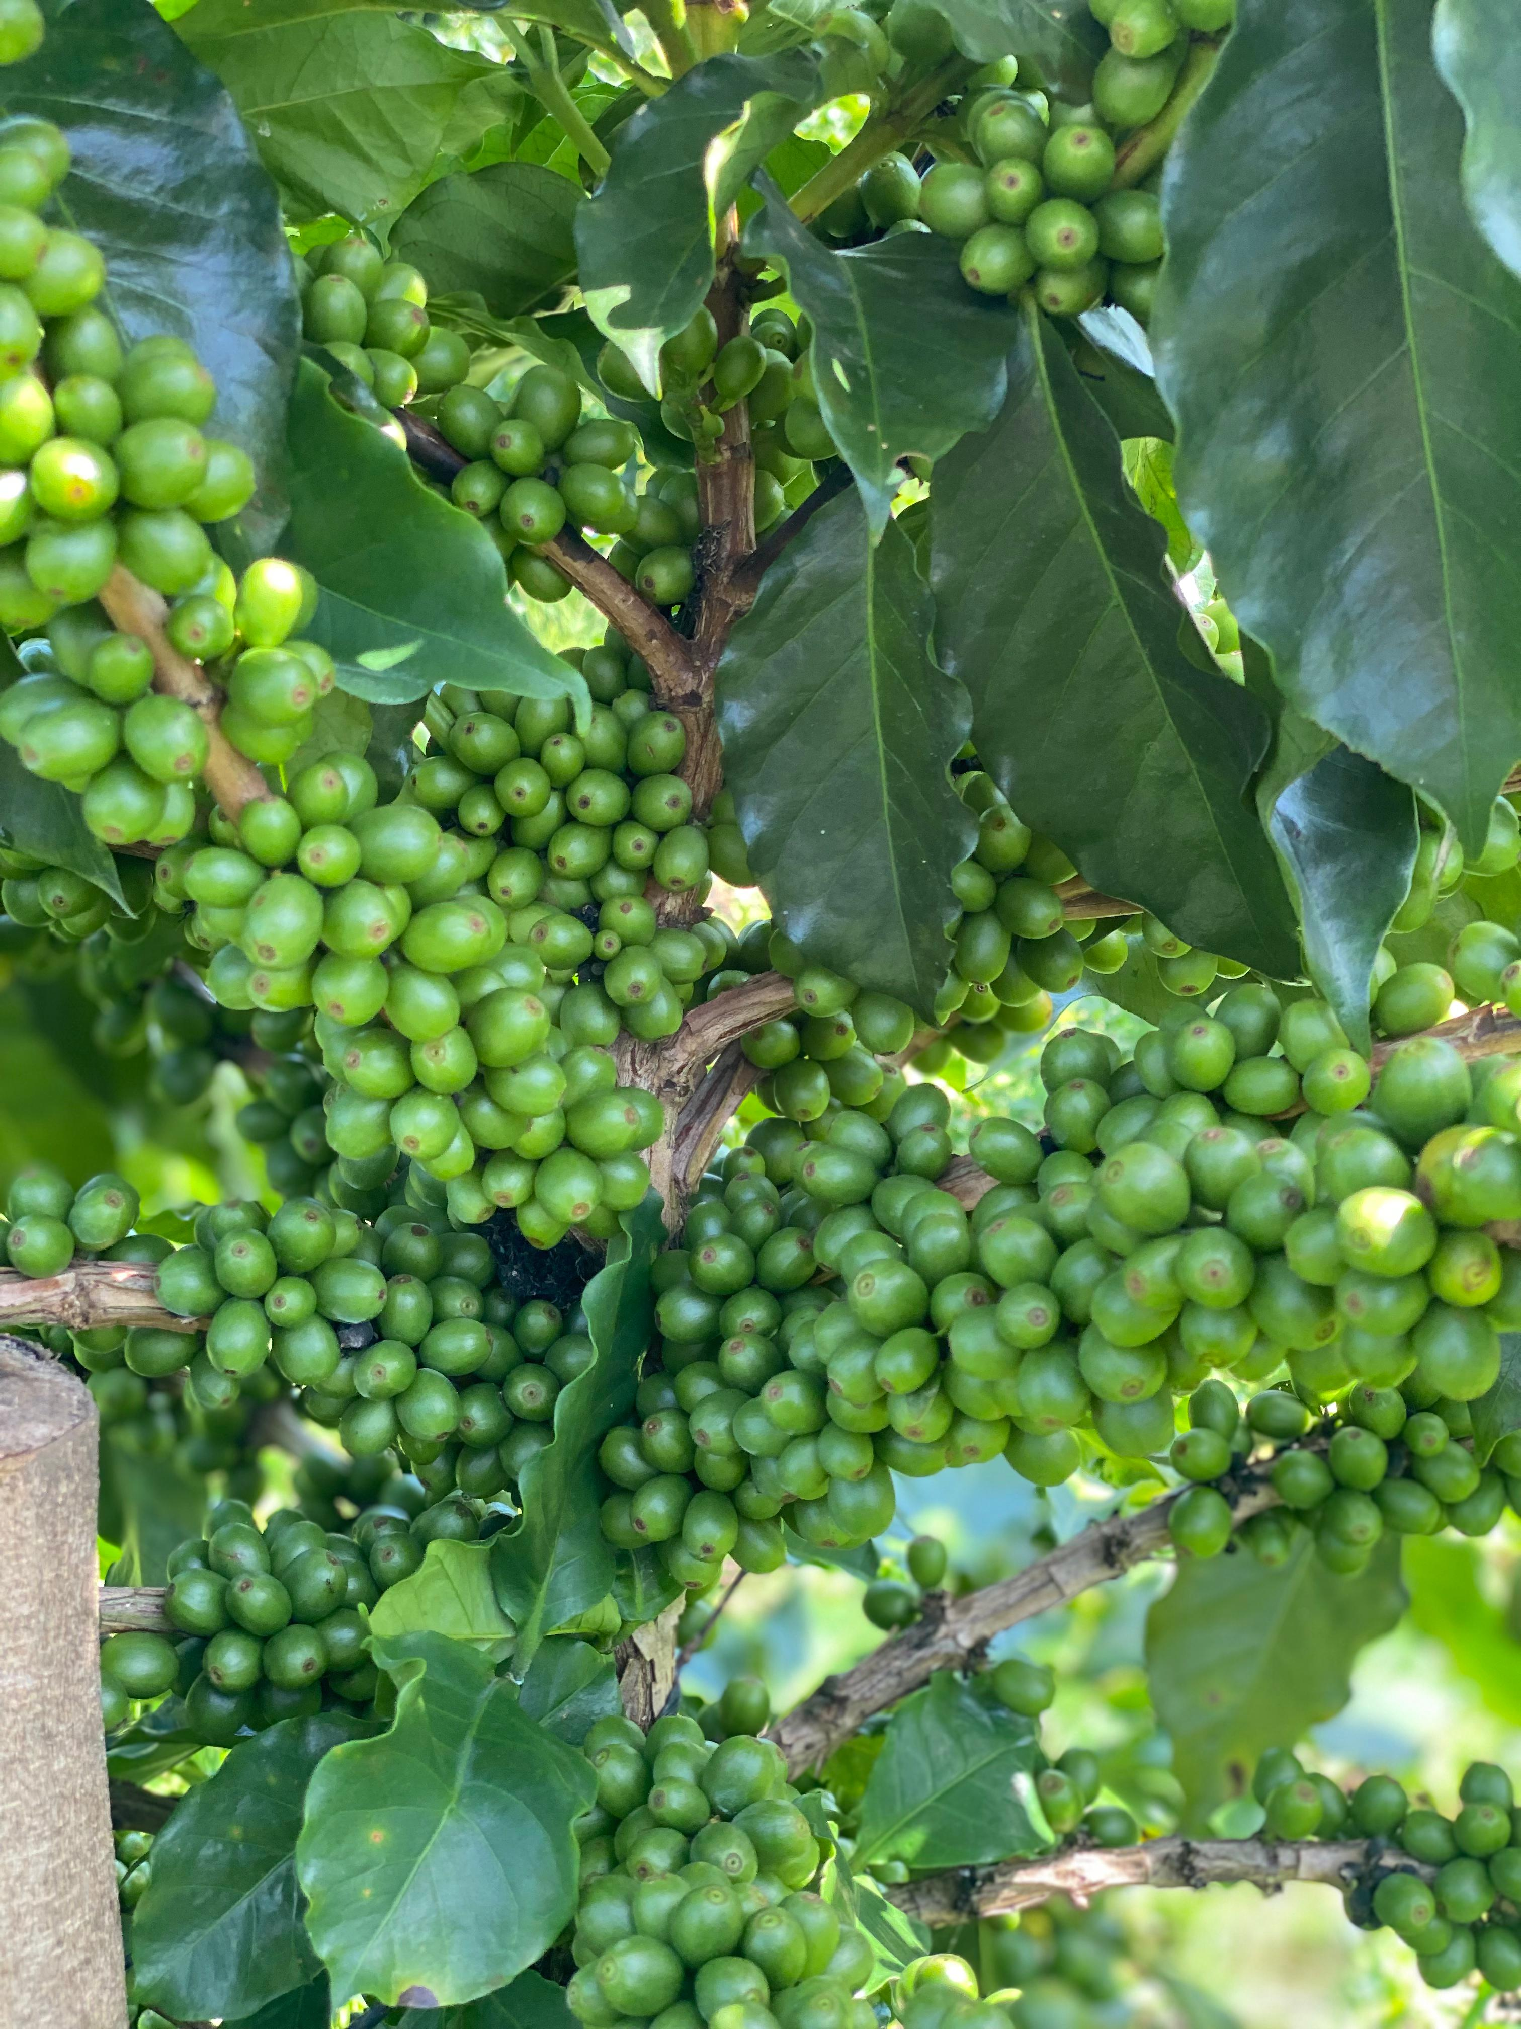

Long term solutions require innovations to keep on track
Breeding Factory October 2025
Notes:
Innovation is really nothing more than this: meeting moments of destructive disruption with constructive new solutions. We are moving forward a pipeline of genetics that will be disruptive in the most fruitful sense. They will alter the trajectory of risk that our industry faces. We are also poised to launch WCR Commercial, which will be similarly disruptive. Animating all of this is a clear and steady vision of advancing genetics that will create farmer prosperity and industry stability—a vision of innovation-driven growth.

Slide 23

What can we do as a breeding community to keep up in this environment and ride this wave?
What are ways we can deliver innovations faster?
Do we need to communicate our work differently?
How can we work together to do this better?
Are different collaborations needed? International collaborations? Private/ public partnerships?

Slide 24
Glossary
Hanna will remove slide after entereing terms into translation glossary
We are using an AI translation tool for live translation during the meeting. To ensure the tool transcribes and translates properly, we need to supply a glossary of all technical terms we plan to use in our presentations. Below, please add all proper names, scientific/technical terms, abbreviations, and acronyms you might use during this presentation. Enter abbreviations and full terms together.
If you will give your talk in Spanish, please put Spanish words in the glossary
Examples
GS = Genomic selection
CLR = coffee leaf rust
Marker-assisted breeding
Population improvement
Cupping

Slide 25
Best practices for replacing a photo
Remove this slide when done.
Select the photo you would like to replace
In the tool bar, select “Picture Format”
Locate “Change Picture” and find your new photo
If the photo is oddly cropped, or needs adjusting, select the “Crop” button and adjust as needed.
!
Make sure photos are not squished or distorted!
1
2
3

Slide 26
Transition Slide Title
Replace placeholder photos with relevant photos as needed. Move green rectangle over image out of way to replace photo and return it when done.

Slide 27
Keep these headlines to fewer than
80 characters including spaces
Subhead can be roughly 80 characters, move bullets down if more space is needed.
Bullet points can be set at size 18-24
Set in Source Sans Pro Light
Keep bullet points short and to the point
Bullets points should not extend beyond 2/3 the length of the page to improve legibility
Replace placeholder photos, with relevant photos as needed

Slide 28
Replace placeholder with graphs, charts, photos, or other content as needed
Short Title
Body copy can range in point size from 18 to 24. Important info can be highlighted with semibold, forest green text. Line spacing should be set to 1.0. Do your best to keep paragraphs short and to the point.
Short Subtitle
Bullet points can be set at
size 18-24
Set in Source Sans Pro Light
Keep bullet points short and
to the point
Bullets points should not extend beyond 2/3 the length
of the page to improve legibility

Slide 29
Short paragraphs can introduce important information. Set in Source Sans Serif Semibold. Highlights can be Leaf Green. Should not exceed 200 character. Adjust +/- 5 to fit space.
Data pullout / headline
Body copy can range in point size from 18 to 24. Important info can be highlighted with semibold,
forest green text. Line spacing should be set to 1.0.
Do your best to keep paragraphs short and to the point.
Replace placeholder with graphs, charts, photos, or other content as needed

Slide 30

Replace placeholder photos, with relevant photos as needed
Short Header
Subhead ~30 character or less
Body copy can range in point size from 18 to 24. Important info can be highlighted with semibold, forest green text. Line spacing should be set to 1.0. Do your best to keep paragraphs short and to the point.
Info highlight
Image credit

