Slide 1
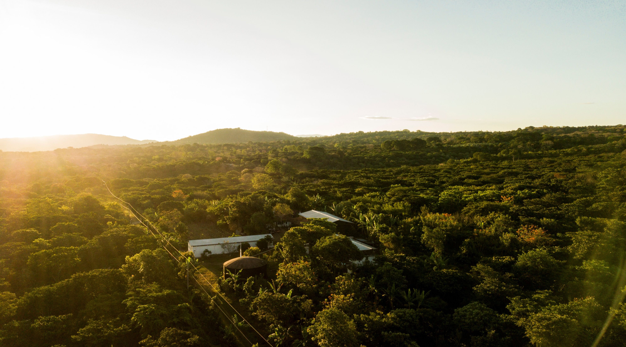


Mid Density Panel Genotyping (Arabica and Robusta)
Innovea Network Breeders Meeting
Cenicafe, Manizales, Colombia
November 17-21, 2025

Slide 2
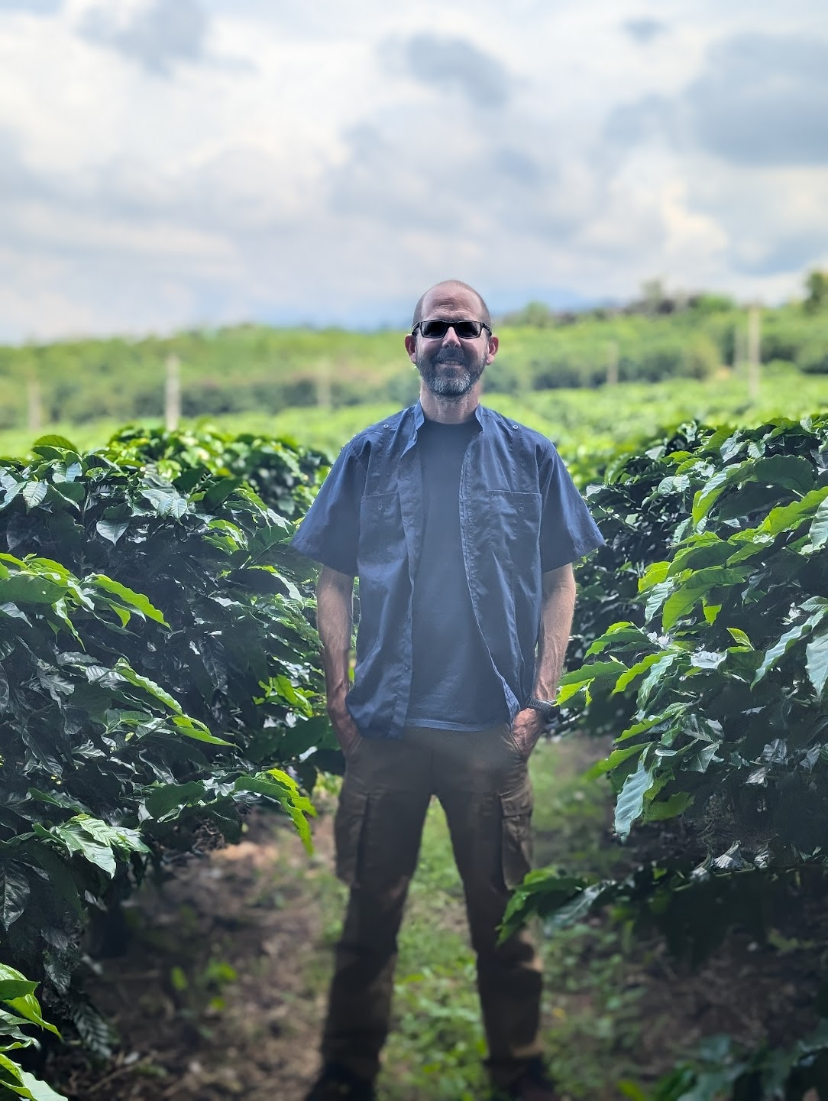
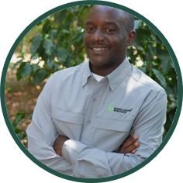
Presenters
Robert Kawuki
Research Scientist, Plant Breeding and Genomics
World Coffee Research
Jorge Berny
Research Scientist, Plant Breeding and Genomics
World Coffee Research

Slide 3
Introduction
Currently, no medium-density panel is broadly available for the arabica & robusta
Use:
Genomic prediction
Trait mapping
Diversity studies
Features:
Economically feasible
Markers relevant to the programs
Doesn´t require complex bioinformatics
Notes:
So, why did we begin this research? As many of you know, traditional Arabica coffee breeding is a slow process, often taking decades to develop a new variety. Historically, these programs haven't been able to routinely use modern molecular tools that could speed things up.
While powerful, high-density genetic tools already exist, they are often too expensive for regular use in public breeding programs. This has left a critical gap in the toolbox for coffee breeders. We realized there was a pressing need for a solution that was both effective and affordable to help us accelerate genetic gain

Slide 4
Developing the arabica mid density panel
Identify and officialise collaborators
Determine and source the relevant diversity to be included (discovery panel)
Collect and ship samples to DArT
Sequencing (DArTreseq™)
Identify Single Nucleotide Polymorphisms (SNPs)
Filtered SNPs down to the 5000 most useful
Development of the DArTag assays
Validation of the panel with independent samples
Publish and release of the panel
FC Attachment Seq Pr Barcode Anneal 1 Target Anneal 2 FC Attachment
Notes:
So, how did we build it? We followed a clear, multi-step process. It began with selecting a wide range of diverse coffee varieties from our partners around the world. We then sent leaf samples to our collaborators at DArT, who extracted the DNA and generated the sequence data. From that data, we identified hundreds of thousands of genetic markers, or SNPs, and filtered them down to the 5,000 most informative ones. Finally, we validated the panel and are making it publicly available.

Slide 5
Materials and Methods
Marker discovery arabica panel
94 accessions from six institutions: Empresa Brasileira de Pesquisa Agropecuária / Empresa de Pesquisa Agropecuária de Minas Gerais (Epamig/Embrapa), Rwanda Agriculture and Animal Resources Development Board (RAB), Instituto del Café de Costa Rica (ICAFE), Centro Agronómico Tropical de Investigación y Enseñanza (CATIE) and World Coffee Research (WCR).
Including historical founders, diversity within wild forms, and improved lines and hybrids currently used in breeding programs
Validaton panel
  the same panel for the marker discovery
  94 accessions of the WCR/CATIE Core Collection
  92 F₂ individuals of the Epamig/Embrapa cross of H514-7-16-3-17 and Siriema
  91 F₂ individuals of a cross of Marsellesa x Geisha from WCR
  259 individuals from different populations of diverse pedigrees from WCR´s breeding program.
Notes:
To ensure the panel would be useful for all breeders, we built it using a very diverse set of genotypes. The initial 'discovery panel' included 94 accessions from six key research institutions. This collection represented everything from historical founding varieties and wild coffee relatives to the modern, improved lines and hybrids used in breeding programs today. We then validated the panel on an even larger set, including the WCR Core Collection and several breeding populations, to ensure it worked reliably across different genetic backgrounds

Slide 6
Results
From an initial filtering of 252,246 SNPs identified through sequencing, 26,424 high-quality SNP markers remained. From these candidates, 5,000 markers were selected, minimizing the gaps across the genome.
In addition, 53 markers from a low-density panel (Zhang et al. 2021) were integrated to enhance connectivity, resulting in a total of 5,053 markers.
  2,893 in the C. canephora subgenome (SubCc) and 2,160 in the C. eugenioides (SubCe)
  Marker density of 0.23 markers per Mega base pairs, and 0.19 and 0.25, for SubCc and SubCe.
  The missing data frequency and heterozygosity frequency were 0.04 and 0.06, respectively.
Notes:
After all the sequencing and filtering, what did we end up with? We started with over 250,000 potential markers and narrowed them down to a final set of just over 5,000 high-quality, reliable SNPs. These markers are distributed across both subgenomes of Arabica coffee—the canephora and eugenioides subgenomes—giving us a clear picture of the full genome. Importantly, the panel has very low rates of missing data, making it a highly reliable tool for analysis.

Slide 7
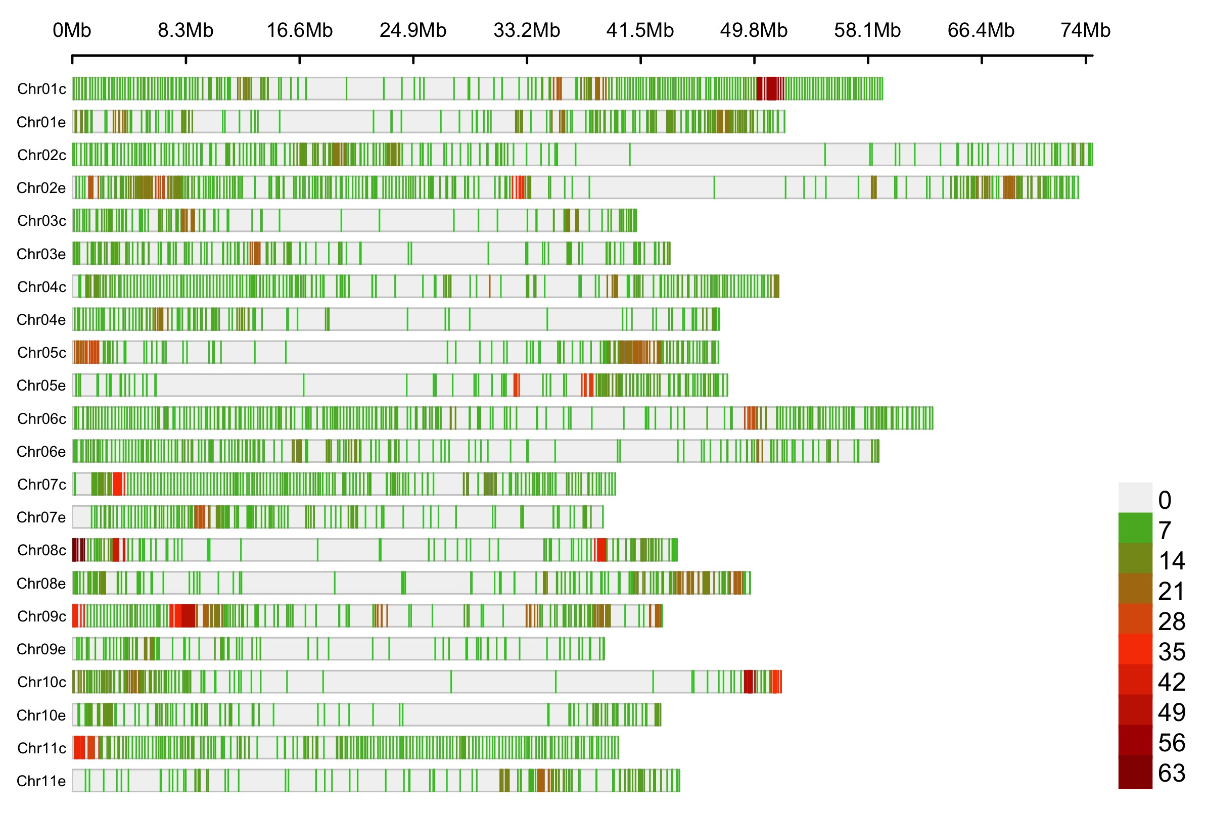
Results
Markers are well dispersed across the chromosomes, although there are gaps in the middle of some of the chromosomes, most notably in subchromosomes 2, 5, and 10 of both subgenomes.
Higher density is usually at the peri-centromeric and telomeric regions, where gene density is generally higher
Notes:
This figure shows the distribution of our 5,000 markers across the coffee genome. As you can see, the markers are well-dispersed, providing good coverage across all the chromosomes. While there are a few gaps, the overall distribution is excellent and concentrated in gene-rich regions, which is exactly what we need for breeding applications

Slide 8
Results
Discriminant analysis of principal components analysis (DAPC) identified seven clusters.
1
Genotypes from the discovery panel and a few samples from the other datasets
+
2
Wild/landraces
3
WCR F₂ population and a few of the breeding programs
x
Introgressed lines from Sarchimor group
4
Introgressed lines, including the three Timor hybrids from CIFC, and the breeding program material
5
6
Epamig/Embrapa F₂ population, its parents, as well as the Timor hybrids from UFV
Y
7
Few introgressed lines, the hybrids with introgressed parents, and a large proportion of breeding program individuals.
Notes:
Next, we tested the panel's ability to distinguish between different genetic groups. This analysis identified seven distinct clusters. We could clearly see the separation of wild and cultivated varieties, as well as distinct groupings for modern breeding material. For instance, Group 6 in purple contains a specific F2 population from our partners at Embrapa, while Group 4 contains introgressed lines like Sarchimors. This confirms the panel is highly effective at revealing the genetic relationships between different breeding populations and coffee varieties.

Slide 9
Results Subgenome-specific hierarchical clusters comparison
Canephora diversity is more affected by the interspecific introgressions (HdTs)
First split is between Core Ethiopia and the rest
Notes:
In the C. canephora subgenome, the first cluster partition differentiated between the Timor hybrids and most of its derivatives, also included C. liberica and C. racemosa introgressed lines, while the second included all the non-introgressed and some of HdT derivatives.
it is partitioned between a cluster of all of the Core Ethiopia grouping, and the others, including Typica/Bourbon, Sudan, Ethiopian legacy, a few of Core Ethiopia, and some HdT derivatives. In the latter cluster, it is also divided into introgressed derivatives and non-introgressed lines and non-introgressed and introgressed hybrids. Further clustering differentiated between Bourbon, Typica, Bourbon x Typica derivatives (Catuai, Mundo Novo), as well as Ethiopian Legacy and Sudan.
In the C. eugenioides subgenome, the first partition differentiated between Core Ethiopia and the other domesticated groups. The latter group is divided between a cluster that includes Typica and Typica derivatives and seven of the eight HdTs, and a second with the rest germplasm. Within the latter group, one subcluster included all Ethiopian Legacy, Sudan, a few Core Ethiopia, and Hybrids. The other subcluster included Bourbon, Bourbon x Typica derivatives, and HdT derivatives.

Slide 10
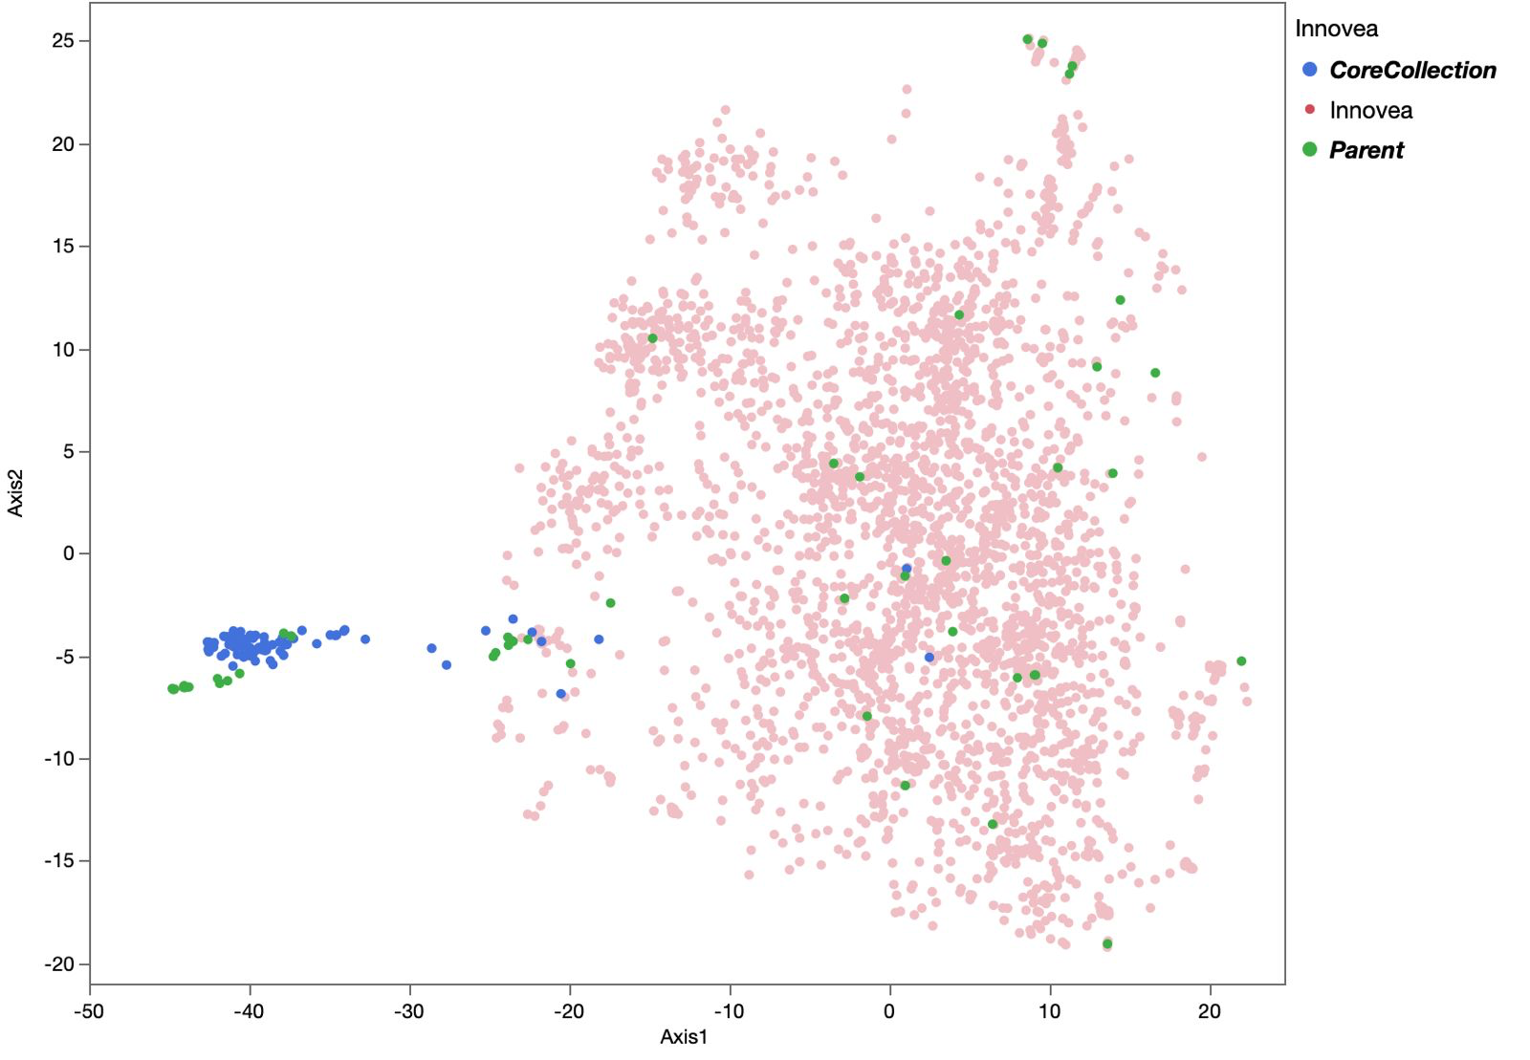
Applications to Innovea
Quality control
Genomic prediction (within and accross sites)
Mapping traits (within and accross sites)
Marker validation of outside projects
Diversity gap analysis
Pareny identification for cycle 2

Slide 11
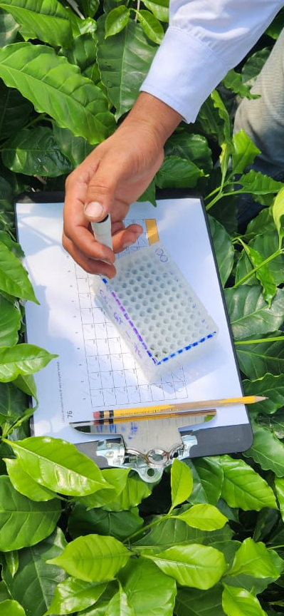
Conclusions and Perspectives
Strategic balance of cost and information: The panel's primary advantage is its strategic balance between genetic information content and cost. It provides enough data for key applications without the prohibitive expense of higher-density platforms like Genotyping by Sequence (GBS), which are often not economically viable for routine use in coffee breeding programs.
Comprehensive and well-characterized panel: The DArTag panel consists of 5,053 SNP markers developed from diverse and relevant germplasm. It offers excellent genome coverage (98.7%) and is well-distributed across both of C. arabica's subgenomes (C. canephora and C. eugenioides).
The panel will be essential for breeding applications such as genomic mapping, genomic prediction, diversity, and phylogenetic analysis.
By providing an affordable, standardized, and effective tool, this panel has great potential for widespread adoption in breeding programs worldwide. It facilitates collaboration and promises to accelerate the development of improved coffee varieties

Slide 12
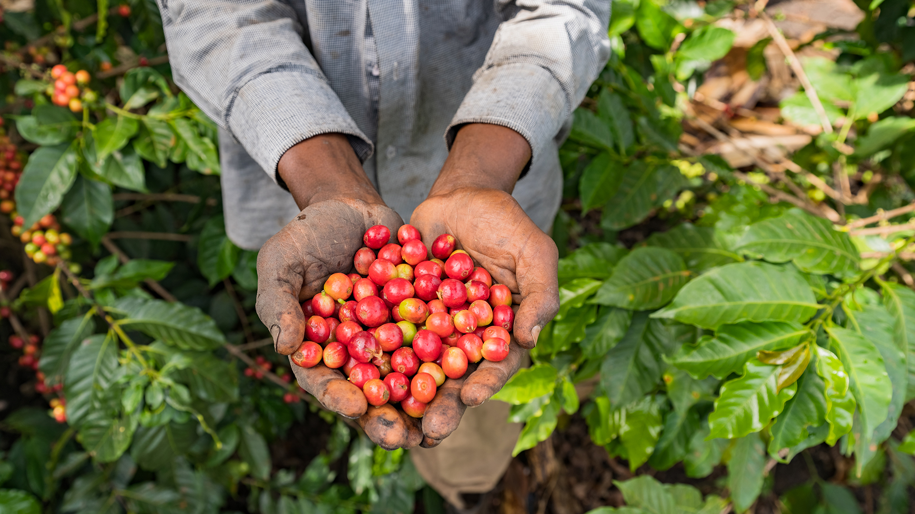
Arabica Foundational Research Essential for Development of Robusta MDP

Slide 13
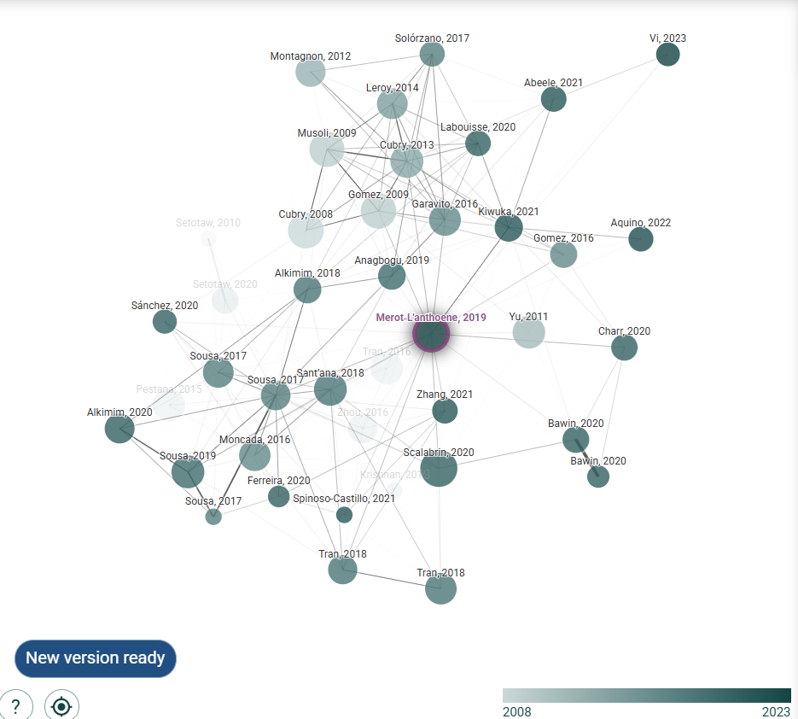
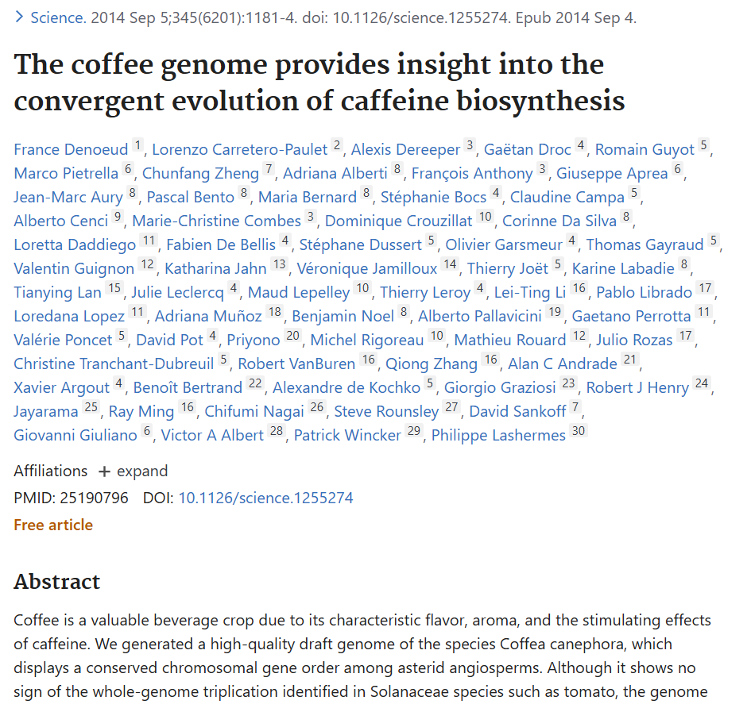
Foundational Empirical Studies Essential

Slide 14
Robusta MDP Considerations
Critical robusta breeding challenge | MDP role
Long breeding cycles and thus long timelines and costs for variety deployment | Genome-wide distribution of MDP enables use of genomic selection to cut back on timelines
Most economically important traits are quantitative | MDP makes it possible to predict traits without the need for phenotyping.
Sensitivity to environment, magnifies GxE interactions | Difficult to identify stable genotypes using phenotypic data alone, use of kinship from MDP essential
Limited pedigree information | MDP can readily reconstruct estimate kinship
Commercial production relies on compatibility of deployed clones | Parental verification and cross-performance prediction made possible with MDP
High heterozygosity complicates conservation efforts | Robustness of MDP makes it possible to generate core collections across wild, semi-wild and cultivated
Notes:
To ensure the panel would be useful for all breeders, we built it using a very diverse set of genotypes. The initial 'discovery panel' included 94 accessions from six key research institutions. This collection represented everything from historical founding varieties and wild coffee relatives to the modern, improved lines and hybrids used in breeding programs today. We then validated the panel on an even larger set, including the WCR Core Collection and several breeding populations, to ensure it worked reliably across different genetic backgrounds

Slide 15
Path To Develop a robust Robusta MDP
Identify partners and clarify why MDP is pertinent now (Yr 0. 2025)
Assemble diverse panel: wild, semi-wild, cultivated, genetic group coverage (Yr1: 2026).
High density genotyping to discover thousands of SNPs (Yr 1: 2026).
Pre-SNP selection: Quality filtering and analyses to infer use and value (Yr 1: 2026)
Validate MDP on old and new individuals to infer call rate, concordance and use (Yr 2: 2027)
Develop frameworks for routine use of MDP (Yr 3: 2028)
Verify pre-selected SNPs (using standard metrics) and submit for MDP design (Yr 1: 2026)
Notes:
To ensure the panel would be useful for all breeders, we built it using a very diverse set of genotypes. The initial 'discovery panel' included 94 accessions from six key research institutions. This collection represented everything from historical founding varieties and wild coffee relatives to the modern, improved lines and hybrids used in breeding programs today. We then validated the panel on an even larger set, including the WCR Core Collection and several breeding populations, to ensure it worked reliably across different genetic backgrounds

Slide 16
Action/Process | Responsible Entity
Finalize FFAR funding contract | WCR
Identify partners and clarify benefits of MDP | WCR
Agreements with partners | WCR
Assemble and ship tissue of diverse clones to constitute discovery panel | National Coffee Institutes; WCR to provide support
High density genotyping to discover thousands of SNPs | Contracted Service (e.g. Diversity Arrays Technology)
Pre-SNP selection: Quality filtering and analyses to infer use and value | Contracted Service (e.g. Diversity Arrays Technology) alongside WCR
Verify pre-selected SNPs and submit for MDP design | Contracted Service (e.g. Diversity Arrays Technology) alongside WCR; Bioinformatics Consultant
Validate MDP to infer call rate and concordance. | National Coffee Institutes; WCR; Bioinformatics Consultant
Develop frameworks for routine use | National Coffee Institutes; WCR; Bioinformatics Consultant
Scientific Collaboration is essential to develop a robust MDP
Notes:
To ensure the panel would be useful for all breeders, we built it using a very diverse set of genotypes. The initial 'discovery panel' included 94 accessions from six key research institutions. This collection represented everything from historical founding varieties and wild coffee relatives to the modern, improved lines and hybrids used in breeding programs today. We then validated the panel on an even larger set, including the WCR Core Collection and several breeding populations, to ensure it worked reliably across different genetic backgrounds

Slide 17
Contextualized Robusta MDP
SNP ID | Chromosome | Position (Base pair) | Reference allele | Alternative allele | PIC (Polymorphism information content) | Minor allele Freq
Cc0001 | 1 | 1,000 | T | C | 0.41 | 0.25
Cc0002 | 7 | 256,730 | C | T | 0.25 | 0.16
. . . | . . . | . . . | . . . | . . . | . . . | . . .
Cc3500 | 8 | 12,603,000 | G | A | 0.43 | 0.11
Genotyping facility provides: variant call format (VCF); SNP map files; QC report and Final Report
Notes:
To ensure the panel would be useful for all breeders, we built it using a very diverse set of genotypes. The initial 'discovery panel' included 94 accessions from six key research institutions. This collection represented everything from historical founding varieties and wild coffee relatives to the modern, improved lines and hybrids used in breeding programs today. We then validated the panel on an even larger set, including the WCR Core Collection and several breeding populations, to ensure it worked reliably across different genetic backgrounds

Slide 18
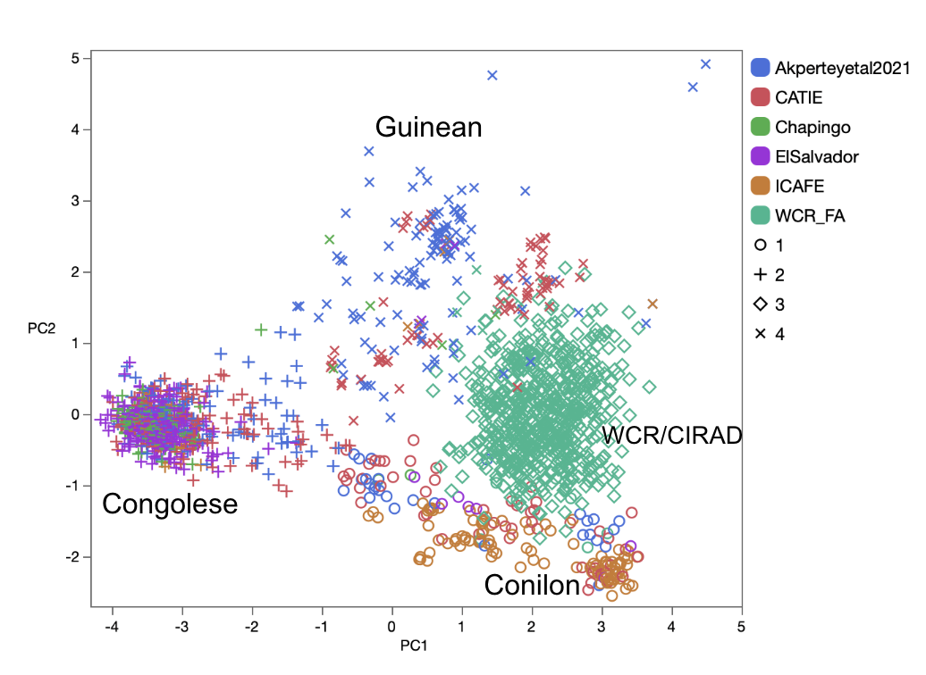
Discovery panel germplasm
  188 samples
  Which
    Overall diversity
    Breeding founders
  Who is donating tissue

