Slide 1
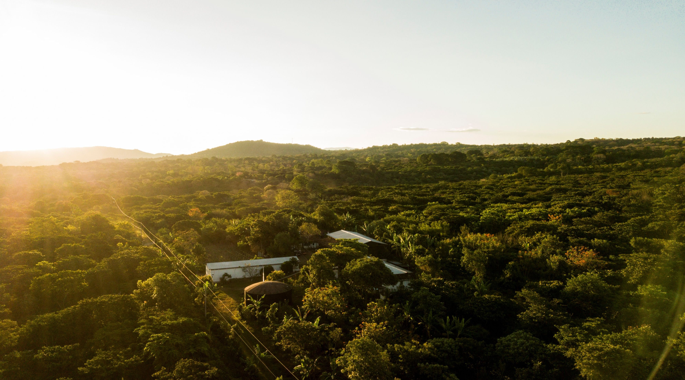


Robusta breeding strategy, progress and field design
Innovea Network Breeders Meeting
Cenicafe, Manizales, Colombia
November 17-21, 2025

Slide 2
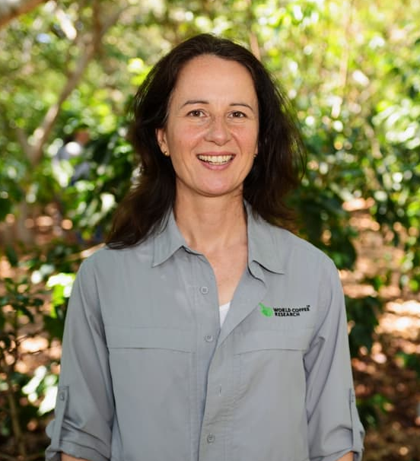

Presenters
Tania Humphrey, Ph.D.
Director, Research & Development
World Coffee Research
Robert Kawuki, Ph.D.
Research Scientist, Plant Breeding and Genomics
World Coffee Research

Slide 3
Glossary
Hanna will remove slide after entereing terms into translation glossary
3Rs = Replication, Randomization and Restriction
WCR-CIRAD genetic group = population generated by hybridisations between "Guinean" and "Conilons"
TPE = Target Population Environment ( this represents real-world environments where majority of farmers cultivate robusta)

Slide 4
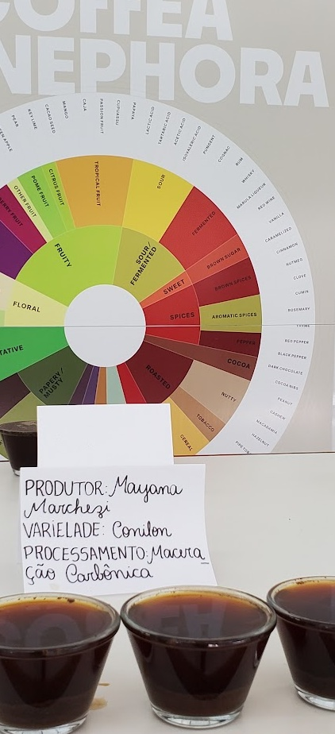
Create new, high quality, high performing, canephora varieties
Cycle 1: Build the foundations for improving global capacity in canephora breeding
Goals
Develop a collaborative platform for organizations to co-operate on breeding
Infuse multiple breeding pipelines with new and diverse germplasm
Evaluate material across multiple environments
Identify early selections suitable for variety registration
Develop a training database for genomic prediction
Generate knowledge to inform strategy for subsequent breeding cycles

Slide 5
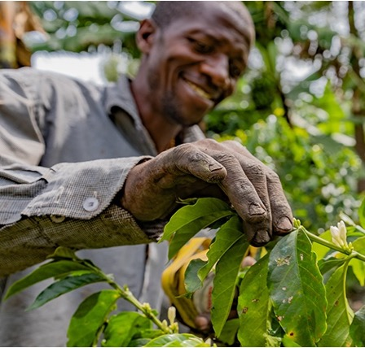

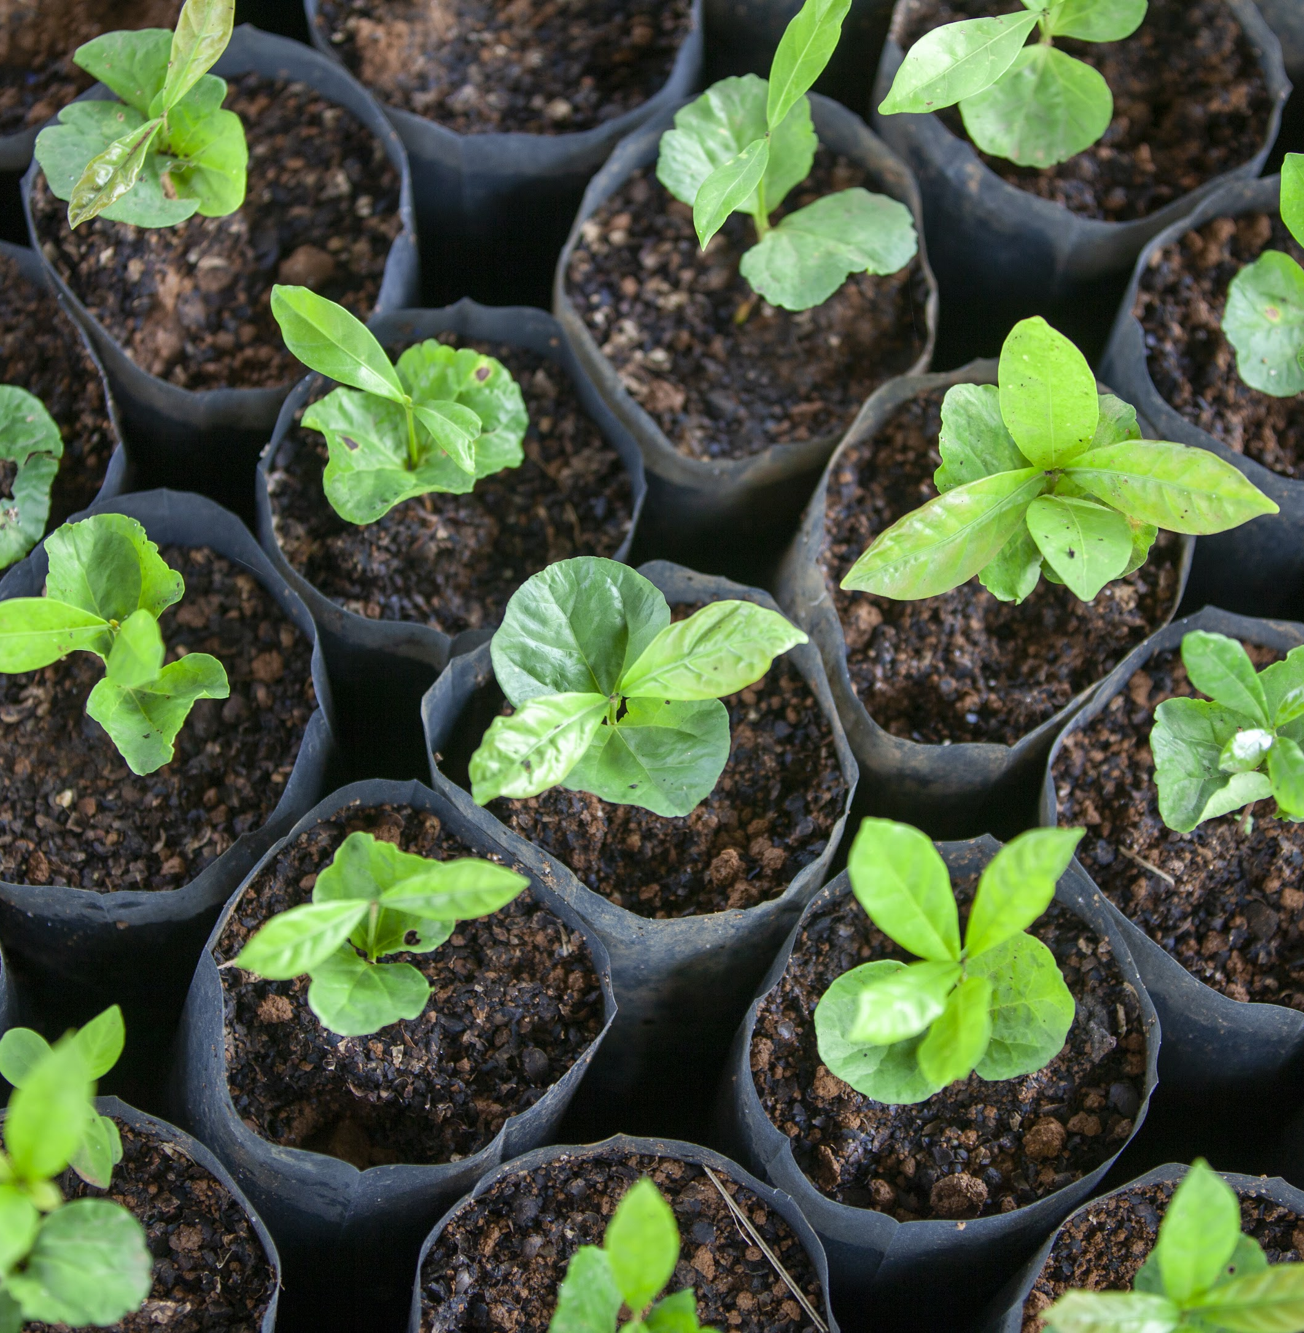
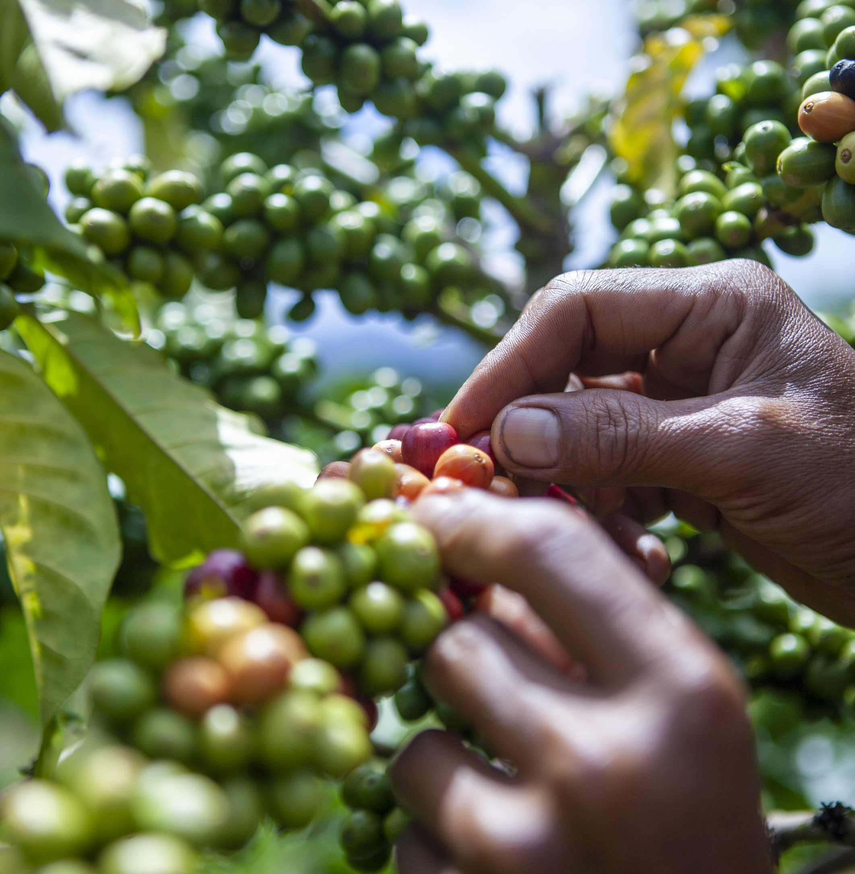
Demand-led
Ensure supply risk mitigation and the continued success of a diverse array of robusta-producing origins.
Design Principles of Robusta Breeding Strategy
Speed is a priority
Climate change is impacting coffee now. Breeding timelines are long. We need to produce more productive and resilient varieties as fast as we can.
PROGRAM DESIGN PRINCIPLES
Creating new, high-quality, high-performing canephora varieties
Use existing resources
There is limited data and barriers exist to germplasm transfer. Start with what we have available.

Slide 6
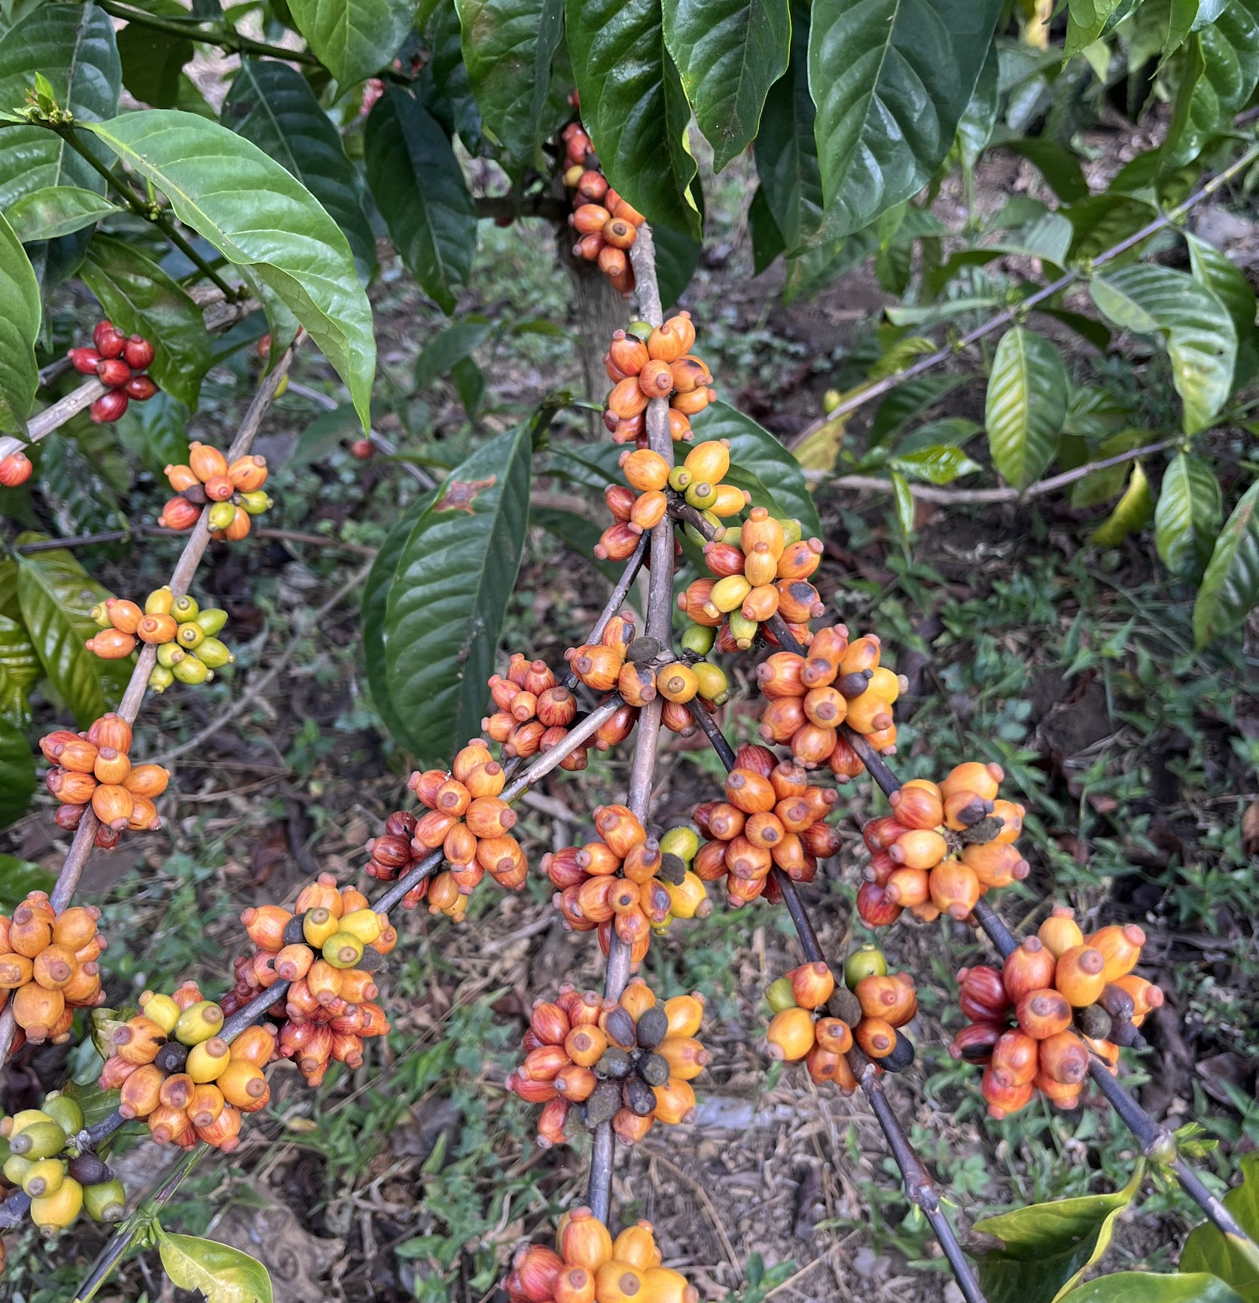

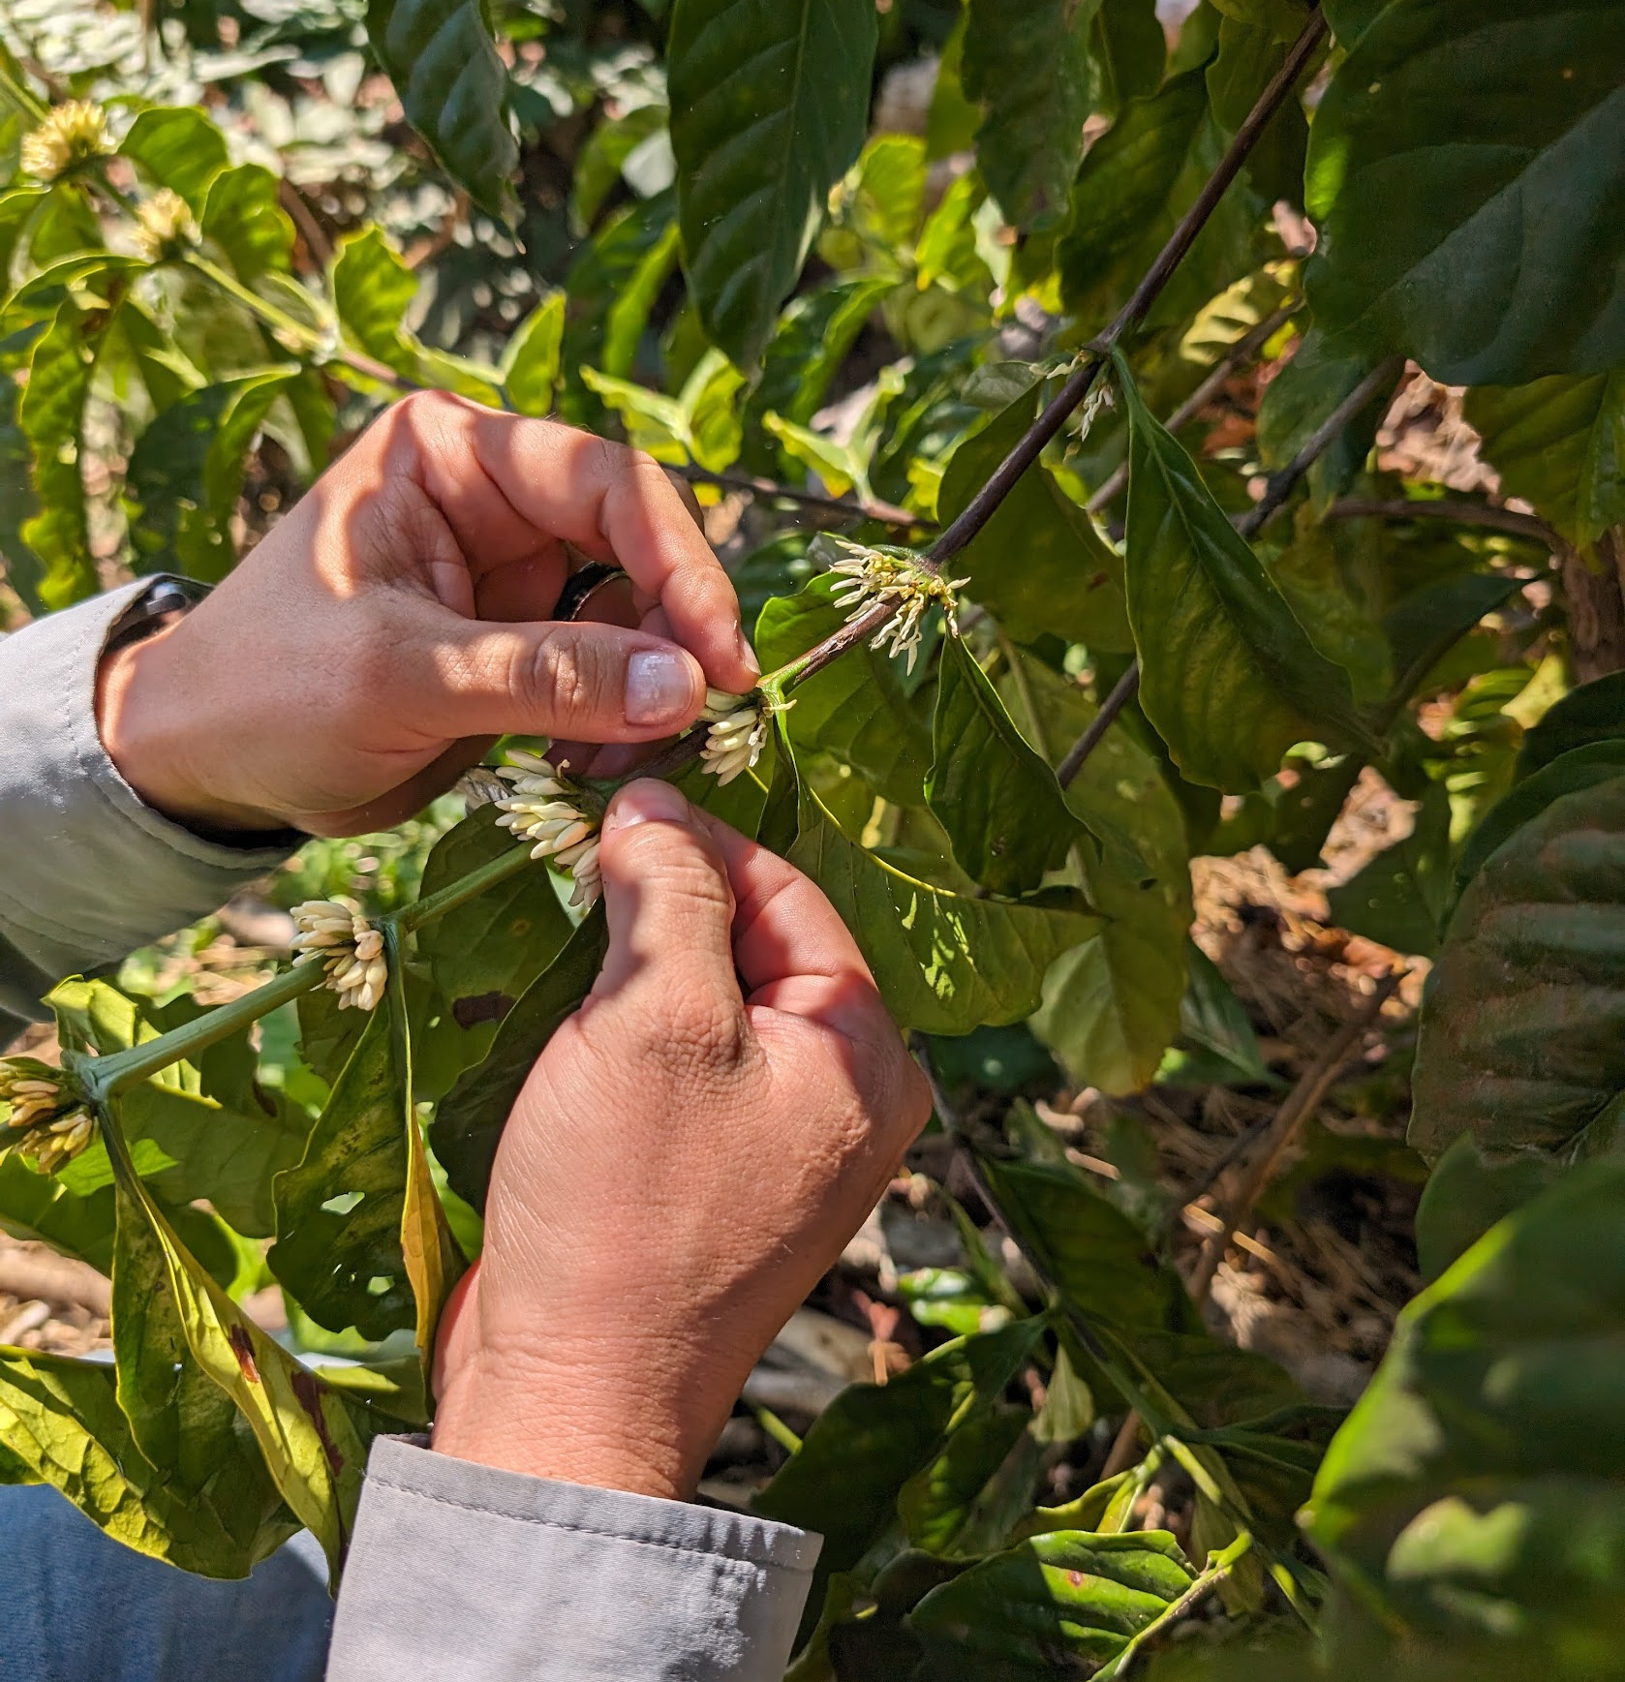

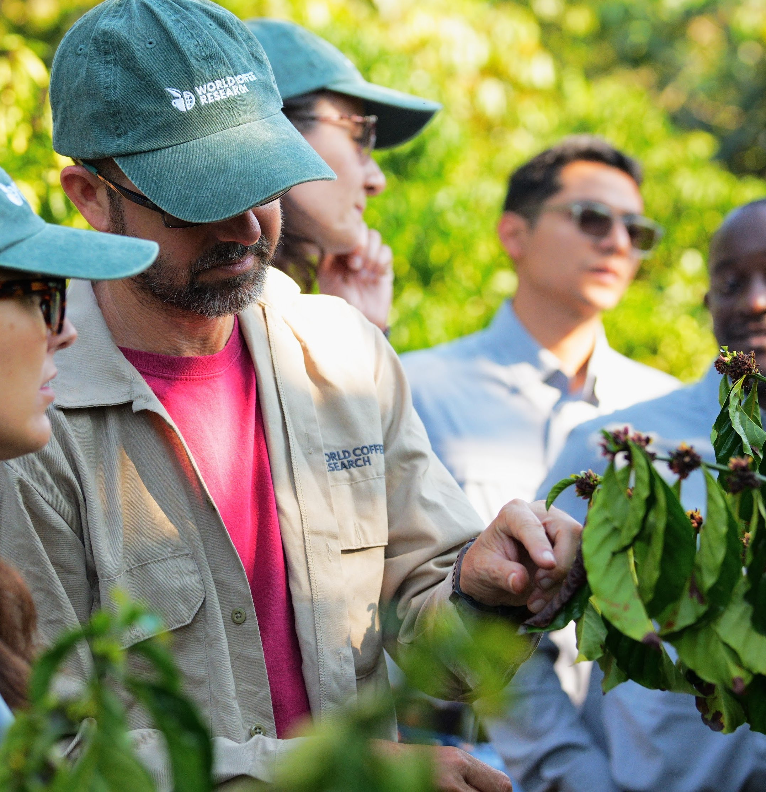

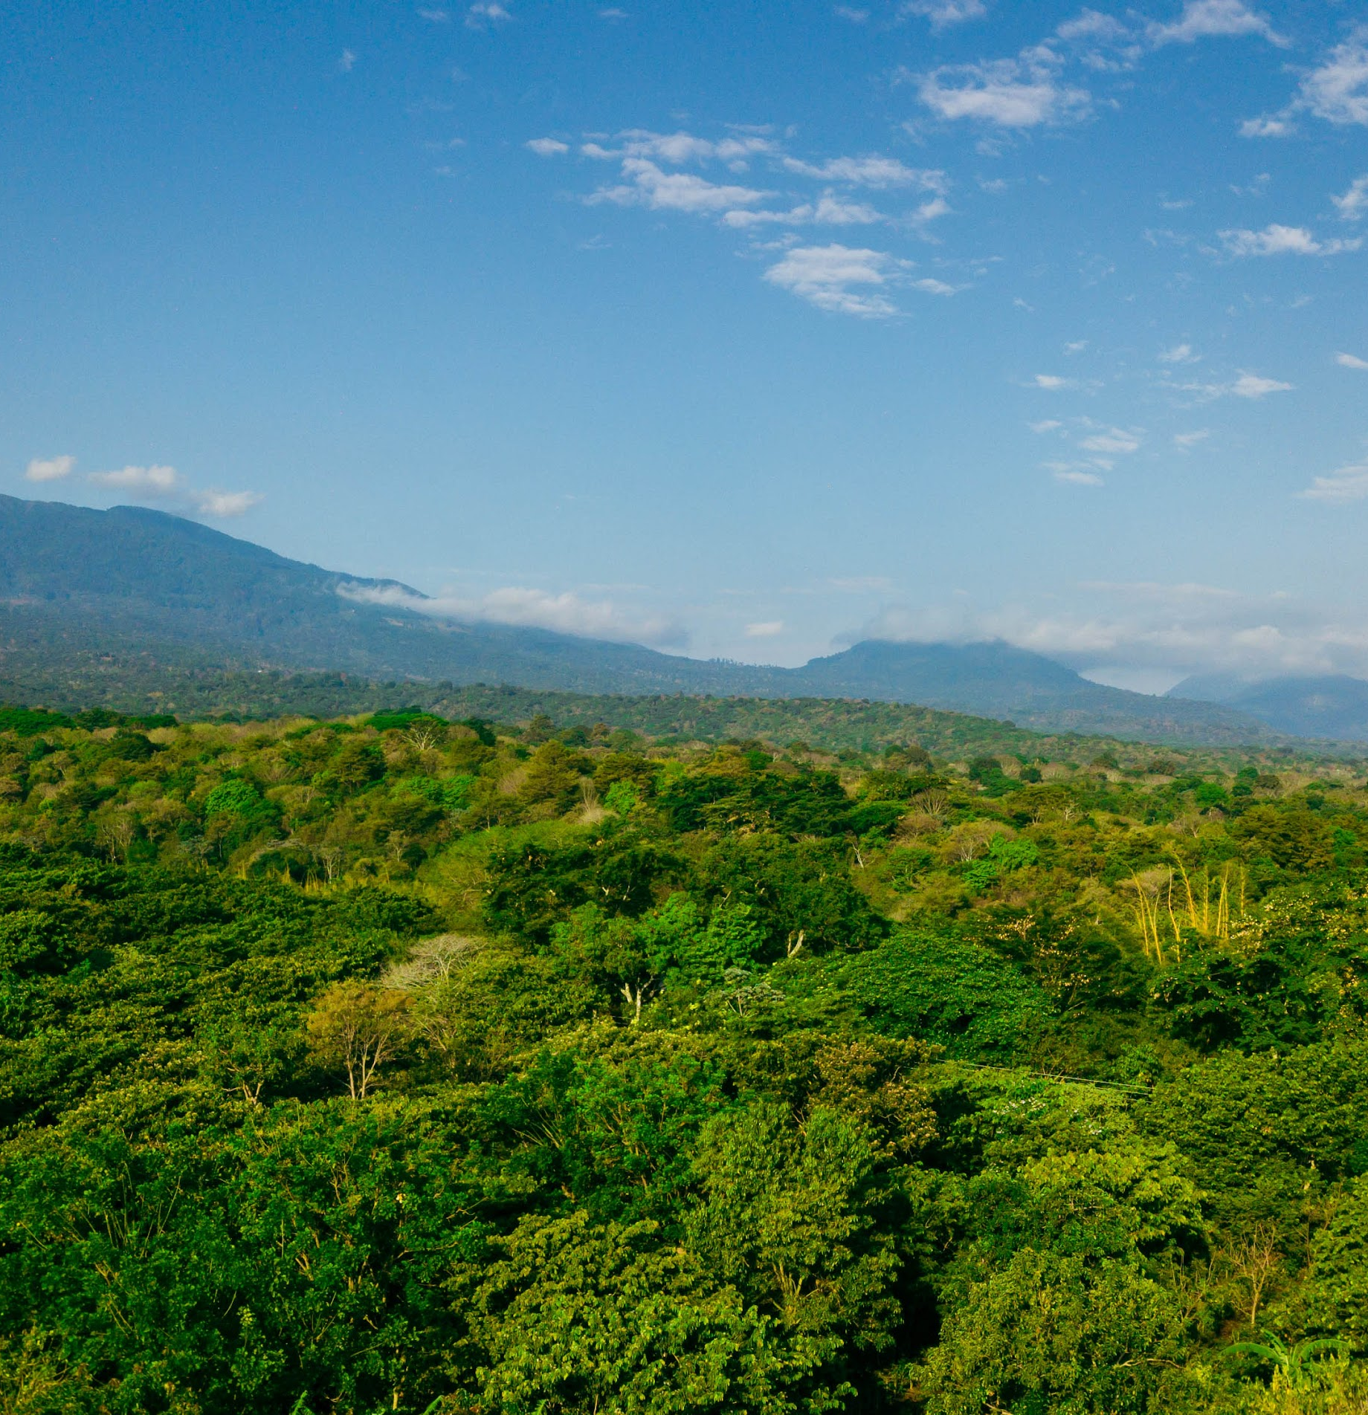

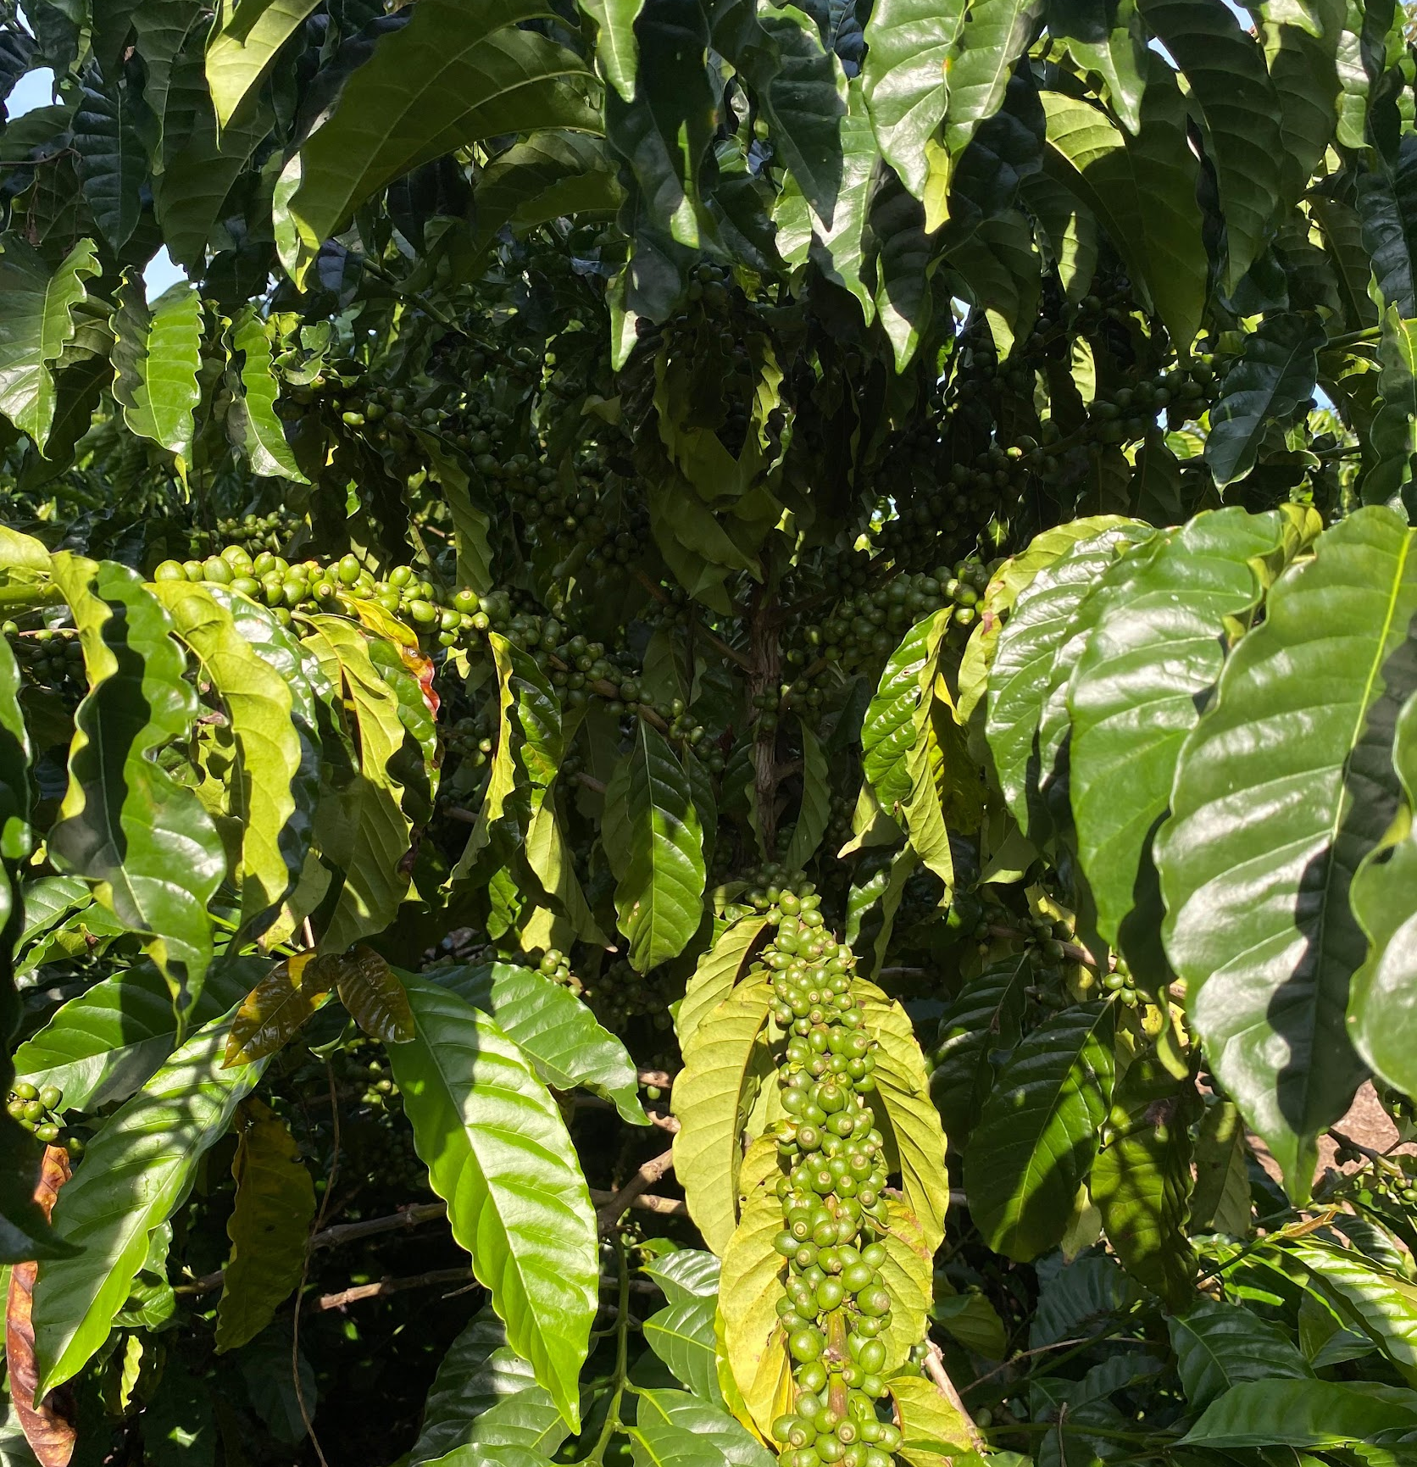

Population improvement
A focus on continuous genetic improvement maximizes the diversity of breeding materials.
1000 unique genotypes
Same initial population of 100 families (10 individuals per family) to be evaluated by all partners to assess family performance.
Key Elements of Robusta breeding strategy
Standardized design
All partners will evaluate materials for 5-6 years under a standardized design to manage sites and data collection.
Multi-environment testing + genomic prediction
Evaluation of materials across multiple environments to generate global performance data to be used for genomic prediction.
Identification of high-performing genotypes
Population size will enable partners to identify high-performing, locally-adapted clones for variety release.

Slide 7
The Global Robusta Breeding Network
Variety release
Variety release
Variety release
Local Trials
Local Trials
A collaborative, globally distributed design (similar to Innovea)
Centralized recombination
Global multi-environment testing
Large populations
Genomic prediction
Rapid cycling recurrent selection
Variety release
Local Trials
Indonesia
Vietnam
Local Trials
India
Rwanda
Variety release
Variety release
Covarrubias-Pazaran et al. 2021. Front. Plant Sci. 12:681624
Uganda
Ghana
Local Trials
Local Trials
x
Global Robusta Breeding Network
Congolese
WCR-CIRAD
Breeding Factory
(El Salvador)

Slide 8
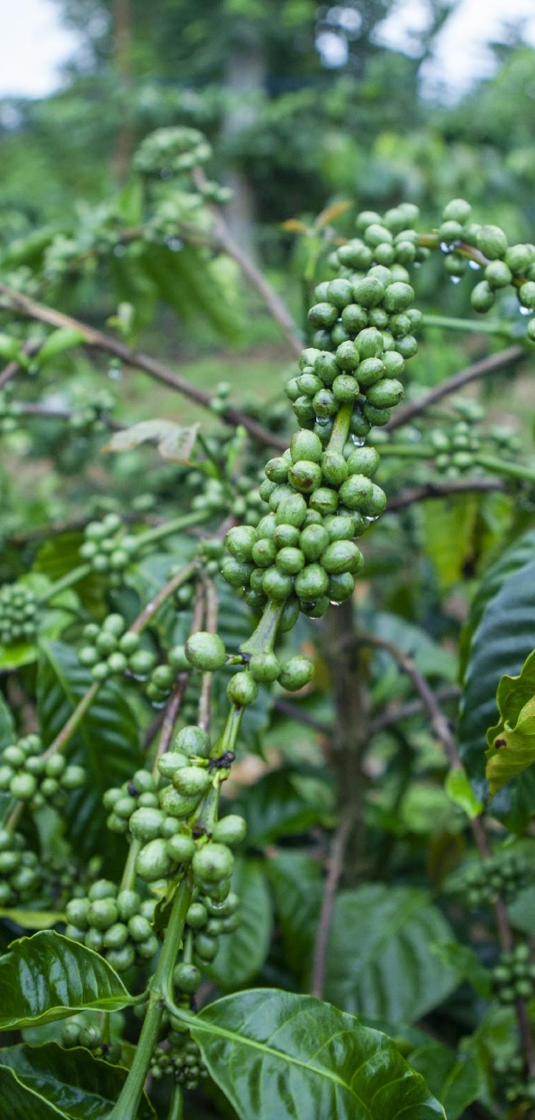
Roles
WCR will
develop and share plant material
compile and analyze global data and report results back to individual partners
host regular network meetings and facilitate discussion and decision-making
provide technical support, troubleshooting, and learning opportunities
provide resources that allow partners to participate fully in the network
Partners will
Participate in planning and design of the network and breeding strategy
Receive, install and manage a Robusta tree population
Collect annual performance data according to a standardized set of protocols
Provide technical input on network protocols, data and analysis
Participate in communications and publication of network research results
Use these resources to strengthen capacity of the national breeding program and advance the release of new varieties to farmers

Slide 9
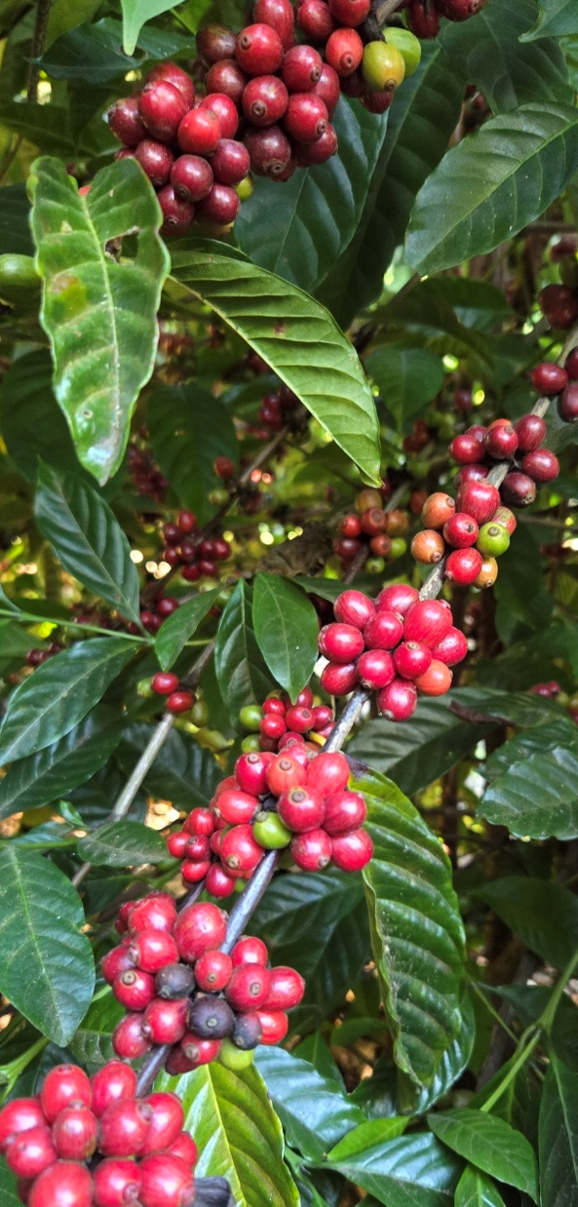
Targeted Results by 2032
Best clones identified for advancing to trials
Best clones identified for use as progenitors in the second breeding cycle

Slide 10
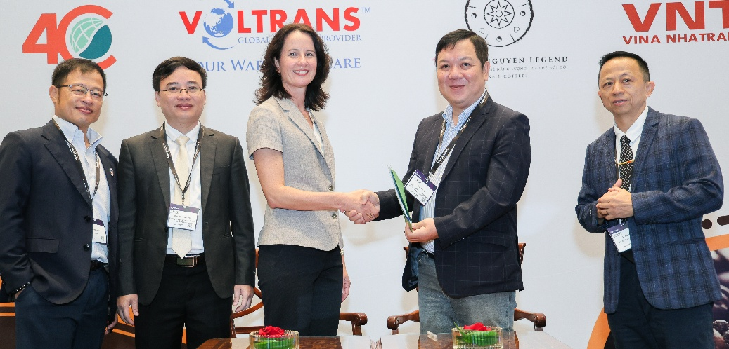
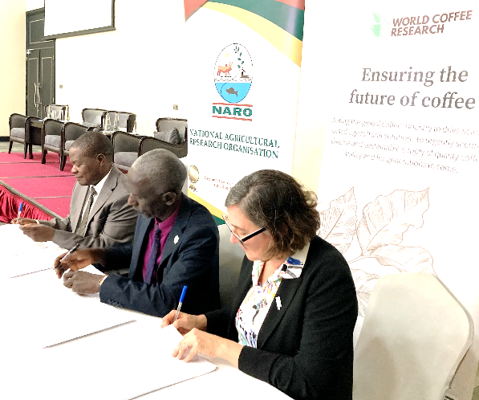
Partnership Agreements
Country | Initial outreach | Concept Note | Technical dialogue | Expression of Interest received | MOU signed with WCR | Detailed planning and negotiations | Collaborative research agreement signed
Vietnam | ✓ | ✓ | ✓ | ✓ | ✓ | ✓ | ✓
Uganda | ✓ | ✓ | ✓ | ✓ | ✓ | ✓ | ✓
Indonesia | ✓ | ✓ | ✓ | ✓ | ✓ | ✓ | ✓
India | ✓ | ✓ | ✓ | ✓ | ✓ | ✓ | ✓
Ghana | ✓ | ✓ | ✓ | ✓ | ✓ | ✓ | ✓
Rwanda | ✓ | ✓ | ✓ | ✓ | ✓ | ✓ | ✓
LatAm?

Slide 11
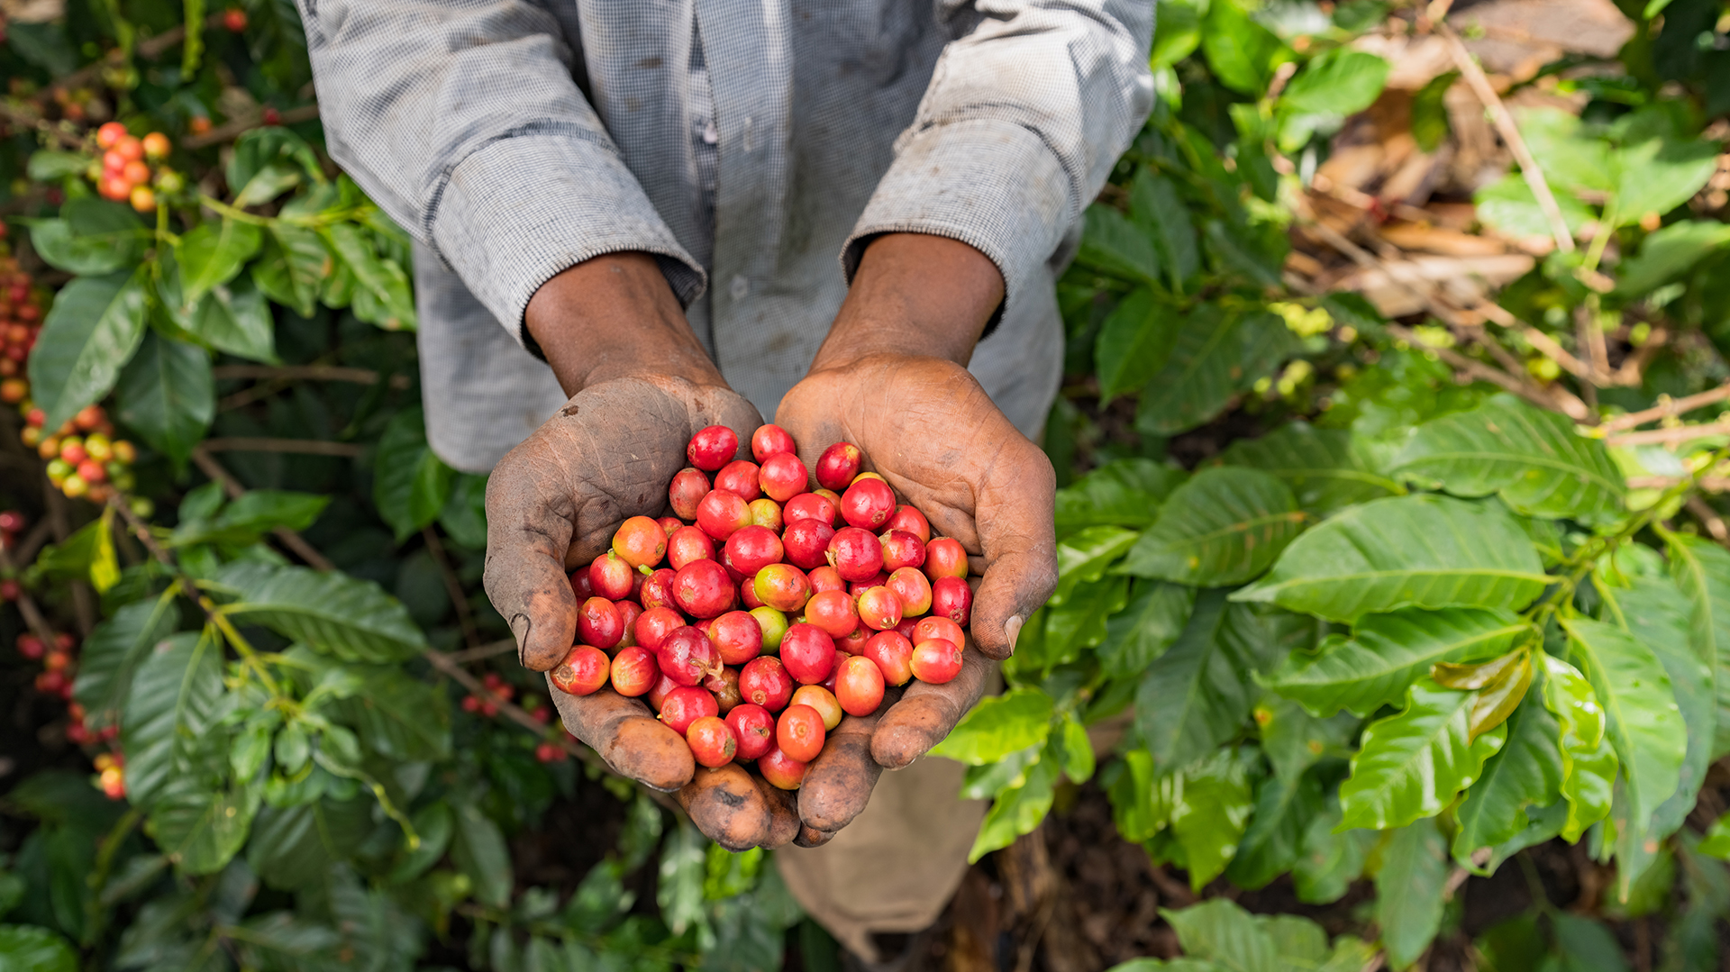
Robusta Breeding Progress

Slide 12
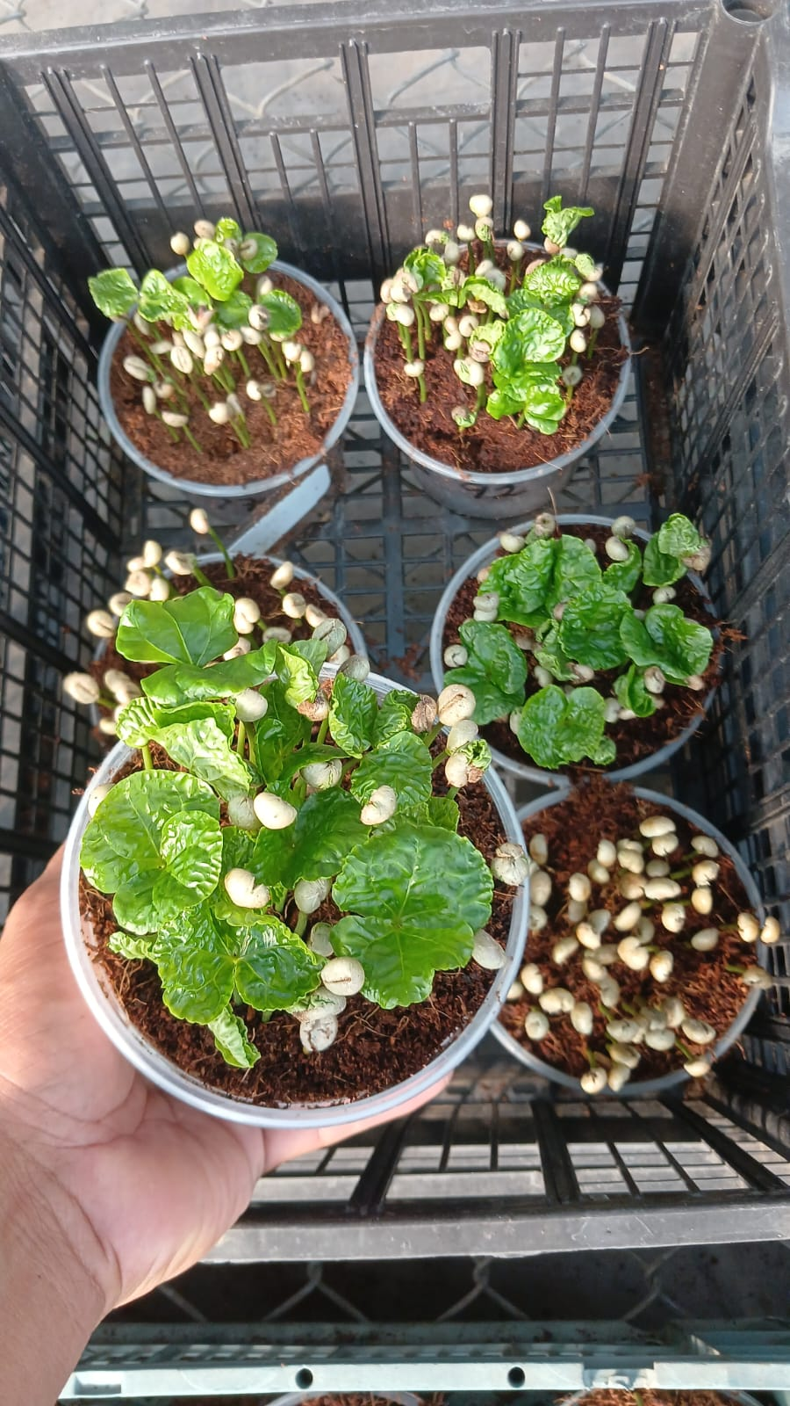
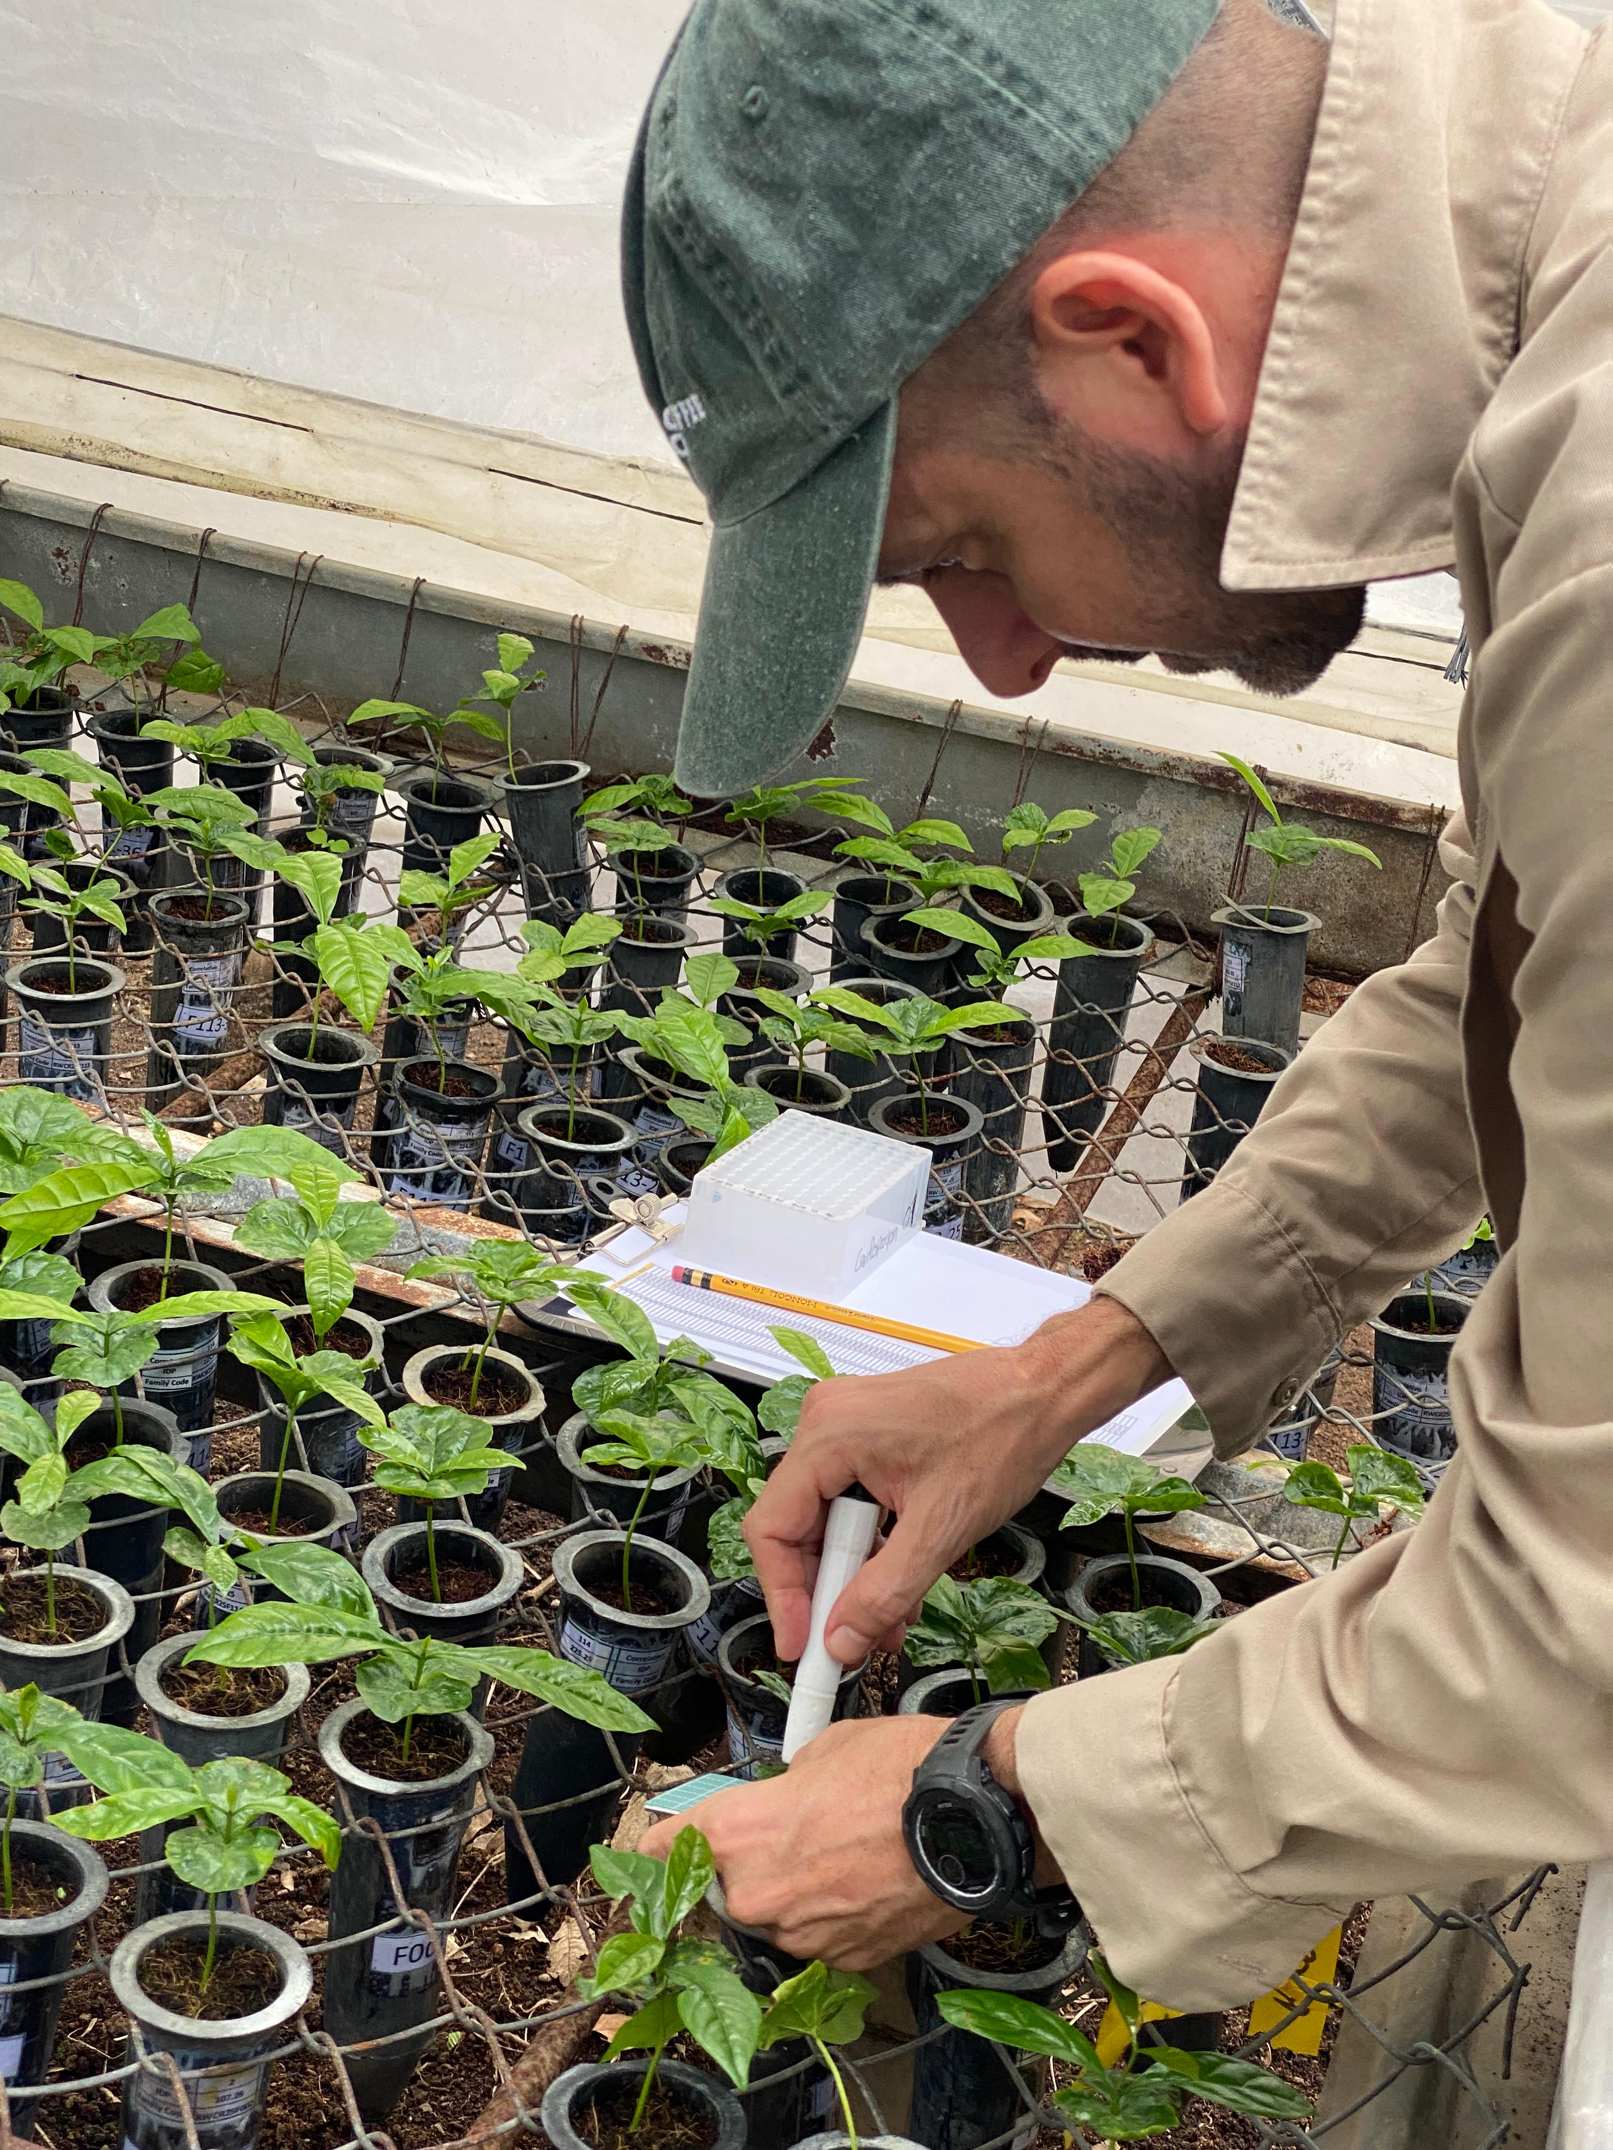
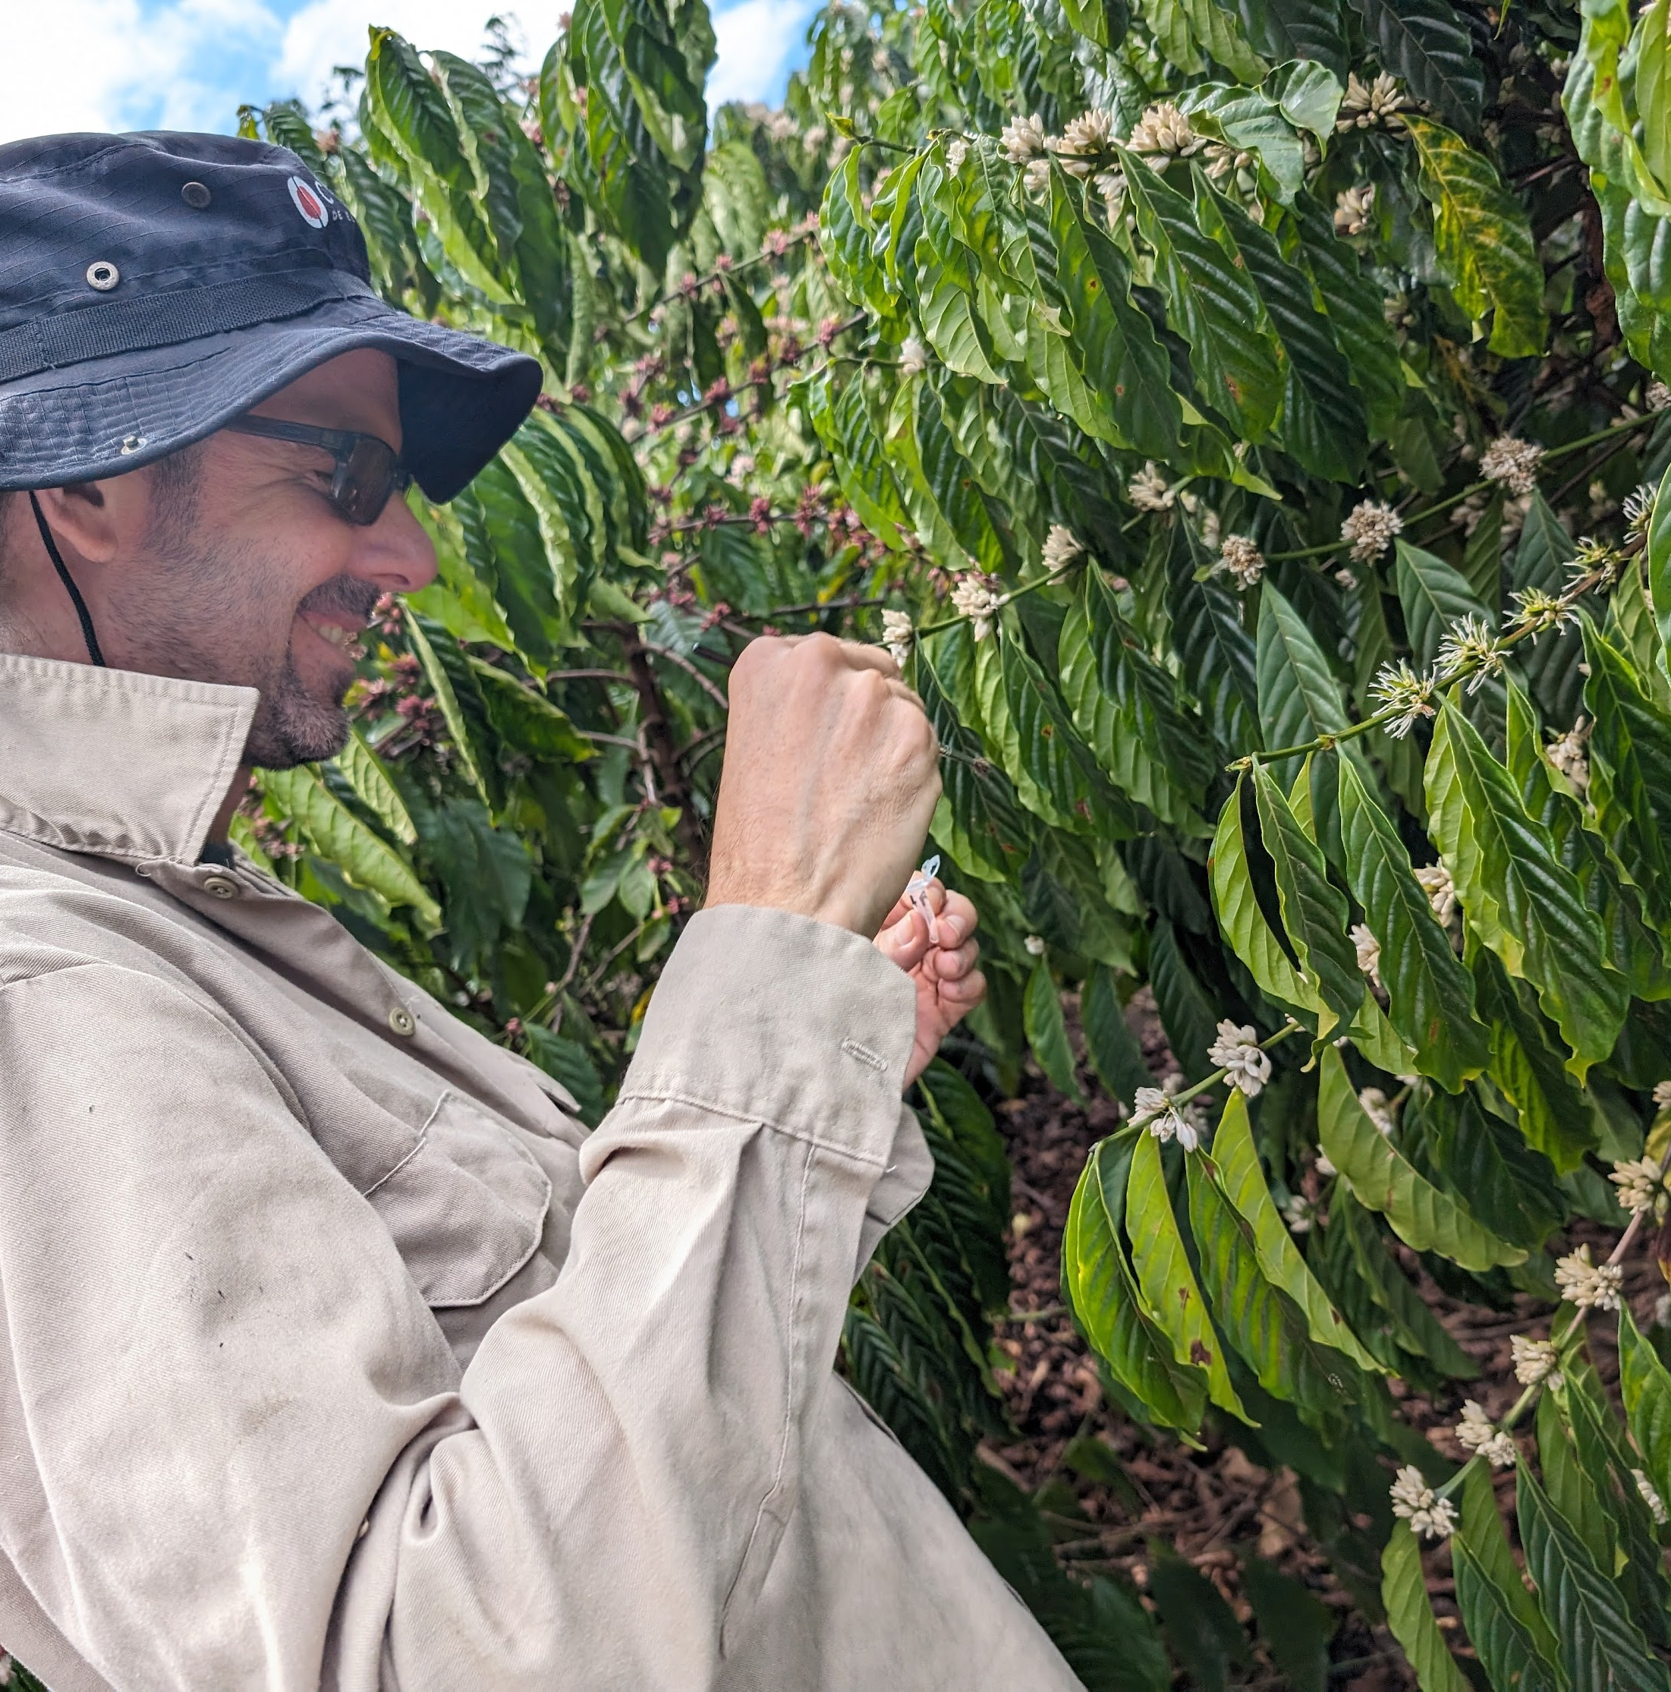
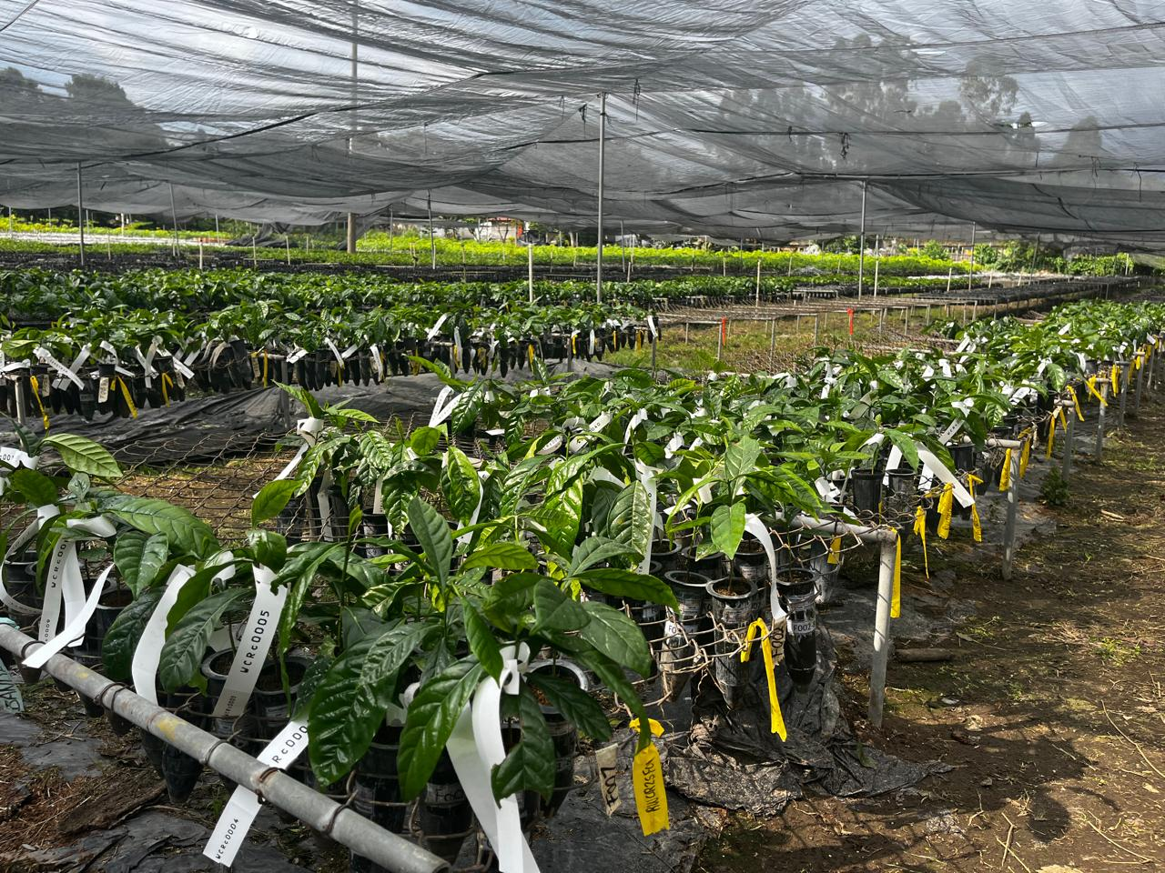
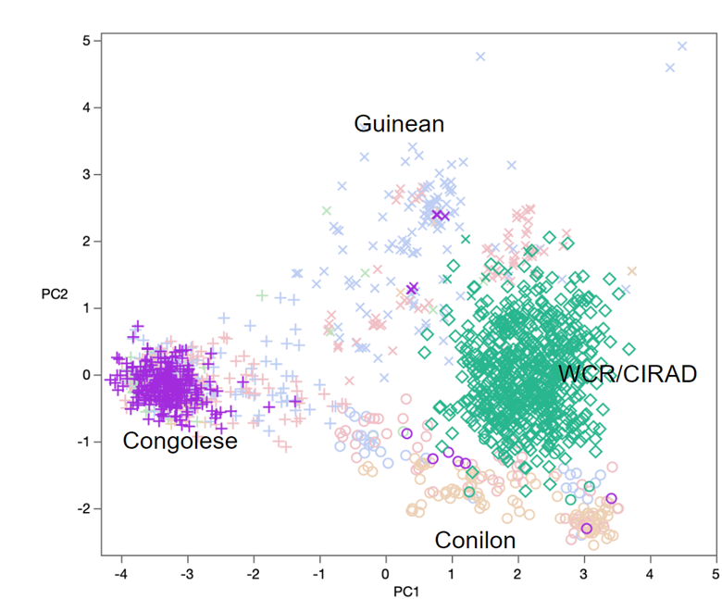
Robusta Breeding Milestones todate
2024
2025
2025
2027
Generation of cycle zero
Recombinant seed harvested, Seed shipment and Seedling germination
Seedling selection following genotyping
Plantlets shipped to partners
Crossing "within" and "between" genetic groups
2025–26
propagation
Seedling genotyping

Slide 13
Selection Force in Numbers
5,207
Seeds shipped to Propagator
3,328
Seedlings germinated (64% of shipment)
2,521
Seedlings genotyped (76% of germinated seedlings)
1,300
1,000
At every step both direct and indirect selection force between and within 114 families
Seedlings selected for propagation (52% of genotyped)
Final seedlings for propagation (30% of germinated seedlings)

Slide 14
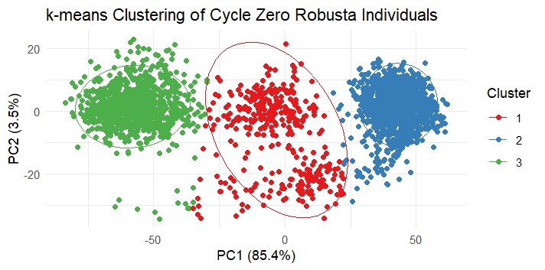
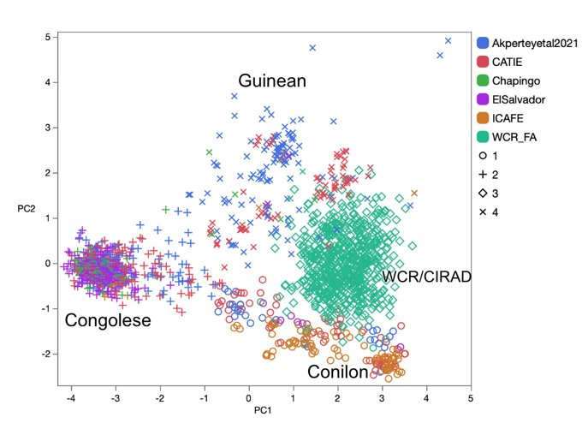
Genetics of the founding population to be shipped
Clustering of founding progenitors of Cycle zero
Cluster 1 (n = 359 Individuals) ~ ("Guinean/Conilon" x "Congolese")
Cluster 2 (n = 1247 Individuals) ~ ("Congolese“ x ("Congolese“ )
Cluster 3 (n = 909 Individuals) ~ ("Guinean/Conilon“ x ("Guinean/Conilon“ )
1300 selected clones undergoing propagation

Slide 15
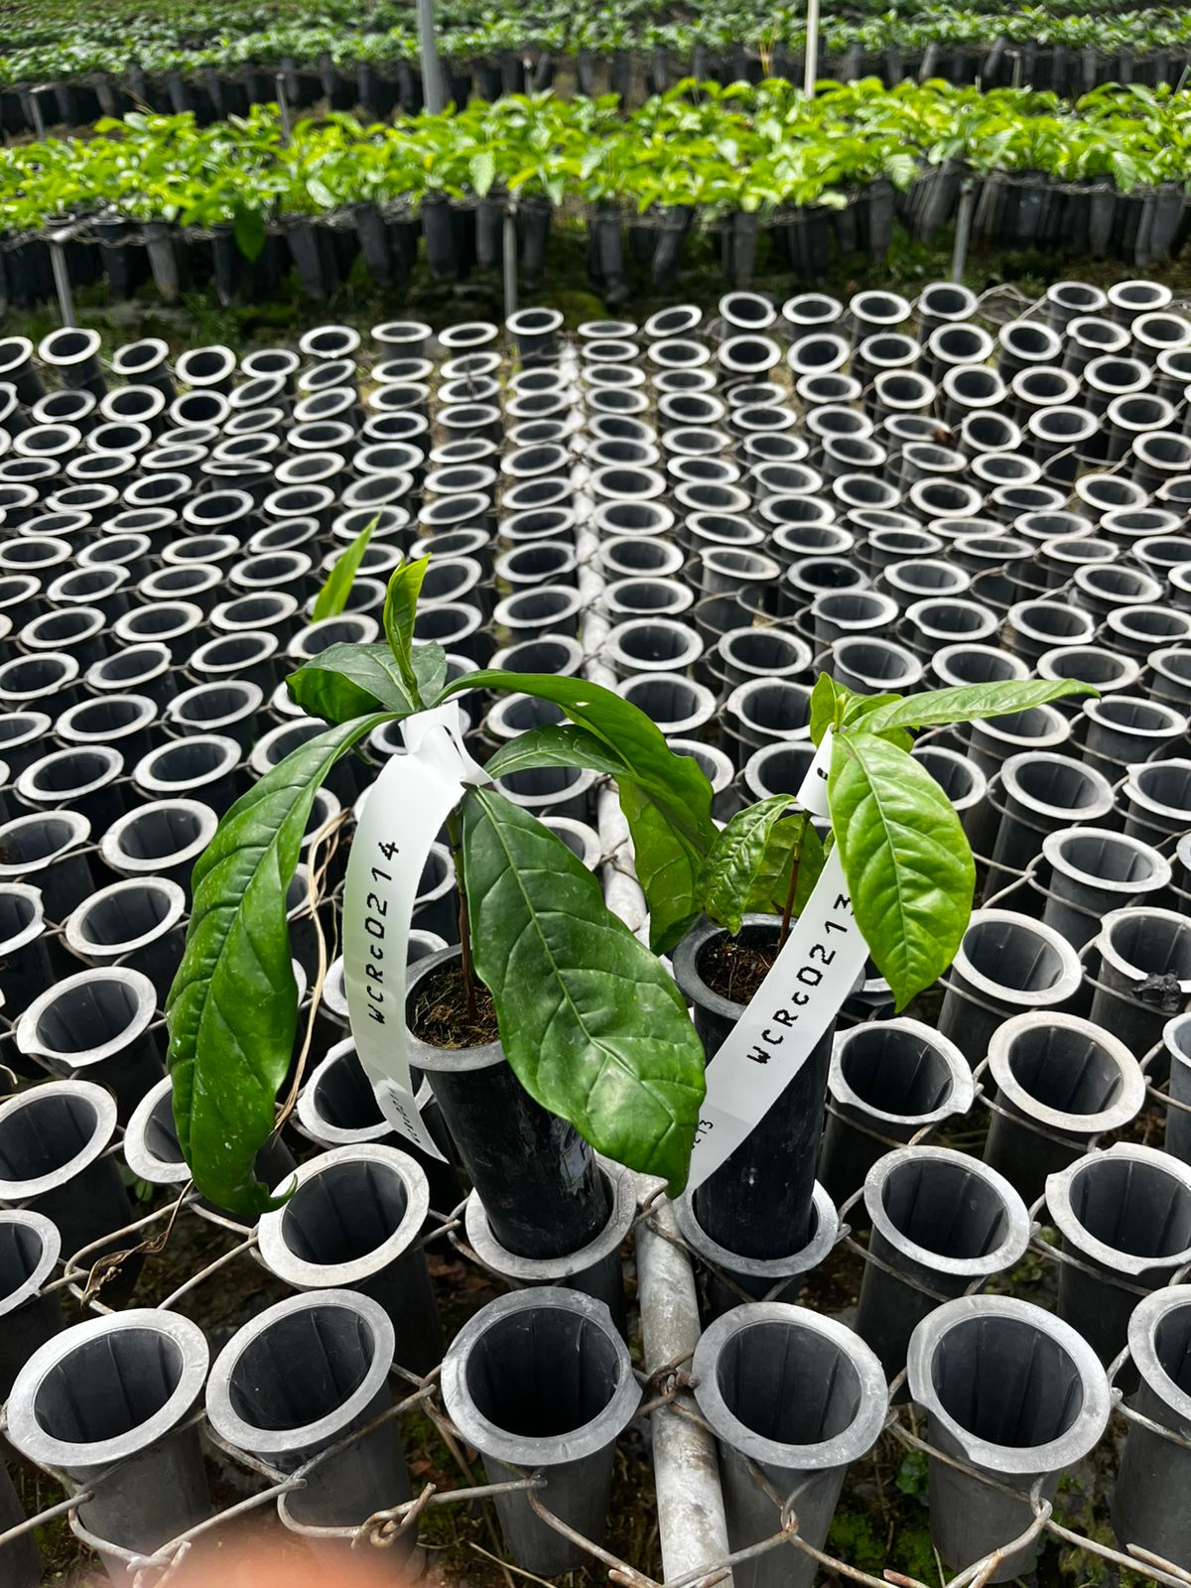
Highlight of ongoing propagation of 1300 individuals
WCRc0214 (Cluster 2) = “Congolese x Congolese”
WCRc0213 (Cluster 3) = "Guinean/Conilon“ x ("Guinean/Conilon“)
Note: All from family F023
Maximum Cross/Selection Number Strategy
Most responsive 1000 clones advanced

Slide 16
Robusta Field Trial Design

Slide 17
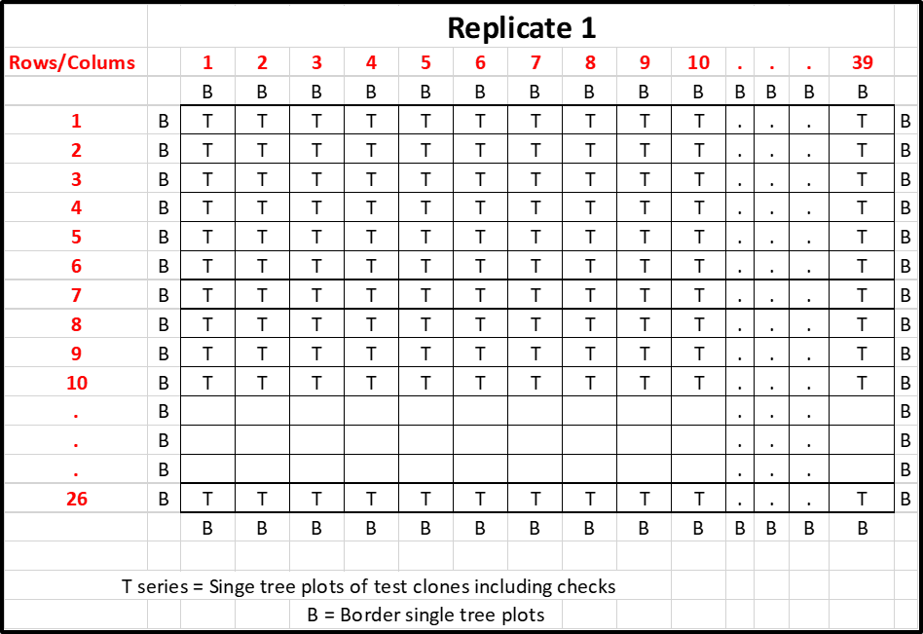
Draft Field Design with single site
Trial Dimension | Randomized complete block design
Imported materials | 5000 plantlets (1000 unique clones; 5 plantlets/clone)
Test clones | 1000
Replication | Replicated x 3 (1000 clones; 100%)
Commercial checks (for Comparative + Precision roles) | Maximum (14 varieties) Replicated x 3 A total of 42 plots
Total single-tree experimental plots | 3042 plots (3,000 replicated + 42 commercial) Av. replications = 3
Total Area (3 x 3 m) | 2.737 ha (27,378 m²)
Partner Feedback | Total tree numbers too large for available land and staff to manage; Low statistical power owing to large blocks;
x 3

Slide 18
Maximizing probability of success within constraints
Evaluation trial workload;
Risks of intervention failure;
Operation costs per plot;
Trait prioritization
Leverage global & local datasets
Trial plotsmanship
Data precision
Statistical power
Selection Intensity
Experimental design help balance
Biological constraints Statistical precision
Resource efficiency

Slide 19
Early Trialing: Lessons from Private & Public Breeding Programmes
Overall Goal: To cull extensively and identify the few superior individual worthy of advanced testing.
Ealy-stage Trial Design | High-level Description | Public Breeding Programmes | Private Breeding Programmes
Philosophy | Public and Private Breeding differ: 1) Scale and focus; 2) Resource allocation and use; and 3) use of breeding tools | Prioritize diversity and foundational research; several traits. Consistently deal with broad germplasm base | Use proprietary germplasm for specific traits to drive genetic gains. Cull a lot; and quickly switch to replicated trials.
Augmented Design | Unreplicated test entries evaluated alongside replicated checks. Test entry is adjusted based on block and check performance. | Very High | Moderate
Resolvable Incomplete Block Designs | Alpha-Lattice, Row-Column. Entry appears only once per replication but in different incomplete blocks. Accounts for variation in two directions and thus increases heritability. | High | High
P-Rep (Partial Replication) Design | A fraction of the entries are replicated, while the rest are unreplicated. Replicated entries used to model spatial trends and thus powerful cost-benefit compromise.. | Gaining popularity | Commonly used

Slide 20
Field Design Options at single site
Trial Dimension | A. Incomplete blocks | B. Incomplete blocks | C. Incomplete blocks | D. Incomplete blocks
Imported materials | 3000 plantlets (1000 unique clones; 3 plantlets/clone) | 3000 plantlets (1000 unique clones; 3 plantlets/clone) | 2250 plantlets (750 unique clones; 3 plantlets/clone) | 3000 plantlets (1000 unique clones; 3 plantlets/clone)
Test clones | 1000 | 1000 | 750 | 1000
Testing Site | One priority site that samples Target Population of Environments (TPE) | One priority site that samples TPE | One priority site that samples TPE | One priority site that samples TPE
3 R's (Replication, Randomization & Restriction) | Replicated (1000 clones; 100%) | Unreplicated (500 clones) Replicate (500 clones; 50%) | Replicated (750 clones; 100%) | Unreplicated (1000 clones)
Checks (for Comparative + Precision roles) | 10 global checks x 5 10 local checks x 5 100 plots | 10 global checks x 5 10 local checks x 5 100 plots | 10 global checks x 5 10 local checks x 5 100 plots | 10 global checks x 5 10 local checks x 5 100 plots
Total single-tree experimental plots | 2100 plots (1000 replicated + 100 checks) | 1600 plots (500 unreplicated + 500 replicated + 100 checks | 1600 plots (750 replicated + 100 checks). | 1100 plots (1000 unreplicated + 100 checks)
Total Area (3 x 3 m) | 1.89 ha (18,900 m²) | 1.4 ha (14,400m² ) | 1.4 ha (14,400m² ) | 1 ha (9,900 m²)
Remark | High resources; High local power | Moderate resource; Moderate power, less replication within site, all genotypes | Moderate resource; High local power, full replication within site, less genotypes | Low resource; less power, no replication within site, OK for global.

Slide 21
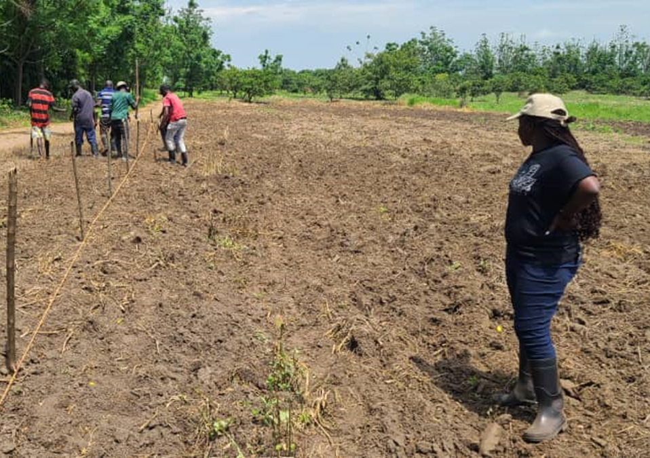
Considerations when selecting trialing site (≤ 1,89 ha)
Technical Considerations
  Should be representative of major robusta growing region and/or a defined mega-environment
  Should be optimal for evaluation of at least 5 priority traits
  Should be reasonably isolated from neighbouring robusta to limit external pollen effects on test clone productivity
Non-technical considerations
  Should be easily accessible to enable timely monitoring, maintenance and data collection (biological and climate)
  Should have well-drained soils and not water-logged
The site should sample the target population of environment, which represents the real-world setting where the new variety is expected to be grown by farmers

Slide 22
Mentimeter Question
Open-ended Question: What is your preferred experimental design?

Slide 23
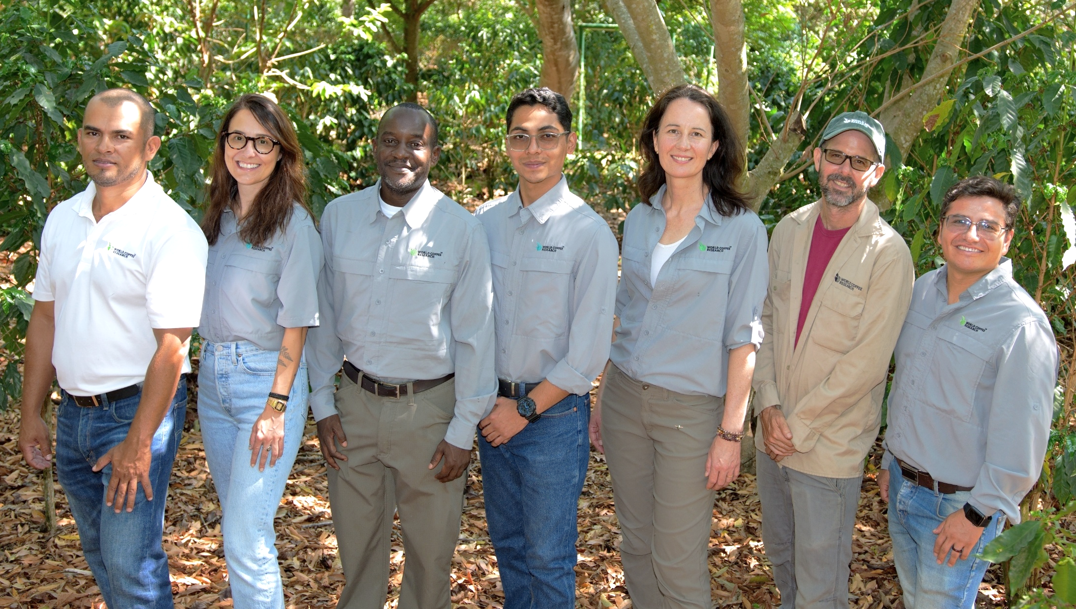







Acknowledgments

