Slide 1
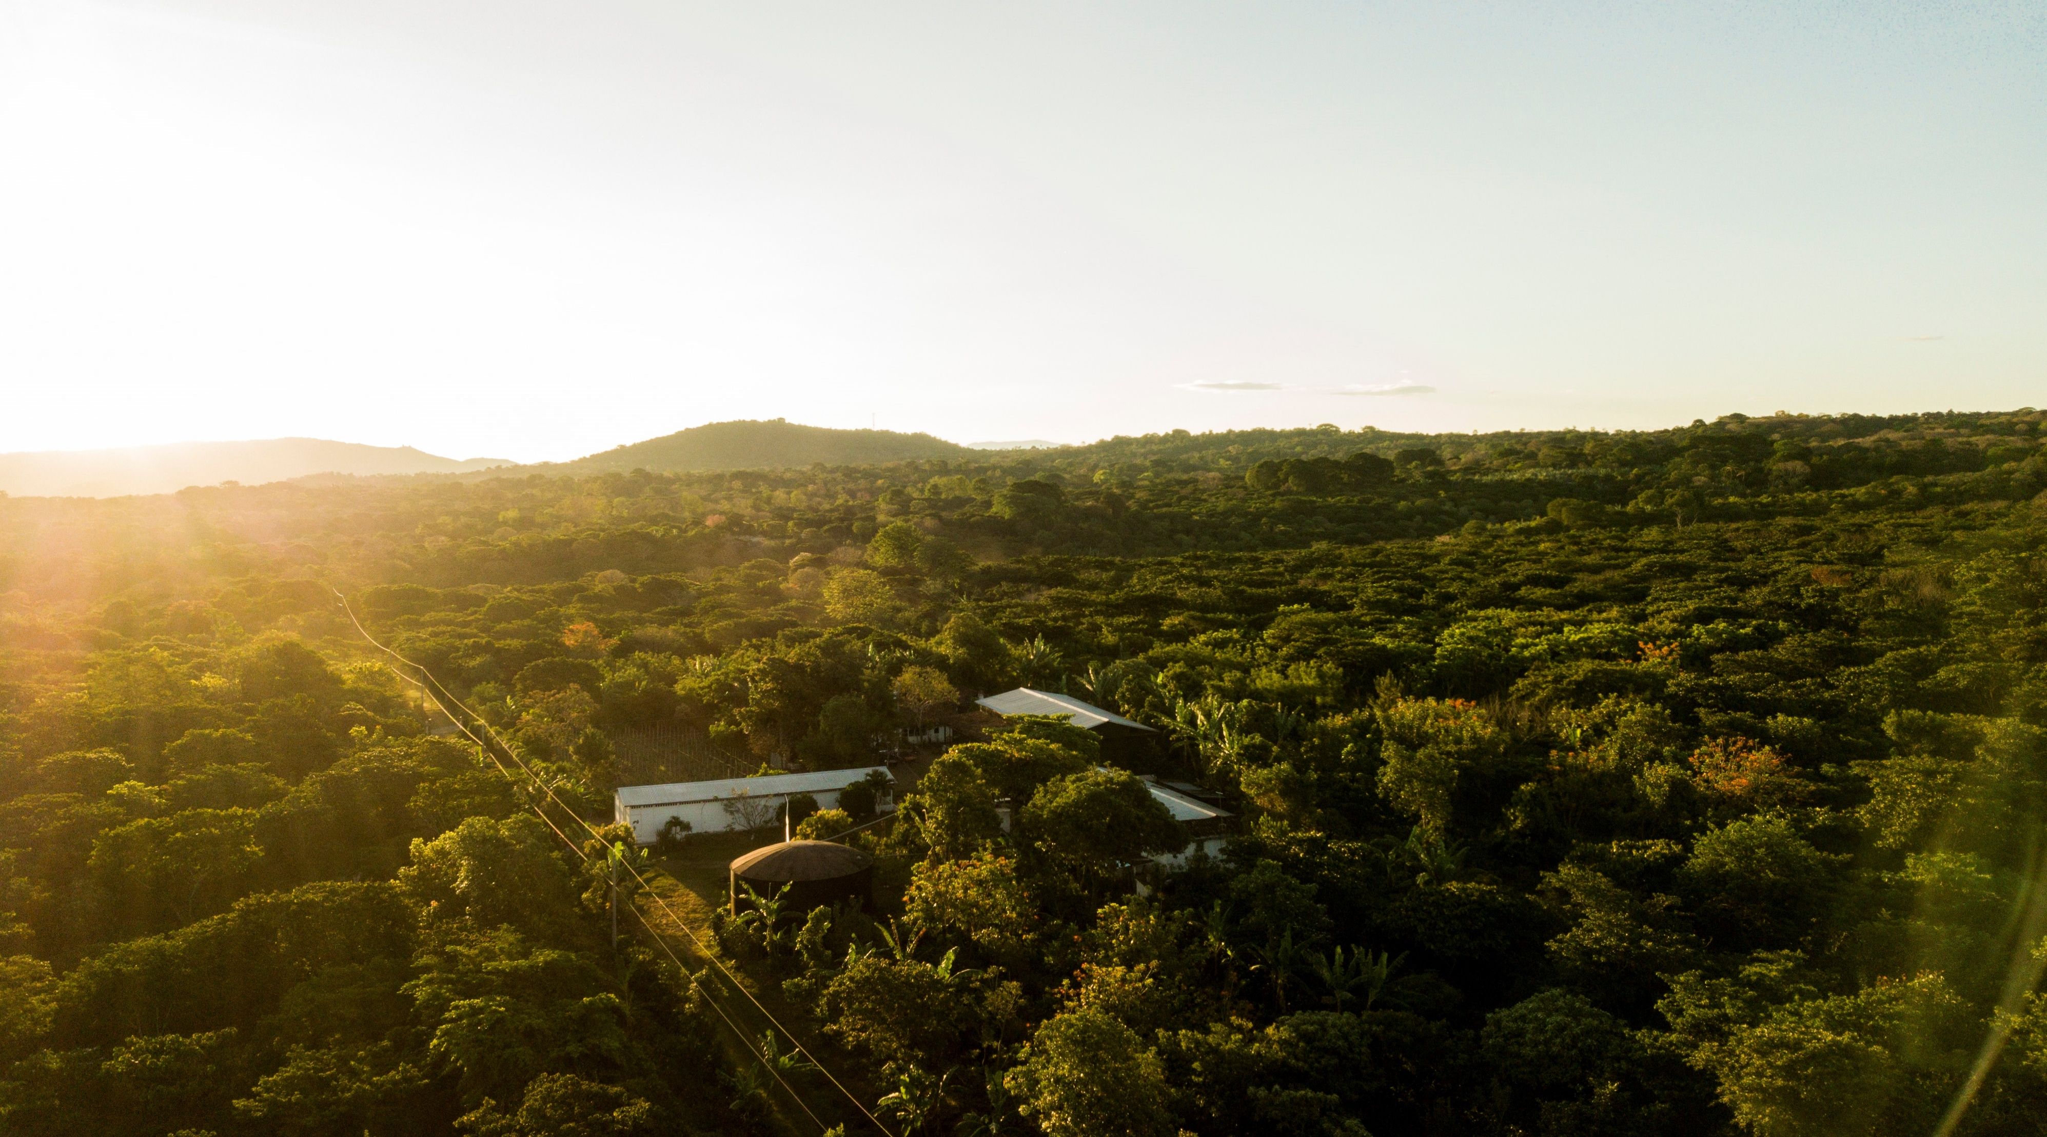


Robusta phenotyping - priority traits
Innovea Network Breeders Meeting
Cenicafe, Manizales, Colombia
November 17-21, 2025

Slide 2

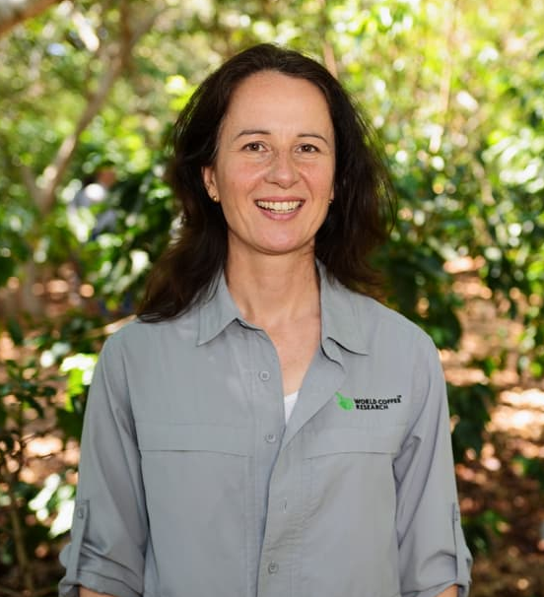
Presenters
Robert Kawuki, Ph.D.
Research Scientist, Plant Breeding and Genomics
World Coffee Research
Tania Humphrey, Ph.D.
Director, Research & Development
World Coffee Research

Slide 3
Glossary
Hanna will remove slide after entereing terms into translation glossary
DLB = Demand-led breeding
TPP = Target product profile
TBD = To be Determined
BP = Besoekisch Proefstation
KR = Kituza Robusta
C x R = Coffea canephora x Coffea congensis

Slide 4
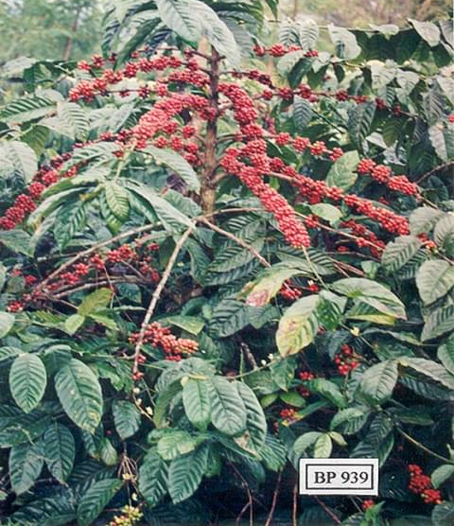
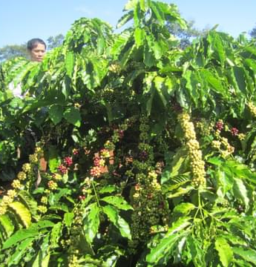
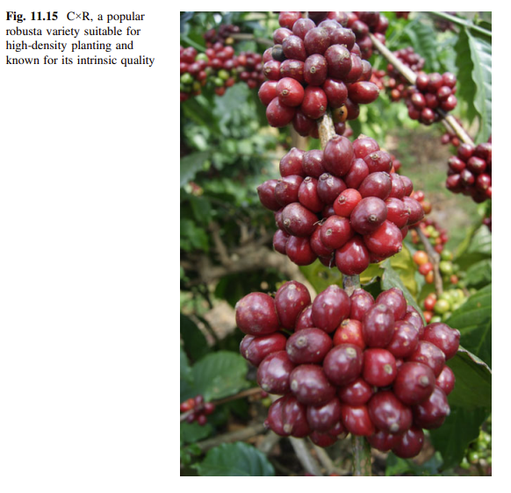
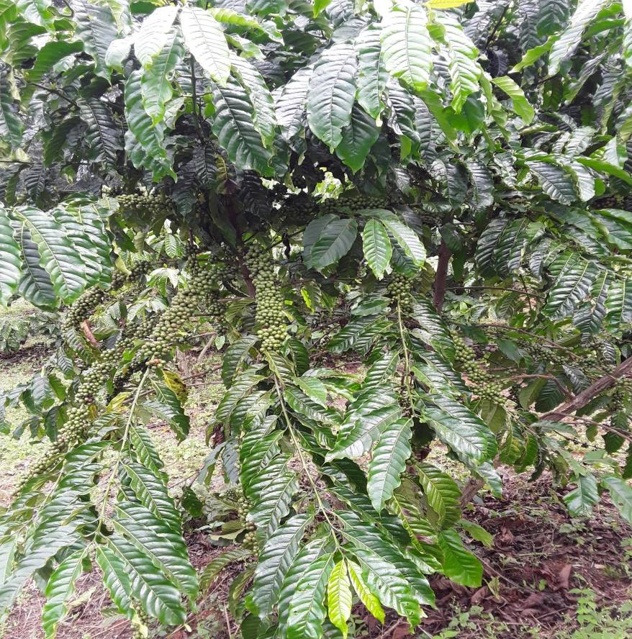
In the end, varieties with a set of priority traits are deployed
BP 939: Wide adaptability, compatible in agro-forestry systems and in dry environments, Indonesia)
TRS1: Synthetic variety, wide adaptation and dominates replanting programme, Vietnam)
CxR; Wide adaptation, drought tolerance and excellent cup qualities, India)
KR10: Coffee wild disease resistance, enhanced yield and quality, Uganda)

Slide 5
Demand-Led Breeding (DLB)
Markets
Target Product Profile
Priority Traits
DLB permits development of varieties with 'high take-off potential and 'adoption-ready' qualities. ​ ​This requires understanding market needs, target product profiles and priority traits. ​

Slide 6
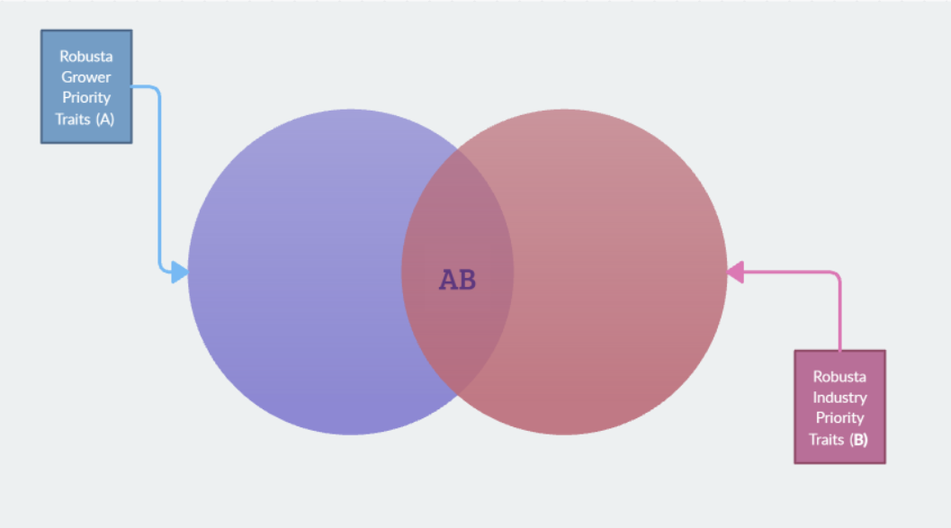
Trait priorities inform the target product profile (TPP)
Trait ranks depend on how quality beans are defined and processed, and what product is put onto the market
Trait rankings depending on how and where robusta is grown
TPP should be Technically and Financially Feasible

Slide 7
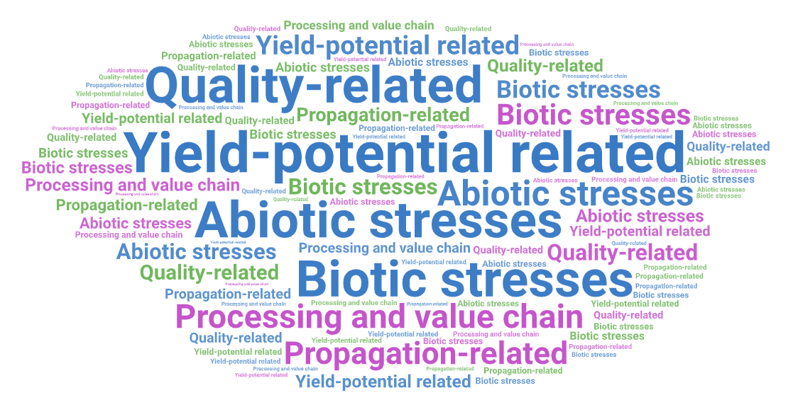
Which traits drive most take-off value in the next generation of robusta varieties?
What can't be measured can't be done!

Slide 8
Prioritized Traits
Trait Category | Priority Traits | Other traits yet to be qualitied (pending discussion with partners)
Yield and production traits | Cherry yield Days to anthesis Days to cherry maturity Plant architecture | Stem diameter Plant height Abortion Fruitification date 100-fresh berry weight
Biotic stress traits | Coffee leaf rust resistance TBD | Coffee wilt disease Coffee berry borer Nematodes
Abiotic Stress traits |  | Drought tolerance Heat tolerance
Value-chain and quality traits | Bean size, Bean density, Outturn Cup quality | 100-green bean weight Consistent bean size Uniformity of maturation % of pea beans

Slide 9
Why these prioritized traits?
Demand-led as reflected by industry and farmers, with validation from breeders.
Priority traits for both population improvement and product development pipelines
Traits are informative and drive value for making selection decisions on 1,000 clones
Any additional traits considered after inclusive discourse with partners.
NCI may collect additional data, but only priority traits will be supported.

Slide 10


Trait Prioritization Activity

Slide 11
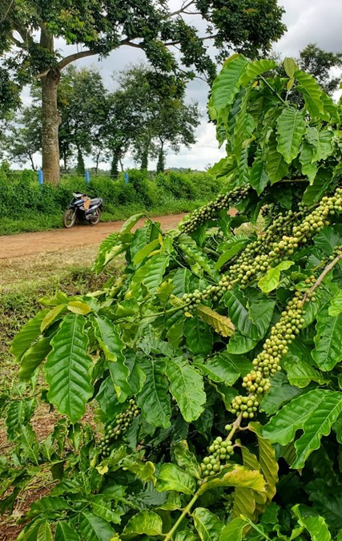
Next Steps
Finalizing the Robusta network plan → updated appendices in the agreement
Field trial design
Site selection
Traits
Budgets
Appendix A: Statement of Work
Appendix B: Budget and Payment Terms
Early 2026: Draft documents will be circulated for feedback
July 2026: Final signatures needed
Nov 2026: shipment of clones

Slide 12
Priority traits
1 -
2-
3 –

