Slide 1
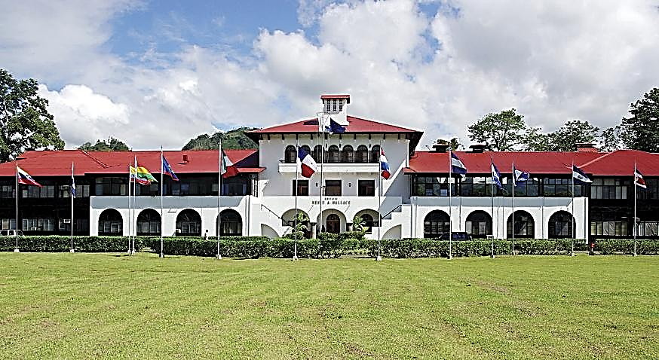

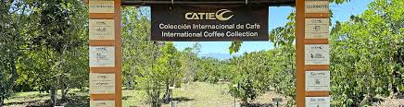
CATIE: Coffee Collection and Breeding
William Solano, Daniel Fernandez, Rolando Cerda
William Solano

Slide 2
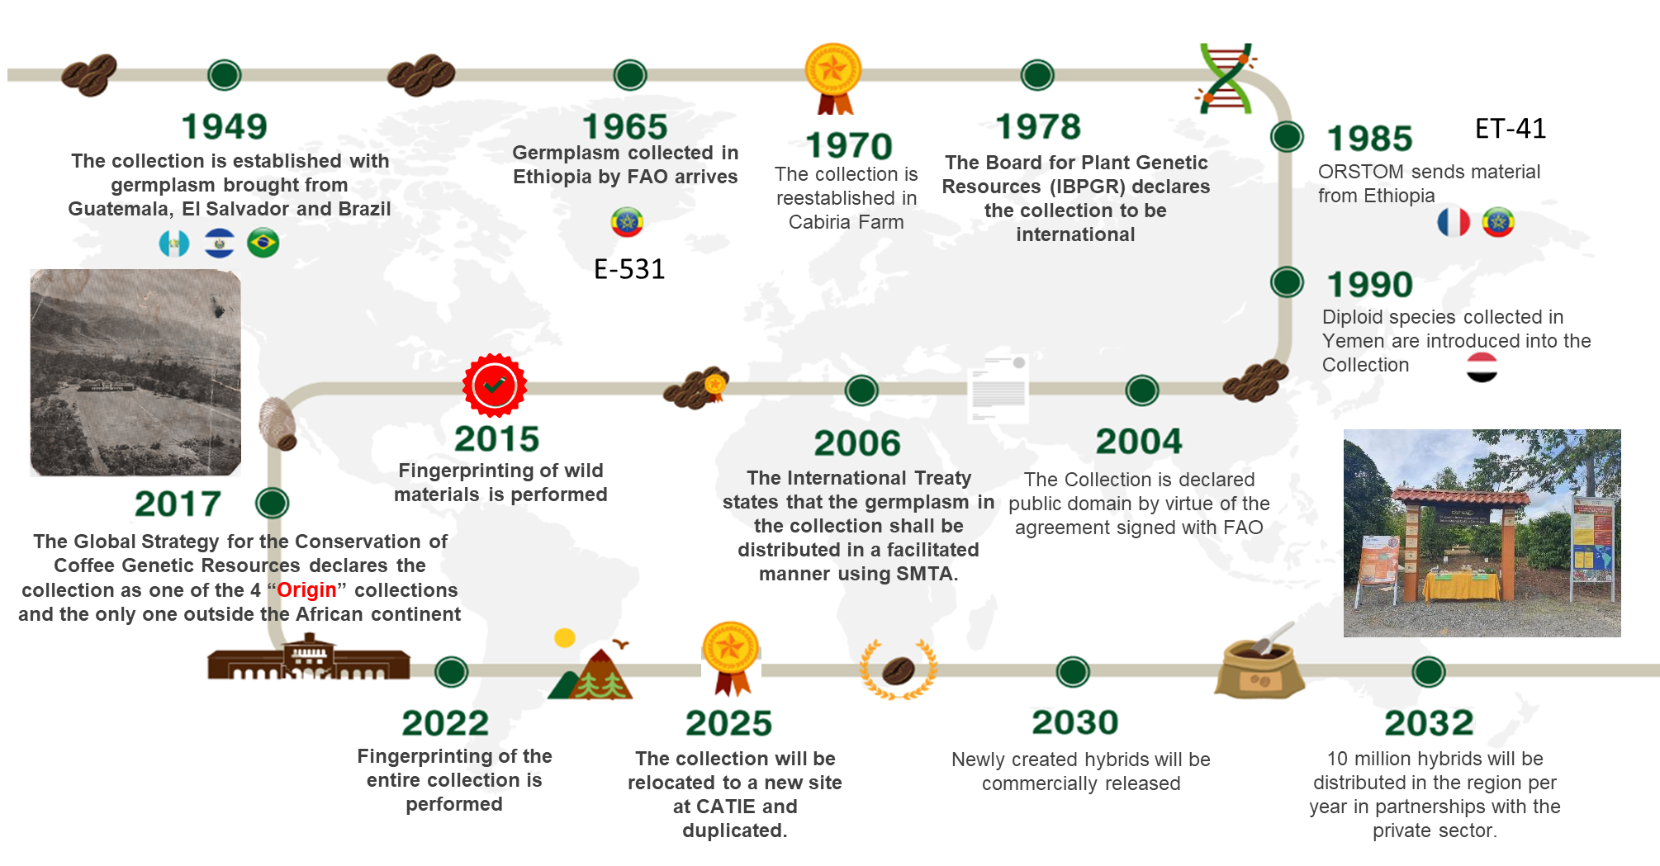
Timeline of the collection

Slide 3
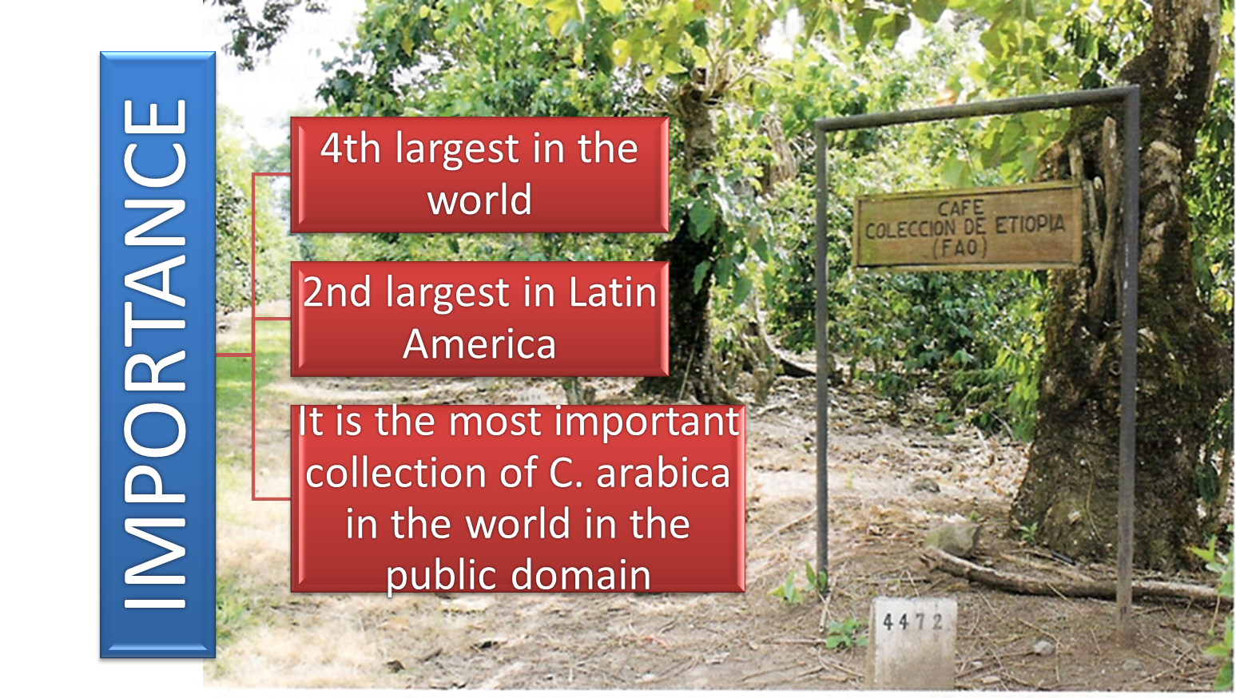
Collection Description
Type of germplasm | Number of accessions | Number of plants
Wild material (includes 22 diploid species) | 837 | 4457
Materials of agricultural interest | 156 | 673
Old varieties (Heirloom) | 621 | 4554
Varieties in greatest demand for research or the coffee sector | 40 | 209
Hybrids, irradiated materials | 325 | 2598
Total | 1979 | 12491

Slide 4



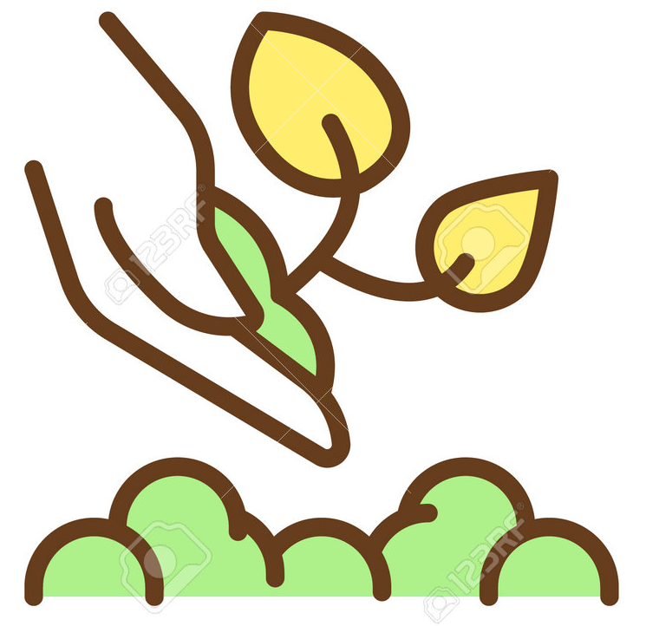
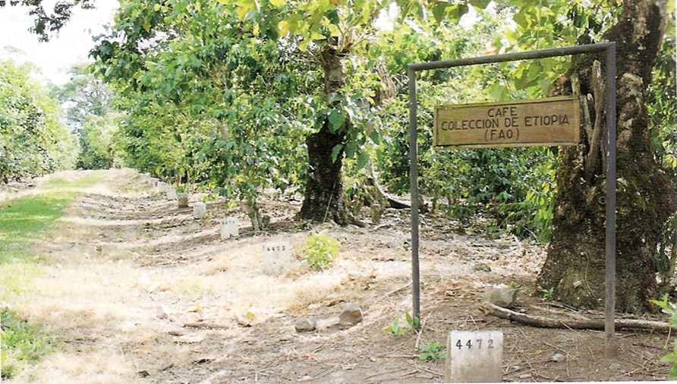




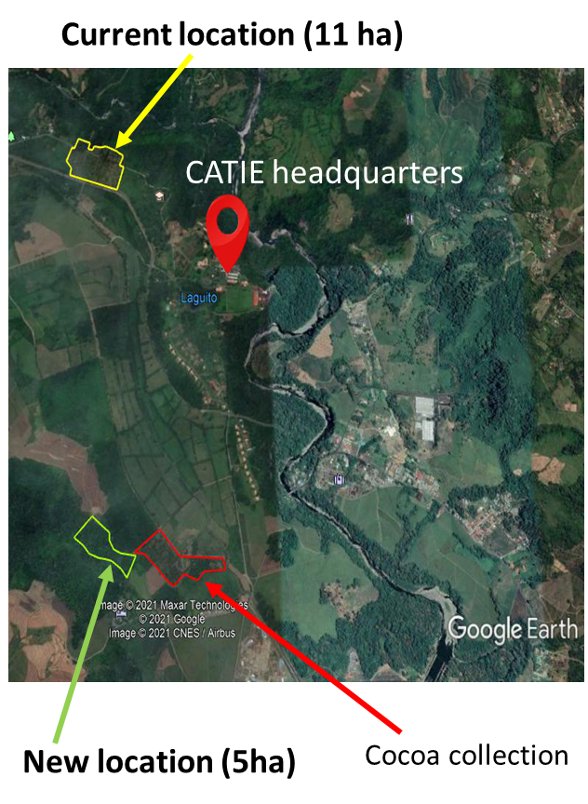
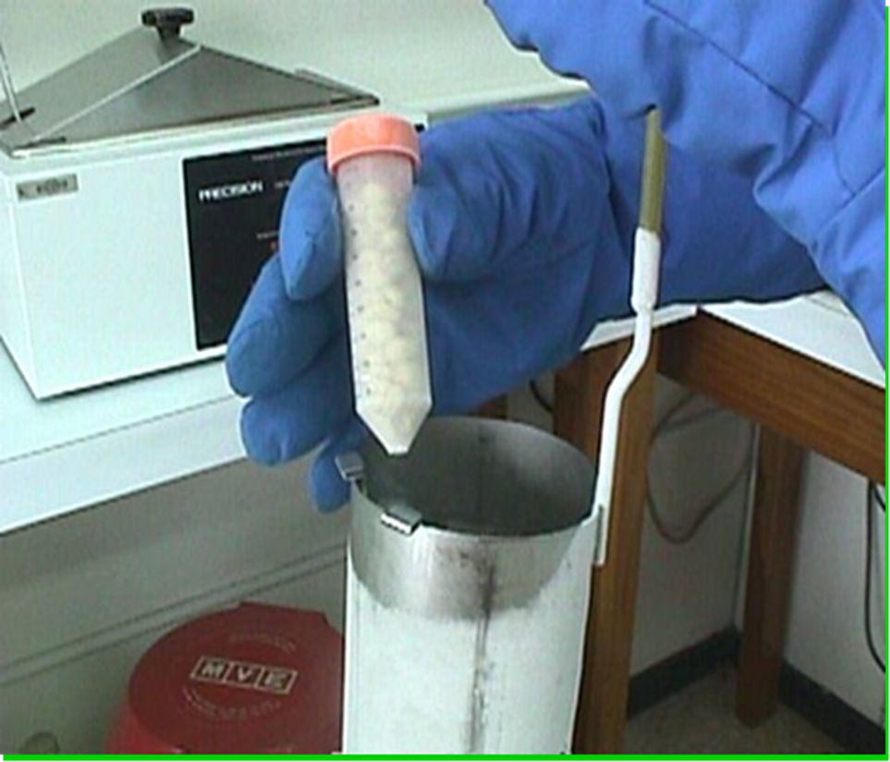
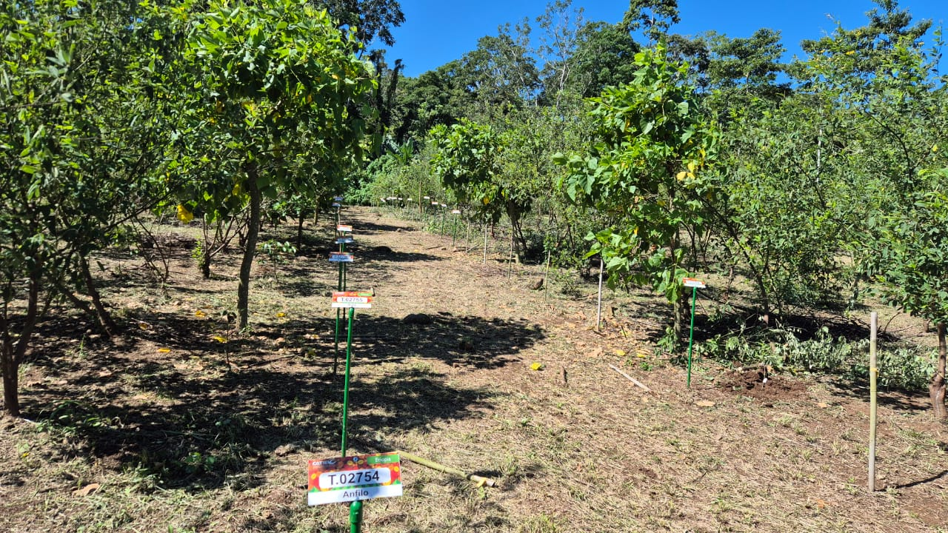
Upgrade of the coffee collection
Re-establishing the collection in a new location
Field safety duplicate
Duplicate in
Cryopreserved safety duplicate
Share the information collected
Current location
New location

Slide 5

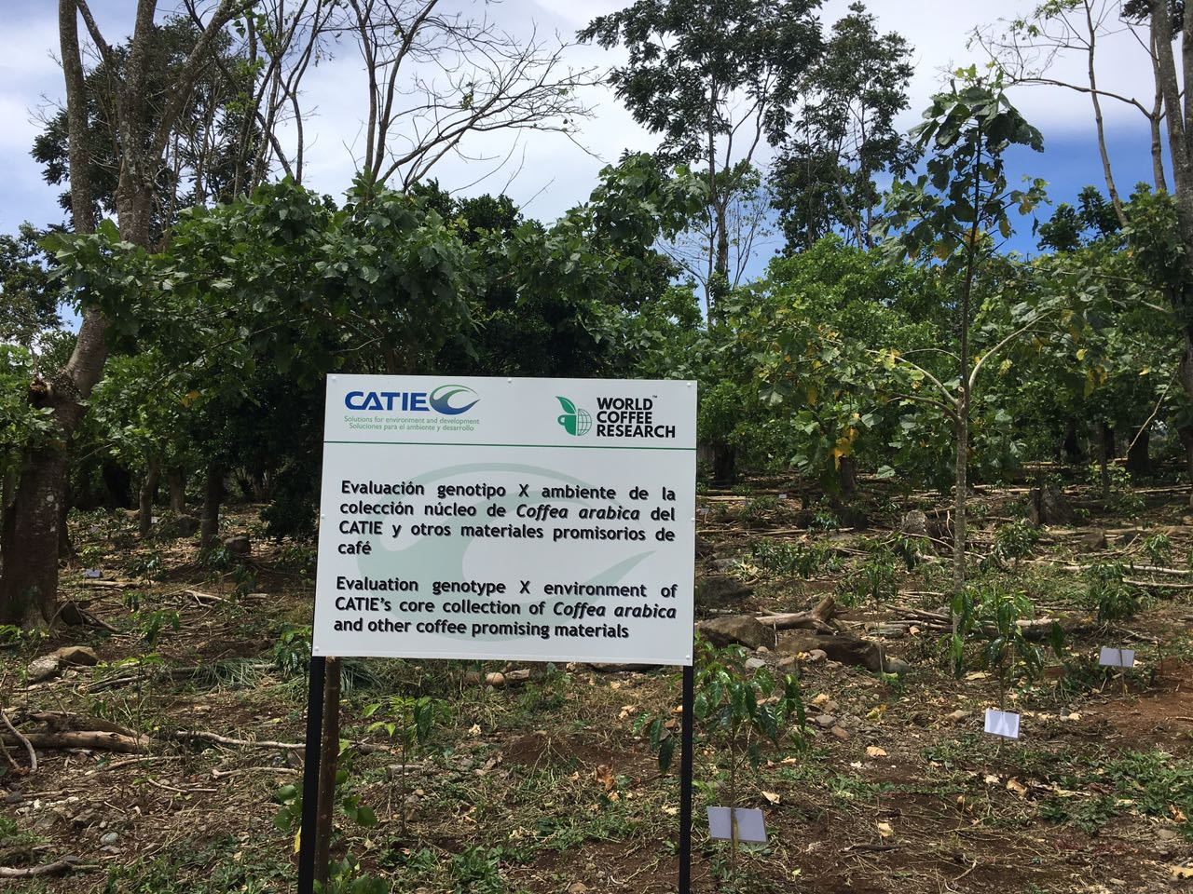


CORE COLLECTION
C. arabica silvestres
de Yemen
100 accesiones
C. arabica silvestres de Etiopia
760 accesiones
Variedades cultivadas
70 accesiones
GBS
Genotyping by Sequencing
Core-Collection
100 accesiones
Triplicada
2 en CR y 1 en el Salvador
fenotipaje
100 accessions representing 95% of the total genetic variability of the 930 genotyped accessions

Slide 6


Products: Coffee hybrids in LAC
Hibryd | Progenitor | Yield* (qq/ha) | Reaction to CLR | Cup quality
Centroamericano | T5296 x Rume Sudán | 83 | Tolerant | Exceptional
Milenio | T5296 x Rume Sudán | 72 | Tolerant | Exceptional
Casiopea | Caturra 7 x ET41 | 65 | Susceptible | Very good
Esperanza | T5296 x ET41 | 75 | Tolerant | Very good
Excelencia | Caturra 7 x E531 | 71 | Susceptible | Excelent Winner CoE 2016
*Average of 7 harvests evaluated in Costa Rica;
Source: reports from ICAFE and CATIE
Average yield in LAC: around 15-25 qq/ha (green coffee)

Slide 7
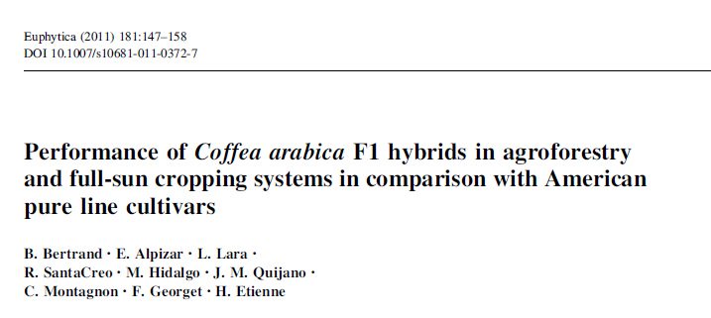
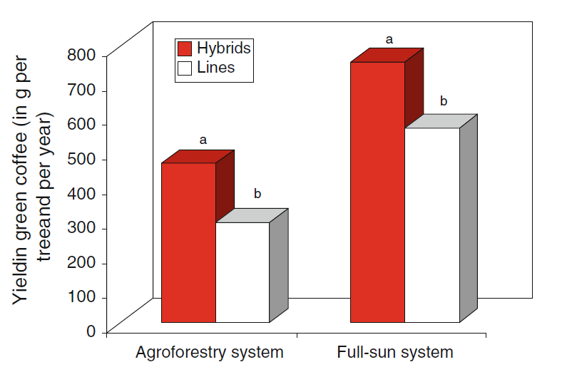
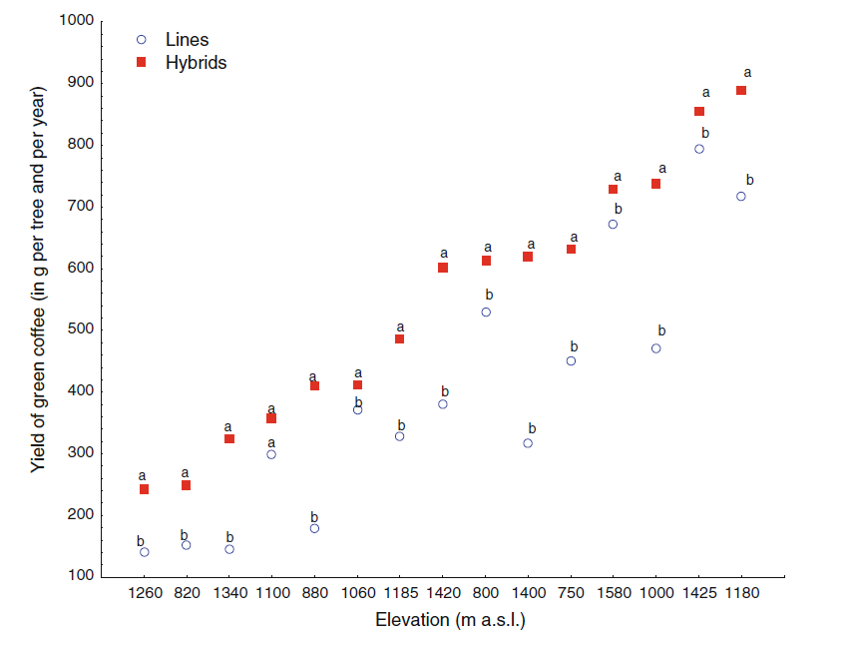
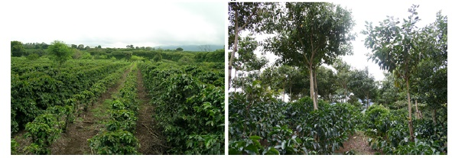

RESULTS OF HYBRIDS IN LAC

Slide 8
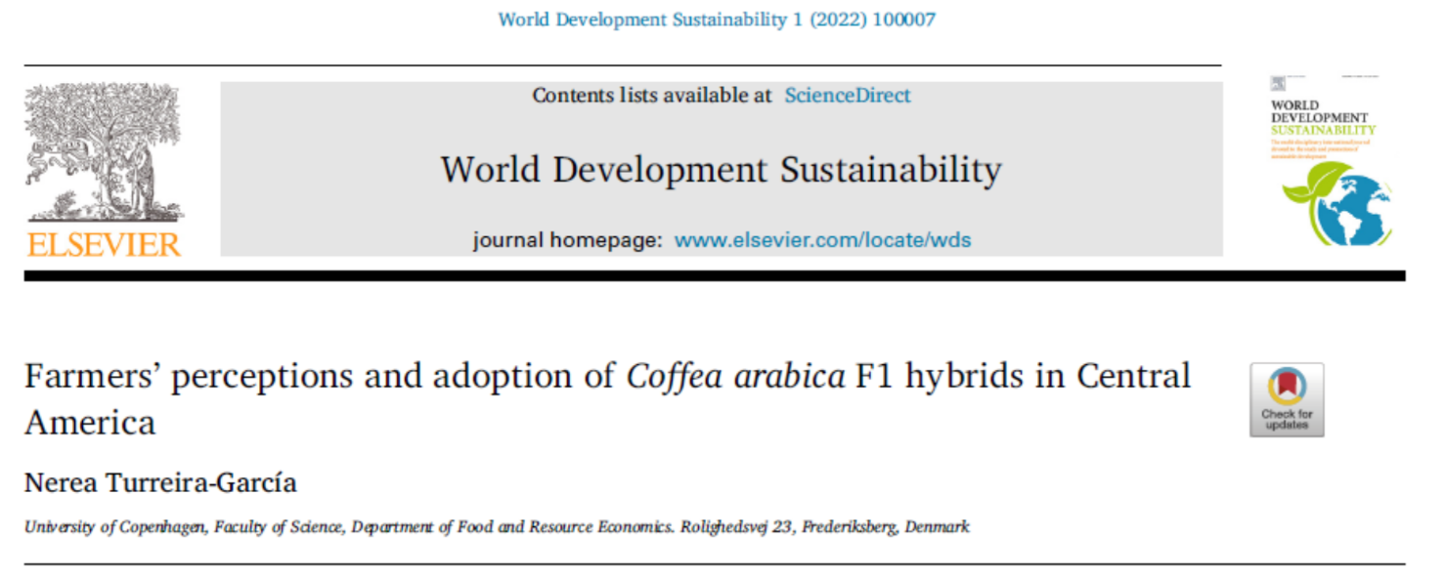
ADOPTION OF HYBRIDS IN LAC
Conclusions:
Hybrids have the potential to adapt to different environments and types of farmers.
Hybrids offer higher and more stable yields, earlier fruiting, uniform ripening, improved plant growth, excellent cup quality, and greater tolerance to pests and diseases.
F1 hybrids are more resilient to climate change.
Improved financial and physical access to hybrids is needed.

Slide 9
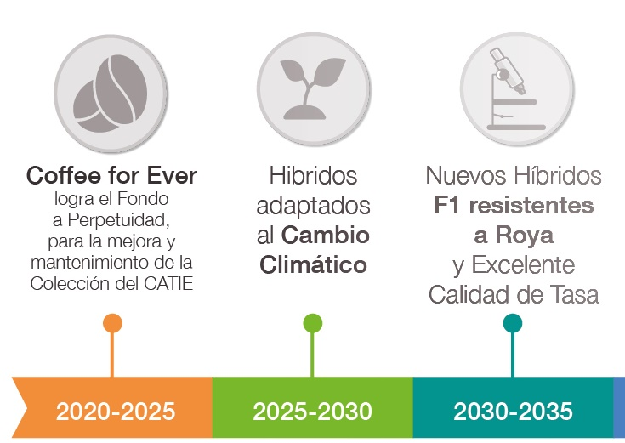
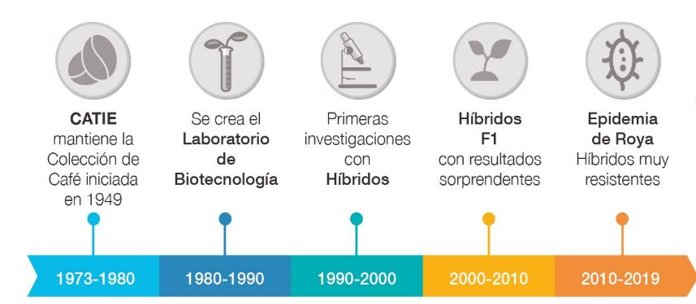
PERSPECTIVES
Review according to new challenges
+ CLR races
Climate Change
CATIE
CROP TRUST
FAO
GIZ
CATIE
WCR
PROMECAFE
INSTITUTOS
EARTH y otras Us
PRIVADOS
CATIE
WCR
PROMECAFE
INSTITUTOS
EARTH y otras Us
PRIVADOS

Slide 10

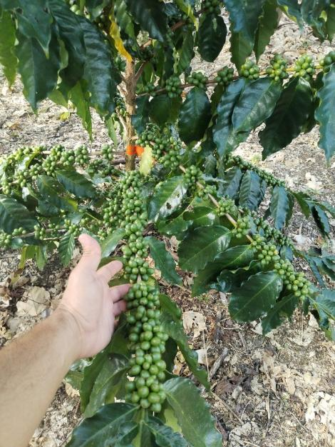
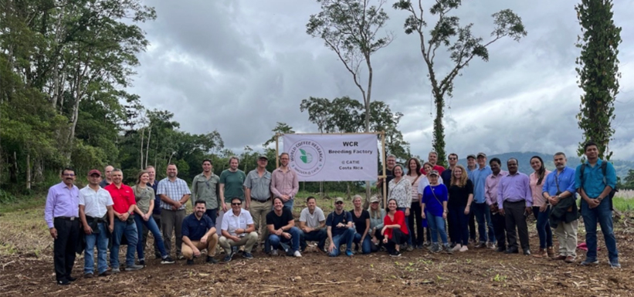
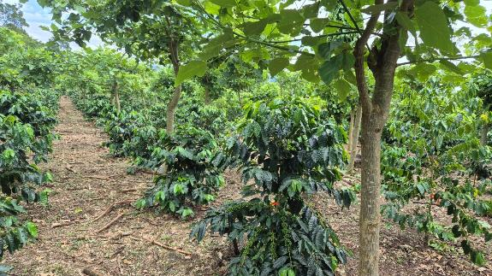
PERSPECTIVES
Evaluations in the coffee breeding factory in CATIE (INNOVEA)
Up to 2025:
Coffee plot of 1.5 ha
214 Innovea new germplasm y 162 F1 (hybrids created in 2015)
Variables been evaluated: morphology, yield, fruit quality and reaction to P&D
Future: use promising materials for new crosses
2022
2025

Slide 11
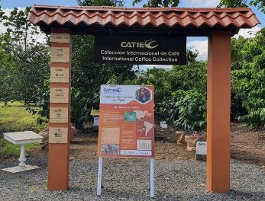
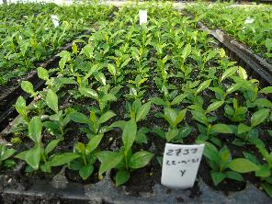
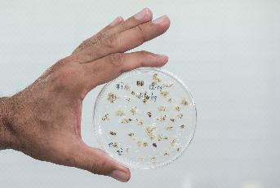
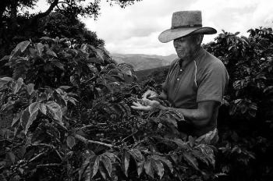
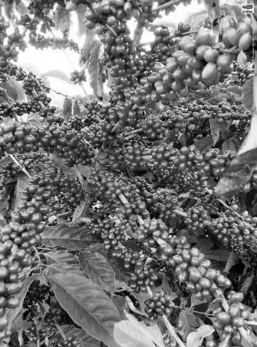
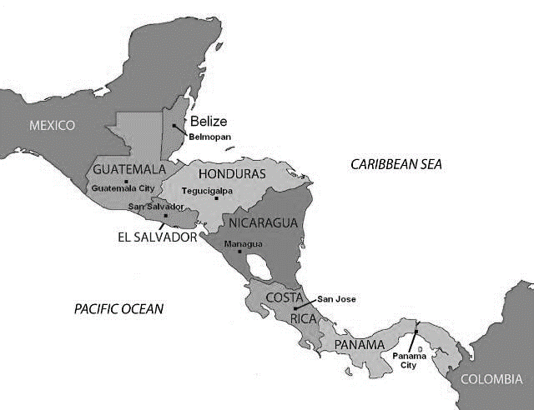
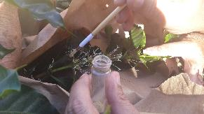
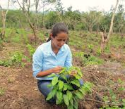
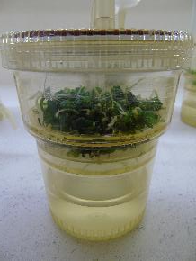
PERSPECTIVES
Hybrids more resilient to climate and disease
2015
2021
2023
2025
2025
2030
Selection of the best individuals
Validation in different areas
New hybrids
Creation of hybrids (126 families)
Vegetative Propagation
2025
2030

Slide 12
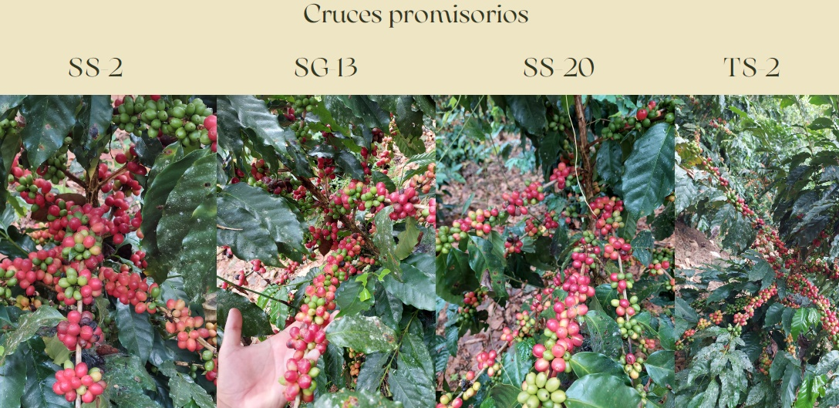
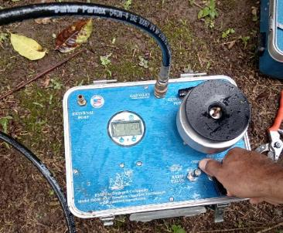
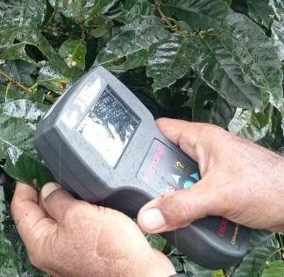
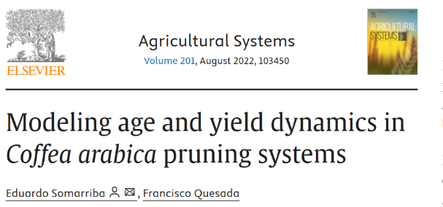
PERSPECTIVES: new hybrids in CATIE
Quality Assessments
Multi-site validation trials
Physiological responses to water deficit and high temperatures
  Nursery
  Field
Pruning modeling

Slide 13
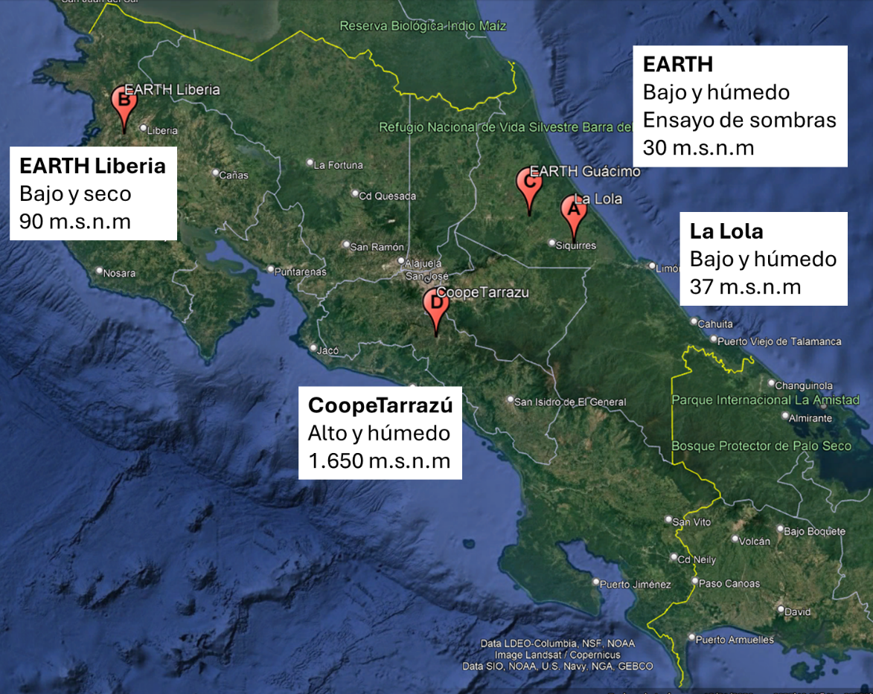
PERSPECTIVES
Multi-site trials of low-altitude coffee hybrids
15 materials to be evaluated
3 CATIE hybrids
4 WCR hybrids
3 Starbucks hybrids
2 Aquiares hybrids
3 controls (Robusta, Liberica, and Arabica)

Slide 14
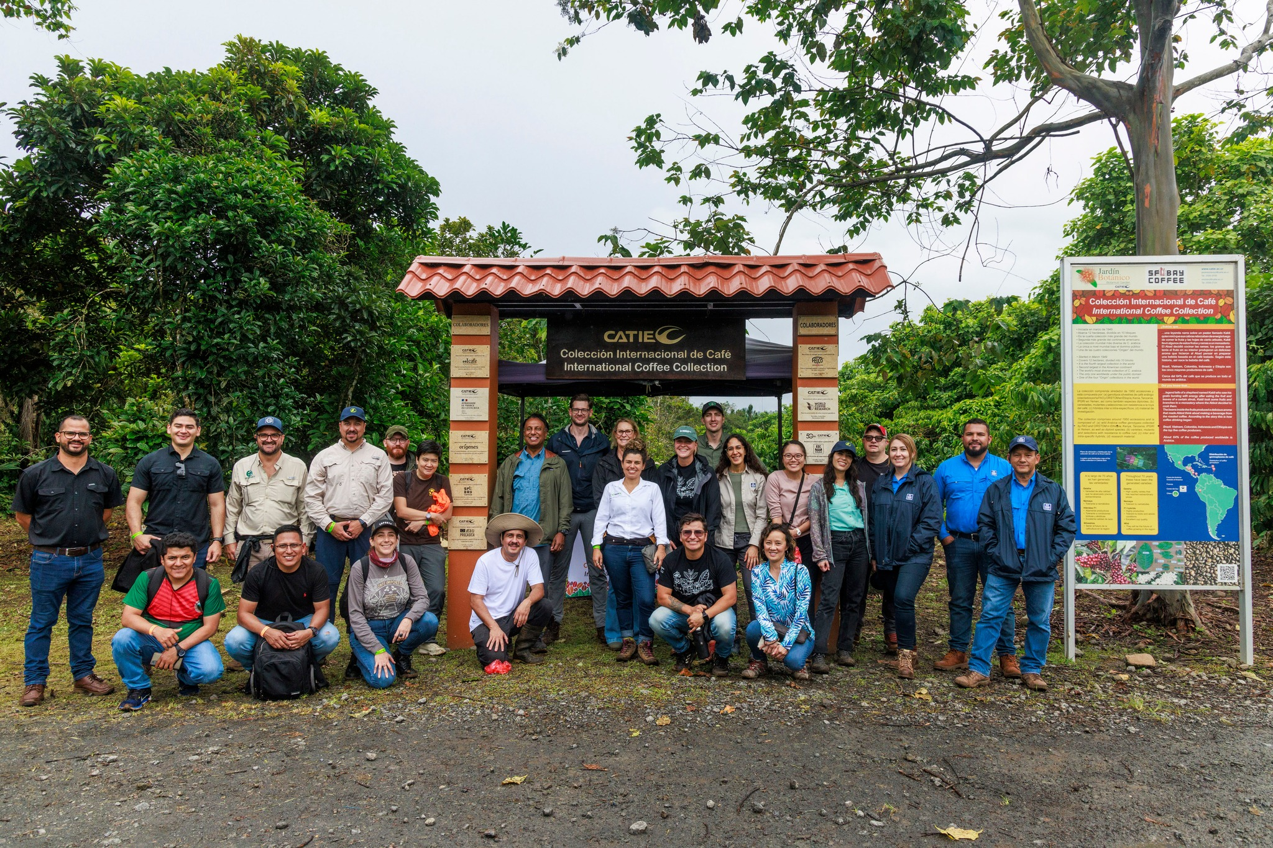
Thank you for your attention
WCR & Sintercafe Field Trip 2024
William Solano wsolano@catie.ac.cr ; Rolando Cerda rcerda@catie.ac.cr

