Slide 1


Innovea trial at ICAFE: Current Progress, Challenges, and Goals

Slide 2

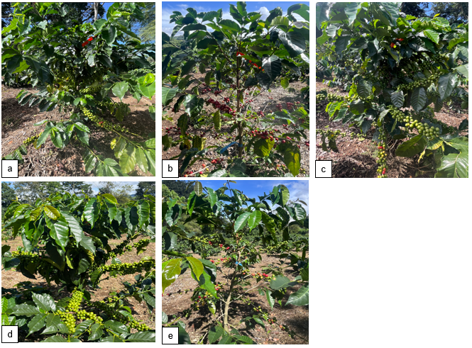
Progress
Figure 1. Some families from Innovea Plot a) WCR0133, b) WCR0140, c) WCR0139, d) ICAFE002 and e) IWCR03101 studied at ICAFE, Costa Rica. Date 10/21/2025

Slide 3
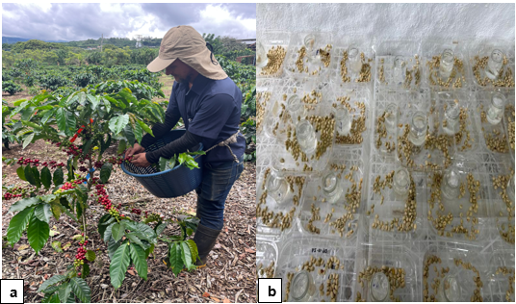
Challenges and Limitations
Figure 2. (a) Harvest activities in the Innovea experimental plot, and (b) example of post-harvest processing for individual trees at ICAFE, Costa Rica. Date 10/21/2025

Slide 4
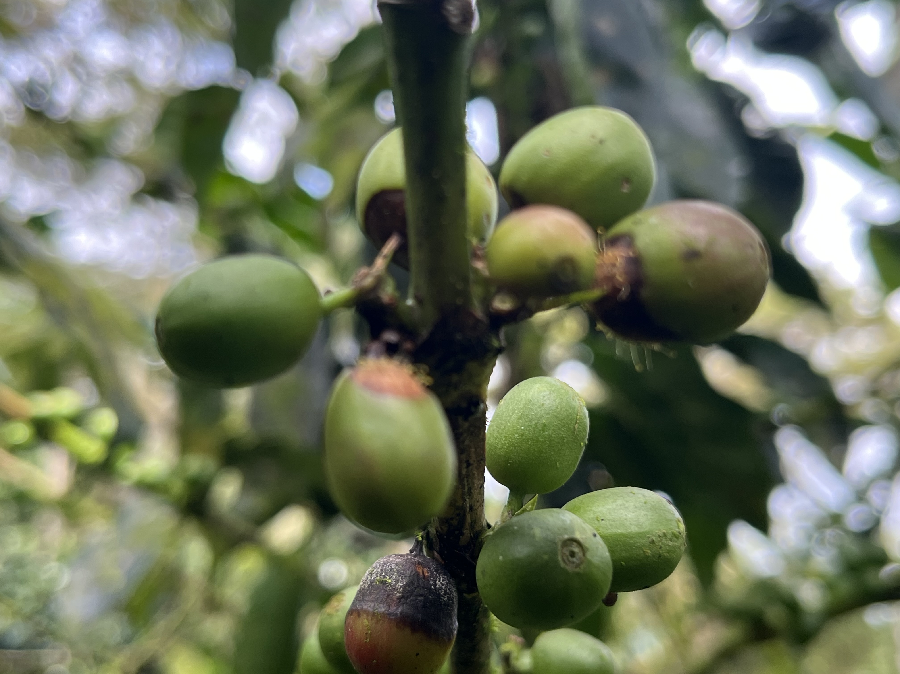
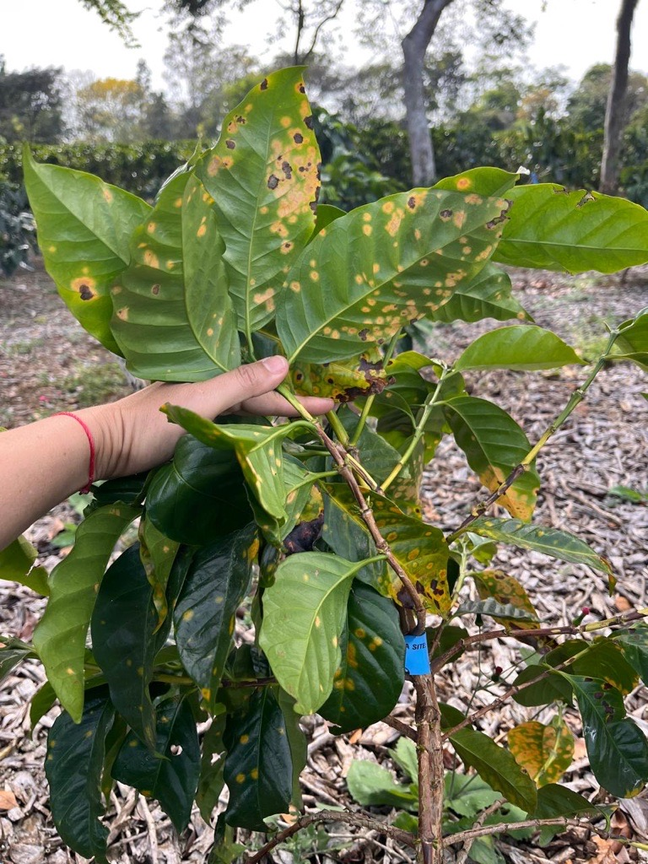
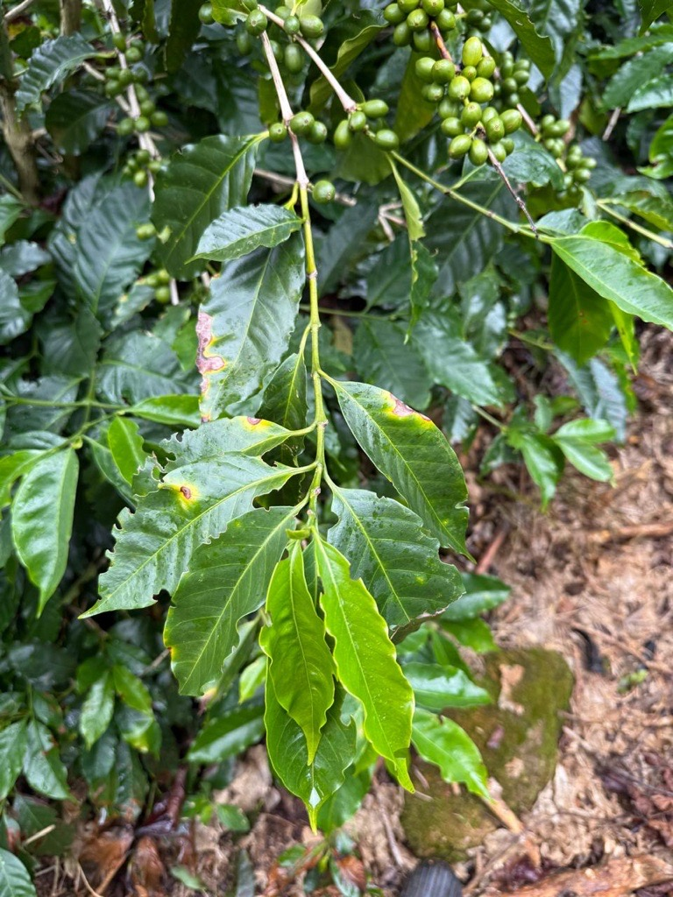
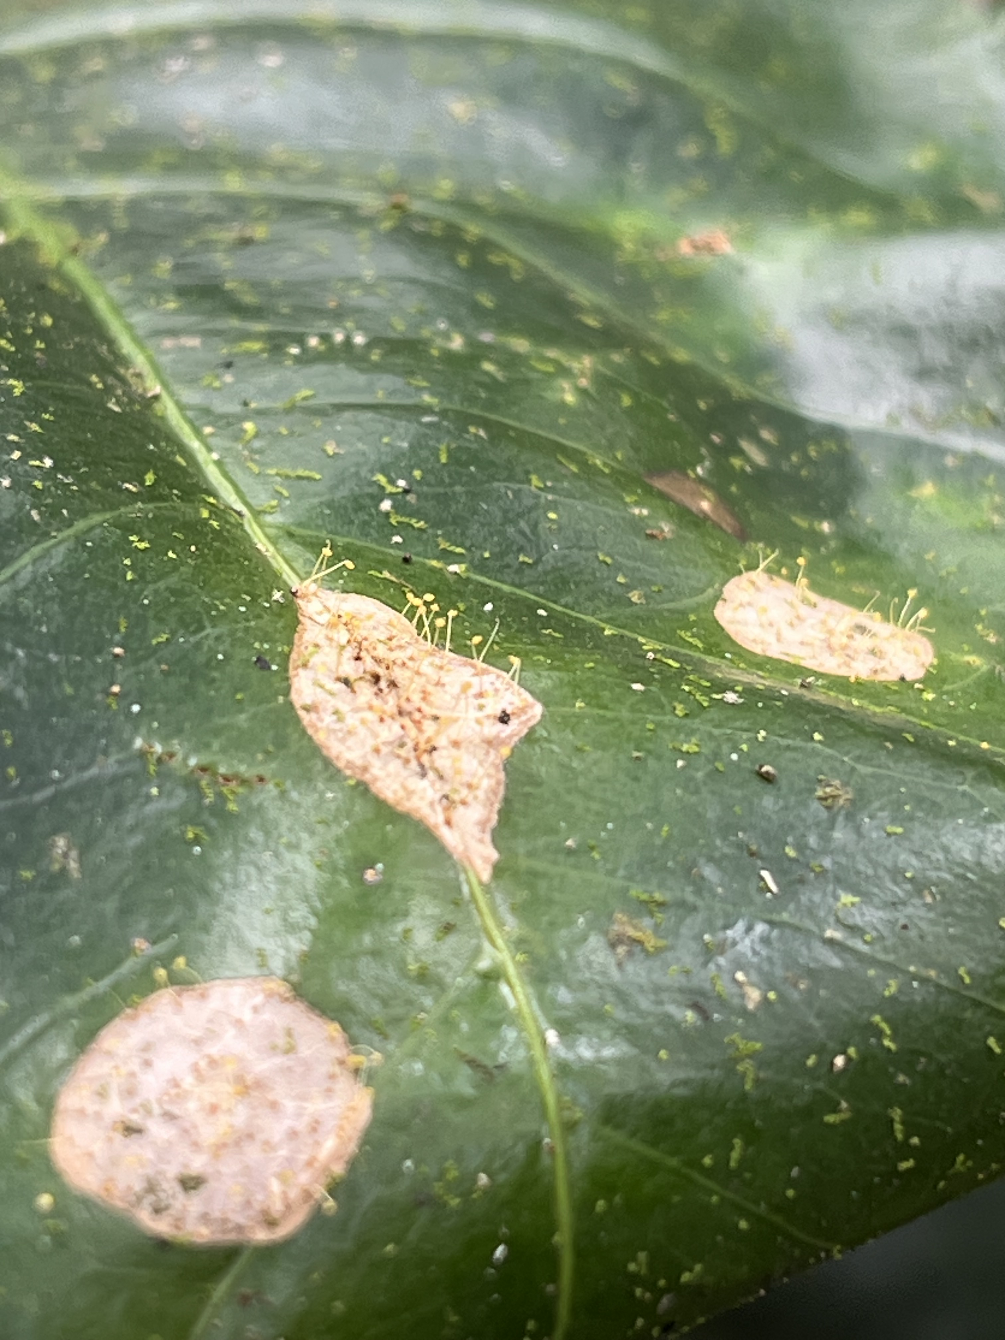
Next Steps and Future Goals
a
b
c
d
Figure 3. (a) Mycena citricolor in fruits, (b) Mycena citricolor, (c) CLR and (d) Antracnose sp in leaves

Slide 5

¡Gracias!
¡Thank you!

