Slide 1

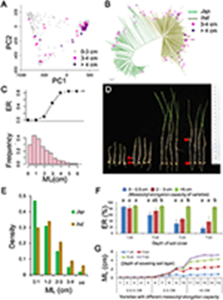
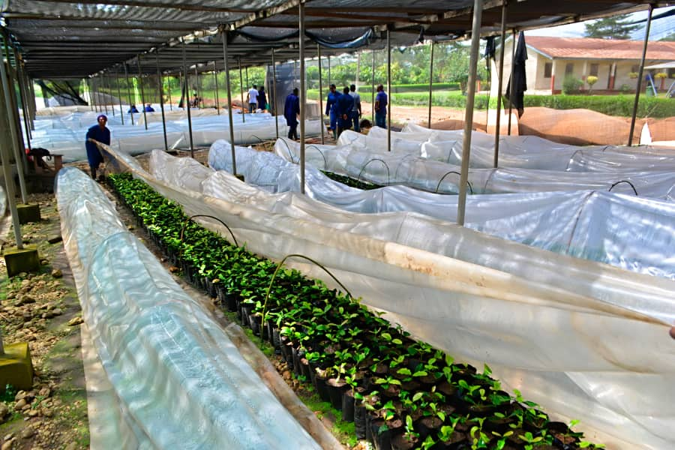
History of Coffee Breeding in Ghana
  Abraham Akpertey, PhD
  Owusu Domfeh, PhD

Slide 2
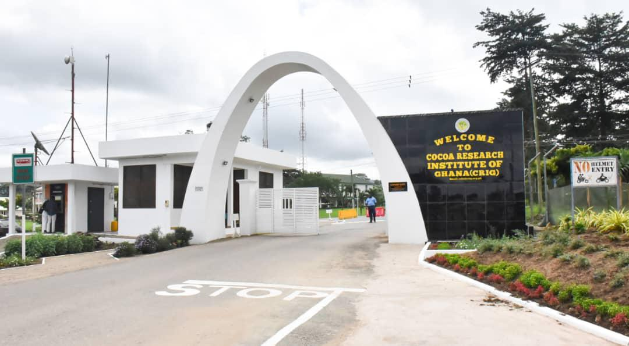
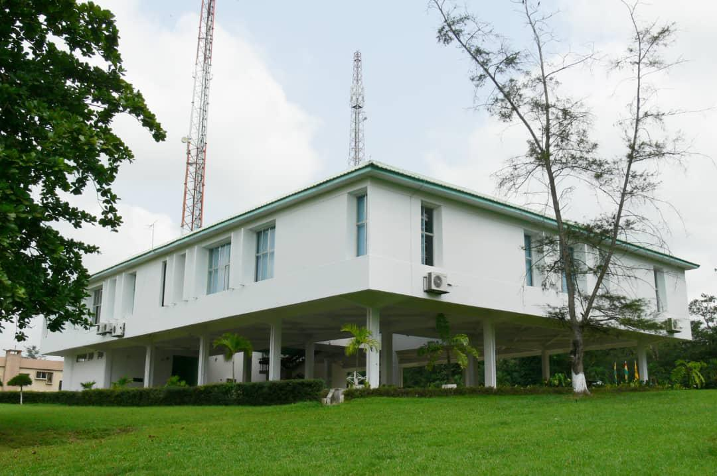
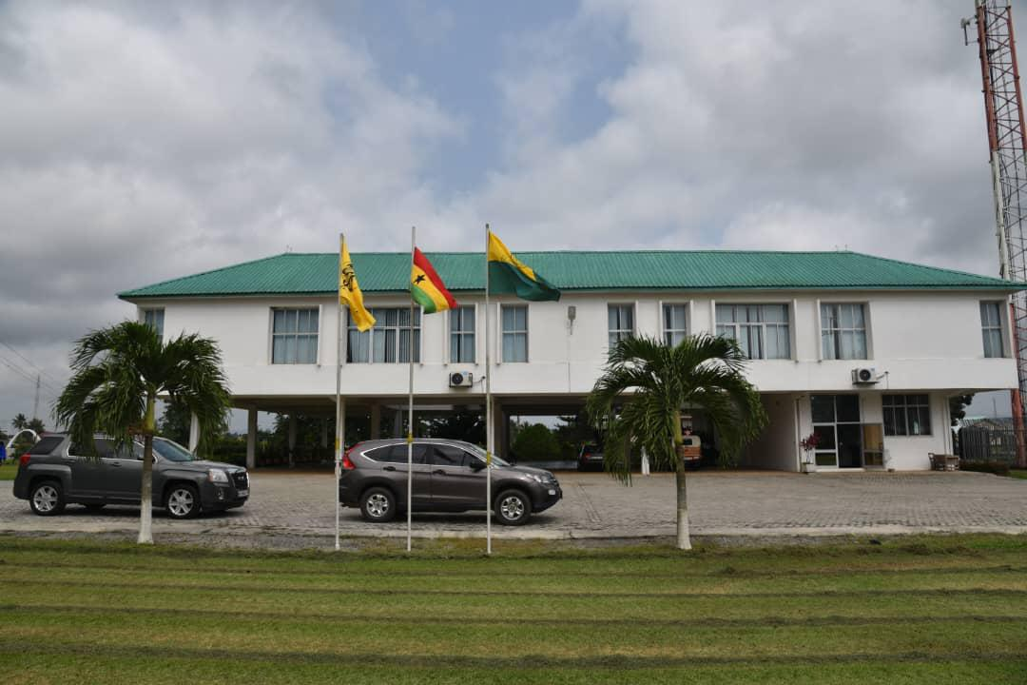
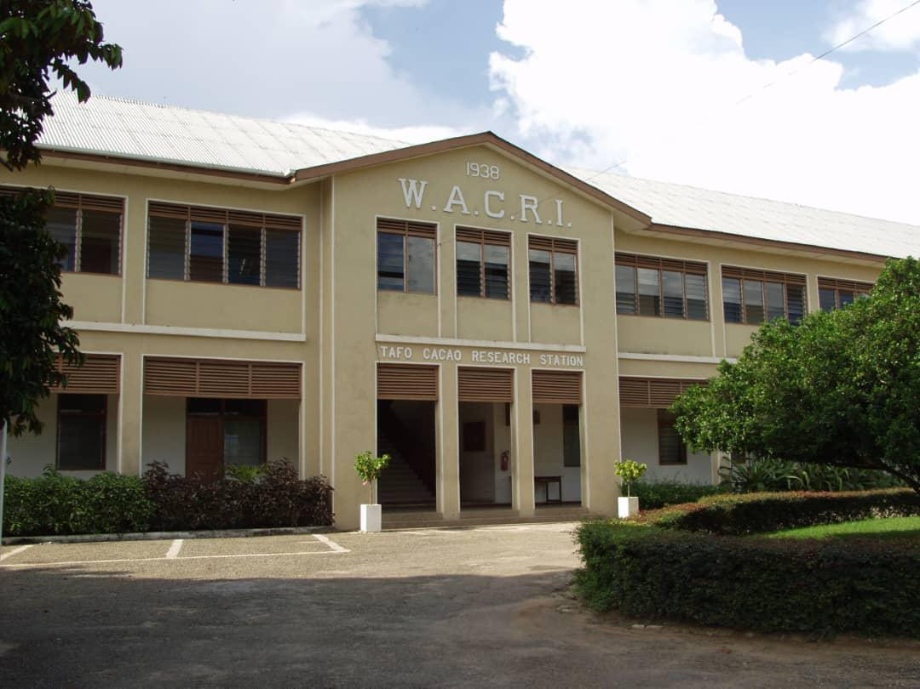
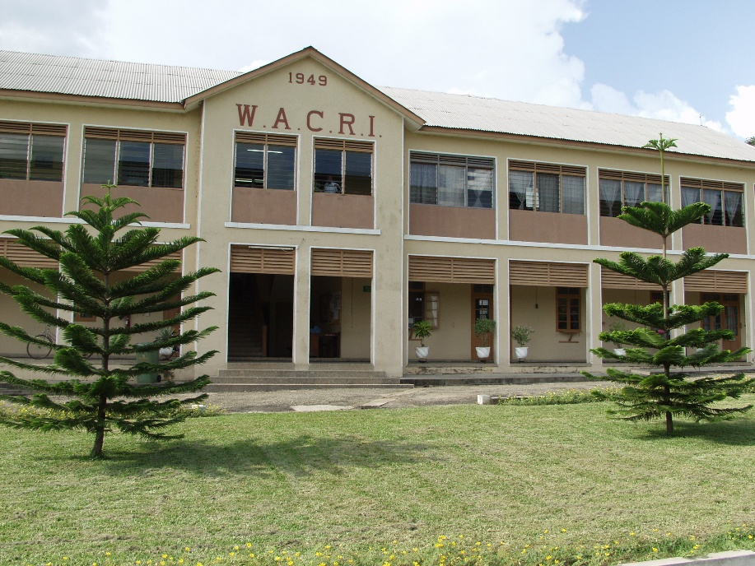
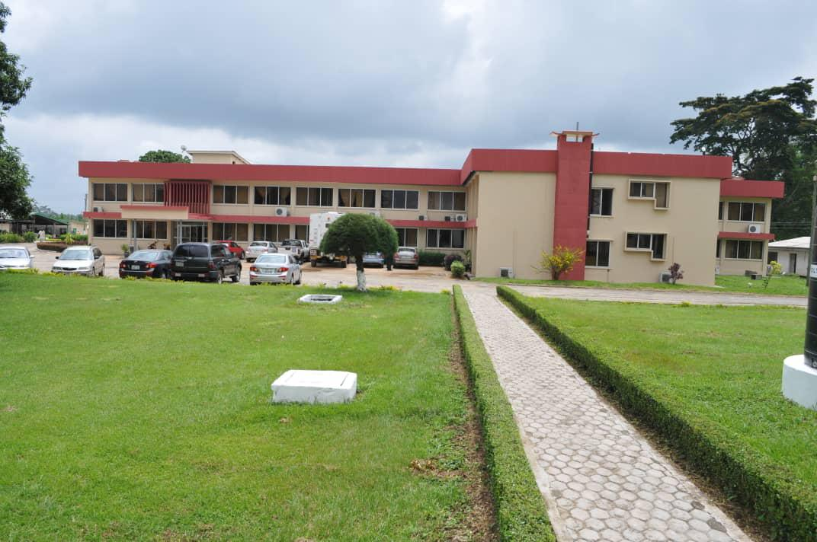
Cocoa Research Institute of Ghana

Slide 3
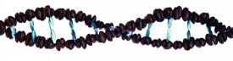

Germplasm Introduction
1966
Formal coffee research commenced
Relied mainly on local germplasm
1977
Open pollinated seeds from Cote d’Ivoire
1992
Clones from Togo
9 clones with average annual yields of 2-3 t/ha released in 1992

Slide 4
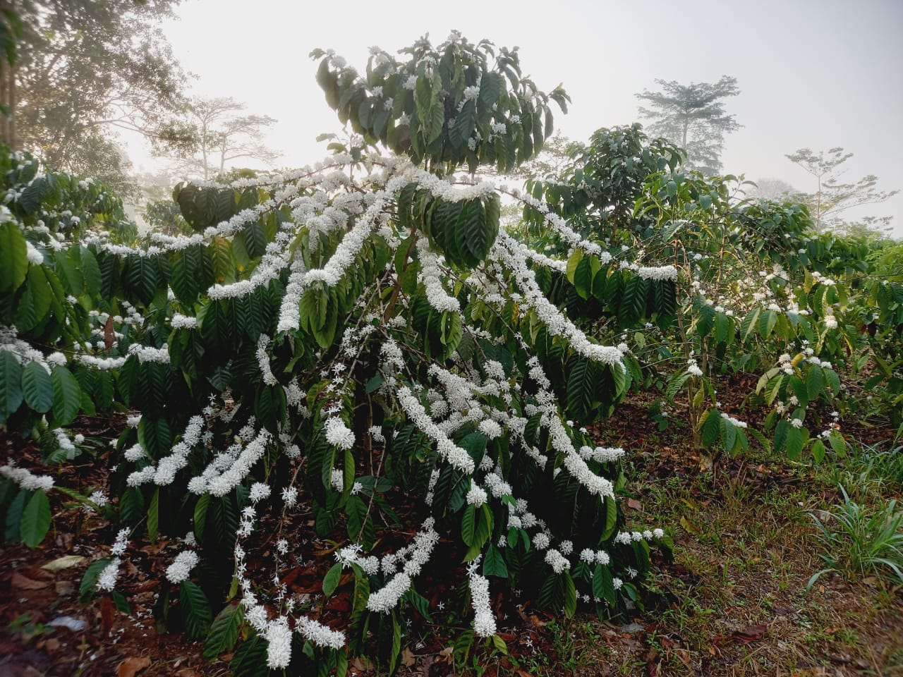
Germplasm Introduction cont’d
2009
Local collections (clones) from COCOBOD plantations
2012
61 clones from Togo
2016
Half-sib seeds from Vietnam
Originally from Uganda and Tanzania

Slide 5
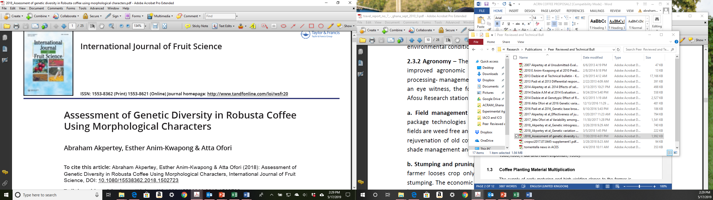
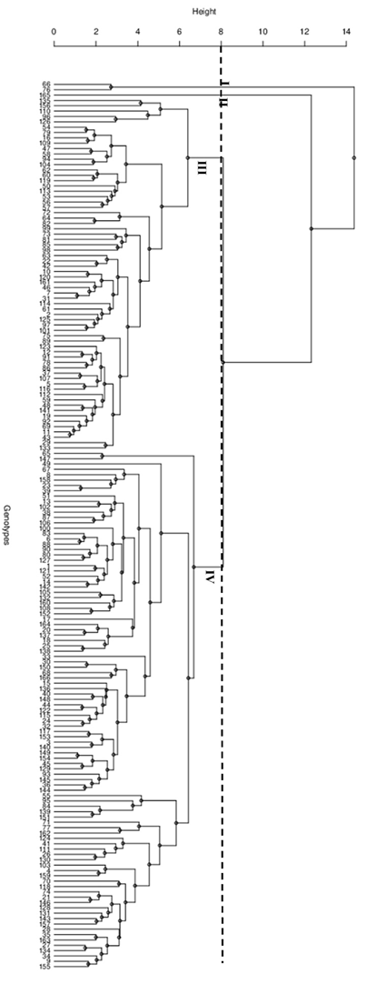
Morphological diversity

Slide 6
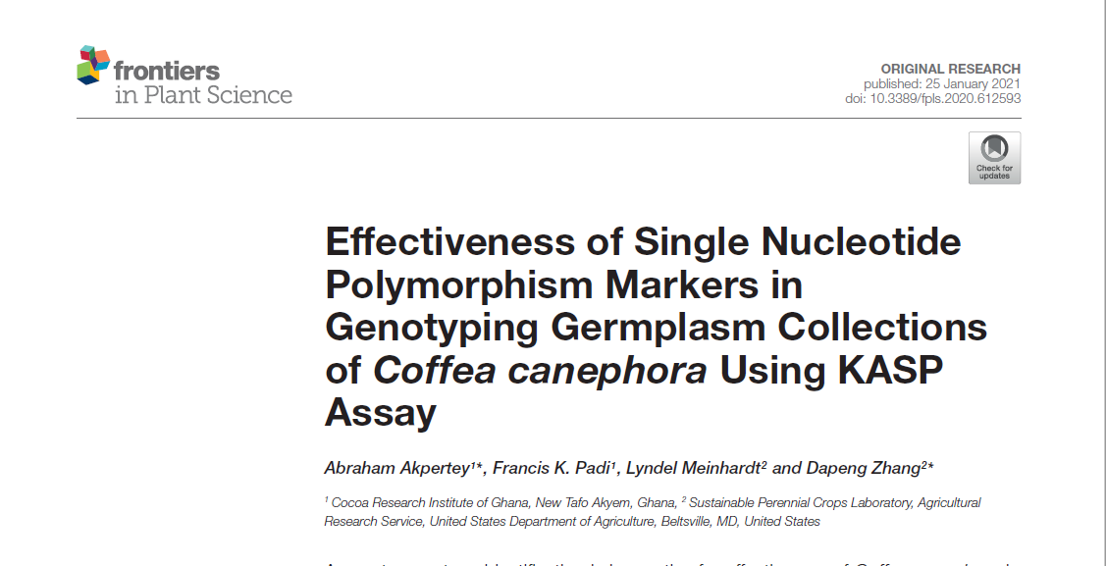
Genetic diversity
(7.59 %)
(23.14 %)

Slide 7
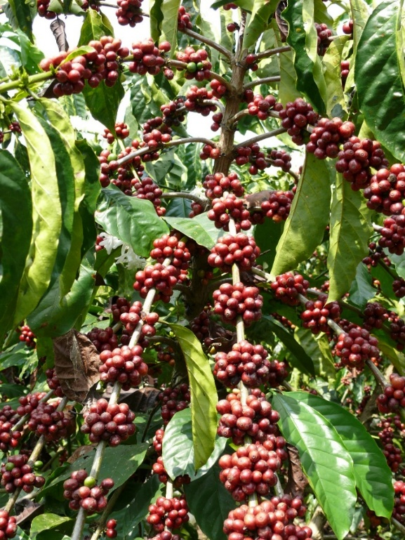
Breeding Approach
1966 - 2001
Clones
Direct clone selections
2002 - date
Clones and “hybrids”
On-station (5-7 yrs) and multi-location trialing (5-10 yrs)
Ortet selections
On-station trialing (5-7 yrs)
Multi-location trialing (5-10 yrs)
Direct clone selections
Ortet selections
Combining ability studies

Slide 8
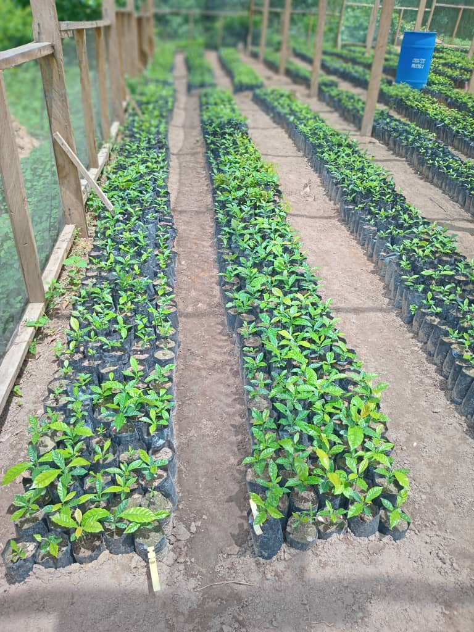
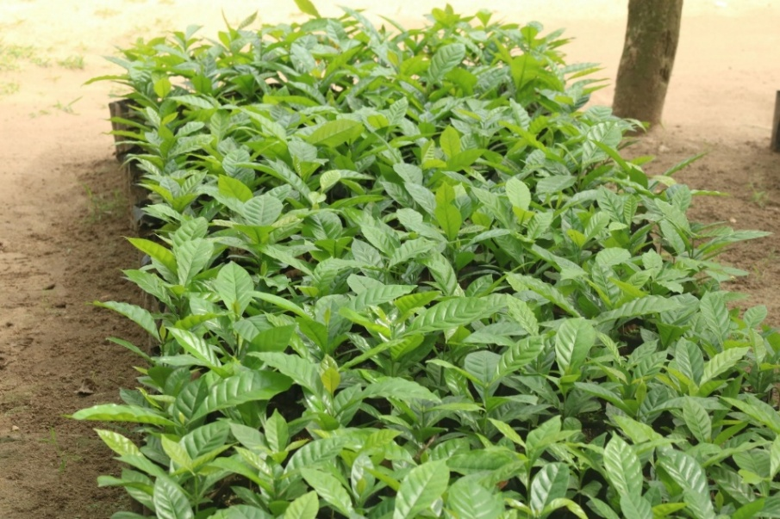
Impact of Pollen Contamination on Cross Fidelity
??- Pollen mixture (MMC26 and A129)

Slide 9
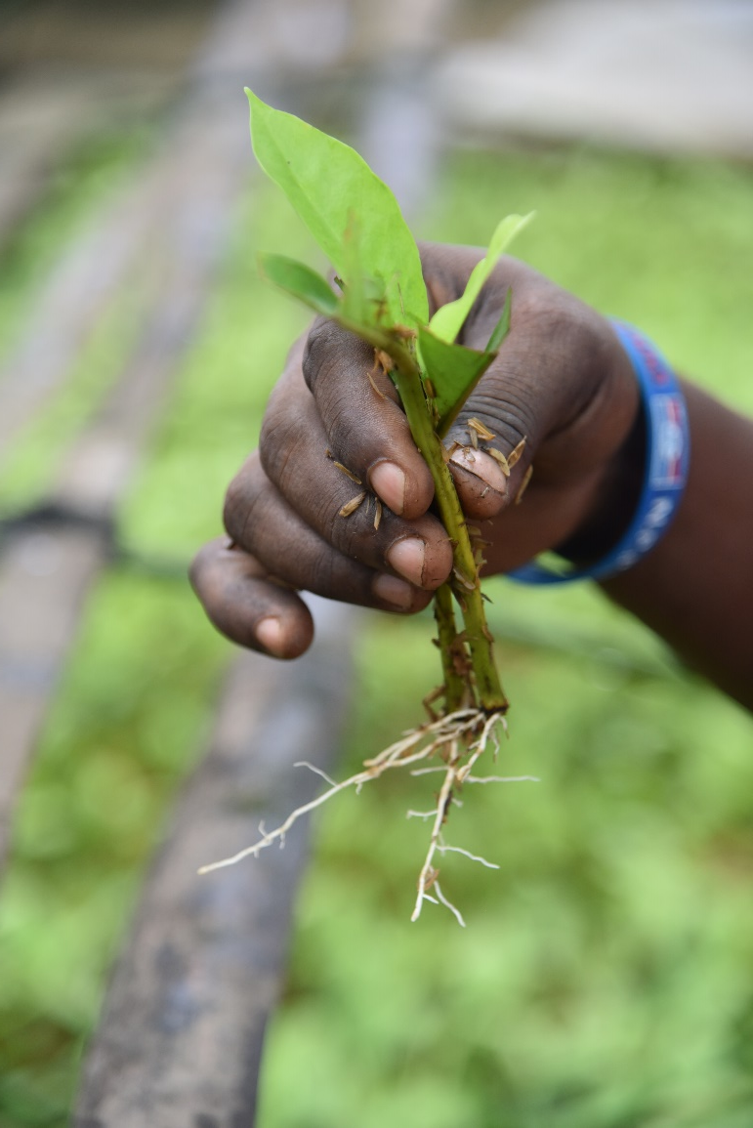
Varieties and their Characteristics
1992
2012
2 hybrids (CRG H001 and CRG H002)
2019
5 clones (CRG H907, CRG TR4-98, CRG TR9-4, CRG TR4-99 and CRG TR9-2)
2-3 t/ha
>2 t/ha
Cup quality >7.5
Starts bearing 2 yrs after planting
Starts bearing 2 yrs after planting
>2 t/ha
Cup quality >7.5
9 clones

Slide 10
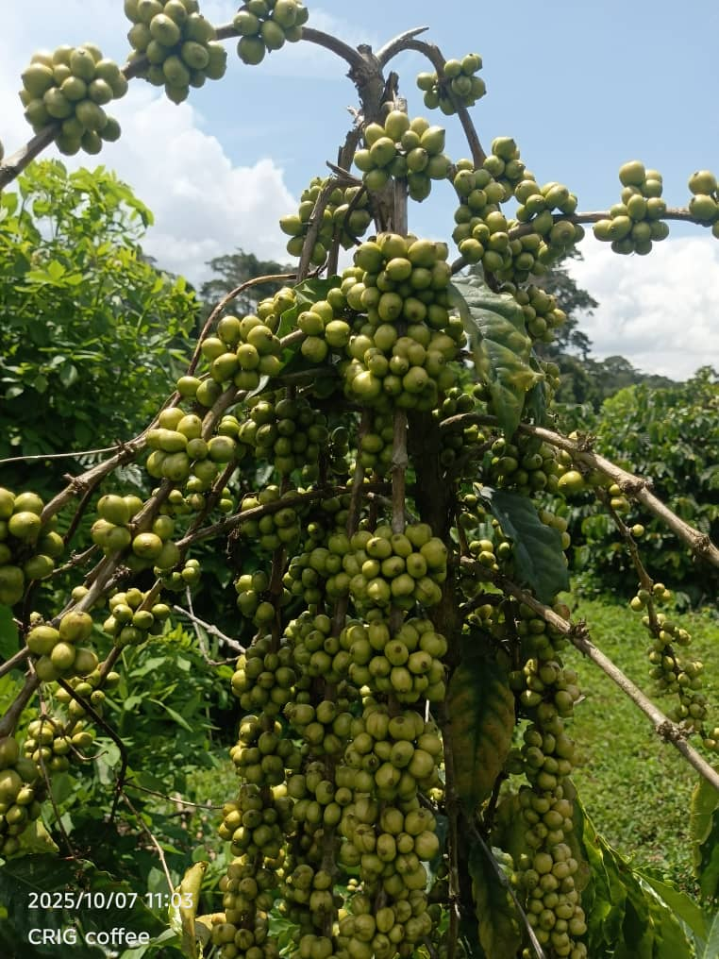
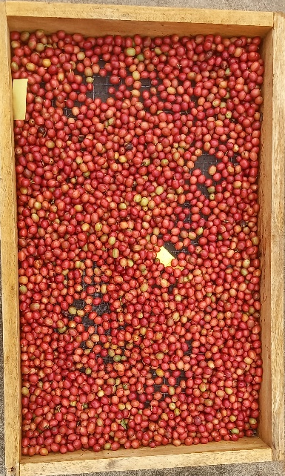
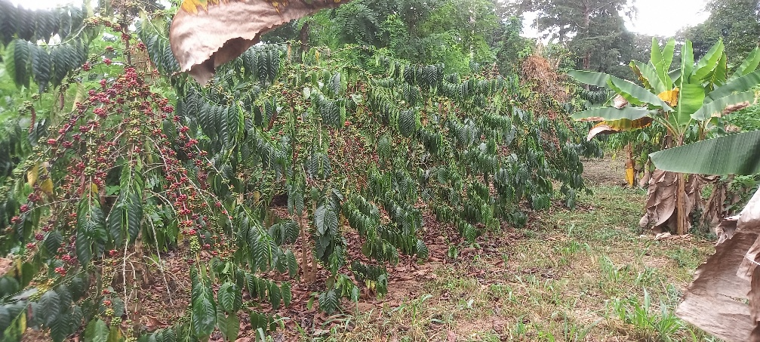
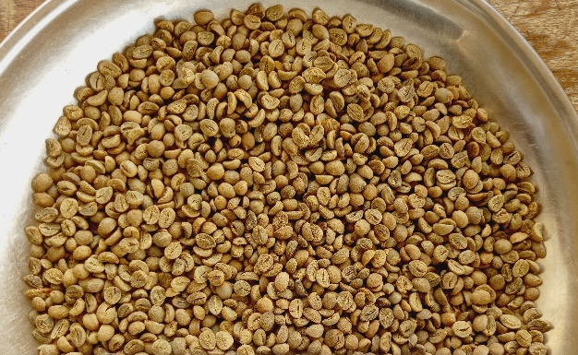
Varieties and their Characteristics cont’d
2025
4 hybrids (CRG H003, CRG H004, CRG H005 and CRG H006)
>2 t/ha
Cup quality >7.5
Starts bearing 2 yrs after planting
Tolerant to abiotic stresses

Slide 11
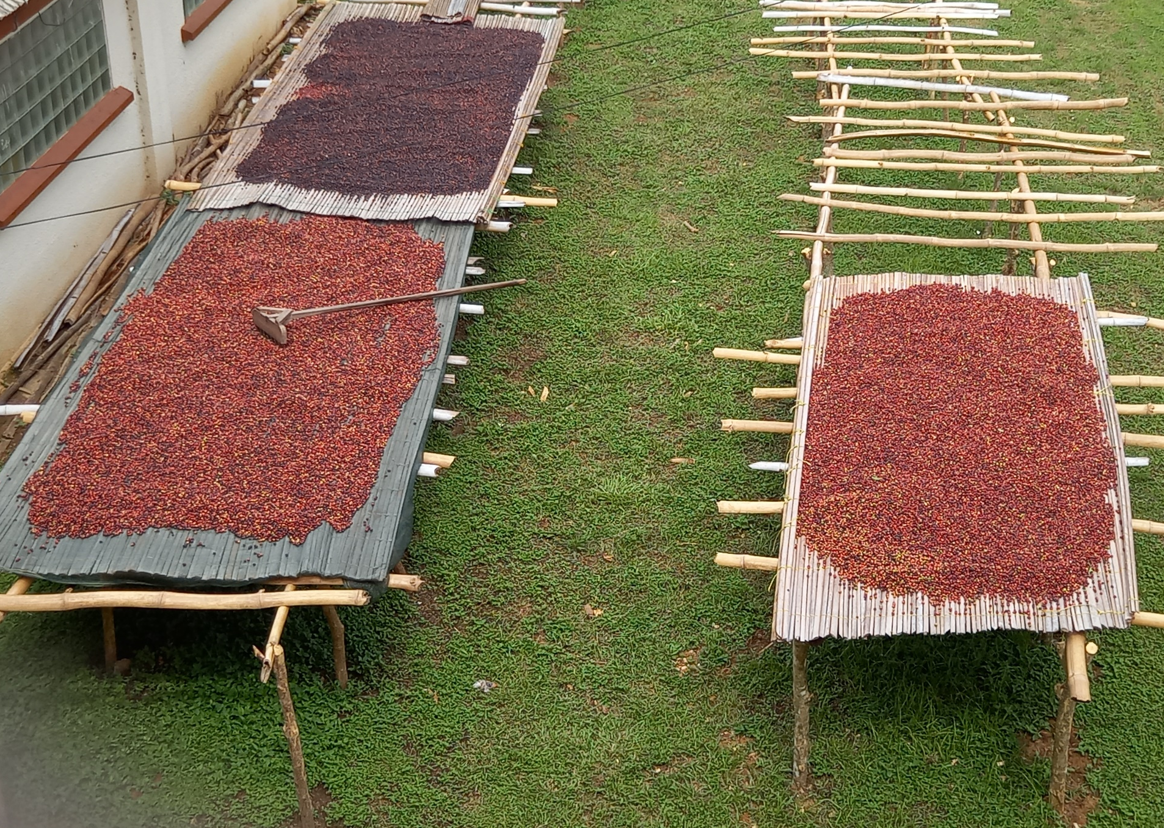
Thank You

