Slide 1


Global Coffee Breeding Meeting, Manizales- Colombia, on November 17 - 21, 2025
Indian Collaboration with World Coffee Research
Dr. Jeena Devasia,
Head, Plant Breeding and Genetics
Central Coffee Research Institute,
Chikkamagaluru,
Karnataka, India

Slide 2
Milestones
MoU Signed with WCR and India for IMLVT
Received 28 Arabica varieties 2015-2017
Establishment of IMLVT plot-2016-2017
Valuation varieties
MoU signed for Global Innovea Network project
MoU Signed with WCR for Global Robusta network project
Received Innovea global varieties Arabica varieties Sept 2024
2014
2022
2024
2025

Slide 3
IMLVT – India
A quick overview

Slide 4
Varieties received for IMLVT
Sl. No. | Variety
1 | Colombia 1 (dwarf)
2 | Colombia 2 (dwarf)
3 | Colombia 3 (dwarf)
4 | Colombia 4 (dwarf)
5 | Colombia 5 (dwarf)
6 | IPR-103 (dwarf)
7 | IPR-107 (dwarf)
8 | Paraiso (dwarf)
9 | Catigua MG2 (dwarf)
10 | IAC 144 (dwarf)
11 | Ruru11 (dwarf)
12 | S.4808 (dwarf)
13 | EC-16 (dwarf)
14 | EC-15 (dwarf)
15 | Marsellesa (dwarf)
16 | Pacamara (dwarf)
17 | Lempira (dwarf)
18 | Parainema (dwarf)
19 | Oro Azteca (dwarf)
20 | Ruru11 (dwarf)
Sl. No. | Variety
21 | Mundo Novo 379/19 (tall)
22 | Batian (tall)
23 | K7 (tall)
24 | SL28 (tall)
25 | S.795 (tall)
26 | S.5B (tall)
27 | Sln.6 (tall)
28 | Geisha (tall)
29 | AB3 (tall)
Local Check varieties
Chandragiri- Semi dwarf (Sarchimor)
Sln.9 - Tall (HDT x Tafarikela)

Slide 5
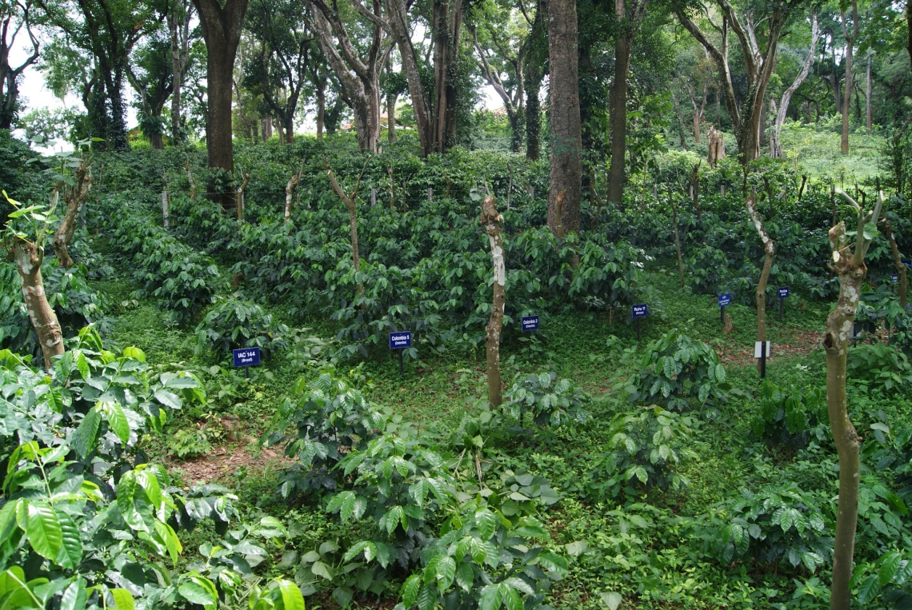

Slide 6
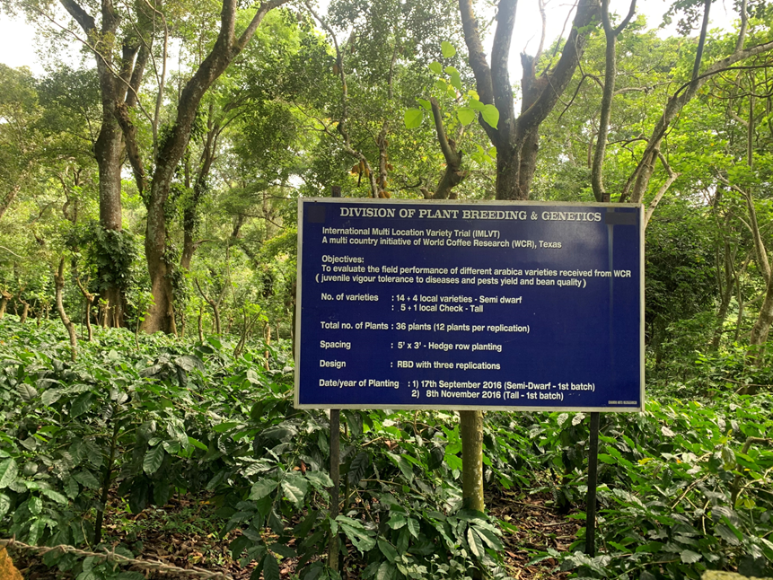
IMLVT Plot, CCRI, INDIA
WCR-IMLVT Block, CCRI
Catigua MG-2
Parainema

Slide 7
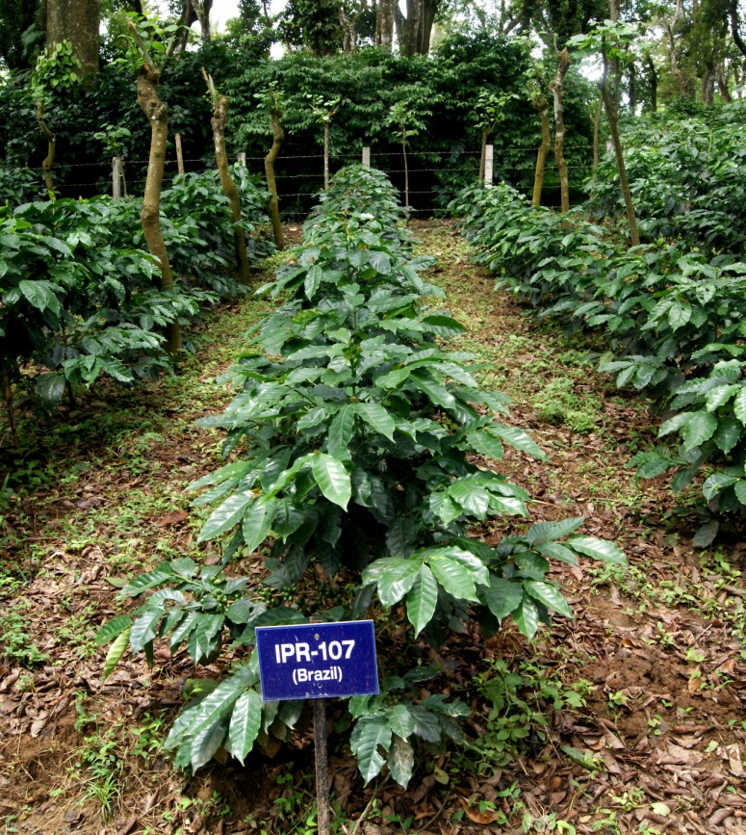
IMLVT Plot, CCRI, INDIA
WCR-IMLVT Block, CCRI
Catigua MG-2
Parainema

Slide 8
Evaluation of varieties in brief- Yield
Status of IMLVT -Collaboration with India & WCR
Yield level ranged from 246 kg /ha to 746 kg cc/ha.
The maximum projected yield was recorded in Paraenema (806 kg cc/ha) followed by EC-16 (744 kg cc/ha) and Marsellesa (700 kg cc/ha)
the maximum mean of five years was recorded EC-16 (746 kg/cc/ha).
The check variety Chandragiri recorded mean yield of 836.7 kg/ha.
The per cent of ‘A ‘grade beans ranged between 11% in Catigua MG-2 and 81% in Pacamara

Slide 9
Evaluation of varieties in brief- CLR
Status of IMLVT -Collaboration with India & WCR
Catigua MG-2 and EC-16 manifested high field tolerance
The per cent of incidence in Catigua MG-2 is 0.55%
In EC-16, 8.3% of incidence reported, where as the severity (1.4) is very less with non sporulated spores.
The sarchimor varieties such as Parainema, Marsellesa were observed to be tolerant in all replications.
Catimors varieties and Pacamara variety were found to be susceptible to coffee leaf rust with high defoliation.

Slide 10
Evaluation of varieties in brief- Cup Quality
Status of IMLVT -Collaboration with India & WCR
Sl.No | Variety | Cup Scores- Mean of three years
1 | Batian | 81
2 | Catigua MG2 | 81.4
3 | EC-16 | 79.4
4 | IPR-103 | 78.9
5 | Marsellesa | 80.2
6 | Pacamara | 82.7
7 | S.795 | 79.4
8 | Sln.6 | 80
The Eight varieties WCR were sent for cup quality assessment in 2021,2022 and 2023.
The results indicated that, the variety Pacamara recorded high SCA score of 82.7 followed by Catigua MG2 and Batian.
The variety Marsellesa and Sln.6 were also recorded high score of 80

Slide 11
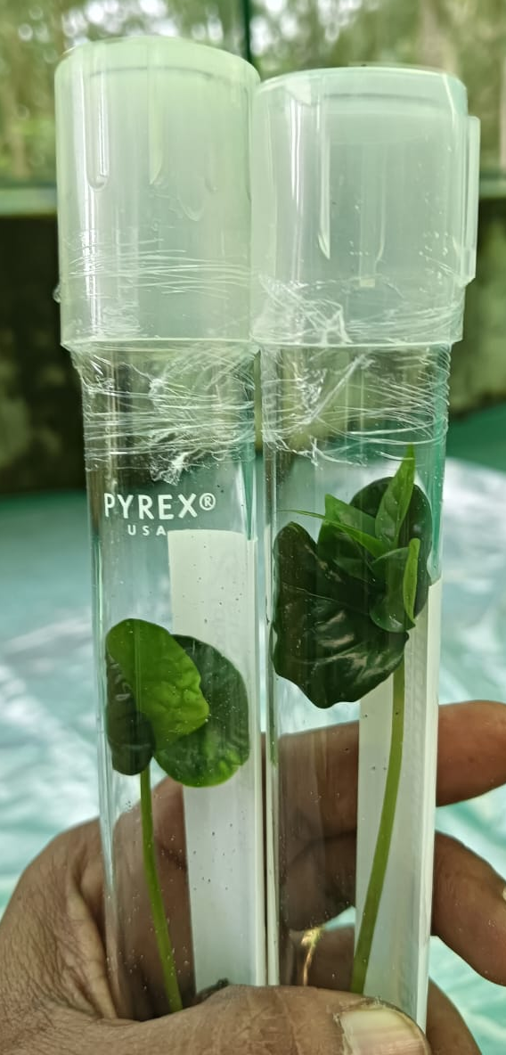
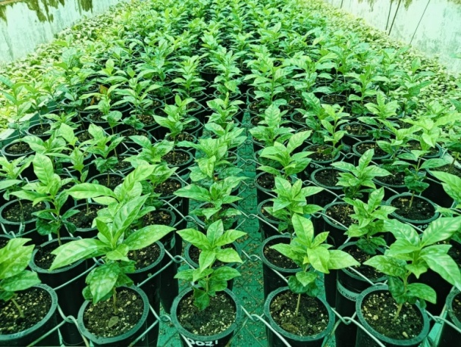
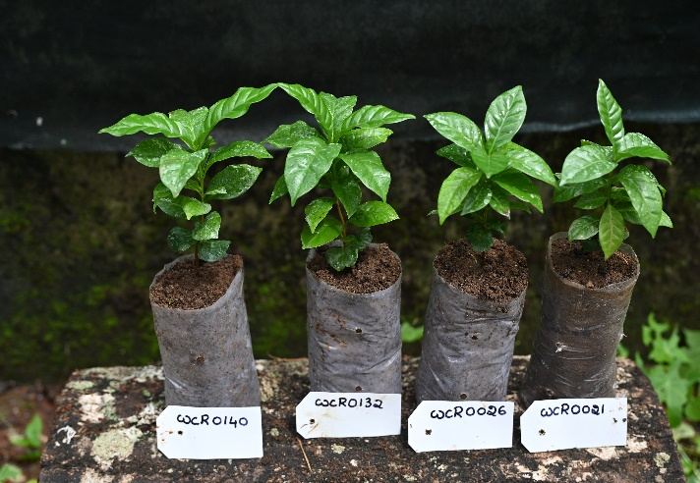
Innovea Global
CCRI, Coffee Board, India joined hands with WCR for evaluating the new breeding lines/hybrids developed by crossing best performing varieties.
As part of INNOVEA team:
September 2024: Received in vitro raised seedlings from Costa Rica through NBPGR after the quarantine clearance.
The in vitro plantlets were transplanted into root trainers in soil rite mixture and maintained in the Isolation for two months
Later shifted to normal nursery mixture and maintained

Slide 12
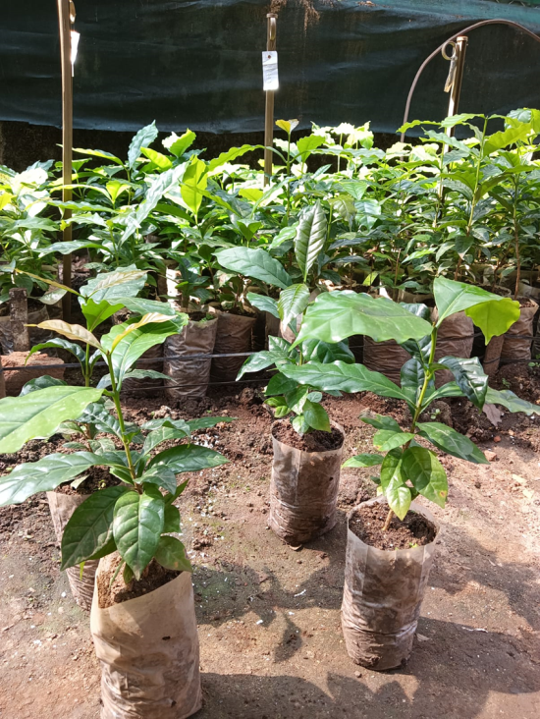
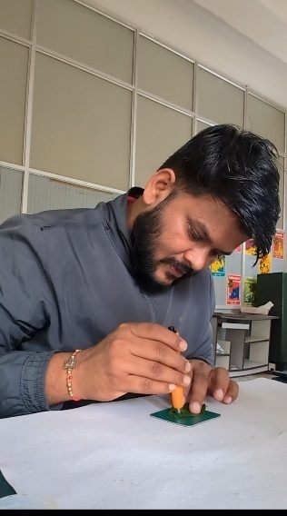
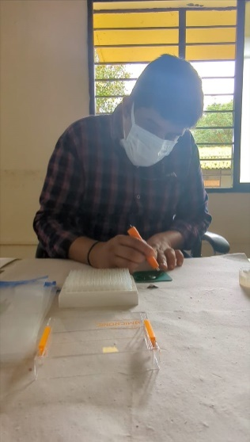
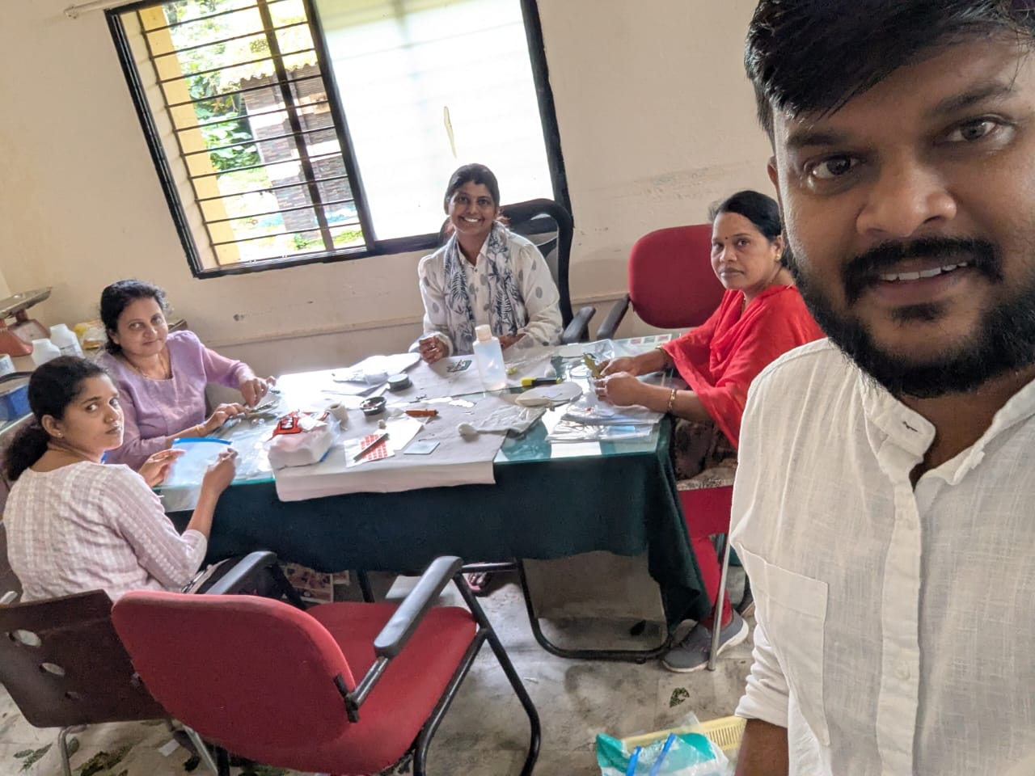
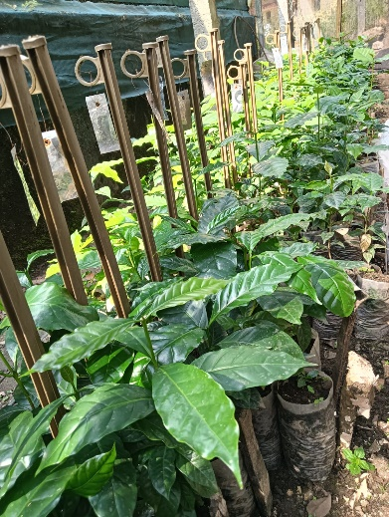
The status of available plants being hardened at CCRI
Sl.No | Code | total plants available at CCRI nursery
1 | WCR0021 | 44
2 | WCR0022 | 30
3 | WCR0023 | 32
4 | WCR0024 | 8
5 | WCR0025 | 7
6 | WCR0026 | 18
7 | WCR0101 | 1
8 | WCR0102 | 5
9 | WCR0103 | 5
10 | WCR0104 | 1
11 | WCR0105 | 2
12 | WCR0106 | 4
13 | WCR0107 | 3
14 | WCR0108 | 1
15 | WCR0109 | 5
16 | WCR0110 | 3
17 | WCR0111 | 5
18 | WCR0112 | 9
19 | WCR0113 | 1
20 | WCR 114 | 3
21 | WCR 115 | 4
22 | WCR 116 | 1
23 | WCR 117 | 3
24 | WCR 132 | 23
25 | WCR 133 | 9
26 | WCR 137 | 28
27 | WCR 138 | 6
28 | WCR 140 | 27
Total |  | 288
Seedling Genotyping:
The genotyping was conducted with WCR’s interventions.

Slide 13
Way Forward
Experimental Design: Establishing trial plot at TEC, Arasinaguppe, Chikkamagaluru with 13°23'33.38"N latitude 75°46'30.42"E longitude 13°23'33.38“
Tree Transplantation: In December 2025
Phenotypic Data Collection:- May 2026
Evaluating the new F1 hybrids on:-
Vegetative Vigour
Leaf Rust Incidence
Yield
Quality
Other pest and disease
Agronomy Management Activities

Slide 14
Robusta Breeding network
MoU signed with WCR in 2025
Looking ahead towards active participation and development of elite promising Robusta varieties in association with WCR.

Slide 15

