Slide 1


Kenya Agricultural & Livestock Research Organization (KALRO)
Presentation at the Coffee Breeding Improvement meeting in Colombia, from November 17 to 21, 2025.
J.J CHESEREK (Ph.D.) and J.M Gimase (Ph.D.)

Slide 2
Alignment of project to KALRO coffee breeding objectives
KALRO’s mandate “to enhance agricultural productivity through technology, innovation, and partnerships.
Supports coffee breeding goals of developing high-value, high-yielding, disease-resistant, adaptable, and high-quality Arabica varieties
Partnership enabled accession of unique international genetic materials, expanding Kenya’s coffee germplasm base.
Introduction of improved lines enhances genetic gain and breeding efficiency for superior varieties

Slide 3
TRIAL SITE DESCRIPTION
Nearest City and Distance: | Nairobi- 380KM
Location of Site | Kitale- West of Rift Valley
Latitude | 0058’35” N
Longitude | 35000’52” E
Altitude | 1880 m a.s.l
Soils | deep sandy to clays-loamy and full of weatherable minerals
Soil pH | pH is moderate to weak acid
Rainfall | unimodal, that starts March – October, about 1400mm/year;
Temperature | Temperature ranges from average to max of 25ºC and min 13ºC

Slide 4
EXPERIMENTAL DESIGN AND MATERIAL
Experimental Design
The Augmented Random Complete Block Design
Trial genotypes
12 F1 hybrids
10 pure lines
5 global checks
3 local checks (Batian, Ruiru 11 and SL28)
Reps – 03
Plots – 4

Slide 5
FIELD ACTIVITIES
S/No. | Activity | Month
1 | Field layout and hole preparation | Jan-March 2024
2. | Genotyping | February 2024
2 | Field planting | April 2024
3 | 1st CLR data collection | August 2024
4 | 6th-month growth data collection | October 2024
5 | 2nd CLR data collection | February 2025
6 | 18th-month growth data collection | April 2025
7 | 3rd CLR data collection | June 2025
8 | Genotyping | July 2025
9 | 4th CLR data collection | August 2025
10 | 24th-Month data collection | November 2025
11 | Cherry harvesting | Ongoing(October…)2025

Slide 6
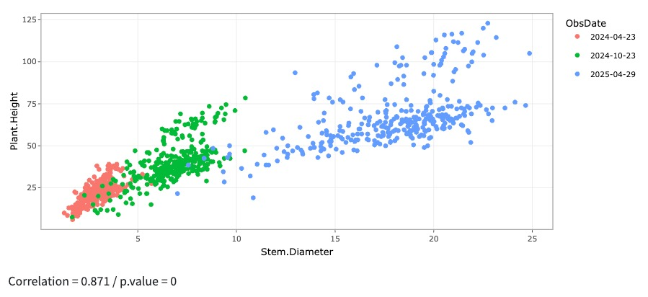
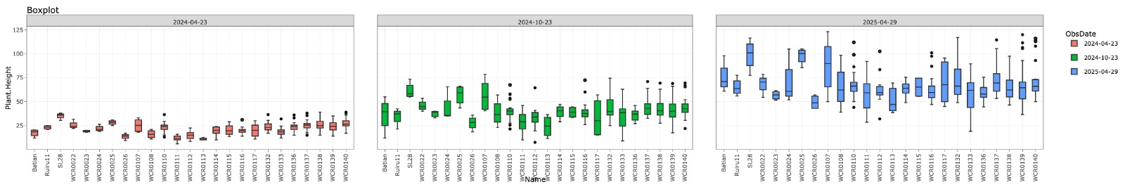
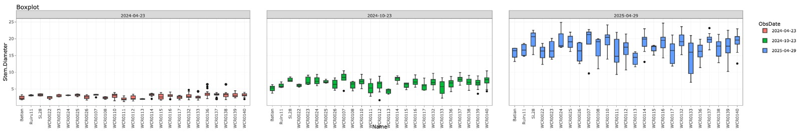
Data analysis results- Growth
Figure 1: PC analysis - plant height and stem diameter – progress for 3 consecutive data recording
Figure 1: PC analysis - plant height
Figure 2: Plant height –Separation of means for 3 data recording – April and May 2023 and April 2025
Figure 3: Stem Diameter - Separation of means for 3 data recording – April and May 2023 and April 2025

Slide 7
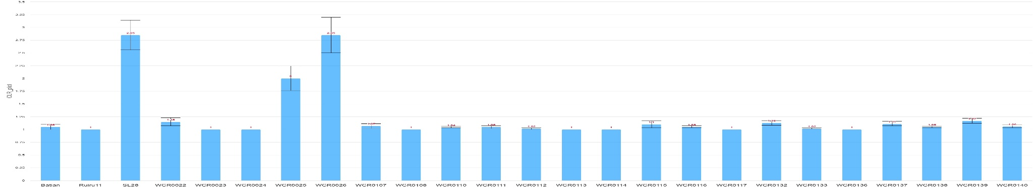
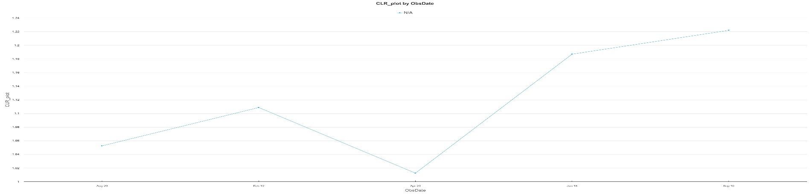
Data analysis results-Leaf Rust
Figure 5: Separation of means of Coffee Rust over the 3 different observation period .
Figure 6: Coffee Rust disease progression since the first to the latest recording

Slide 8
Challenges
A. Establishment & Agronomic Challenges
Coffee Leaf Rust infection was severe in some genotypes
Destruction of plants by wild animals, hares, deer
Climate change related challenges e.g crinkling of leaves
Unexplained of death of some individual trees
Stunted growth of some trees
B. Research & Analysis Limitations
Synchronized data analysis by WCR team and KALRO is yet to be realized

Slide 9
Next Steps and Future Goals
  Next steps
  Continuous collaboration with WCR and improvements in field data systems are expected to enhance the efficiency and accuracy of future analyses.
  Continue yield and morphological data collection through 2026 harvest.
  Initiate cup quality evaluation of early maturing selections after 2026 harvest
  Future Goals
  Multiply the most promising genotypes through tissue culture and carry out a National Performance trial across different environments for variety release as hybrids
  Selfing the best performing genotypes for further selection
  The lines selected from pedigree selection could be used in generating more crosses to create new varieties.

Slide 10
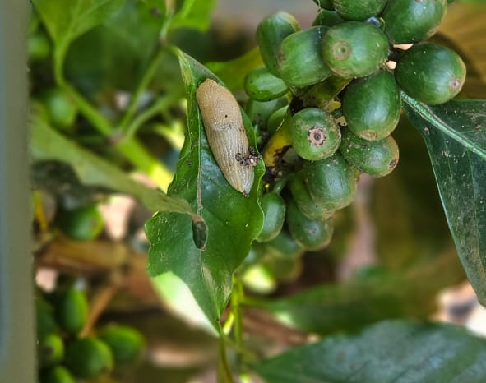
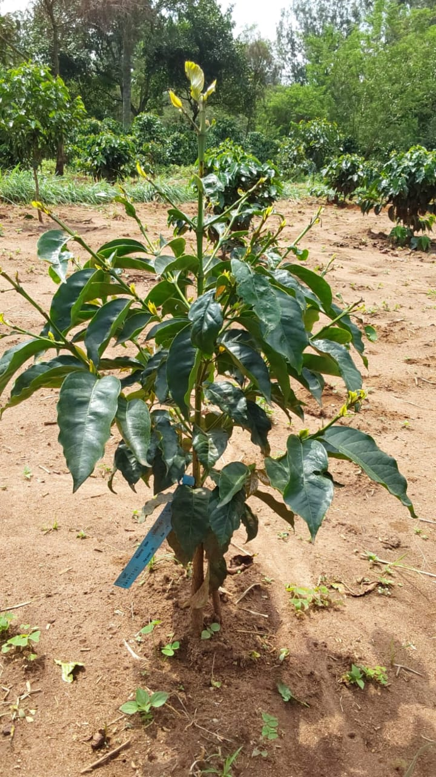
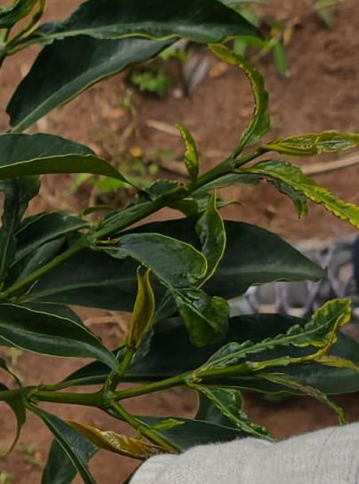
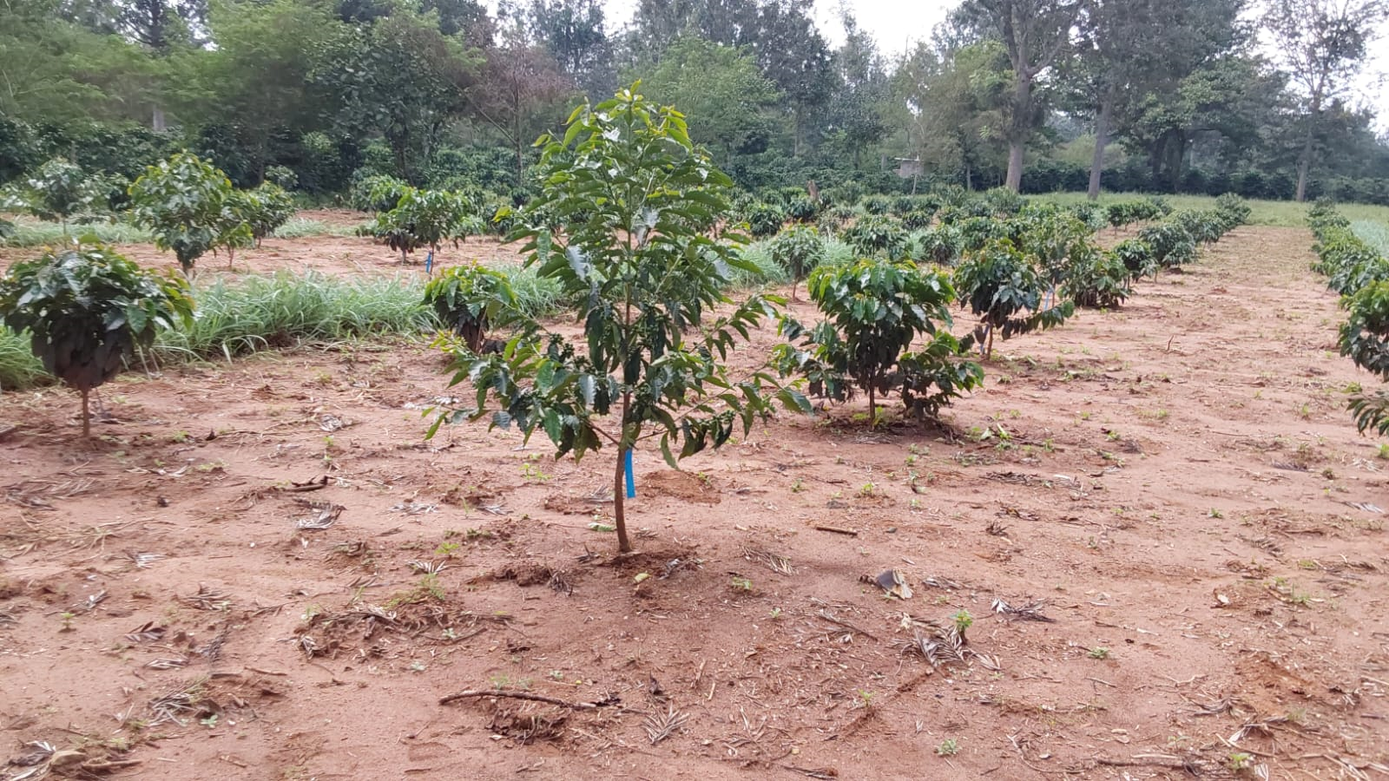
OBSERVATION
Blooming
BLOOMING | No of Genotypes | %
9-10 Months | 138 | 42.6
11-12 Months | 115 | 35.5
Late bloomers | 71 | 21.9
 | 324 | 100
Others
Multiple deficiencies
Snail infestation
Boron Deficiency
Crinkle leaf
WCR0139 - Tallest
Nutritional Deficiencies
Environmental effects on plants – Crinkle leaf
Insect and other Pest damages

Slide 11

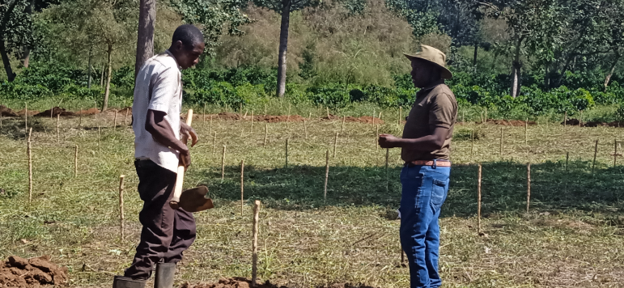
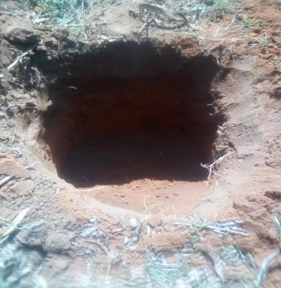
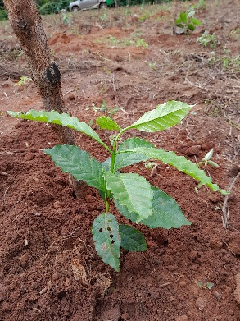
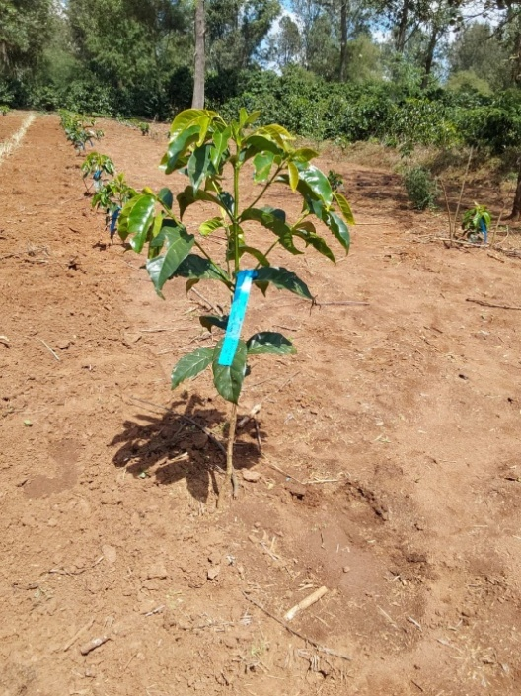
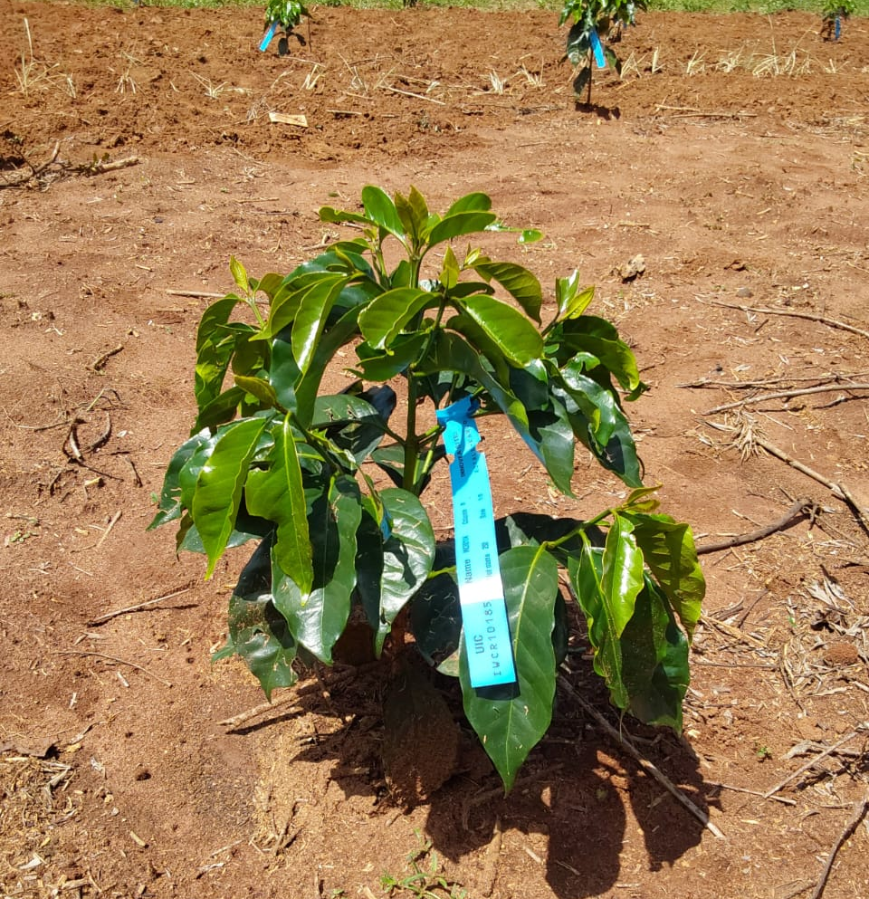
Photos
Field layout and holing.

Slide 12
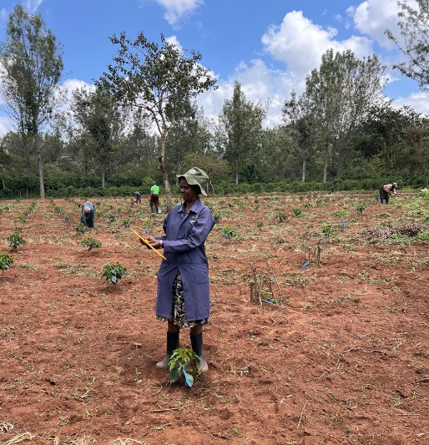
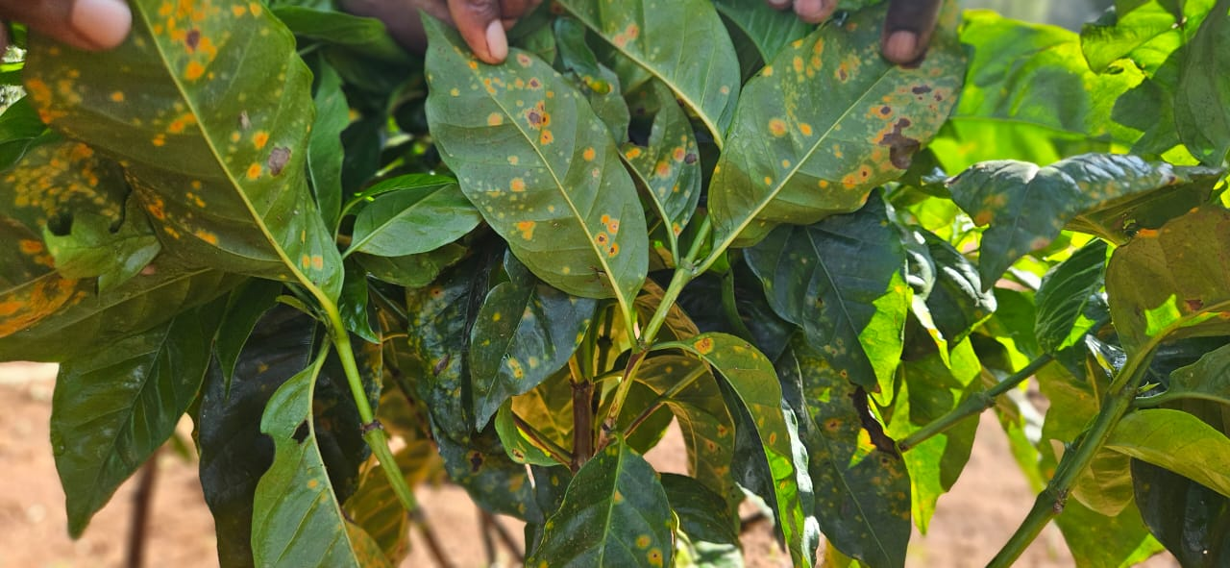
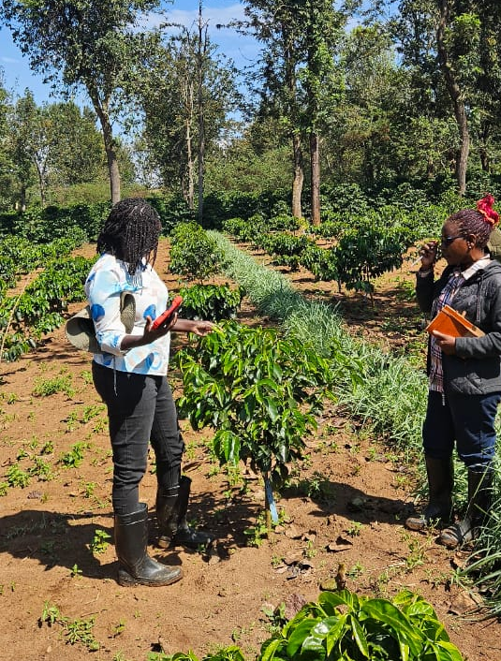
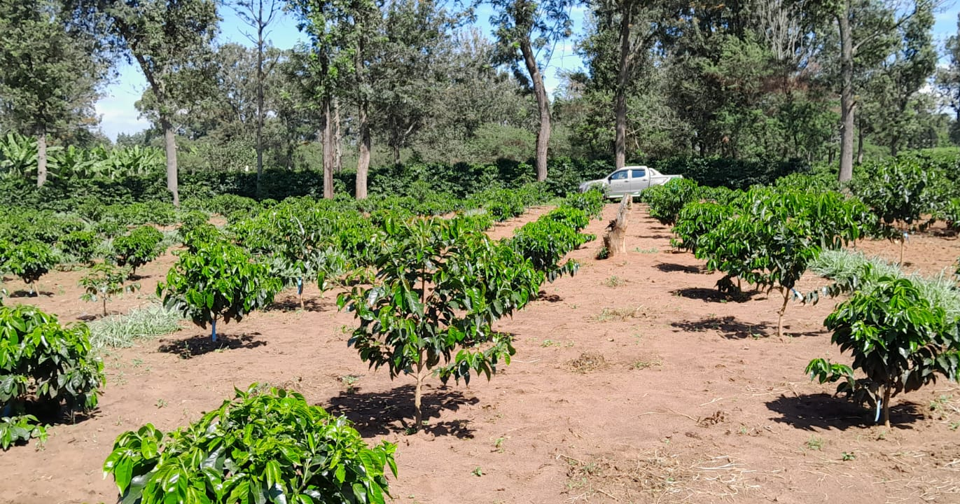
Data collection: Growth and disease.
Trial field progress monitoring

Slide 13
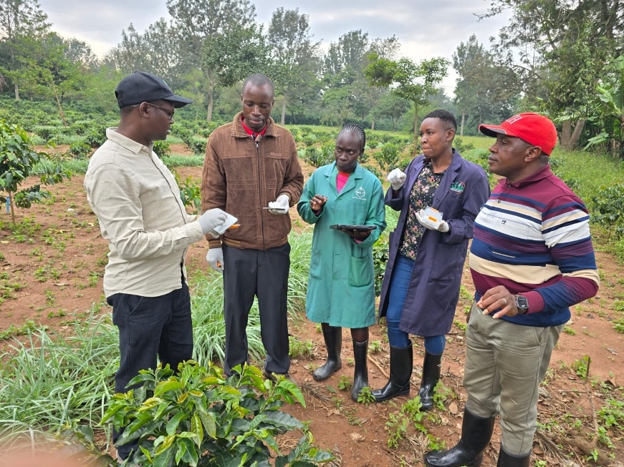
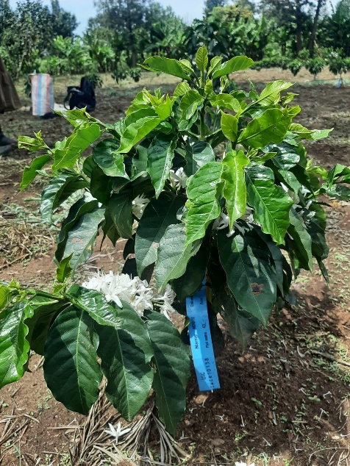
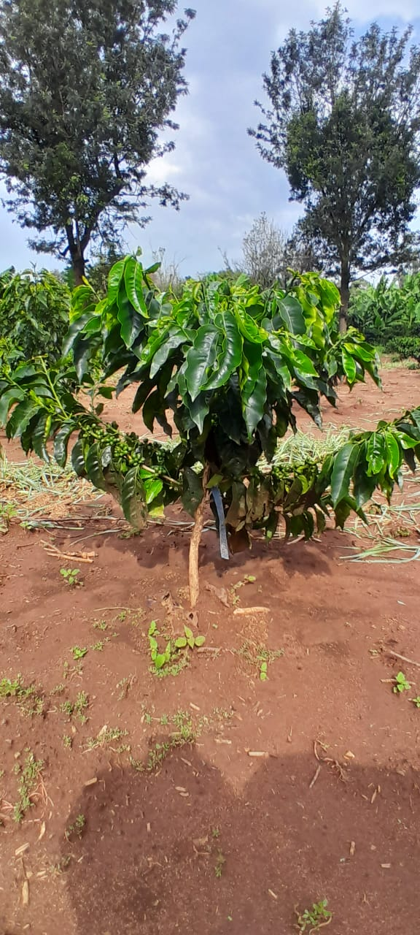
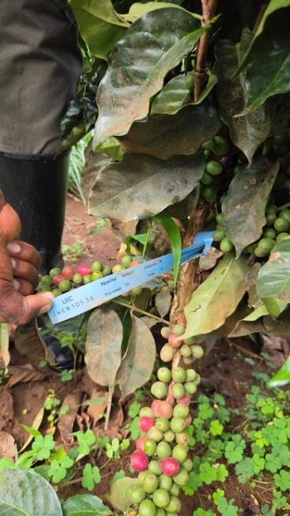
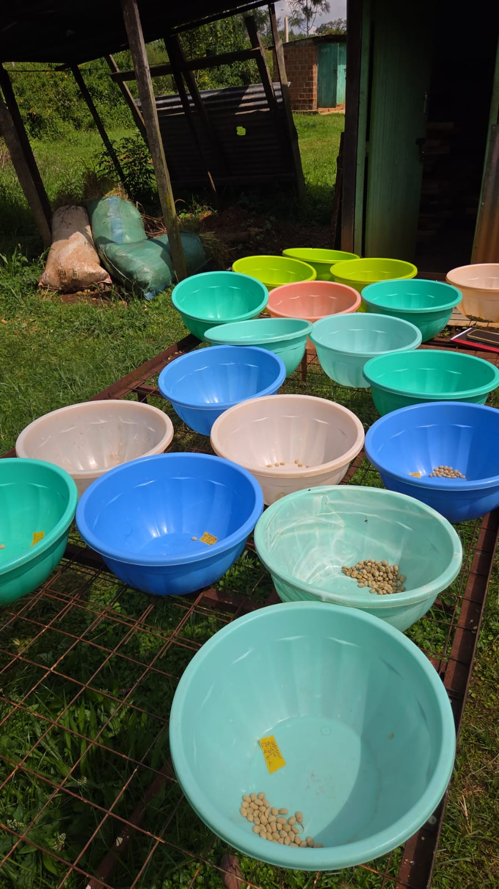
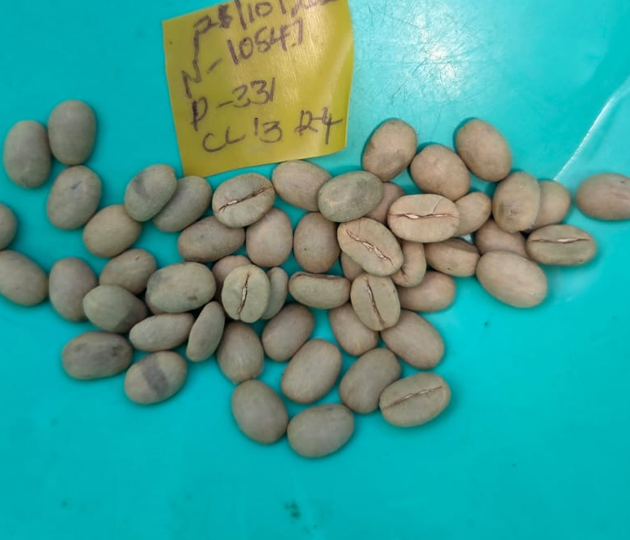
Sampling : Phenotyping.
Yield performance monitoring.
YIELD Data collection: Cherry harvesting and processing.

Slide 14

Thank you for listening

