Slide 1


Instituto Nacional de Innovación Agraria
Innovea Global Breeding Network
Progress Report
Jazmín Maraví Loyola
Itnan Oscco Medina
November, 2025

Slide 2
INIA’s roles
Lead the National System for agrarian innovation
Public Institute for Research
MISSION
Manage innovation and value agrobiodiversity for agricultural producers through the development and transfer of sustainable
technologies
Research and transfer of technology
Conservation and put in value the genetic resources

Slide 3
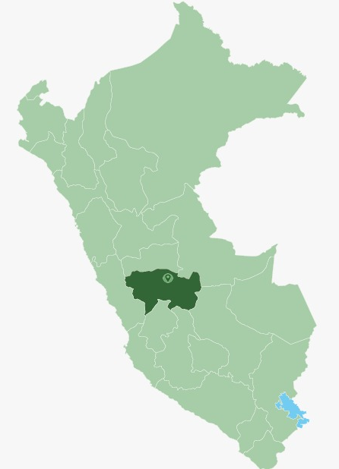
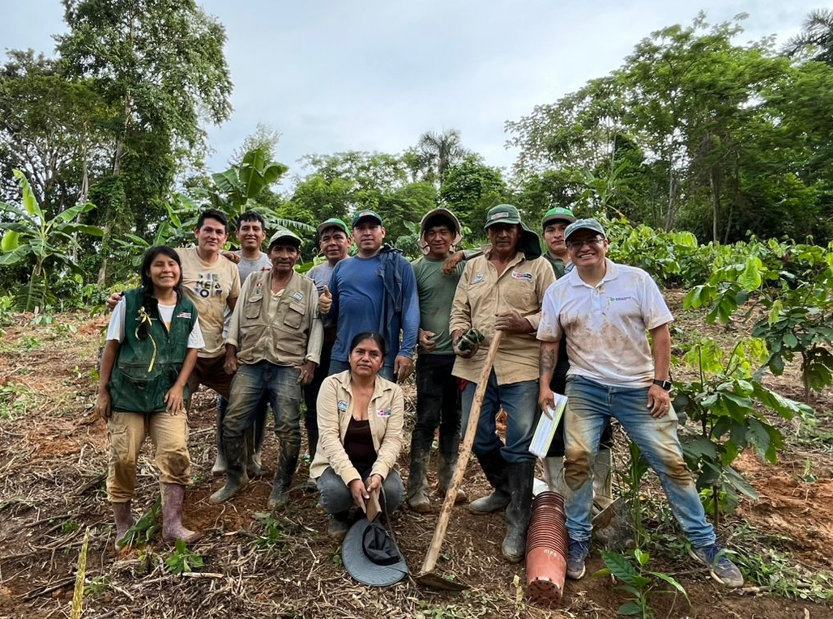
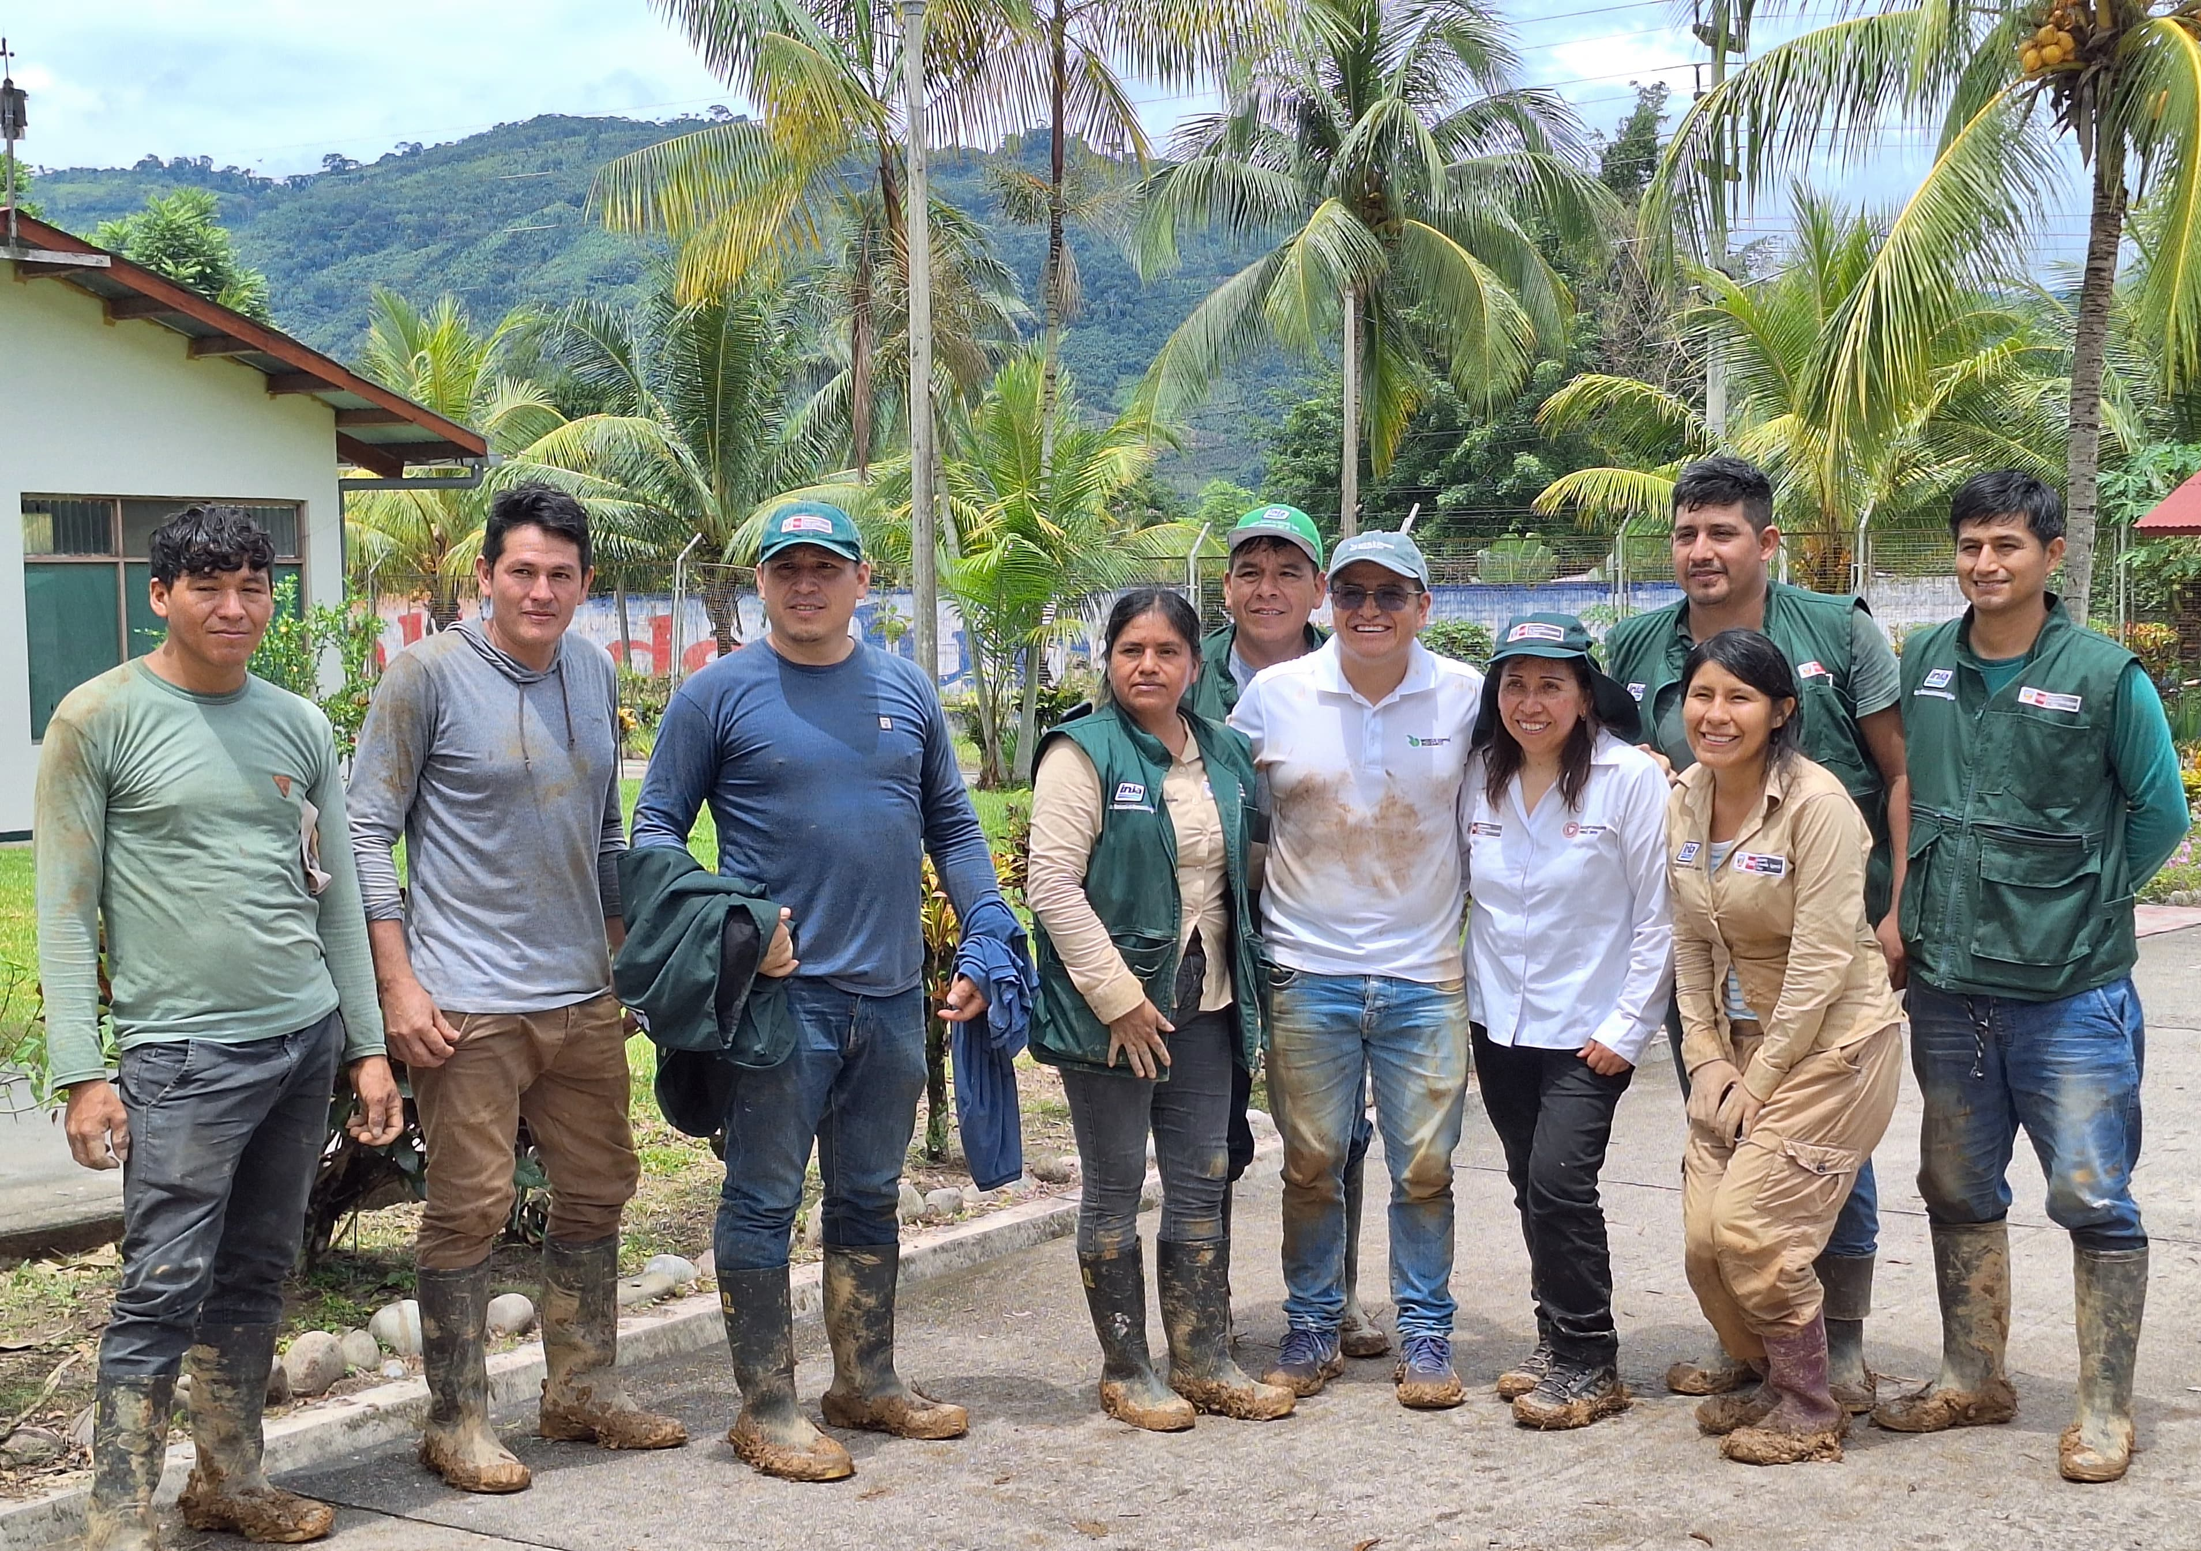
Participation of INIA in the Innovea Breeding Network
Implementation Period: From January 26, 2023 to December 31, 2028
Installed Plot: Agricultural Experimental Station Pichanaki
Area: 2000 m², N° Plants: 400
Slope: 10 %, Altitude: 600 m.a.s.l.
Technical Team: Itnan Oscco Medina, Jazmín Maraví Loyola, José Flores Inga, Víctor Gonzales Toledo, Dina Gutiérrez Reynoso
Agricultural Experimental Station Pichanaki, Junín, Peru

Slide 4
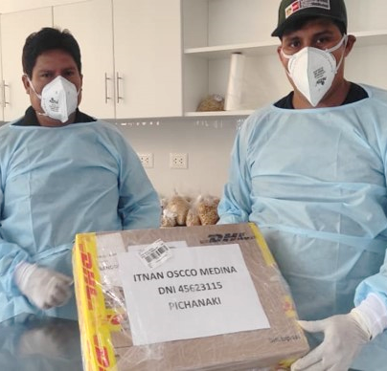
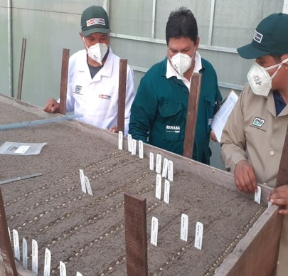
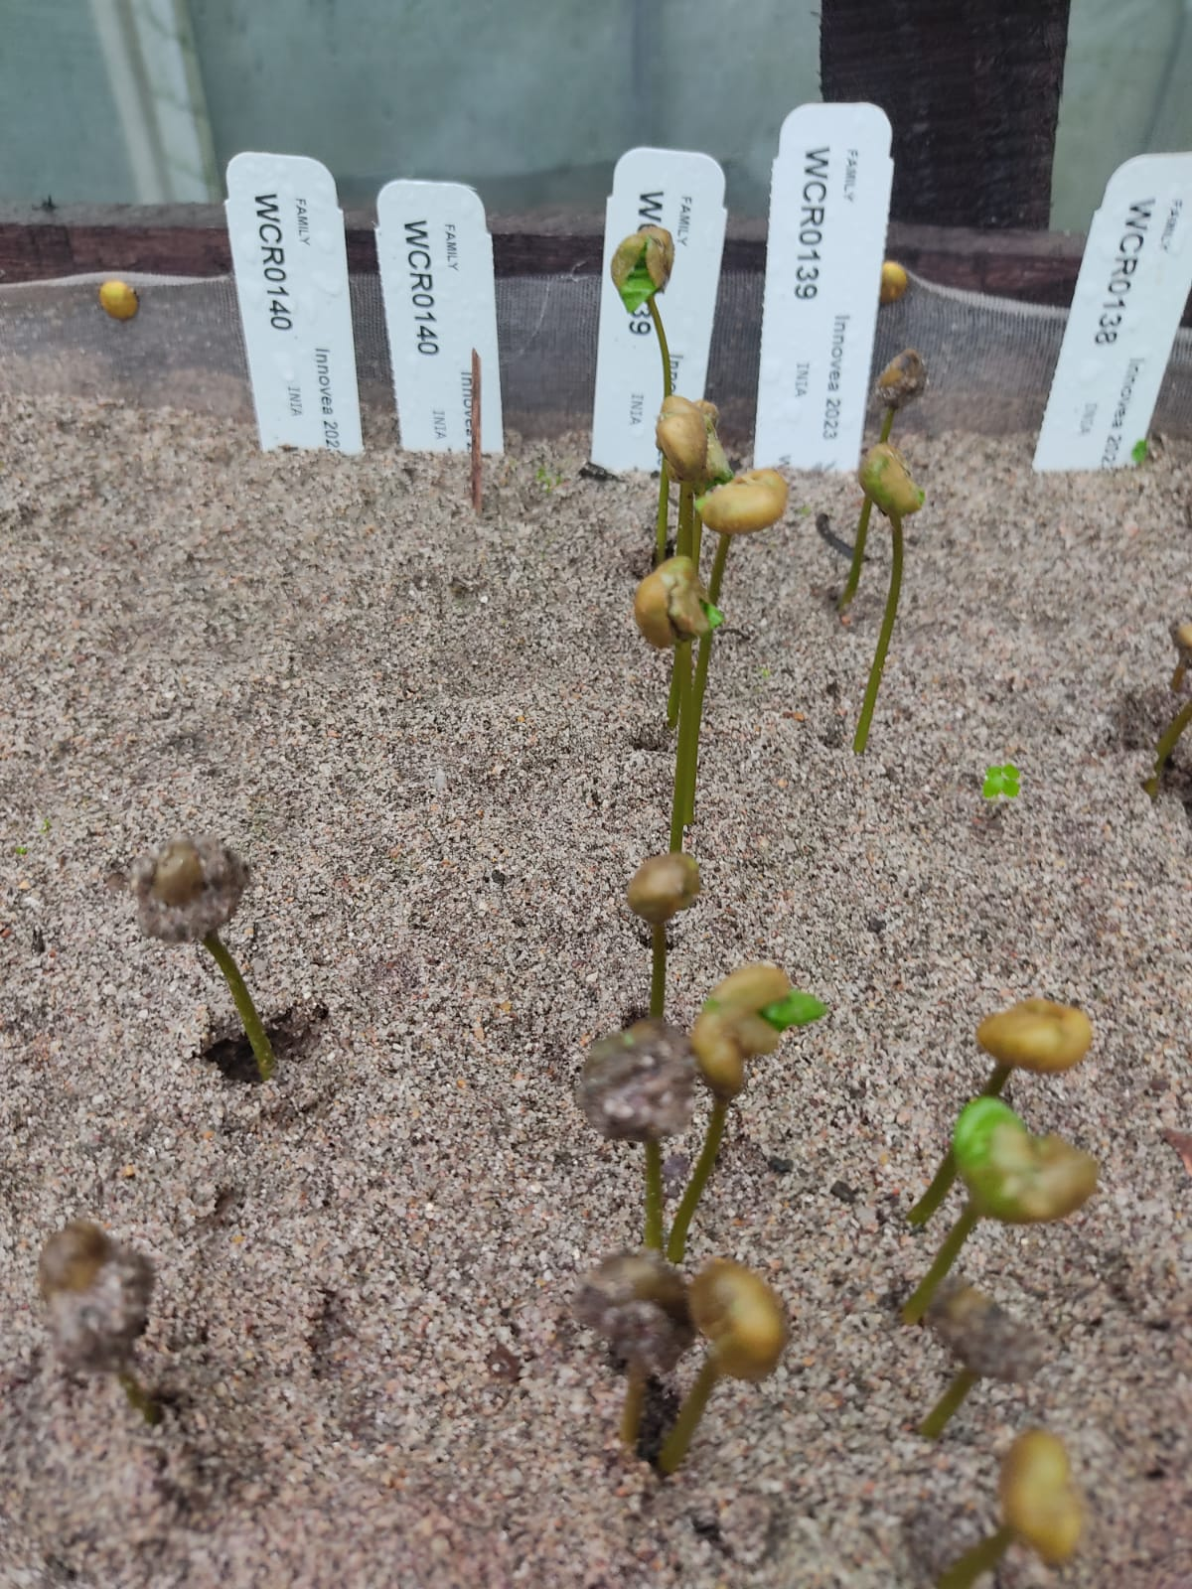
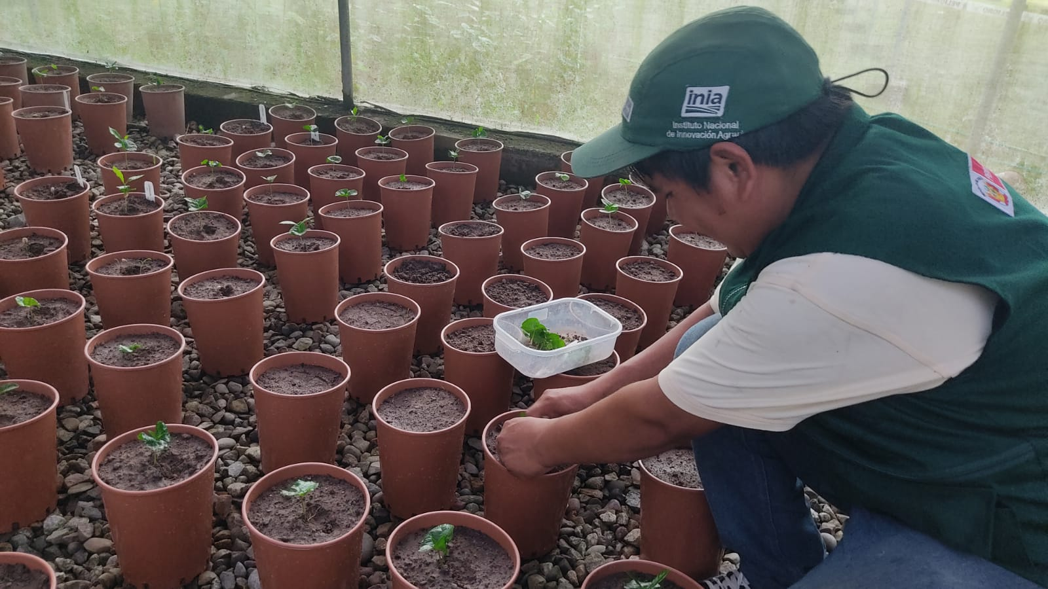
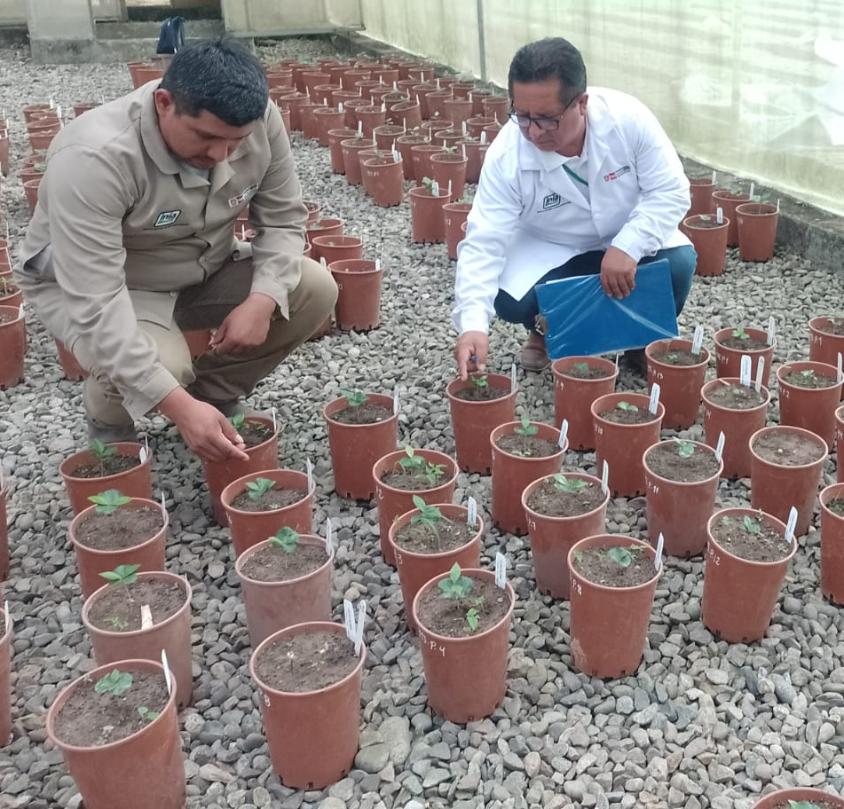
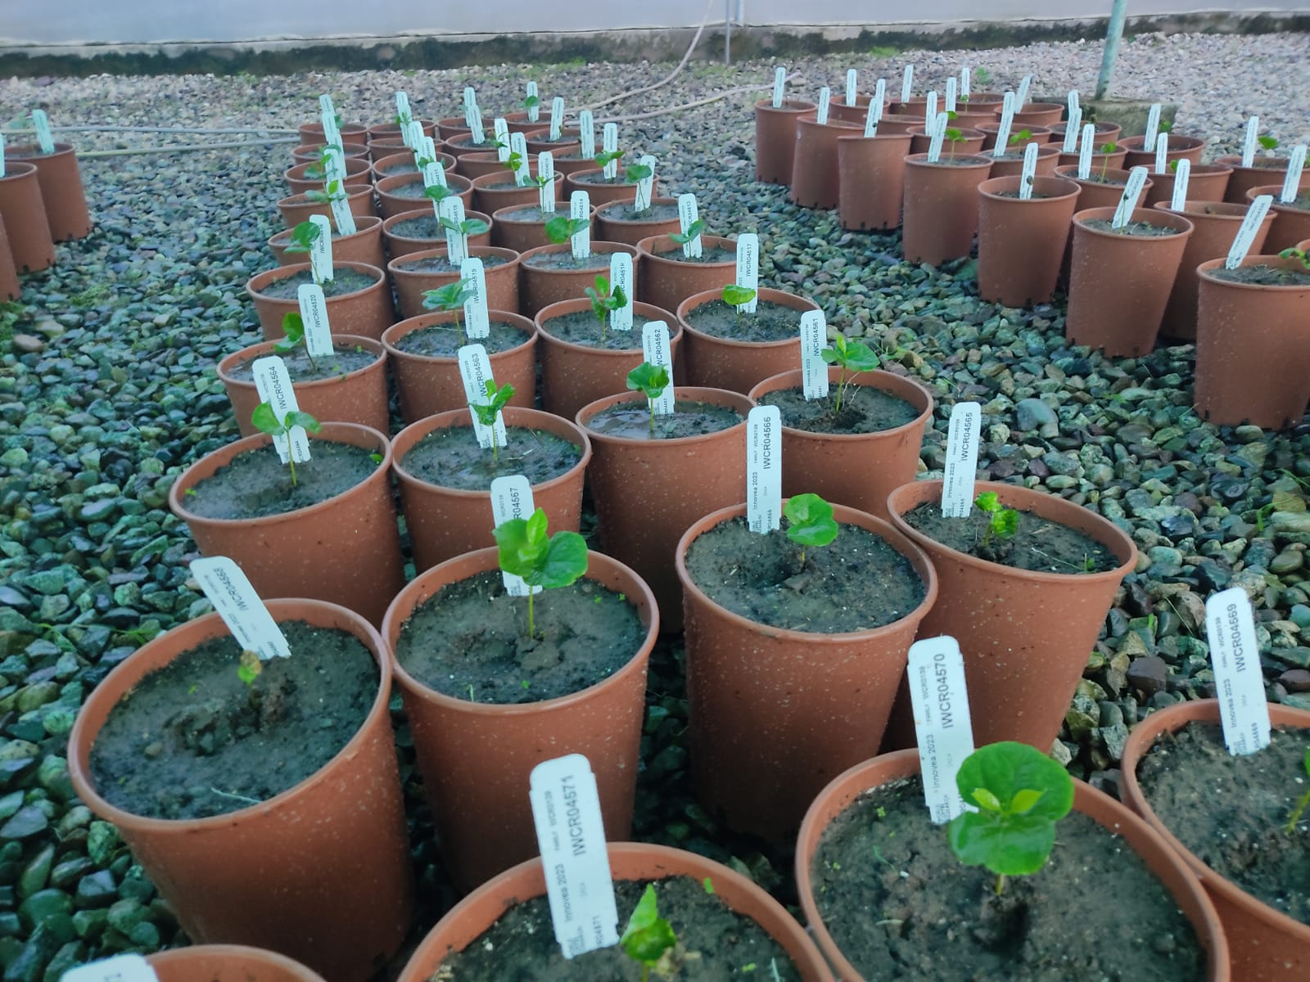
SENASA supervision of seed reception, germination process and seedling planting in the quarantine area
Seed reception in coordination with SENASA
Seed germination in coordination with SENASA
Verification of seed germination in the quarantine area
Transplanting the plants into pots in the quarantine area
SENASA evaluation of plant development in nurseries
Development of potted plants in the quarantine area
March, 2024
March, 2024
May, 2024
July, 2024
July, 2024
August, 2024

Slide 5
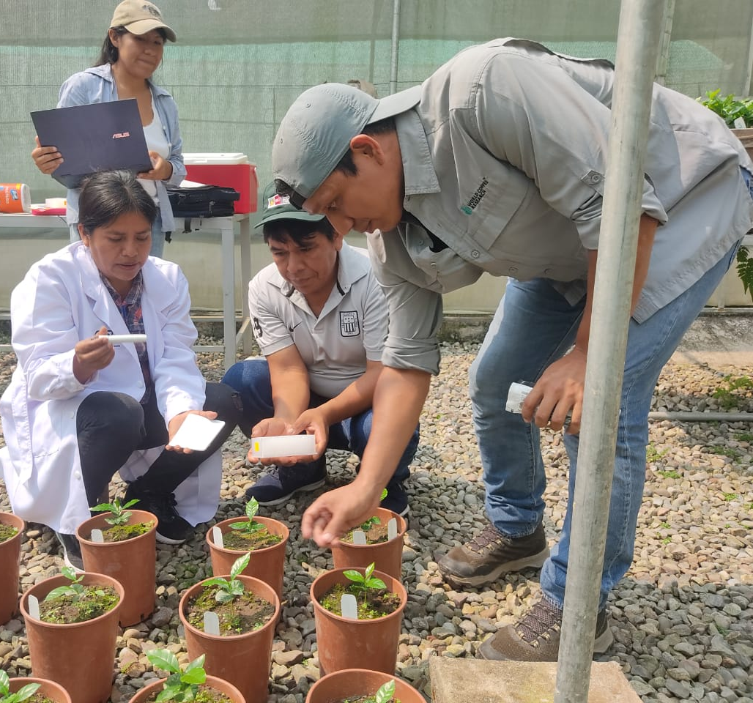
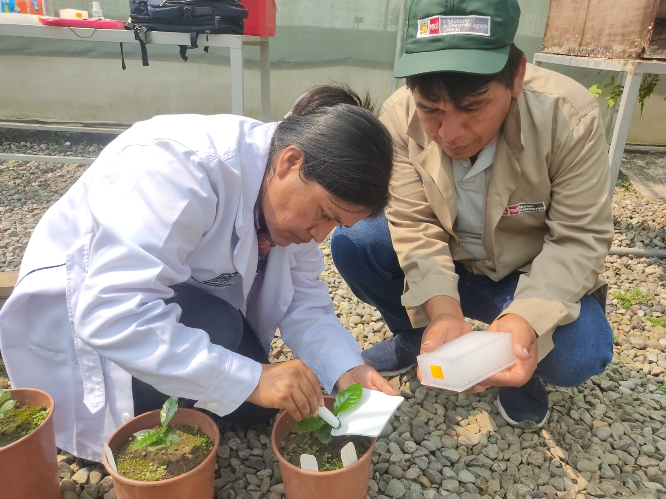
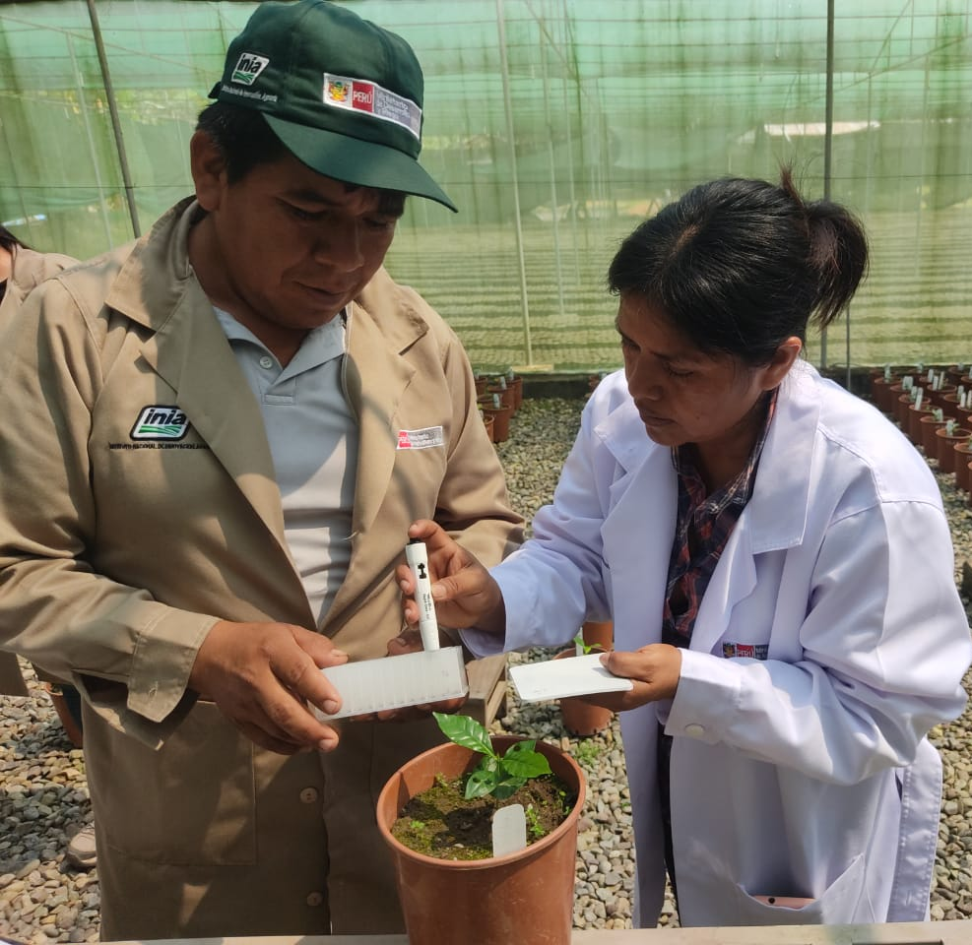
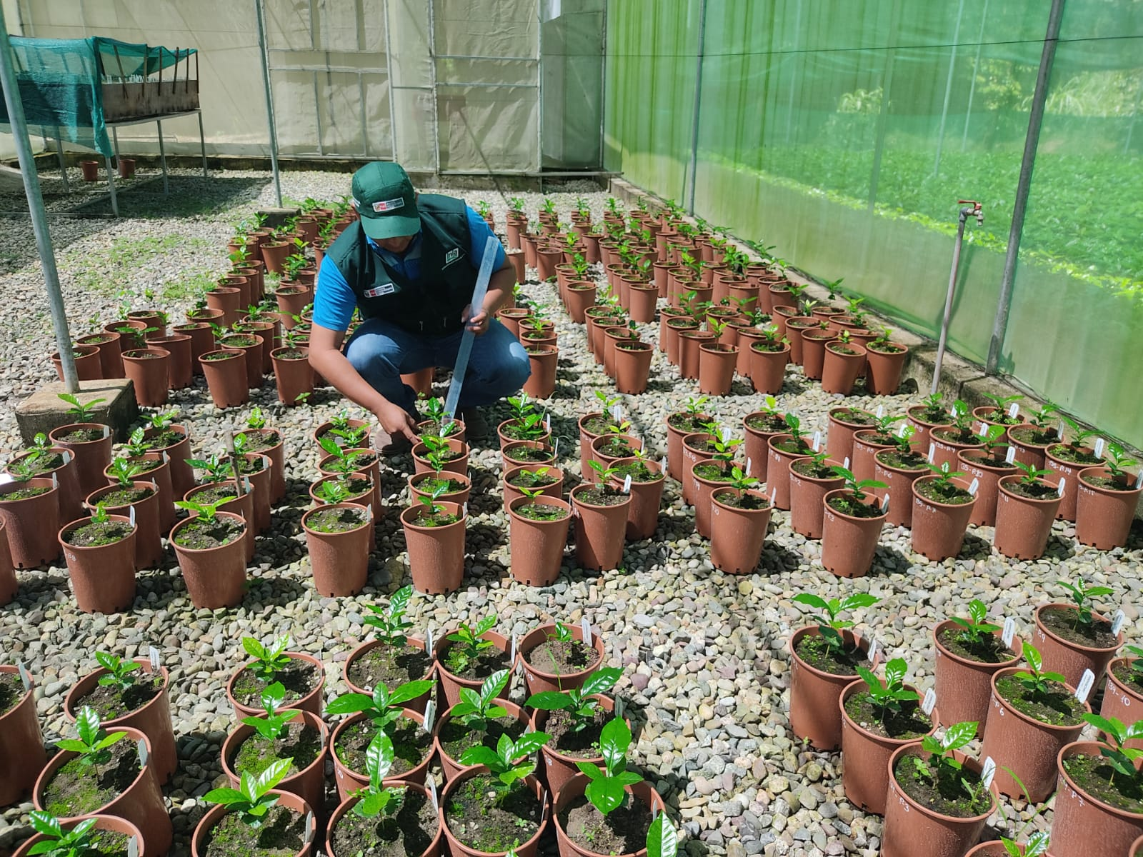
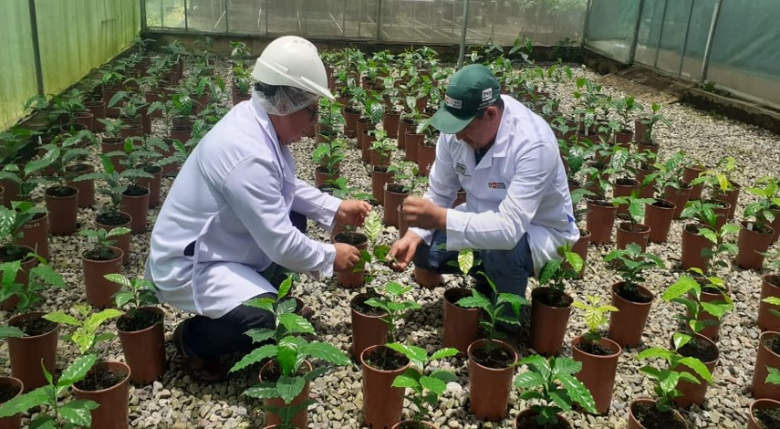
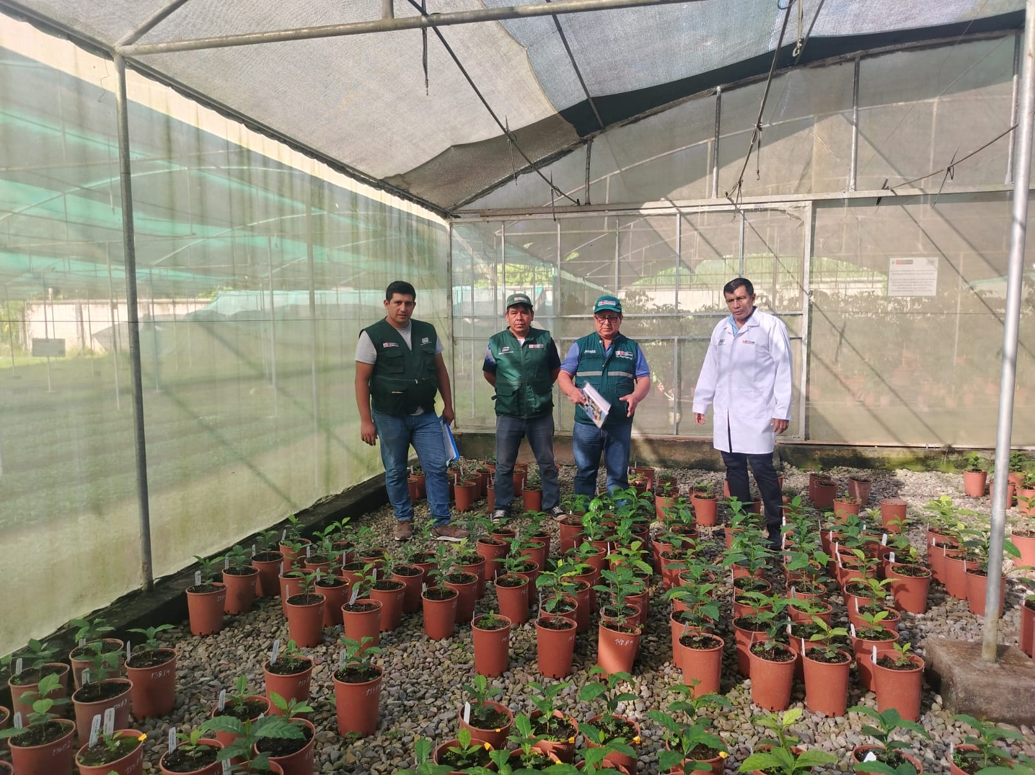
Leaf sampling of plants in nurseries for DNA analysis and SENASA supervision in the quarantine area
Training by the WCR for leaf sampling in nurseries
Leaf sampling for DNA analysis
Agronomic management and fertilization of coffee in quarantine areas
Sampling for phytopathological evaluation by SENASA
Completion of post-entry quarantine by SENASA
August, 2024
August, 2024
September, 2024
October, 2024
November, 2024

Slide 6
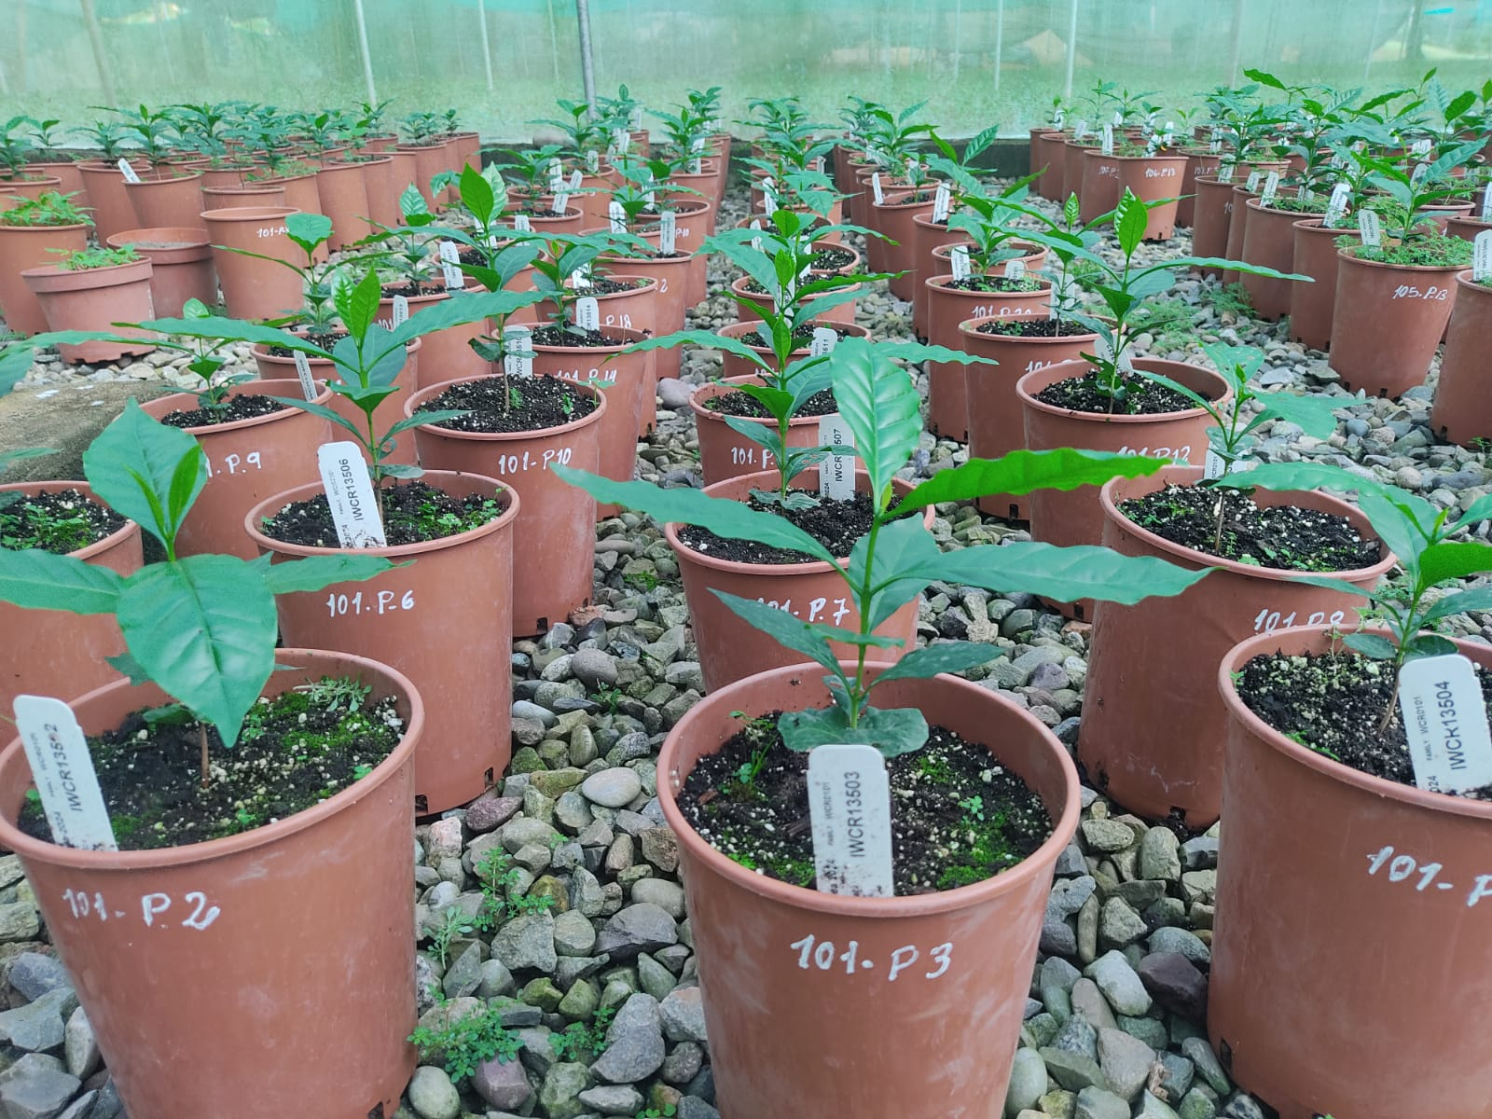
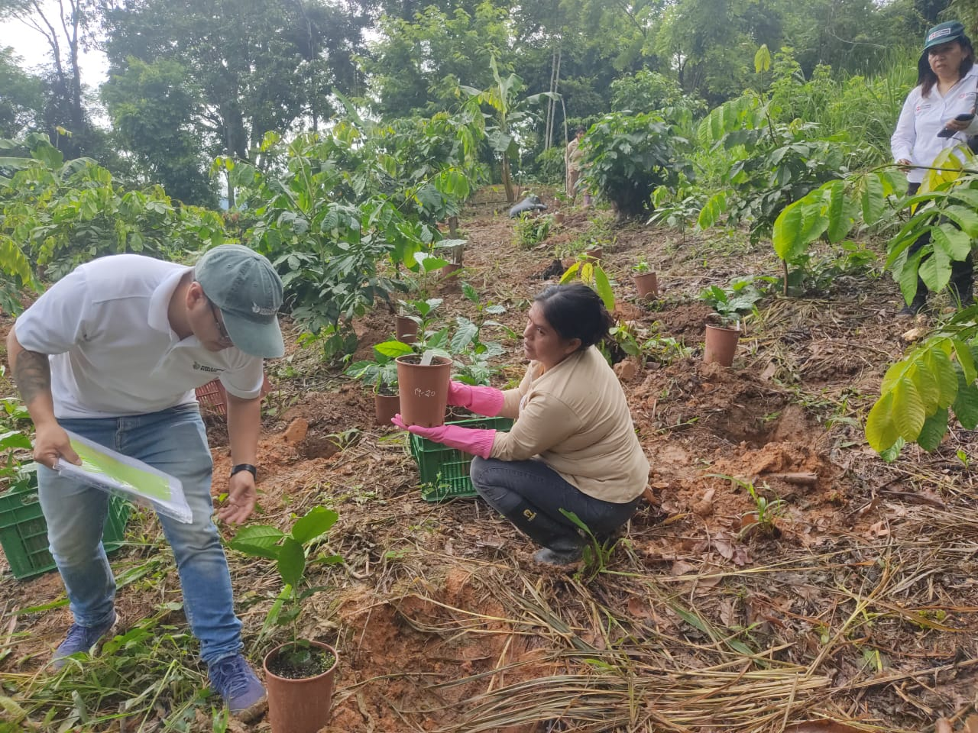
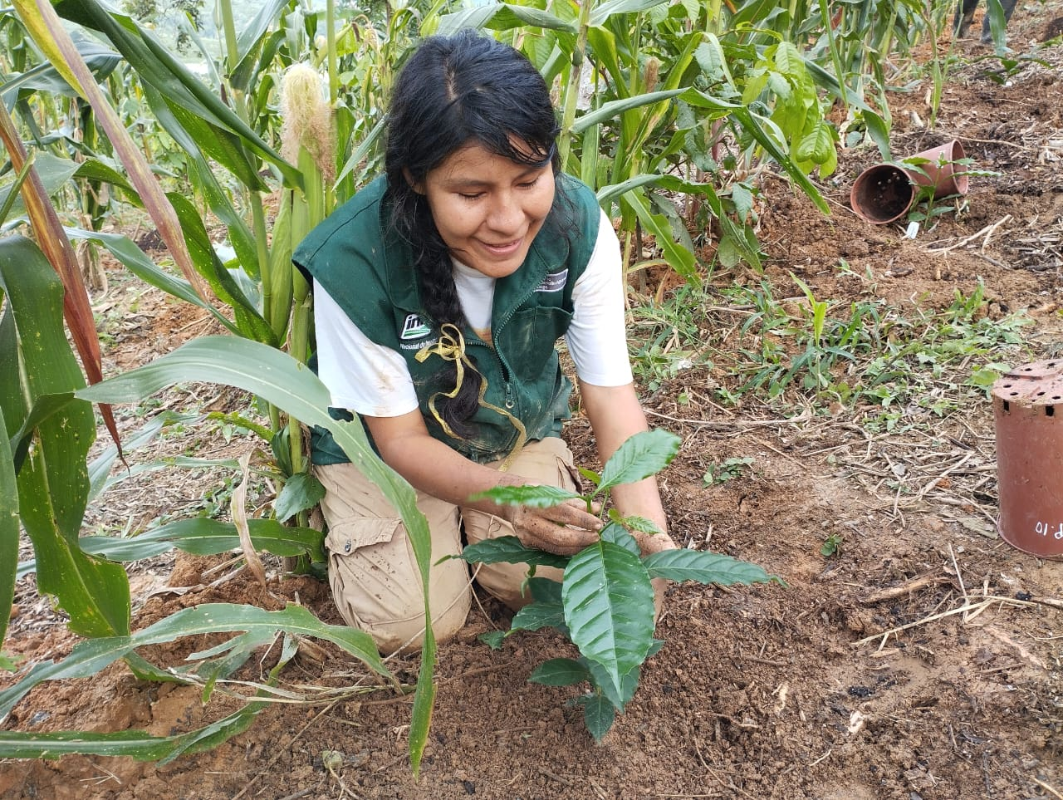
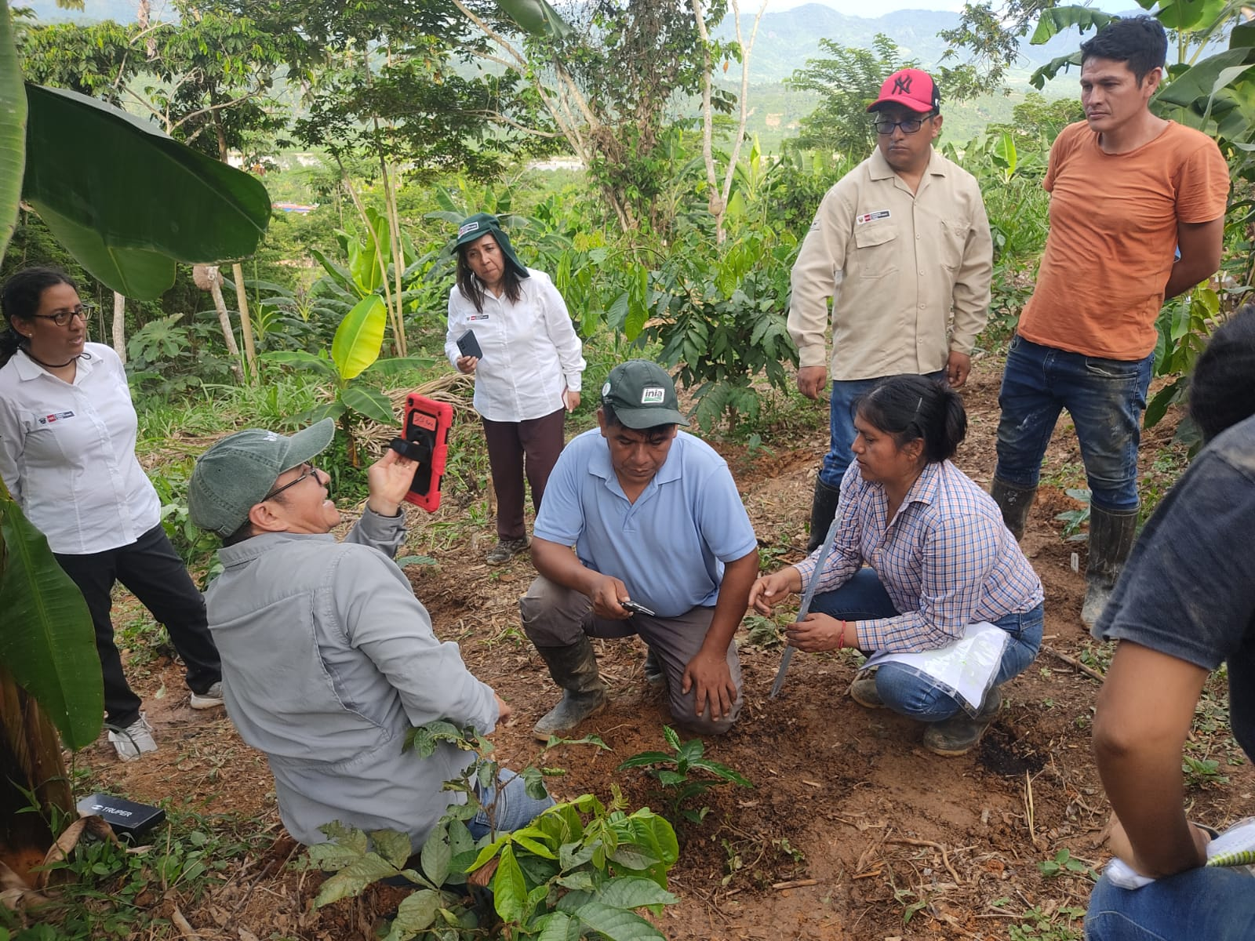
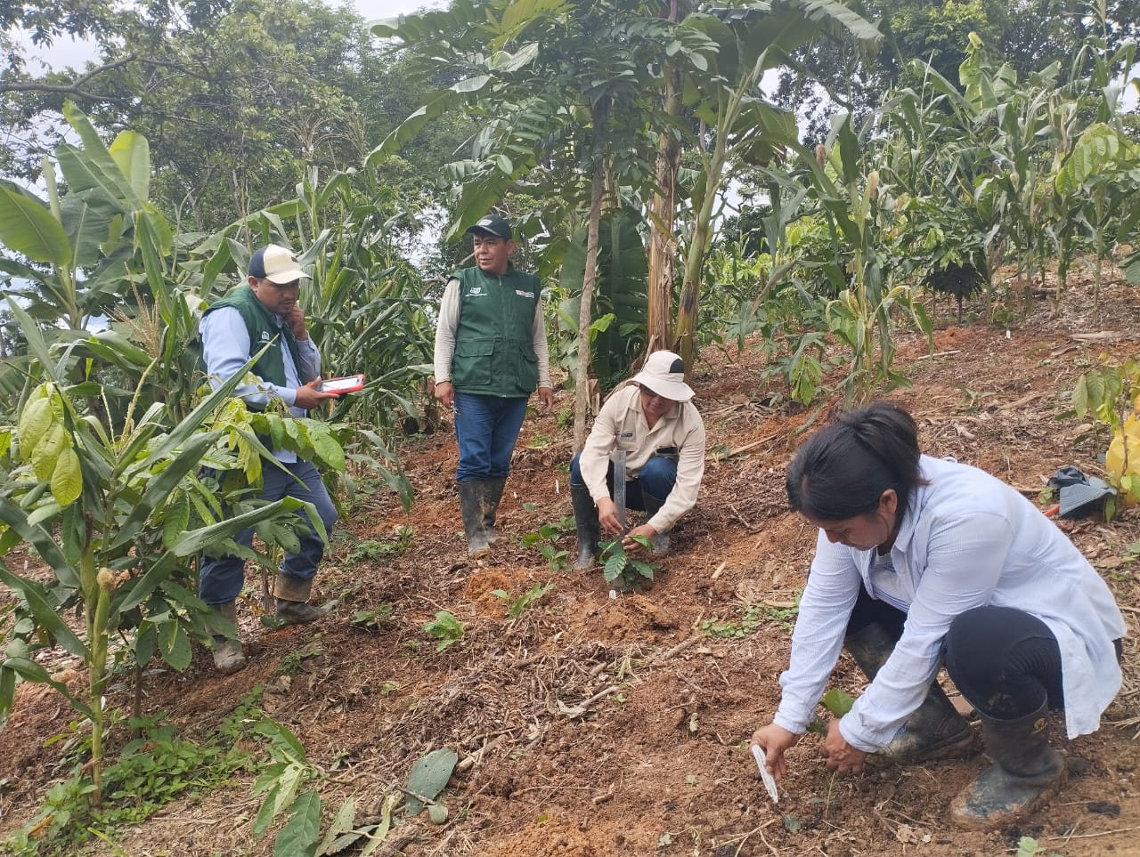
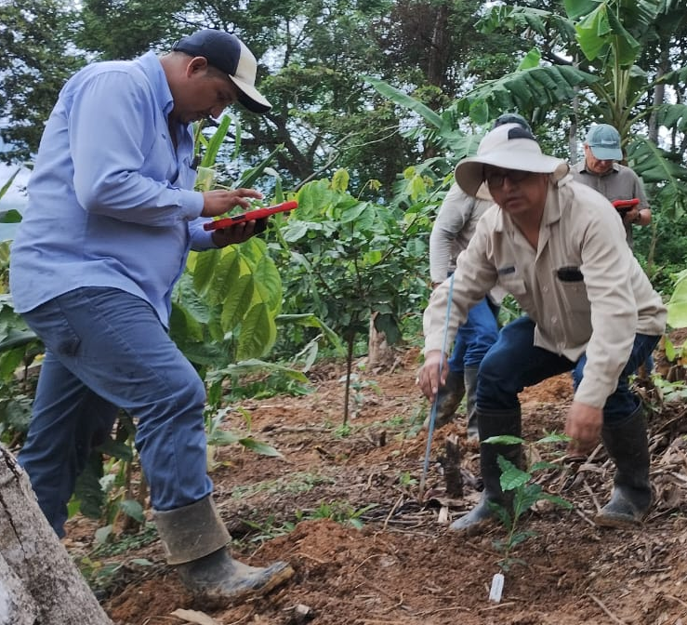
Transplanting seedlings to the field and first evaluation of the plants
Pest and disease-free plants in nurseries
Verification of the installation of coffee plants in the field by the WCR
Planting coffee plants in the field
Training in the use of the application for coffee morphological evaluation
First evaluation of hybrid coffee varieties in the field
November, 2024
December, 2024
December, 2024
December, 2024
December, 2024

Slide 7
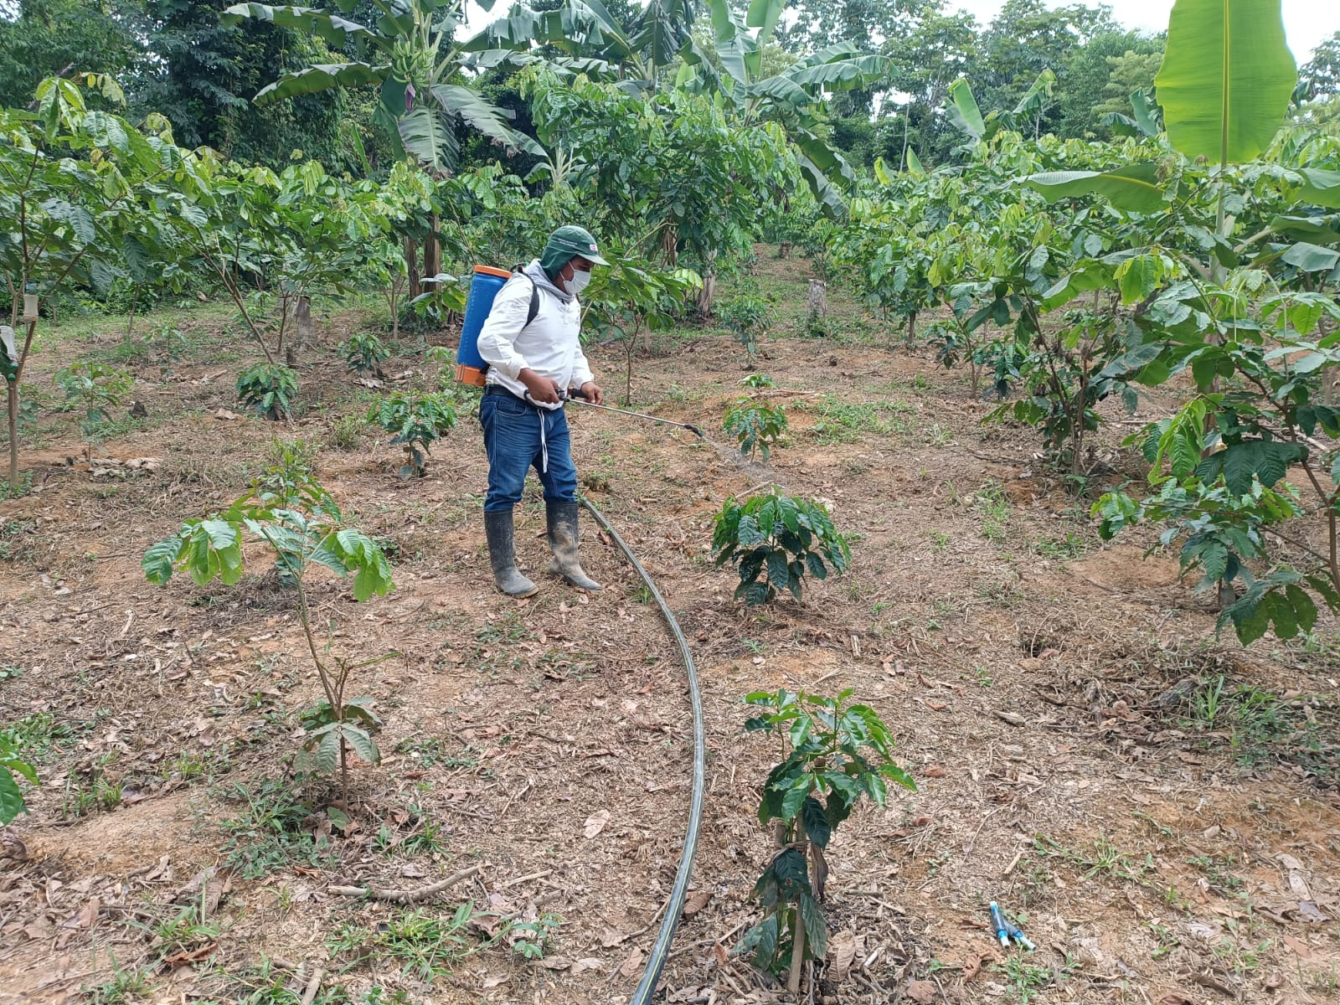
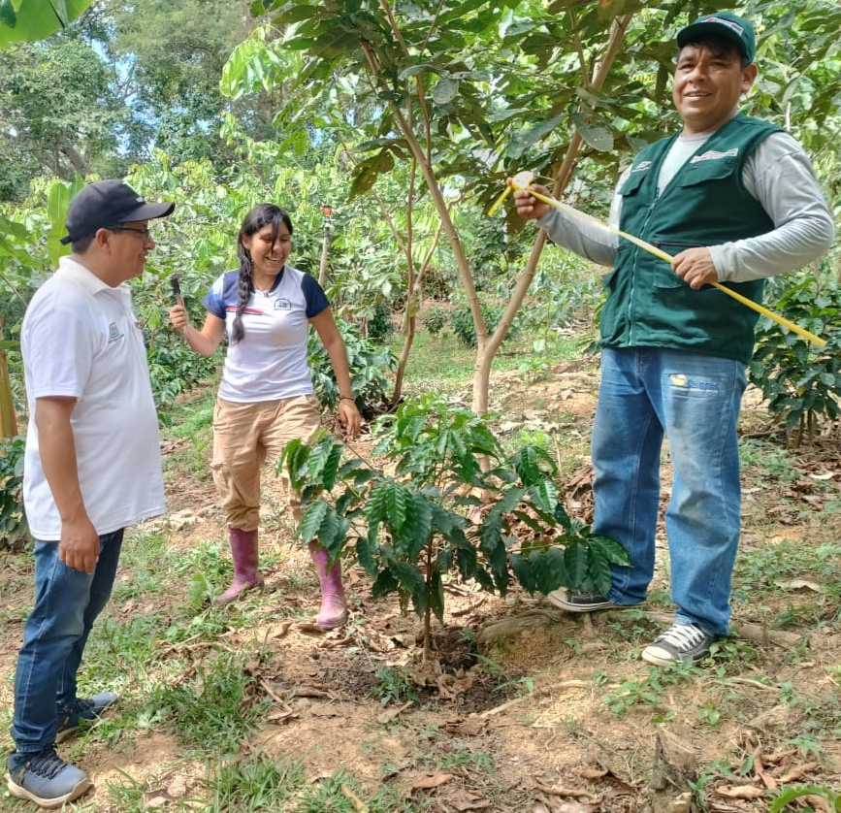
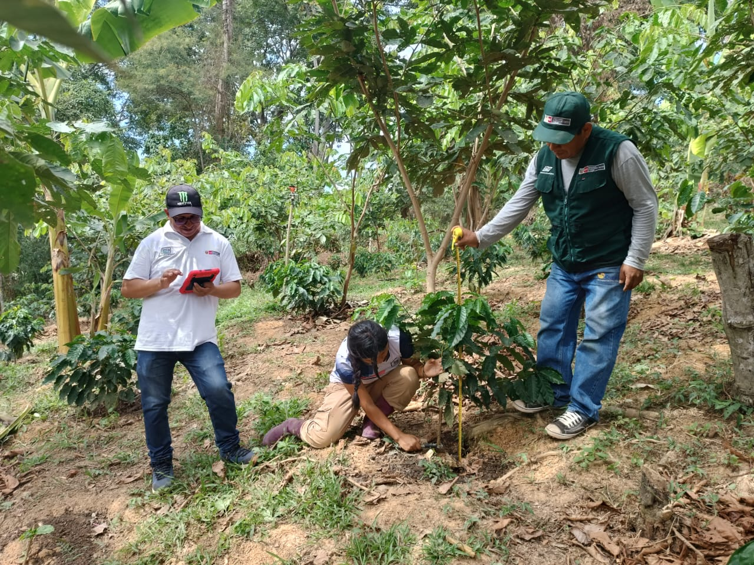
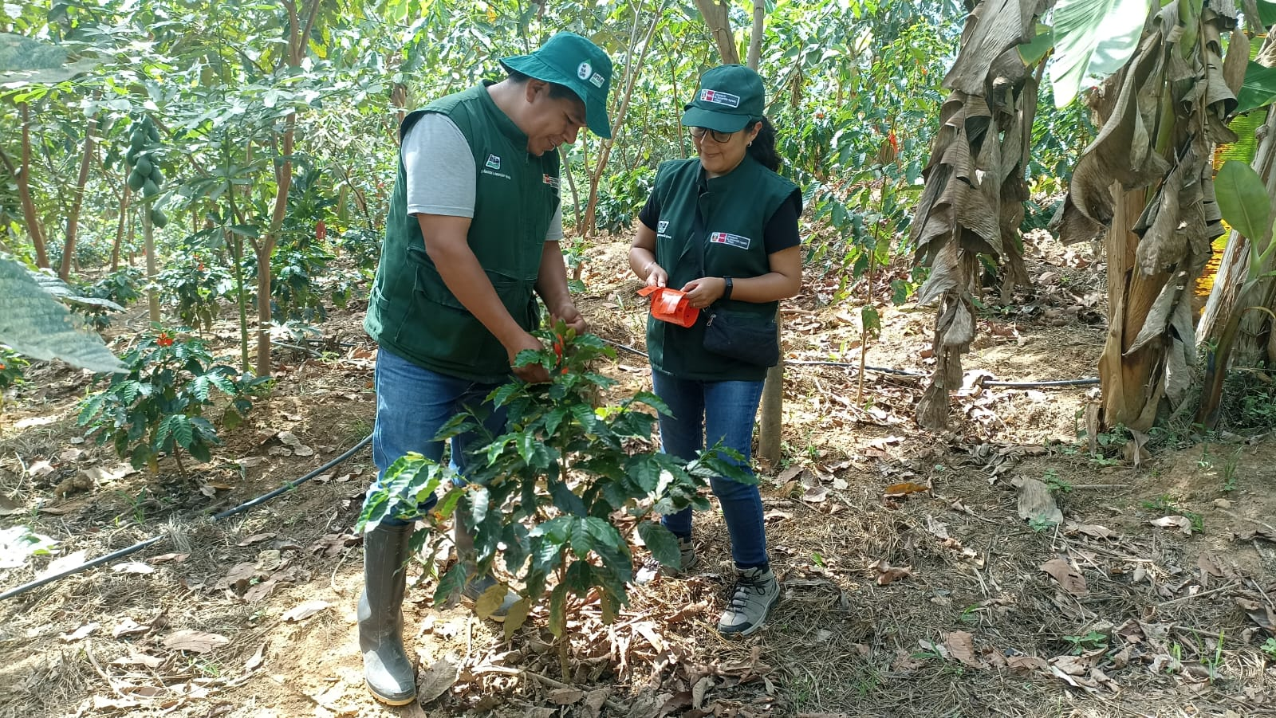
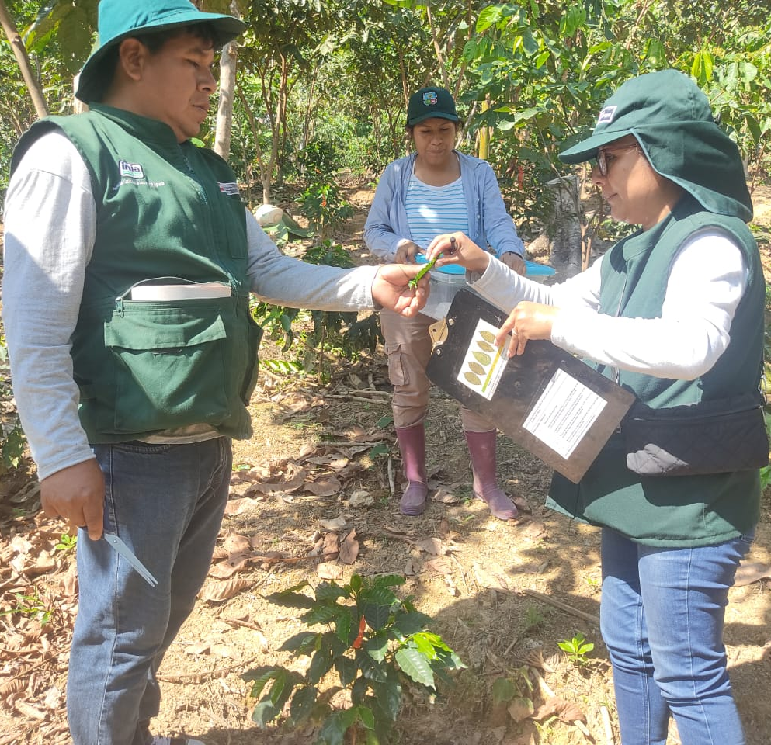
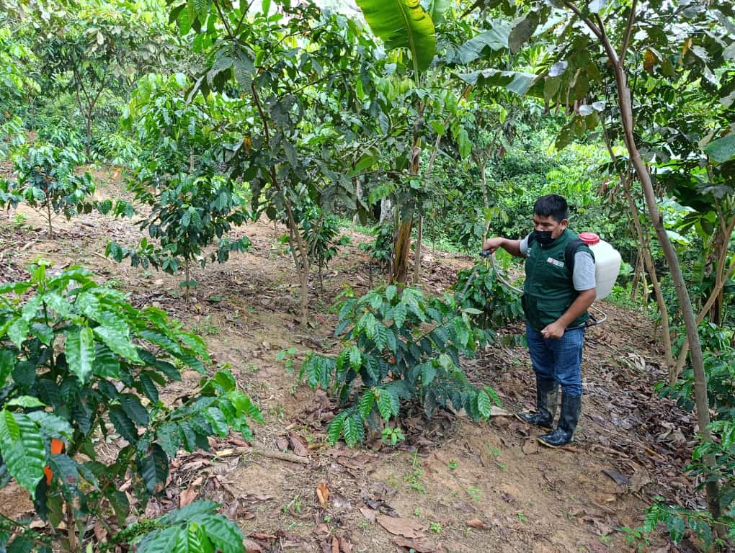
Agronomic management, second evaluation and field leaf sampling assessment for DNA analysis
Weed control in the coffee field plot
Second evaluation of hybrid coffee in the field
Plant labelling
Field leaf sampling for DNA analysis
Pest control in the field plot
March, 2025
June, 2025
August, 2025
August, 2025
September, 2025

Slide 8
THANK YOU

