Slide 1



Innovea Global Breeding Network
Rwanda Chapter
Revolutionizing Arabica coffee through collaborative, science-driven breeding to develop climate-resilient, high-performing varieties and ensure the future of coffee.
Presentation by: Simon Martin Mvuyekure
Rwanda Agriculture and Animal Resources Development Board (RAB)

Slide 2
Project Overview & Objectives
Strategic objectives
Develop a collaborative network of partners to increase genetic gain in coffee breeding.
2. Improve populations from which national coffee institutes can continuously select high-performing coffee varieties.
3. Enhance national breeding and research capacity to effectively implement product-focused research.
4. Contribute to the development of national varieties that respond to both the international export market and farmer demands.
Core Mission
Reporting Period
2023–2025
Accelerate development and delivery of climate-resilient Arabica varieties through standardized data collection and genetic gain metrics.
Partner
Rwanda Agriculture and Animal Resources Development Board (RAB)

Slide 3
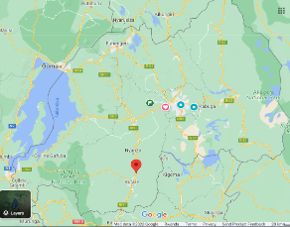
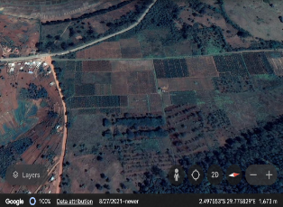
Trial location

Slide 4
RAB's Role in the Global Network
Multi-Location Field Trials
Phenotyping & Genotyping
Host standardized trial site for diverse, WCR-sourced breeding materials from multi-parental crosses.
Collect comprehensive data on observable traits and molecular markers using SNP panels.
Modern Breeding Techniques
Local Adaptation Testing
Apply data-driven approaches including genomic selection and advanced molecular tools.
Test diverse genetics under Rwanda's specific agroecological challenges and environmental pressures.

Slide 5
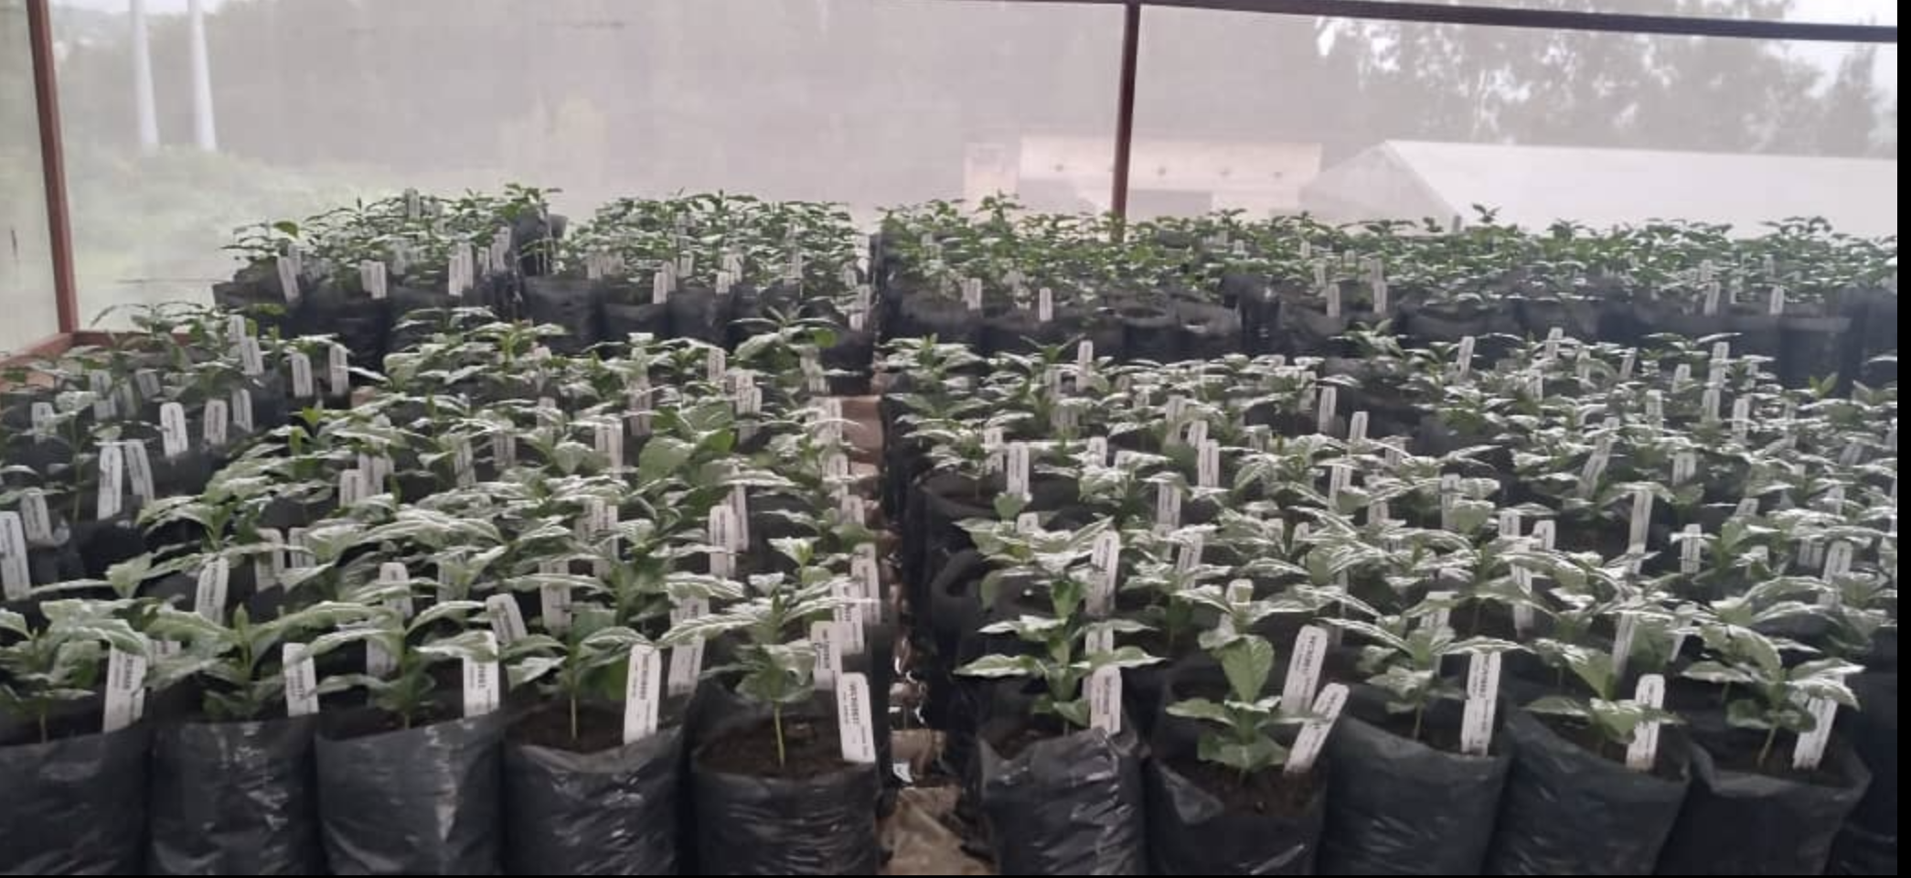

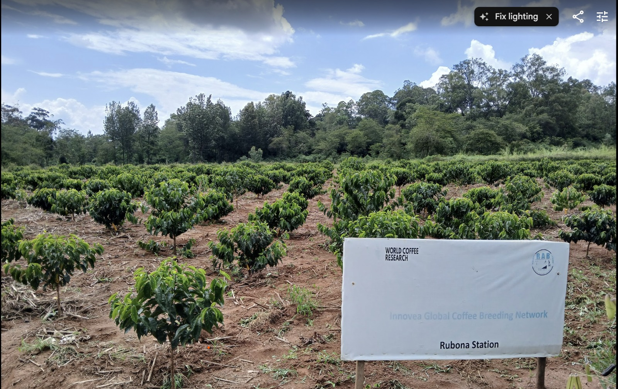
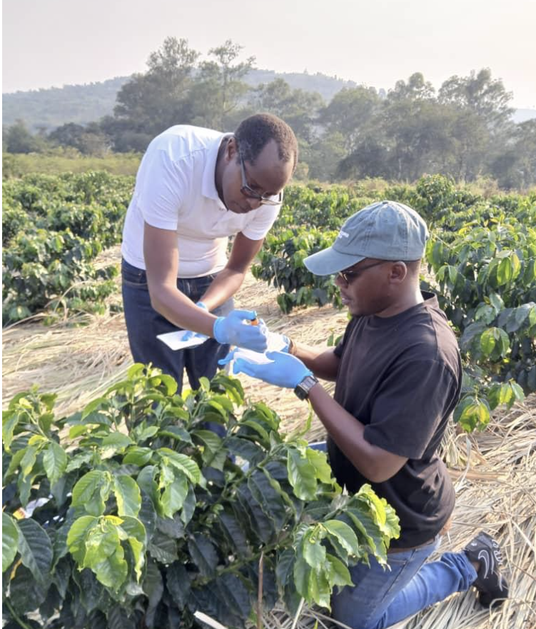
Implementation Milestones
1
Seed Receipt & Germination
June-July 2023: Rwanda received first wave of genetically unique seeds from WCR's breeding factory.
2
Nursery Establishment
August 2023–March 2024: Seeds germinated and raised at Rubona research station in controlled environment.
3
Genotyping & Quality Check
Leaf samples collected and DNA tested to confirm pedigree and hybridity of seedlings.
4
Field Transplanting
March 2024: Seedlings transplanted to experimental field trial sites; phenotyping phase begins.
Field Performance Evaluation
5

Slide 6
Field Performance Evaluation
Core phenotyping phase (2024–2028) measures key performance indicators across all trial plants.
Disease Resistance
Score severity of Coffee Leaf Rust and Coffee Berry Disease
Ongoing
Plant Architecture
Measure height, stem diameter
Ongoing
Yield & Productivity
Annual cherry yield and bean quality assessment
Started Oct 2025
Cup Quality
Sensory analysis of processed green coffee samples
Pending

Slide 7
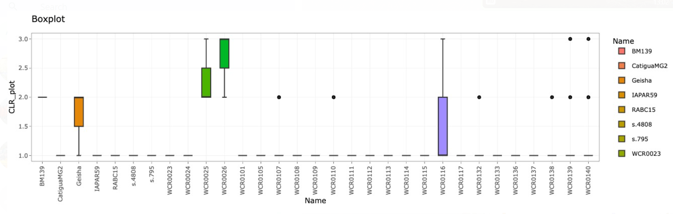
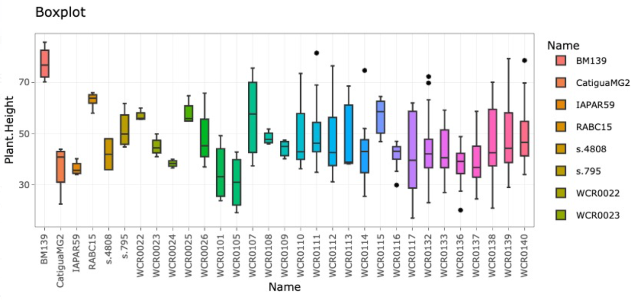
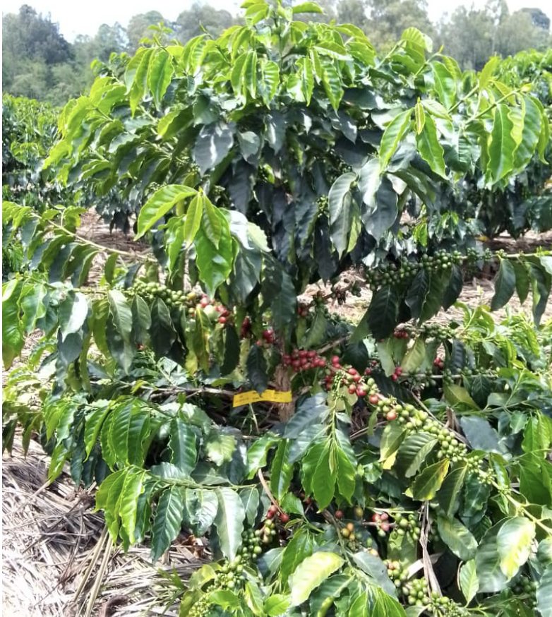
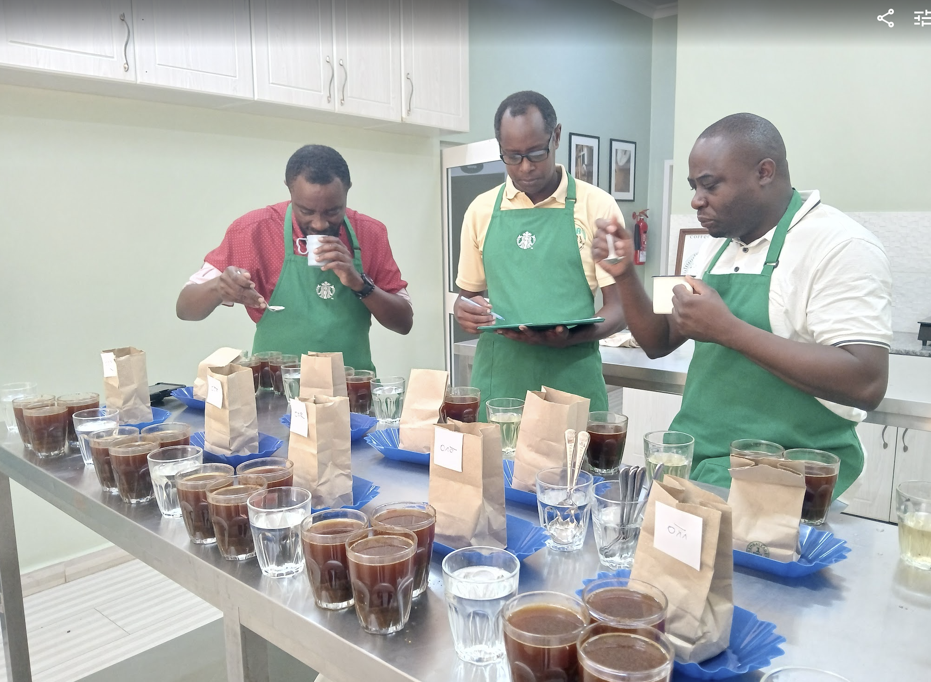
Field Performance Evaluation
Core phenotyping phase (2024–2028) measures key performance indicators across all trial plants.
Disease Resistance
Plant Architecture
Yield & Productivity
Cup Quality
Ongoing
Ongoing
Started Oct 2025
Pending

Slide 8


Challenges & Limitations
Weather Variability
Erratic rainfall patterns and drought stress young plants, inhibit flowering, and reduce yield data reliability.
Genomic Data Analysis
Limited in-house skills in genomic data analysis; WCR scientific team providing mitigation support.

Slide 9
Plan for Improved Materials from RAB Sites
Track 1: Hybrid Variety Fast-Track
Commercialization
Pre-Commercial Trials
Establish clonal propagation system and officially release elite hybrids to farmers by 2033.
Elite Selection
Test selected hybrids across key Rwandan coffee zones to verify stable performance and mitigate risk.
Identify top 1% of F1 hybrids combining phenotype and genotype data for immediate genetic gain.

Slide 10
Plan for Improved Materials from RAB Sites
Track 2: Development of finished varieties
Release & Integration
Testing & Stabilization
Release stabilized pure lines as national varieties; serve as parent stock for future breeding cycles.
Line Initiation
Select superior F2–F4 generations and initiate self-pollination for uniformity and stability.
Conduct rigorous field trials and molecular screening; advance only homozygous lines with key traits.

Slide 11
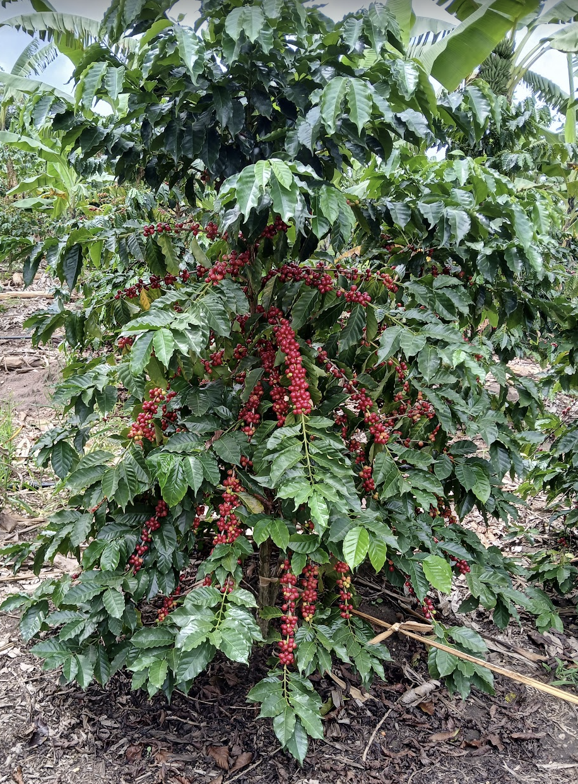
Future Impact & Next Steps
Adaptation & Profitability
Market Access
High yield and resilience matched with premium cup quality maintain Rwanda's export reputation.
Farmers receive varieties proven to yield well and resist key diseases, increasing stability and income.
Speed of Innovation
Genomic Selection reduces variety development from ~25 years to <10 years, addressing climate urgency.

Slide 12
🤝👏

