Slide 1

WESTERN HIGHLANDS AGRICULTURE & FORESTRY SCIENCE INSTITUTE (WASI)
Research results on coffee breeding in Vietnam
Address: 53 Nguyen Luong Bang Street, Dak Lak Province, Vietnam
Telephone): (84-0262). 3833369 - 3862097 Fax: (84-0262). 3862097
Email: viennlntn@gmail.com Website: http://wasi.org.vn

Slide 2
I. Origin of Robusta in Vietnam

Slide 3
II. Robusta varieties selection diagram in Vietnam
Target: High yield and quality
Mother trees:
- Production materials
- Imported materials
Varieties for production
Clone selection trials
Storing varieties field
Selected clones
(grafting propagation)
Clone selection trials
Selected clones
(grafting propagation)
Hybrids trials
Poly-clones seed garden
Synthesis seeds

Slide 4
III. Drought tolerant Robusta coffee varieties
Additional selection of domestic and imported materials: high yield, drought resistant
2010
2010 - 2014
Preserving genetic resources, preliminary selection in the field: drought tolerance based on morphology, yield, quality
+ Evaluation of drought tolerance in greenhouse conditions (potted plants)
+ Evaluation in the field - by physiological and biochemical indicators
Hybridization 2012 and 2015
Breeding new varieties from selected parent materials,
Selecting good individuals in hybrid combinations
Hybridization 2016 - 2021
Selection and testing in main growing regions
Provide new varieties

Slide 5
IV. Nematode-resistant Robusta coffee varieties
Collecting materials of Nematode-resistant Robusta coffee (production, imported, etc.)
Selected population of nematode-resistant Robusta coffee metarials
Evaluation of nematode resistance under greenhouse conditions
Evaluation on nematode-infected soil background under greenhouse conditions
Artificial infection under greenhouse conditions
Rapid assessment on nematode-infested soil area in the field
Evaluation of resistant materials as rootstocks in the field

Slide 6
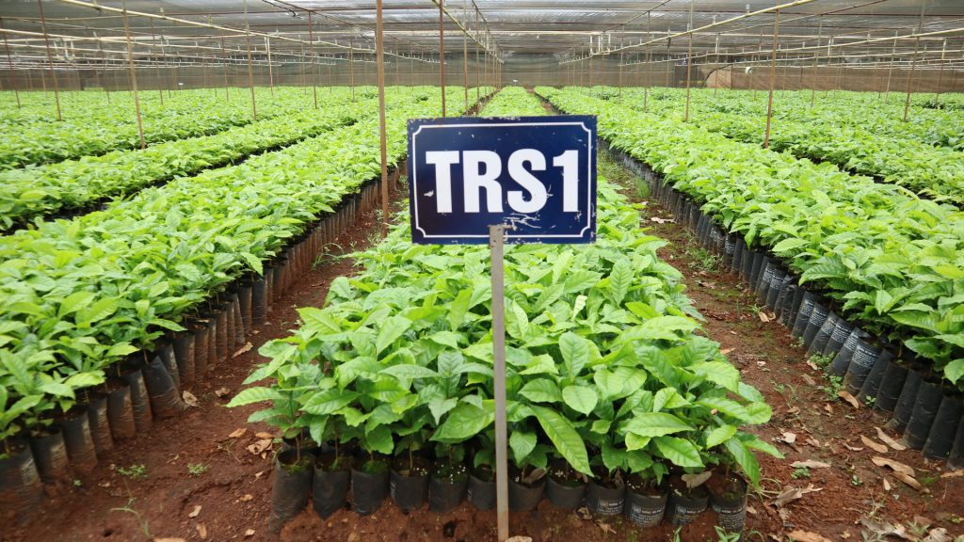
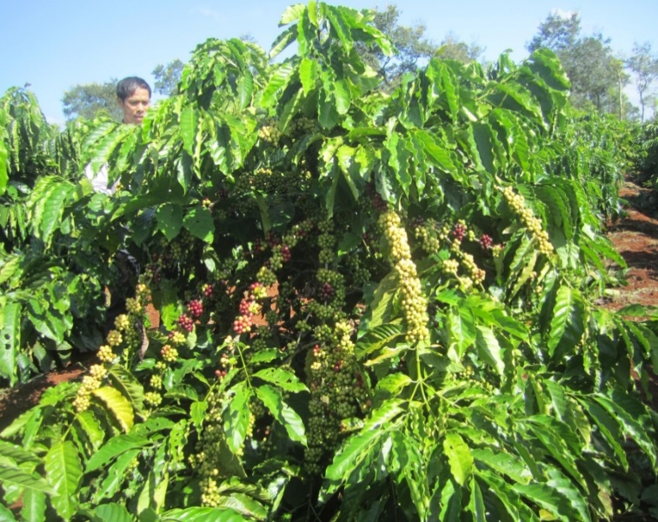
ROBUSTA Coffee varieties
13 high yield Robusta clones: TR4, TR9, TR11, TR12 TR13, TR14, TR15, Xanh Lun, Day …..
TRS1 – Synthesis of 4 different Robusta Clones
Working on some drought & nematode resistant/tolerant R-materials
Notes:
Total: 645 ha, ave. yield: 2.5 tons/ha (3 times higher than ave. of the world), ~ 1.8 mil tons, ~ 3.4 bil $, 600,000 growers
Problem: Re-planting & nematode – 140,000 – 150,000 ha

Slide 7
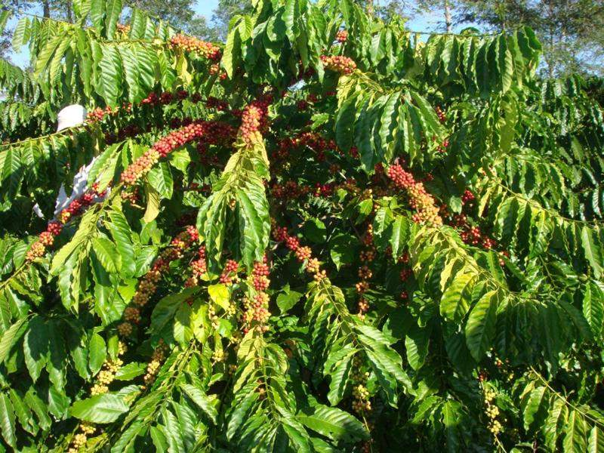
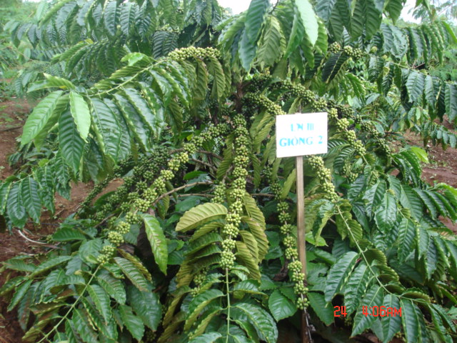
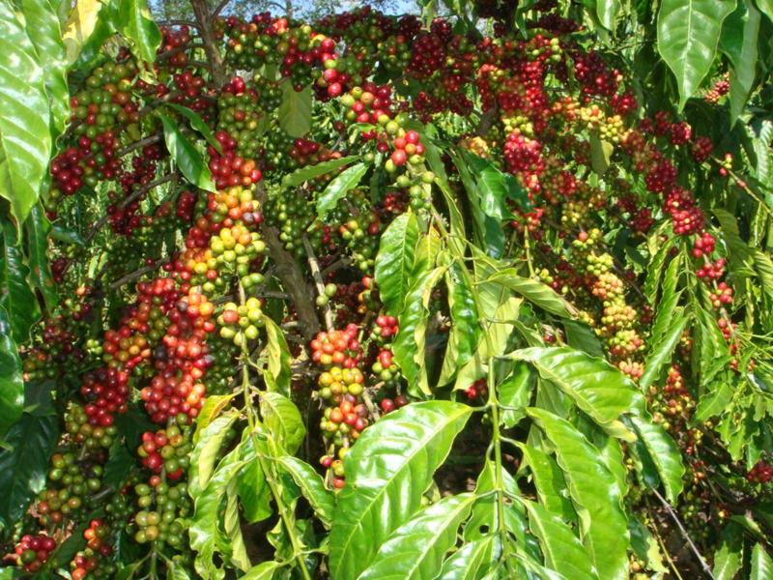
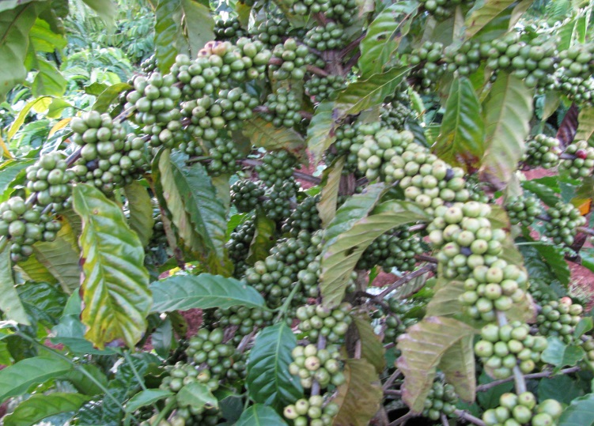
Clone TR4
Yield: 7.3 tons/ha
Weight of 100 beans: 17.1g
Grade I beans: 70.8%
Resistance to leaf rust disease: High
Cupping score : > 78.75/100
Clone TR14
Yield: 4.5 - 5 tons/ha
Weight of 100 beans: 19.1g
Grade I beans: 94%
Resistance to leaf rust disease: High
Cupping score : > 78.25/100
RELEASED CULTIVARS
Clone TR9
Yield: 5 - 6 tons/ha
Weight of 100 beans: 24.1g
Grade I beans: 85.8%
Resistance to leaf rust disease: High
Cupping score : > 80/100
Clone TR15
Yield: 4.5 - 5 tons/ha
Weight of 100 beans: 21.9g
Grade I beans: 97%
Resistance to leaf rust disease: High
Cupping score : > 82.50/100
Notes:
New varieties released to production: 21%

Slide 8
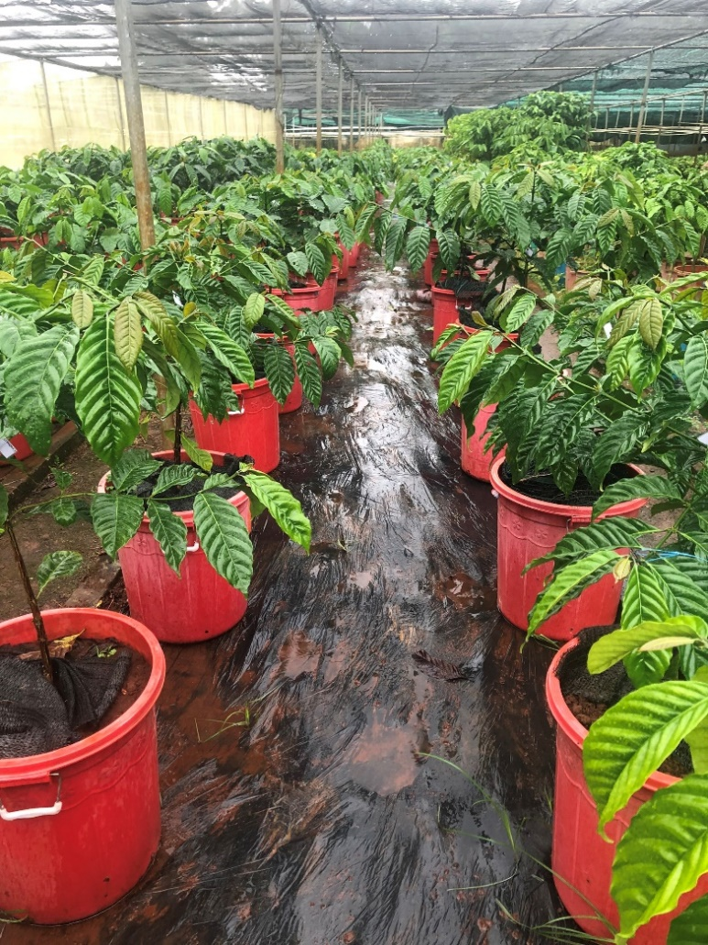
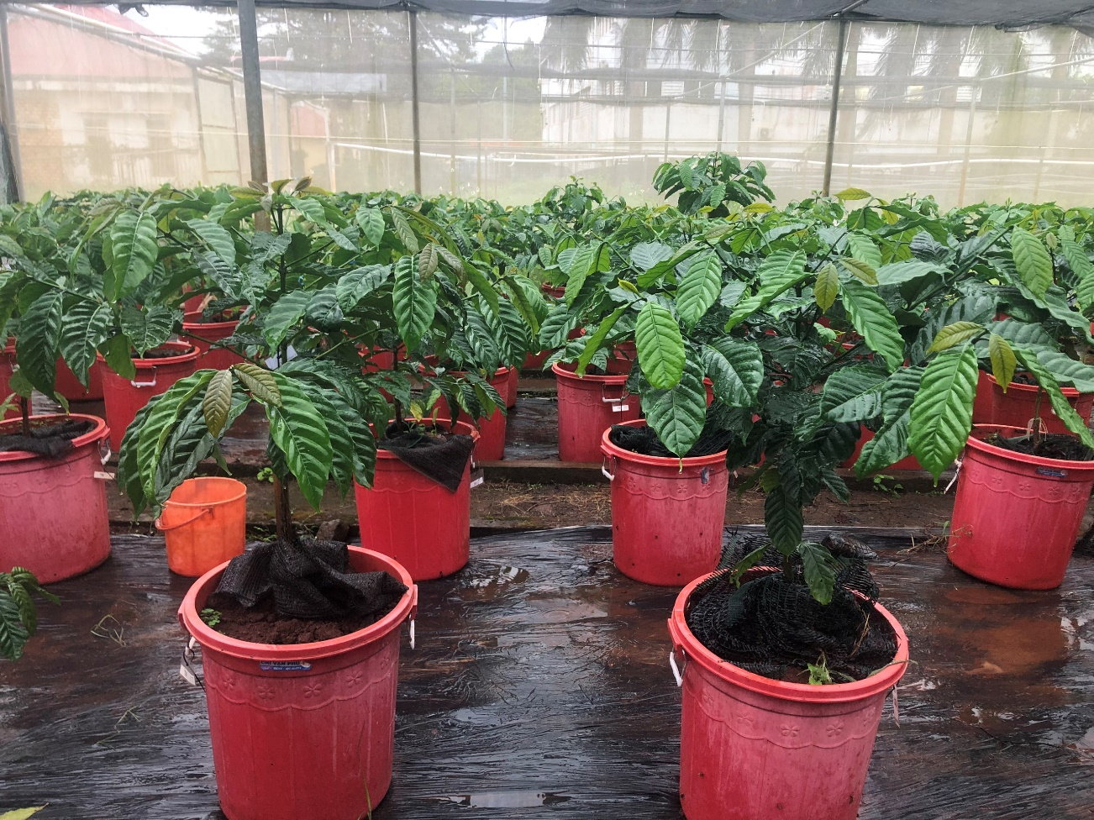
Images: The experiment of evaluation of the drought tolerance of selected robusta coffee materials under potted conditions

Slide 9
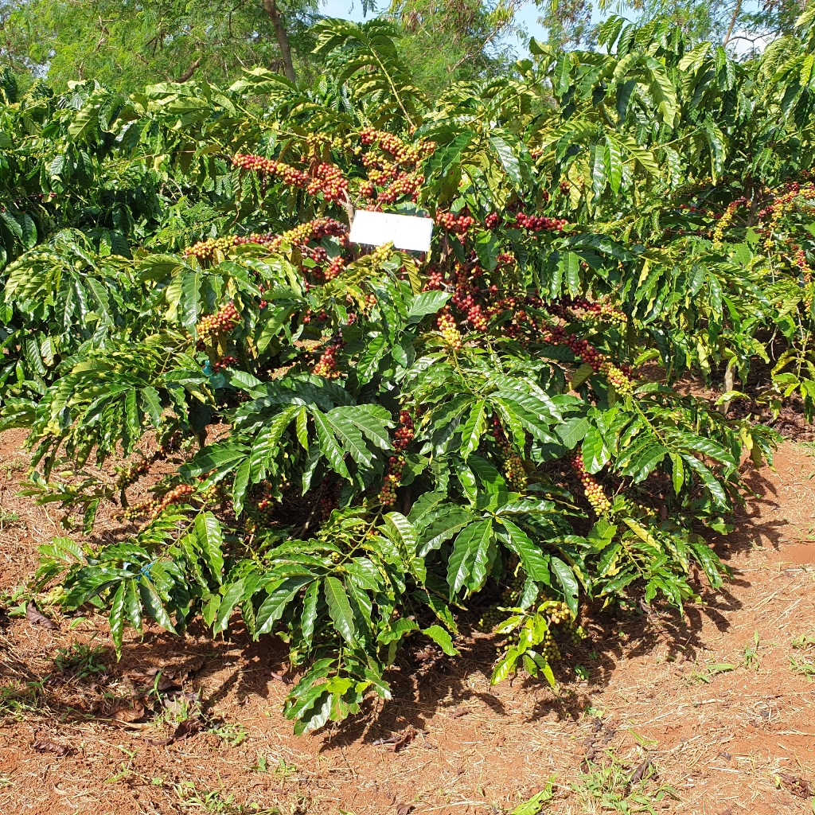
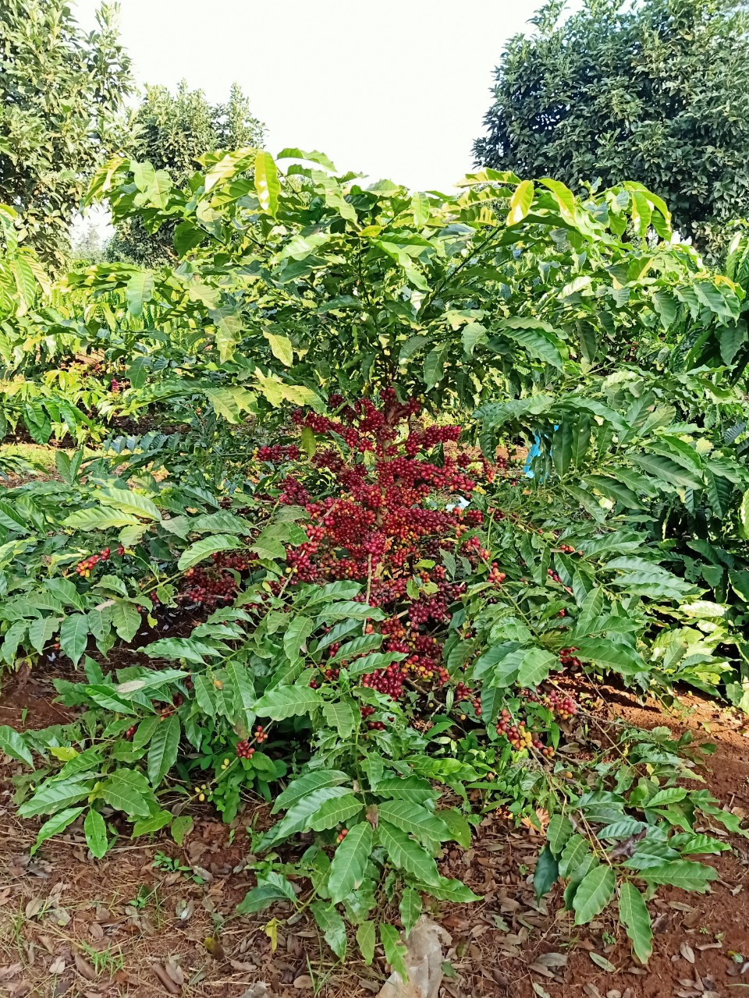
Evaluation on hybrid combinations of Robusta coffee
L2H36C1
L4H6C4

Slide 10
ROBUSTA COFFEE BREEDING
WASI is storing 65 of robusta coffee clones in the field (imported and domestic).
High-yield and high quality clones: Selected from clones collected in production, and bred clones, including: TR4, TR6, TR9, TR11, TR12, TR13, TR14, TR15,…
Robusta coffee synthesis variety with high-yield, high-quality: TRS1 (from 4 elite clones TR4, TR9, TR11, TR12).
Drought tolerant Robusta coffee varieties: Selected 2 - 3 drought-resistant promising coffee clones/materials.
Nematode-resistant Robusta coffee varieties: Selected 1 - 2 nematode-resistant coffee clones/materials under controlled greenhouse conditions.

Slide 11
Context and challenges
Limitations of molecular biotechnology breeding (expertise and equipment)
Lack of materials for drought-tolerant and nematode-resistant varieties
Vietnam is using traditional breeding methods, which take a long time to have new varieties.
Some suggestions
Cooperating in training on coffee breeding methods
Exchange of breeding materials: Drought tolerant varieties and Nematode-resistant varieties

Slide 12
THANK YOU!

